Slide 1
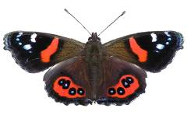
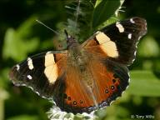
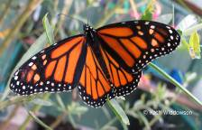
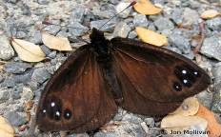
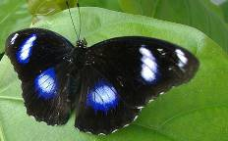
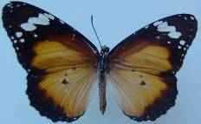
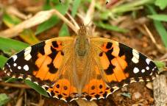
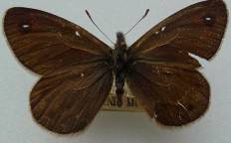
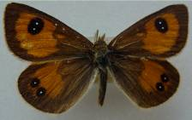
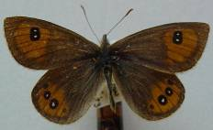
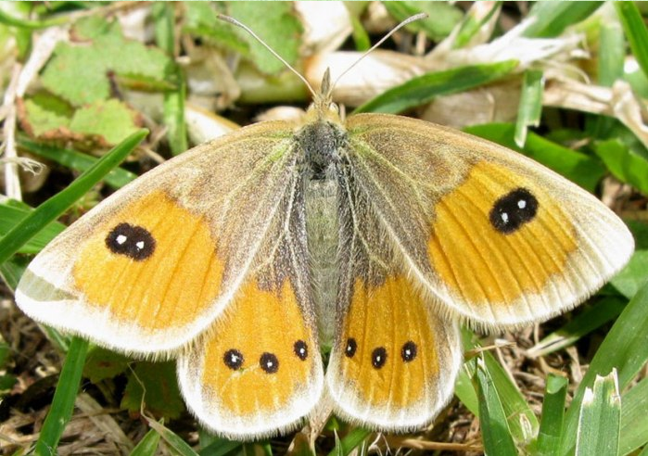
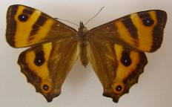
Nymphalidae
New Zealand butterfly families
Red admiral
Yellow admiral
Monarch
Black mountain ringlet
Blue moon
(blown here, not known to breed here)
Lesser wanderer
(blown here, not known to breed here)
Painted lady
(blown here, breeds occasionally)
Butler’s ringlet
Janita’s tussock
Harris’s tussock
Common tussock
Forest ringlet
© Copyright. Science Learning Hub Pokapū Akoranga Pūtaiao The University of Waikato Te Whare Wānanga o Waikato.
All rights reserved | www.sciencelearn.org.nz. All images are copyrighted. For further information, please refer to enquiries@sciencelearn.org.nz.
Notes:
Red Admiral © Tony Wills
Yellow Admiral © Tony Wills
Monarch © Kath Widdowson
Black Mountain Ringlet © Jon Mollivan
Blue Moon Public Domain
Lesser Wanderer © Robert Arter-Williamson
Printed Lady Public Domain
Butler’s Ringlet © Robert Arter-Williamson
Janita’s Tussock © Robert Arter-Williamson
Harris’s Tussock © Robert Arter-Williamson
Common Tussock © Jerome Albre
Forest Ringlet © Landcare Research

Slide 2
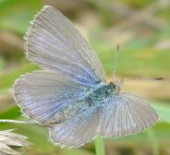
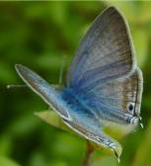
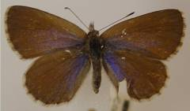
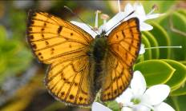
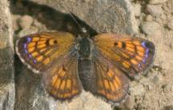
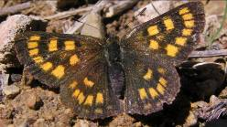
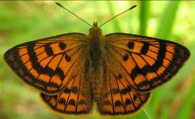
Lycaenidae
New Zealand butterfly families
Common blue
Southern blue
Long-tailed blue
Common copper
Boulder copper
Glade copper
Rauparaha’s copper
© Copyright. Science Learning Hub Pokapū Akoranga Pūtaiao The University of Waikato Te Whare Wānanga o Waikato.
All rights reserved | www.sciencelearn.org.nz. All images are copyrighted. For further information, please refer to enquiries@sciencelearn.org.nz.
Notes:
Common blue ©Robert Arter-Williamson
Southern blue ©Robert Arter-Williamson
Long Tailed blue © Robert Arter-Williamson
Common copper © Norm Twigge
Boulder copper © Mike Lusk
Glade copper © Tony Wills
Rauparaha’s copper © Jerome Albre

Slide 3
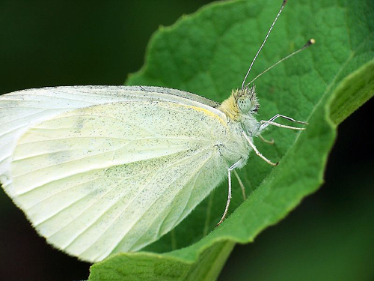
Pieridae
New Zealand butterfly families
The sole representative of the Pieridae family is the introduced white butterfly.
© Copyright. Science Learning Hub Pokapū Akoranga Pūtaiao The University of Waikato Te Whare Wānanga o Waikato.
All rights reserved | www.sciencelearn.org.nz. All images are copyrighted. For further information, please refer to enquiries@sciencelearn.org.nz.
Notes:
White butterfly © Christopher Zaborsky

Slide 4
Papilionidae Riodinidae
New Zealand butterfly families
These butterflies are not represented in New Zealand.
© Copyright. Science Learning Hub Pokapū Akoranga Pūtaiao The University of Waikato Te Whare Wānanga o Waikato.
All rights reserved | www.sciencelearn.org.nz. All images are copyrighted. For further information, please refer to enquiries@sciencelearn.org.nz.

Slide 5
The Science Learning Hub would like to thank the following for the use of their images for this activity
New Zealand butterfly families
Nymphalidae family
Tony Wills: Red and yellow admiral
Kath Widdowson: Monarch
Jon Sullivan: Black mountain ringlet
Robert Arter-Williamson:
Lesser wanderer
Butler’s ringlet
Janita’s tussock
Harris’s tussock
Jerome Albre: Common tussock
Manaaki Whenua – Landcare Research: Forest ringlet
Public domain:
Painted lady
Blue moon
Lycaenidae family
Robert Arter-Williamson:
Common blue
Southern blue
Long-tailed blue
Norm Twigge:Common copper
Mike Lusk: Boulder copper
Tony Wills: Glade copper
Jerome Albre: Rauparaha’s copper
Pieridae family
Christopher Zaborsky: White cabbage butterfly
© Copyright. Science Learning Hub Pokapū Akoranga Pūtaiao The University of Waikato Te Whare Wānanga o Waikato.
All rights reserved | www.sciencelearn.org.nz. All images are copyrighted. For further information, please refer to enquiries@sciencelearn.org.nz.

