Slide 1

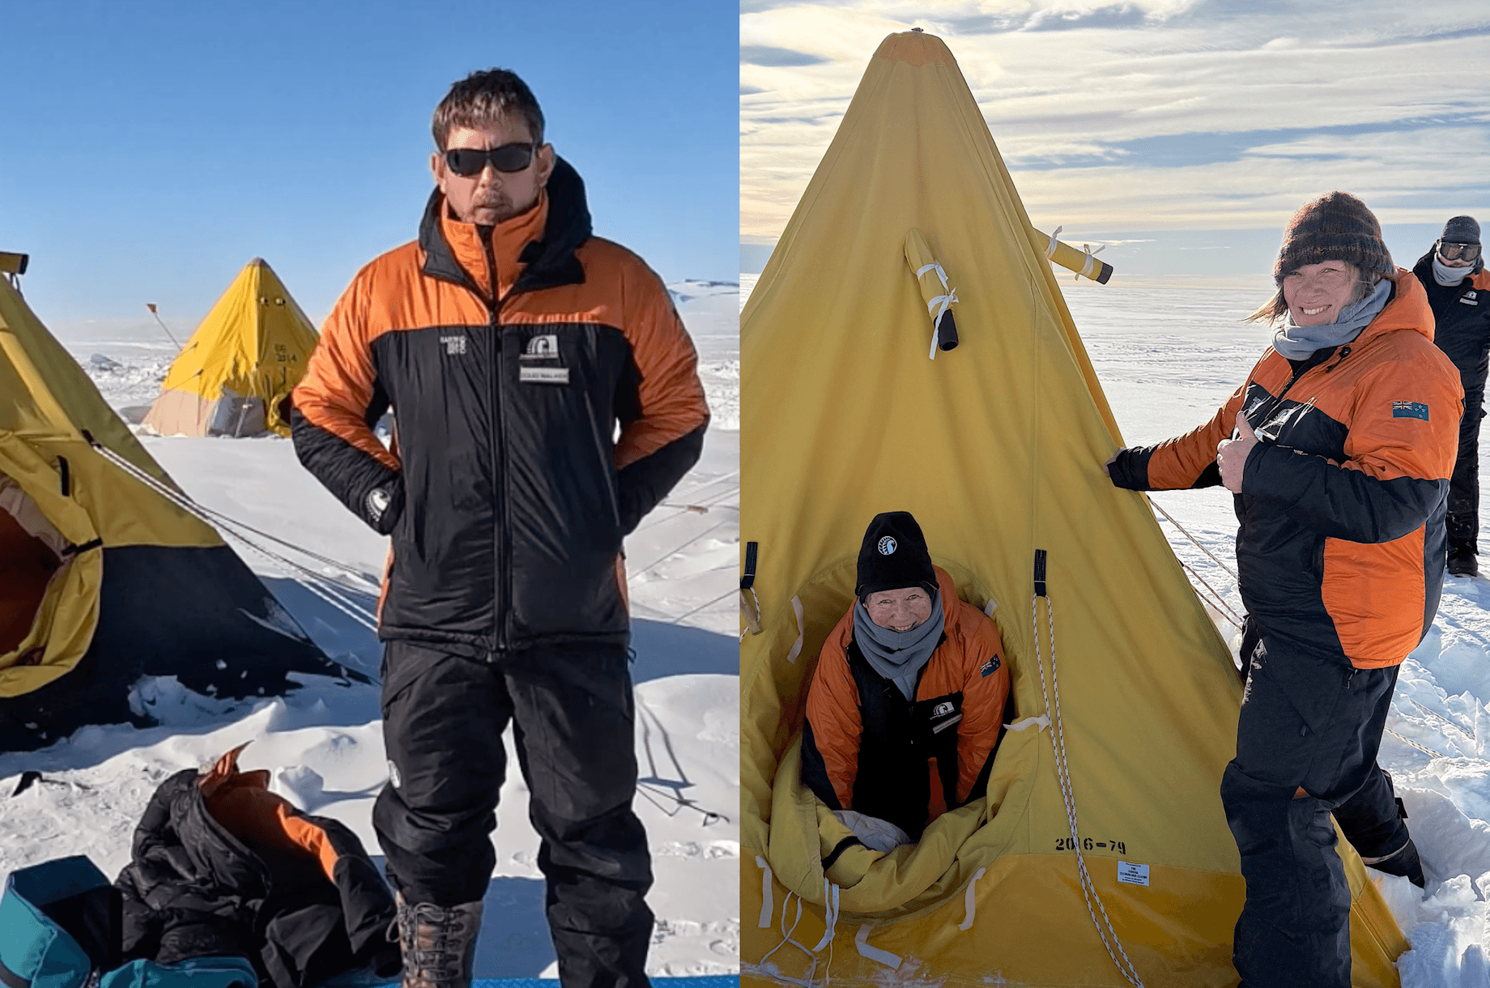
Educators on the ice
Rights: Douglas Walker, Dianne Christenson and Carol Brieseman
Doug Walker, Dianne Christenson and Carol Brieseman
© Copyright. Science Learning Hub Pokapū Akoranga Pūtaiao The University of Waikato Te Whare Wananga o Waikato.All Rights Reserved | www.sciencelearn.org.nz. All images are copyrighted. For further information, please refer to enquiries@sciencelearn.org.nz

Slide 2
Index
Topic | Slideshow number(s) | Video timecode
Introducing the Science Learning Hub and presenters | 1 | 00:00
Index | 2 | 01:48
How did you end up going to Antarctica? | 3 | 02:06
What did you do and what did you learn? | 9 | 07:52
How do you deal with waste? | 23 | 27:24
Any other stories to share? | 25 | 29:37
Key takeaways for teachers | 33 | 36:42
SLH links, keep in touch and thanks | 42 | 40:13
© Copyright. Science Learning Hub Pokapū Akoranga Pūtaiao The University of Waikato Te Whare Wananga o Waikato.
All Rights Reserved | www.sciencelearn.org.nz. All images are copyrighted. For further information, please refer to enquiries@sciencelearn.org.nz

Slide 3
How did you end up going to Antarctica?

Slide 4
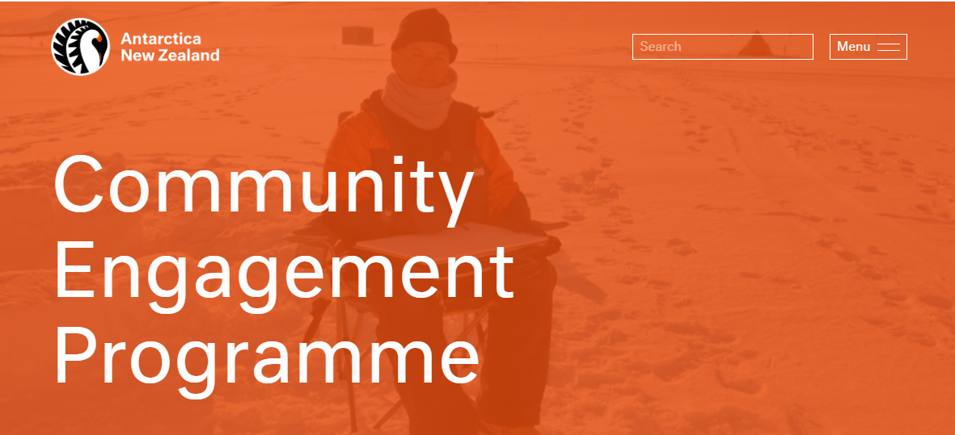
www.antarcticanz.govt.nz/media/community-engagement
Notes:
https://www.antarcticanz.govt.nz/media/community-engagement

Slide 5
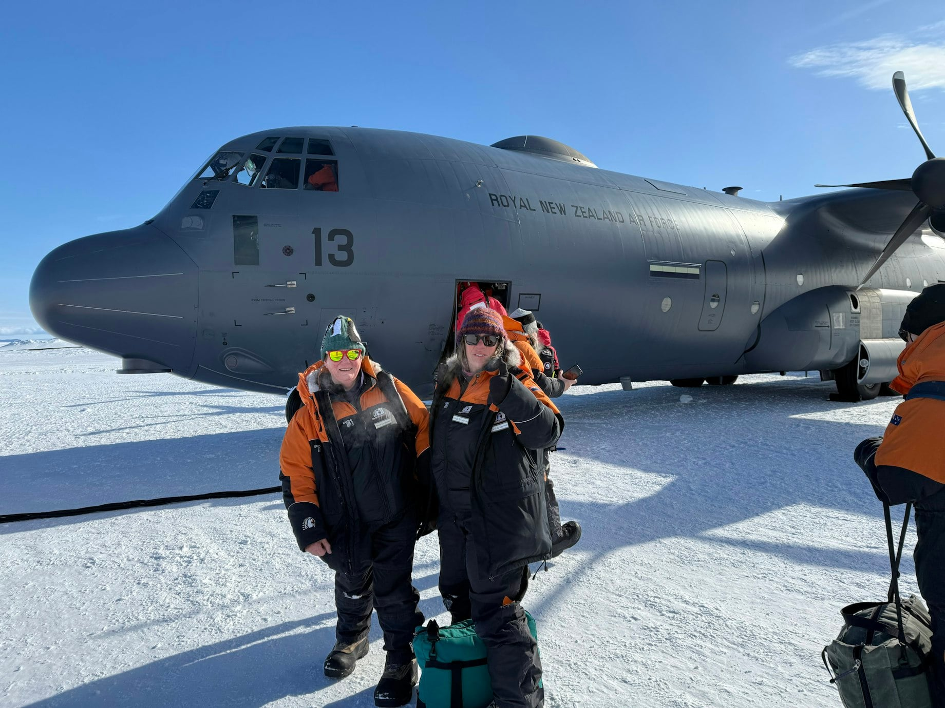
© Dianne Christenson and Carol Brieseman
Notes:
https://www.sciencelearn.org.nz/images/arriving-in-antarctica

Slide 6
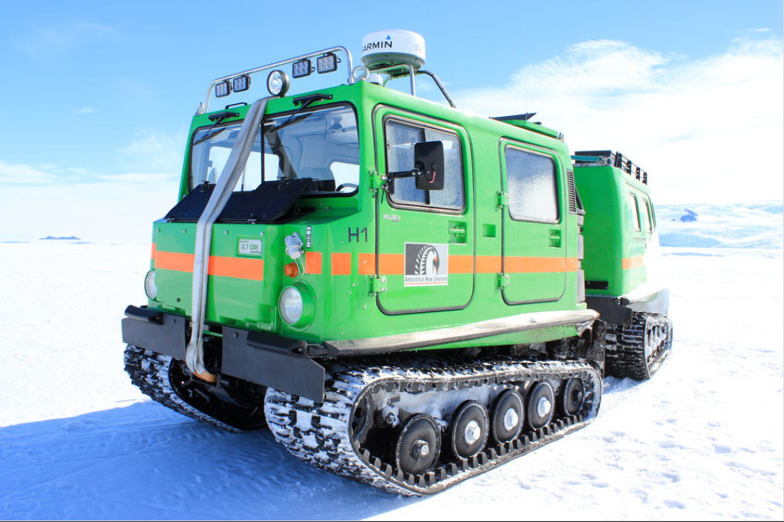
© Krystie Hedley, Antarctic New Zealand Image Library, CC BY-NC-ND 3.0 NZ
Notes:
https://adam.antarcticanz.govt.nz/nodes/view/44147
This work is licensed under a Creative Commons Attribution-Noncommercial-No Derivative Works 3.0 New Zealand License

Slide 7
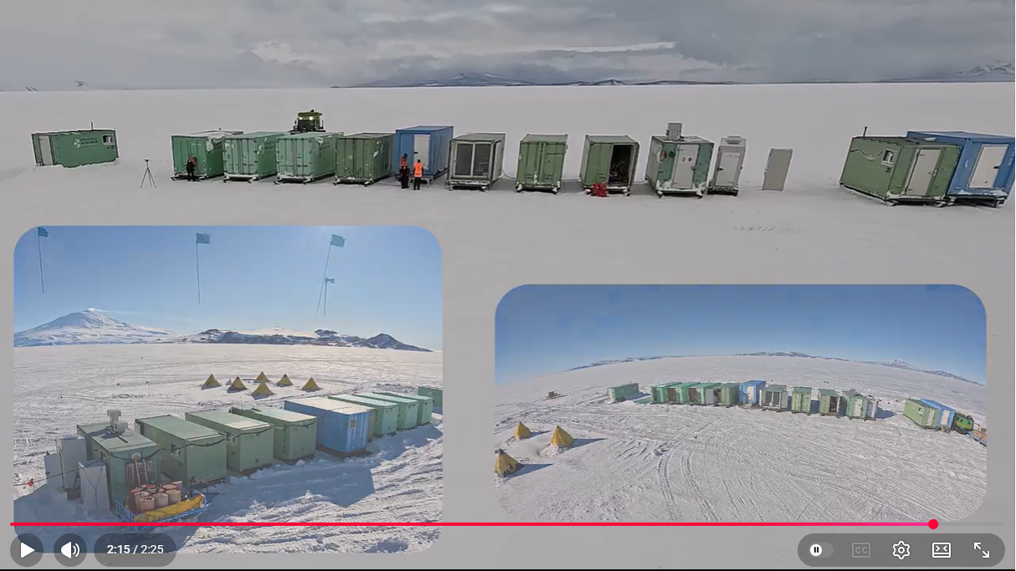
Setting up a research camp on sea ice
© Douglas Walker
Notes:
Time lapse of camp set up: https://www.youtube.com/watch?v=ttCodrk1UOI
Also
Di and Carol: https://drive.google.com/file/d/1jT1-Njt2hwH1wTq6fAI9Cjan43loHu9Z/view?usp=sharing

Slide 8
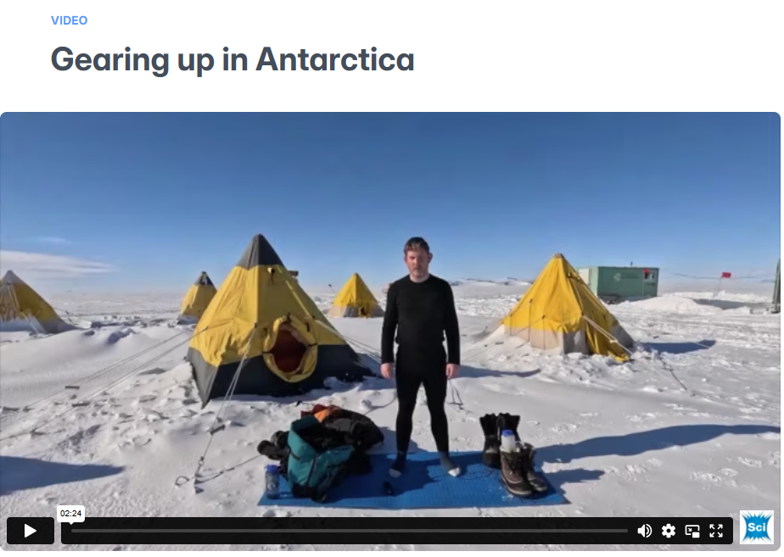
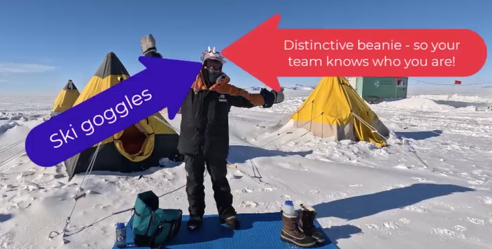
© Douglas Walker
Notes:
Gear video: https://www.sciencelearn.org.nz/videos/gearing-up-in-antarctica

Slide 9
What did you do?
What did you learn?

Slide 10
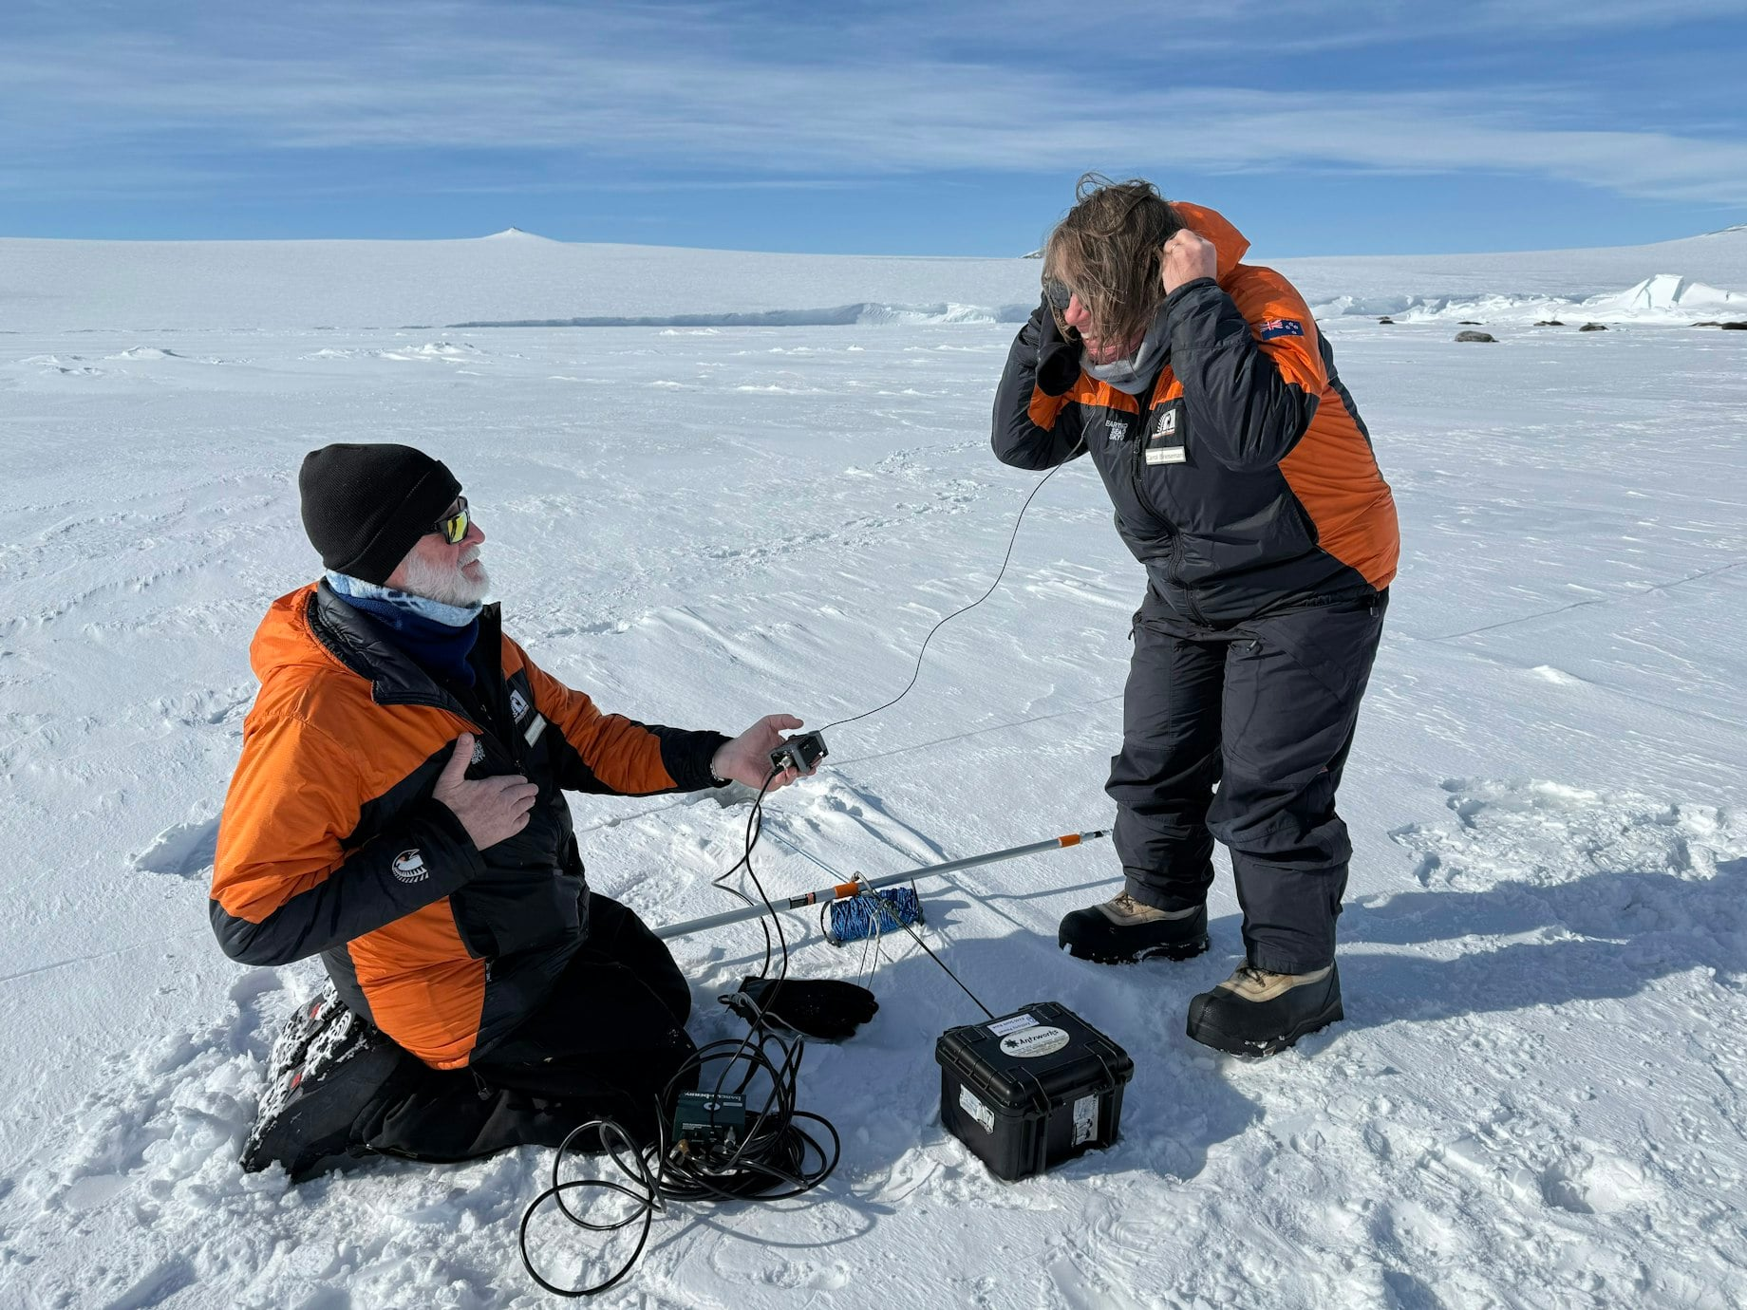
© Dianne Christenson and Carol Brieseman​
Notes:
https://www.sciencelearn.org.nz/images/listening-to-weddell-seals

Slide 11
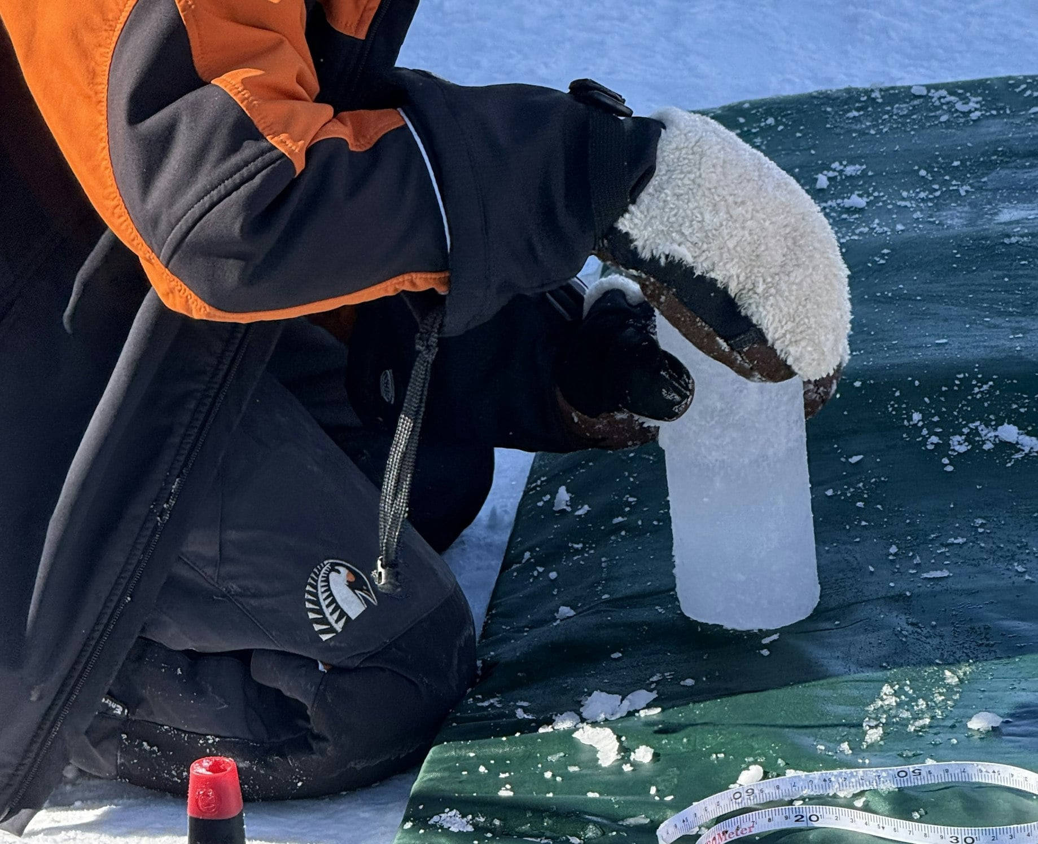
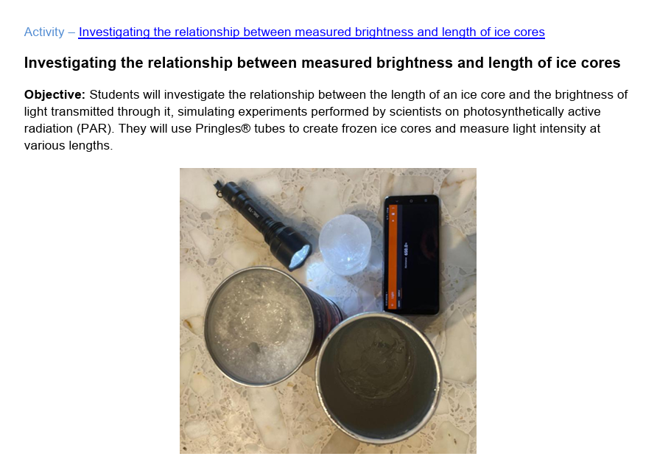
© Dianne Christenson
Notes:
Activity https://www.sciencelearn.org.nz/resources/investigating-the-relationship-between-measured-brightness-and-length-of-ice-cores

Slide 12
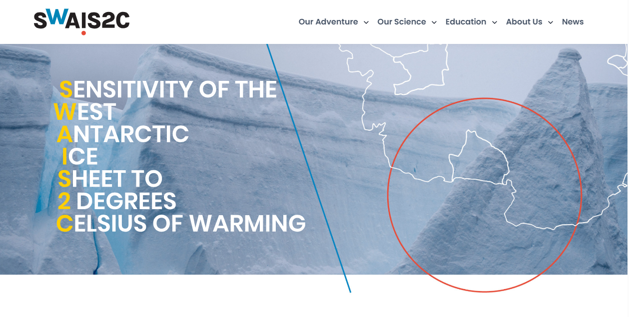
swais2c.aq
Notes:
https://www.swais2c.aq

Slide 13
What happens in Antarctica doesn’t stay there.
Antarctica’s ice is changing fast.
Its ecosystems feel it first.

Slide 14
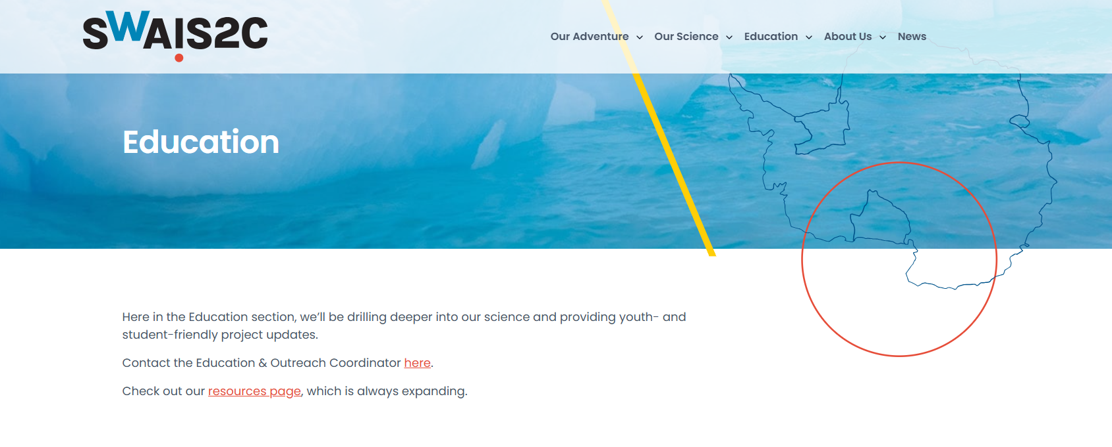
swais2c.aq/education
Notes:
https://swais2c.aq/education

Slide 15
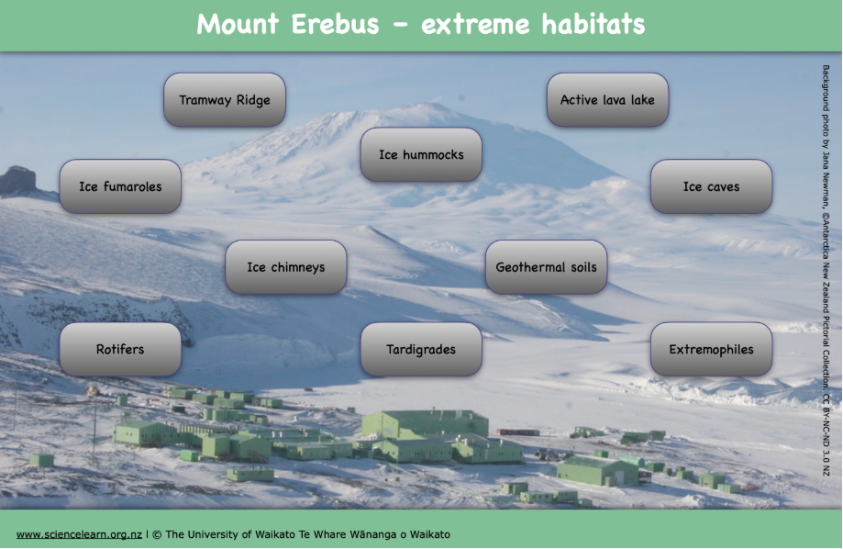
Notes:
https://www.sciencelearn.org.nz/image_maps/mount-erebus-extreme-habitats

Slide 16
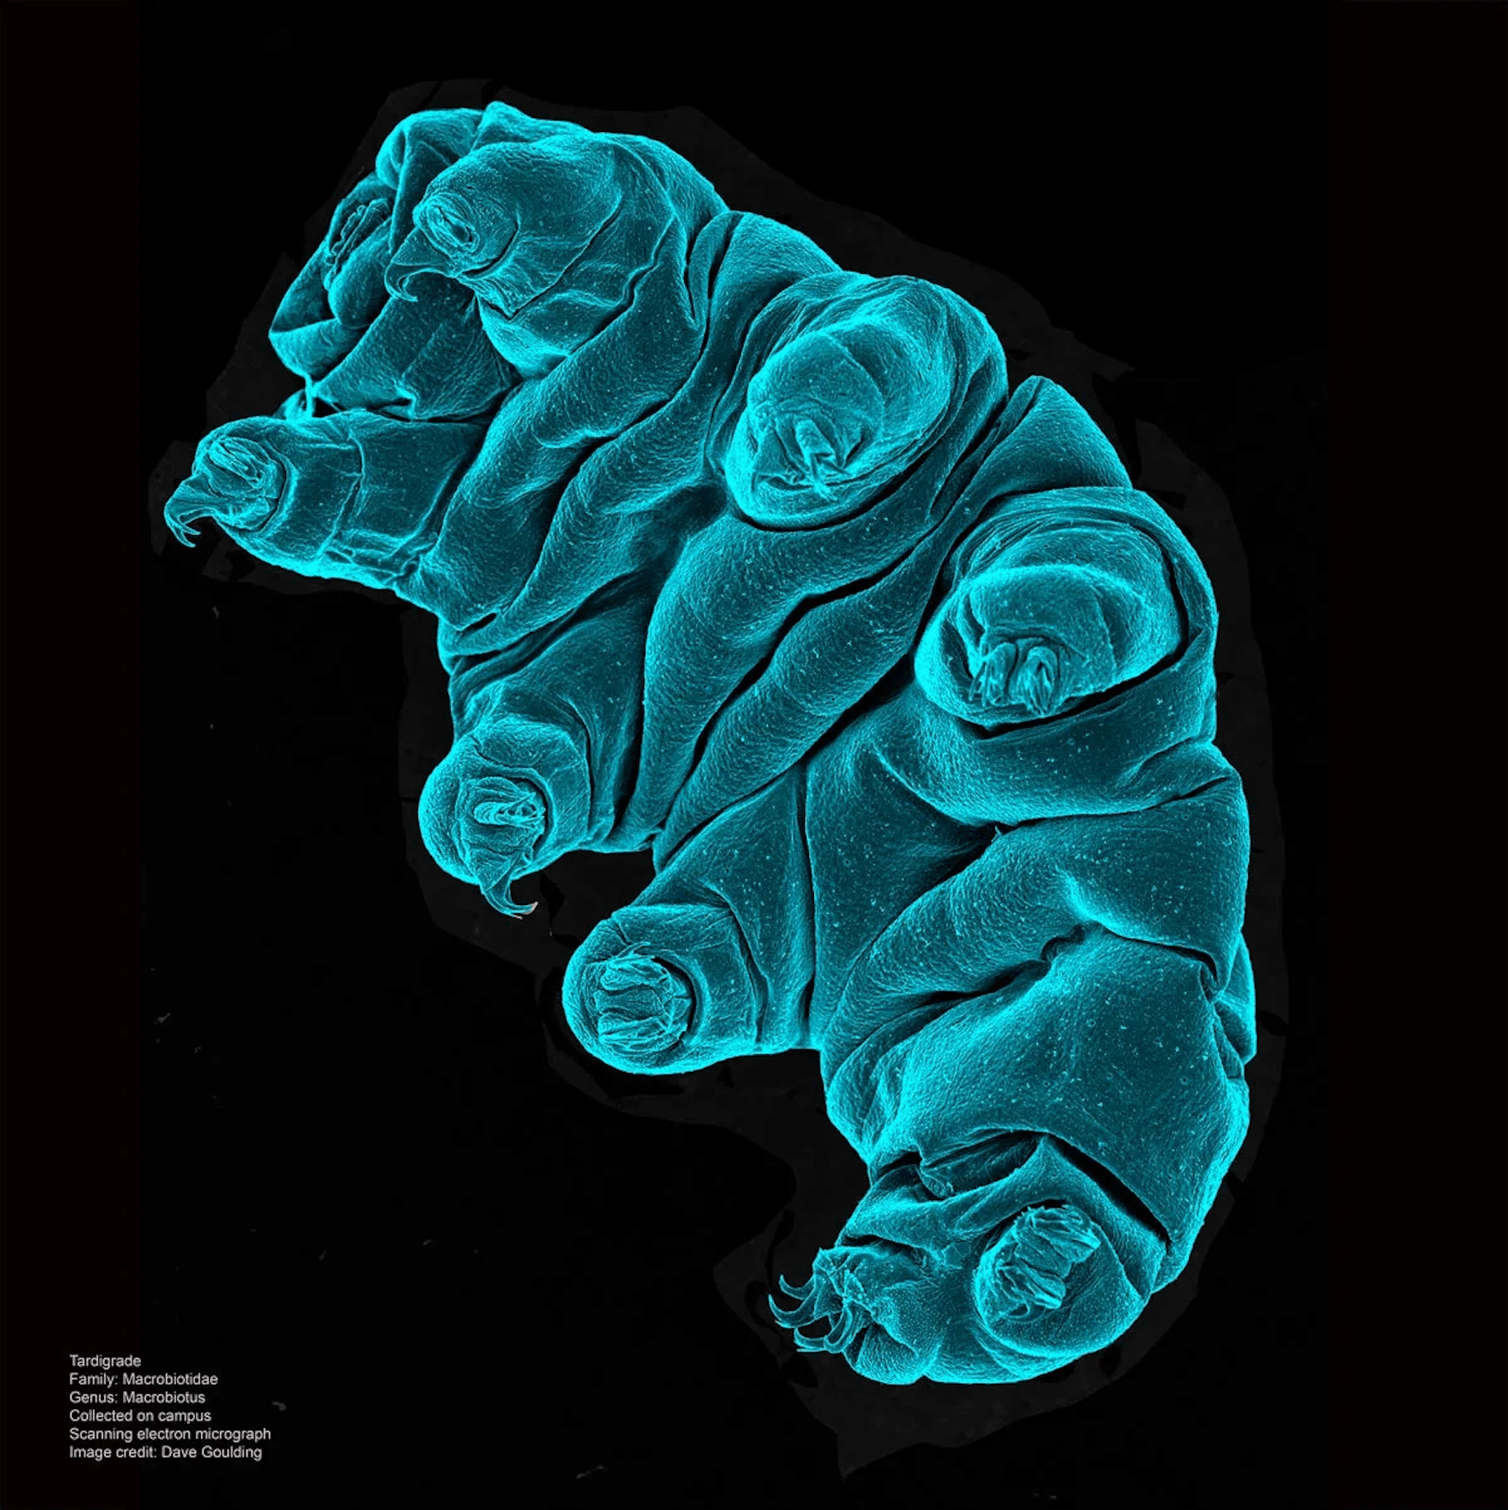
© Dave Goulding, Wellcome Sanger Institute, CC BY-NC-ND 4.0
Notes:
Article: https://www.sciencelearn.org.nz/resources/tardigrades-and-rotifers-life-on-the-edge
Image: https://www.sciencelearn.org.nz/images/tardigrade-in-its-active-state

Slide 17
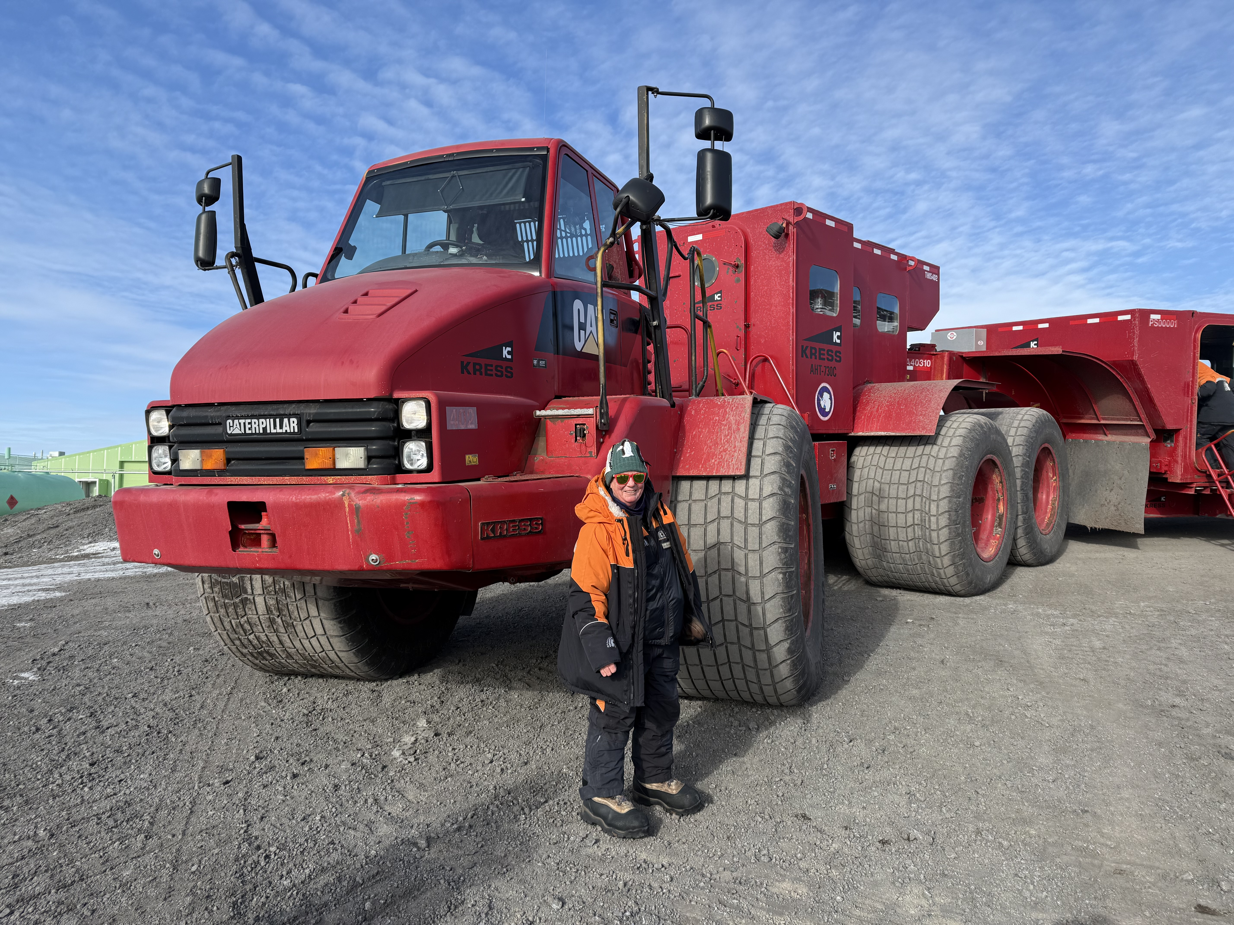
© Carol Brieseman

Slide 18
© Douglas Walker

Slide 19
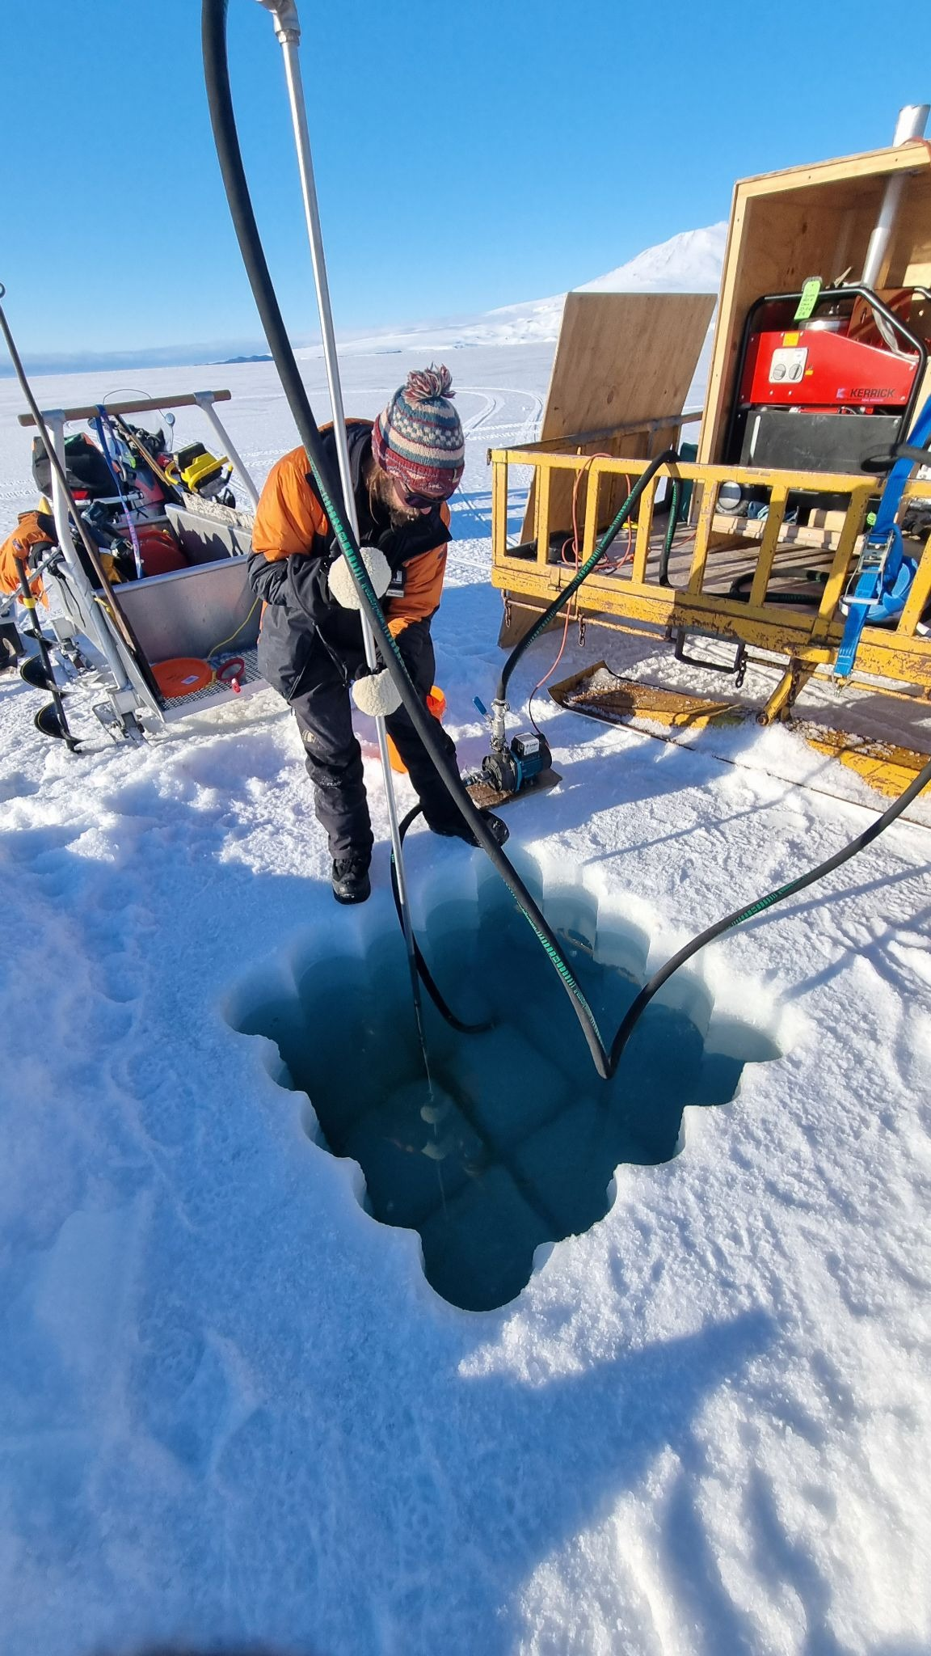
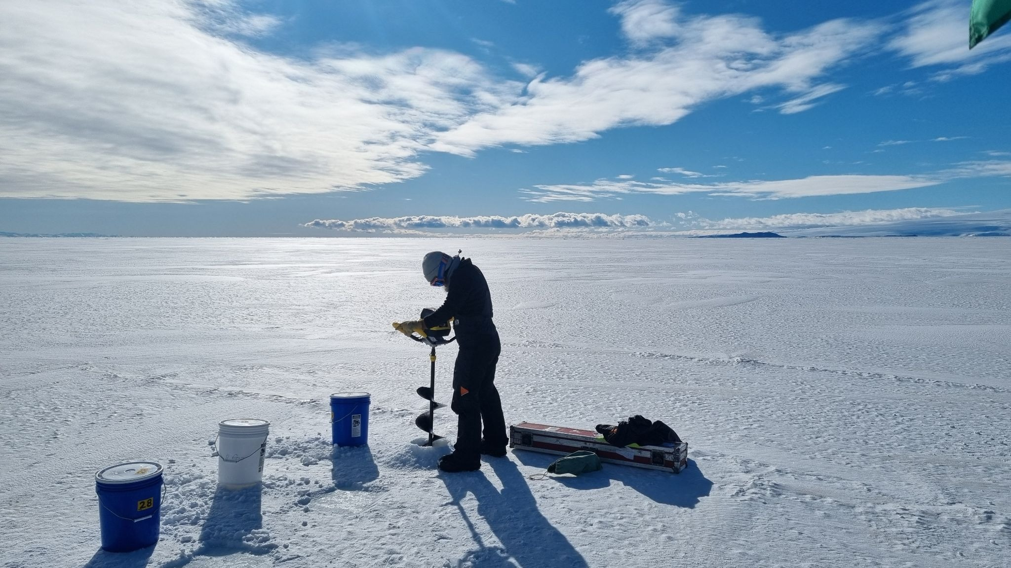
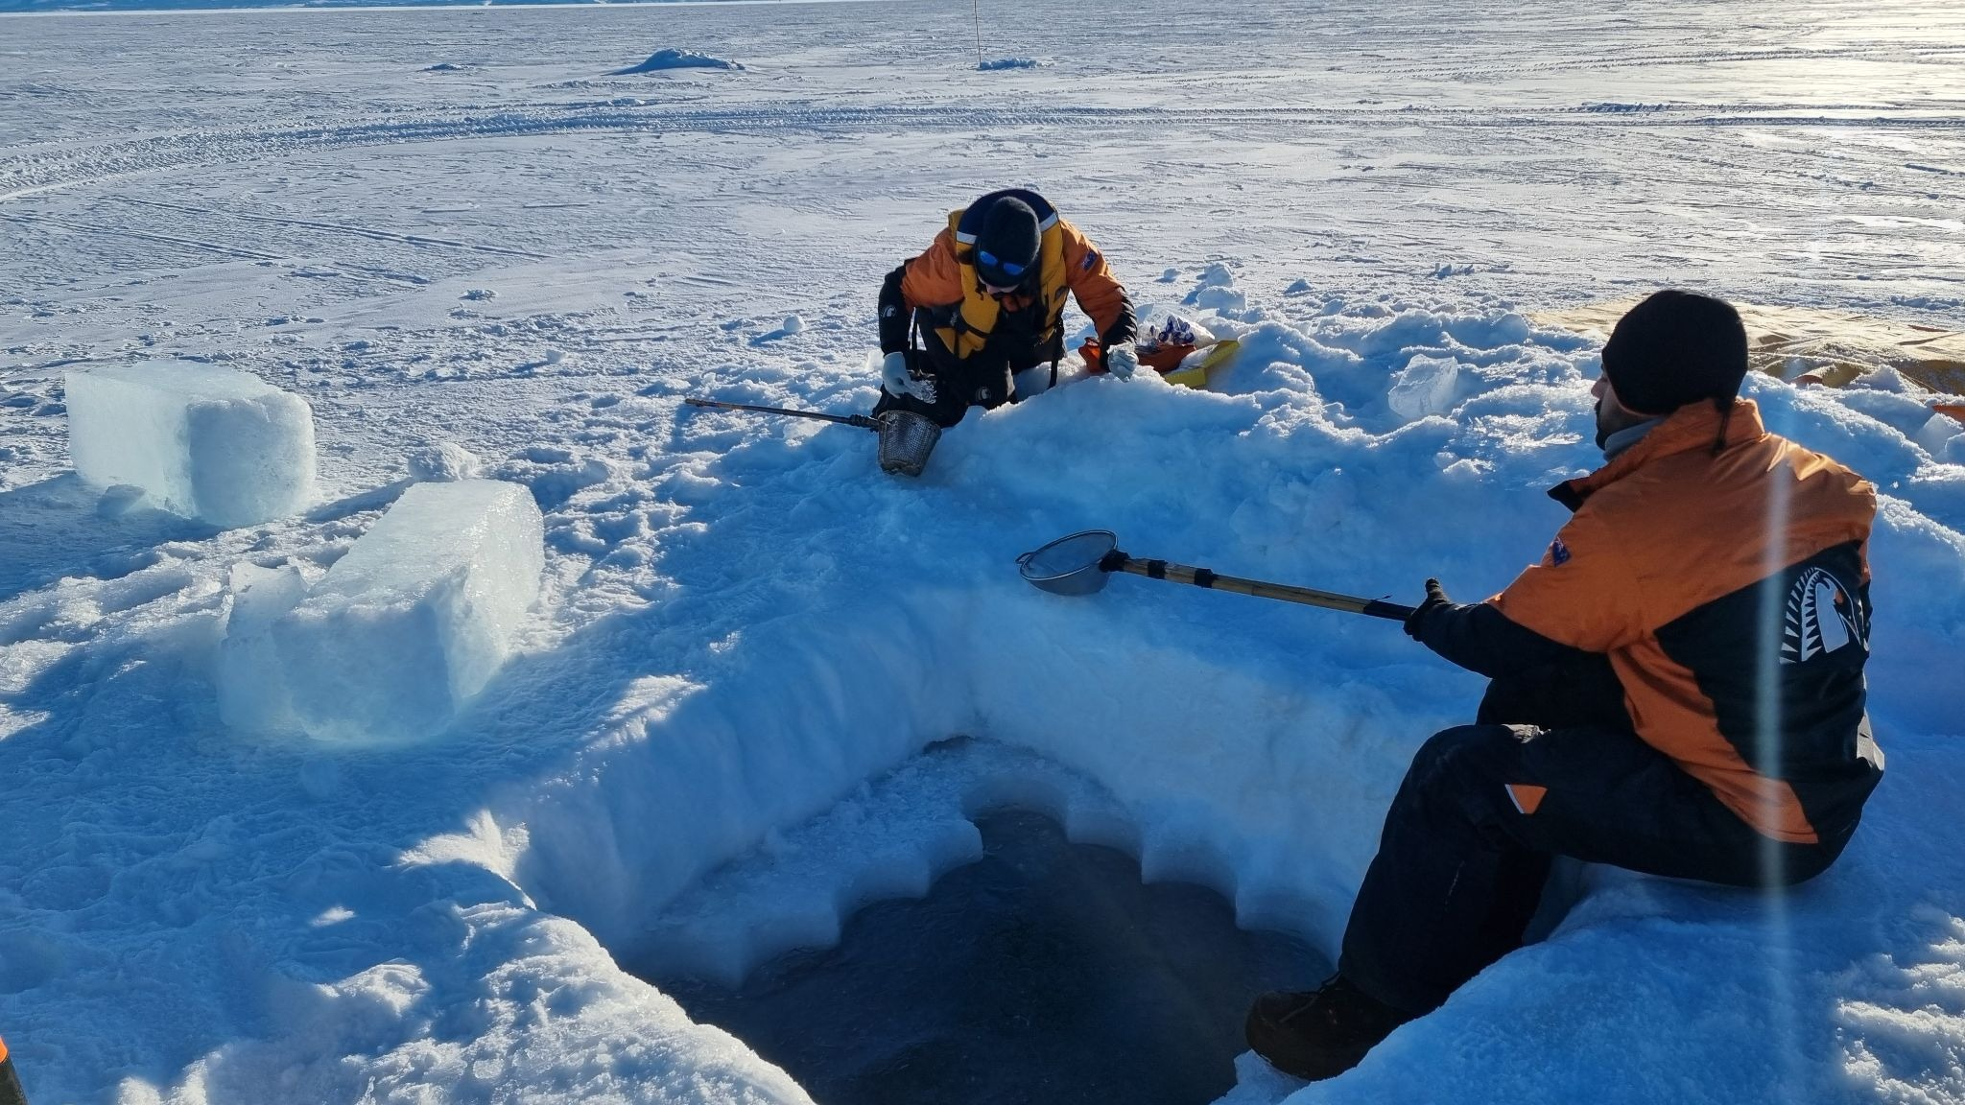
All images, © Douglas Walker

Slide 20
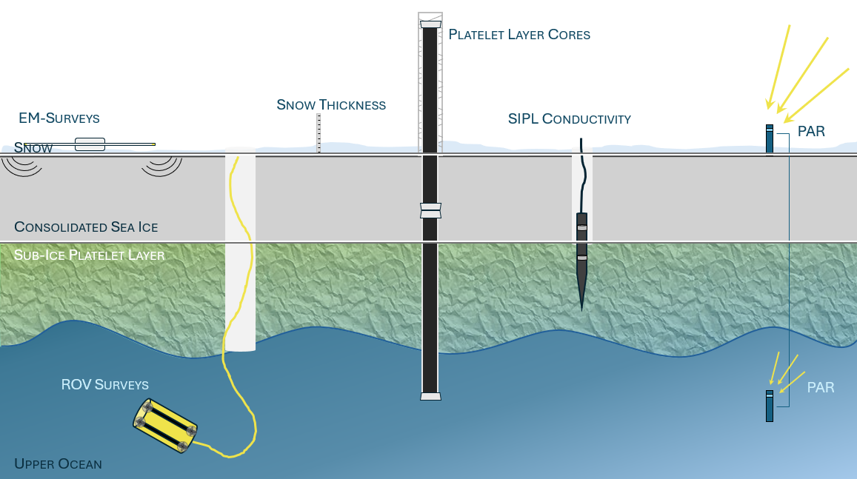
© Dr Natalie Robinson​
Notes:
Image credit: Dr Natalie Robinson

Slide 21
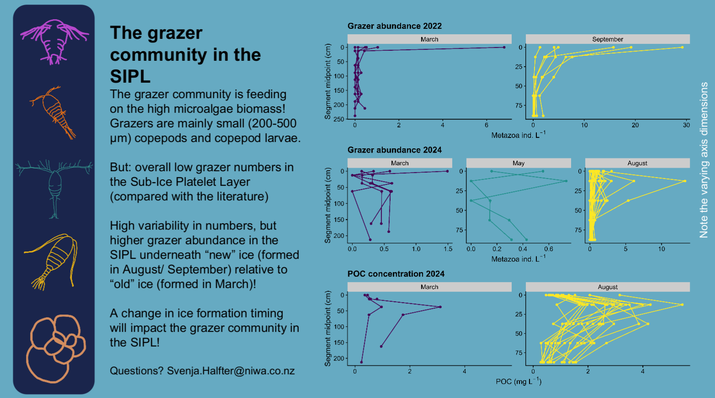
© Svenja Halfter, NIWA
Notes:
Image credit: Svenja Halfter

Slide 22
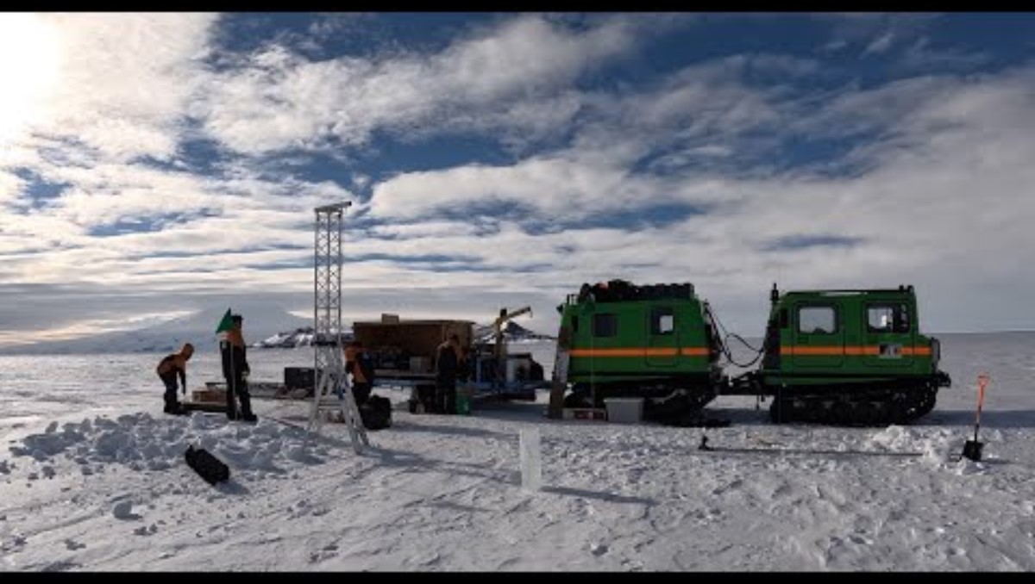
© Douglas Walker​
Notes:
Antarctica: platelet sampling on our K892 expedition - YouTube

Slide 23
...what about waste?
Notes:
https://www.sciencelearn.org.nz/resources/managing-wastes-at-scott-base

Slide 24
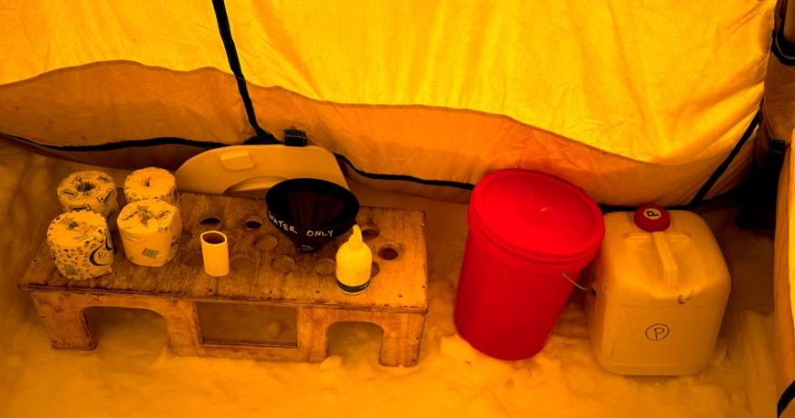
© Dianne Christenson and Carol Brieseman​
Notes:
https://www.sciencelearn.org.nz/videos/wastewater-treatment-at-scott-base
and https://youtu.be/ttCodrk1UOI

Slide 25
Any other stories to share?

Slide 26
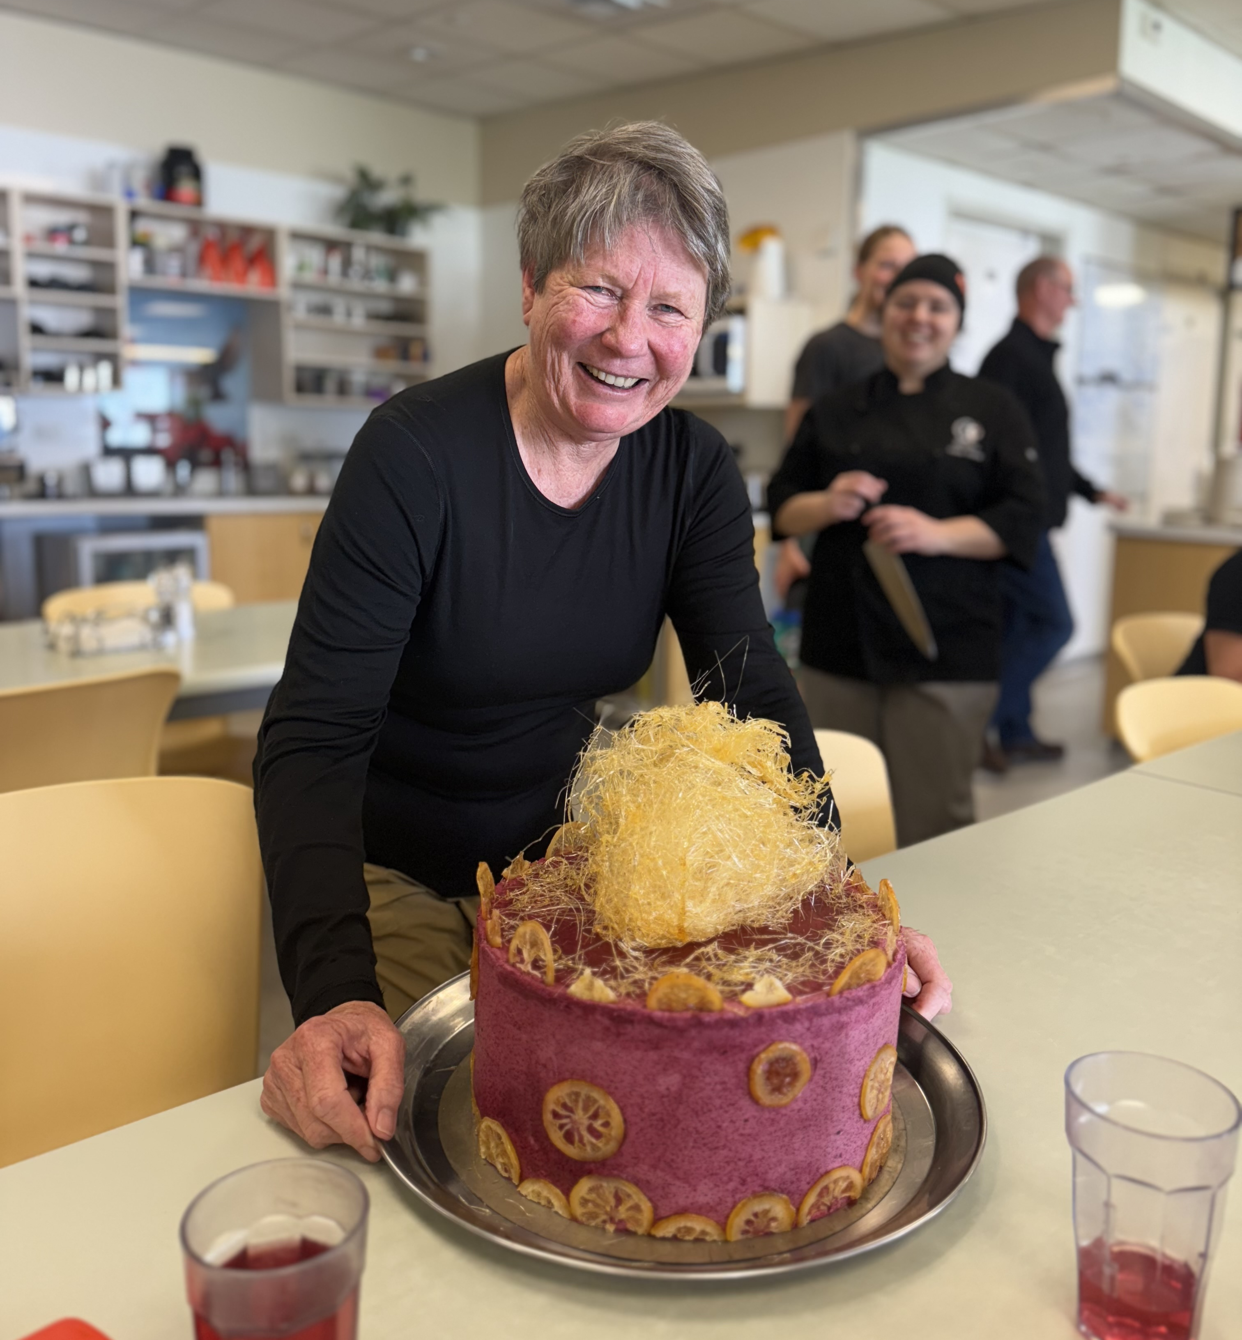
© Carol Brieseman

Slide 27
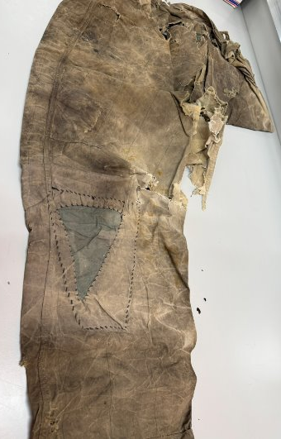
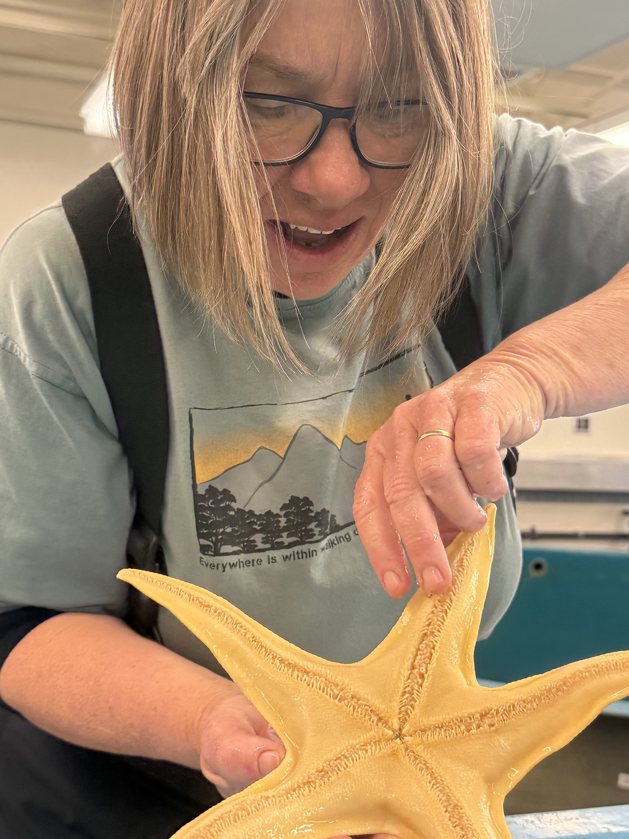
© Dianne Christenson and Carol Brieseman​

Slide 28
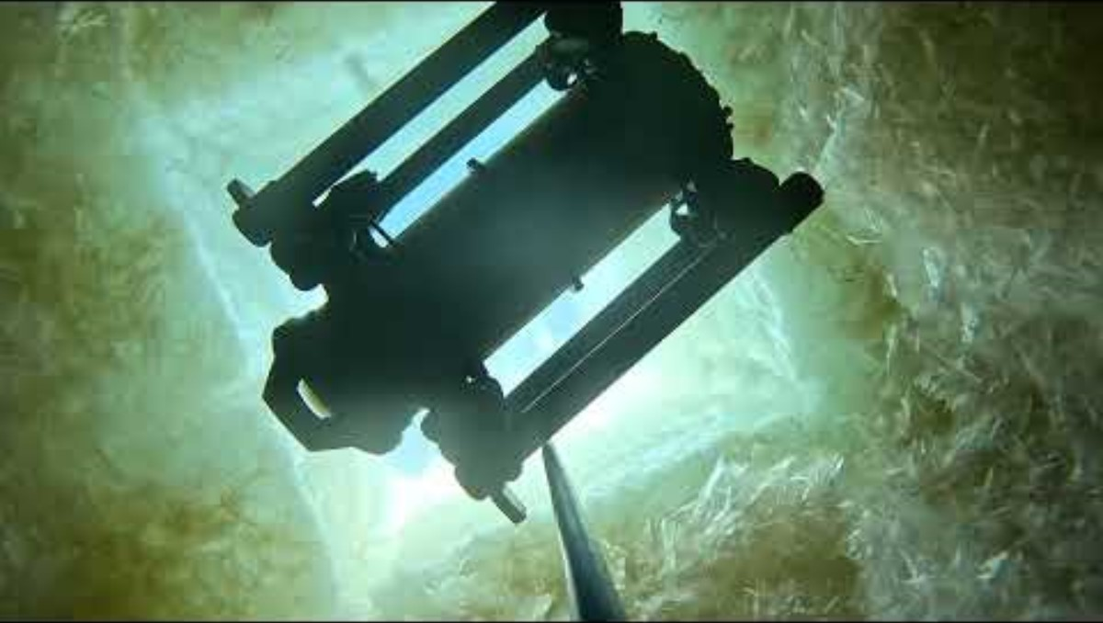
Notes:
LUNA underwater – YouTube: https://www.youtube.com/watch?v=GgyaqsJZ4Vw&t=3s

Slide 29
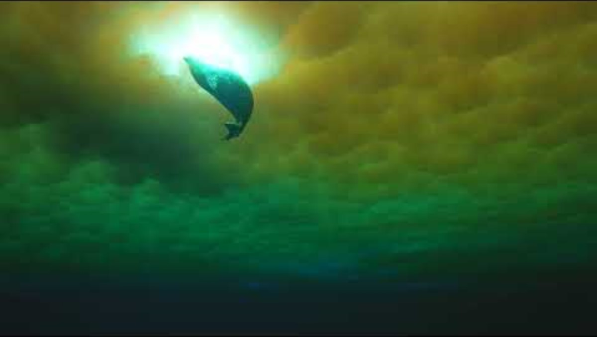
Credit: Dr Leigh Tait, NIWA
Notes:
Seal at ice hole

Slide 30
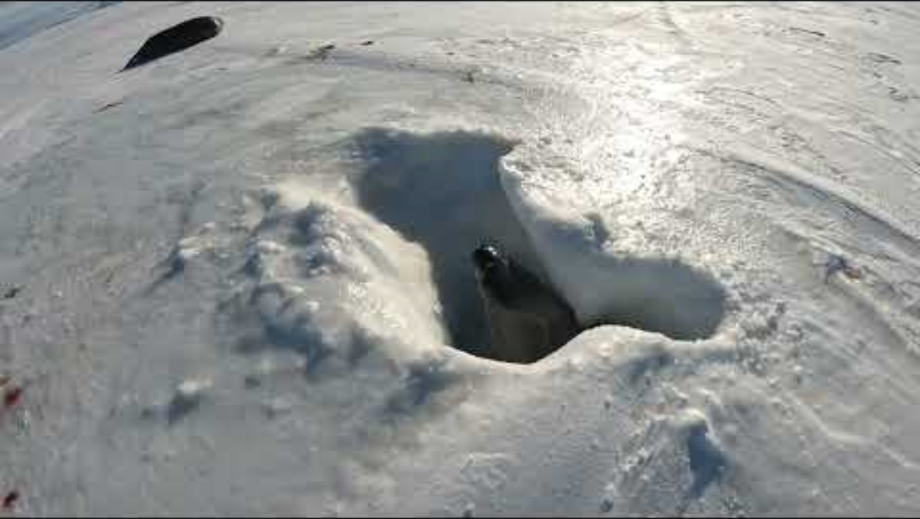
Notes:
Weddell Seal emerging from ice hole K892: https://www.youtube.com/watch?v=ly7bC2RV8_4

Slide 31
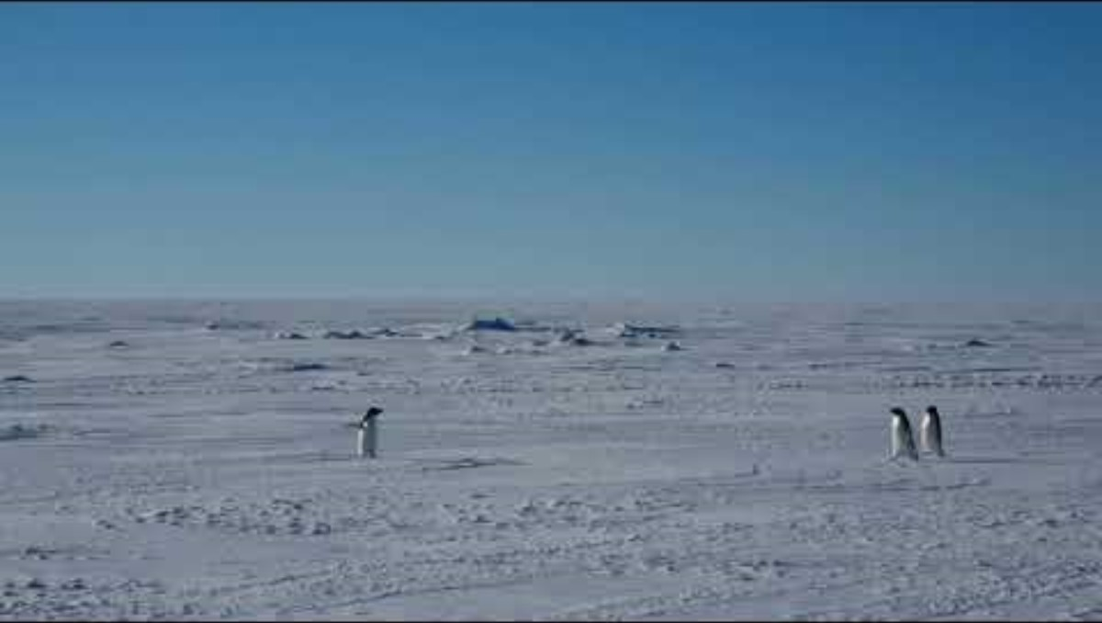
Notes:
Penguins K892: https://www.youtube.com/watch?v=i7jwA-9J9iQ

Slide 32
Key takeaways for teachers

Slide 33
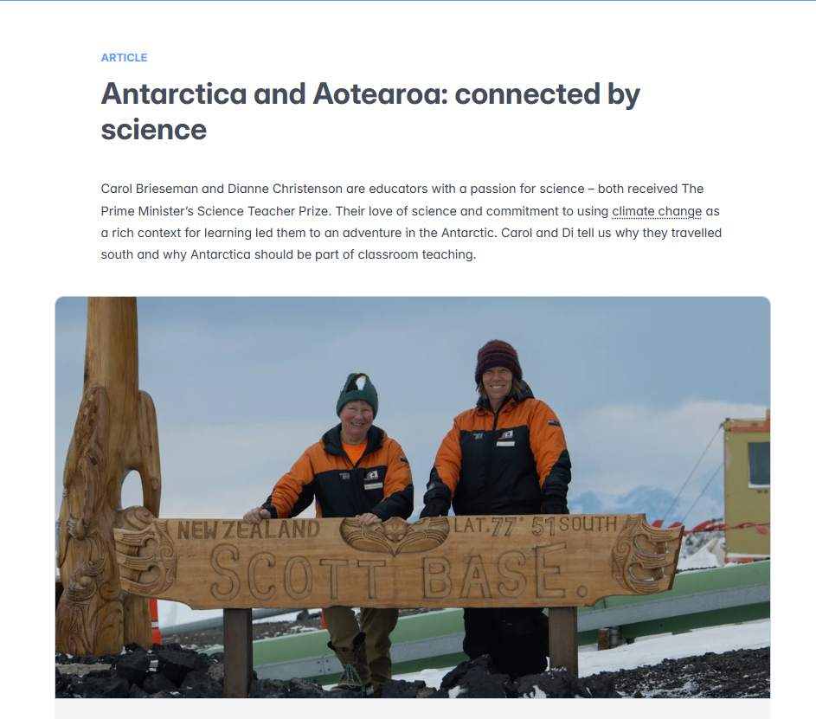
© Dianne Christenson and Carol Brieseman​​
Notes:
https://www.sciencelearn.org.nz/resources/antarctica-and-aotearoa-connected-by-science

Slide 34
Antarctica may be physically distant, but its story is tightly woven into our own.
Understanding that connection is essential – for our students, for our communities and for the future of Aotearoa.
Notes:
https://www.sciencelearn.org.nz/resources/antarctica-and-aotearoa-connected-by-science

Slide 35
www.antarcticanz.govt.nz/media/community-engagement
Notes:
https://www.antarcticanz.govt.nz/media/community-engagement

Slide 36
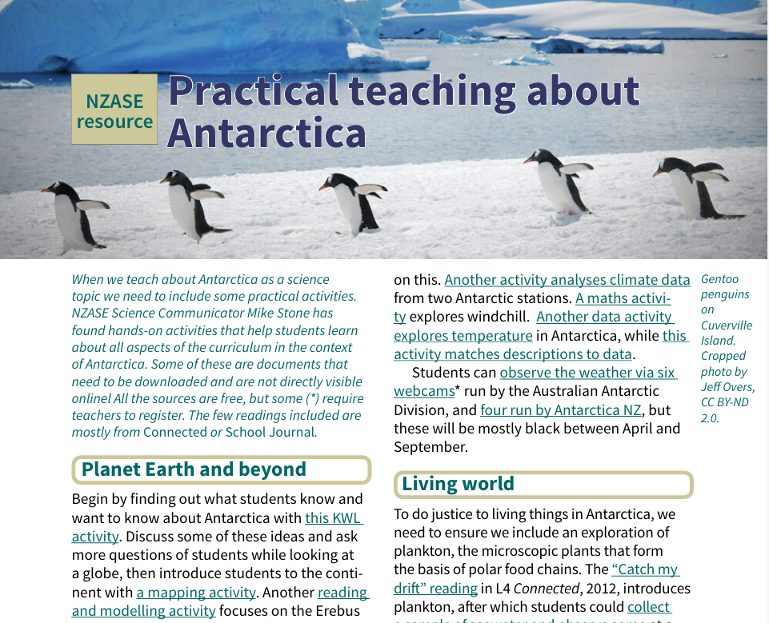
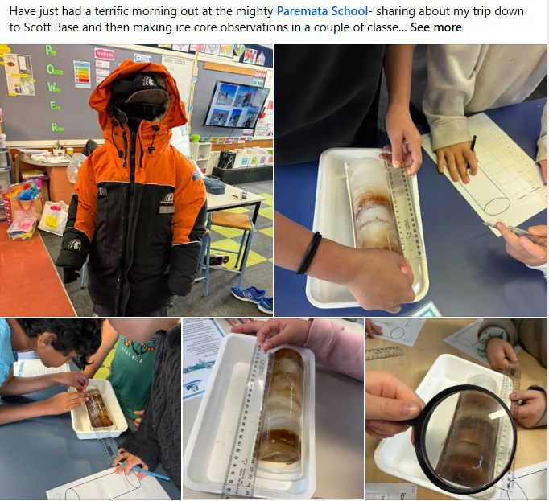
NZASE resource, © NZASE
Notes:
https://nzase.org.nz/category/resources/practical-teaching-about-antarctica

Slide 37
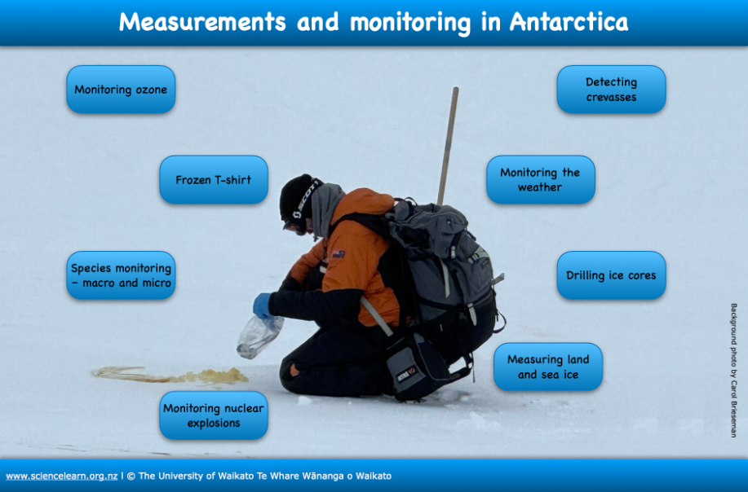
Notes:
https://www.sciencelearn.org.nz/image_maps/measurements-and-monitoring-in-antarctica

Slide 38
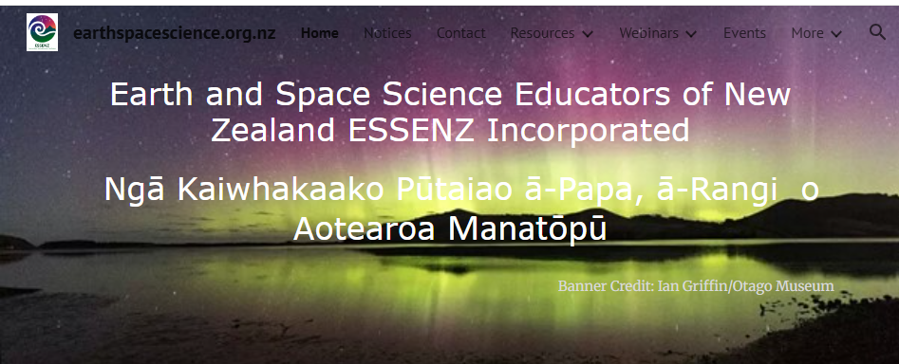
Earth and Space Science Educators of New Zealand, © ESSENZ
Notes:
https://www.earthspacescience.org.nz and https://nzase.org.nz

Slide 39
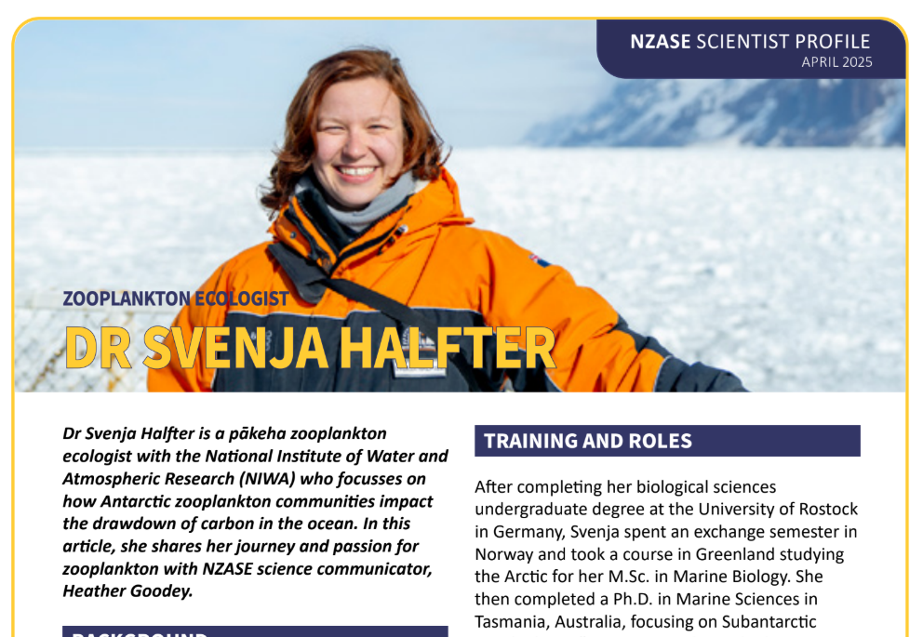
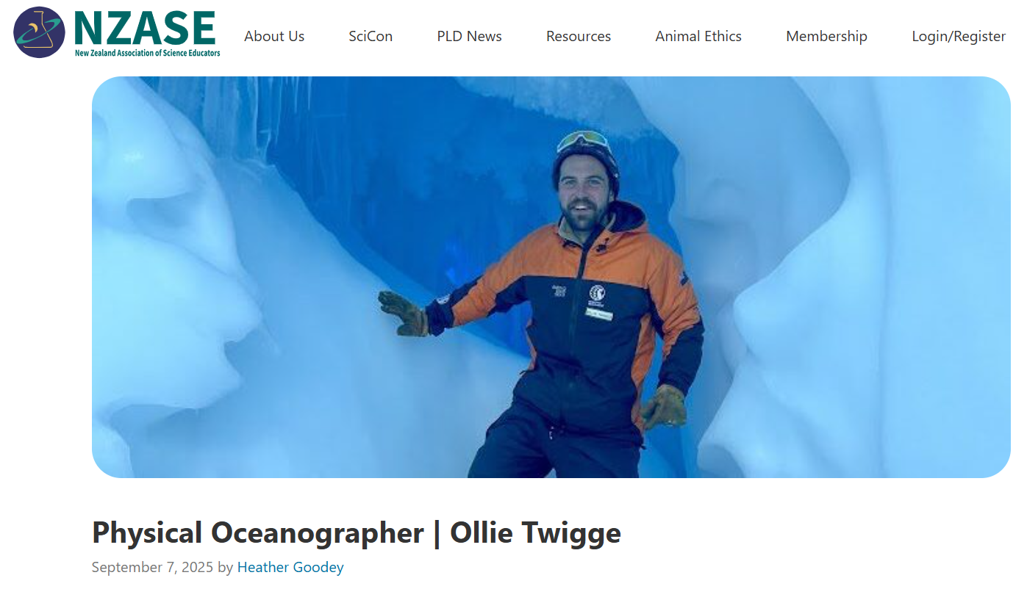
Scientist Profiles, © NZASE
Notes:
https://nzase.org.nz/category/resources/zooplankton-ecologist-svenja-halfter/
https://nzase.org.nz/wp-content/uploads/2025/04/NZASE-Scientist-Profile-Svenja-Halfter-April-2025.pdf

Slide 40
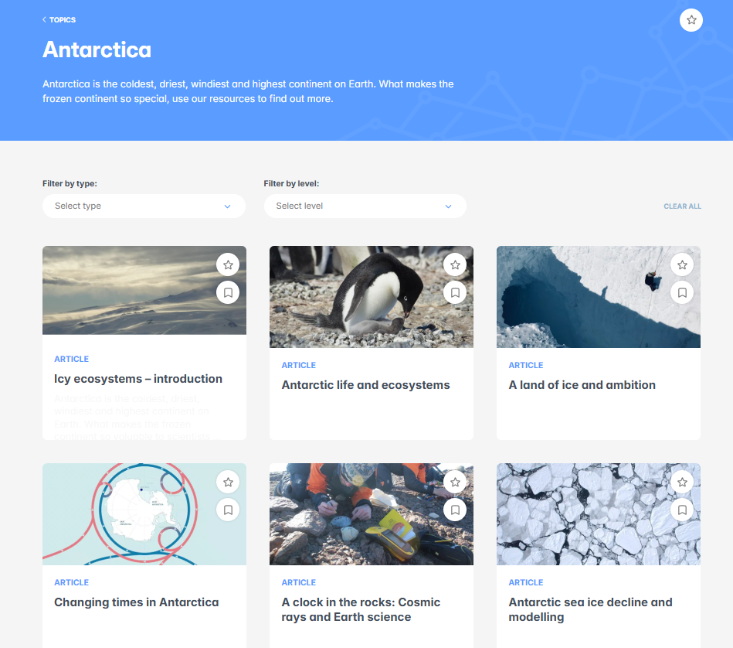
Notes:
https://www.sciencelearn.org.nz/topics/antarctica
https://www.sciencelearn.org.nz/resources/antarctica-literacy-learning-links
https://www.sciencelearn.org.nz/image_maps/measurements-and-monitoring-in-antarctica

Slide 41
www.antarcticanz.govt.nz/media/community-engagement
Notes:
https://www.antarcticanz.govt.nz/media/community-engagement

Slide 42
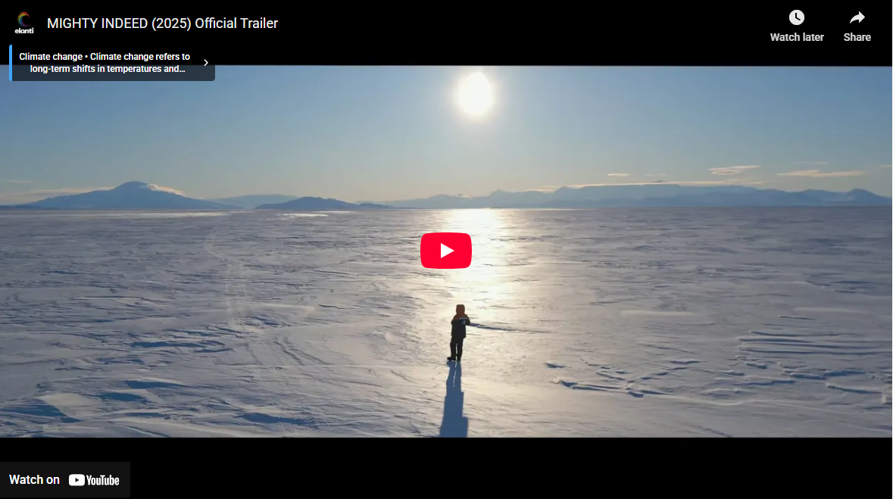
Mighty Indeed, Directed by Vanessa Wells, © Elanti Media
Notes:
Mighty Indeed: South of the South Tour | Antarctica New Zealand: https://www.antarcticanz.govt.nz/media/news/mighty-indeed-sea-ice-scientists-shine-in-award-winning-film-2-2

Slide 43






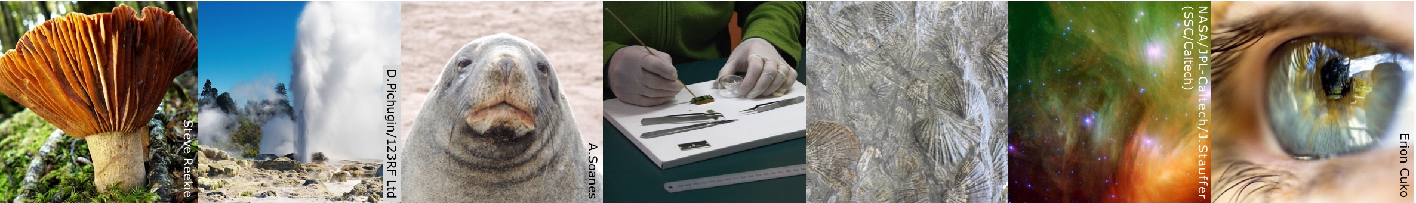
Thanks – want to keep in touch?
Email us on enquiries@sciencelearn.org.nz
facebook.com/nzsciencelearn
instagram.com/sciencelearninghubnz
bit.ly/slhnz_li
youtube.com/@ScienceLearningHubNZ
pinterest.com/nzsciencelearn

