Slide 1

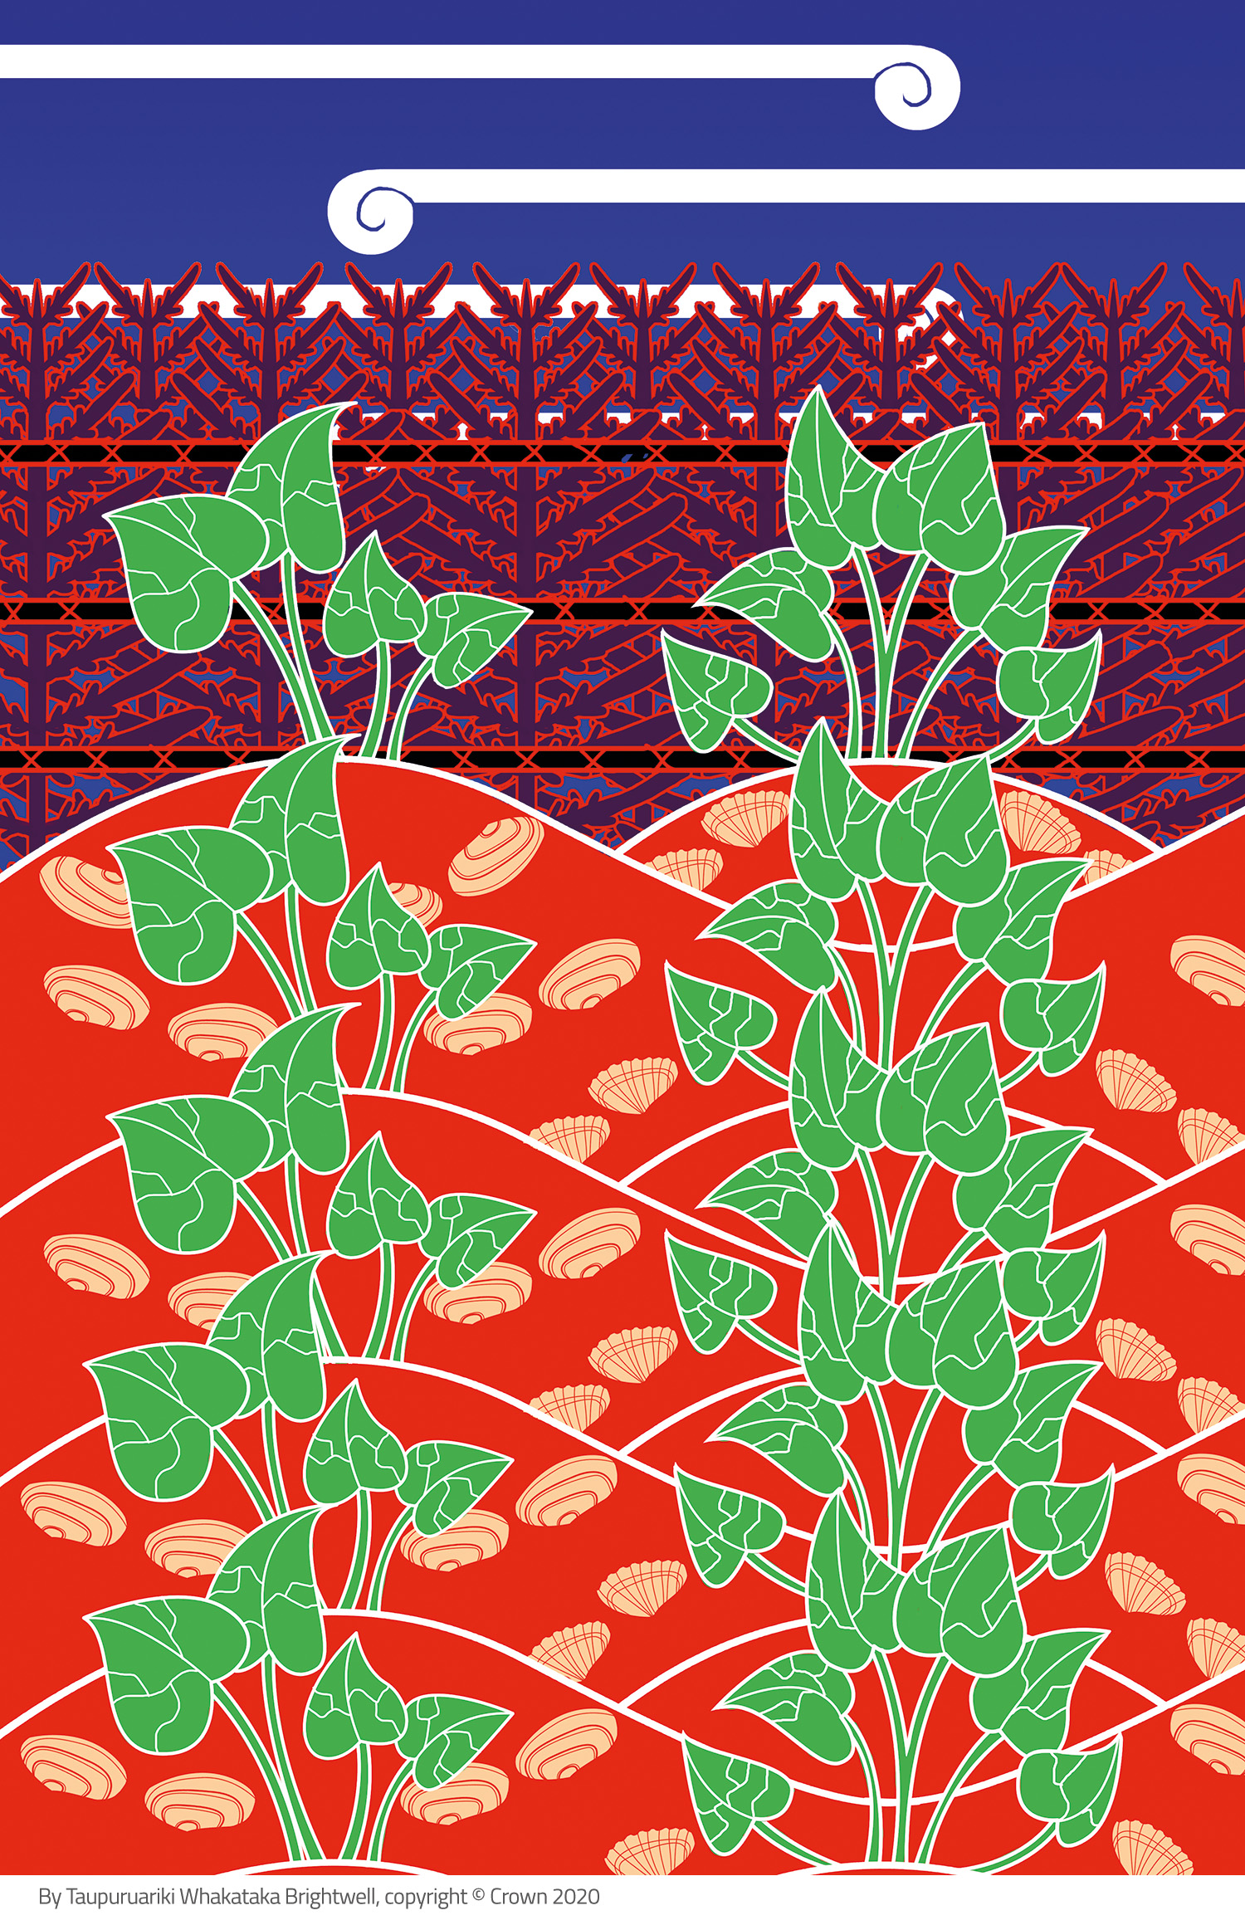
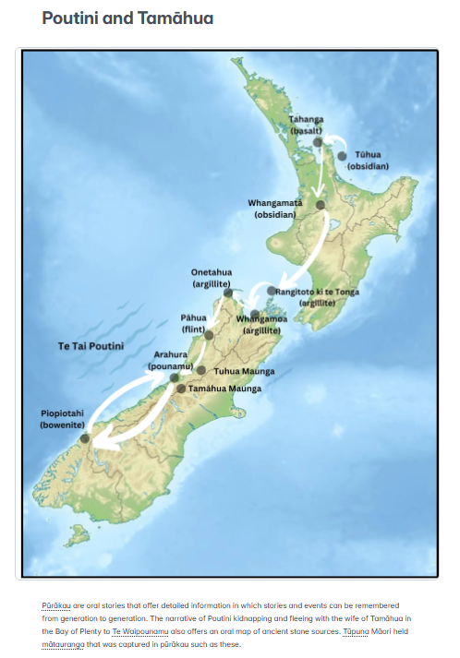
Stories o te taiao
From the article Whakaotirangi and her Kete of Kūmara in the 2020 level 2 Connected journal ‘Digging deeper’ published by the Ministry of Education, New Zealand. Illustrations by Taupuruariki Whakataka Brightwell. Crown copyright 2020.
© Steve Hathaway
© Copyright. Science Learning Hub Pokapū Akoranga Pūtaiao The University of Waikato Te Whare Wananga o Waikato. All Rights Reserved | www.sciencelearn.org.nz. All images are copyrighted. For further information, please refer to enquiries@sciencelearn.org.nz
Notes:
Images:
https://newzealandcurriculum.tahurangi.education.govt.nz/whakaotirangi-and-her-kete-of-k-mara/5637165654.p
www.sciencelearn.org.nz/images/5419-poutini-and-tamahua

Slide 2
Karakia tīmatatanga
Tuia ki te rangi​
Connected with the sky
Tuia ki te whenua​
Connected with the land
Tuia ki te moana​
Connected with the ocean
Ka rongo te pō​
The night listens
Ka rongo te ao​
The world of light listens
Tihei mauri ora!
Let there be life!
© Steve Hathaway
© Copyright. Science Learning Hub Pokapū Akoranga Pūtaiao The University of Waikato Te Whare Wananga o Waikato. All Rights Reserved | www.sciencelearn.org.nz. All images are copyrighted. For further information, please refer to enquiries@sciencelearn.org.nz

Slide 3
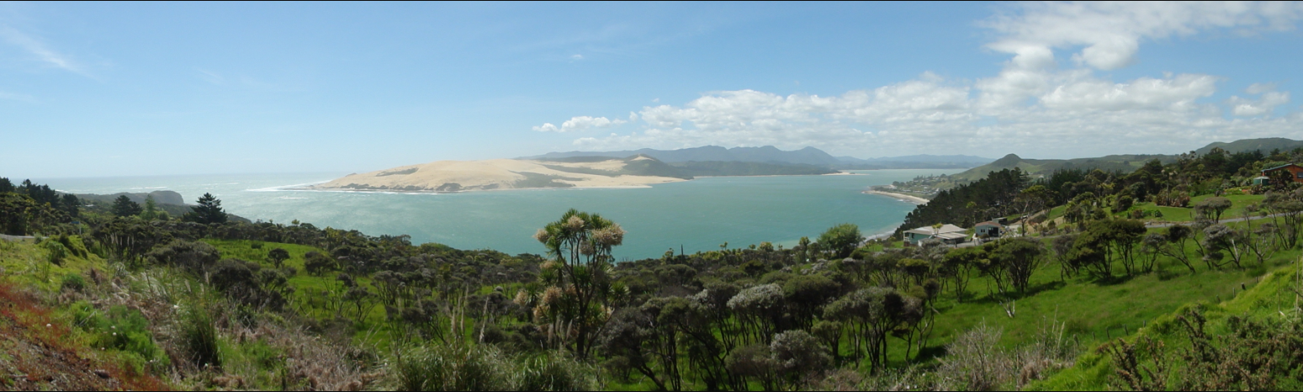
© Steve Hathaway
© Andy king50, CC BY-SA 3.0
Ka mimiti te puna i Hokianga, ka toto te puna i Taumārere.
Ka mimiti te puna i Taumārere ka toto te puna i Hokianga
© Copyright. Science Learning Hub Pokapū Akoranga Pūtaiao The University of Waikato Te Whare Wananga o Waikato. All Rights Reserved | www.sciencelearn.org.nz. All images are copyrighted. For further information, please refer to enquiries@sciencelearn.org.nz
Notes:
Image: https://commons.wikimedia.org/wiki/File:Hokianga_Entrance_Pano.JPG

Slide 4
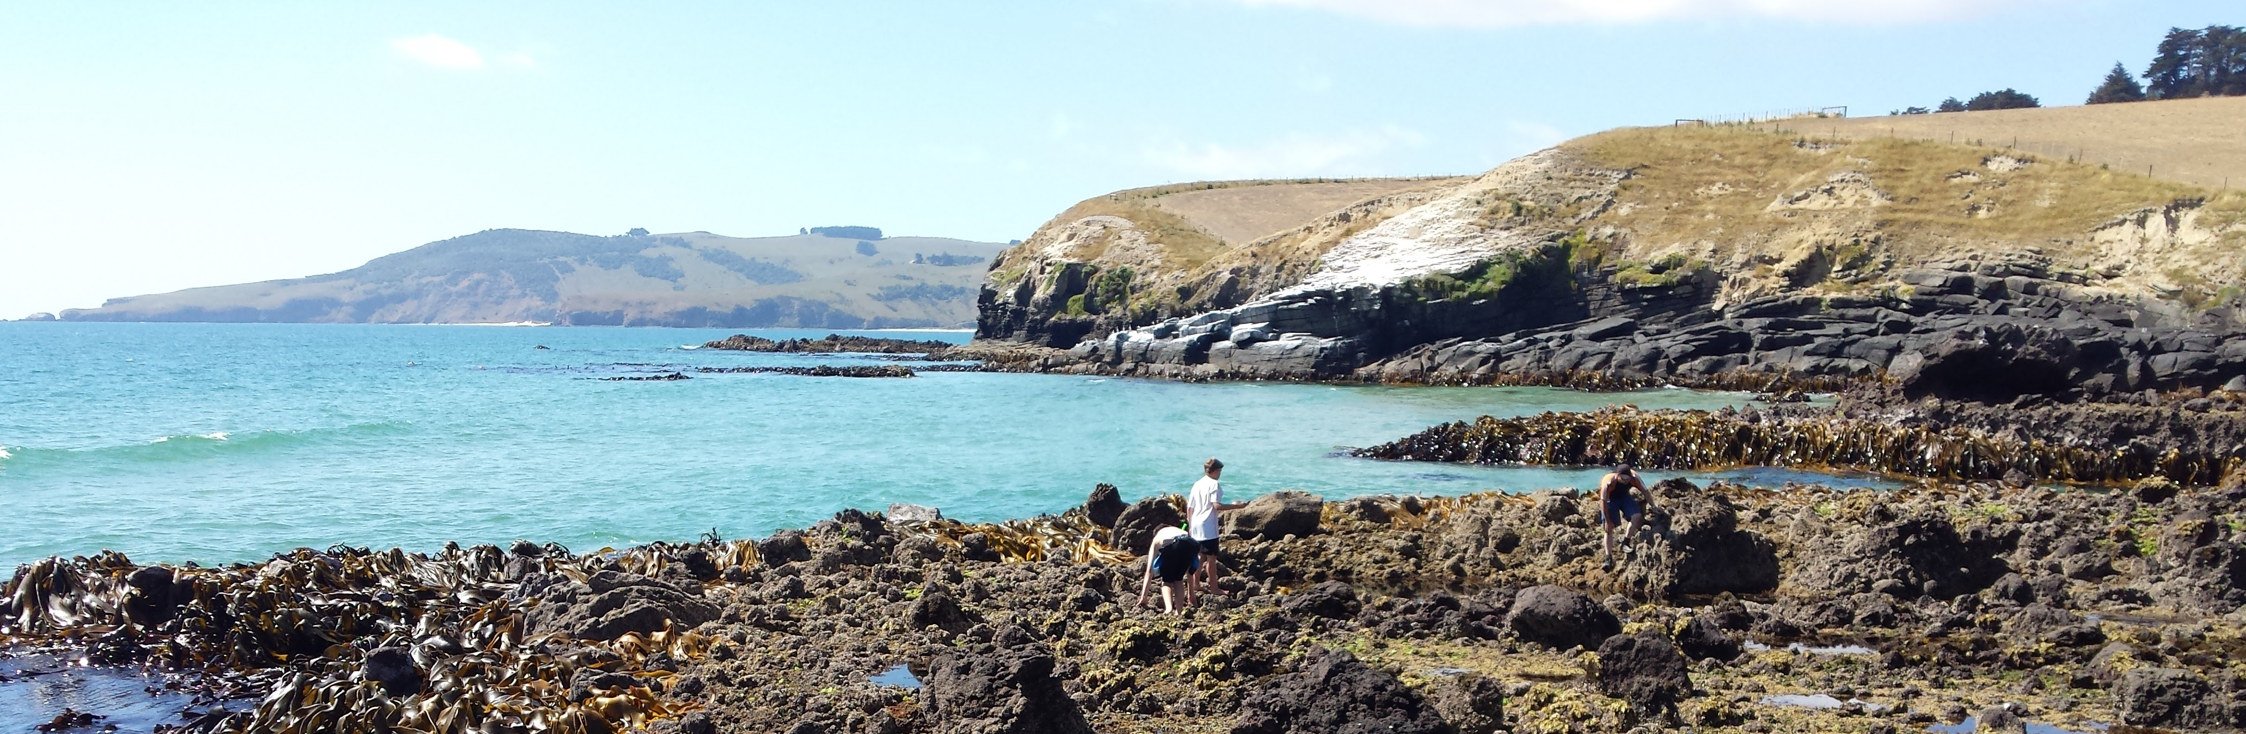
© Steve Hathaway
Private collection
© Copyright. Science Learning Hub Pokapū Akoranga Pūtaiao The University of Waikato Te Whare Wananga o Waikato. All Rights Reserved | www.sciencelearn.org.nz. All images are copyrighted. For further information, please refer to enquiries@sciencelearn.org.nz

Slide 5
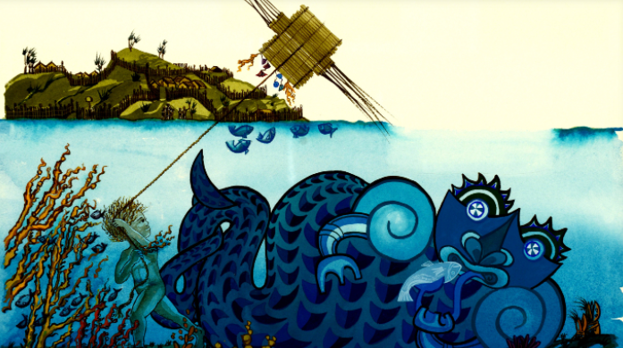
Pūrākau stories o te taiao
© Steve Hathaway
Nga Tamariki Iti o Aotearoa - Te Taitama / The Boy from the Sea - Smith, Miriam; Bowes, Clare; Mahuika, Apirana, 1934-2015.; Mahuika, A. T. (Apirana Tuahae); 1988.
New Zealand. School Publications Branch. Te Rua Mahara o te Kāwanatanga Archives New Zealand. CC BY-SA 2.0
© Copyright. Science Learning Hub Pokapū Akoranga Pūtaiao The University of Waikato Te Whare Wananga o Waikato. All Rights Reserved | www.sciencelearn.org.nz. All images are copyrighted. For further information, please refer to enquiries@sciencelearn.org.nz
Notes:
Image: Pūrākau (Māori origin stories) | Record | DigitalNZ

Slide 6
Traditional Māori narratives such as pūrākau are far more than mere myths or legends—they encode deep knowledge, ethical guidance, and explanations of natural and social phenomena, and have always functioned as vehicles for transmitting this cultural wisdom across generations
— Hirini Moko Mead, Tikanga Māori
© Steve Hathaway
© Copyright. Science Learning Hub Pokapū Akoranga Pūtaiao The University of Waikato Te Whare Wananga o Waikato. All Rights Reserved | www.sciencelearn.org.nz. All images are copyrighted. For further information, please refer to enquiries@sciencelearn.org.nz

Slide 7
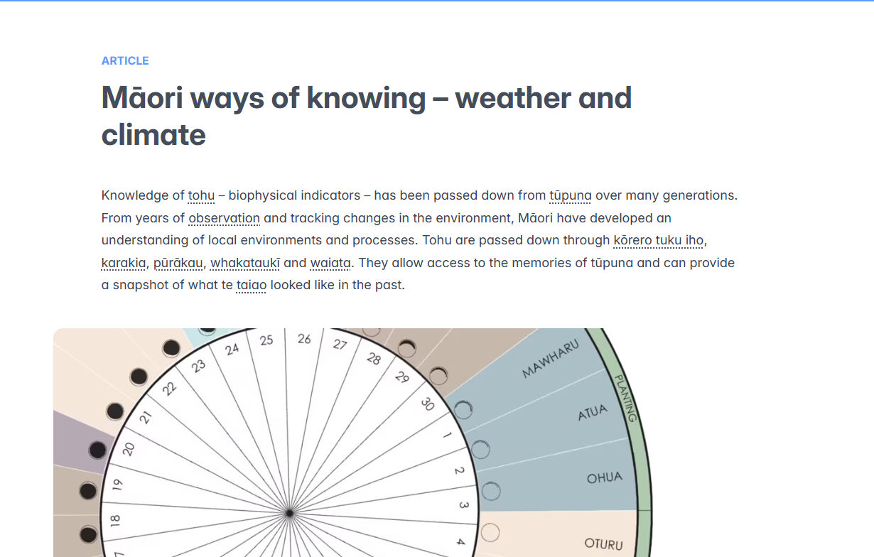
Maramataka dial, courtesy of Ayla Hoeta and Matua Rereata Makiha. Sourced from The Spinoff
© Copyright. Science Learning Hub Pokapū Akoranga Pūtaiao The University of Waikato Te Whare Wananga o Waikato.All Rights Reserved | www.sciencelearn.org.nz. All images are copyrighted. For further information, please refer to enquiries@sciencelearn.org.nz
Notes:
Image taken from video: www.sciencelearn.org.nz/videos/2006-the-impact-of-climate-change-and-matauranga-maori part of www.sciencelearn.org.nz/resources/2961-maori-ways-of-knowing-weather-and-climate

Slide 8
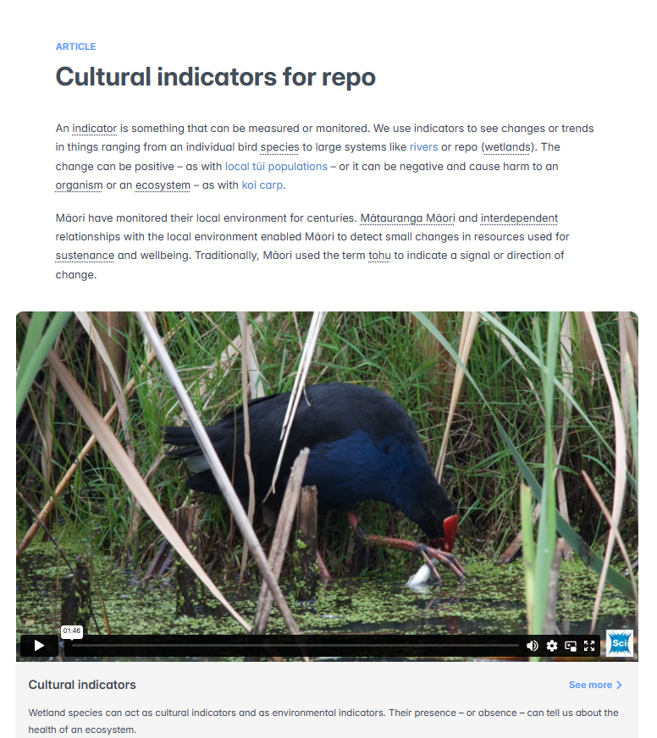
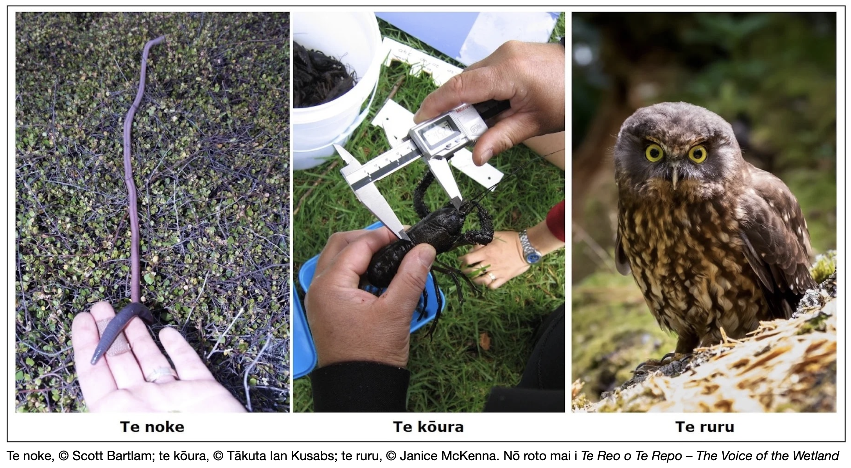
Notes:
Images: www.sciencelearn.org.nz/resources/2992-cultural-indicators-for-repo

Slide 9
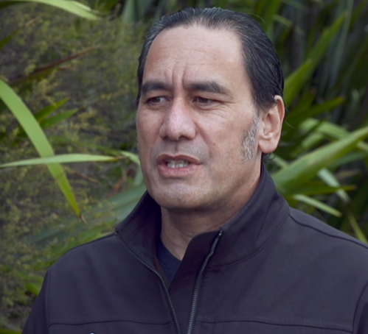
Observing environmental change
"Climate change has the potential to throw out those observations that the maramataka had been based upon."
Dr Shaun Awatere
© Copyright. Science Learning Hub Pokapū Akoranga Pūtaiao The University of Waikato Te Whare Wananga o Waikato.All Rights Reserved | www.sciencelearn.org.nz. All images are copyrighted. For further information, please refer to enquiries@sciencelearn.org.nz
Notes:
Image: www.sciencelearn.org.nz/videos/2006-the-impact-of-climate-change-and-matauranga-maori

Slide 10
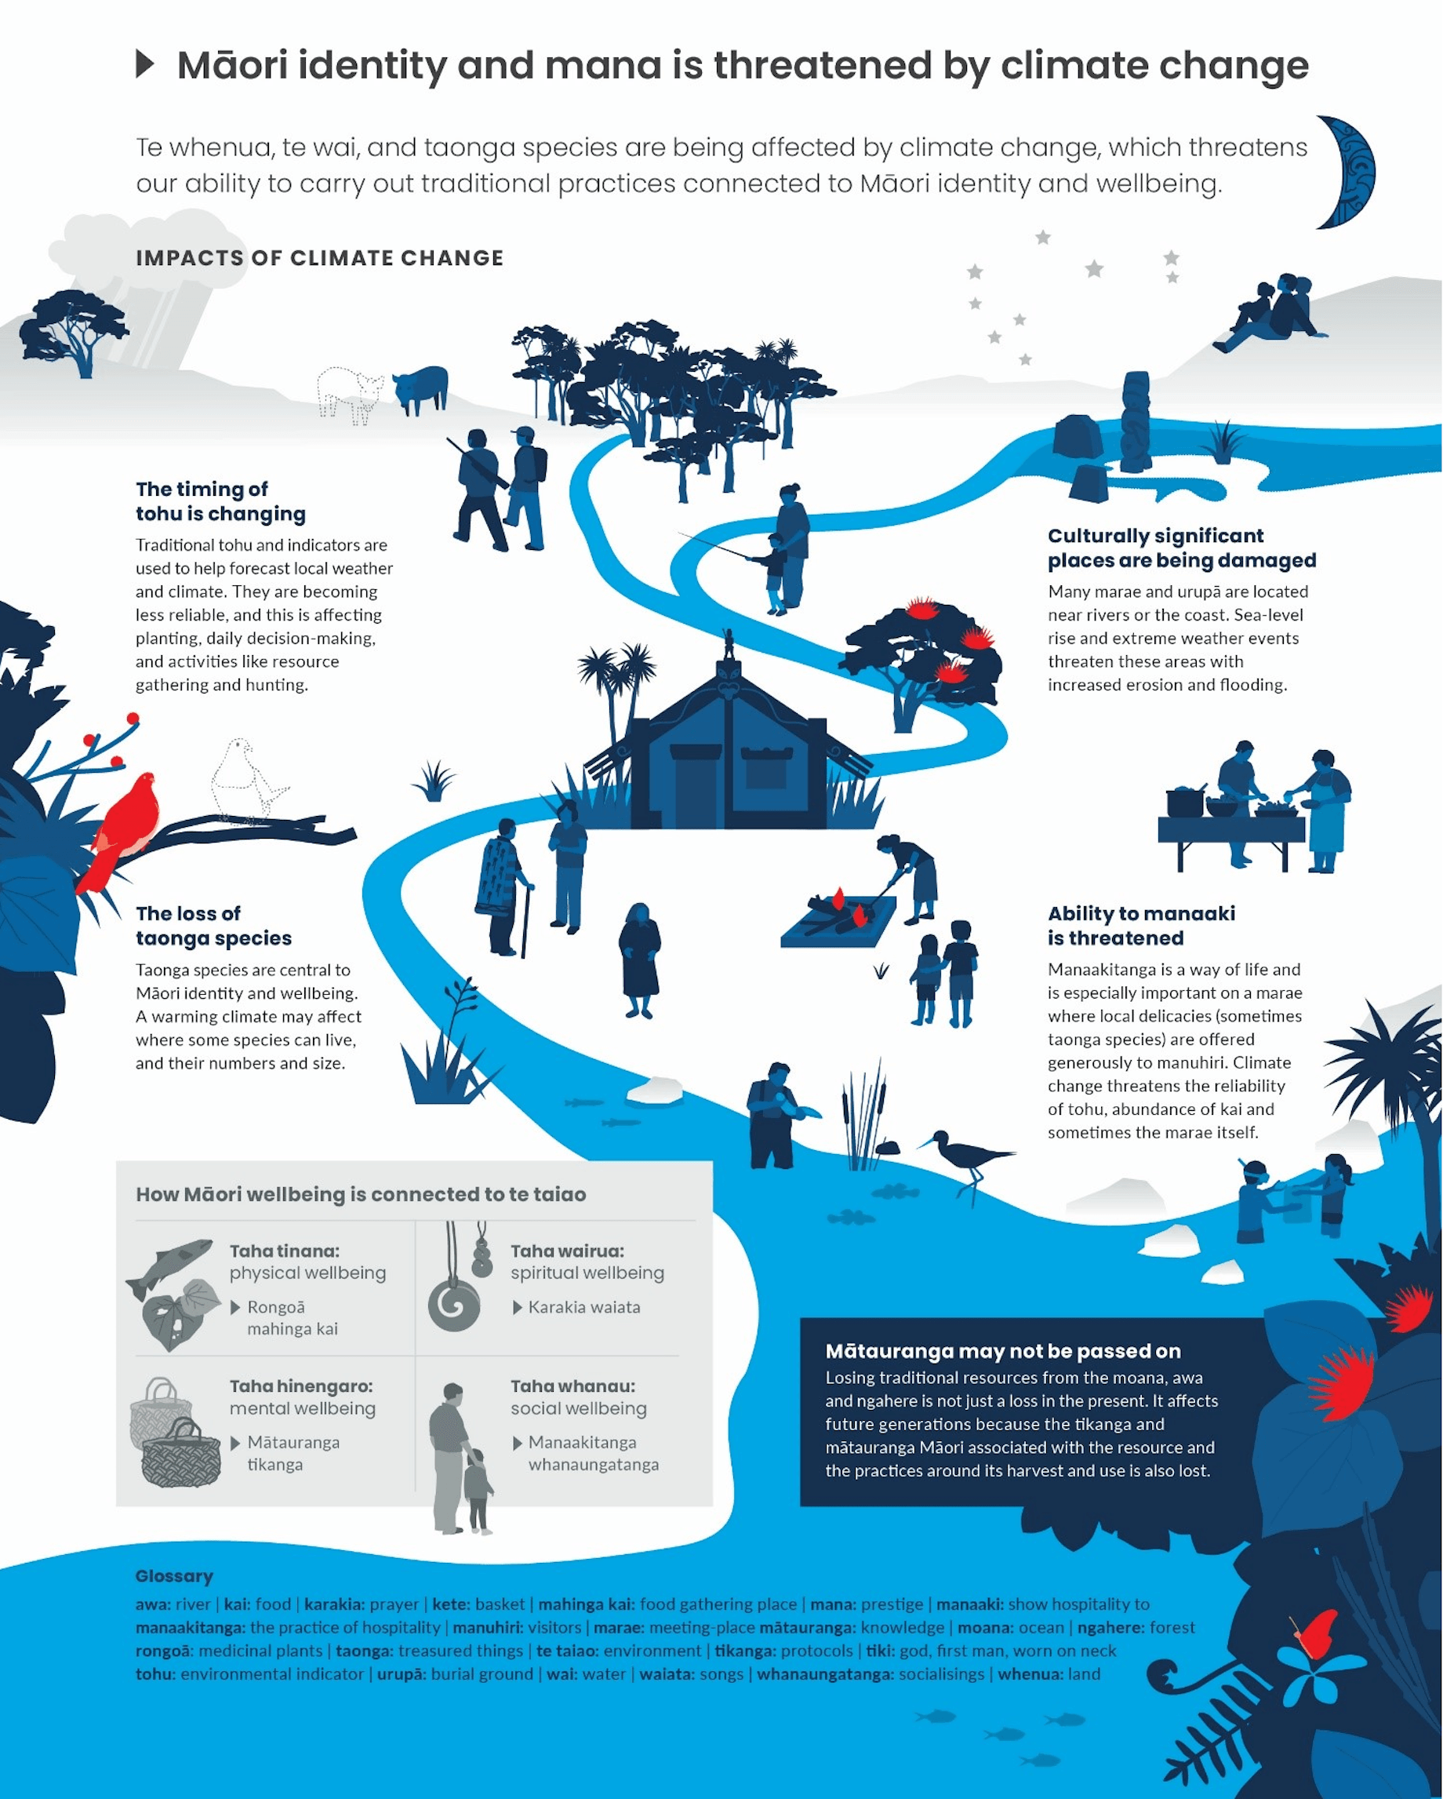
© Copyright. Science Learning Hub Pokapū Akoranga Pūtaiao The University of Waikato Te Whare Wananga o Waikato.All Rights Reserved | www.sciencelearn.org.nz. All images are copyrighted. For further information, please refer to enquiries@sciencelearn.org.nz
Notes:
www.sciencelearn.org.nz/images/4442-climate-change-impacts-on-maori

Slide 11
Poutini and Tamāhua
© Steve Hathaway
Map © Nordnordwest, CC BY-SA 3.0
© Copyright. Science Learning Hub Pokapū Akoranga Pūtaiao The University of Waikato Te Whare Wananga o Waikato. All Rights Reserved | www.sciencelearn.org.nz. All images are copyrighted. For further information, please refer to enquiries@sciencelearn.org.nz
Notes:
Image: https://commons.wikimedia.org/wiki/File:New_Zealand_relief_map.jpg

Slide 12
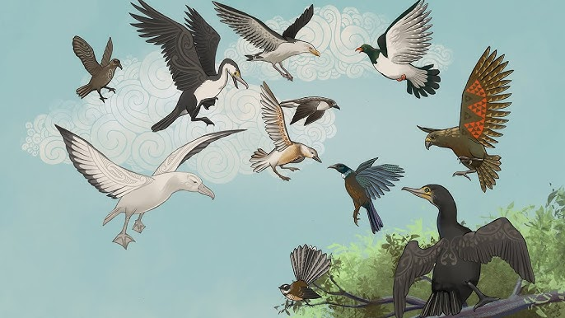
He Paki Taonga i a Māui: Ko te Pakanga a ngā Manu
Battle of the Birds
© Steve Hathaway
© Production Shed TV
Video link: https://www.youtube.com/watch?v=AS72gLdVS0c&t=1s
© Copyright. Science Learning Hub Pokapū Akoranga Pūtaiao The University of Waikato Te Whare Wananga o Waikato. All Rights Reserved | www.sciencelearn.org.nz. All images are copyrighted. For further information, please refer to enquiries@sciencelearn.org.nz
Notes:
Te Papa video series – battle of the birds. https://youtu.be/AS72gLdVS0c

Slide 13
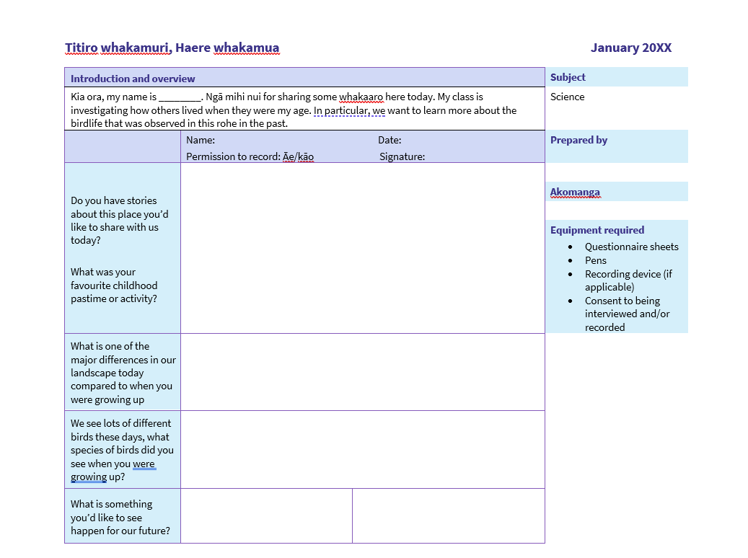
Ake Ake – forever and ever
Bit.ly/4l3Hrs2
© Copyright. Science Learning Hub Pokapū Akoranga Pūtaiao The University of Waikato Te Whare Wananga o Waikato.All Rights Reserved | www.sciencelearn.org.nz. All images are copyrighted. For further information, please refer to enquiries@sciencelearn.org.nz
Notes:
Image: https://www.sciencelearn.org.nz/resources/3345-manu-past-present-and-future

Slide 14
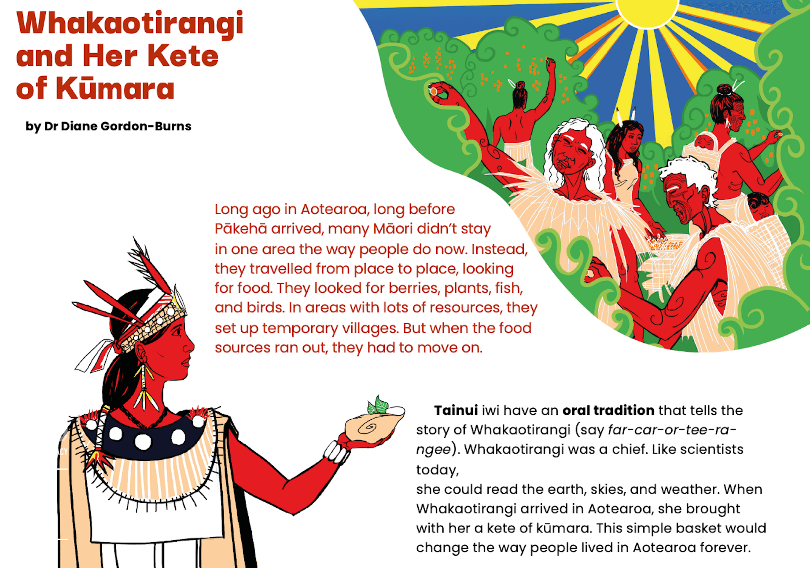
© Steve Hathaway
From the article Whakaotirangi and her Kete of Kūmara in the 2020 level 2 Connected journal ‘Digging deeper’ published by the Ministry of Education, New Zealand. Illustrations by Taupuruariki Whakataka Brightwell. Crown copyright 2020.
Notes:
Image: www.sciencelearn.org.nz/resources/3035-whakaotirangi-and-her-kete-of-kumara

Slide 15
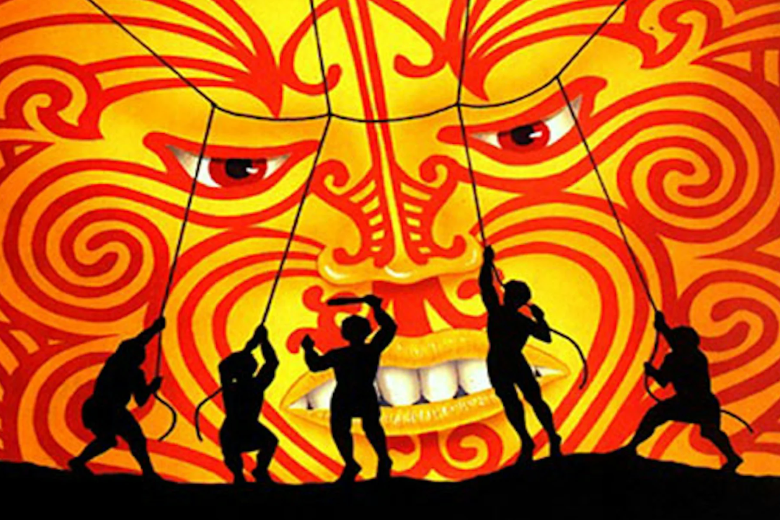
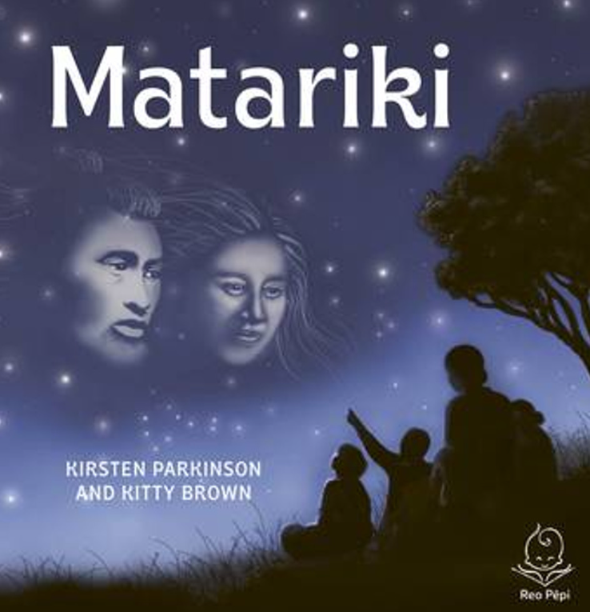
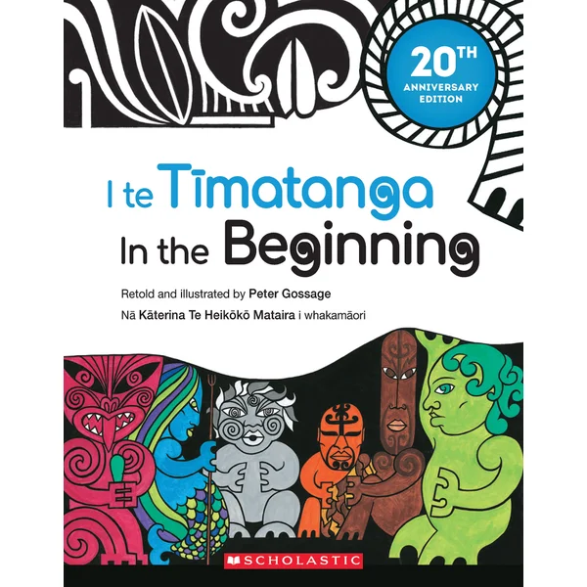
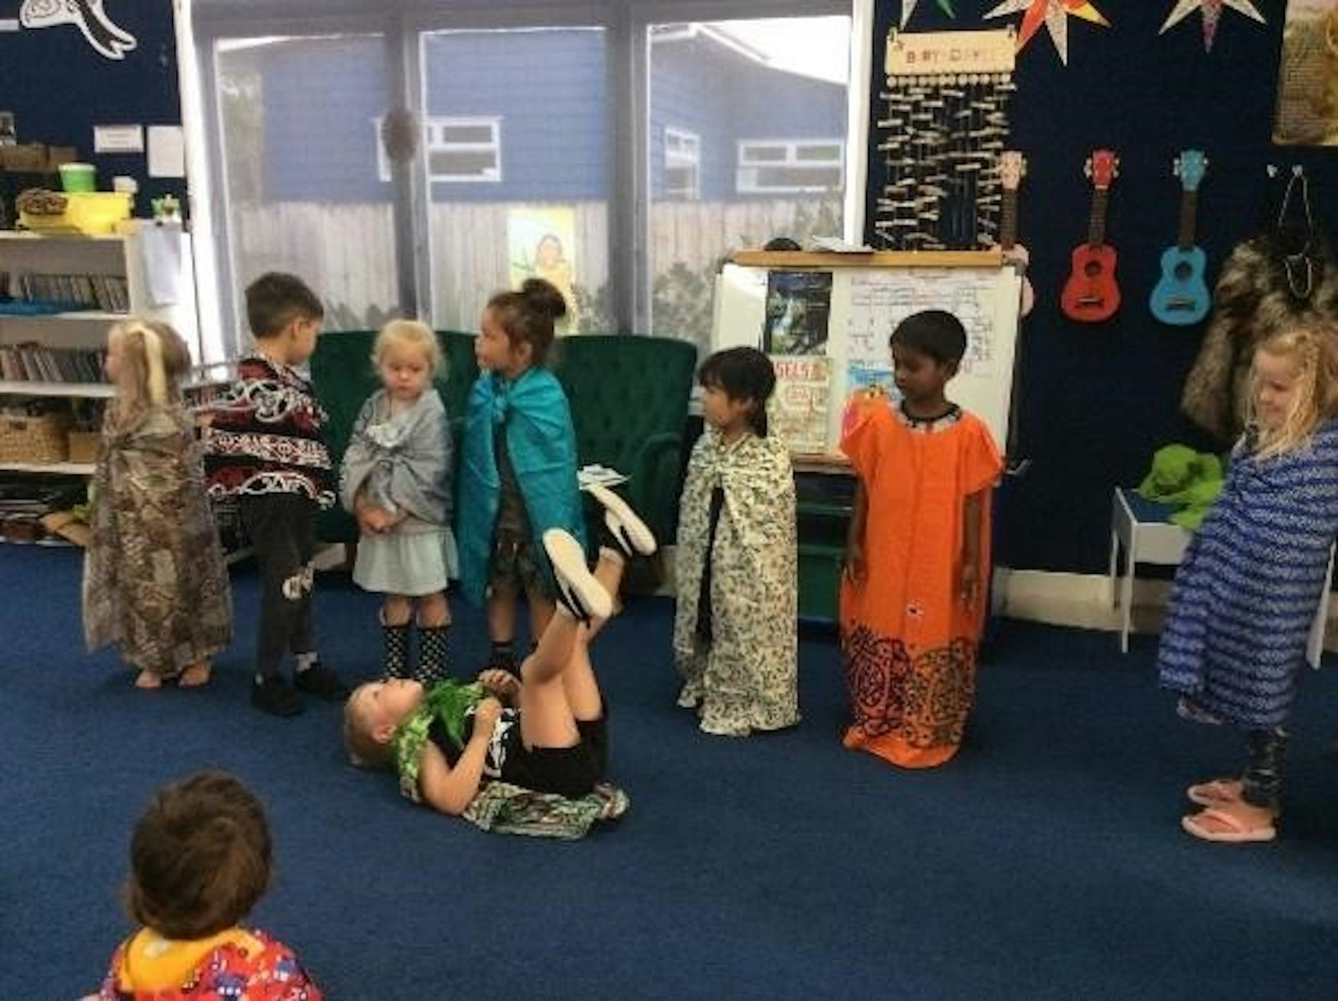
© Tim Tripp
Published by Allen & Unwin Aotearoa New Zealand. ISBN: 9781988547992. 2022.
© Steve Hathaway
Published by Scholastic NZ Ltd. ISBN: 9781775436850. 20th Anniversary edition, 2021
© Hillcrest Kindergarten
© Copyright. Science Learning Hub Pokapū Akoranga Pūtaiao The University of Waikato Te Whare Wananga o Waikato. All Rights Reserved | www.sciencelearn.org.nz. All images are copyrighted. For further information, please refer to enquiries@sciencelearn.org.nz
Notes:
Images:
Ihttps://www.sciencelearn.org.nz/resources/3053-belonging-through-storytelling
Māui harnessing the Sun — Science Learning Hub
Aotearoa Books | Matariki

Slide 16
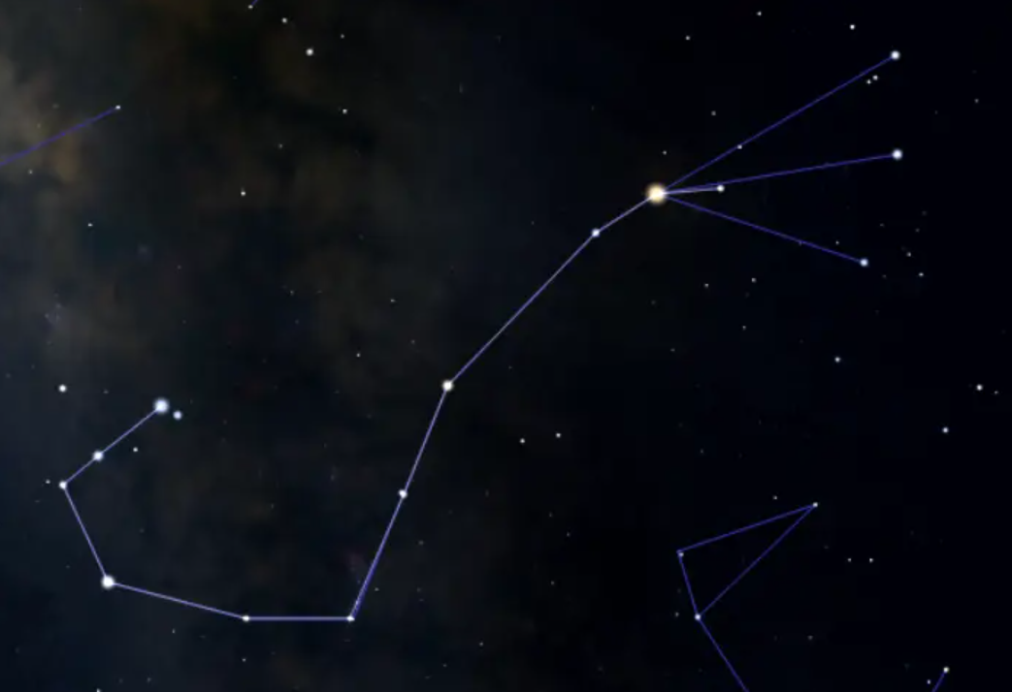
© Steve Hathaway
© Copyright. Science Learning Hub Pokapū Akoranga Pūtaiao The University of Waikato Te Whare Wananga o Waikato. All Rights Reserved | www.sciencelearn.org.nz. All images are copyrighted. For further information, please refer to enquiries@sciencelearn.org.nz
Notes:
Image: The Fish Hook: Stars, Deep Sky Objects and Location – Constellation Guide

Slide 17
“Pūrākau are a valid and rich form of indigenous theorising. They carry embedded epistemologies—ways of knowing and being that differ from Western science but are equally valuable.”
— Georgina Stewart, 2019
© Steve Hathaway
© Copyright. Science Learning Hub Pokapū Akoranga Pūtaiao The University of Waikato Te Whare Wananga o Waikato. All Rights Reserved | www.sciencelearn.org.nz. All images are copyrighted. For further information, please refer to enquiries@sciencelearn.org.nz
Notes:
Stewart, G. (2019). Indigenous knowledge in the school curriculum: Whose knowledge? Whose truth? In M. Peters (Ed.), A Companion to Research in Teacher Education (pp. 275–286). Springer.

Slide 18
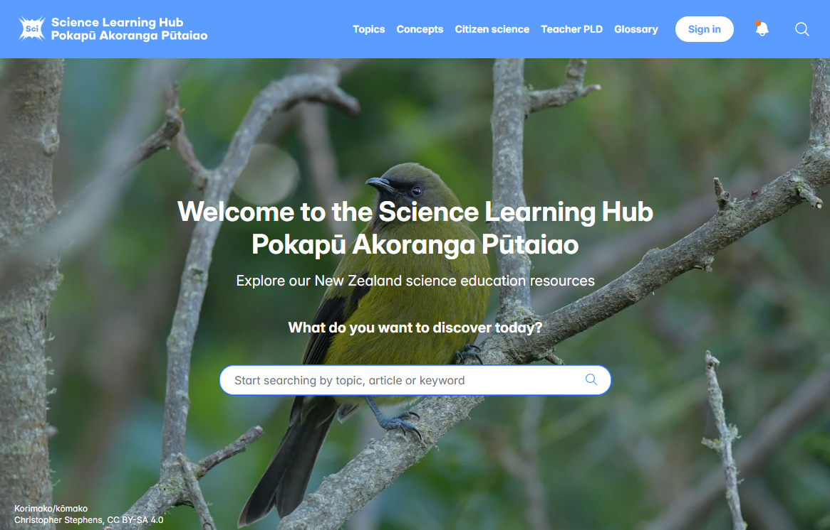

Slide 19






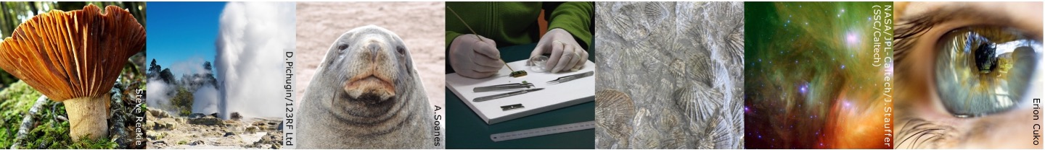
Thanks – want to keep in touch?
Email us on enquiries@sciencelearn.org.nz
facebook.com/nzsciencelearn
instagram.com/sciencelearninghubnz
bit.ly/slhnz_li
youtube.com/@ScienceLearningHubNZ
pinterest.com/nzsciencelearn

Slide 20
Karakia whakamutunga
Whakairia ake te tapu
Remove and lift the sacredness and restrictions
Kia wātea ai te ara
So the pathway is clear
Kia turuki whakataha ai
Let it be pushed aside
Kia turuki whakataha ai
Let it be pushed aside
Haumi e, hui e, taiki e
Join, gather, it is done
© Copyright. Science Learning Hub Pokapū Akoranga Pūtaiao The University of Waikato Te Whare Wananga o Waikato.All Rights Reserved | www.sciencelearn.org.nz. All images are copyrighted. For further information, please refer to enquiries@sciencelearn.org.nz

