Slide 1

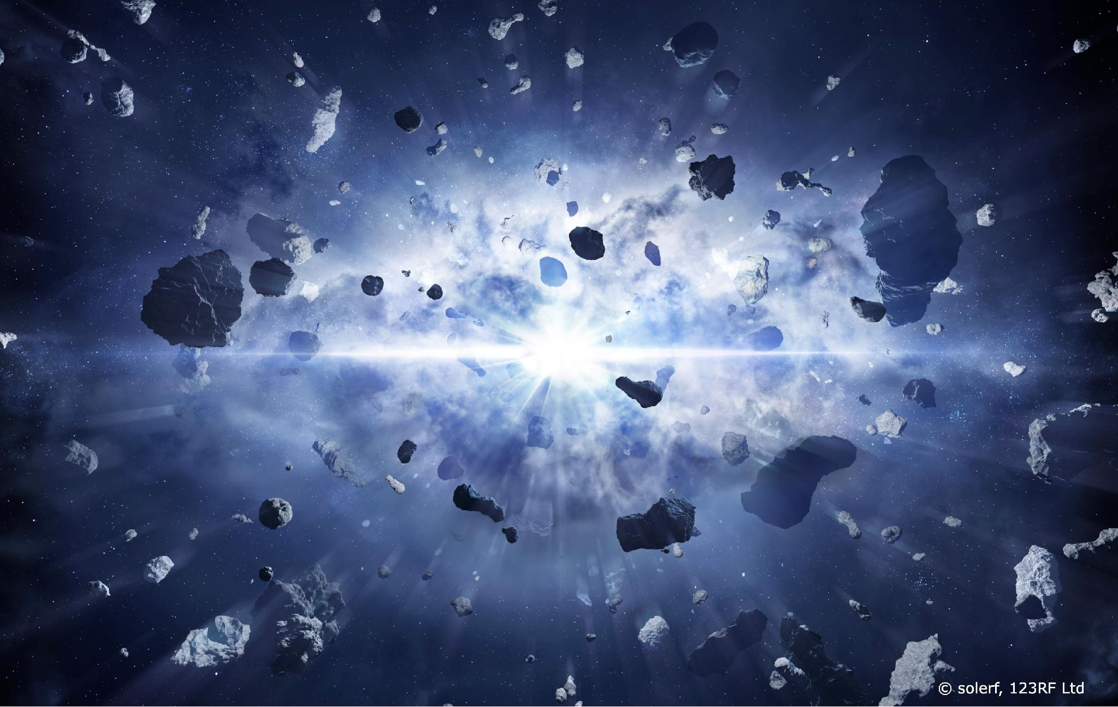
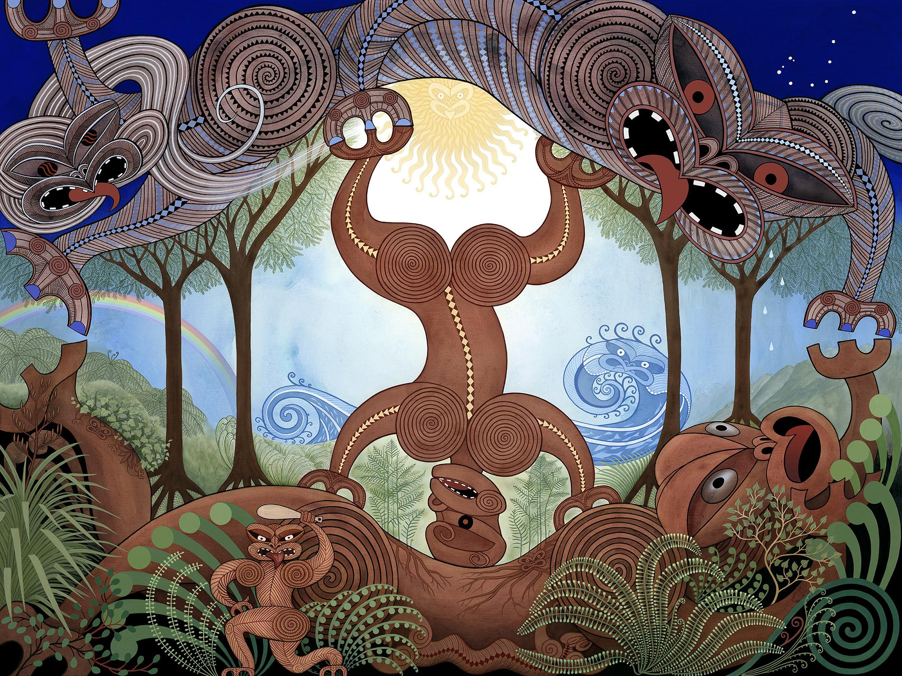
It all started with the Big Bang
and Te Kore
Dual knowledge systems
The Separation of Ranginui and Papatūānuku,
© Marian Maguire, 2024
© University of Waikato Te Whare Wānanga o Waikato | www.sciencelearn.org.nz
All images are copyrighted. For further information, please refer to enquiries@sciencelearn.org.nz

Slide 2
The Big Bang
The Big Bang theory proposes that the universe began approximately 13.8 billion years ago from an extremely hot, dense point and has been expanding ever since.
© University of Waikato Te Whare Wānanga o Waikato | www.sciencelearn.org.nz
All images are copyrighted. For further information, please refer to enquiries@sciencelearn.org.nz

Slide 3
Balloon universe expansion
Materials: balloons, permanent markers, ruler​
Instructions:​
Draw dots to represent galaxies on an uninflated balloon.
Measure the distance between dots​.
Slowly inflate the balloon.
Observe how the dots have moved away from each other. Measure the distances again.
Discussion: This models how space itself expands, carrying galaxies apart.
© University of Waikato Te Whare Wānanga o Waikato | www.sciencelearn.org.nz
All images are copyrighted. For further information, please refer to enquiries@sciencelearn.org.nz

Slide 4
Cosmic timeline ribbon
Materials: 1.38 m of ribbon, labels, tape measure​
Instructions:​
Lay out the ribbon, which represents 13.8 billion years
(1 m = 1 billion years so 1.3 m = 13 billion years)​.
Mark key events:​
  0 m: Big Bang​
  0.003 m (0.3 mm): First atoms form​
  2 cm: First stars​
  9 cm: Our Solar System forms​
  1.37 m: First humans (just 3 cm from the end!)​
Walk the timeline and discuss the vast scales of cosmic time.
© University of Waikato Te Whare Wānanga o Waikato | www.sciencelearn.org.nz
All images are copyrighted. For further information, please refer to enquiries@sciencelearn.org.nz

Slide 5
The tīmatatanga – the creation
The creation moved through stages: Te Kore (the void/
potential), Te Pō (the darkness/night) and finally Te Ao Mārama (the world of light). Ranginui and Papatūānuku were locked in embrace, and their children lived in darkness between them until Tāne Mahuta separated them.
The Separation of Ranginui and Papatūānuku,
© Marian Maguire, 2024
© University of Waikato Te Whare Wānanga o Waikato | www.sciencelearn.org.nz
All images are copyrighted. For further information, please refer to enquiries@sciencelearn.org.nz

Slide 6
Te Pō – physical drama
Materials: blindfold, darkened room free of hard furniture, speaker and soundtrack of choice or The Great Order of Things by Atrium Carceri & Cities Last Broadcast on Spotify ​
Instructions:​
Line students up close together, one behind the other.​
Last student wears a blindfold.​
Instruct students to recreate Te Pō by reaching up with their hands to gently cover the eyes of the person in front.​
Keeping eyes covered, teacher leads the students into a darkened space, with track playing at medium-high volume. ​
Lead students into spiral or circle.
© University of Waikato Te Whare Wānanga o Waikato | www.sciencelearn.org.nz
All images are copyrighted. For further information, please refer to enquiries@sciencelearn.org.nz

Slide 7
The separation – physical drama
Materials: blue and brown/green fabric sheets, students​
Instructions:​
Two students hold fabric representing Rangi (blue, above) and Papa (brown/green, below) pressed together.​
Other students crouch between them in darkness (Te Pō).​
One student (Tāne) slowly pushes them apart –others emerge into the light (Te Ao Mārama).​
Discuss the themes of transformation, relationships and sacrifice in creation.
© University of Waikato Te Whare Wānanga o Waikato | www.sciencelearn.org.nz
All images are copyrighted. For further information, please refer to enquiries@sciencelearn.org.nz

Slide 8
Comparison – Venn diagram
Similarities might include:​
Both describe a beginning/origin.​
Both involve transformation from one state to another.​
Both explain how light/the universe came to be​.
Both involve time and stages of development​.
Both deal with the fundamental question:
Where did we come from?​
© University of Waikato Te Whare Wānanga o Waikato | www.sciencelearn.org.nz
All images are copyrighted. For further information, please refer to enquiries@sciencelearn.org.nz

Slide 9
Comparison – Venn diagram
Differences might include:​
Big Bang focuses on physical processes – Māori story includes relationships and whakapapa (genealogy)​.
Scientific theory uses evidence and mathematics – Māori story uses metaphor and teaches values​.
Big Bang describes what and when – Māori story explores why and meaning.​
Different purposes – scientific prediction vs cultural identity and connection.
© University of Waikato Te Whare Wānanga o Waikato | www.sciencelearn.org.nz
All images are copyrighted. For further information, please refer to enquiries@sciencelearn.org.nz

Slide 10
Discussions – multiple ways of knowing
Can both be true in different ways? How?​
What does science teach us?
What does the Māori story teach us?​
Why might different cultures develop different creation stories?​
How does the Māori story connect people to the land and each other?​
What questions does each story answer best?
© University of Waikato Te Whare Wānanga o Waikato | www.sciencelearn.org.nz
All images are copyrighted. For further information, please refer to enquiries@sciencelearn.org.nz

Slide 11
Student reflections
Choose one activity. ​
How did it help you understand a creation story?
How did it help you understand the Big Bang theory? ​
What did you learn about different ways of knowing?
© University of Waikato Te Whare Wānanga o Waikato | www.sciencelearn.org.nz
All images are copyrighted. For further information, please refer to enquiries@sciencelearn.org.nz

