Slide 1
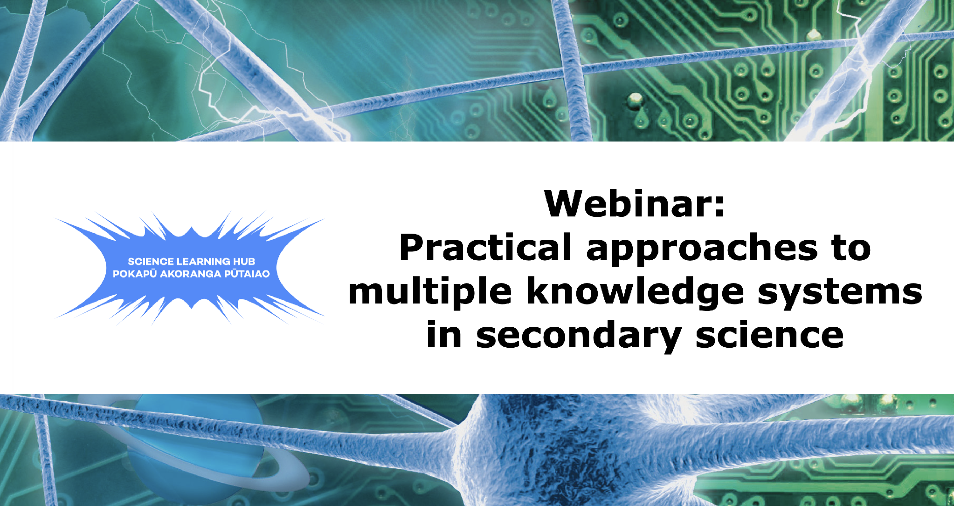

Slide 2

Index
Topic | Slideshow number(s) | Video timecode
Welcome, index and Introducing the Science Learning Hub | 1–3 | 00:00
Karakia timatanga, acknowledgements, whakataukī and introducing the presenters | 4–8 | 01:06
Sharing each school's journey | 9–11 | 07:44
Practical examples from Wellington East Girls' College (Te Whanganui-a-Tara Wellington) | 12–13 | 33:18
Practical examples from Green Bay High School (Tāmaki Makaurau Auckland) | 14–15 | 41:47
Practical examples from Lincoln High School (Waitaha Canterbury) | 16–17 | 46:46
Final words and karakia whakamutanga | 18–19 | 49:18

Slide 3

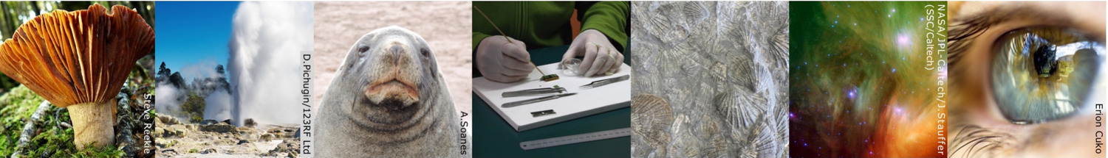
Science Learning Hub Pokapū Akoranga Pūtaiao
A trustworthy online resource – produced by educators and scientists.
Based on world-class New Zealand science research.
Supported by learning activities, key science ideas and concepts, multimedia tools and other resources.
Written for New Zealand teachers and students.
Designed to build understanding and confidence in science and science education.
The Science Learning Hub Pokapū Akoranga Pūtaiao is funded through the Science in Society initiative of New Zealand's Ministry of Business, Innovation and Employment ( MBIE).
© Copyright. Science Learning Hub Pokapū Akoranga Pūtaiao The University of Waikato Te Whare Wananga o Waikato.
All Rights Reserved | www.sciencelearn.org.nz. All images are copyrighted. For further information, please refer to enquiries@sciencelearn.org.nz

Slide 4
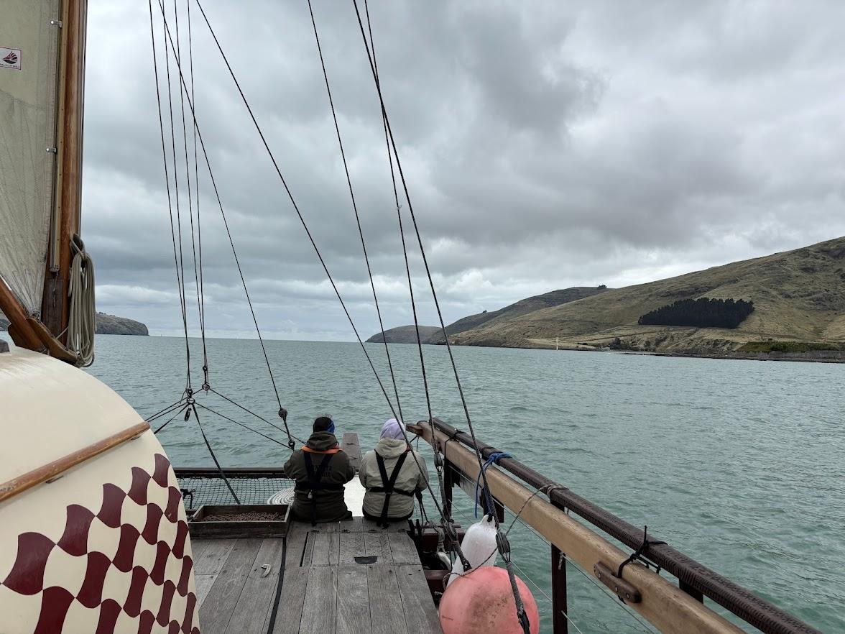
Kia hora te marino
Kia whakapapa pounamu te moana
Hei huarahi mā tātou i te rangi nei
Aroha atu, aroha mai
Tātou i a tātou katoa
Hui e, tāiki e

Slide 5
ACKNOWLEDGEMENTS
Teaching and Learning Research Initiative (TLRI) The Science Learning Hub Pokapū Akoranga Pūtaiao Sara Tolbert Kari Moana Te Rongopatahi Sriparna Saha Pauline Waiti Pania Te Maro | University of Canterbury Te Toki Voyaging Trust Green Bay High School Lincoln High School Bioeconomy Science Institute Flying Geese Trust

Slide 6
A JOURNEY, NOT A DESTINATION
Working with multiple knowledge systems in science is an ongoing journey.
We are still learning. We are still questioning. We are still adapting.
Complex problems need multiple perspectives.
Change requires courage, curiosity and relationships.
We don't have to have all the answers to begin.
Our hope is that you leave feeling encouraged to keep asking, keep learning, keep advocating and have relentless forward motion with this kaupapa, no matter which way the wind blows.

Slide 7
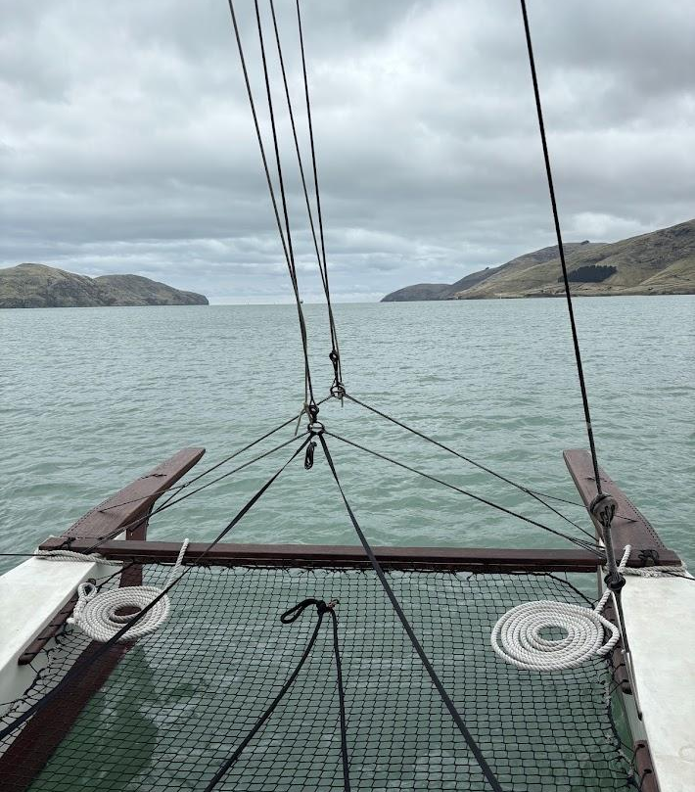
Enduring in a time of change
He moana pukepuke e ekengia e te waka
Unsettling times can be overcome if the people are resolute to do so.
Stable waka… storms may come but we adapt and hold fast to the importance of the journey.

Slide 8
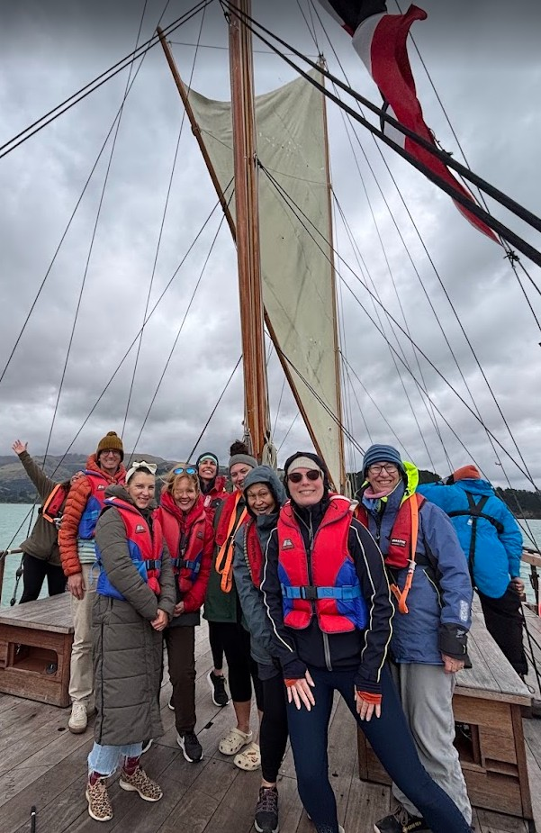
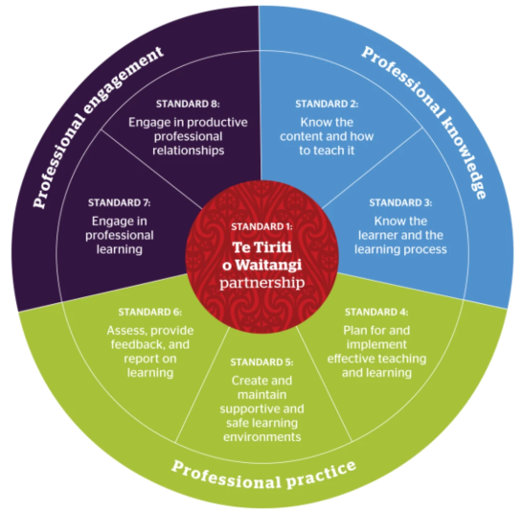
Ko wai mātou?
Wellington East Girls’ College:
Alana Cockburn
Green Bay High School:
Madeleine Collins
Zev Fishman
Lincoln High School:
Bronwyn Hooper
Anna Milne
© Teaching Council of Aotearoa New Zealand

Slide 9
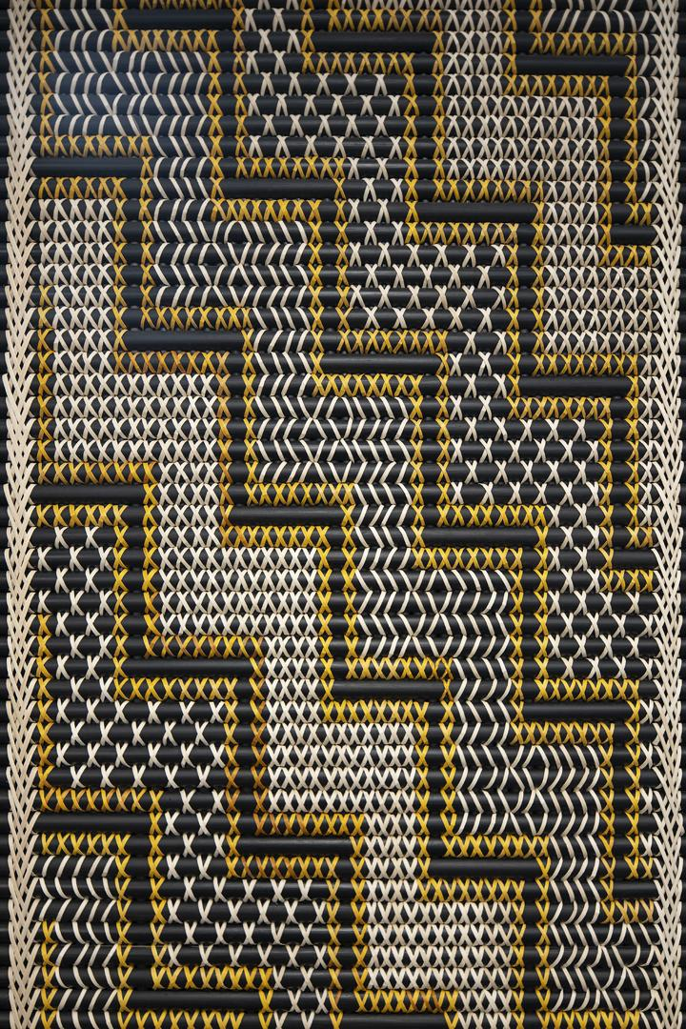
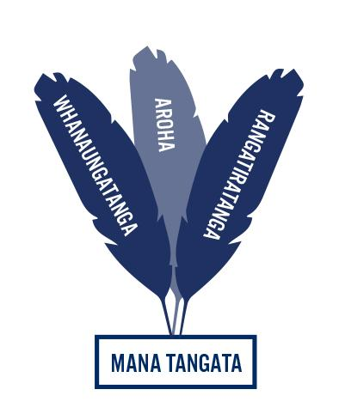

Science in Aotearoa and the Pacific Course (SP100)
2020
Bicultural unit planner for all science courses
2022
Interfaces Models - Two-Eyed-Seeing
2024
Embedding our practice and planning for the new curriculum
2026

Slide 10
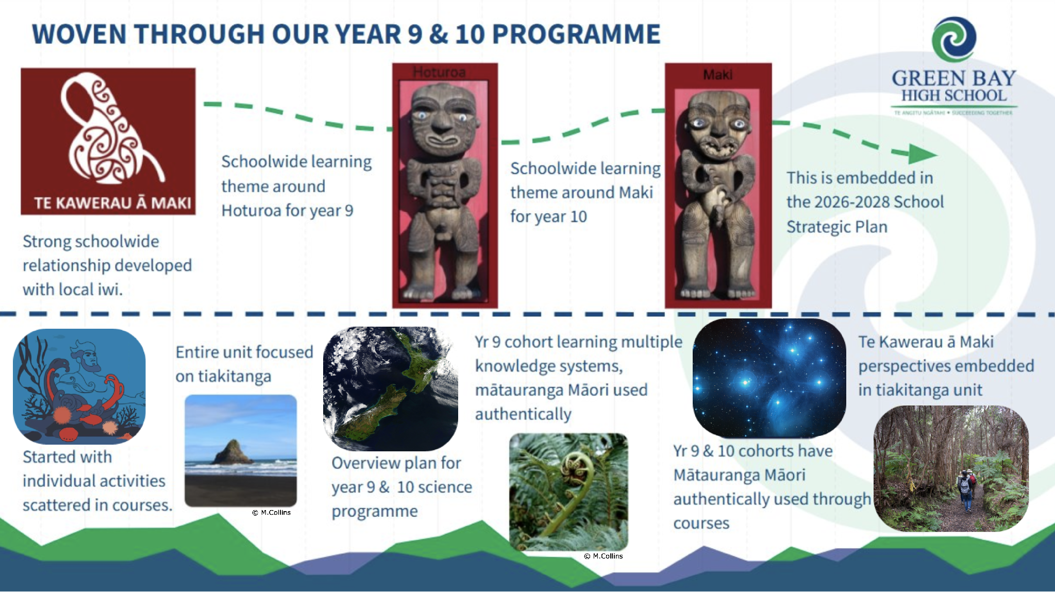
© Crown Copyright, CC BY 4.0

Slide 11

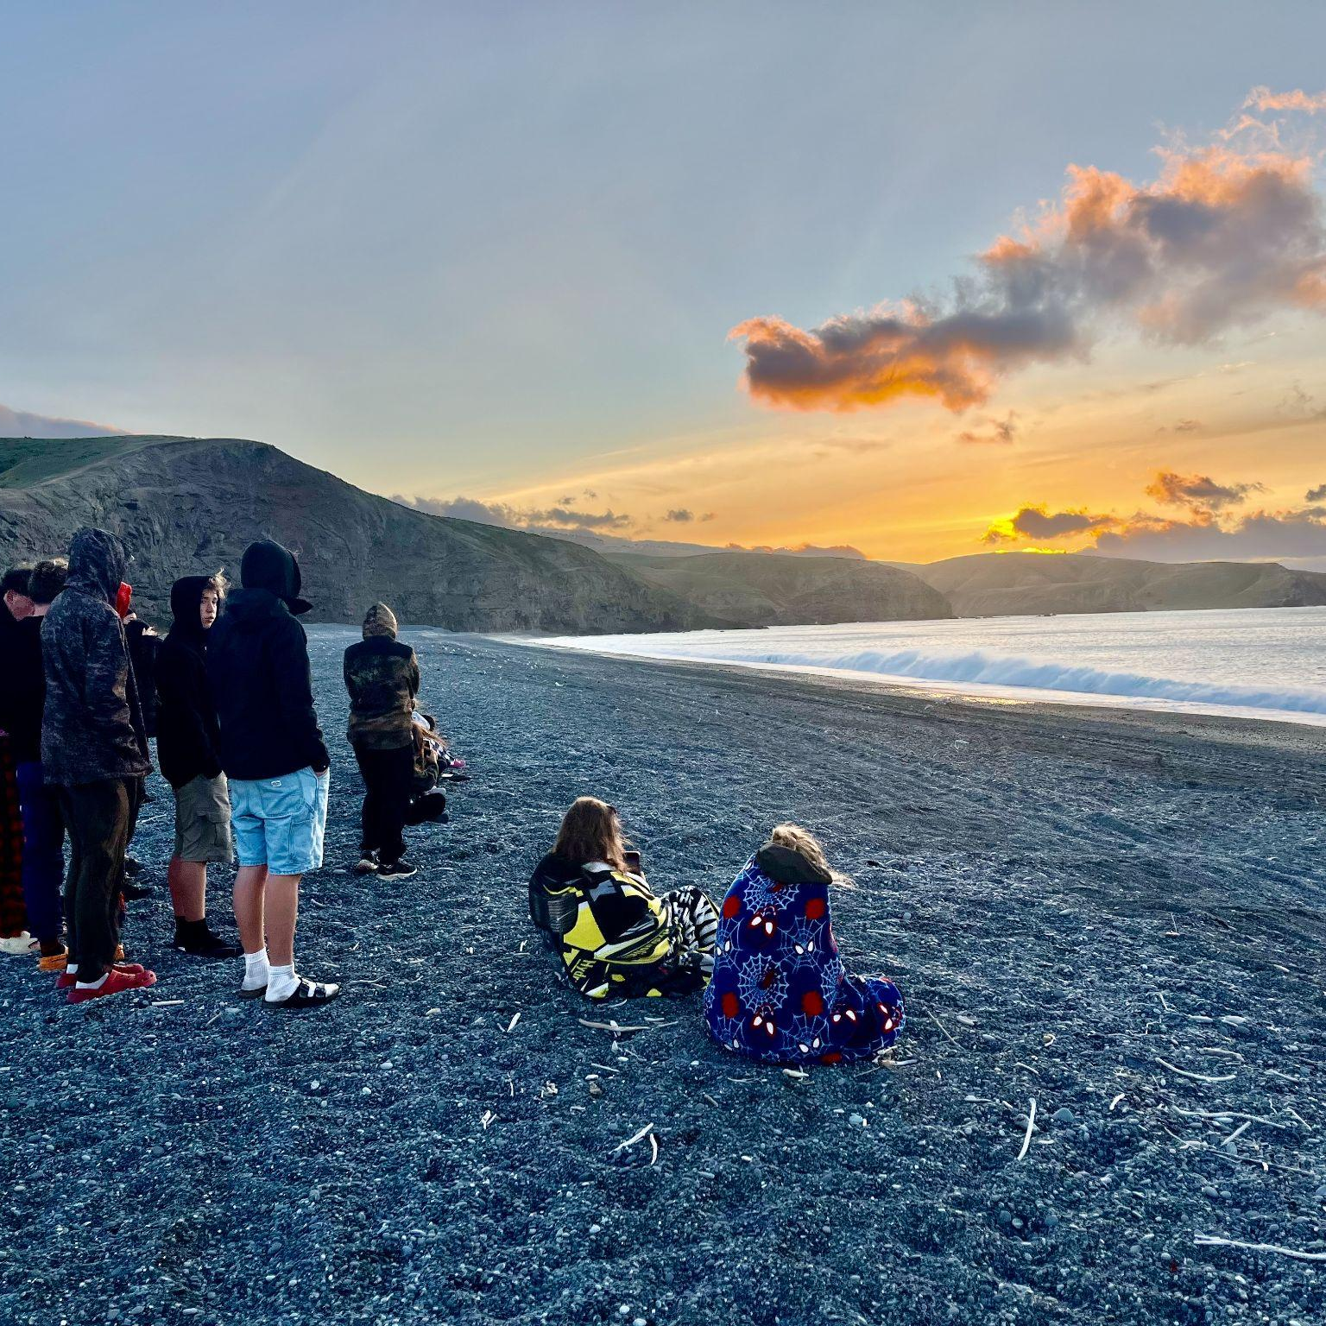
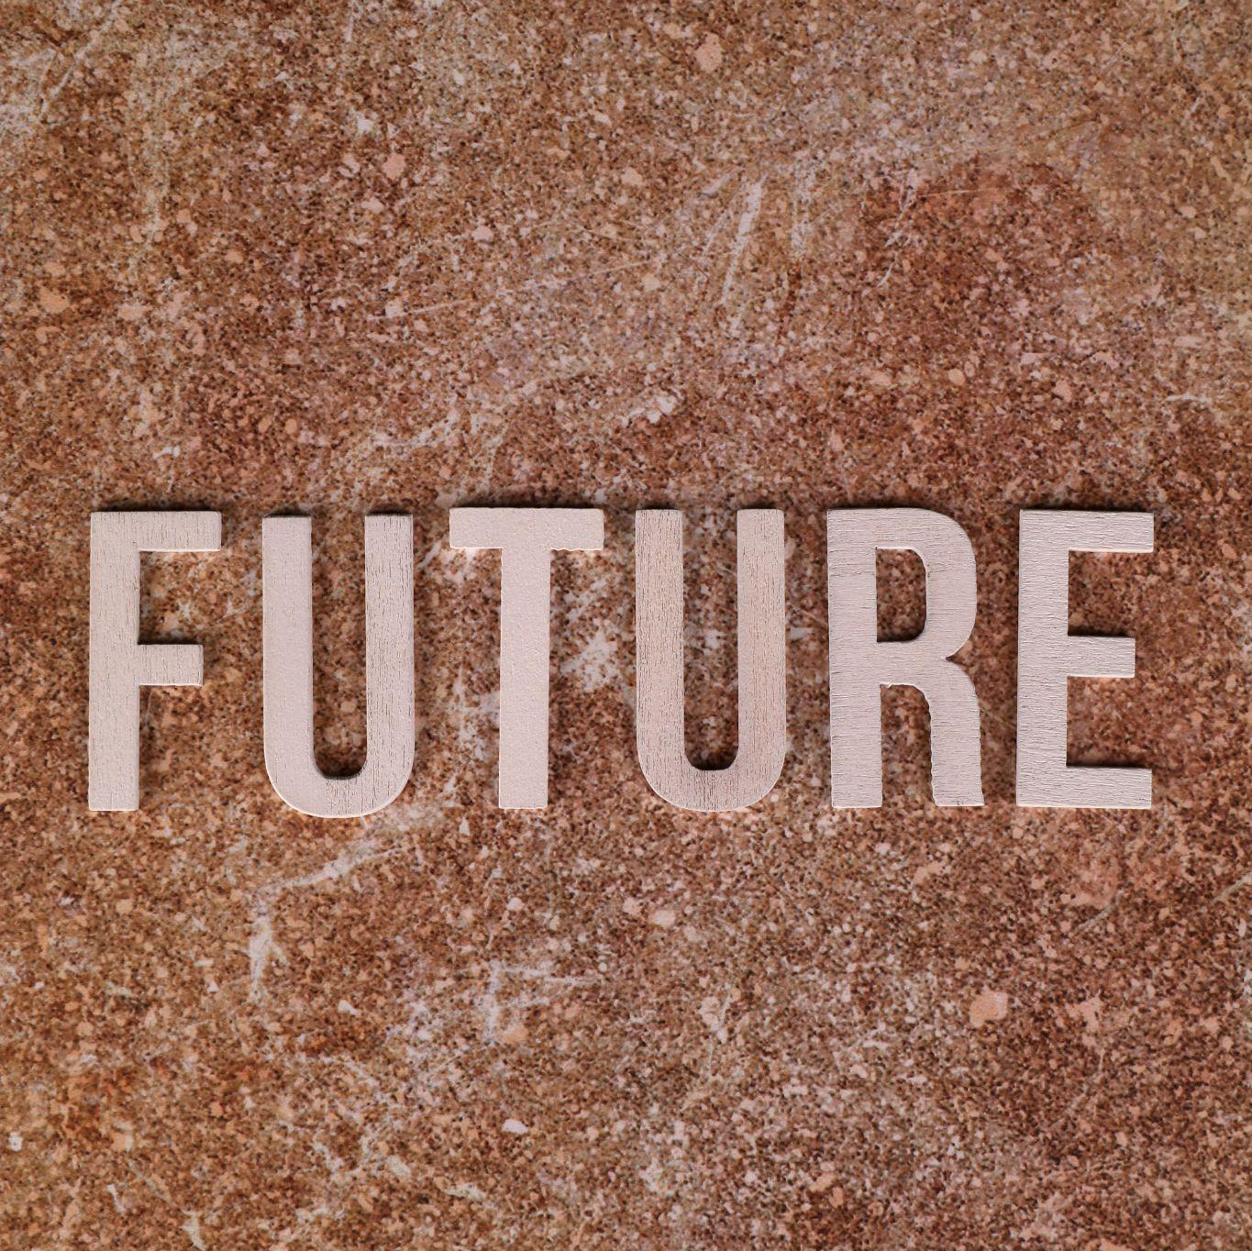
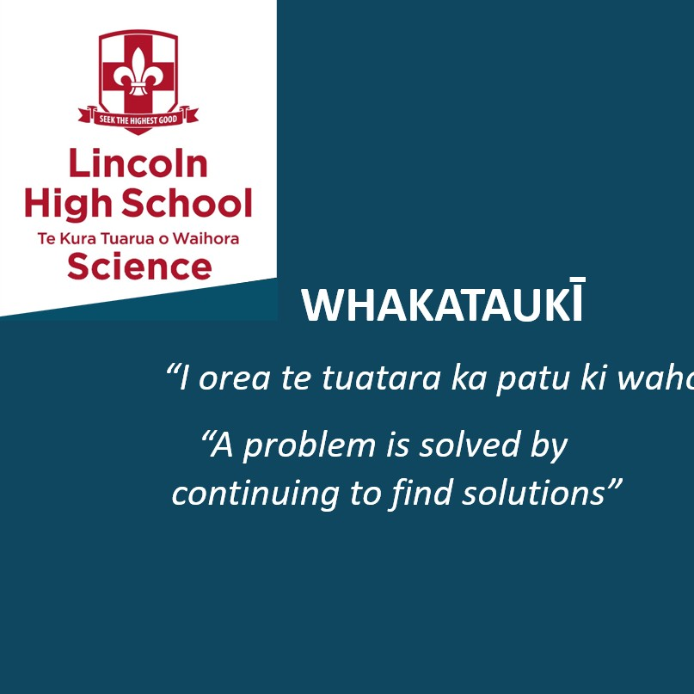
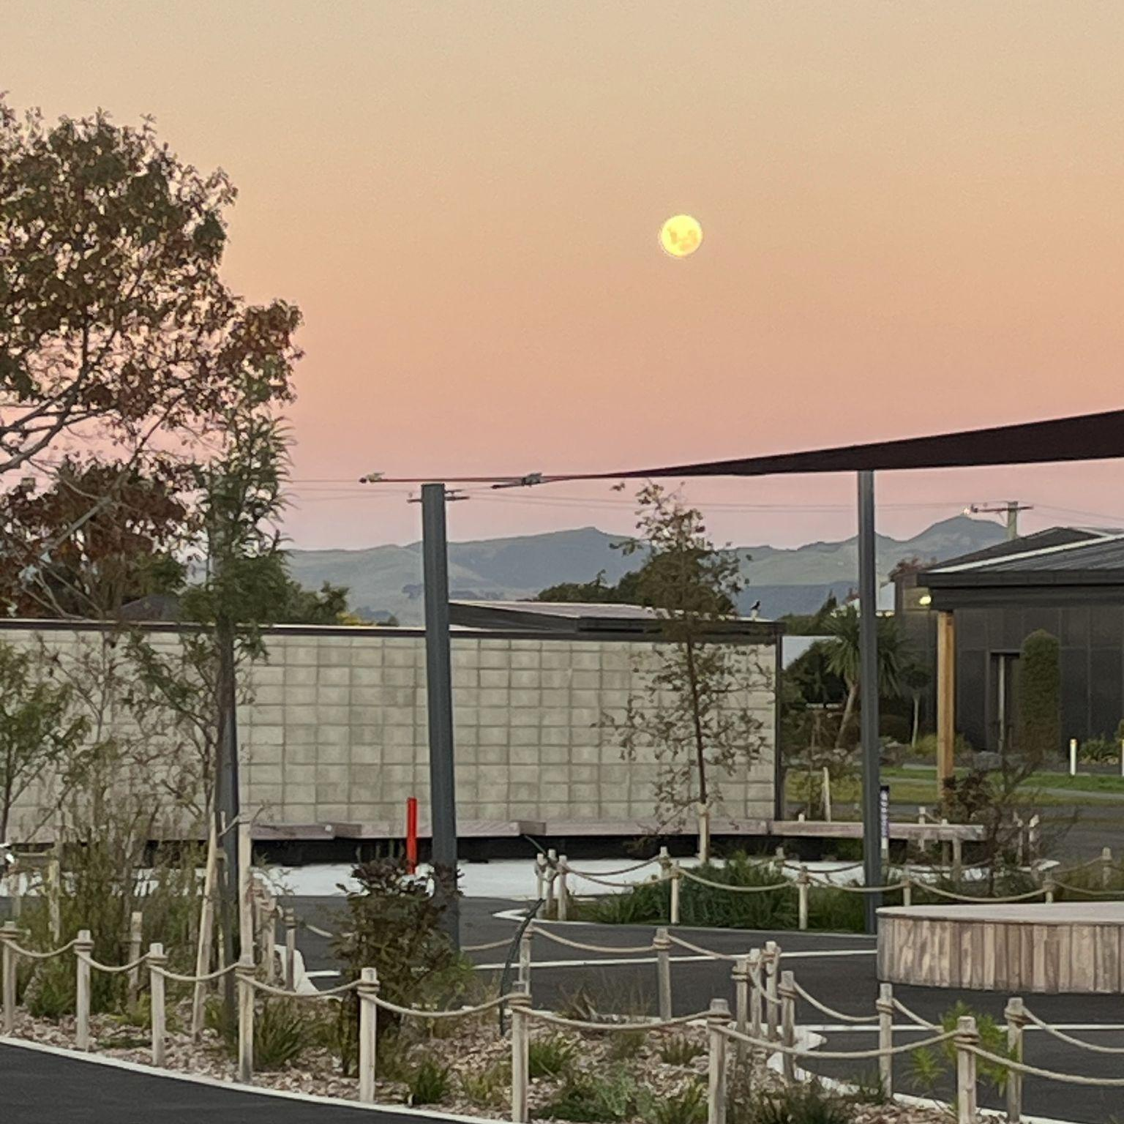
Our Journey
Te Kura Tuarua o Waihora - Lincoln High School
Building Mātauranga Māori and Science course
Explicit teaching of MKS in year 9. Commitment to applying new curriculum through MKS lens
Starting point
New astronomy unit across all Year 11, Rongoā unit in 11BIO

Slide 12
Year 11 Science in Aotearoa and the Pacific - Mātauranga Māori and Pacific Indigenous Knowledge alongside Science in all units of work
A course
A unit
“Me mahi tahi tātou mō te oranga o te katoa”
“We should work together for the wellbeing of everyone.”
Science 1.1 science-informed response to a local issue
How multiple models of health can be used to address the issue of impetigo in our community
A moment every day
Using the Maramataka and decentering the Gregorian calendar in everyday classroom practice

Slide 13
“SP100 teaches me about science about New Zealand and the Pacific Islands and it helps connect me to my culture which I haven’t really been doing, so this is a good chance for me to do it.”
“In New Zealand people used games, stories and waiata as a way to pass down information about Pacifica navigation. I learnt that the Samoa(n) people saw the ocean as a connection to other places instead of a barrier. I find that amazing. It tells me that there are more than one way to look at things. Overall, I think wayfinding is about using the environment to find your way and travel. I want to find out more about where I come from and more about Māori culture.”
“Overall I think wayfinding is about remembering who you are, where you are and where you're going. Because I felt that experience when we went sailing I felt a deeper connection to my Pasifika side as well as being more connected to Tawhirimatea. I really hope to experience more of what it's like to be in my tupunas shoes.”
“Value me as a student by valuing the knowledge of my tūpuna” - Pauline Harris

Slide 14
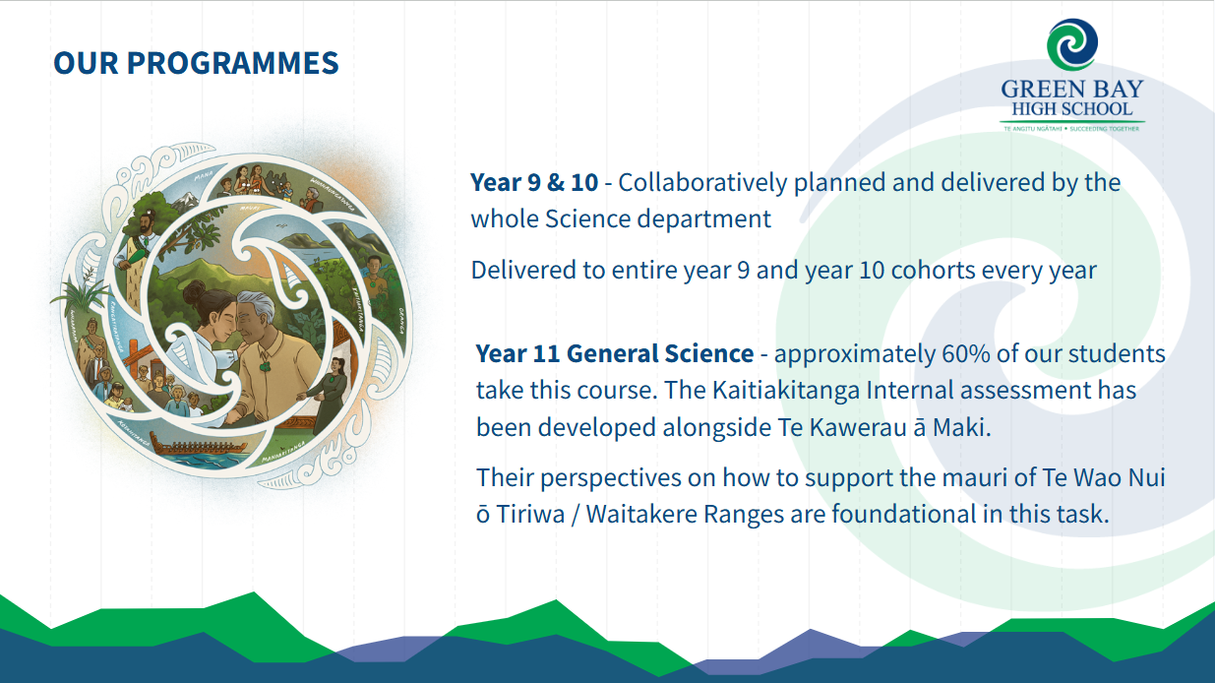
© Crown Copyright, CC BY 4.0

Slide 15
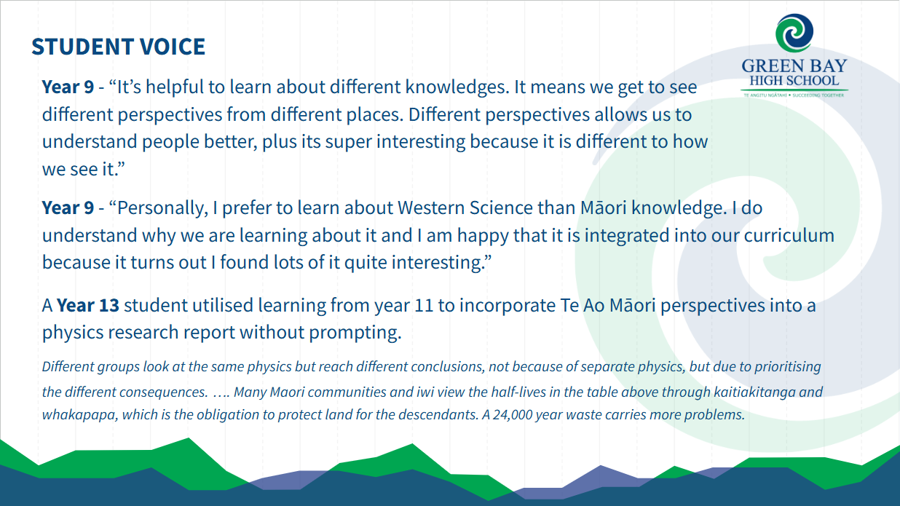

Slide 16
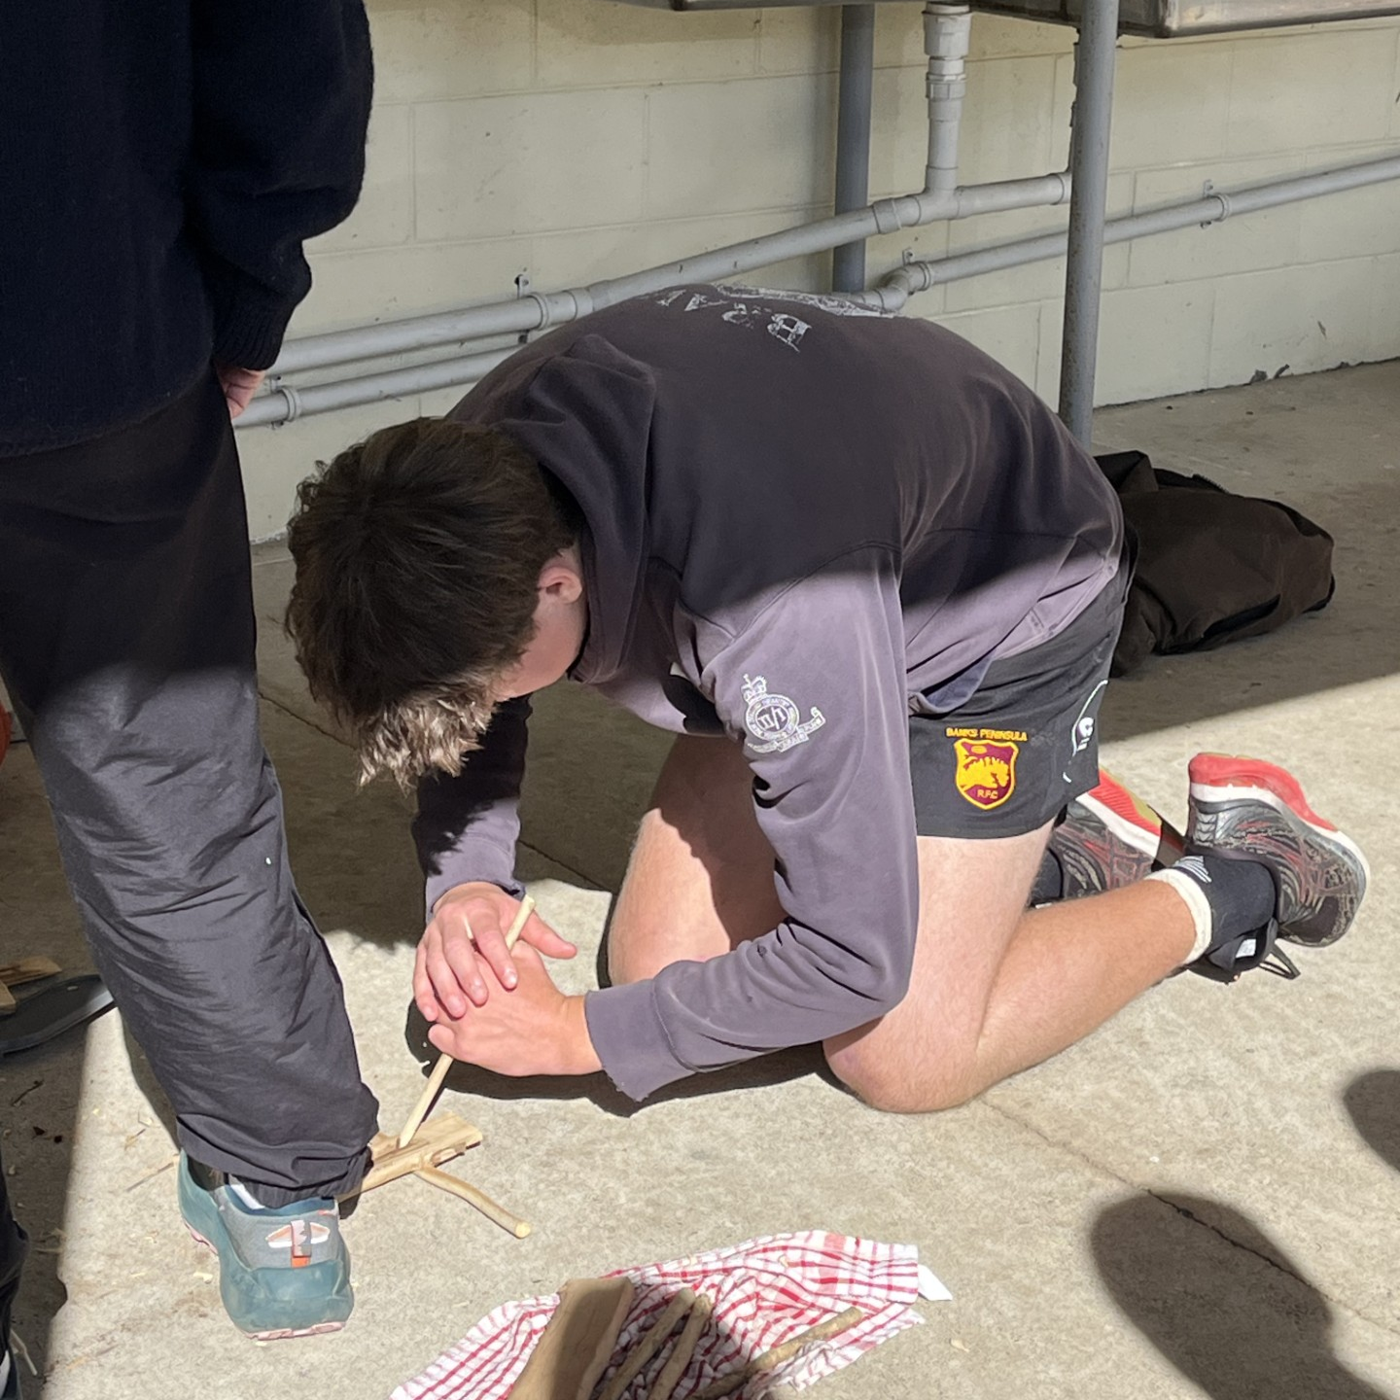
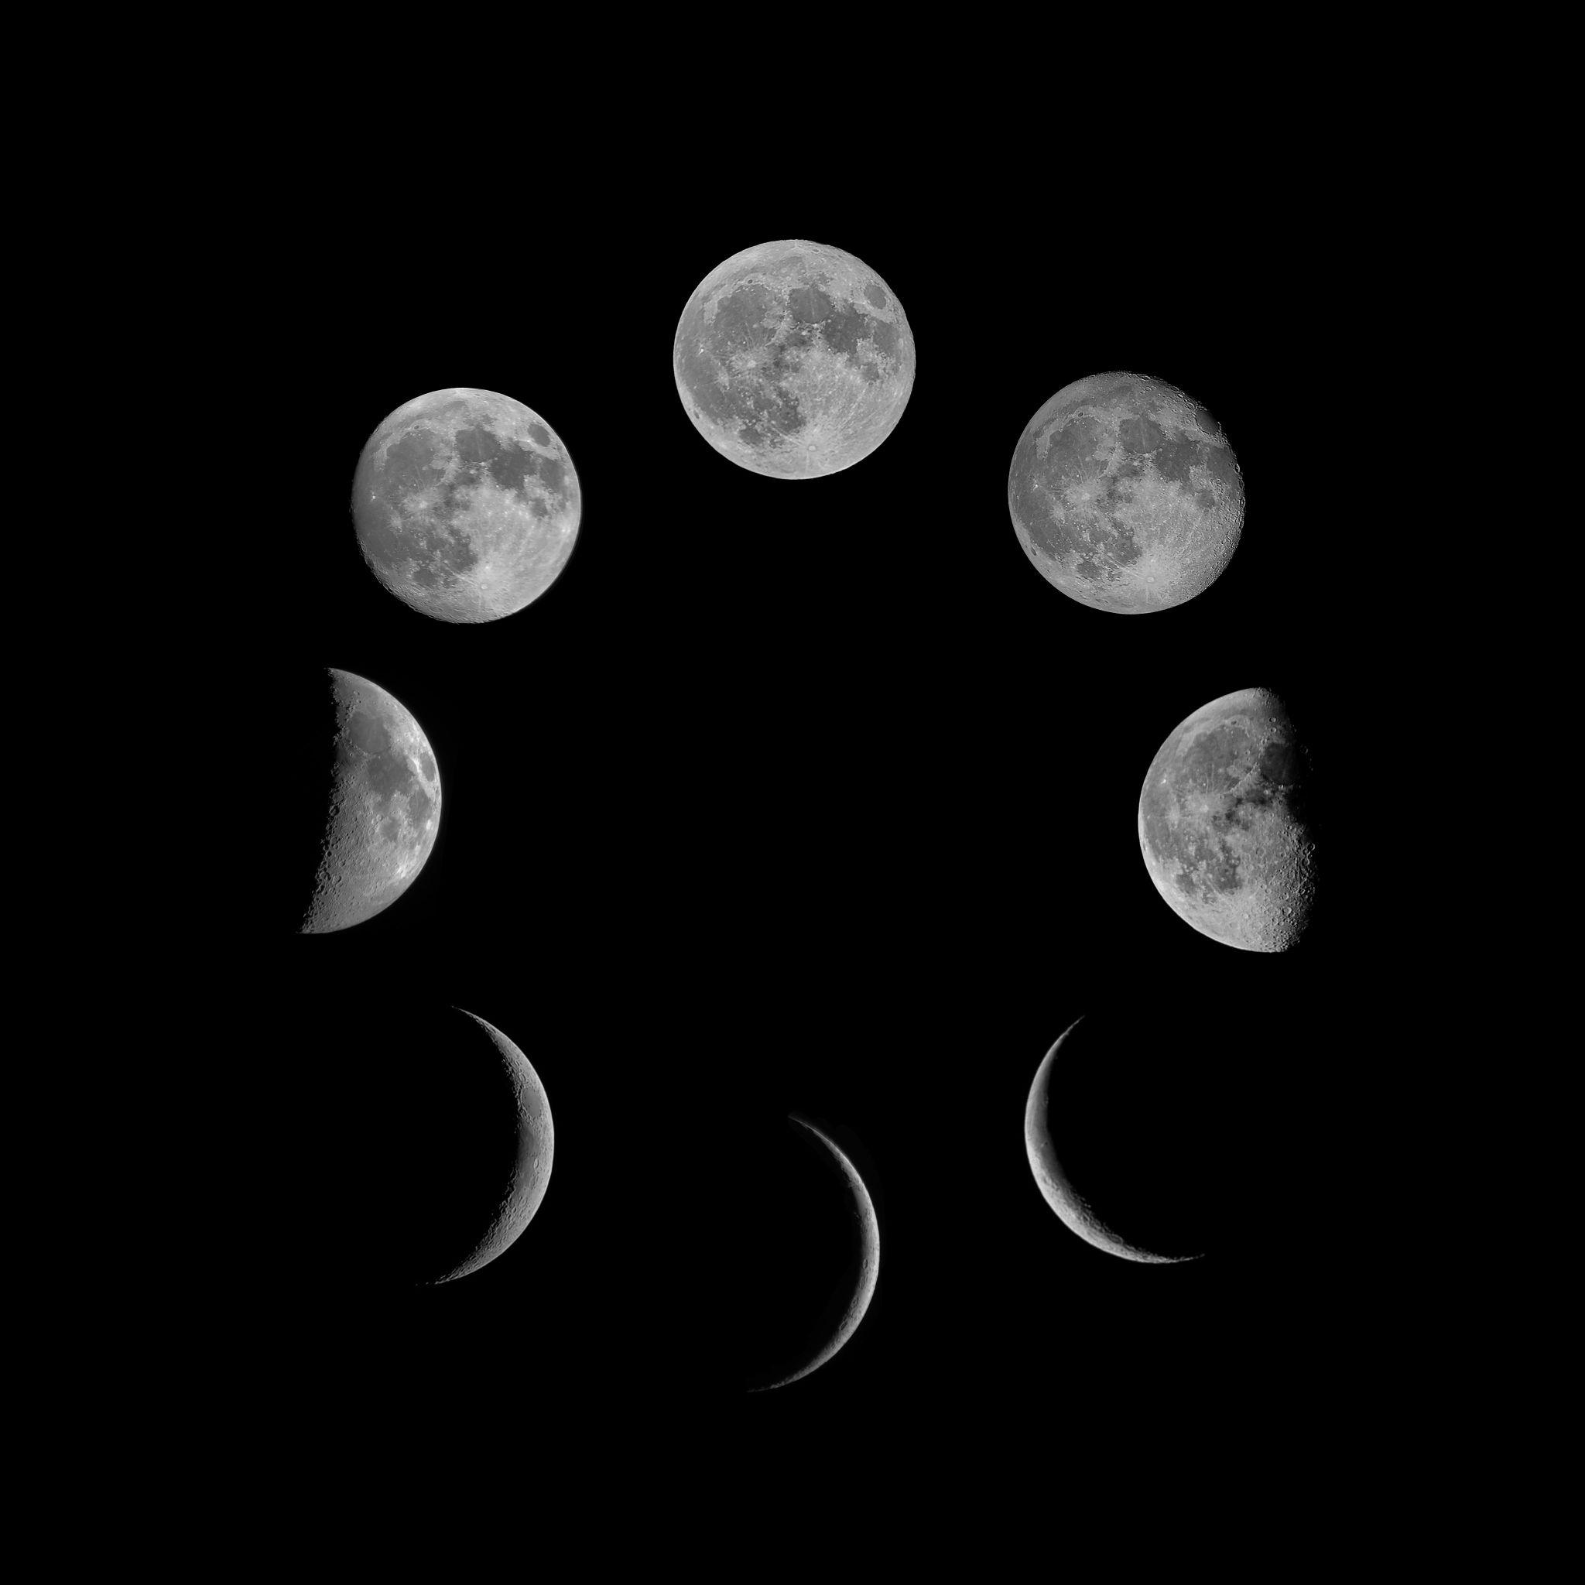
In Practice
Te Kura Tuarua o Waihora - Lincoln High School
As a course
Mātauranga Māori and Science at Year 11. Full year course of ~ 20 students.
As a unit
Development of Year 11 astronomy unit that explores how similar observations are codified by different knowledge systems and the importance to life in Aotearoa
As a moment
Example activity from astronomy unit, looking at cultural interpretations of astrological observations.

Slide 17
"When we did waka ama, there's the physics side of it and then there's also the waka ama and the journey that Māori made from all those places to New Zealand. It was quite clear how the knowledge systems connected, but how they were different at the same time. "
Ana, LHS student
A
“This course taught me to look at stuff, different perspectives, in science and in life as well. Then you can find new stuff out about the exact same thing because you're looking at it in a different way.”
Nick, LHS student
Multiple knowledge systems ensure that our results are not biased because we are only using one perspective. We are decolonizing our minds; retaining principles of Western science in our understandings but acknowledging its prejudices and failings, and allowing indigenous knowledge – in this case, mātauranga Māori – to dictate learning and understanding. After all, those connected to the land know it better than anyone. They know its stories, its identity, and its science.”
Fiona, LHS student

Slide 18
A JOURNEY, NOT A DESTINATION
Working with multiple knowledge systems in science is an ongoing journey.
We are still learning. We are still questioning. We are still adapting.
Complex problems need multiple perspectives.
Change requires courage, curiosity and relationships.
We don't have to have all the answers to begin.
Our hope is that you leave feeling encouraged to keep asking, keep learning, keep advocating and have relentless forward motion with this kaupapa, no matter which way the wind blows.

Slide 19
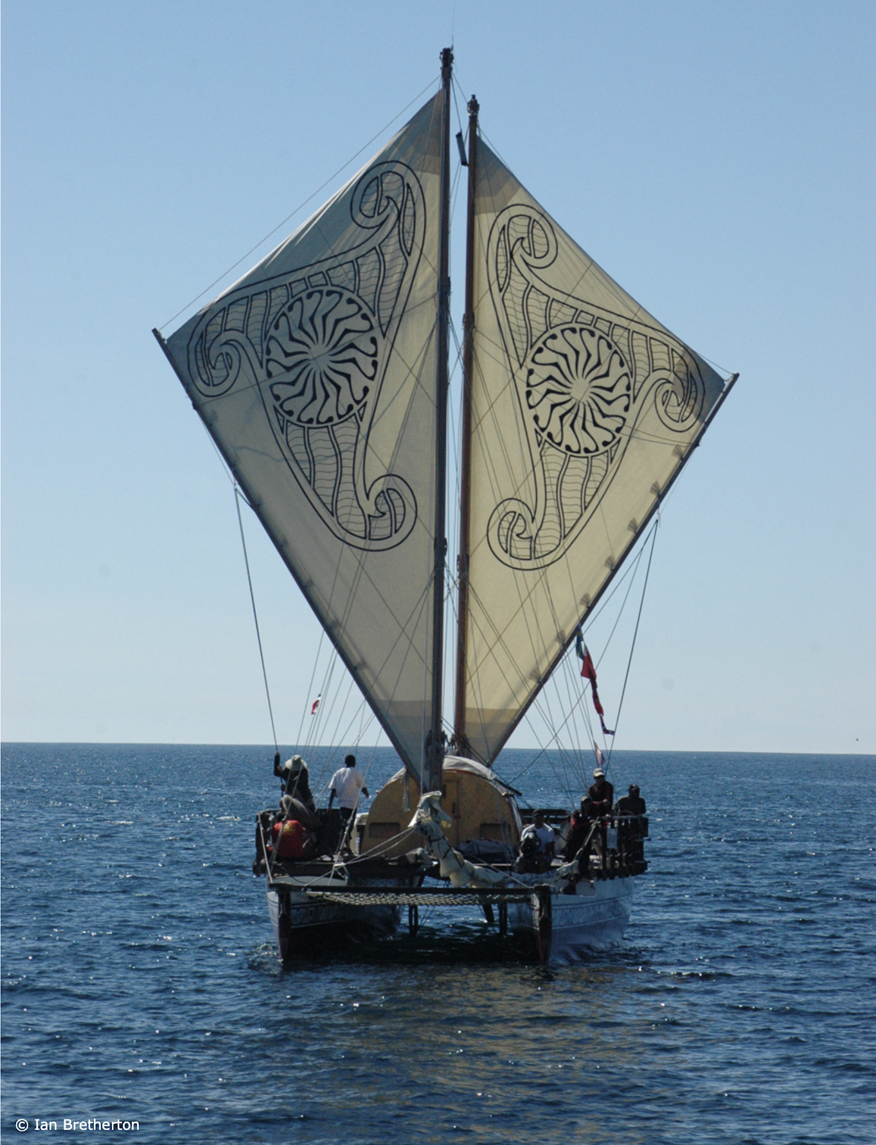
Kia hora te marino
Kia whakapapa pounamu te moana
Hei huarahi mā tātou i te rangi nei
Aroha atu, aroha mai
Tātou i a tātou katoa
Hui e, tāiki e

