Slide 1
STRATEGIC PLAN
2013
How quickly can you find these facts about Japan?

Slide 2
Go to
http://web-japan.org

Slide 3
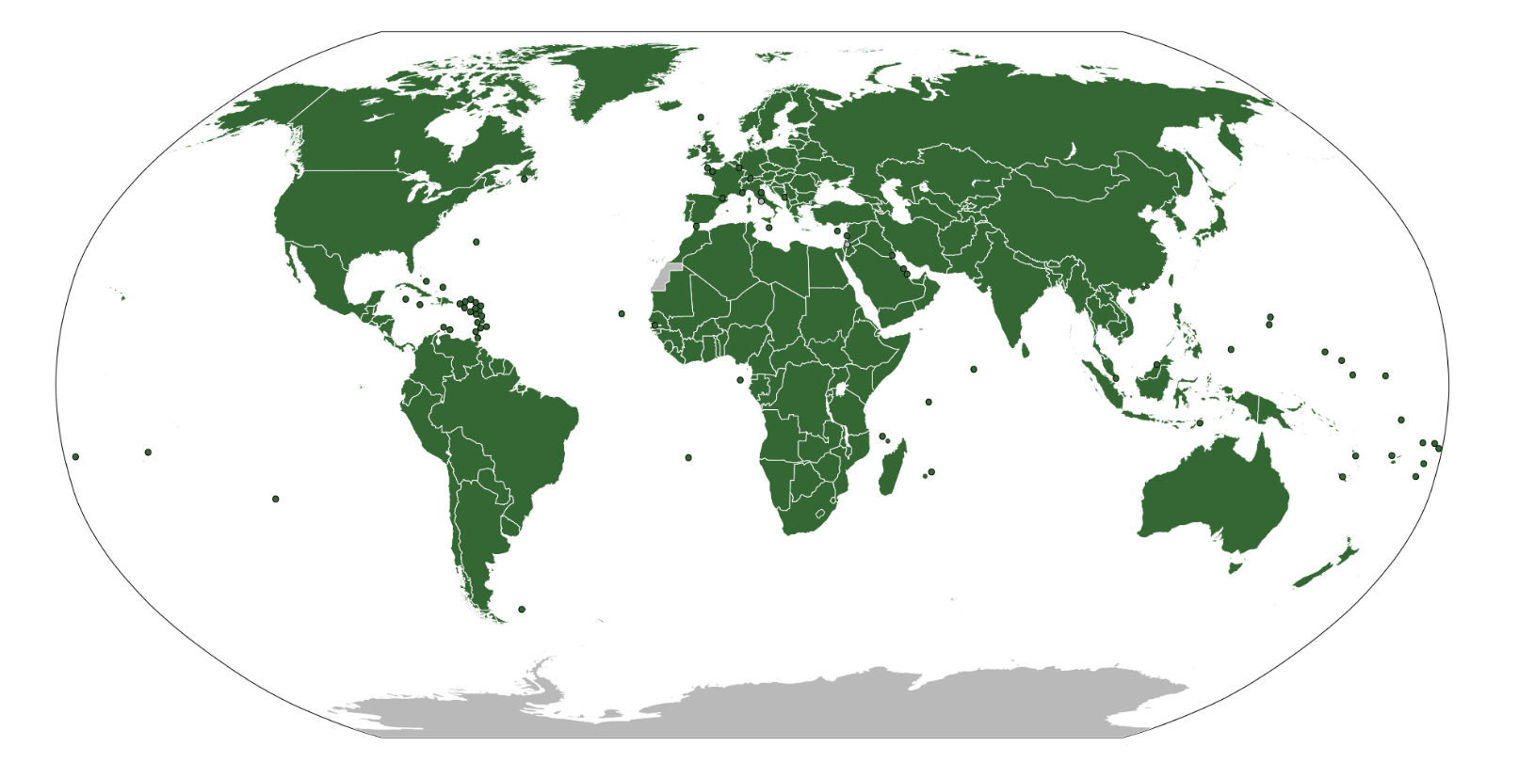
Which countries share a border with Japan?

Slide 4
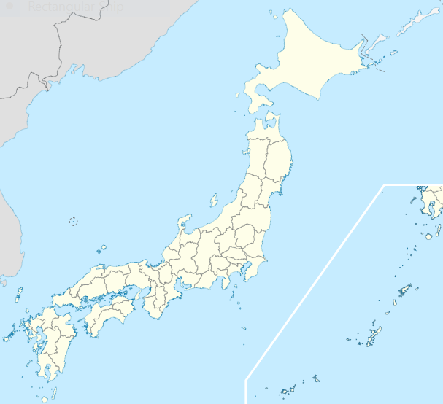
How many regions does Japan have?
* Map retrieved from https://en.wikipedia.org/wiki/Provinces_of_Japan

Slide 5
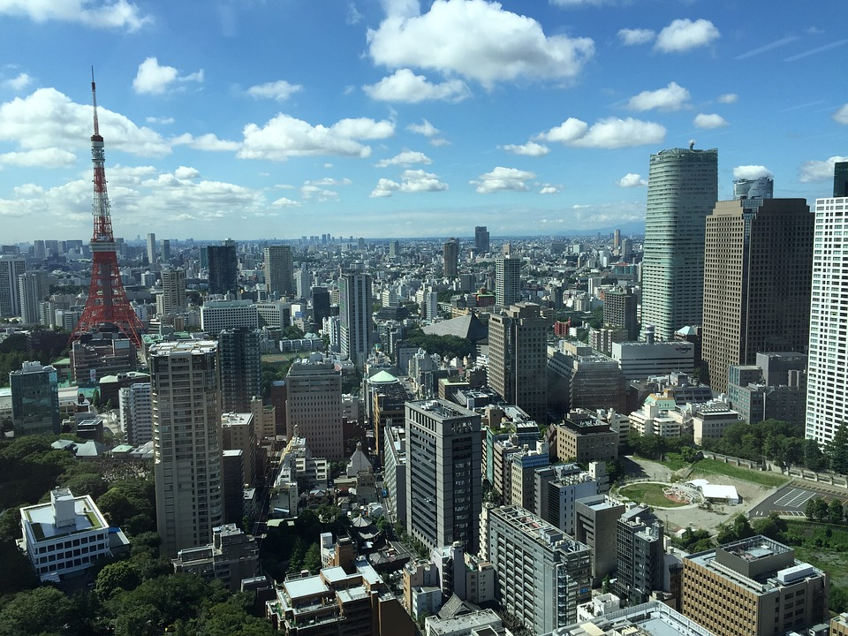
The capital of Japan is in the Kanto region. What is the name of the capital?
* Photo retrieved from https://pixabay.com/en/tokyo-japan-city-office-1121869/

Slide 6
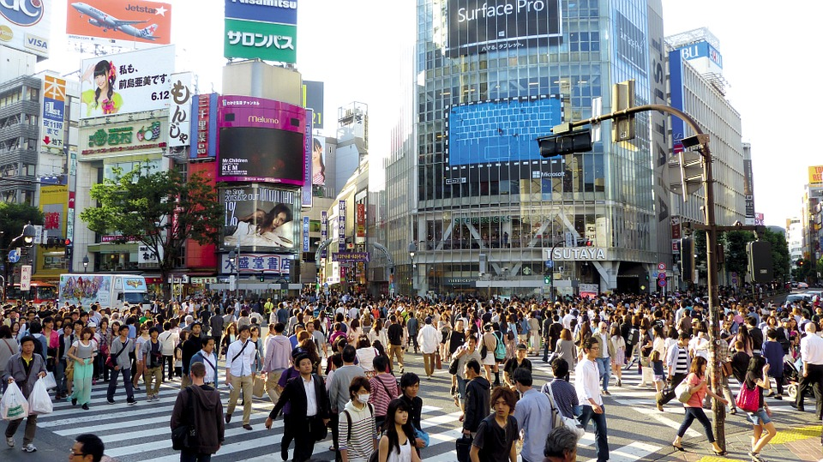
What is the population of Japan?
* Photo retrieved from https://pxhere.com/en/photo/1004785

Slide 7
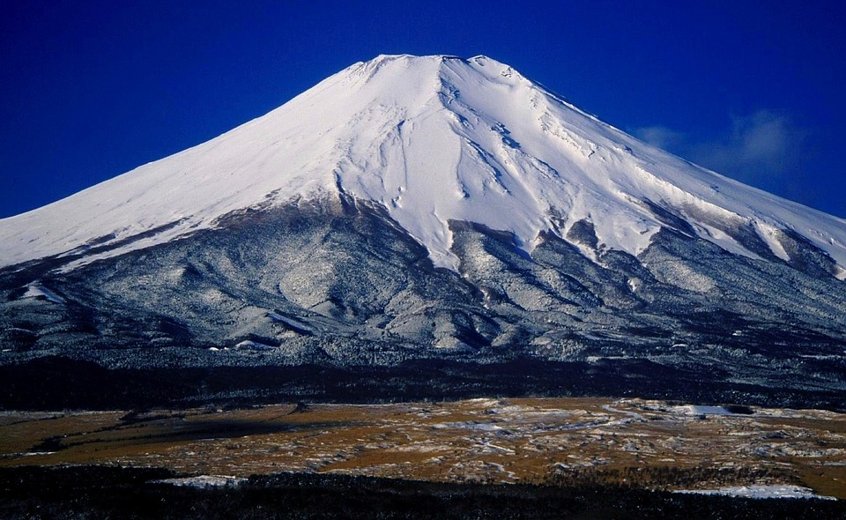
How much of the country is covered in mountains?
Mount Fuji is the highest mountain in Japan.
* Photo retrieved from https://pixabay.com/en/mount-fuji-japan-landscape-84135/

Slide 8
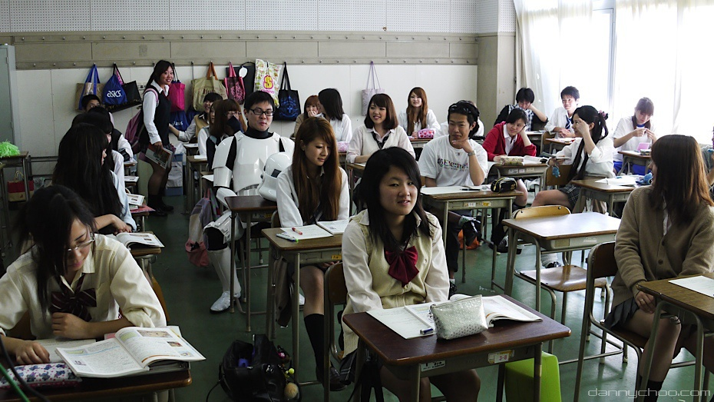
How long do students in Japan go to High School for?
* Photo retrieved https://www.flickr.com/photos/aisforangie/28997419

Slide 9
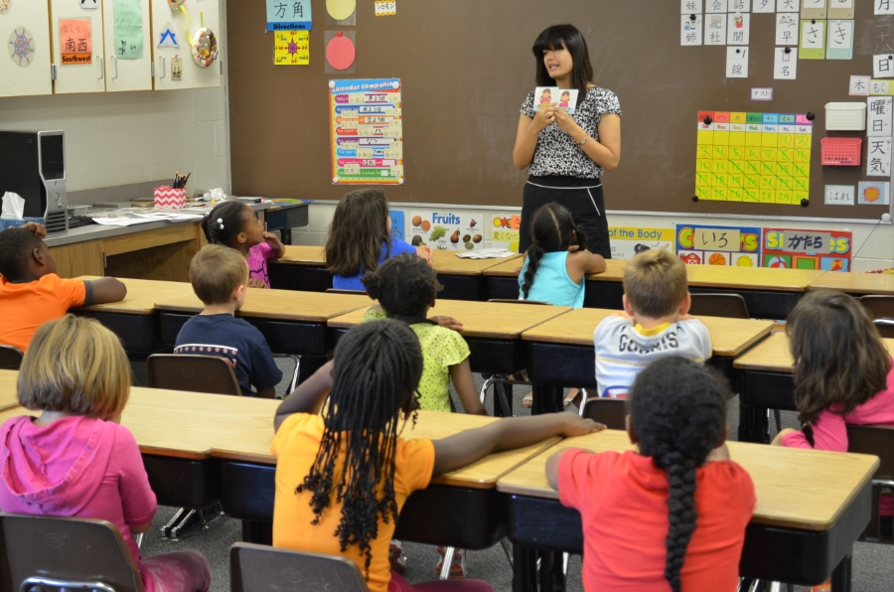
At schools in Japan, how many students are there in each class?
* Photo retrieved http://schoolofopen.p2pu.org/the-2nd-oer-summer-camp-on-luxi-island-of-cc-china-mainland/

Slide 10
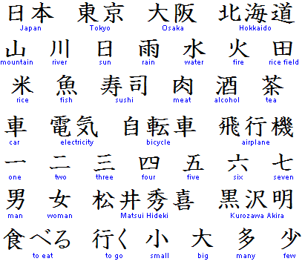
What are the characters (letters) called that are used to write Japanese?
* Image retrieved from https://en.wikipedia.org/wiki/Katakana

Slide 11
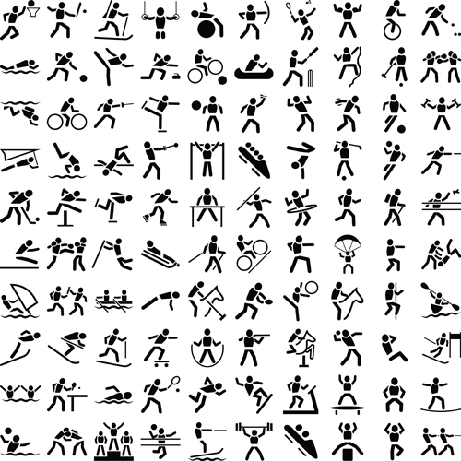
What is Japan’s national sport?
* Image retrieved from http://www.publicdomainfiles.com/show_file.php?id=13526795418186

Slide 12
www.asianz.org.nz

