Slide 1
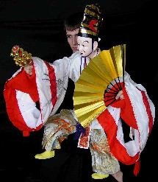
STRATEGIC PLAN
2013
Bunraku Puppet Theatre
By Carolyn Osborne

Slide 2
Theatre Style
Bunraku - pronounced ‘boon-rah-koo’
Ningyo joruri = chanting puppet
Merges music, puppetry and storytelling.
Was performed originally by travelling storytellers

Slide 3
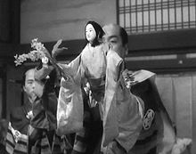
History
Earliest form by Uemeura Bunrakuken in 11th century
Bunraku originated in Osaka in late 1600’s and developed during the Edo period
1955 Ningyo Joruri become an Intangible Cultural Property of Japan
Bunraku has influenced modern western puppetry e.g. Lion King

Slide 4
Audience
This is a puppet show for adults not children.
It is presented in old Japanese language so even modern day Japanese often do not understand it.
Performed for the merchant men and nobility.

Slide 5
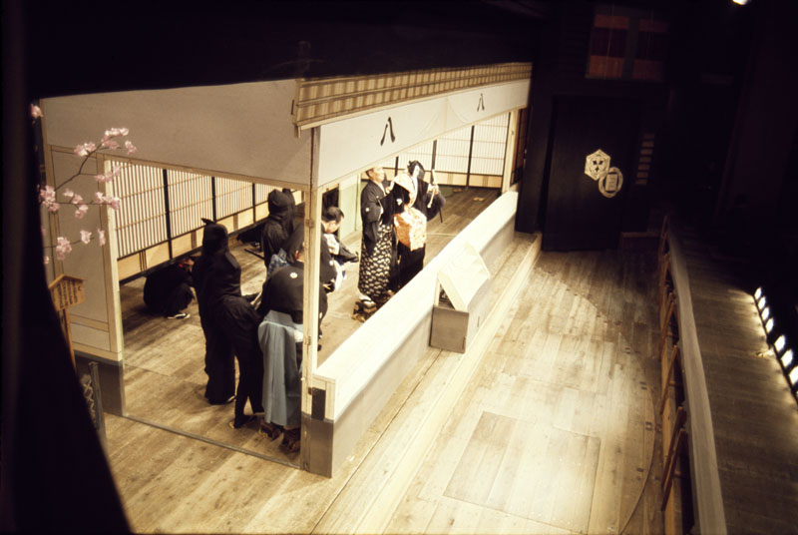
Stage Setting
Audience sits below stage.
Three stage partitions to create - a place to hide the curtain stagehand
- a space for the puppet to perform
- and the raised platform for the puppet house
To the right is the music and narration platform
Today national theatres are in Osaka and Tokyo.

Slide 6
Performers
Three puppeteers per puppet
Tayu – storyteller
Shamisen player
All are male performers

Slide 7
Puppeteers
Did you Know.?
It takes ten years training for each puppet body part. Omozukai have had at least 30 years training.
Omozukai is the lead puppeteer, responsible for right hand and arm movement and the head expression.
Hidarizukai operates the left arm and hand, and any props the puppet is carrying.
Ashizukai moves the puppets legs, or makes the shape of leg movement with his fist on the female puppet.

Slide 8
Bunraku Puppets
Female puppets do not have legs
Everyone's eyes are on these key figures
They are two-thirds the size of an adult

Slide 9
Narration
Tayu provides voice for the dialogue of all characters
He chants, sings and narrates story

Slide 10
Music and Sound
Shamisen is a three stringed instrument
Shamisen players set the pace, timing and dramatic tone and tension of the play.
Accompanies the narrator to express the emotional mood of each character.

Slide 11
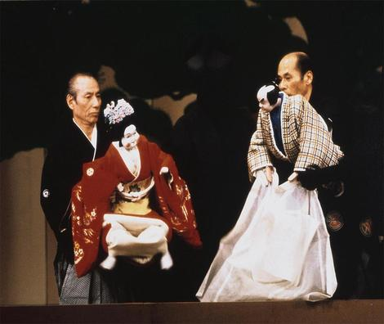
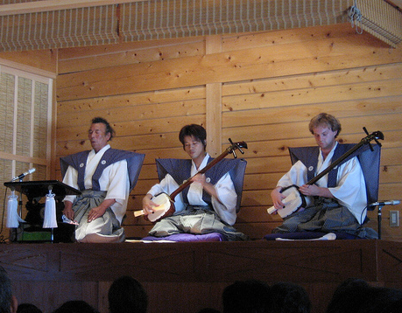
Costumes
Puppets
Elaborate
Traditional
Exact replicas
Other Performers
Puppeteers dress in black with black hoods unless a famous head puppeteer.
Tayu and Shamisen wear traditional kamishimo dress.

Slide 12
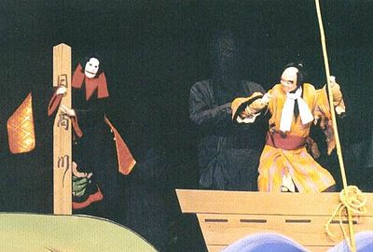
Stories of Bunraku
Jidaimono – historical plays about epic battles.
Sewamono – everyday tales based on real events of love, longing and tragedy.

Slide 13
Themes
Love, intrigue, money, social and family obligations
Presented to evoke a response and express thoughts and feelings of the characters.

Slide 14
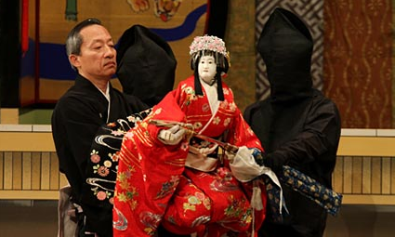
Structure of a Bunraku Play
A play is divided into five acts
The play takes a whole day to watch
There are two or three sessions lasting two and a half hours to four hours each
The audience will have lunch and dinner in the session breaks.

Slide 15
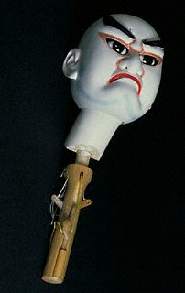
Puppet Construction
Kashira – Head
Kataita – Shoulder pieces
Dō – Trunk
Te-ashi – Legs and arms
The handle at the base of the head is called dōgushi. It has a mechanism to move its eyes, mouth and eyebrows.
The head, wrist and fingers are moved by pulling cords called kozaru.

Slide 16
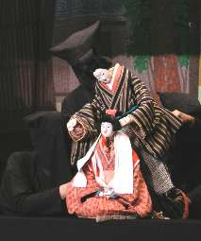
Conventions
Life-sized puppets with carved wooden heads
Puppeteers are in black but visible.
Themes of heroism and noble values
Exquisite gesture by puppets
Dialogue, chanting and songs
Colourful traditional costumes
Emotional atmosphere is important

Slide 17
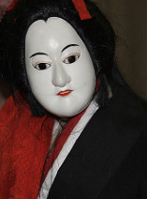
References
Japan Arts Council
http://www2.ntj.jac.go.jp/unesco/bunraku/en/
Facts and Details website by Jeffrey Hays. 2013
http://factsanddetails.com/japan/cat20/sub131/item713.html

Slide 18
www.asianz.org.nz

