Slide 1
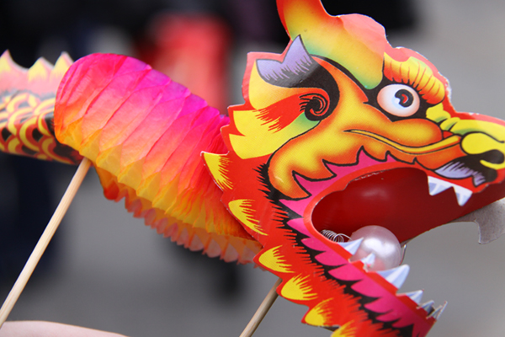
STRATEGIC PLAN
2013
Introduction To Puppetry
By Carolyn Osborne

Slide 2
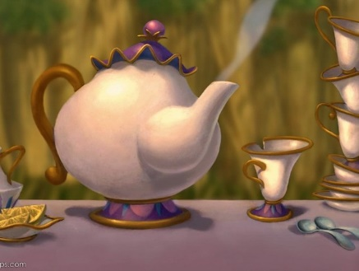
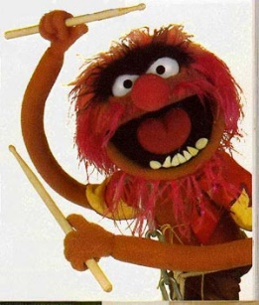
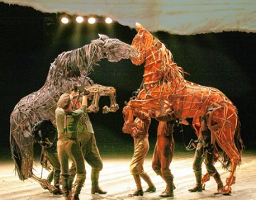
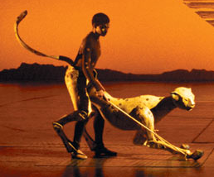
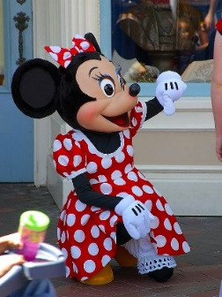
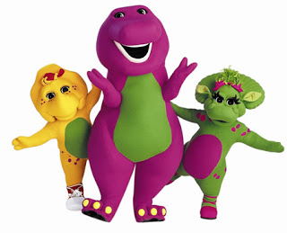
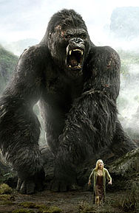
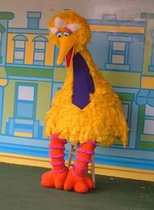
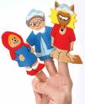
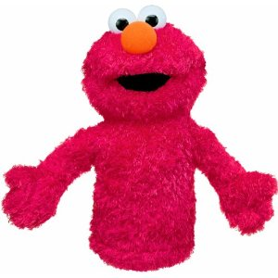
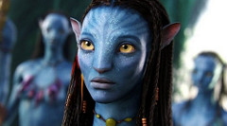
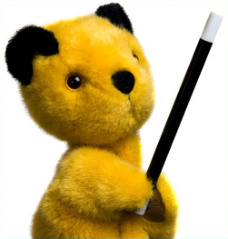
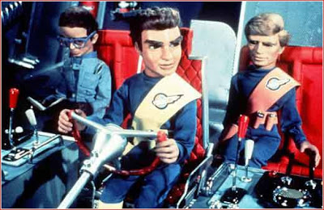
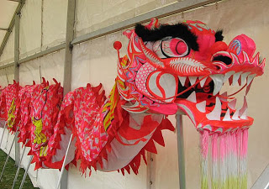
Name these modern puppets.

Slide 3
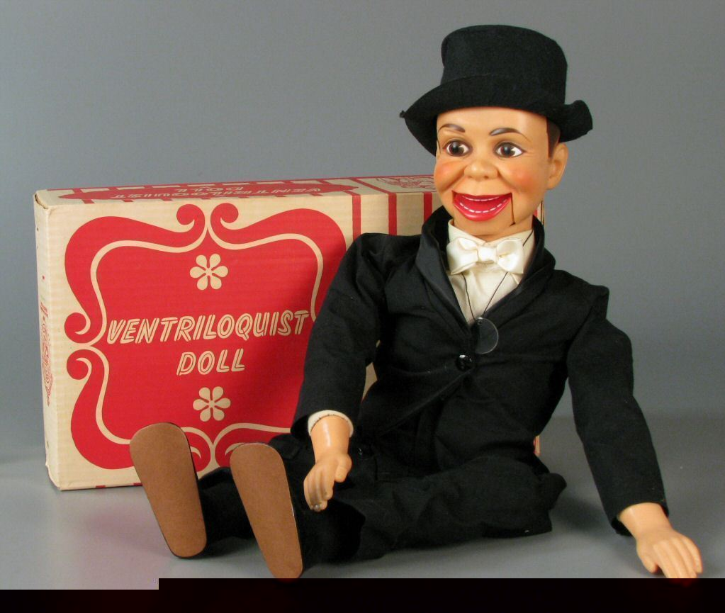
What is a puppet?
Puppets are inanimate objects brought to life by a puppeteer.

Slide 4
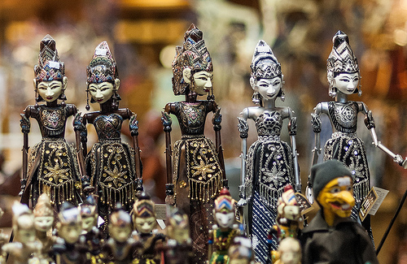
What purpose do puppets have?
Historically, puppets have been used in religious rituals and by the ruling classes
to entertain,
to communicate important messages,
share cultural values,
and to tell stories from the past.

Slide 5
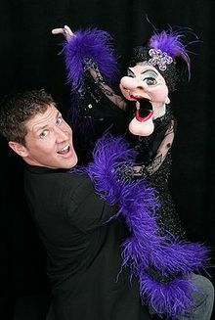
Nowadays, puppets are used in
advertising,
art,
celebrations,
education,
entertainment,
and therapy.

Slide 6
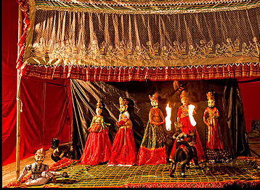
Puppet Shows combine elements of music, dance, theatre, folklore, sculpture and visual artistry to communicate stories and information to the audience.

Slide 7
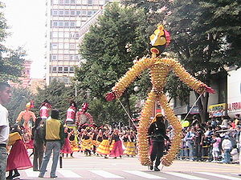
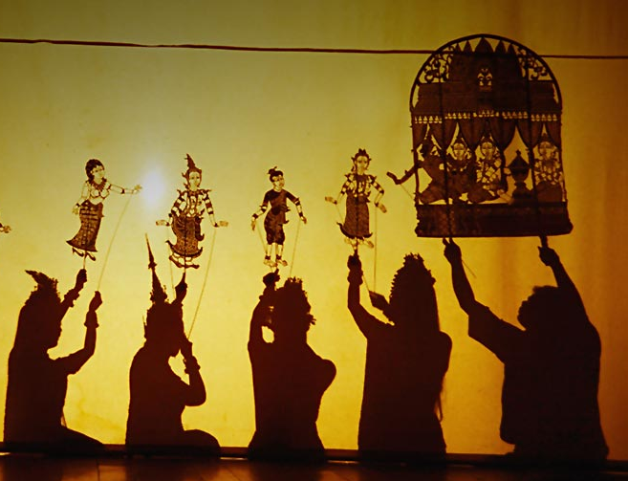
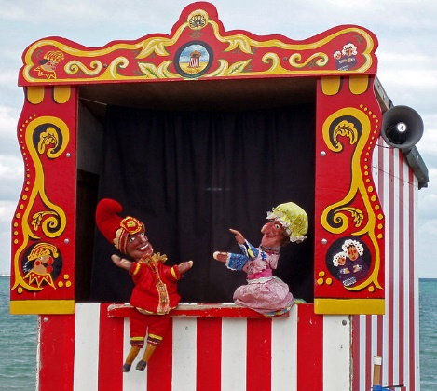
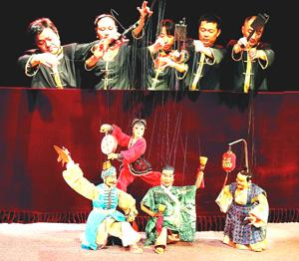
Puppetry exists as a performing art in many cultures around the world.

Slide 8
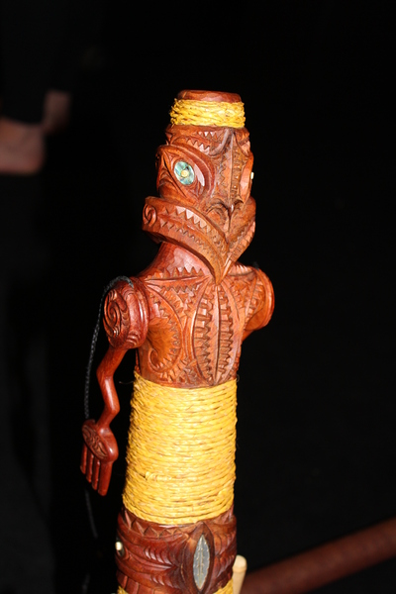
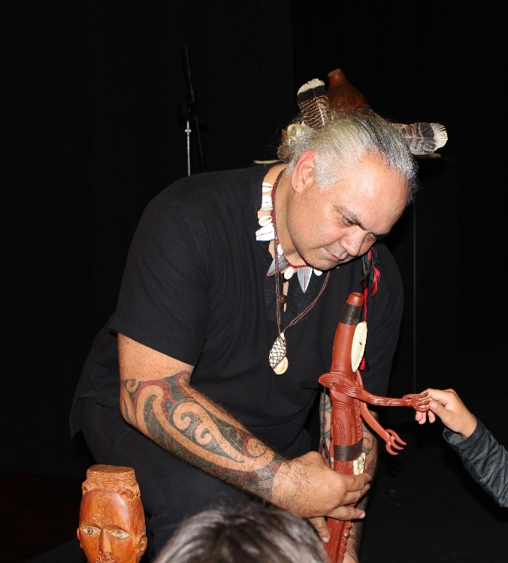
In New Zealand, there is a rare form of traditional Maori puppetry known as karetao.

Slide 9
There are many different types of puppet and they are categorised according to how they are manipulated by the puppeteer.

Slide 10
Finger Puppets
This is the simplest form of puppetry. The puppeteer manipulates the puppet by moving their finger.

Slide 11
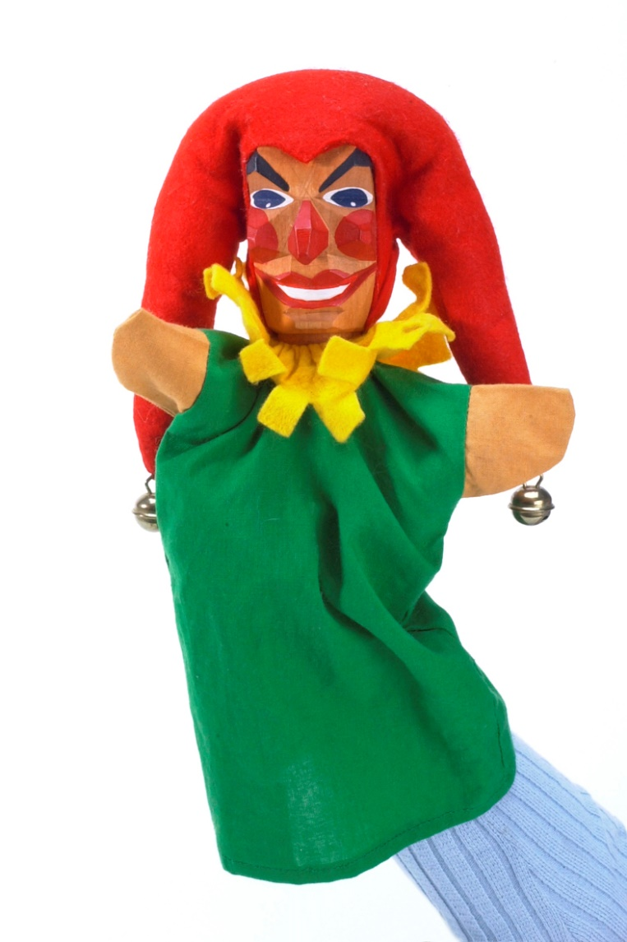
Hand or Glove Puppet
This puppet fits over the hand of the puppeteer, with the fingers and thumb manipulating the head and arms of the puppet.

Slide 12
Stick Puppet
This type of puppet is attached to a stick and the puppeteer moves the stick to create movement.

Slide 13
Rod and Stick Puppet
These puppets have arms, and sometimes legs, that are moved by one or more rods.

Slide 14
Pop-Up Puppet
Another simple form of puppet controlled by pushing a rod up and down.

Slide 15
Shadow Puppet
This is a two dimensional or flat puppet which becomes a silhouette from light projected behind it. Shadow puppets are controlled by wire or rods.

Slide 16
Jumping Jack Puppet
These are simple puppets with jointed limbs attached to a string that is pulled to animate it.

Slide 17
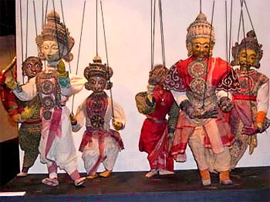
Marionette or String Puppets
These puppets are built with jointed parts which are connected by string to a control rod, which the puppeteer uses to move the puppet from above.

Slide 18
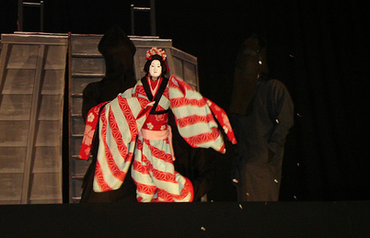
Bunraku Puppets
These are life-size Japanese puppets which have their head, arms and legs operated by three puppeteers who are dressed in black.

Slide 19
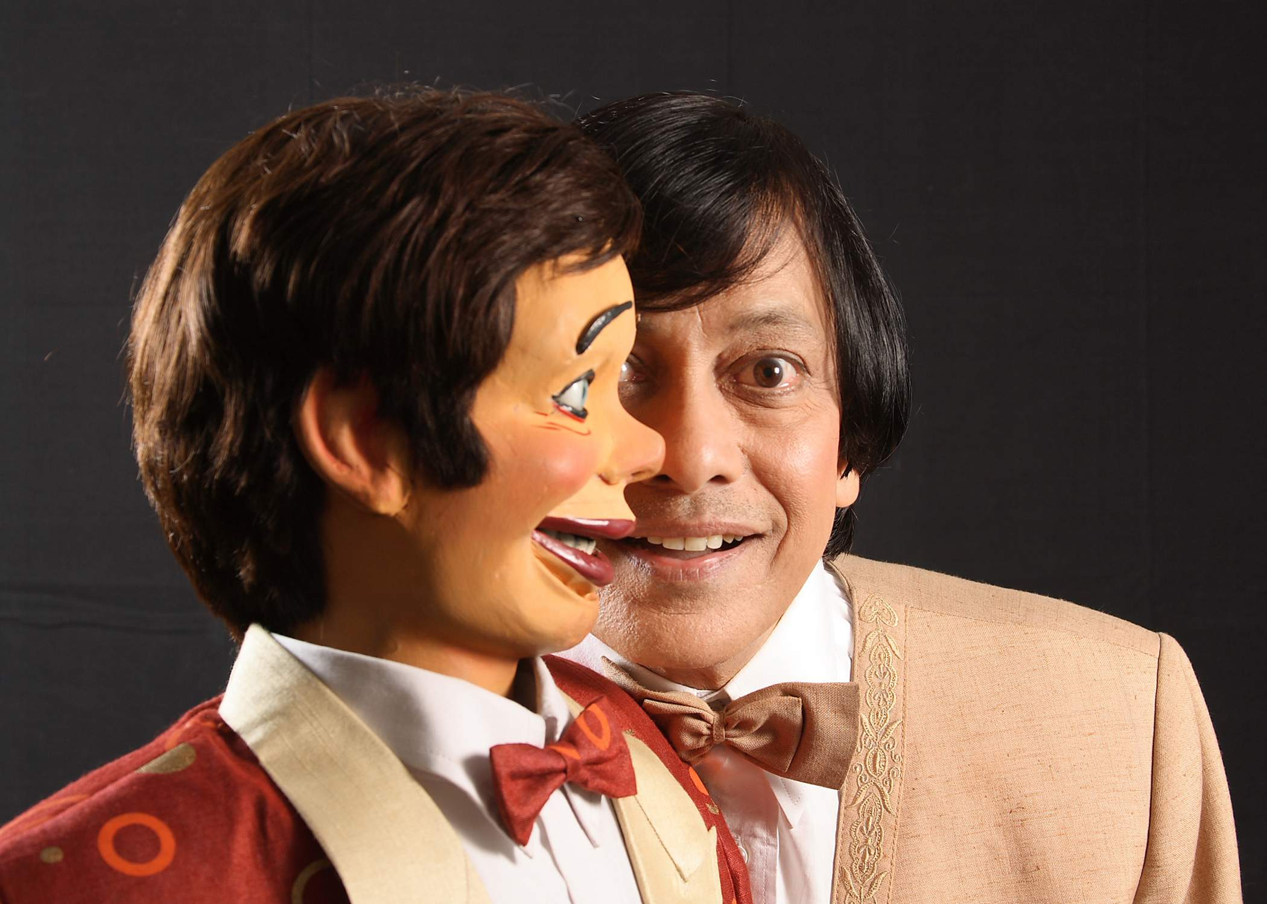
Ventriloquist Dummy
The puppeteer 'throws’ their voice while not moving their own lips, to make it appear as if the puppet dummy is speaking.

Slide 20
Animatronic Puppets
These puppets are remote controlled by robotics technology and computers.

Slide 21
Body Suit Puppets
These puppets are worn over the body and head of the puppeteer like a costume.

Slide 22
Digital Puppets
Are digitally animated two dimensional and three dimensional figures, which perform in real time, in a virtual environment, under the control of a computer.

Slide 23
References
Information sourced from Wikipedia website
https://en.wikipedia.org/wiki/Puppet

Slide 24
www.asianz.org.nz

