Slide 1


AS91171
Mechanics:
Japanese Rail & the
Shinkansen
Demonstrate Understanding
Of Mechanics- 6 credits

Slide 2
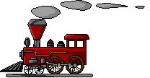
This presentation supports the learning required for AS99171- Demonstrate Understanding of Mechanics
It utilises the context of rail transportation in Japan and covers the following aspects of the standard:
Motion • Constant acceleration in a straight line
• Circular motion
Force • Force components
• Vector addition of forces
• Unbalanced force and acceleration
• Equilibrium (balanced forces and torques)
• Centripetal force
Momentum and Energy • Momentum
• Change in momentum in one dimension and impulse
• Impulse and force
• Conservation of momentum in one direction

Slide 3
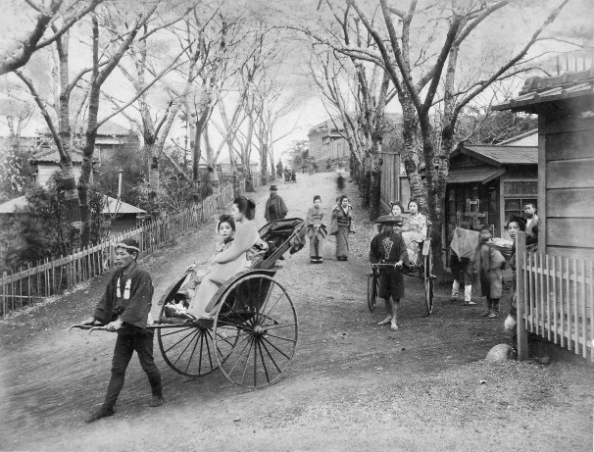
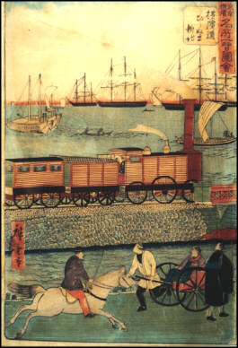
Introduction- Industrial Revolution
Until the early 1850’s Japan was a closed country with little external trade. The 1853 visit of U.S. Commodore Perry began the opening up of Japan to the rest of the world.
Industrialization of Japan began in the 1880s when Emperor Meiji declared the “Meiji Restoration” must begin and young Japanese students were sent to other countries to learn modern science and technology.
Rail transport was an integral part of the successful modernisation of Japan that was to follow. Trains in Japan symbolise modernity and the nation continues to be the world leader in high speed trains.
vintage.es
virtualmuseum.ca

Slide 4
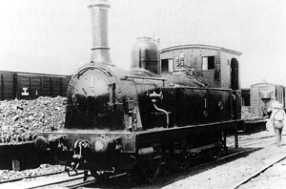
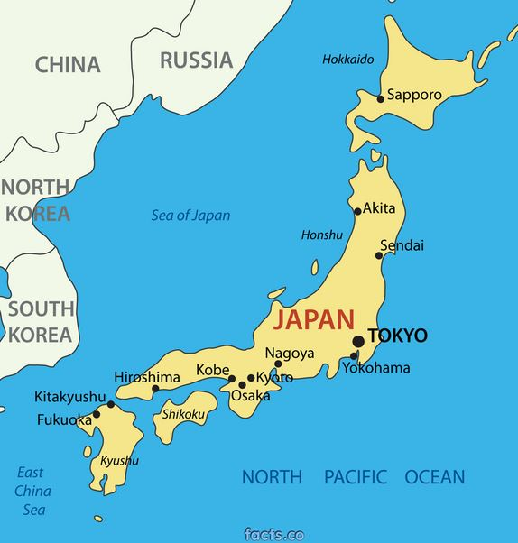
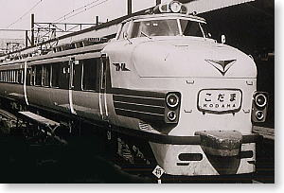
Japanese Rail- Background
Japan’s railway has opened up the country for subsequent generations, changed society and helped Japan to become the economic super power that it is.
1872: first railway in Japan opens with 29.0km covered in 53 minutes.
Railway Museum
1889: 602km of track links Kobe to Tokyo (Tokaido Main Line). Trip time is 20 hours and 5 minutes.
1930: 100% Japanese C51 Tsubame Super Express, 8 hours 20 minutes for the same journey.
www.1999.co.jp
Late 1950’s: C62 Kodama Limited Express cuts the journey to 6 hours 50 minutes.

Slide 5
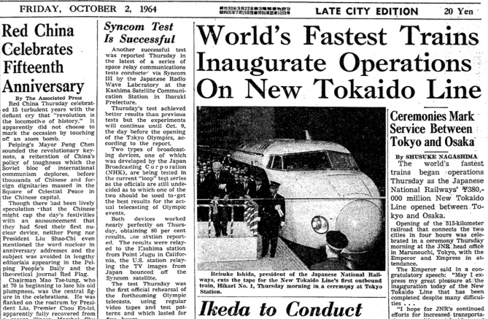
These advancements, however, would be quickly overshadowed by the age of the Shinkansen that was to follow………………

Slide 6
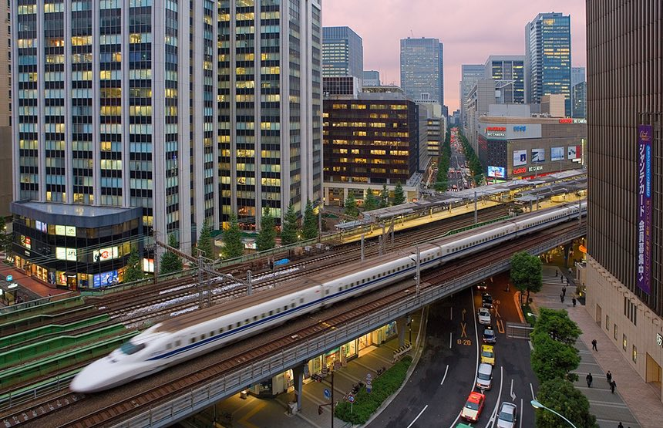
Shinkansen (literally: ‘new trunk line’)
Inadequate transportation capacity in the post WWII boom drove the development of Japans’ bullet trains which form part of the shinkansen system. Just before the 1964 Tokyo Olympics commercial operations began.
Initially operating at a maximum speed of 200 km h⁻¹ on a new 515 km line from Tokyo to Osaka the journey took 4 hours (previously 6 hours 50 mins)
The maximum speed is now 320 km/h – the same journey takes only 2 hours 30 minutes.
2620 km = current length of shinkansen network.
Photo Credit: Prisma Bildagentur Alamy

Slide 7
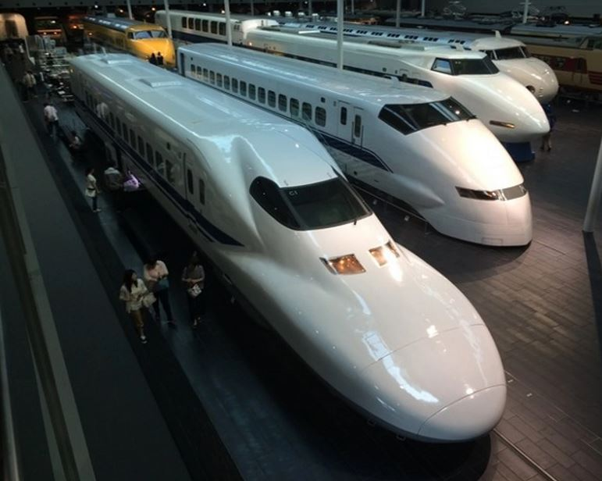
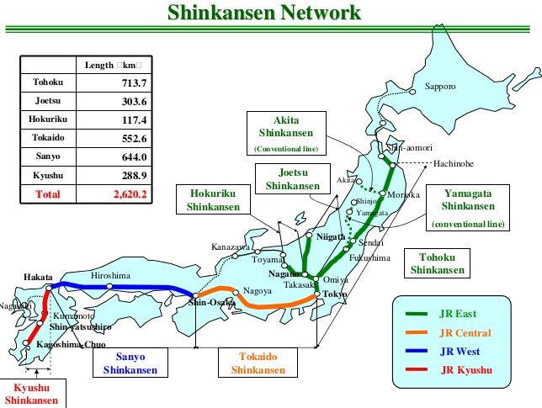

Slide 8
L1 Revision- Train Speed
Calculated via:
distance (in metres)
time (in seconds)
d
t
Speed (m s⁻¹) =
v =
How fast something is going
e.g. In units of metres per second, what was the average speed of the first trains in use in Japan in 1872?
d
t
29000
53 x 60
29000
3180
v =
=
=
= 9.1 m s⁻¹
Can you convert this to units of km h⁻¹?

Slide 9
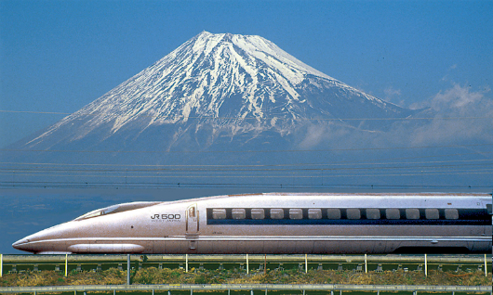
m s⁻¹ to km h⁻¹
÷ 1000
Firstly, to get metres kilometres:
d
t
= 9.1 m s⁻¹ ÷ 1000 = 0.0091
v =
km s⁻¹
× 3600
Secondly, to get seconds hours:
So, the average speed of the first trains in use in Japan in 1872 was 32.76 km h⁻¹.
= 0.0091 x (60 x 60) = 32.76
km h⁻¹
Which is faster –
9.1 m s⁻¹ or
32.76 km h⁻¹?
Top speeds of 10x this are hit every day now!

Slide 10
Vectors

Slide 11
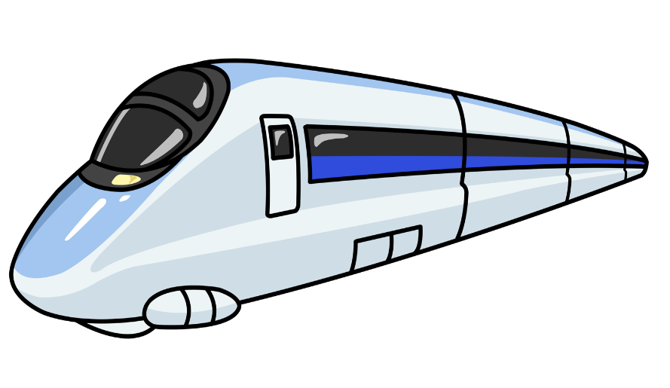
SCALARS
VECTORS
have
have
MAGNITUDE
ONLY
MAGNITUDE
MAGNITUDE
and
N
O
I
ONLY
T
C
E
R
D
I

Slide 12
Vectors
Not only does this give much more information but many quantities have to be vector quantities (e.g. you can’t actually have a force without a direction)
A friend stands 100m down the platform at the train station and says a train is moving at 10m/s. What could you add to your friends statement to describe whether the train is coming or going?
DIRECTION
This turns what was a scalar quantity, speed, into a vector quantity, velocity.
SCALARS
VECTORS
Distance
Displacement
Speed
Velocity
Mass
Acceleration
Energy
Force
Density
Momentum

Slide 13

Vector Representation
Vectors are represented in diagrams by arrows.
Length of arrow → MAGNITUDE of the vector
Direction of arrow → DIRECTION of the vector
Example- A N700 shinkansen travels at 75 ms⁻¹ East could be represented simply as:
75 ms⁻¹
Note: If compass directions are appropriate to give the direction for a particular situation then unless stated otherwise North is assumed to be up the page.
N

Slide 14

Combining Vectors
Vectors can be added or subtracted. This involves both one dimensional and two dimensional scenarios at this curriculum level.
The overall effect of the vectors that are acting is called the resultant.
Resultant
7000 N
Friction
7500 N
Thrust
500 N
Resultant
7000 N
Friction
7800 N
Thrust +
Tailwind
800 N

Slide 15
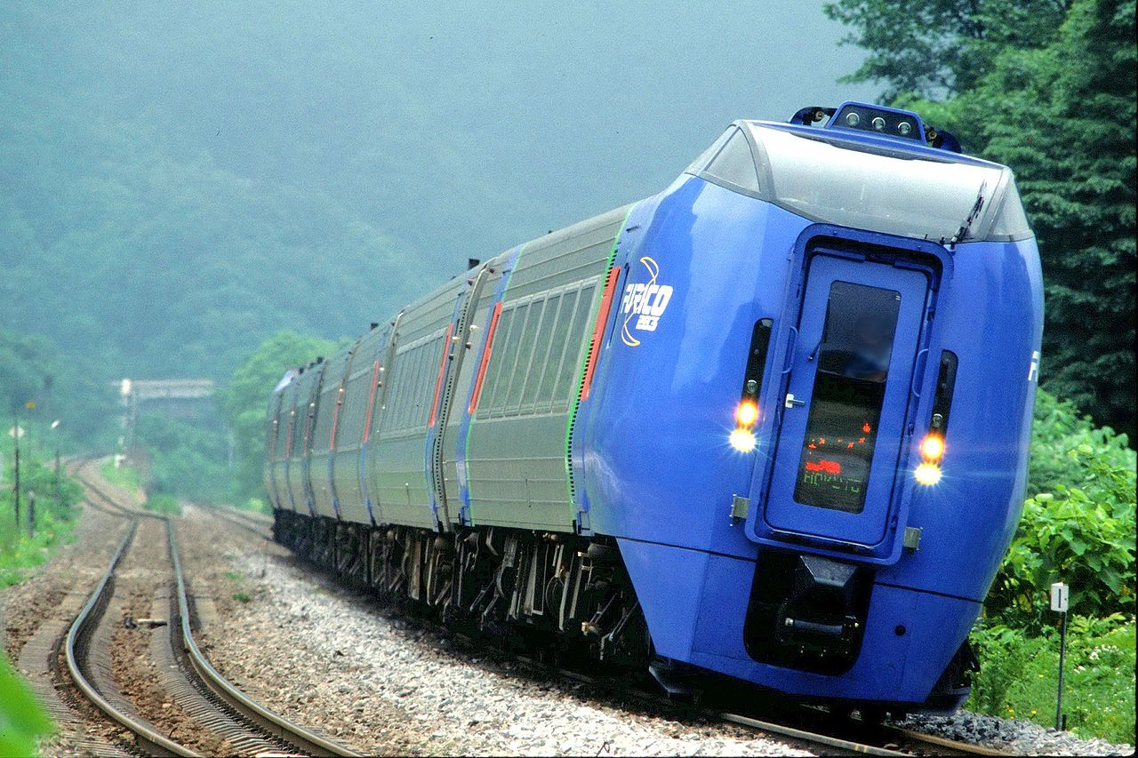
Example- Forces at Angles
Hokkaido, the northernmost of Japan’s main islands, is known for its volcanoes, natural hot springs (onsen) and ski areas. Rugged terrain is common and narrow guage train track weaves through the mountains.
The KiHa283 is a common passenger train built for this environment. It tilts up to 6º in operation to enable faster cornering on narrow tracks and therefore faster journeys.
If a 150 tonne KiHa 283 travels around a bend with a 6º tilt what are the horizontal and vertical components of the reaction force?
http://www.thetransportpolitic.com
Starting with a Free body force diagram………………

Slide 16
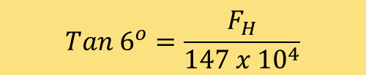

Starting with a Free body force diagram………………
F_{V}
6º
F_{R}
F_{H}
F_{w}
= 147 x 10⁴ N
http://www.thetransportpolitic.com
F_{V} must be equal in size to F_{w} (the vertical component of the reaction force balances F_{w})
Trigonometry can now be used to find F_{H} :
$$Tan 6^{o}=\frac{F_{H}}{147 x {10}^{4}}$$
$F_{H}=$154500 N

Slide 17
The Kinematic Equations

Slide 18
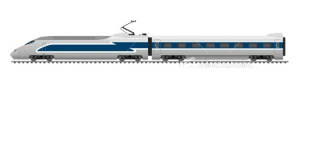

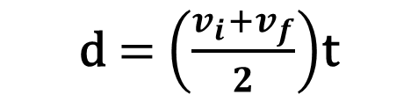

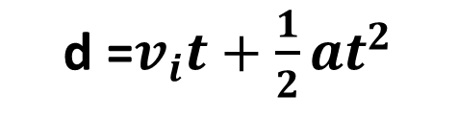
The Kinematic Equations
In addition to the Level 1 equations of motion 4 additional equations are used. (Note that uniform acceleration is assumed)
d $=$ $\left(\frac{v_{i}+v_{f}}{2}\right)$t
$v_{f}$ $= v_{i}+at$
SYMBOLS:
a = ACCELERATION (ms⁻²)
v_{i} = INITIAL VELOCITY (ms⁻¹)
v_{f} = FINAL VELOCITY (ms⁻¹)
d = DISTANCE TRAVELLED (m)
t = TIME TAKEN (s)
d =$v_{i}t+\frac{1}{2}at^{2}$
${v_{f}}^{2}$ $={v_{i}}^{2}+2ad$

Slide 19
Using the Kinematic Equations
1. Write down the symbols of the quantities that you know
2. Write down the symbol of the quantity that you require
3. Select the equation that contains all of the symbols in 1 & 2 above
Example 1
A bullet train leaves Tokyo Station and constantly accelerates at 0.72 ms⁻² over at distance of 2.5km. What is it’s final velocity?
This must be the equation as it is the only one with “v_{f}”, “v_{i}”, “a” and “d” in it
v_{i} | = 0 from rest
d | = 2500 m
v_{f}² = v_{i}² + 2ad
a | = 0.72 ms⁻²
V_{f} | = ?
= 60 m s⁻¹

Slide 20
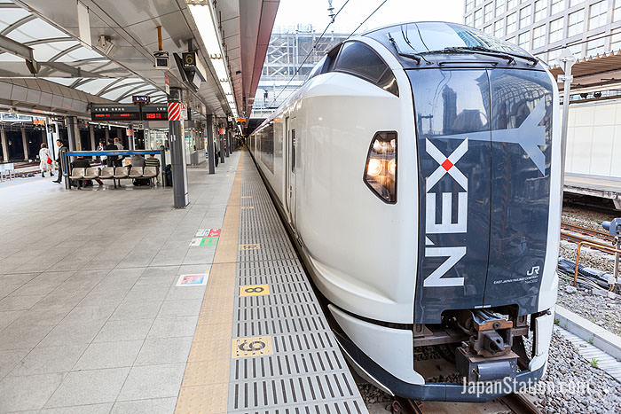
Example 2
The Narita Express is a train connecting Narita Airport (Japan’s largest) to Tokyo (some 75km away). It’s typical constant speed is 130 kmh⁻¹ but with a couple of stops along the way the journey takes around 53 minutes.
The Narita Express is travelling at 36 ms⁻¹ and is approaching Tokyo Station. The driver applies the brakes and it constantly decelerates at 1.44 ms⁻². What distance will it cover before it comes to a stop?
1. Symbols of the quantities you know
v_{i}
a
v_{f}
d
2. Symbol of the quantity that you require
3. Select equation with all of the symbols
v_{f}² = v_{i}² + 2ad
450m
Can you also work out how long (time) it took the train to stop?
25s

Slide 21
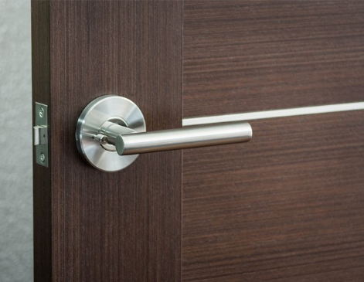
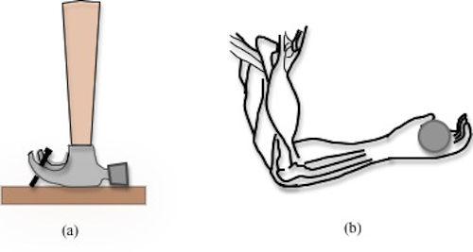
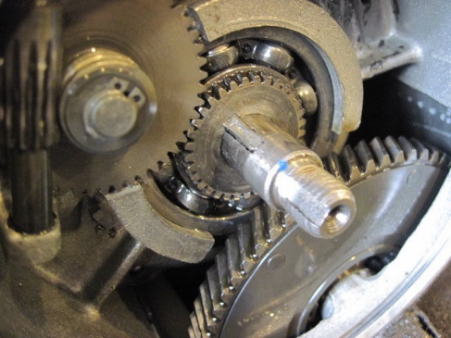
Forces- Torques
A torque is a turning force that occurs when a force acting on an object is not directed at it’s centre of mass. If unbalanced rotation will result.
This means there is a pivot point (fulcrum) and the size of a torque (or ‘moment’) depends on the:
 Size of the force
 Perpendicular distance of the force from the pivot point
Note: The direction of torque is given as clockwise or anti-clockwise
How does torque apply to these situations?

Slide 22
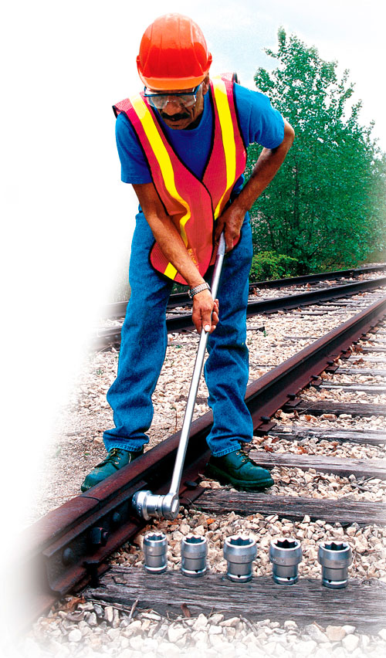
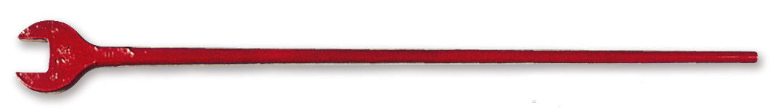
Calculating Torque
Torque (Nm)
= Force (N) x Perpendicular Distance (m)
τ = F x d
Example1 A long arm wrench is used to tighten rail track bolts:
Nut- pivot in centre
200 N
Pull
0.5m
If 200N of force is applied 0.5m from the pivot how much torque is generated?
What would be a simple way of generating more torque?
aldonco.com

Slide 23
Calculating Torque
Example 1 A long arm wrench is used to tighten rail track bolts:
Nut- pivot in centre
200 N
Pull
0.5m
If 200N of force is applied 0.5m from the pivot how much torque is generated?
= F x d
= 200 x 0.5
= 100 Nm
What would be a simple way of generating more torque?
aldonco.com

Slide 24
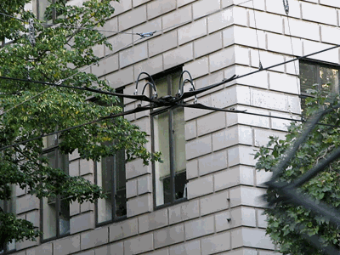
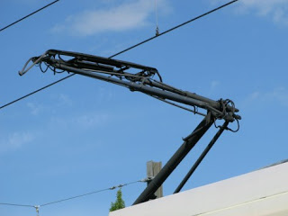
Calculating Torque
Example 2
A pantograph is a device used for maintaining contact with the overhead electricity cables that an electric train uses to get it’s power.
The shinkansen pantograph was one factor that limited the trains speed for a period of time due to the noise it created when passing through cities and their suburbs.
A Japanese scientist solved this problem via biomimicry of an owl’s feathers- copying how they can fly almost silently.
To maintain a consistent electrical contact without too much pressure between the pantograph and the overhead wires a lever system is used……………….

Slide 25
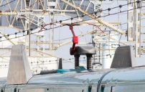
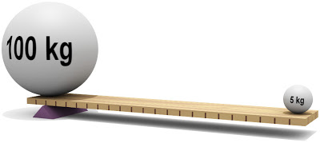
Calculating Torque
Example 2
The pantograph has to be able to move up and down with small changes to line height- both railway line height and overhead electricity cable height.
Too much force will cause excessive wear and too little will not deliver sufficient electricity and lead to arcing problems.
Having a large force close to the pivot delivers a small, consistent force at the wire end a greater distance from the pivot.
1000N
50N
The 1000N force is 10cm from the pivot. How far out can the 50N force be if the system is balanced?
τ_{anticlockwise} = τ_{clockwise}
1000 x 0.1 = 50 x d
100 = 50d
100/50 = d
d = 2 metres

Slide 26
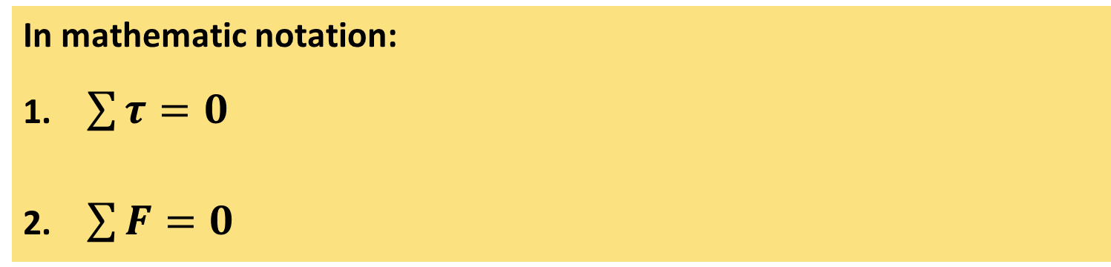
Forces- Equilibrium
To solve the previous problem you have used the principles of equilibrium.
Equilibrium in physics describes a particular situation involving torques and forces.
For a system to be in equilibrium:
the sum of the clockwise & anticlockwise torques about any point must be zero
the sum of the forces must be zero
In mathematic notation:
$\sum{τ=0}$
$\sum{F=0}$

Slide 27
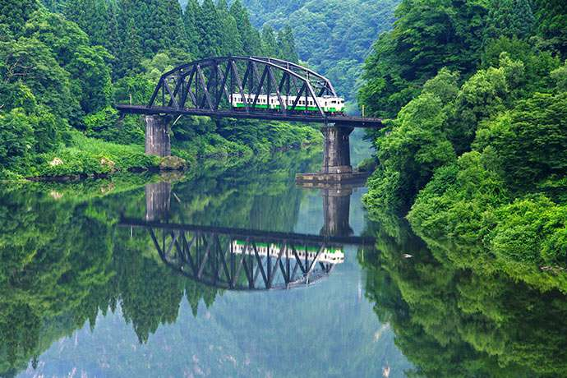
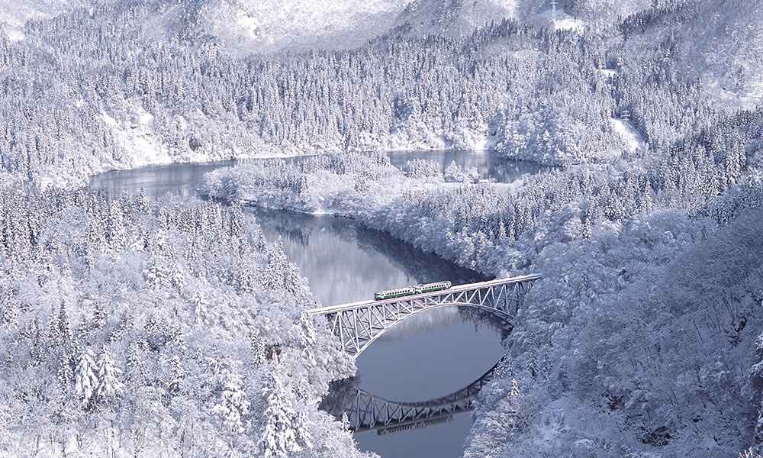
Outside of its four main islands Japan has thousands of smaller ones. Over 50% of the country is mountainous and covered in forest.
Although Japan has very large urban populations ( ̴125 million people) it also has stunning national parks.
The rail network allows easy access to its wilderness.
japan-magazine.jnto.go.jp
One such rural area is only ̴200km north of Tokyo, in the Fukushima prefecture.
Via a local railway line, the Tadami line, one can access the area called Oku-Aizu which has rich natural surroundings including geothermal hot pools (onsens).
tadami line japan-magazine.jnto.go.jp
We will apply equilibrium principles to a train on a bridge in one of these areas…..

Slide 28
Example 1
A uniform bridge is 90m long with a mass of 280 tonnes. At a particular instant a train crossing it is in the position shown. It has a mass of 120 tonnes and is situated 25m from point A. Find the reaction force at each support R₁ & R₂. (we will use g = 10 ms⁻² for this example)
R₁
25m
Firstly, label the diagram with everything that is known.
45 m
R₂
A
B
We could take moments about either A or B here.
Taking moments about A eliminates R₁:
120000 N
280000 N
τ_{clockwise} = τ_{anticlockwise}
120,000 x 25 + 280,000 x 45 = 90 R₂
3,000,000 + 12,600,000 = 90 R₂
90 m
15,600,000/90 = R₂
R₂ = 173,000 N

Slide 29
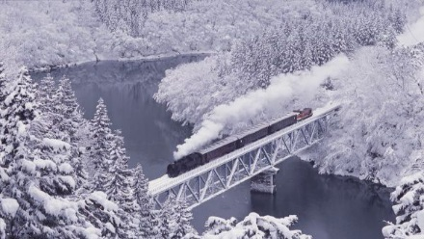
Example 1
Now that we know the value of R₂ we can utilize the second condition for equilibrium to find R₁.
Vertically R₁ + R₂ = total weight force
= 120,000 + 280,000
= 400,000 N
R₁
25m
45 m
R₂
So, if R₂ = 173,000N then R₁ =
= 400,000 – 173,000
= 227,000N
A
120,000 N
B
280,000 N
R₂ = 227,000 N
90 m
travel.rakuten.co.jp

Slide 30
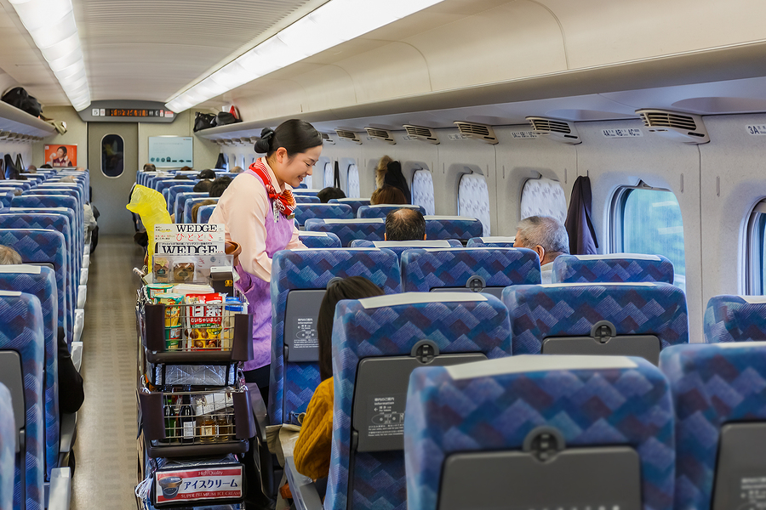
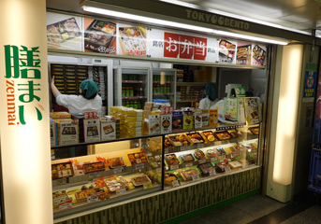
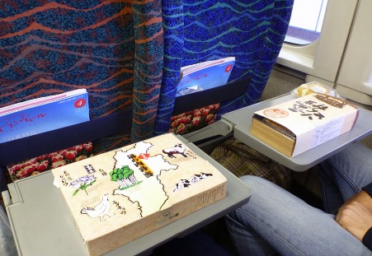
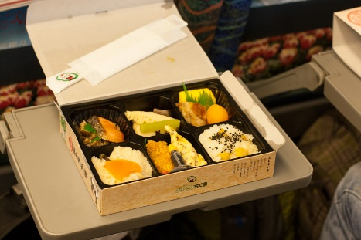
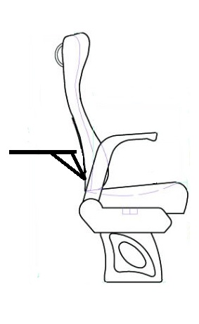
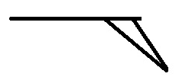
Example 2
A feature of Japanese train travel is the ekiben - eki meaning station, ben short for bento, meaning traditional Japanese packed lunch. As the name suggests they are sold at station shops but are also available on board shinkansen via a trolley service.
waytomuchcoffee.com
seat61.com/japan
waytomuchcoffee.com
In this example we will look at the equilibrium around the seat back meal tray.

Slide 31
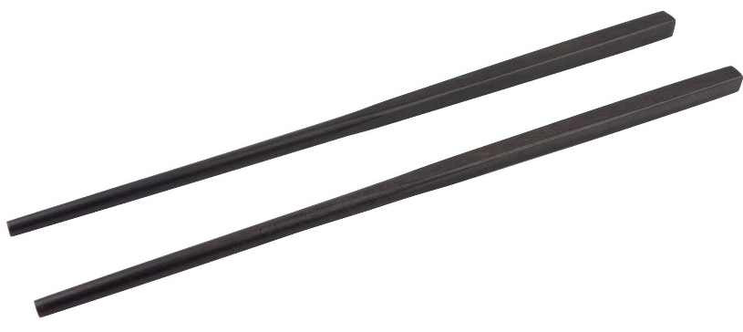
Example 2
The seat back tray must be light weight but strong enough to handle a significant load.
0.08 m
0.19 m
pivot
0.28 m
An 800g, 16cm deep ekiben box is positioned as shown on a meal tray of mass 600g. The meal tray is 40cm deep with the pivot located 2cm in from the back.
How much force must a support strut that is 8cm from the pivot provide for the system to remain in equilibrium? (use g = 9.81ms⁻²)
τ_{anticlockwise} = τ_{clockwise}
5.89N
7.85 x 0.28 + 5.89 x 0.19 = 0.08 F_{strut}
7.85N
support
strut
2.20 + 1.12 = 0.08 F_{strut}
3.32 = 0.08 F_{strut}
3.32/0.08 = F_{strut}
F_{strut} = 42 N
F_{strut} = 41.5 N

Slide 32
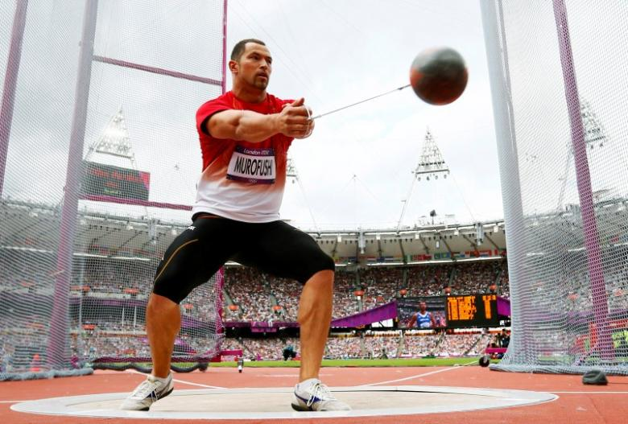
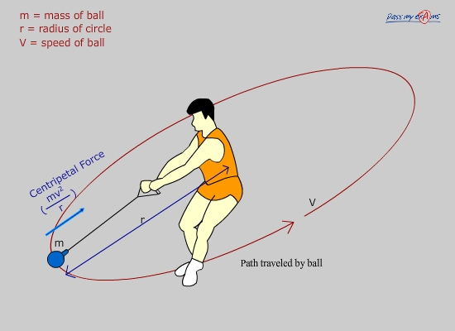
Circular Motion
What is it?
Think about spinning a steel ball attached to a piece of string in a horizontal circle…………..the hammer throw………..
Koji Murofushi, Japanese Olympic Gold Medallist,
Hammer Throw
What would happen if you let go?
Would it continue to move in a circle? If not,why not?
What causes it to follow a circular path?
passmyexams.co.uk
Newton’s 1st Law (The Law of Inertia)
“An object will continue with a constant velocity (constant speed in a straight line) unless acted on by an external force”
A FORCE must cause an object to move in a circle!
http://uk.reuters.com

Slide 33
What is Circular Motion?
The net force causing the circular motion always acts towards the CENTRE of the circle centripetal force.
v
F_{C}
r
At any given moment, the velocity of the object is straight ahead at right angles (perpendicular) to the direction of force.
Time Period, T: time taken for one revolution
Frequency, f: number of revolutions in 1 second
Distance travelled in 1 revolution: circumference of circle 2𝜋r
1
f =
T

Slide 34
Centripetal Acceleration
Remember that velocity is a vector – it has size AND direction.
If either of these change, then the velocity changes.
As an object follows a circular path with constant speed, its velocity is constantly changing because its direction is changing, therefore it is accelerating.
The object experiences an acceleration in the same direction as the change in velocity – towards the centre.
Newton’s 2nd Law
“A net force on an object will cause that object to accelerate proportionally to the force, in the same direction as the force acting on it (F_{net}= ma)”

Slide 35
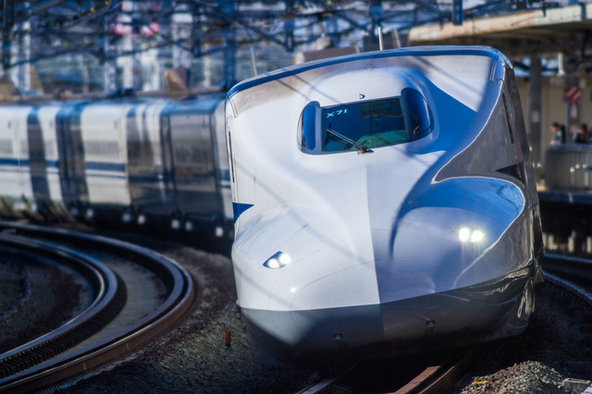
Centripetal Acceleration
Why is the acceleration towards the centre?
http://voyapon.com/trains-japan/s_pixta_14099285_m/
Acceleration IS a change in velocity...
v_{f}
Δv = v_{f} - v_{i}
v_{i}
acceleration =
Δv
Drawing a vector diagram:
v_{f}
r
-v_{i}
Δv
At the object’s average position, the change in velocity vector, Δv, points towards the centre of the circle.

Slide 36
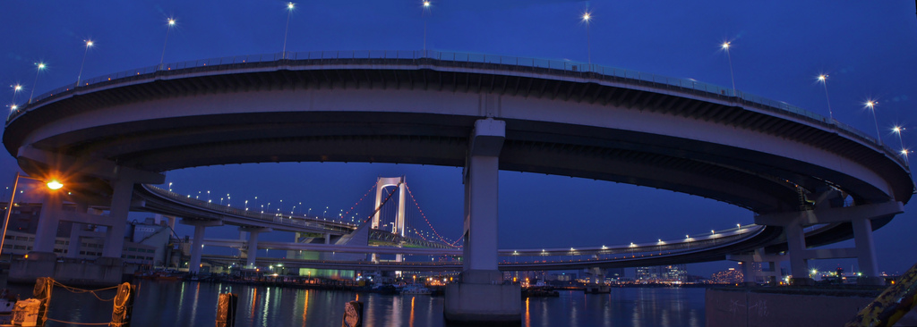
Calculating a_{c} & F_{c}
For an object moving at constant speed, v:
Centripetal Force Centripetal Acceleration
v
mv²
v²
F_{C}
a_{c}
F_{c} =
a_{c} =
r
r
What Provides Centripetal Force?
  Tension Force
  Friction Force
  Reaction Force
  Weight Force
Rainbow Bridge access ramp, Tokyo
Quest-for-japan.com

Slide 37
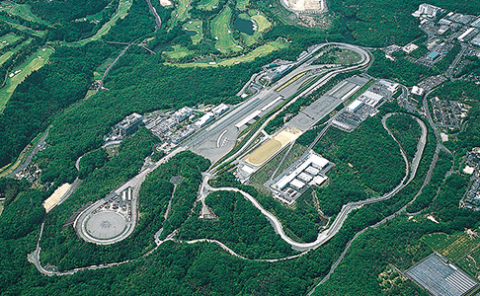

Example 1
A Toyota Prius (mass= 1325 kg) is being tested on a Toyota City circular track with a 50m radius. If the car is travelling at 20 ms⁻¹ what is the necessary centripetal force and what provides this?
F_{c}
Fujioka Proving Ground (Toyota City, Aichi, Japan) Land area: approx. 670,000 m²
F = 10,600 N
The necessary centripetal force, F is provided by the friction at the tires
http://www.aisin.com/technology/reli/comprehensive/

Slide 38
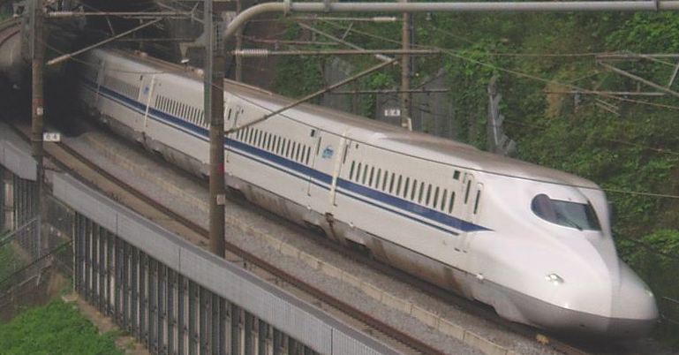
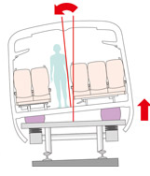
Circular Motion- Shinkansen Cornering
One challenge in reducing shinkansen journey time was increasing cornering speed. Camber (sloping track) helped but only up to a point as slower locomotives on the same line would be unstable with too much camber.
N700 Shinkansen train (2007) with Active Tilt System
The solution to this problem came in an active tilt system that ‘leans’ the train itself into corners.
http://web-japan.org/trends/09_sci-tech/sci101209.html
track camber
Air springs that inflate/deflate as required to tilt train
www.thetransportpolitic.com
http://www.thetransportpolitic.com
Tilting the train improved passenger comfort. Tilting reduced the tendency of things to want to move sideways and passenger motion sickness was more or less eliminated.

Slide 39
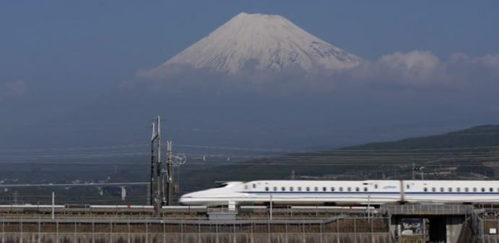
How Much Faster?
Example 2
A N700 shinkansen train (mass 715000kg) moves around a corner of radius 2500m.
For it to travel at 250 km/h (69 ms⁻¹) how
much centripetal force is required?
A Tokyo bound Japan Rail N700 series Shinkansen train passes snow-covered Mount Fuji in Shizuoka Prefecture
videoblocks.com
F_{c} = 1,361,646 N
F_{c} = 1,361,646 + 120,000
= 1,481,646 N
The train engages its tilt system. Just one degree of tilt provides 120,000 N of additional centripetal force. How fast can it now travel around the same bend?
v = 72 ms⁻¹
v = 260 km h⁻¹

Slide 40
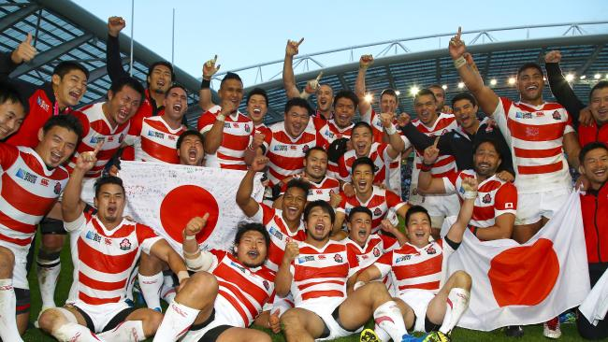
Momentum
News article: “The Japanese Cherry Blossoms (national rugby team) aim to gain momentum in the lead up to the 2019 Rugby World Cup that they will host”
Momentum is a term in physics used to describe the quantity of motion an object has.

Slide 41
Momentum
Any object in motion has momentum. The amount of moment that object has depends on two variables:
        Mass (kg)
        Velocity (ms⁻¹)
ρ = mv
ρ: momentum (kgms⁻¹)
m: mass (kg)
v: velocity (ms⁻¹)
** momentum is a vector quantity - direction must be taken into consideration and stated in your answers where appropriate.

Slide 42
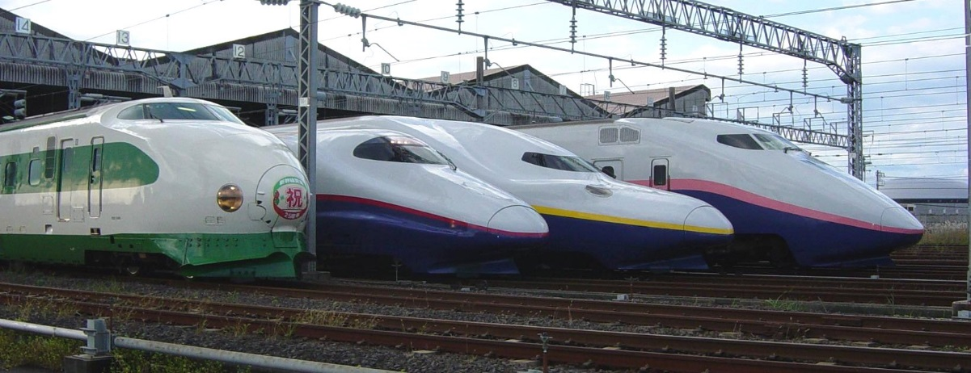
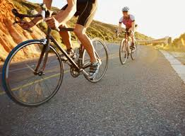
Momentum
Which is harder to stop, a bullet train or a bicycle?
An object with more momentum is harder to stop (i.e. it requires more force to stop it)

Slide 43
Conservation of Momentum
The total momentum of a system is conserved only if there are no net external forces acting on the system.

Slide 44
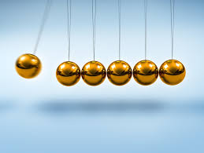

Momentum & Collisions
During collisions, momentum is conserved (unless there is a net external force). The total momentum before a collision is equal to the total momentum after (direction must be accounted for).
NB: an external force is one that acts from outside the system. Obviously there are forces on the objects involved in the collision, but these are considered internal forces because they come from within the interaction of the objects involved.
Elastic Collision:
KE conserved
Inelastic Collision:
KE not conserved

Slide 45
Momentum & Collisions
Example 1 Calculate the total momentum before and after the collision
Total momentum before = total momentum after
Before
After
v_{i1} = 5.0 ms⁻¹
v_{i2} = 3.0 ms⁻¹
v_{f1} = 0.5 ms⁻¹
v_{f2} = 8.0 ms⁻¹
m₁ = 2.0 kg
m₂ = 1.0 kg
Solution: right is positive
Before: Σρ = (m₁v_{i1} + m₂v_{i2}) = (2.0 x 5.0) + (1.0 x -3.0) = 7.0 kgms⁻¹
After: Σρ = (m₁v_{f1} + m₂v_{f2}) = (2.0 x -0.5) + (1.0 x 8.0) = 7.0 kgms⁻¹
HINT: when calculating momentum, you should alway have a positive direction defined. Remember that you must take into account the direction of the velocities (and hence direction of the momentum) when calculating the total.
The total is simply the sum of the momentums for each individual object involved.

Slide 46

Momentum & Collisions
Example 2: Two train carriages collide in the shunting yard. Calculate the velocity of the blue cart after the collision.
http://www.otenko.com
Before
After
v_{i1} = 2.0 ms⁻¹
v_{i2} = 3.0 ms⁻¹
v_{f2} = 0.25 ms⁻¹
v_{f2} = ? ms⁻¹
JR Freight Yard, Umeda, Osaka
m₁ = 4.0 kg
m₂ = 2.0 kg
before
after
Σp = (4.0 x 2.0) + (2.0 x -3.0)
= 2.0 kgms⁻¹
Σp = (4.0 x 0.25) + (2.0 x v_{f2})
= 1.0 + 2v_{f2}
2.0 = 1.0 + 2v_{f2}
1.0 = 2v_{f2}
v_{f2} = 0.50 ms⁻¹

Slide 47

Impulse
In physics, IMPULSE is the concept of change of momentum and the relationship between force applied and time taken for the force to act in order to cause the change.
The more time something has to lose it’s momentum, the smaller the average force it will experience.
Δp = FΔt
Δp: change in momentum (Ns)
F: force causing Δp (N)
Δt: change in time (s)
IMPULSE = Δp (change in momentum)

Slide 48

Mighty Trains Episode 2- Shinkansen
https://youtu.be/drVbGSuxmYI
www.asianz.org.nz

Slide 49
BBC- Richard Hammonds’ Engineering Connections- Bullet Train
https://youtu.be/_Ja59uLKVqI
www.asianz.org.nz

Slide 50

www.asianz.org.nz

