Slide 1
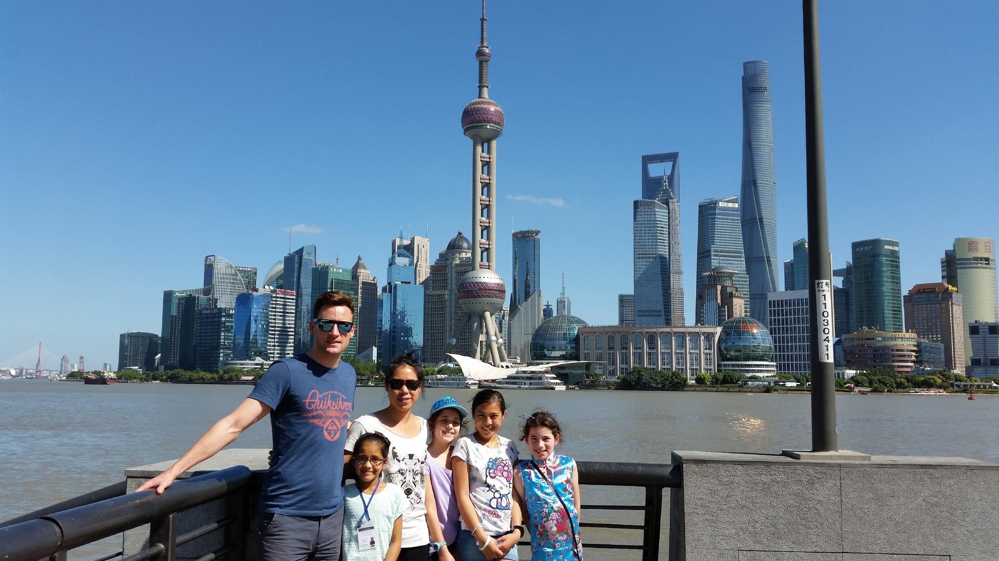
Cultural Exchange Programme – Student Trip
FRIENDSHIP IS KNOWLEDGE
Notes:
In 2015 we gave Year 5 students the opportunity to go and experience some time at our Sister School in Yuyoa, China. I will present a little about how we got to this trip and our pedagogy and planning that was involved.

Slide 2
How it all started...
http://www.asianz.org.nz/about-us/our-programmes/education
Notes:
Over two years ago Neil and I went to a conference to Sydney and got a very good understanding of how far along or how far behind our NZ schools are with a learning relationship with an Asian school. We could have gone the route of any part of Asia however Ningbo being a sister city to Auckland and our high % of Chinese students here at school, well China was an obvious choice. So the journey started. I would like to say that BHBP are the first state primary school to ever have taken students on a sister exchange to China. Having visited China in 2014 as part of the exchange programme I formed a great friendship with Number 1 Experimental Primary School in Yuyao, China. With key-note speakers quote’s ringing in my ears I was determined to see how far our school could take this friendship journey. 4 wonderful, energetic, strong, resilient, cultured students that myself and Mrs Casse my fellow travelling teacher are very, very proud of were able to experience school in China first hand. But first I would like to share a video that you will find on AsiaNZ Foundation website that brought us to where we are today……..

Slide 3
A little about me and Blockhouse Bay Primary School
5 Years at Blockhouse Bay Primary School.
Year 3 and 4 Team Leader, Sports Co-ordinator and Mandarin Liaison Co-ordinator.
Blockhouse Bay Primary have been in the Mandarin Language Programme for 2 years, currently in our 3rd.
Year 3, 4 and 5 and 6 participate in the programme. We have a school role of approx. 550 students Yr 0-6 and are a decile 8 school.
Children also have the opportunity to carry on with learning mandarin at Blockhouse Bay Intermediate and Lynnfield College.

Slide 4
Purpose of the Trip
To use the language skills obtained while participating in the Blockhouse Bay Primary School’s MLA (Mandarin Language Assistant) programme.
To experience and appreciate a different culture.
To live the life of a student in our sister school Number 1 Yuyao Experimental Primary School.
To create friendships, connections and knowledge that will help them in the Asian century.
Notes:
This slide shows the purpose of the trip. We have been in the MLA programme for two years now and it continues to grow with Melody being able to teach Chinese to our Year 3 and 4 syndicate earlier in the year and using resources where possible to maximize our children's learning potential. Our students have 1 Mandarin lesson a week which involves around 50% learning the language and 50% learning the culture. Each year our Sister School sends a group of students to experience the Kiwi way and we encourage parents that showed an interest of sending their children to China to have a home stay student for this time. This is important as it creates a known face, a friendship and a connection. Vital for when our students go to China. Through a friendship with an English teacher in our Sister school we endeavor to again match these students up to be home stays again. To our delight the friendships from our 2015 trip are still strong and these children still communicate. Who know’s what will happen in these children’s future. University, Travel?

Slide 5
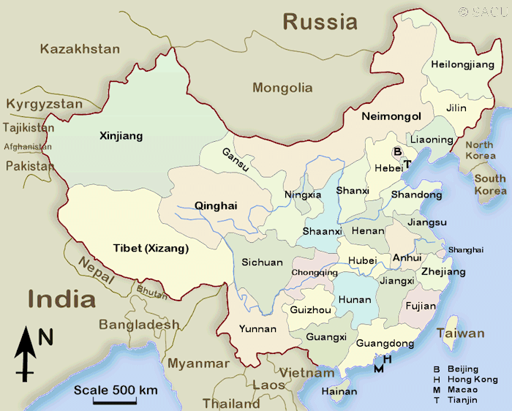
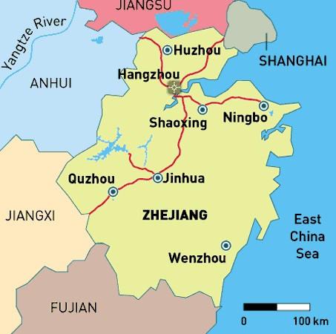
China, Shanghai, Yuyao
Notes:
It was important that we specifically show our parents where we are going. China is a big place. Having a person on the trip that has been to China is important. For those that have been you can understand that everything is on a huge scale. Having someone that can speak the language is a bonus, however not a must have.

Slide 6
Outline of the trip
Itinerary was created with the help of A & E International.
Day 1
Fly direct to Shanghai and travel to Ningbo, Yuyao.
Night in Hotel at Yuyao
Day 2, 3 and 4
Days spent at sister school and nights spent with homestay family (in pairs).
Day 5, 6, 7
Train to Shanghai to experience sights, markets, tall towers, boat cruises etc.
Day 8
Direct flight to New Zealand
Notes:
This is an outline of the trip. The red carpet is very much rolled out for you in China, students a very well cared for at school and we as teachers stayed on site and often stepped into class to check on our students. It was important that time be given for these students away from their home class socialize with eachother. We always felt extremely safe and well provided for. It was encouraged that our students gave a performance to showcase NZ and our 4 girls were all involved in School KapaHaka. Giving the 4 girls a booklet of worksheets from their NZ class meant they could at anytime pull this out and work on it. Every location that we visit we are accompanied by our tour guide Mr Stone Shi. He made sure we were all well cared for and transport turned up on time (which was a mini van) Included in the land based cost which I will discuss later in the presentation. We were able to have a shared apartment, accommodation which worked well for Year 5 students. Having this style of accommodation had its benefits, however it did push our commute time in Shanghai and children did not return home until 8pm at night. Having a guide was essential, Mr Stone was very positive while being firm with a bunch of girls that at times all they wanted to do was gossip. For our future trips we will always use Mr Stone. It was important that us as teacher could change the itinerary, as we knew what was best for our students. At times they needed a good feed of McDonalds and at times they needed rest. The girls were out the door at 8am and not home until 8pm. Being organized was of huge importance. I have had to turn down students for our 2016 trip as I felt they would mentally and emotionally deal with the influx of responsibility. Don’t discount your flight, we found specials, however using a trusted, reliable carrier like AirNZ with no stop overs was ideal.

Slide 7
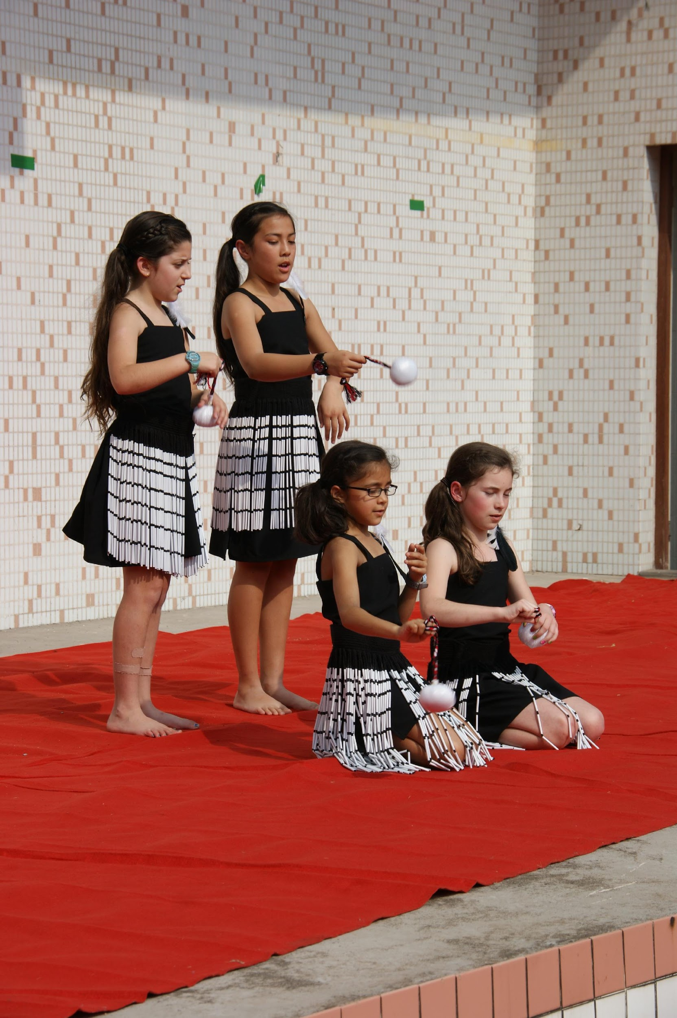
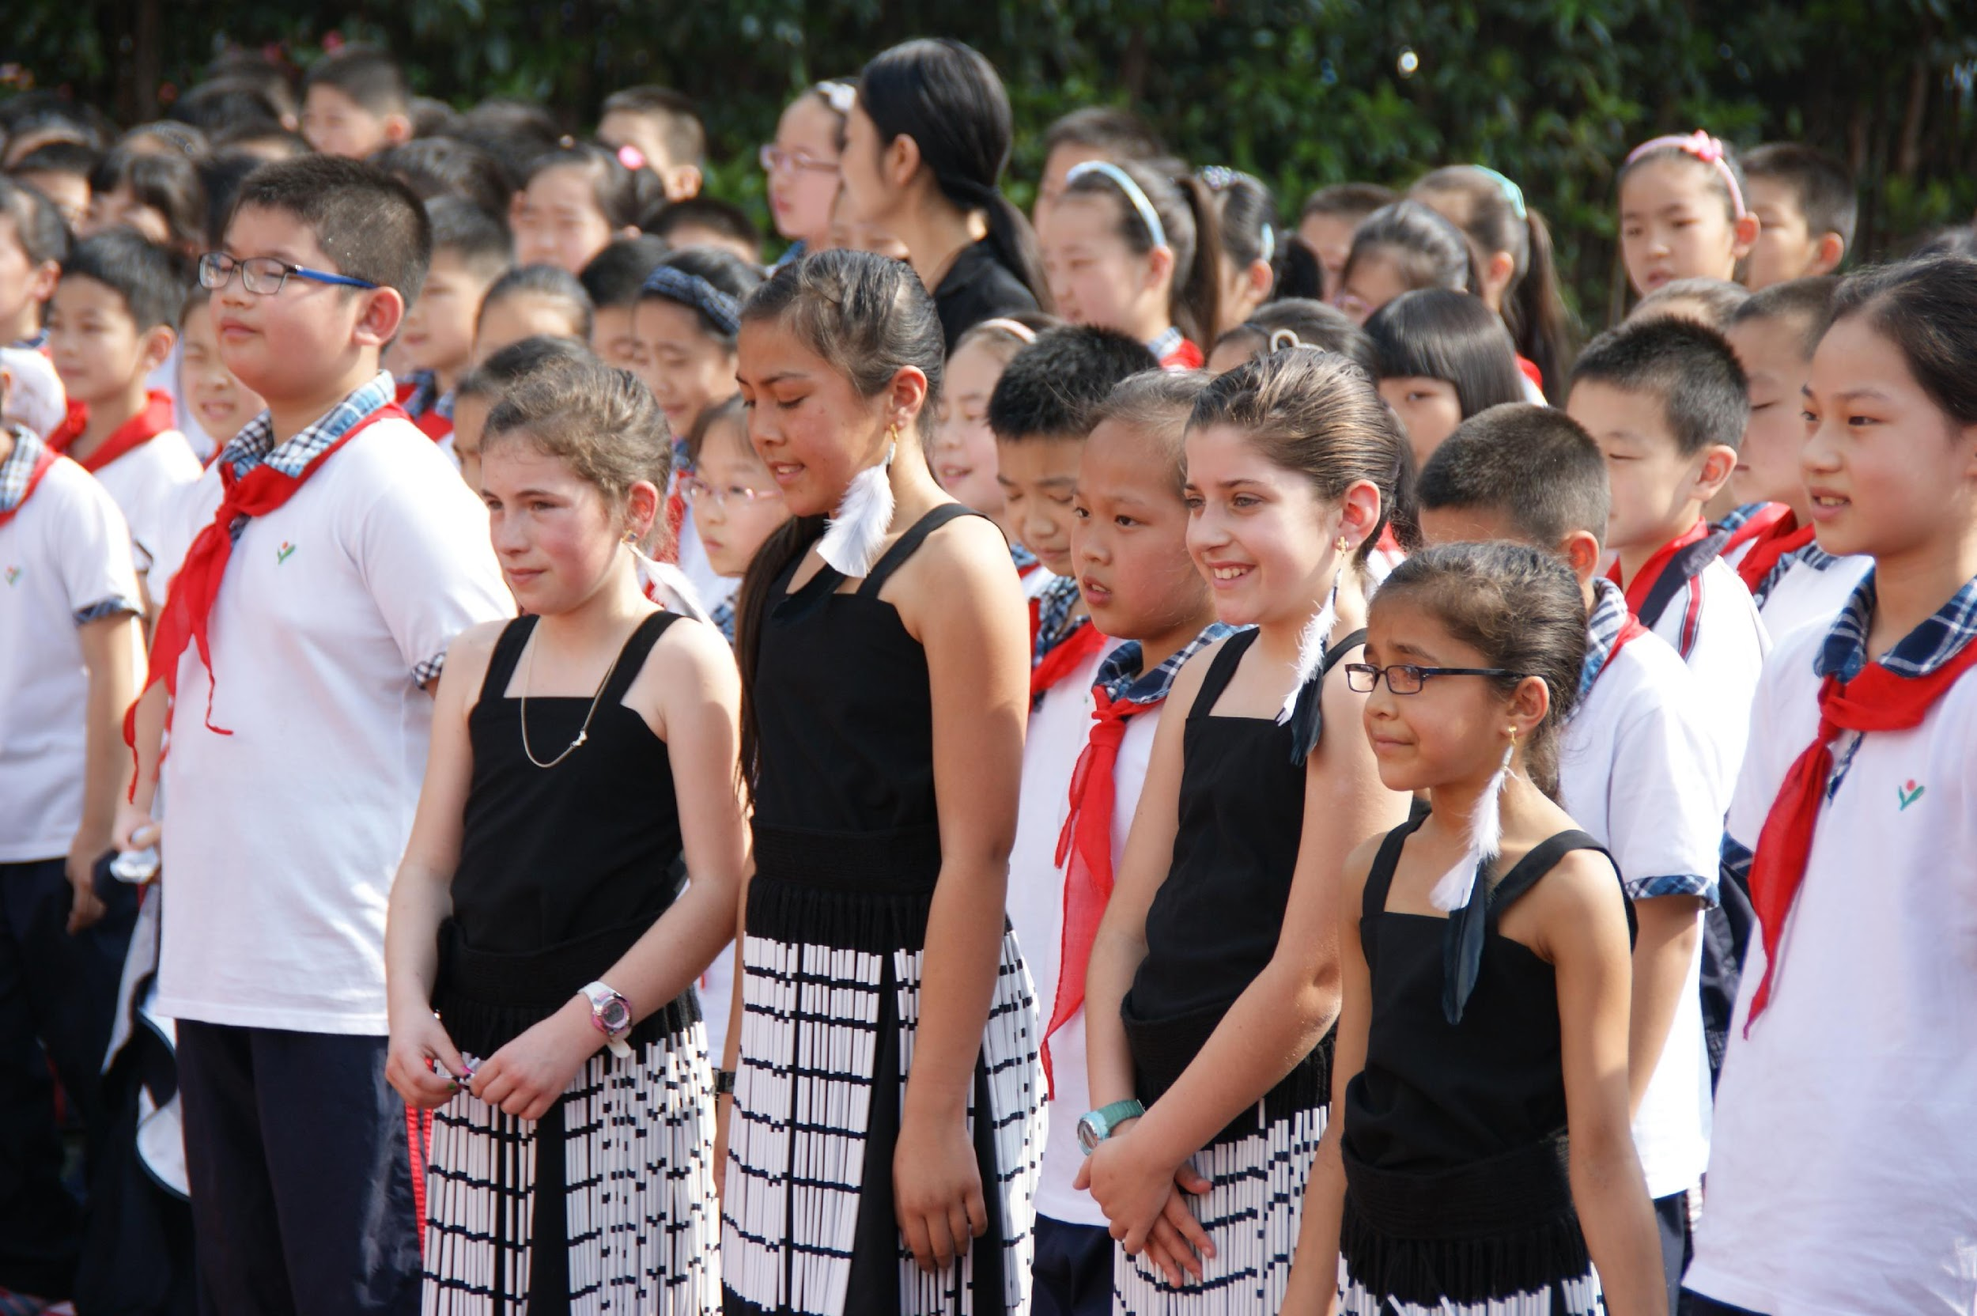

Slide 8
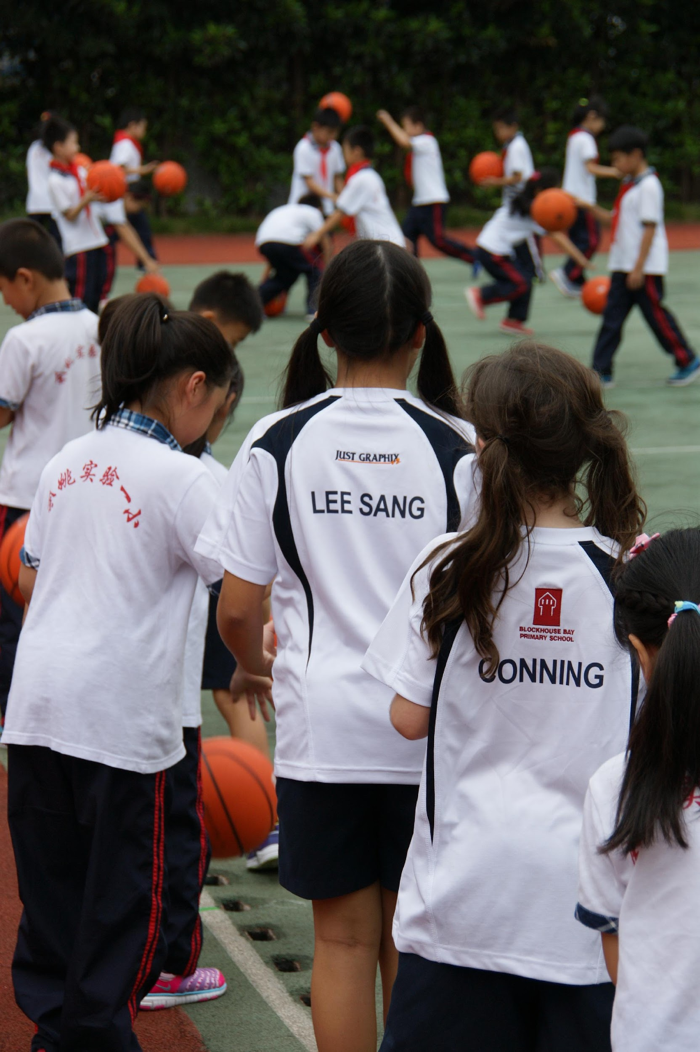
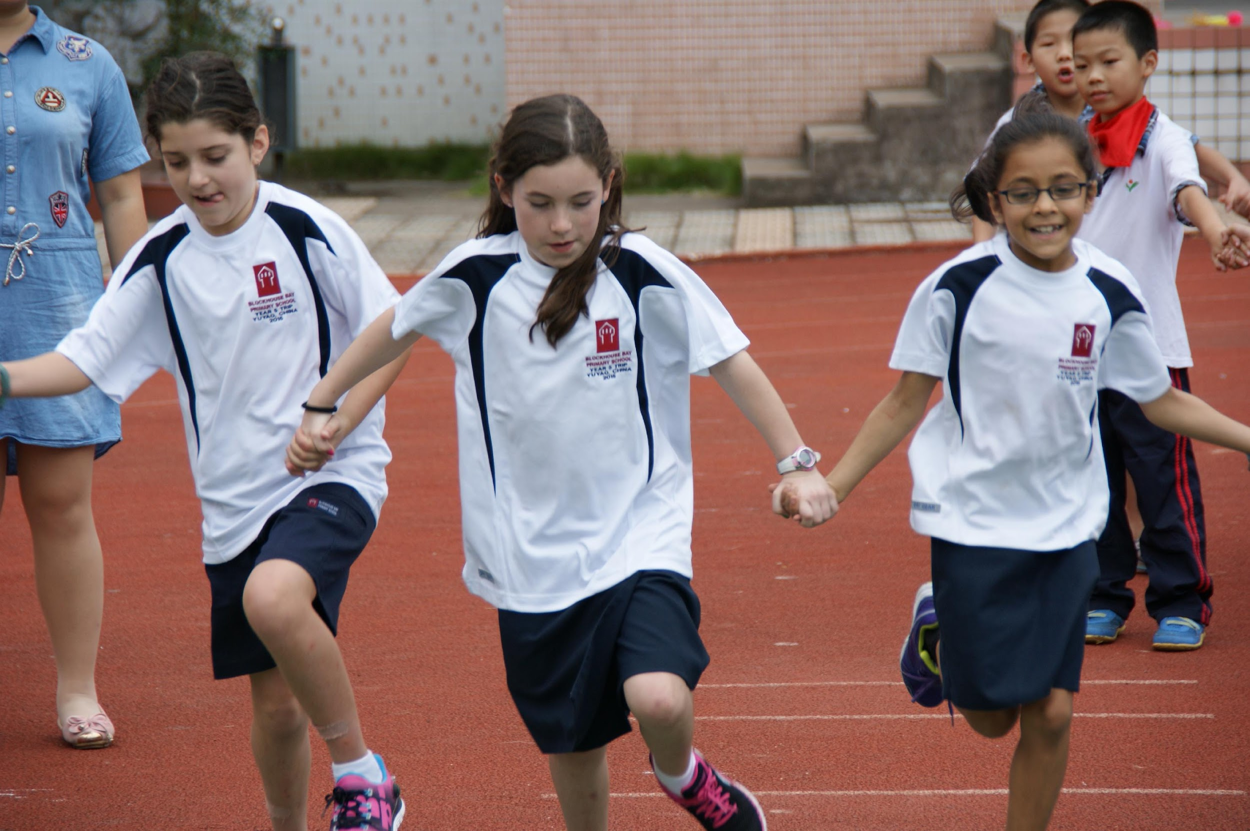

Slide 9
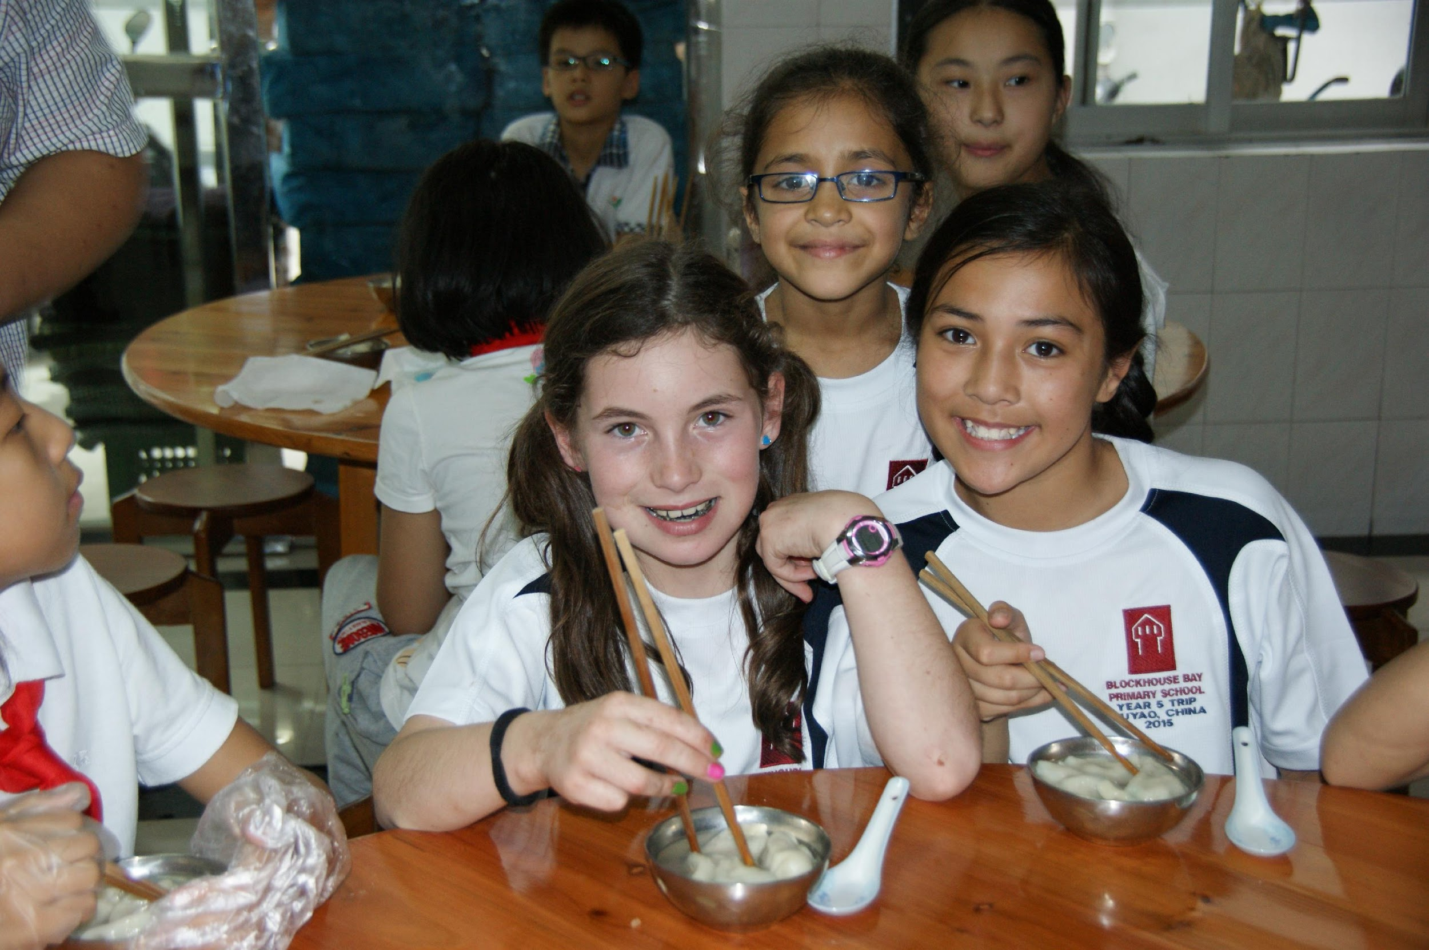
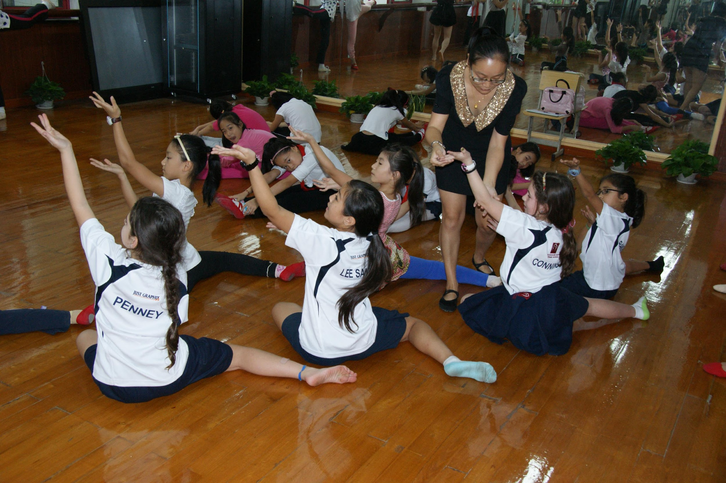

Slide 10
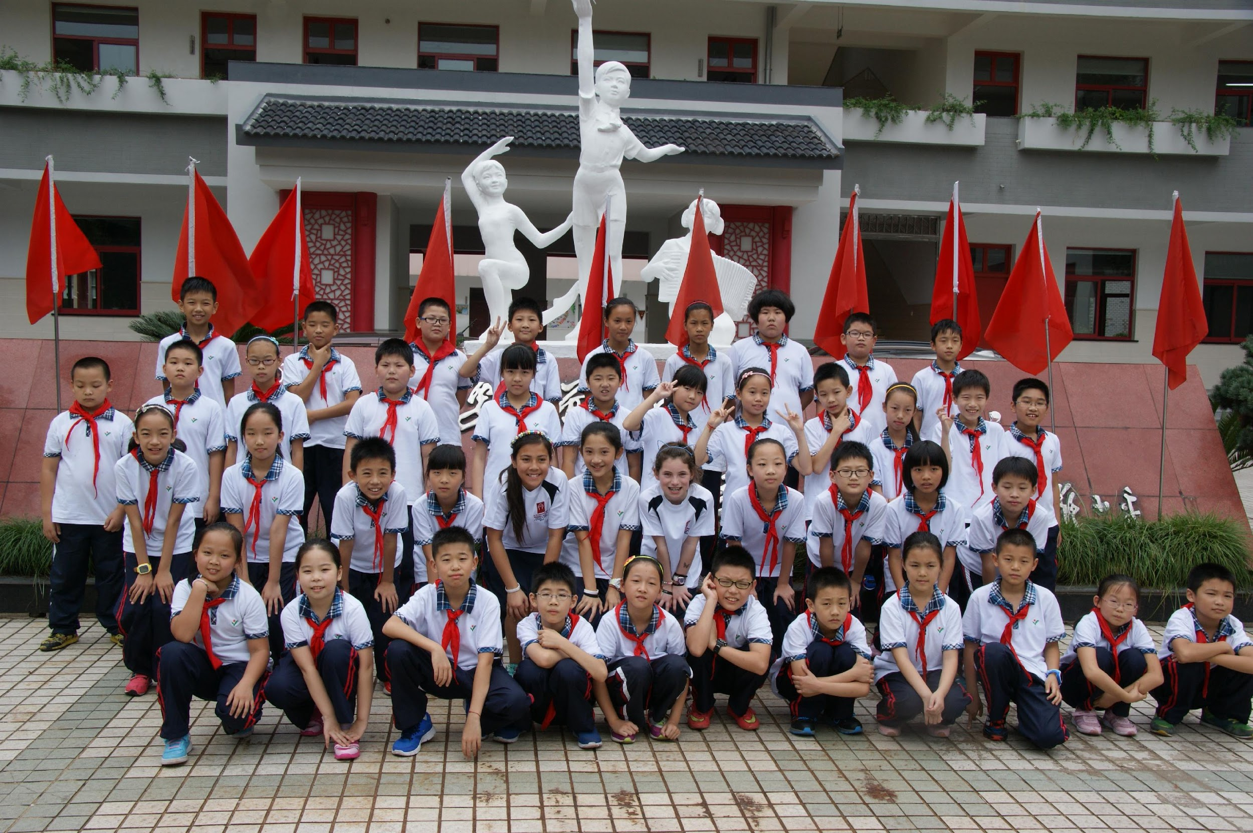
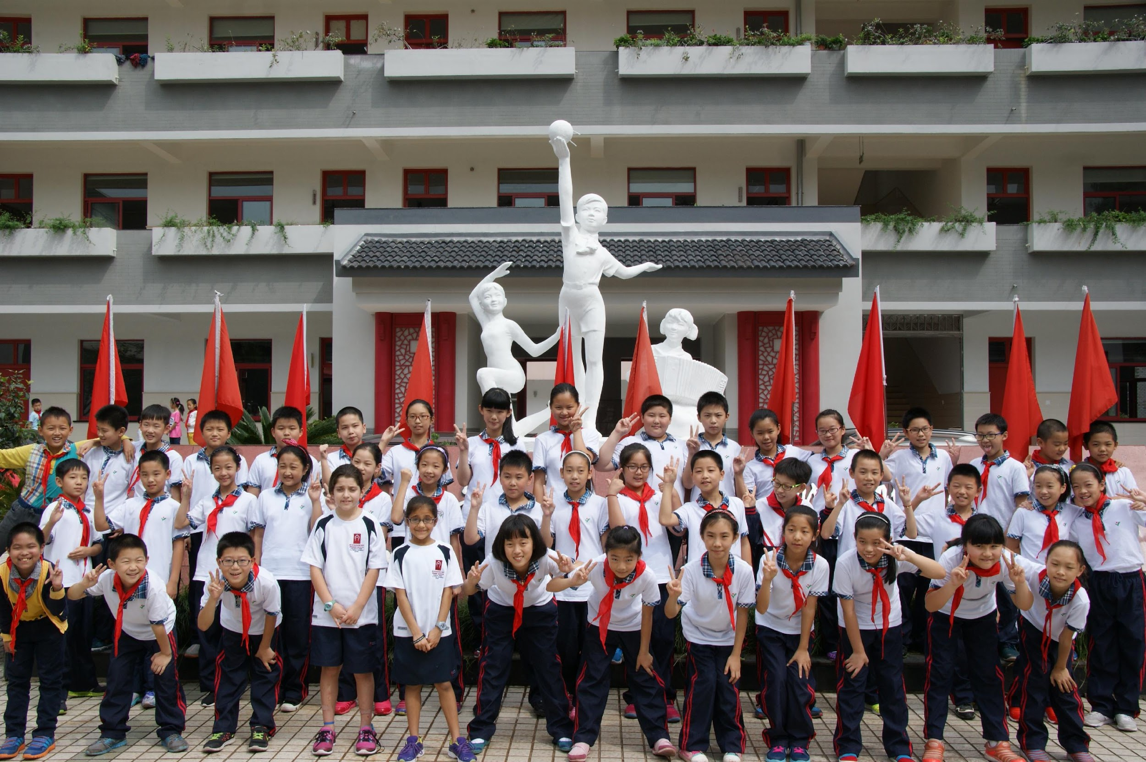

Slide 11
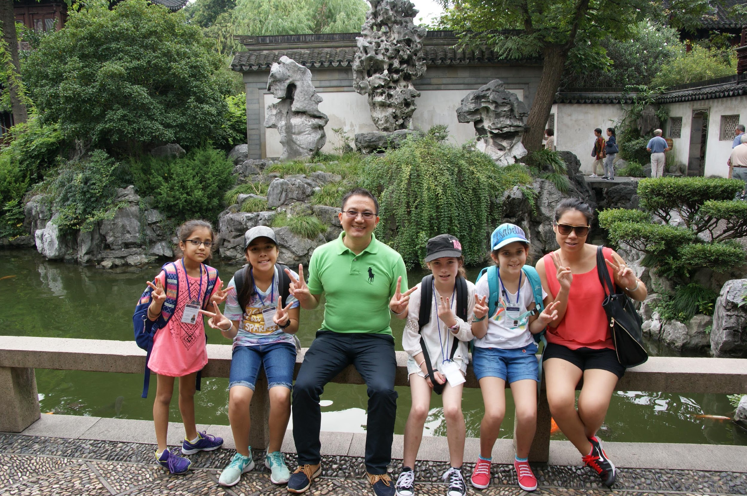
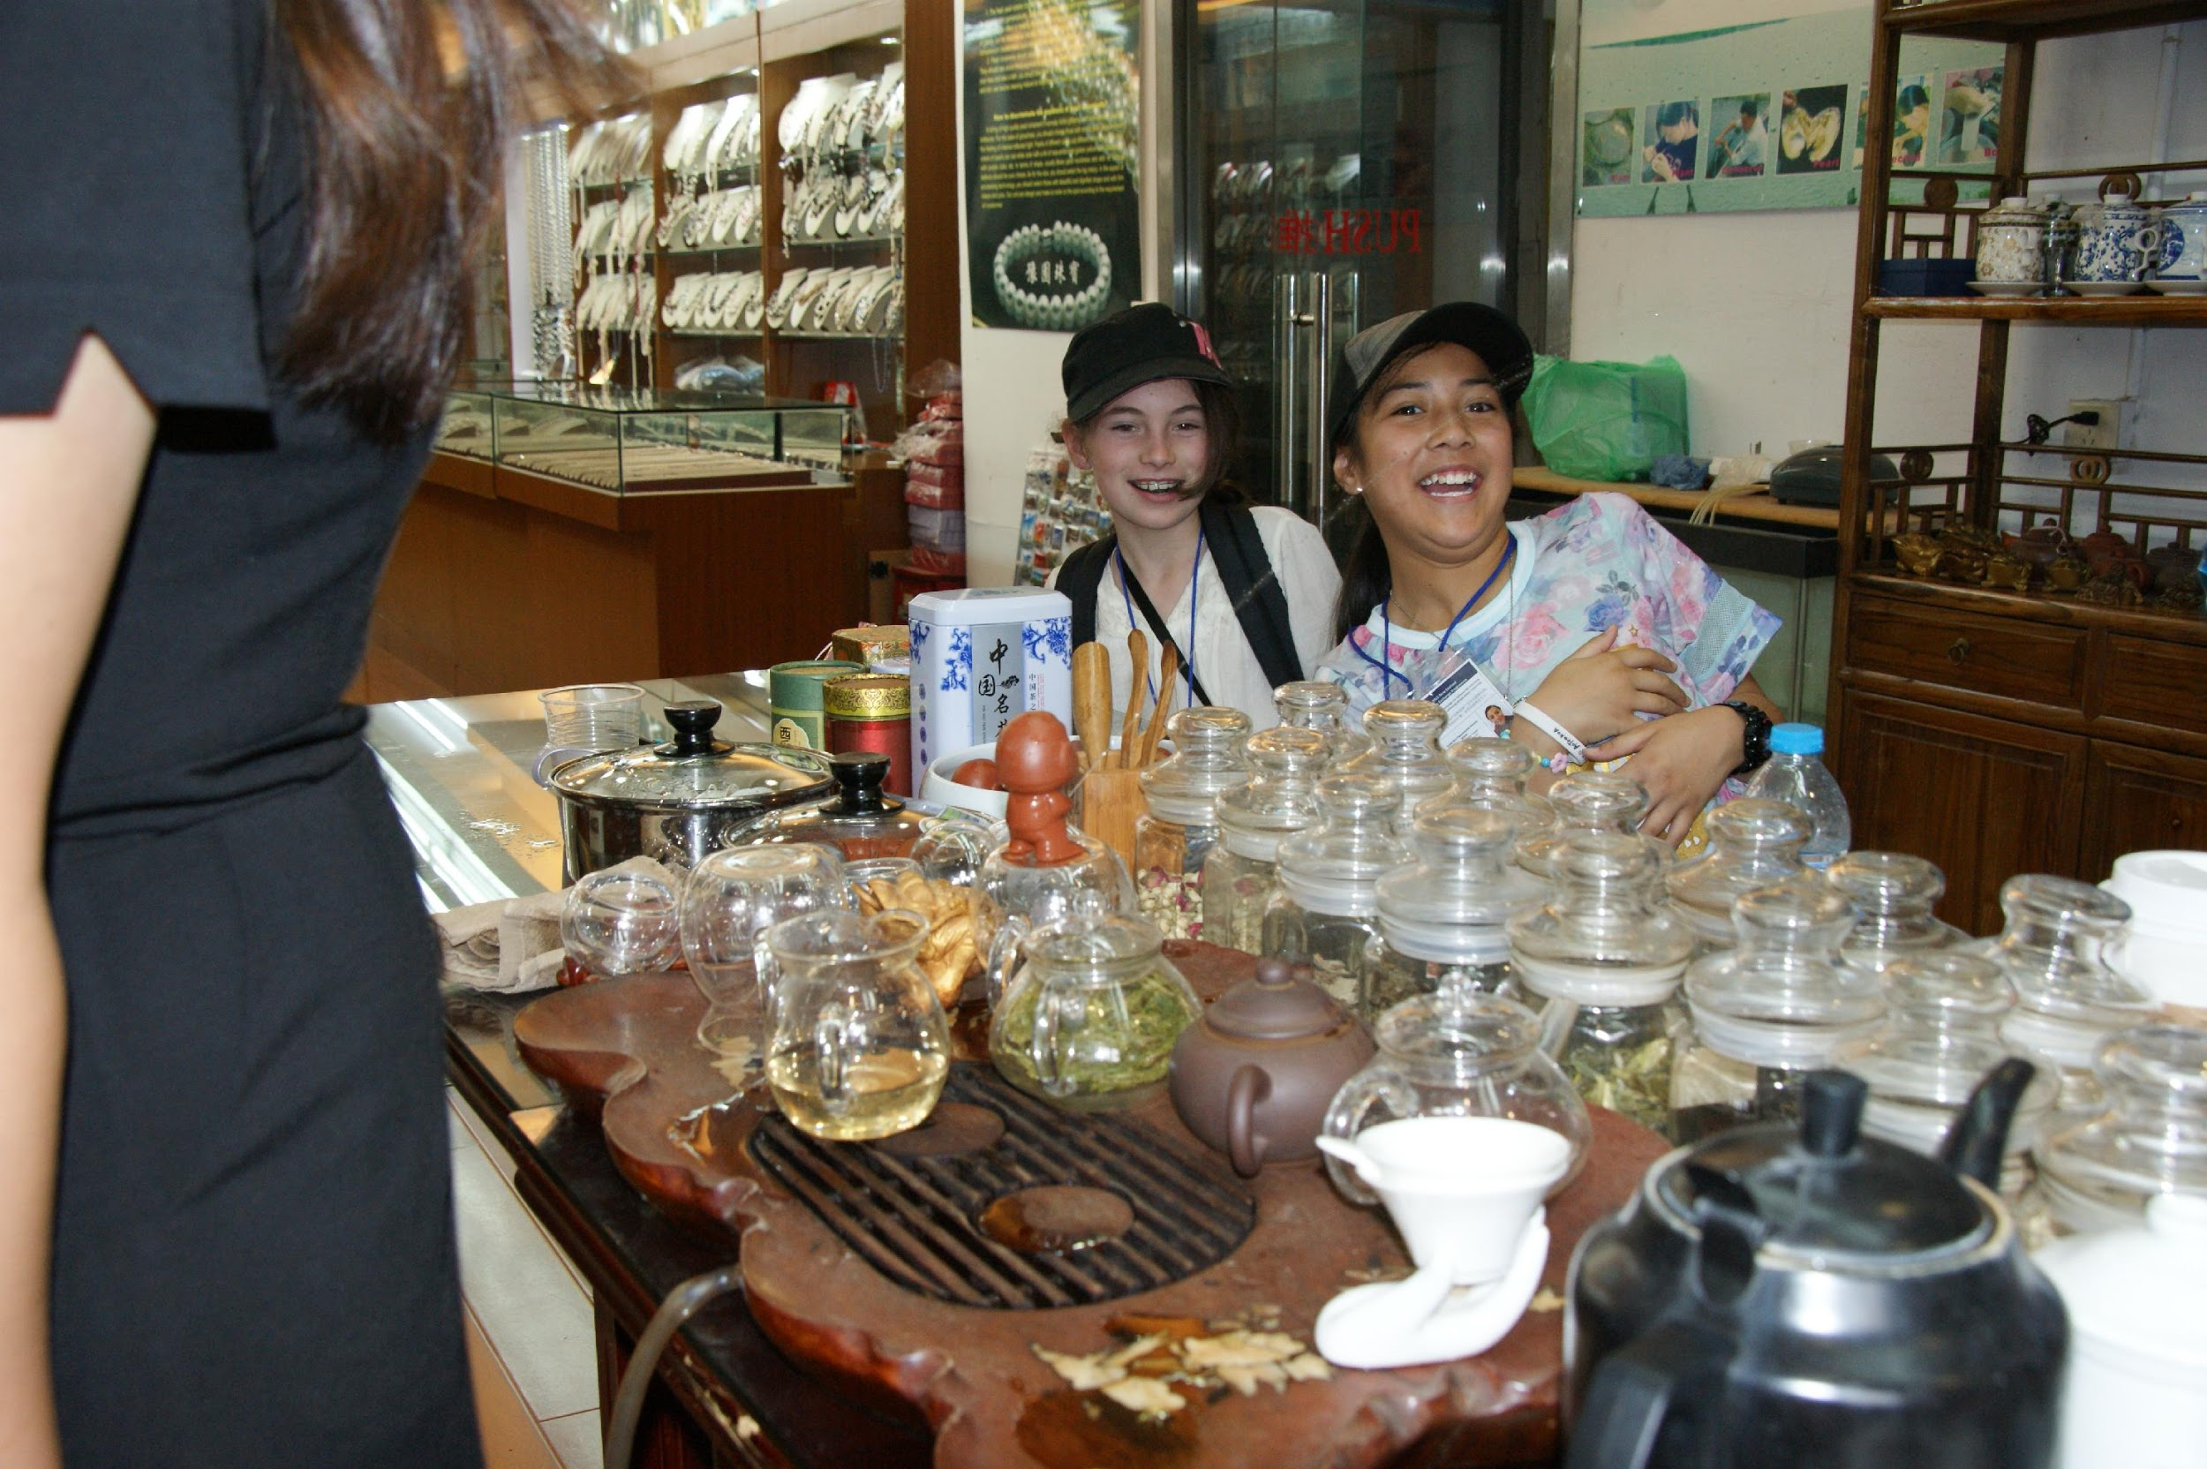
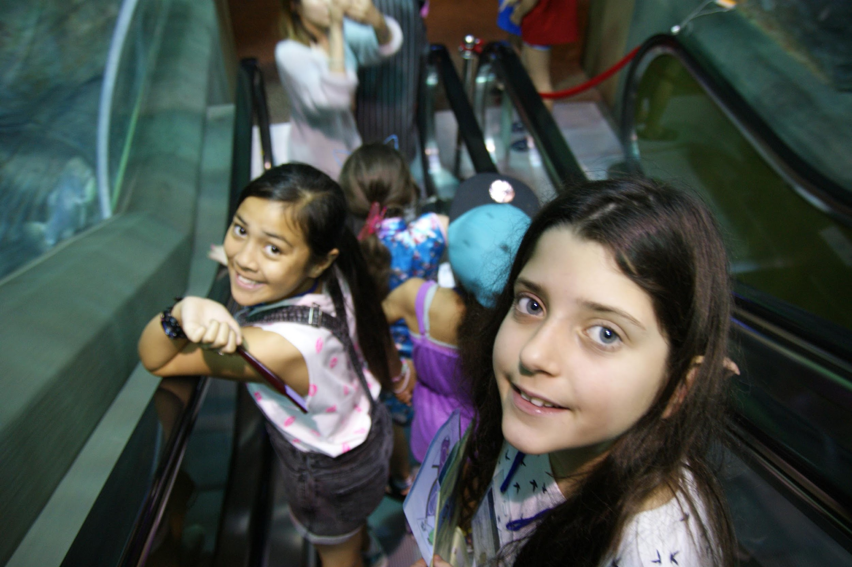
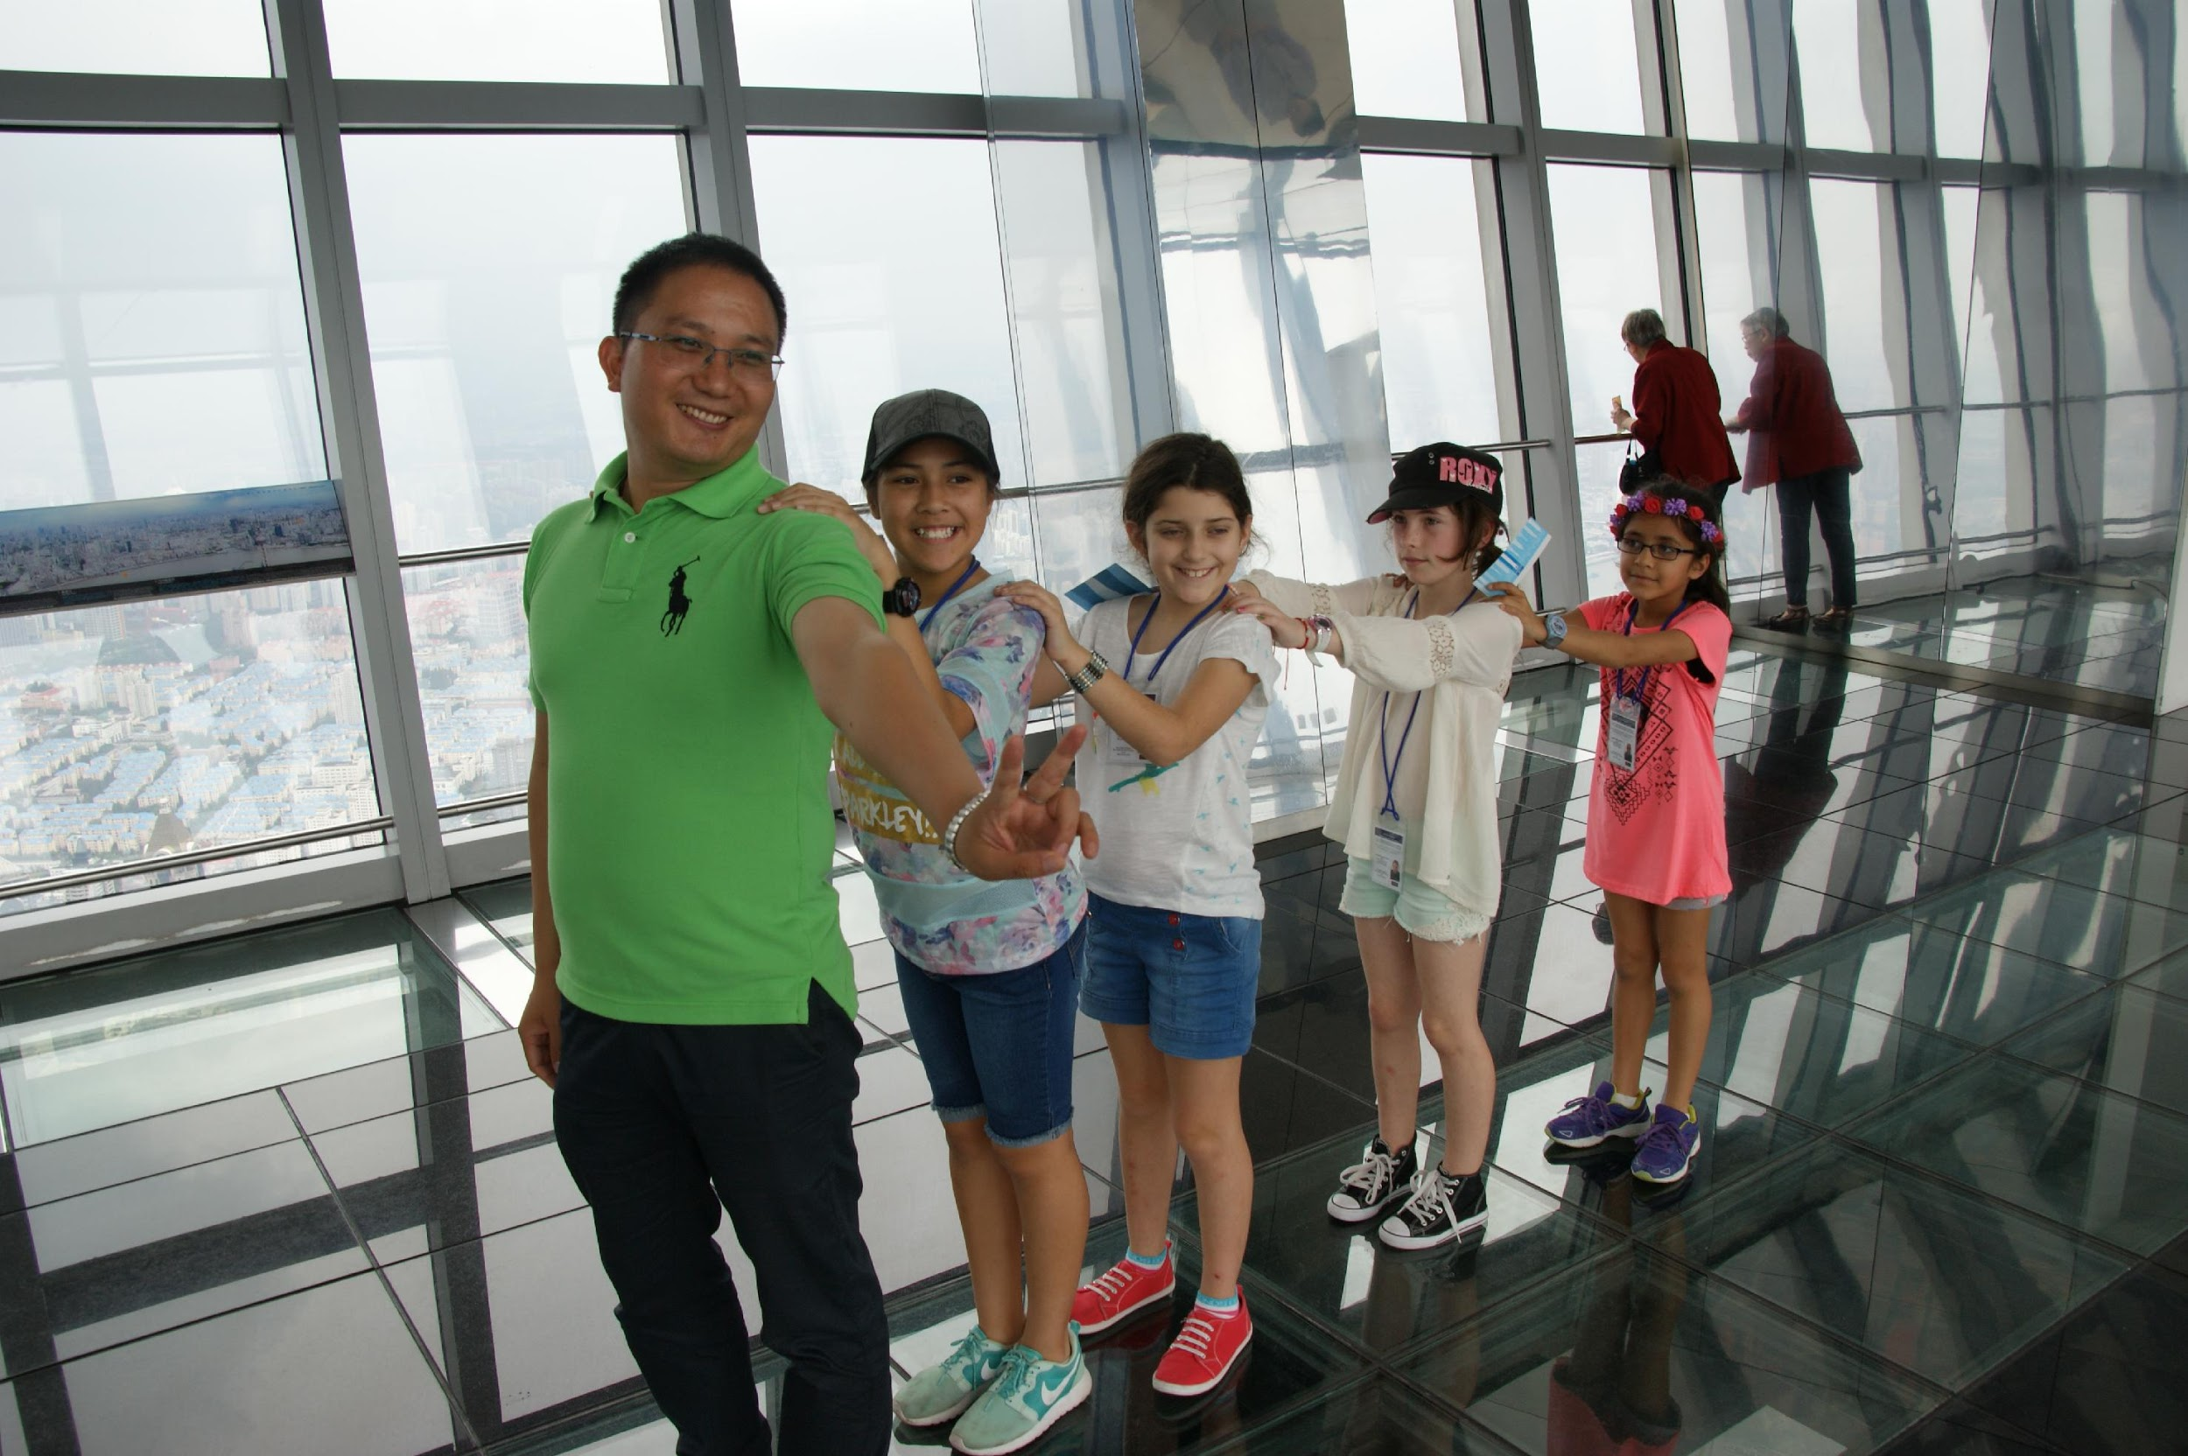

Slide 12
Parents – Fundraising and parent concerns
Fundraising opportunities were available. Sausage Sizzles at Bunnings etc.
Our students raised $1000 each towards their trip as well as some doing their own personal fundraising.
All parents sharing information, contacts, possible connections within businesses to access funds or equipment and resources for the trip.
School T-Shirts and polo tops with last names printed on the back.
Parent and student anxiety.
Children reflect their parents attitudes. The process of fundraising and coming together every month for a meeting created trust between teachers and parents. Communication via “wechat” and friendly NZ/China app. No parent policy.
Notes:
Discuss where the best places are to fundraise, how early to book in, what worked....what didnt, how important it is that if you fundraise everyone needs to be onboard, support of eachother, wechat and its benifits, othe worries.

Slide 13
Our sayings..........
If you want a holiday, go to flight centre!
This is a cultural exchange programme, there are times when what you experience may be out of your comfort zone (homestay families can be different, travel is different) there is no opting out in these situations. You are exchanging a week at Blockhouse Bay Primary for a week at Yuyao Experimental School so we say.......
Different isn't bad, it’s just different
It is important for all traveling children to understand this is a different country with its own rules and culture. This experience is a chance to appreciate a different way of life.
You get out what you put in!
We take children that are energetic, vibrant, resilient, empathetic, polite and willing to try almost anything.
Notes:
Children will get upset, homesick and tired. I always knew that they would come out the other side strong, more empathetic, resilient and possibly a thirst for more travel. There were many pep talks, a few tears and “I’m not eating that!” however with everyone on board accounted for traveling back to NZ I checked in with each girl and they were proud of what they had achieved and couldn’t wait to tell their friends about their experience.

Slide 14
End result
The children walk away with an experience of a lifetime. You cannot replicate what this company provides, The four girls that embarked and returned from this journey have all experienced the highs and lows of an international school exchange. However, they also walk away with knowledge, understanding and friendships that could span many years. Who knows what lies ahead based on this trip.
University in China? Job opportunities?
This is the Asian Century and these four students are already a step ahead!

Slide 15
Costs – please note these are our costs and from year to year these can change.
Air New Zealand Flight direct to Shanghai – estimate $1,100
Land based costs in China, this includes all meals, entry into sights and exhibitions, transport within China, accommodation – estimate $1600. Some of the cost is dependant on hotels. Having shared apartments vs double rooms.
Spending money for markets, small snacks, gift purchasing at markets and shops - $300
Total estimate cost - $3000 (this is with maximum land based cost, this is dependant on hotels and transport)

Slide 16
Timeline
November 10th 2015 - Written confirmation for 2016 trip.
November 24th 2015 - Meeting for confirmed to discuss fundraising possibilities.
February 2016 - Possible visit to New Zealand of Yuyao students. If possible we think it is important for parents with children going on the trip to take 2 students at this time.
March 2016 Booking of Flights and distribution of consent, medical forms and visa.
September 17th – September 25th 2016 - Possible trip date
Notes:
Communication and timelines are key. There is a lot of paper work that goes with a trip like this. This is an example of our timeline.

Slide 17
Documentation
Student Consent Forms
Medical Forms
Board paper work
Student Lanyards
Risk Analysis Forms
China Itinerary Documentation
Flight Itinerary
Chinese Visa Application
Student Equipment List
Listing all teachers and students on the NZ safe Travel website.
Notes:
There is a mountain of paperwork. It can all be very overwhelming however, any teacher knows that taking a student even of school grounds requires paperwork so therefor taking a student out of the country is a far larger task.

Slide 18
What’s next
Please take time to discuss this trip with all member of your family. It is a big commitment.
Please understand that it is a student/teacher trip. No parents.
Email ################### when you have made your decision stating if you would like to be a part of fundraising or opt out to pay for the trip in its entirety .
In order for the trip to be viable we require 4 students with a maximum of 10.

