Slide 1
Have you had your rice today?
Fun Facts

Slide 2
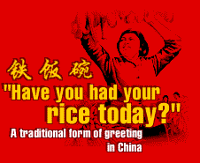
Asia
In many countries across Asia
“Have you eaten rice today?”
is a common phrase to greet your fellowmen with
and it means
“How are you?”

Slide 3
Asia
Rice is considered as the link between heaven and earth
Rice is also the symbol for fertility – hence the habit of throwing confetti at the bride and groom at weddings
Rice is regarded as a symbol of luck

Slide 4
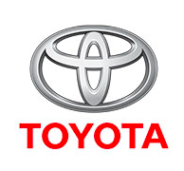
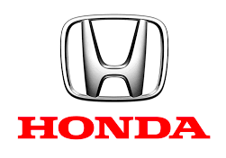
Japan
Toyota means bountiful rice field
and
Honda means main rice field.

Slide 5
Japan
Japanese meal names are based around rice:
Breakfast = 'Morning Rice' = asa gohan Lunch = 'Afternoon Rice' = hiru gohan Dinner = 'Evening Rice' = ban gohan

Slide 6
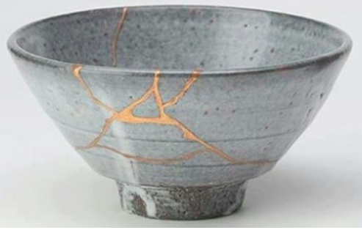
Singapore
In Singapore a good job is symbolised by an
iron bowl, and being out of a job,
a broken rice bowl.

Slide 7
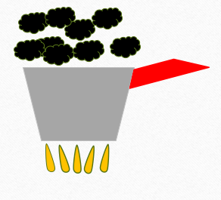
China
At the beginning of the new year, people do not say, "Happy New Year!" but
"May your rice never burn!”

Slide 8
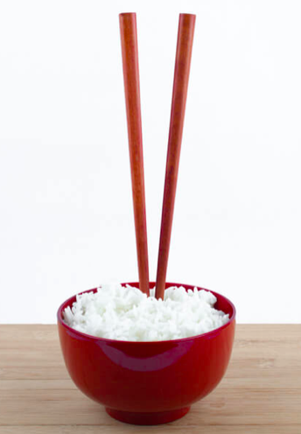
Japan
Death is symbolised by chopsticks stuck into a mount of rice. This gesture is used at funerals to symbolise the passing on of the dead person’s soul.

Slide 9
Brainstorm
Rice pudding
Pilaf
Risotto
Sushi
Congee
Fried Rice
Biryani
Jeera rice

