Slide 1
So how healthy is your rice?
Disassembly of rice into components and nutrition

Slide 2
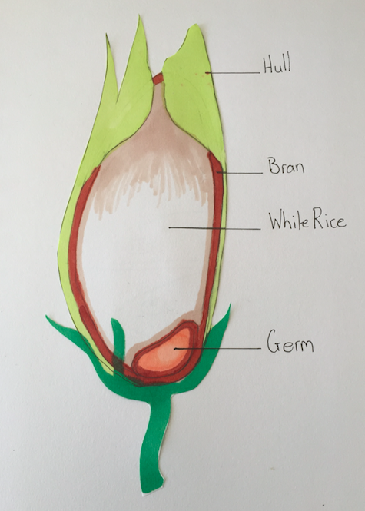
Anatomy of the rice grain

Slide 3
Anatomy of the rice grain
The husk is the outermost layer of the rice and is made of two overlocking halves. The purpose of the husk is to protect the rice and is removed during the milling process
The bran layer is the most nutritious part of the grain and is made up of:
fibre
Vitamin B complex
Protein
Fat
When the bran is left in tact it creates brown rice
The most inner part is the rice kernel, which is composed mainly of starch
After the milling process the kernel creates white rice
At the base of each grain is an embryo or germ, which if planted will grow into a new plant

Slide 4
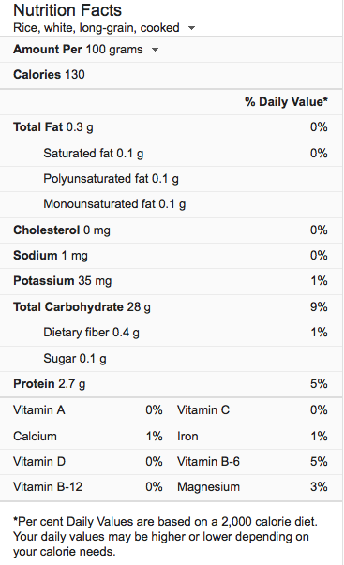

Slide 5

Vitamin deficiencies in rice-eating populations
Rice is the staple food in many countries of Asia
Rice eating populations generally suffer from Vitamin A, Riboflavin and energy deficiencies
Dry skin
Poor night vision
Weak immune system
Lack of energy

Slide 6
Video: Healthier rice for healthier people
MALNUTRITION: is a condition that results from eating a diet lacking in nutrients such as calories, protein, carbohydrates, vitamins or minerals.
HIDDEN HUNGER: or micronutrient deficiency, occurs when people don't get enough vitamins and minerals in their diet.
ANAEMIA: Is the result due to a lack of Iron in the diet.
Vitamin B12: The main source is animal derived foods and many vegetarians needs to take an additive on a daily basis.
FORTIFICATION: Food fortification is the enrichment of food with micronutrients.

Slide 7
What can we do to improve the nutritional value of a rice dish?
While scientists are working hard at improving the nutrition of natural rice, we need to make an effort to improve our rice based meals.
TIPS
Adding dark green leafy vegetables and deep yellow fruits will prevent vitamin A deficiency
Eggs, milk or milk products, meat and fresh fruit will improve iron intake
exposure to sunlight, moderate exercise will tackle the Vitamin D problem
The combination of rice with other healthy foods, may contribute to improvements in physical and mental health

Slide 8
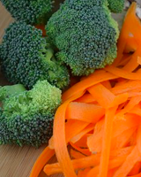
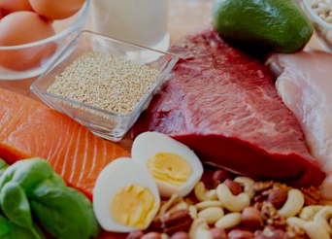
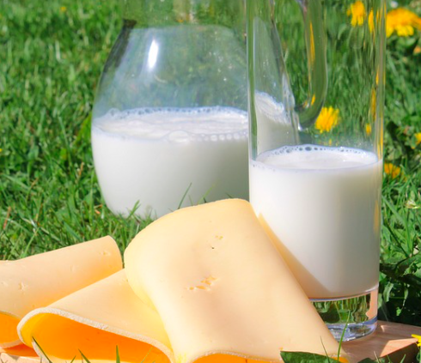
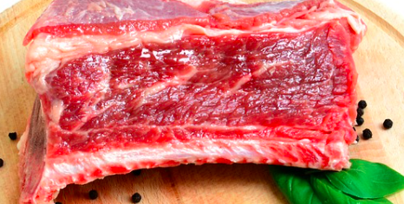
Foods rich in:
Vitamin A Leafy, Green and orange coloured vegetables | Vitamin B12 Meat and dairy products
Calcium Milk and cheese and other dairy products | Iron Red beef and lamb

