Slide 1
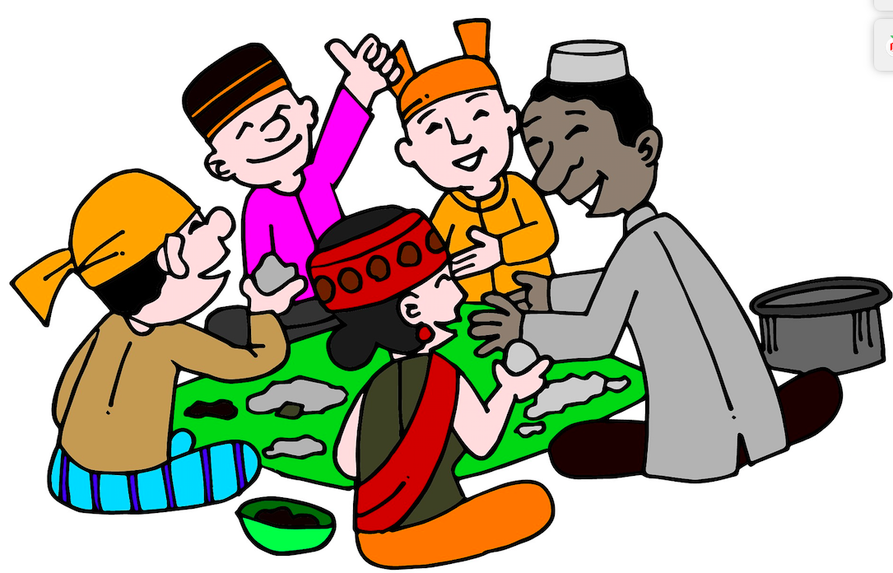
Rice festivals in India and Japan

Slide 2
Japan
The Japanese Moon Festival, or Otsukimi, is a time for introspection and gazing at the moon, a practice known as tsukimi. Again, rice-based dishes are a signature here, with tsukimi dango (rice-flour dumplings) enjoyed by one and all.
O-Taue Matsuri - rice-planting festival - is held every June in Taga Taisha shrine in Shiga Prefecture.

Slide 3
India - Makar Sankranti
This is the oldest and most colourful harvest festival in India.
Makar Sankranti is celebrated with music, bonfires, dances and snacks like peanuts and popcorn
The older woman cook meals throughout the day
In the morning people donate generous portions of black lentils, rice sesame and jiggery to the poor and needy
People take a dip in the holy Ganges river

Slide 4
India-Hindu's Pongal Festival
The Pongal festival is dedicated to the cycle of growing and harvesting food, especially rice as it is Asia’s staple food. It celebrates the rice harvesting period.
Pongal is a four day festival mainly celebrated by the Tamil.
Pongal rice dish served as a breakfast meal is usually a sweet rice dish flavoured with coconut and jaggery.
Jaggery is a concentrated mixture of cane and palm sugar.

Slide 5
India – Assam
This is a rice festival celebrated by bonfires and serving various kinds of rice fritters.
India – Nuakhai
Nuakhai is popular in India and in the Odisha region ‘nua’ means new and
‘khai’ means food. Key attractions of Nuakhai festival are the delicious Arsaa Pitha (sweet pancakes).
India -Nabanna The festival of the new harvest
This rice festival is celebrated in West Bengal. The rice is cheerfully harvested and then stocked in the farmers’ homes. The first grains are offered to the goddess Lakshmi to thank her for all the blessings. The key attractions of Nabanna festival is Payesh (Kheer) made from the newly harvested rice.

Slide 6
Poster Time!
Pick a festival for your poster
Japanese Moon Festival (Otsukimi)
O-Taue Matsuri
Makar Sankranti
Pongal festival
Assam Festival
Nuakhai Festival
Nabanna festival

