Slide 1

STRATEGIC PLAN
2013
New Zealand and the Association of South East Asian Nations (ASEAN)

Slide 2
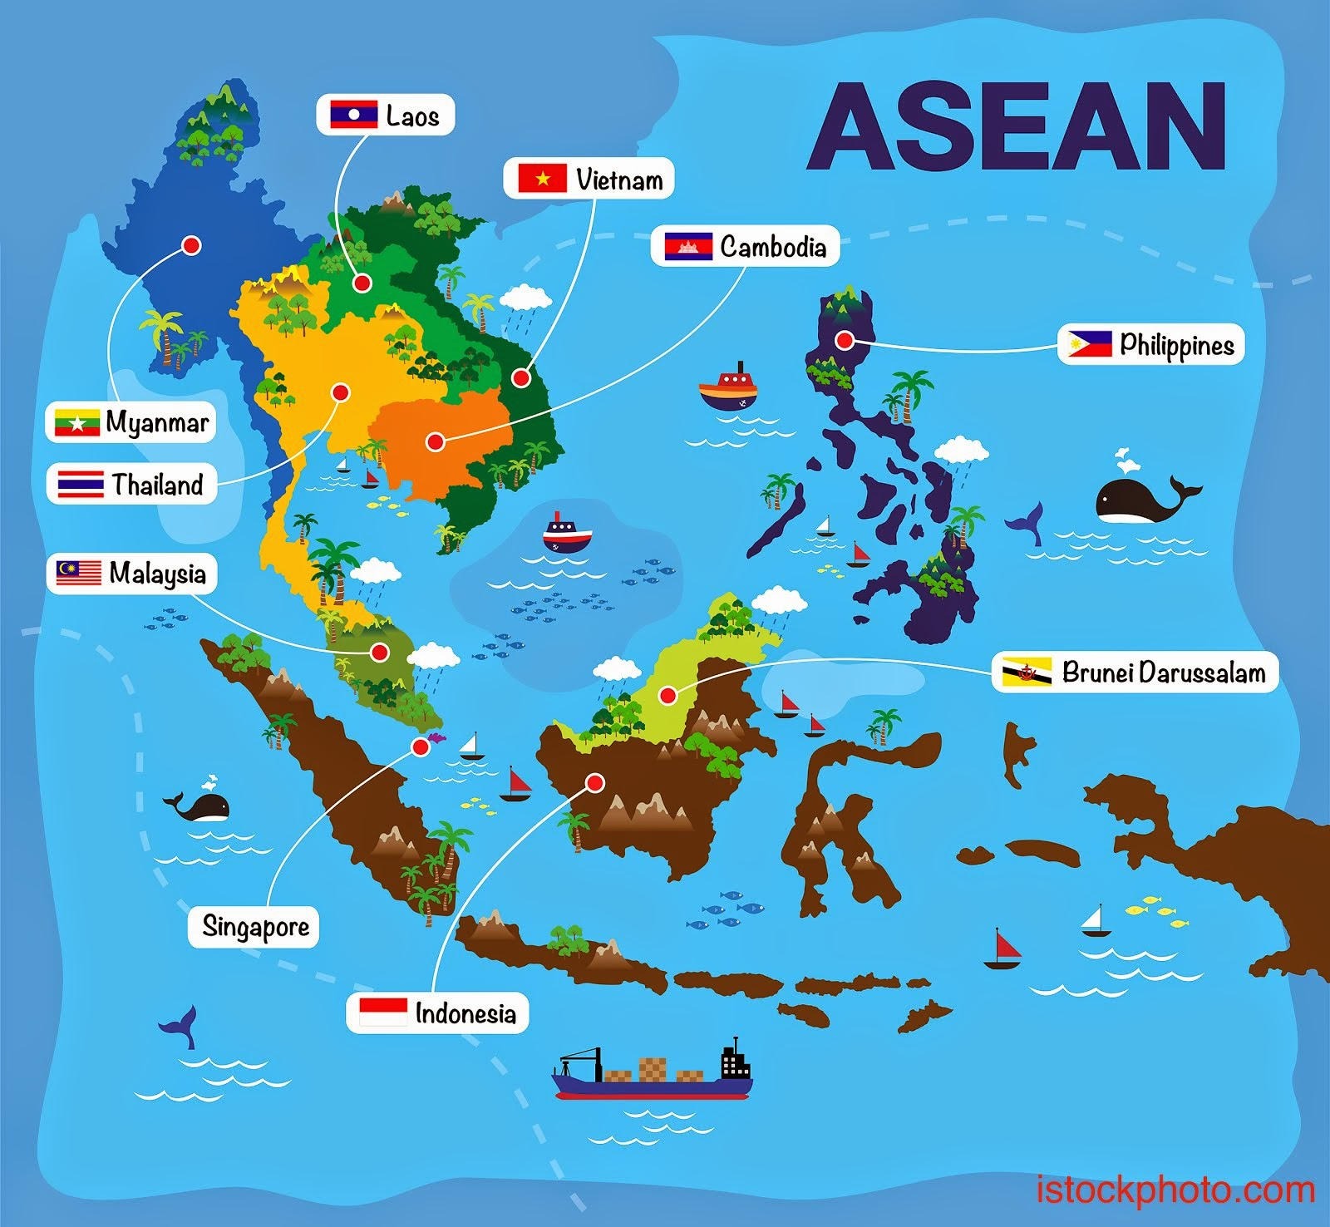
www.dreamstime.com

Slide 3
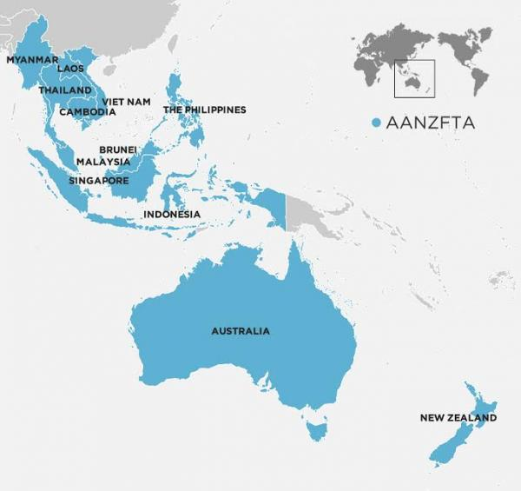
AANZFTA (ASEAN Australian New Zealand free trade agreement) is a free trade agreement between New Zealand, Australia and ASEAN.
It makes it easier for New Zealand producers to export their products into ASEAN because there are less barriers such as costs and regulations.
New Zealand's major goods exported to ASEAN are milk powder, butter and dairy spreads, cheese
New Zealand's major imports from ASEAN are crude and non-crude petroleum oils, waste oil, biodiesel, trucks and vans
www.mfat.govt.nz

Slide 4
ASEAN-NZ trade – year ended March 2017
ASEAN-NZ trade, investment and migration year ended March 2017
www.stats.govt.nz
Exports to ASEAN
NZ$ million
Goods | 4,678
Services | 1,358
Total | 6,036
Imports from ASEAN
NZ$ millions
Goods | 6,753
Services | 1,812
Total | 8,565

Slide 5
South East Asia – key features
Key features of ASEAN
$US2 trillion consumer spending
670 million people
A youthful population with a median age of 30 years in 2020
135 million smartphone users in 2015
The packaged food and drink sector South East Asia September 2016
http://www.pwc.com.au

Slide 6
ASEAN country study
In teams you are to carry out an inquiry into an ASEAN country.
The purpose of this study is to present information that a producer would need to know before they consider selling their product in the region.
The type of information could include:
Population size, median age, GDP per capita, languages spoken, what the people are interested in, what foods they like most……
Present your findings as a visual to share with the class. Your visual could include: video, photographs, diagrams….

Slide 7

www.asianz.org.nz

