Slide 1
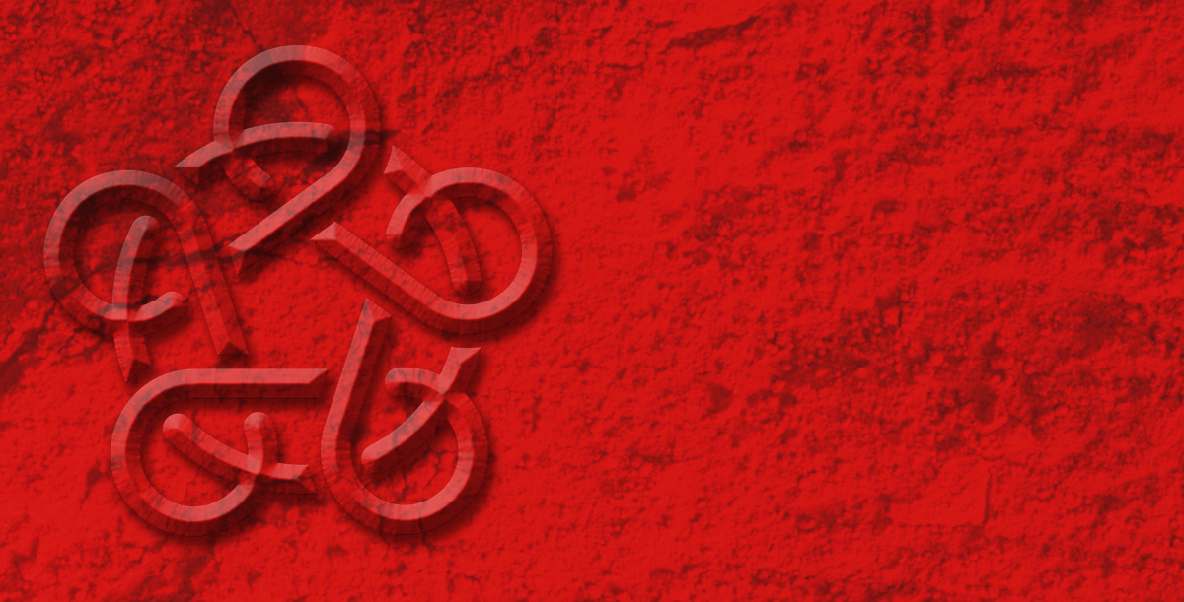
STRATEGIC PLAN
2013
Would you eat these foods?

Slide 2
This fruit is Durian.
Durian is popular in Malaysia and Singapore.
It has a hard surface and has a very pungent smell but tastes sweet and creamy.

Slide 3
These are Chicken feet.
Chicken feet are popular in China.
They sometimes are very chewy.

Slide 4
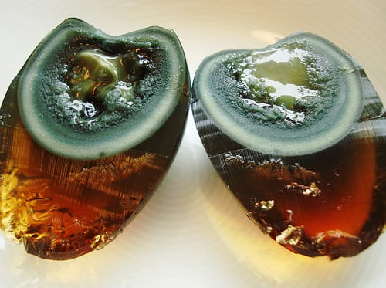
This is a Century egg.
Century eggs are popular in China.
They are preserved duck or quail eggs.
They taste different to chicken eggs we eat.

Slide 5
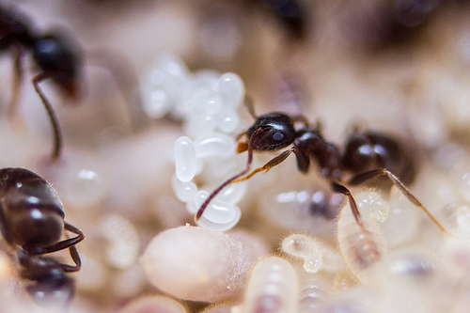
These are White ant eggs.
White ant eggs are popular in South East Asia.
They are sometimes in soups. They pop in your mouth and are sour.

Slide 6
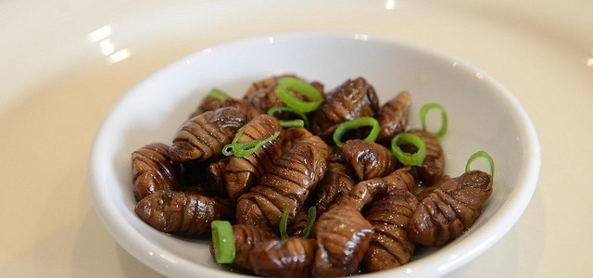
These are Beondegi.
Beondegi are popular in Korea.
Beondegi means chrysalis and are the pupa of silkworms.

Slide 7
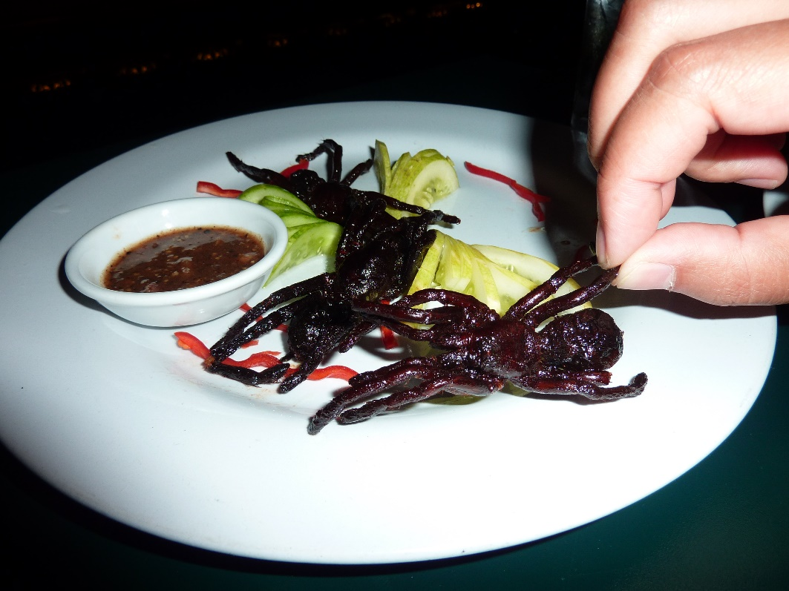
These are tarantulas.
Tarantulas are popular in Cambodia.
Some people think they taste a bit like chicken.

Slide 8
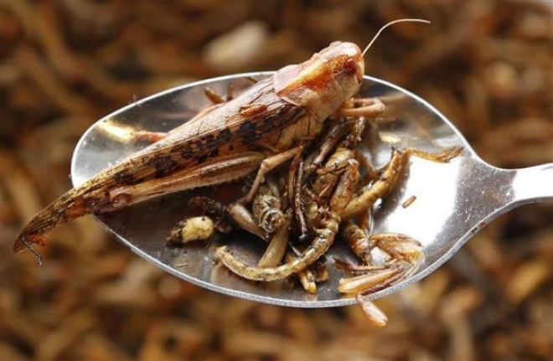
These are crickets and grasshoppers.
Crickets and grasshoppers are popular in Japan.
They add crunch to a dish.

Slide 9
www.asianz.org.nz

