Slide 1

STRATEGIC PLAN
2013
Do I come from Asia?

Slide 2
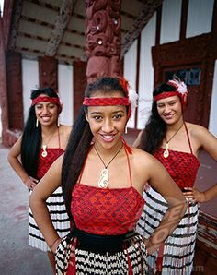

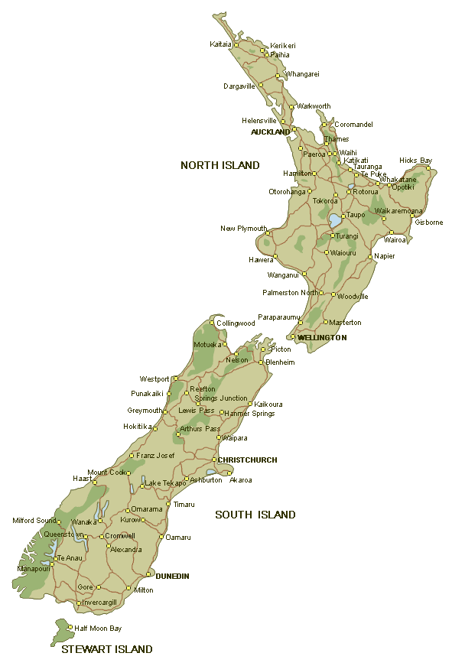
Do we come from Asia?

Slide 3
No, we don’t come from Asia.
We come from New Zealand.

Slide 4
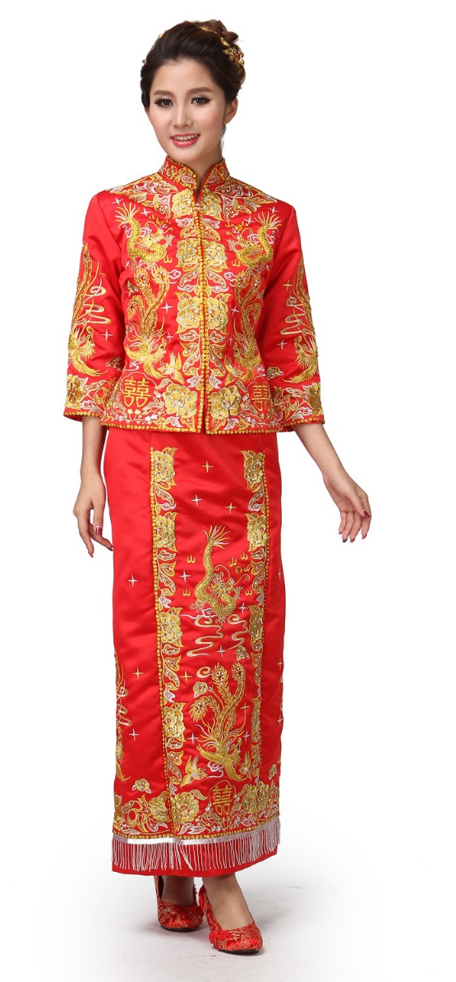

Do I come from Asia?

Slide 5
Yes, I do come from Asia.
I’m from China.

Slide 6

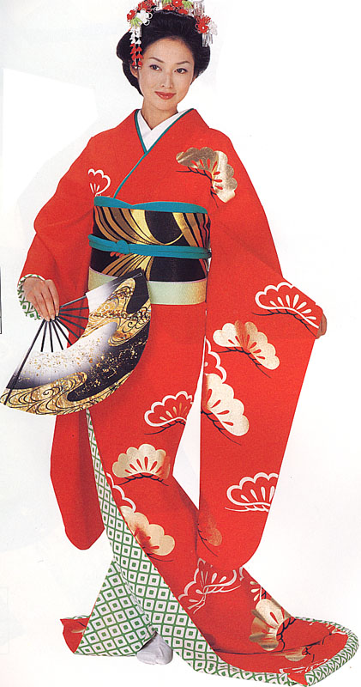
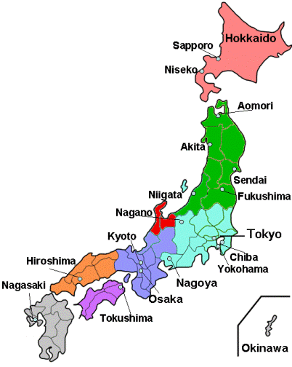
Do I come from Asia?

Slide 7
Yes, I do come from Asia.
I’m from Japan.

Slide 8

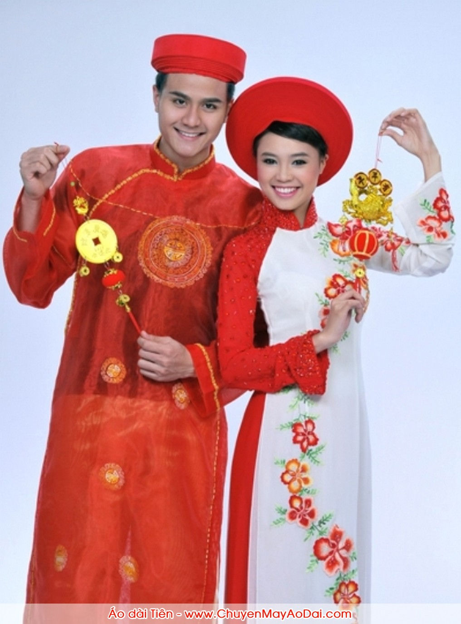
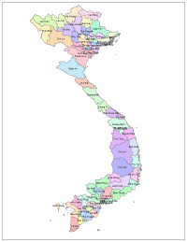
Do we come from Asia?

Slide 9
Yes, we do come from Asia.
We come from Vietnam.

Slide 10


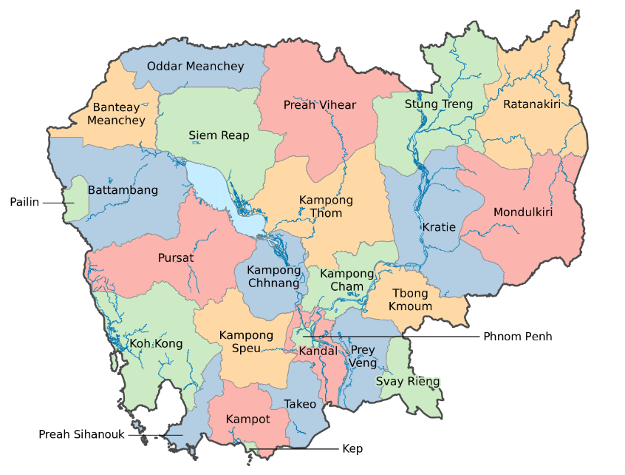
Do I come from Asia?

Slide 11
Yes, I do come from Asia.
I’m from Cambodia.

Slide 12
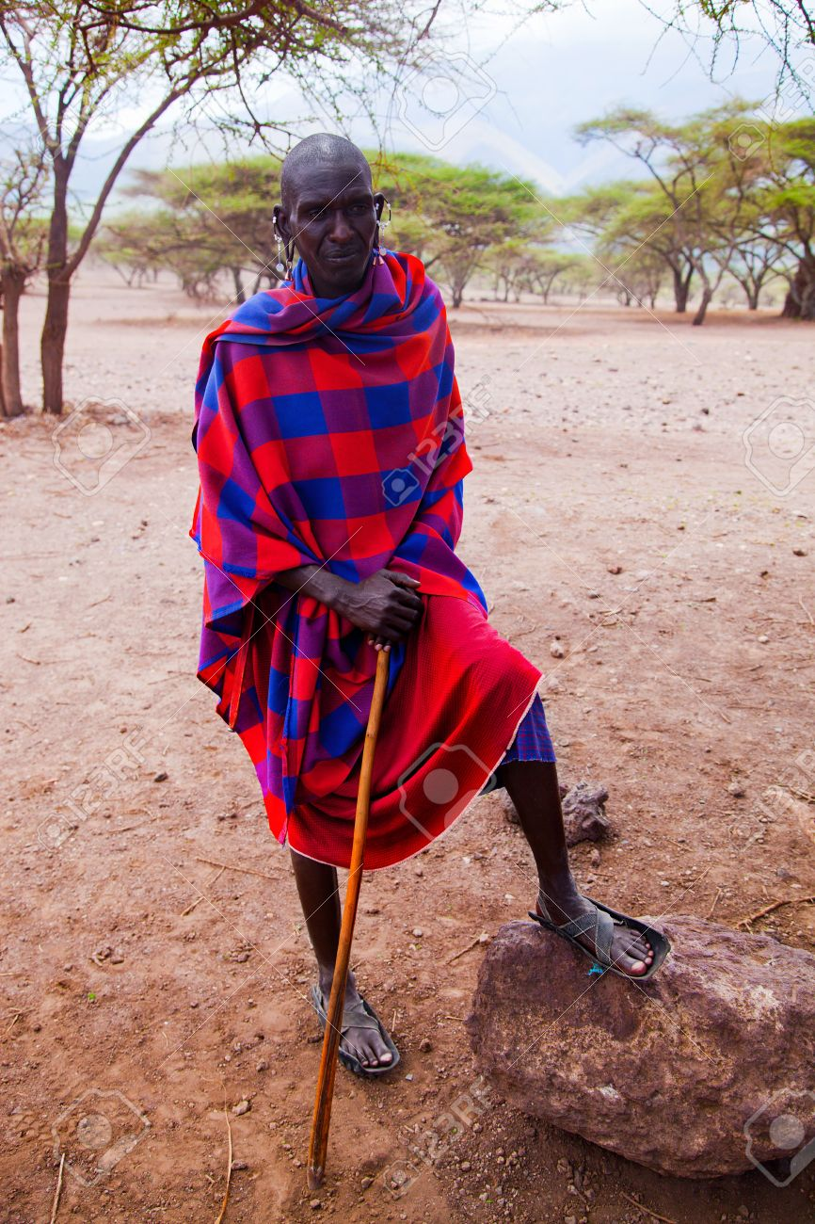

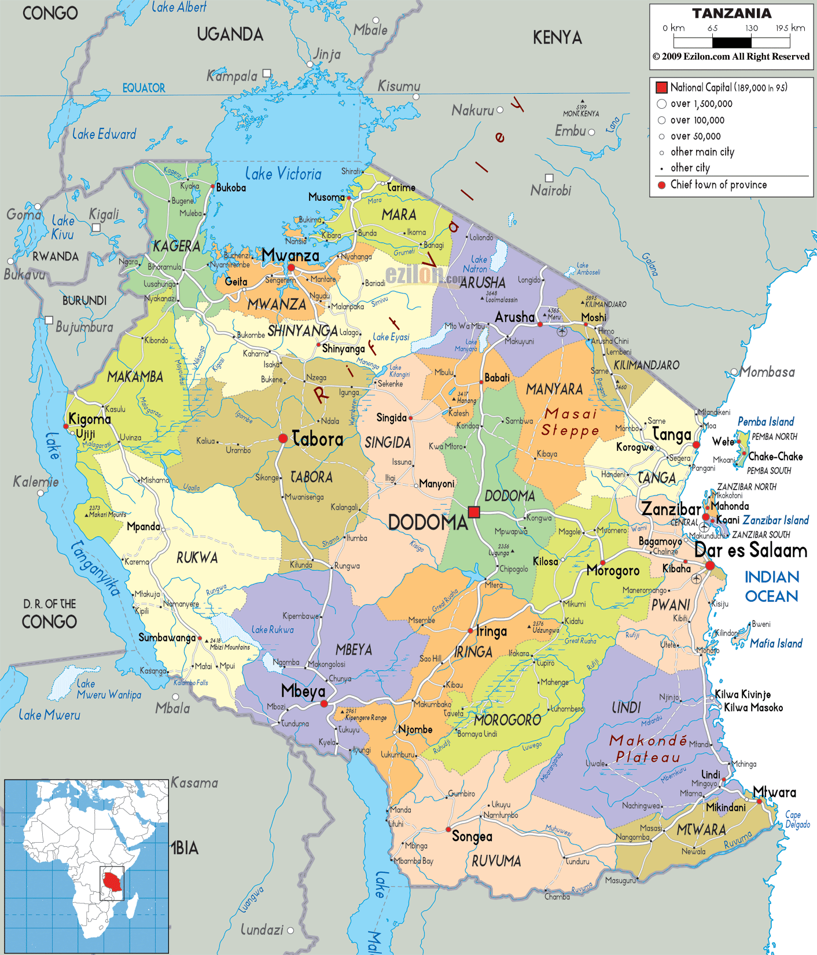
Do I come from Asia?

Slide 13
No, I don’t come from Asia.
I’m from Tanzania.

Slide 14

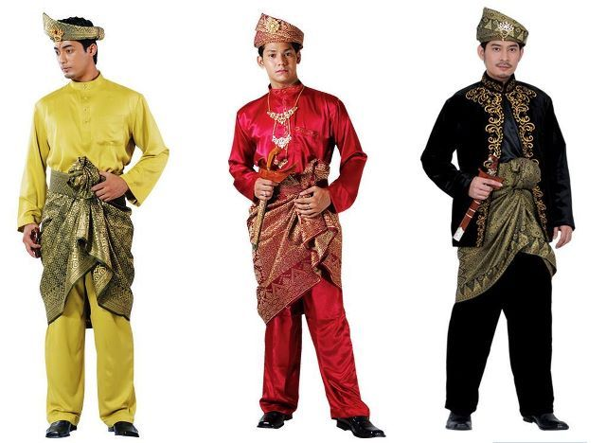
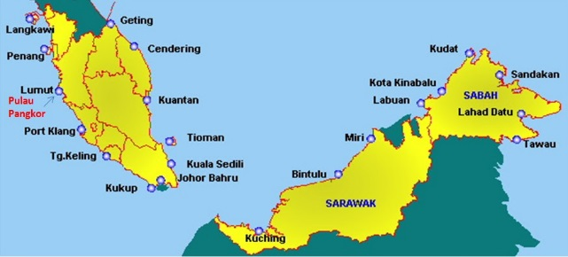
Do we come from Asia?

Slide 15
Yes, we do come from Asia.
We come from Malaysia.

Slide 16
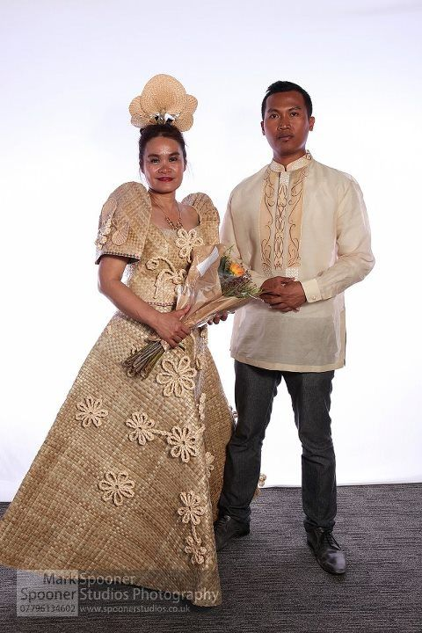

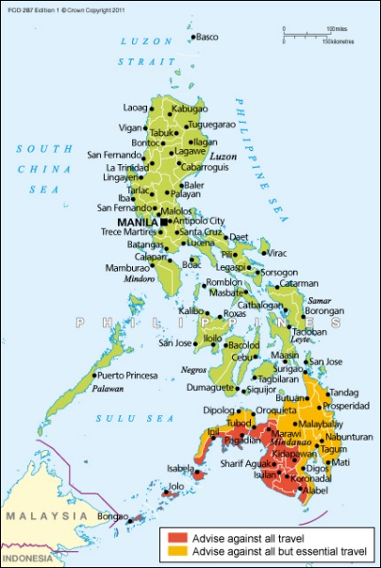
Do we come from Asia?

Slide 17
Yes, we do come from Asia.
We come from the Philippines.

Slide 18

www.asianz.org.nz

