Slide 1
AFSP Research Grant Roundtable
Jill Harkavy-Friedman, PhD
July 8, 2021

Slide 2
AFSP’s Vision, Position and Bold Goal
Vision: A world without suicide
Position: Leading the fight to prevent suicide
Bold Goal: To reduce the suicide rate in the U.S. by 20% by 2025

Slide 3
AFSP’s approach is comprehensive
Funds scientific research
Offers educational programs for professionals
Educates the public about causes, prevention
Promotes policies and legislation
Provides support, information, opportunities for involvement for those bereaved by suicide, people at risk and their families

Slide 4
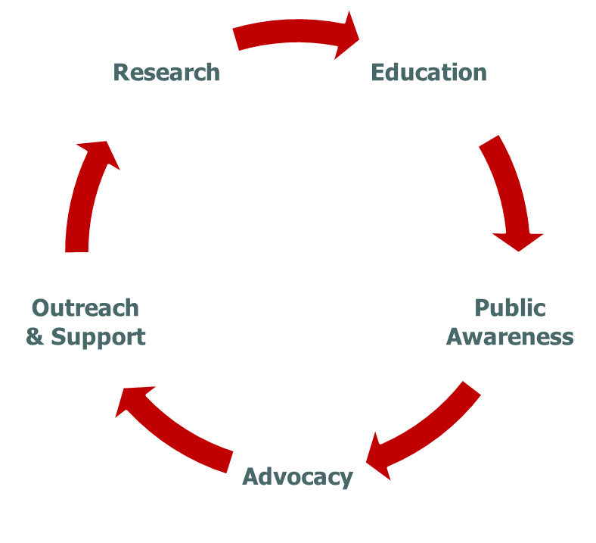
A sustainable, growing resource
Five Core Strategies

Slide 5
AFSP Research Strategic Plan
Goal: Advance the scientific knowledge needed to reduce the suicide rate
Significantly increase investment in research
Expand the scope of AFSP’s funded research across the spectrum of suicide prevention
Increase the impact of AFSP funded research by improving quality, breadth, depth, and communicate results

Slide 6
AFSP’s current research investment
Funding $6.43M new scientific studies this year
35 Innovation grants
2 Focus Grants
40% were resubmissions
Currently over 100 active grants
Over $22 million in current research

Slide 7
Types of Research Supported by AFSP
Neurobiological studies
Genetic studies
Psychosocial studies
Clinical treatment studies
Community intervention studies
Survivors of suicide loss studies

Slide 8
TYPES OF GRANTS
Distinguished Investigator Grant
Standard Research Grant
Young Investigator Grant
Postdoctoral Research Grant
Pilot Study Grant
Linked Standard Research Grant
Focus Grants

Slide 9
Focus Grants
Fund up to two 3-year grants. LOI required. up to $1.5M
RFA’s in 3 areas:
Short-term risk
Reaching 20% by 2025
Blue Sky

Slide 10
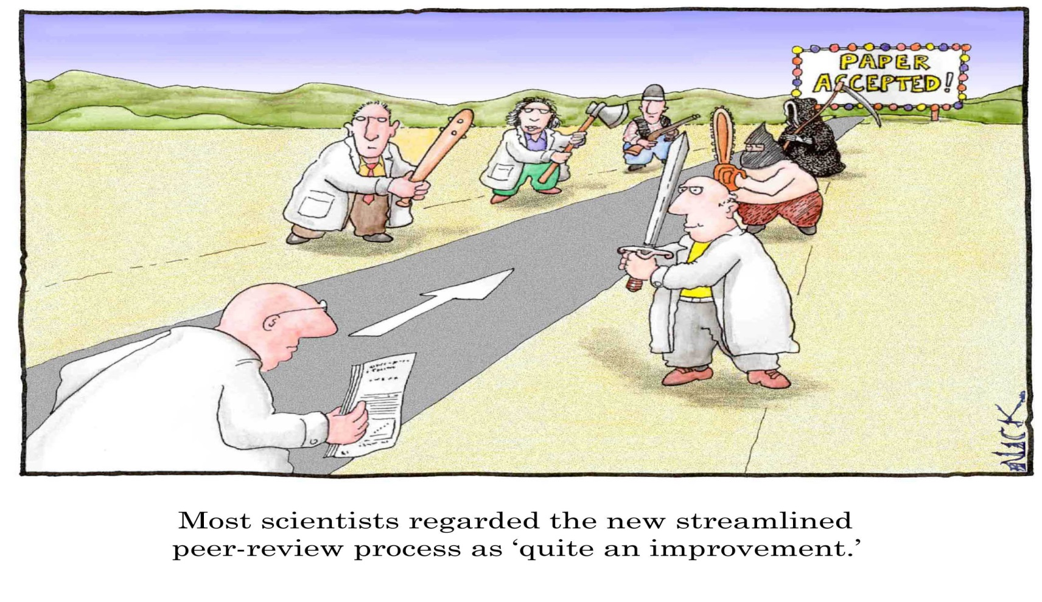
Grant Submission and Review Process

Slide 11
Review Process
Application submitted November 15, 2021
Staff review for appropriateness for AFSP
Assigned to two outside expert reviewers
Better-scoring applications assigned to one member of the RGC
Top applications presented for discussion, review and scoring at the RGC meeting

Slide 12
Scoring results and Recommendations are presented by AFSP staff to Scientific Board and Board of Directors for Approval in May 2022 Critical feedback provided to all applicants and meritorious applications are funded (based on the availability of funds) We allow up to two revised resubmissions
Review Process- continued

Slide 13
Timetable
REVIEW CYCLE | DUE DATE | REVIEW DATES | FUNDING DECISIONS | EARLIEST START DATE
All Grants | Nov. 15, 2021 (Focus LOI Aug.1; Invited applicants Dec. 2021) LSRG LOI Sep. 15 | Spring 2022 | End of May 2022 | July 2022

Slide 14
Ideal Study
Innovative
Includes suicide outcome measure
Ultimately has potential impact on suicide
Sound methodology
Investigator(s) with relevant expertise
Evidence of feasibility
Investigator(s) with ongoing interest in suicide research
Expertise represented among investigators
Adheres to Grant Procedure Manual

Slide 15
Application process
Everything you need to know can be found at:
afsp.org/research
Contact us at: grantrsmanager@afsp.org

Slide 16
Save Lives and Bring Hope to those affected by suicide

Slide 17
Thank you

Slide 18
@afspnational

