Slide 1
Introduction to Implementation Science with Examples in Suicide Research
Gregory K. Brown, PhD
Department of Psychology, Perelman School of Medicine of the University of Pennsylvania
Sara J. Landes, PhD
Behavioral Health QUERI, Central Arkansas Veterans Healthcare System
Department of Psychiatry, University of Arkansas for Medical Sciences
Edwin D. Boudreaux, PhD
Departments of Emergency Medicine, Psychiatry, and Population and Quantitative Health Sciences, University of Massachusetts Medical School

Slide 2
Disclosure
Drs. Brown, Landes, and Boudreaux have no relevant financial conflicts of interest to disclose.

Slide 3
Learning Objectives
Describe implementation science
Define implementation science terms and provide resources
Provide two examples of projects that evaluate the implementation of evidence-based interventions to reduce suicide risk:
Implementation of Caring Contacts
Implementation of the Safety Planning Intervention

Slide 4
What is implementation science?
Eccles & Mittman, Implementation Science, 2006
“The scientific study of methods to promote the systematic uptake of research findings and other evidence-based practices into routine care…”

Slide 5
When defining implementation science, some very non-scientific language can be helpful…
The intervention/practice/innovation is THE THING
Effectiveness research looks at whether THE THING works
Implementation research looks at how best to help people/places DO THE THING
Implementation strategies are the stuff we do to try to help people/places DO THE THING
Main implementation outcomes are HOW MUCH and HOW WELL they DO THE THING
Curran, 2020
Notes:
Implementation science differs from intervention research in that it focuses on the strategies used to implement evidence-based practices, rather than on intervention effectiveness.

Slide 6
Why should you think about implementation research?

Slide 7
If individuals are at risk for suicide in your treatment setting, would you want clinicians to use an evidenced-based intervention to reduce this risk?
?
I’ve had the worst week of my life. I feel so ashamed that I just don’t know if I can take it anymore. I’ve even thought about just ending it all.

Slide 8
How do you get leadership, clinicians, and staff to do THE THING?

Slide 9
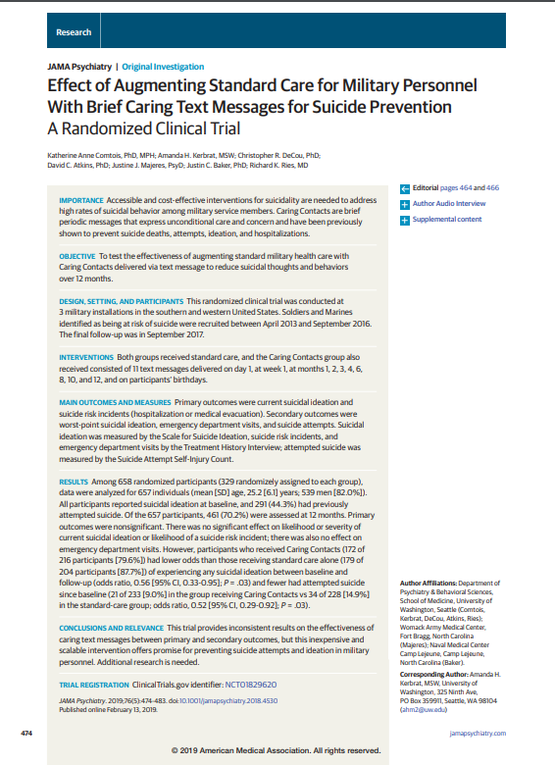
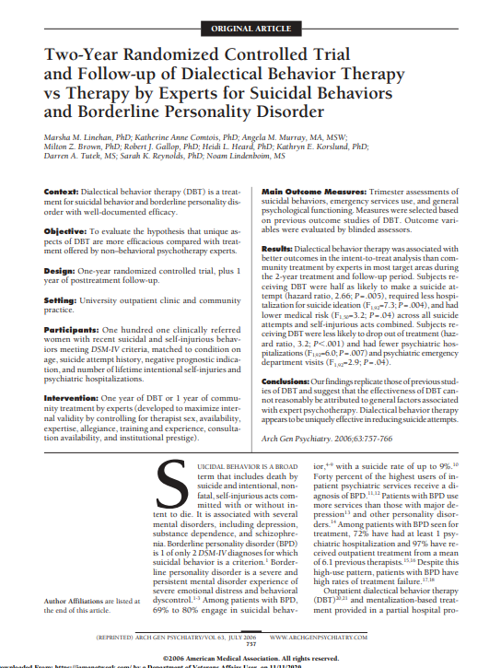
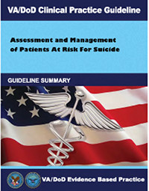
Publications and guidelines are necessary but not sufficient.

Slide 10
Why worry about implementation?
Establishing the effectiveness of an intervention does not guarantee its uptake in routine clinical practice
Classic studies indicate that it takes 17-20 years to get clinical innovations into practice
Moreover, fewer than 50% of clinical innovations ever make it into clinical practice
Bauer & Kirchner, 2020

Slide 11
Key Foci of Implementation Science
Identify uptake barriers and facilitators across multiple levels of context (individuals in treatment, providers, organization, and other stakeholder groups)
Apply implementation strategies that overcome these barriers and enhance the facilitators to increase the uptake of evidence-based clinical innovations

Slide 12
Steps for Implementation & Evaluation
Identify an evidence-based intervention or practice
Partner with an operations partner/leadership/system
Use an implementation framework to guide implementation & evaluation
There are 60+ theories/models/frameworks to pick from (Tabak et al., 2012)
Select an implementation strategy
There are 73 identified strategies to pick from (Powell et al., 2015)
Develop the hypotheses and identify implementation outcomes
Select a study design
Hybrid effectiveness-implementation designs are more of an approach
Three broad categories of designs that provide within-site, between-site, and within- and between-site comparisons of implementation strategies (Brown et al., 2017)

Slide 13
Puddy, R. W. & Wilkins, N. (2011). Understanding Evidence Part 1: Best Available Research Evidence. A Guide to the Continuum of Evidence of Effectiveness. Atlanta, GA: Centers for Disease Control and Prevention.

Slide 14
CONTEXT
Implementation Outcomes
Feasibility
Fidelity
Penetration
Acceptability
Sustainability
Uptake
Costs
Service
Outcomes
Efficiency
Safety
Effectiveness
Equity
Patient-
centeredness
Timeliness
Patient
Outcomes
Clinical/health status
Symptoms
Function
Satisfaction
What?
How?
CONTEXT
EBPs
Implementation
CONTEXT
Strategies
Implementation Research Methods
CONTEXT
Proctor et al., 2009 & Dr. Ana Baumann
Notes:
Typical implementation science foci
Aim: To evaluate an implementation strategy
Intervention: Directed at clinician behavior, and/or organizational practice change
Outcomes: Acceptability, adoption, appropriateness, feasibility, fidelity, implementation cost, penetration/reach, and sustainability
Unit of analysis and randomization: The clinician, team, facility, or organization

Slide 15
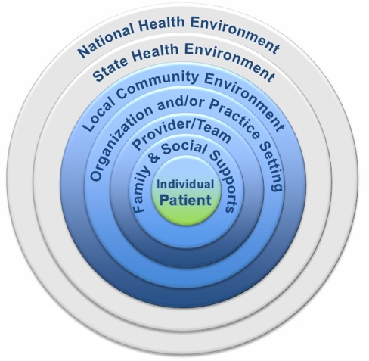
Implementation science uses a variety of implementation strategies to address different aspects of a system to help it do THE THING.

Slide 16
Implementation Strategies (“How to get others to do THE THING”)
Expert Recommendations for Implementing Change (ERIC) project
Used rigorous consensus development process to address the need for a common nomenclature of implementation strategies
Identified 73 discrete implementation strategies with provided definitions
Powell et al., 2015
Notes:
develop an implementation blueprint – creating an implementation road map
Engaging stakeholders

Slide 17
Implementation Strategies with Examples
Use evaluative and interactive strategies
Assess for readiness; identify barriers and facilitators
Audit and provide feedback
Provide interactive assistance
Clinical supervision
Facilitation
Adapt and tailor to context
Promote adaptability
Tailor strategies
Change infrastructure
Change record systems
Mandate change
Develop stakeholder interrelationships
Identify and prepare champions
Identify early adopters
Recruit, designate and train leaders
Train and educate stakeholders
Educational meetings
Learning collaboratives
Support clinicians
Create new clinical teams (task shifting)
Revise professional roles
Use financial strategies
Fund clinical innovation and EBPs
Develop disincentives
Kirchner, Smith, Powell, Waltz & Proctor, 2020
Powell et al., 2015

Slide 18
Selecting an Implementation Strategy
Guided by the implementation science framework or theory. For example:
Promoting Action on Research Implementation in Health Services (i-PARIHS)
uses facilitation to guide and support clinical staff through change processes or contextual challenges to implementation (Harvey and Kitson, 2016)
Replicating Effective Programs (REP)
a stepwise approach (strategy) to be taken within stages in the process of implementing a clinical innovation into practice (Kilbourne et al., 2007; Institute for Healthcare Improvement, 2017)
Consolidated Framework for Implementation Research (CFIR)
includes a process domain that addresses broad processes of implementation effort (Damschroder et al., 2009; Kirk et al., 2016)
Tabak et al., 2012

Slide 19
But I’m an intervention researcher and don’t feel like completely changing career paths.

Slide 20
Let’s find the middle ground and talk about hybrid effectiveness-implementation designs.

Slide 21
Spatially speaking, hybrids fit here
Curran et al., 2012
Landes et al., 2019

Slide 22
Types of Hybrids
Clinical
Effectiveness
Research
Implementation
Research
Hybrid Type 1
Hybrid Type 2
Hybrid Type 3
Hybrid Type 1:
test the thing, observe/gather information on doing the thing
Hybrid Type 2:
test thing, test/study do the thing
Hybrid Type 3:
test do the thing, observe/gather information on the thing
Curran et al., 2012
Landes et al., 2019

Slide 23
Effectiveness vs Implementation Clinical Trials
 | Effectiveness | Implementation
Hypothesis | Intervention vs controls/other intervention | Implementation strategy vs control/other strategy
Populations | Patient population uses few exclusion criteria (to reflect the site population) | Unit of observation may be patients, providers, or clinical sites
Clinical Intervention | Uses clinicians typically paid for and trained by the research study | Uses clinicians paid by the sites
Intervention Fidelity | Trained to criterion, uses quality improvement strategies | Monitor and intervene to improve fidelity
Outcome Measures | Assessment battery is focused and efficient | Similar to effectiveness studies but may be briefer or use existing databases

Slide 24
Why use implementation science in suicide prevention trials?
Further use of implementation science methodologies will accelerate the public’s access to evidence-based interventions that have demonstrable public health impact, including the prevention of suicide.

Slide 25
Example Project
Adapting and Implementing Caring Contacts in a Department of Veterans Affairs Emergency Department
Sara J. Landes, PhD
Email: sara.landes@va.gov Twitter: @SJLandes
Landes et al., 2019

Slide 26
Acknowledgement & Disclaimer
This work is supported by Department of Veterans Affairs Quality Enhancement Research Initiative (QUERI) grants (PII 18-195, Landes; QUE 20-026, Landes). Dr. Landes is also supported by the Translational Research Institute (TRI), UL1 TR003107, through the National Center for Advancing Translational Sciences of the National Institutes of Health (NIH).
Disclaimer: The views expressed in this presentation are those of the author and do not necessarily reflect the position or policy of the Department of Veterans Affairs or the United States Government.

Slide 27
Research Team
JoAnn Kirchner
Susan Jegley
Jeff Pitcock
Nyssa Curtis
Traci Abraham
Mary Bollinger
Jeff Smith
Jack Woods
Robert Lew
Kelly Stolzmann
Brandy Smith
Jennifer van Tiem
Barbara Johnson
Bo Kim
Kathy Dollar
Bridget Matarazzo
Kate Comtois
Mark Reger
Jacob Painter
Krissi Morris
Kathy Marchant-Miros
Kristen Wing
Princess Ackland
Ché Reed
Dustin Rhodes

Slide 28
Improving Suicide Prevention
Transitions in care (e.g., discharge from the hospital) are critical time periods for suicide prevention
The majority of deaths by suicide occur within 30 days after discharge from the hospital or emergency department (ED), with most occurring within one week
We wanted to improve care during the critical transition following ED discharge with Caring Contacts
Notes:
In one study, nearly 25% of patients either attempted or died by suicide within 12 months after screening positive for suicidal ideation in an ED

Slide 29
The Thing: Caring Contacts
Sending patients who are suicidal brief, non-demanding expressions of care and concern at specified intervals over a year
The theory is that the contacts serve to make people feel connected to others (and therefore reduce suicide)
Notes:
Significant reductions in suicide deaths^{1,2}, suicide attempts, and suicide ideation at one and two-year follow-up^{3,4,5}
Feasible and acceptable with military and veteran populations^{6,7}
Helpful with active duty military populations⁸
Cost effective in a simulation study⁹

Slide 30
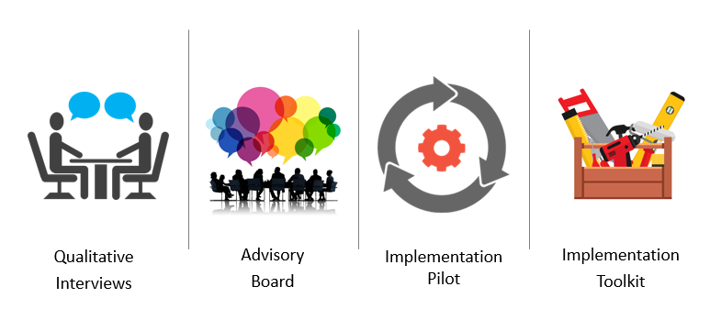
Pilot Project to Adapt & Create Implementation Toolkit
Landes et al., 2019

Slide 31
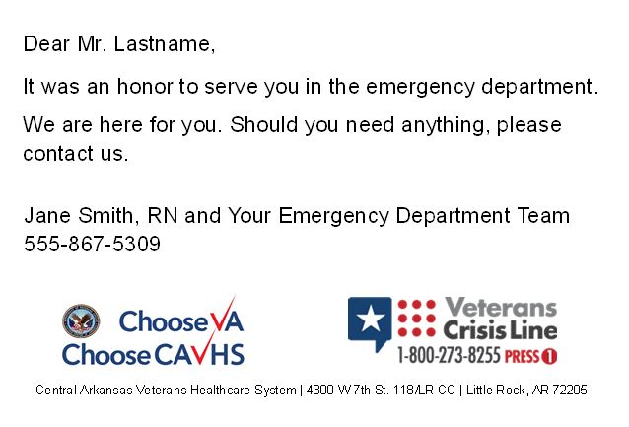
Caring Contact
Landes et al., 2019

Slide 32
Caring Contact Protocol (simplified)
A positive suicide screen triggers Caring Contacts
VA has already implemented screening for suicide
A dashboard provides information on screening results
Veterans receive a different card for each time:
First week after discharge
Months 1, 2, 3, 4, 6, 8, 10, 12
Veterans Day
Birthday
Once a week, staff pull list of positive screens to send Caring Contacts & document in EHR
Landes et al., 2019

Slide 33
Implementation Tools & Strategies
Implementation toolkit
Implementation planning guide
Standard operating procedures
Card templates
Educational materials
Research summaries
Facilitation to support facilities in implementation
Landes et al., 2019

Slide 34
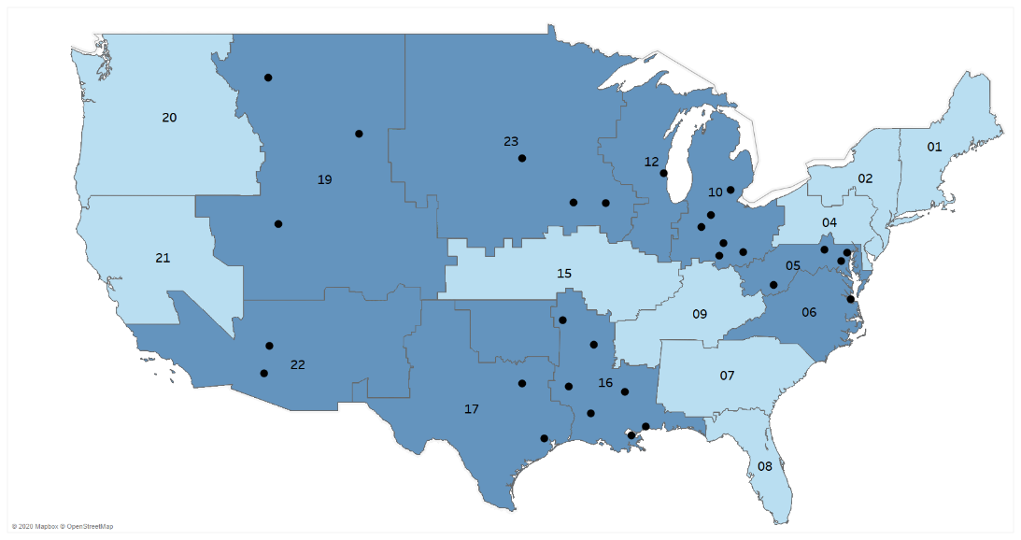
Implement & Evaluate
VA QUERI Partnered Implementation Initiative grant
Grant supports implementation strategy (facilitation) and evaluation
Facility provides staff and materials
Landes et al., 2019
Notes:
28 sites in 9 VISNs

Slide 35
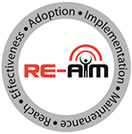
RE-AIM Evaluation Framework
Using the RE-AIM evaluation framework
Reach
Effectiveness
Adoption
Implementation
Maintenance
This framework includes outcomes for:
Effectiveness (does THE THING work?)
Implementation (did we implement THE THING?)
http://www.re-aim.org/

Slide 36
Evaluation
Process/Outcome Metric | Definition
Reach | Number and % of veterans receiving CC per facility
Adoption | Sending CC
Implementation Fidelity | Content of CC Date sent and alignment with schedule Responses to veteran replies consistent with protocol
Maintenance | Still sending CC one year after facilitation
Landes et al., 2019

Slide 37
Evaluation
Process/Outcome Metric | Definition
Effectiveness: Suicide-Related Behavior | Self-directed violence rate Injury rate Fatality rate
Effectiveness: Service Utilization | Outpatient mental health encounters Outpatient health/other encounters Emergency services for mental health Inpatient services for mental health Emergency services for health/other
Landes et al., 2019

Slide 38
Evaluation
Process/Outcome Metric | Definition
Cost | Cost of implementing CC Cost of providing CC Downstream healthcare utilization costs
Staff Perspective | Qualitative interviews focused on staff perspective of CC
Veteran Perspective | Qualitative interviews focused on Veteran perspective of CC
Landes et al., 2019

Slide 39
Outcomes for Pilot Site at 1 Year
Reach
532 unique positive screens
475 mailed CC (89%)
Adoption
Implementing at 6 months
Implementation fidelity (sampled 90-day timeframe)
100% sent with appropriate template
65% sent within 7 days of scheduled date
Landes et al., under review

Slide 40
Outcomes for Pilot Site at 1 Year
Effectiveness
Waiting for Veterans to receive full intervention
Cost
10% time of ED Nurse Manager for 6 months for planning
50% time of a program support assistant
Material costs for CC for 1 Veteran: $2.45
Landes et al., under review

Slide 41
“I felt like my life matters to ‘em, you know?”
“I appreciate them sending the cards out though to check on me because, you know, I have several suicidal attempts. That made me feel good, that hey, I’m being thought about.”
“It made me feel like I wasn’t a number. Like it was more personable and seems like they really took the time out to care…”
Qualitative Interviews
Veterans Receiving CC
N=10
Landes et al., under review

Slide 42
“But if you’re not in any program if you just live out here in the real world… Around the holidays, I get kind of left out because I live alone, you know.”
“It made me feel really important. Like I belonged at the VA.”
“It was nice to get something […] I’m an older person and a lot of people in my family have passed on and I’ve lost some close friends and stuff so…your support circle starts to shrink.”
Qualitative Interviews
Veterans Receiving CC
N=10
Landes et al., under review

Slide 43
Example Project
ED-SAFE 2: Continuous Quality Improvement and Implementation Strategies
Edwin D. Boudreaux, PhD
This project was supported by Award Number R01MH106726 from the National Institute of Mental Health. The content is solely the responsibility of the authors and does not necessarily represent the official views of the National Institute of Mental Health or the National Institutes of Health.

Slide 44
ED-SAFE 2: Overview
To further improve suicide risk screening and best practice implementation in 8 EDs across US
Implement the Safety Plan Intervention for those with active suicidal ideation or an attempt in the past 6 months who are discharged from the ED
Routine clinical practice by ED clinicians, not research staff
Implemented using Lean Continuous Quality Improvement (CQI)
Study factors associated with implementation success/failure

Slide 45
Lean
CQI philosophy and a set of principles and tools that originated with Toyota
The philosophy revolves around three basic tenets:
(1) create a culture of continuous improvement,
(2) engage the frontline people doing the work (respect for people), and
(3) focus on value and process from a customer perspective.
Created multi-disciplinary teams
Mapped current workflow related to suicide-risk screening and management

Slide 46
Lean
Built “future state” workflow with associated protocols to address problems identified with current state
At minimum, Safety Planning was added for discharged patients.
Encouraged training, performance monitoring and fidelity, and reinforcement of performance
Built tools to facilitate implementation of protocols, including EHR templates and alerts
Lean tools (sample)
A3 Problem solving
Kaizen events
Results boards

Slide 47
ED-SAFE 2: “Stepped-Wedge” Study Design
Stepped Initiation
 | Time in Months
Cohort | 0 | 0+2 | 0+4 | 0+6
1 | Start
2 |  | Start
3 |  |  | Start
4 |  |  |  | Start
Timeline was based on the Exploration, Preparation, Implementation, and Sustainment (EPIS) framework.
Aarons et al., 2011

Slide 48
ED-SAFE 2
Best Practices
Lean
Clinician Change
Screening
Safety Planning
Used to identify process improvement, implement best practices
Patient Outcomes
Screening
Safety planning
Suicidal behavior after visit
Detection of risk

Slide 49
ED-SAFE 2
Implementation Strategies
Powell et al, 2015
ERIC Taxonomy
Best Practices
Lean
Clinician Change
Screening
Safety Planning
Used to identify process improvement, implement best practices
Patient Outcomes
Screening
Safety planning
Suicidal behavior after visit
Detection of risk

Slide 50
ED-SAFE 2
Implementation Strategies
Powell et al, 2015
ERIC Taxonomy
Implementation Outcomes
Proctor et al, 2011
Best Practices
Lean
Clinician Change
Screening
Safety Planning
Used to identify process improvement, implement best practices
Patient Outcomes
Screening
Safety planning
Suicidal behavior after visit
Detection of risk

Slide 51
Lean and Implementation Strategies (Select)
Strategy Name | Lean Tools/Tasks | What We Did
Assess for readiness and identify barriers and facilitators | • A3 • Kaizen Events • Current state map | • Built an A3 that defined the problem/gap in performance, understand current state, readiness to change, barriers, and facilitators. • Used Kaizen events to help flesh this out and develop a current state process map, with barriers and potential failure points identified

Slide 52
Lean and Implementation Strategies (Select)
Strategy Name | Lean Tools/Tasks | What We Did
Develop a formal implementation blueprint | • A3 • Kaizen Events • Future state map | Used Kaizen events, small groups to define a future state map and associated protocols, timeline, milestones, trainings, and performance measures This was described on the A3

Slide 53
Lean and Implementation Strategies (Select)
Strategy Name | Lean Tools/Tasks | What We Did
Develop and implement tools for quality monitoring | • A3 • Results Board • Key Behav Indicator (KBI) | • Built reports using EHR data to track screening, safety planning • Reported this in the A3 and results boards

Slide 54
Implementation Outcomes (Select)
Outcome Name | Measure | What We Did
Acceptability, Appropriateness, Feasibility | • Clinician surveys (KAEP) | • Assessed all ED clinicians over three periods about their suicide related knowledge, attitudes, efficacy, and practices

Slide 55
Implementation Outcomes (Select)
Outcome Name | Measure | What We Did
Patient reach, penetration | • Chart reviews | Proportion of adult patients who got screened Proportion of patients with suicide risk that were discharged who received a safety plan

Slide 56
Implementation Outcomes (Select)
Outcome Name | Measure | What We Did
Intervention fidelity | SPISA ratings Fidelity interviews | Rated safety plans using a structured tool that reflected quality of the safety plan Interviewed patients about whether the screening questions were asked

Slide 57
Resources
Psychiatry Research special issue: Introduction to Implementation Science: Increasing the Public Health Impact of Research
https://www.sciencedirect.com/journal/psychiatry-research/special-issue/1083N7JBHZF
This special issue, written in part by a number of VA researchers, focuses on introducing implementation science for those working in clinical trials research. The entire special issue is available via Open Access.

Slide 58
Resources
VA Health Services Research & Development Cyberseminars
QUERI Implementation Seminar: https://www.hsrd.research.va.gov/cyberseminars/catalog-archive.cfm?SeriesSortParam=y&SeriesIDz=25
QUERI Practice Seminar: https://www.hsrd.research.va.gov/cyberseminars/catalog-archive.cfm?SeriesSortParam=y&SeriesIDz=39
QUERI Implementation Research: https://www.hsrd.research.va.gov/cyberseminars/catalog-archive.cfm?SeriesSortParam=y&SeriesIDz=41
Enhancing Implementation Science Seminar: https://www.hsrd.research.va.gov/cyberseminars/catalog-archive.cfm?SeriesSortParam=y&SeriesIDz=57

Slide 59
Resources
Resource lists
https://www.fic.nih.gov/About/center-global-health-studies/neuroscience-implementation-toolkit/Pages/resources.aspx
https://impsciuw.org/implementation-science/learn/implementation-science-overview/
https://publichealth.wustl.edu/resources-dissemination-implementation/
Implementation science video resources
Rachel Shelton, Columbia University, https://www.youtube.com/playlist?list=PLzyPCWX3M2syQogSLEyLRvwbUl3mwXcLc

Slide 60
Resources
Society for Implementation Research Collaboration (SIRC)
https://societyforimplementationresearchcollaboration.org/
The Society for Implementation Research Collaboration (SIRC) is a society dedicated to facilitating communication and collaboration between implementation research teams, researchers, and community providers. SIRC aims to bring together researchers and stakeholders committed to the rigorous evaluation of implementation of evidence based psychosocial interventions.
SIRC hosts a conference every other year and membership benefits include access to webinars and other resources.

Slide 61
Questions?

Slide 62
Contact Information
Sara J. Landes, PhD Director, Behavioral Health QUERI Central Arkansas Veterans Healthcare System Email: sara.landes@va.gov Twitter: @SJLandes
Gregory K. Brown, PhD Director, Penn Center for the Prevention of Suicide University of Pennsylvania Email: gregbrow@pennmedicine.upenn.edu

