Slide 1
AFSP Research Connection+ Program Spring 2023
Genetics of Suicide: Bypassing the Blood-Brain Barrier
Epigenetic aging in suicide and potential implications for the blood-brain-barrier
Gabriel R. Fries, MSc, PhD
Assistant Professor
Department of Psychiatry and Behavioral Sciences, McGovern Medical School
Center for Precision Health, School of Biomedical Informatics

Slide 2
Disclosures
Research Funding:
American Foundation for Suicide Prevention (AFSP)
National Institute of Mental Health (NIMH)
Milken Institute
UTHealth Center for Clinical and Translational Sciences
UTHealth Consortium on Aging
McGovern Medical School
UTHealth Department of Psychiatry
I have no conflicts of interest to declare.

Slide 3
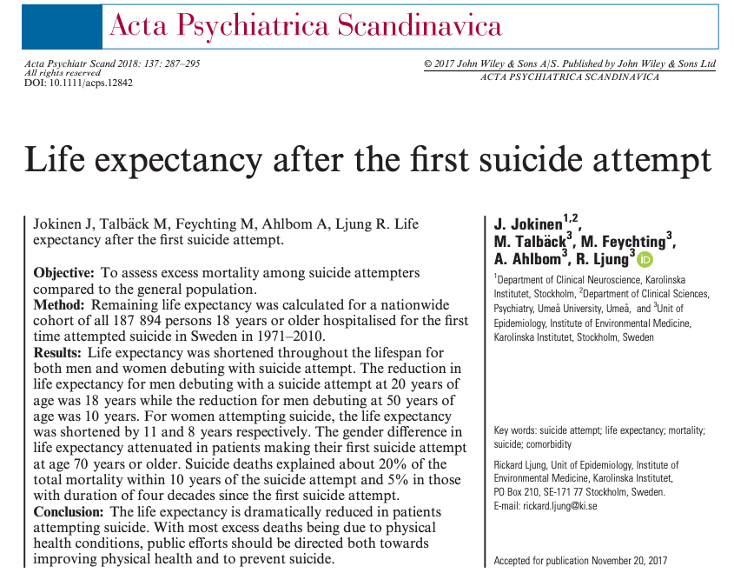
Premature mortality after suicide attempt
Joniken et al., Life expectancy after the first suicide attempt. Acta Psychiatr Scand. 2018 Apr;137(4):287-295.

Slide 4
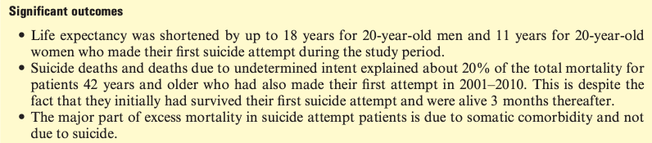
Premature mortality after suicide attempt
Joniken et al., Life expectancy after the first suicide attempt. Acta Psychiatr Scand. 2018 Apr;137(4):287-295.

Slide 5
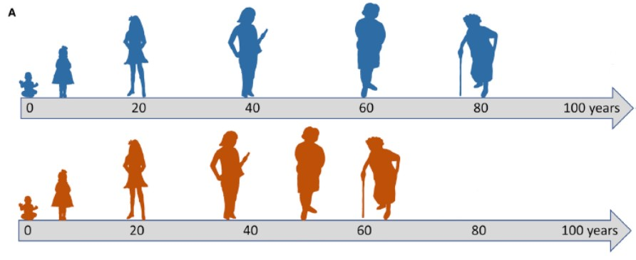

Premature mortality after suicide attempt
General population
Individuals after suicide attempt
ACCELERATED AGING!
Premature mortality
Joniken et al., Life expectancy after the first suicide attempt. Acta Psychiatr Scand. 2018 Apr;137(4):287-295.

Slide 6
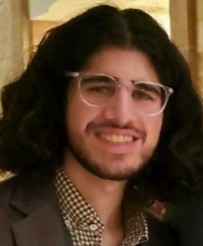
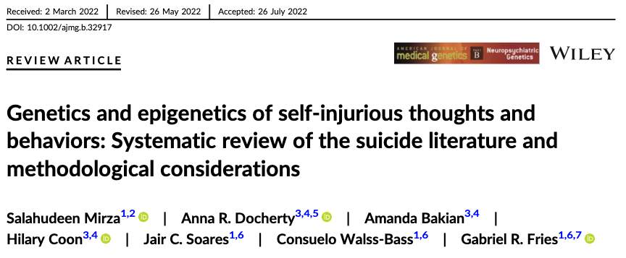
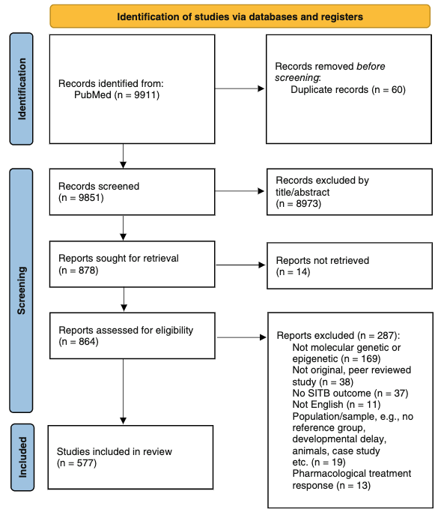
Suicide has a genetic basis
Salahudeen Mirza
Genetic correlations between suicide attempt and several psychiatric disorders:
Bipolar disorder (BD):
r_{GC} = 0.38, p=4.5E-09 (Kimbrel et al., 2022)
r_{GC} = 0.49, p=1.16E-30 (Mullins et al., 2021)
Mirza et al. Genetics and epigenetics of self-injurious thoughts and behaviors: Systematic review of the suicide literature and methodological considerations. Am J Med Genet B Neuropsychiatr Genet. 2022 Oct;189(7-8):221-246.

Slide 7
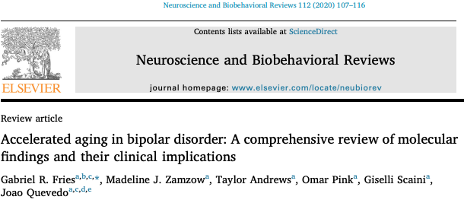
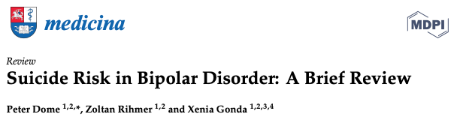
Suicide in bipolar disorder (BD)
BD → suicide rate 10-30x higher than the general population;
20-60% of patients with BD attempt suicide at least once in their lifetime;
Premature mortality in BD: individuals with BD die in general 8-9 years earlier than the general population.
Dome P, Rihmer Z, Gonda X. Suicide Risk in Bipolar Disorder: A Brief Review. Medicina (Kaunas). 2019 Jul 24;55(8):403.
Roshanaei-Moghaddam, Katon. Premature mortality from general medical illnesses among persons with bipolar disorder: a review. Psychiatr Serv. 2009;60:147-156.
Crump et al. Comorbidities and Mortality in Bipolar Disorder A Swedish National Cohort Study. JAMA Psychiatry. 2013;70:931-939.

Slide 8
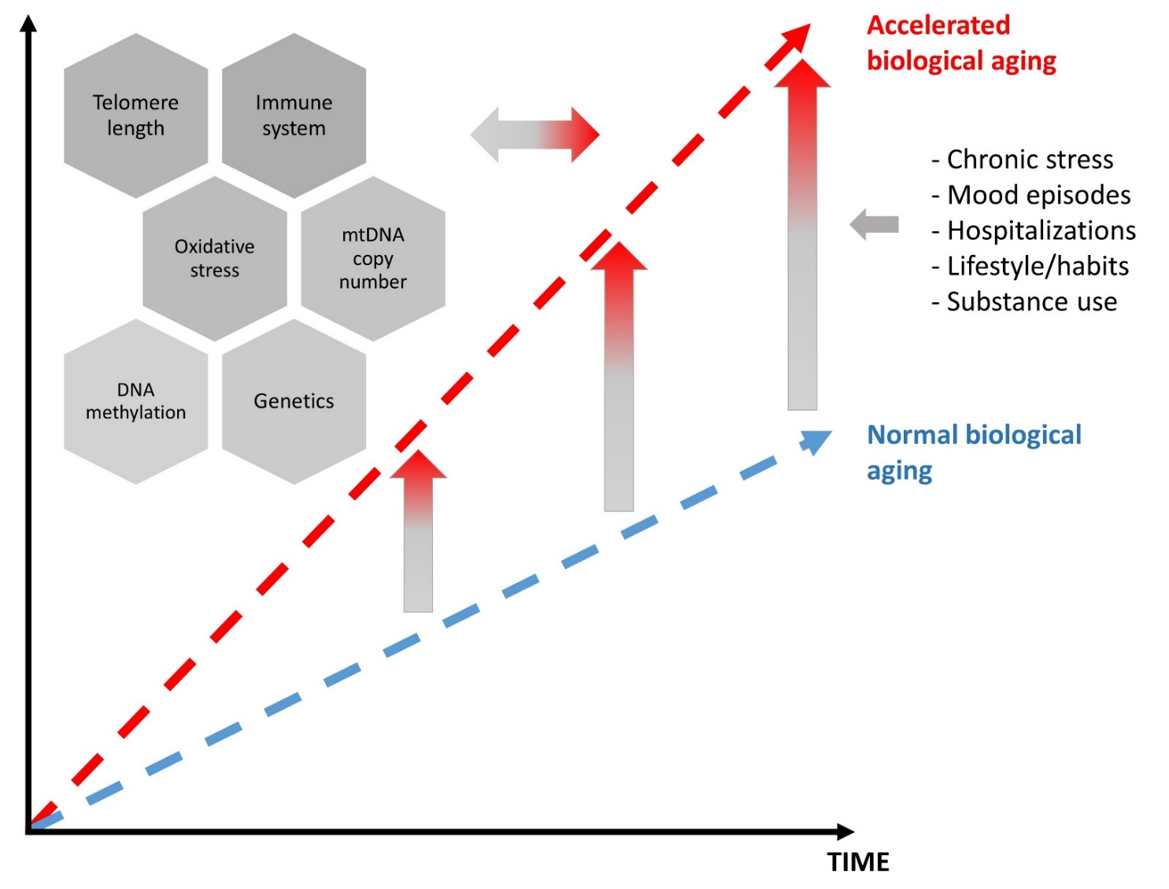
Hypothesis: Accelerated aging
Fries et al. Accelerated aging in bipolar disorder: A comprehensive review of molecular findings and their clinical implications. Neurosci Biobehav Rev. 2020;112:107-116.

Slide 9
Telomere shortening with suicide attempt
Birkenæs et al. Telomeres are shorter and associated with number of suicide attempts in affective disorders. Journal of Affective Disorders, 295 (2021) 1032–1039.

Slide 10
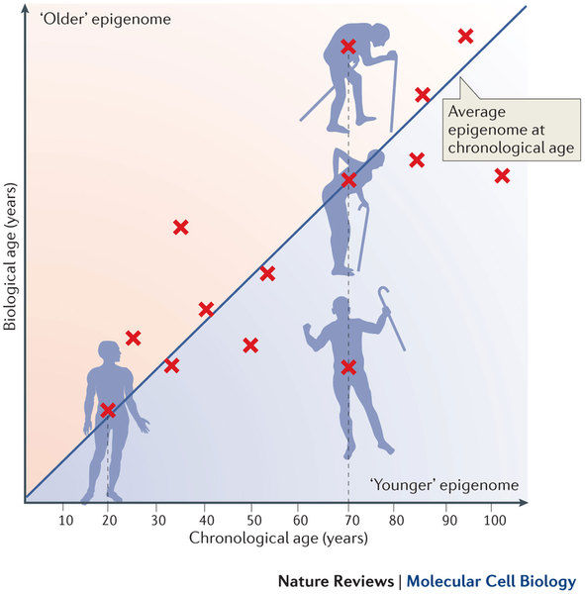
Hypothesis: Accelerated aging
EPIGENETIC CLOCKS
Fries et al. Accelerated aging in bipolar disorder: A comprehensive review of molecular findings and their clinical implications. Neurosci Biobehav Rev. 2020;112:107-116.

Slide 11

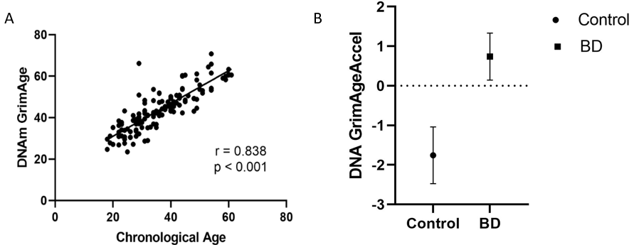
GrimAge is accelerated in BD
Dr. Camila Lima
DNAm levels at 1,030 CpGs predict “time-to-death” based on estimators of 7 plasma proteins (previously associated with mortality and morbidity) and a DNAm-based estimator of smoking pack-years.
From the original study: significant association with morbidity and mortality, survival, cognitive decline, clinical biomarkers, lifestyle factors, blood cell composition, and telomere length.
Lima CNC, Suchting R, Scaini G, Cuellar VA, Favero-Campbell AD, Walss-Bass C, Soares JC, Quevedo J, Fries GR. Epigenetic GrimAge acceleration and cognitive impairment in bipolar disorder. Eur Neuropsychopharmacol. 2022 Sep;62:10-21.

Slide 12
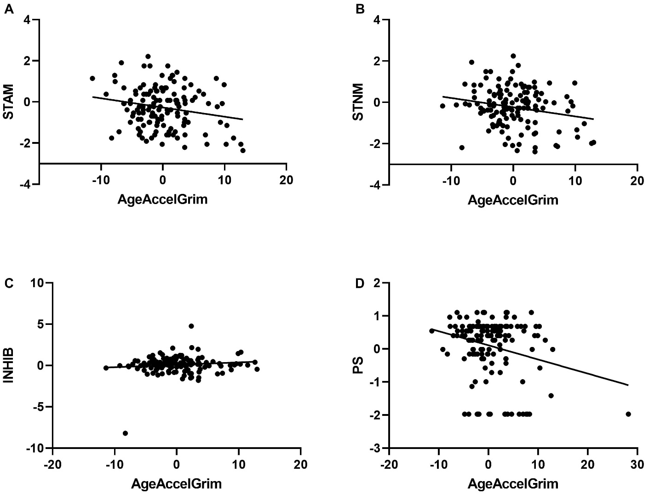
GrimAge and cognitive dysfunction in BD
Dr. Camila Lima
Lima CNC, Suchting R, Scaini G, Cuellar VA, Favero-Campbell AD, Walss-Bass C, Soares JC, Quevedo J, Fries GR. Epigenetic GrimAge acceleration and cognitive impairment in bipolar disorder. Eur Neuropsychopharmacol. 2022 Sep;62:10-21.

Slide 13
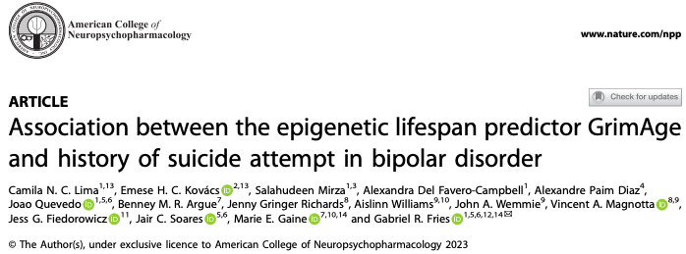
Aims of this study
To investigate the acceleration of GrimAge, a novel epigenetic clock trained on time-to-death data and uniquely associated with mortality and lifespan, in patients with BD with and without a lifetime history of suicide attempt (SA).

Slide 14
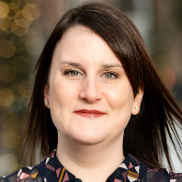



Sample
Dr. Marie Gaine
Emese Kovacs
Discovery cohort: UTHealth
Replication cohort: UIowa
 | BD/SA (n=77) | BD/non-SA (n=67) | Control (n=50) | p-value
Age (years), mean (SD) | 36.62 (10.83) | 37.36 (11.96) | 37.36 (11.96) | 0.500¹
Sex (%) Female Male | 71.4 28.6 | 71.2 28.8 | 68.6 31.4 | 0.496²
Race/Ethnicity (%) Non-Hispanic White or Caucasian Hispanic or Latinx Black or African American Asian Others | 45.5 15.6 31.2 2.6 5.1 | 33.3 15.2 34.8 3.1 13.6 | 27.5 19.6 43.1 5.9 3.9 | 0.108²
Body Mass Index (%) Underweight Normal Overweight Obese Missing | 3.1 20.9 17.6 47.3 11.1 | 0 32.5 25 42.5 0 | 2 15.6 20 41 21.4 | 0.760²
 | BD/SA (n=48) | BD/non-SA (n=47) | p-value
Age (years), mean (SD) | 44.23 (12.95) | 39.29 (13.81) | 0.957¹
Sex (%) Female Male | 70.8 29.2 | 59.6 40.4 | 0.249²
Race/Ethnicity (%) Non-Hispanic White or Caucasian Hispanic or Latinx Black or African American Asian Others | 85.1 8.5 0 2.1 4.3 | 77.1 8.3 8.3 0 6.3 | 0.257²
Body Mass Index (%) Underweight Normal Overweight Obese Missing | 2.1 25.5 25.5 46.8 0 | 0 20.8 25 54.2 0 | 0.686²
¹Mann-Whitney Test, ² Chi-squared Test
¹Mann-Whitney Test, ² Chi-squared Test
Lima CNC, Kovács E, Mirza S, Favero-Campbell AD, Diaz AP, Quevedo J, Argue BMR, Richards JG, Williams A, Wemmie JA, Magnotta VA, Fiedorowicz JG, Soares JC, Gaine ME, Fries GR. Association between the Epigenetic Lifespan Predictor GrimAge and History of Suicide Attempt in Bipolar Disorder. Neuropsychopharmacology. 2023. In press.

Slide 15
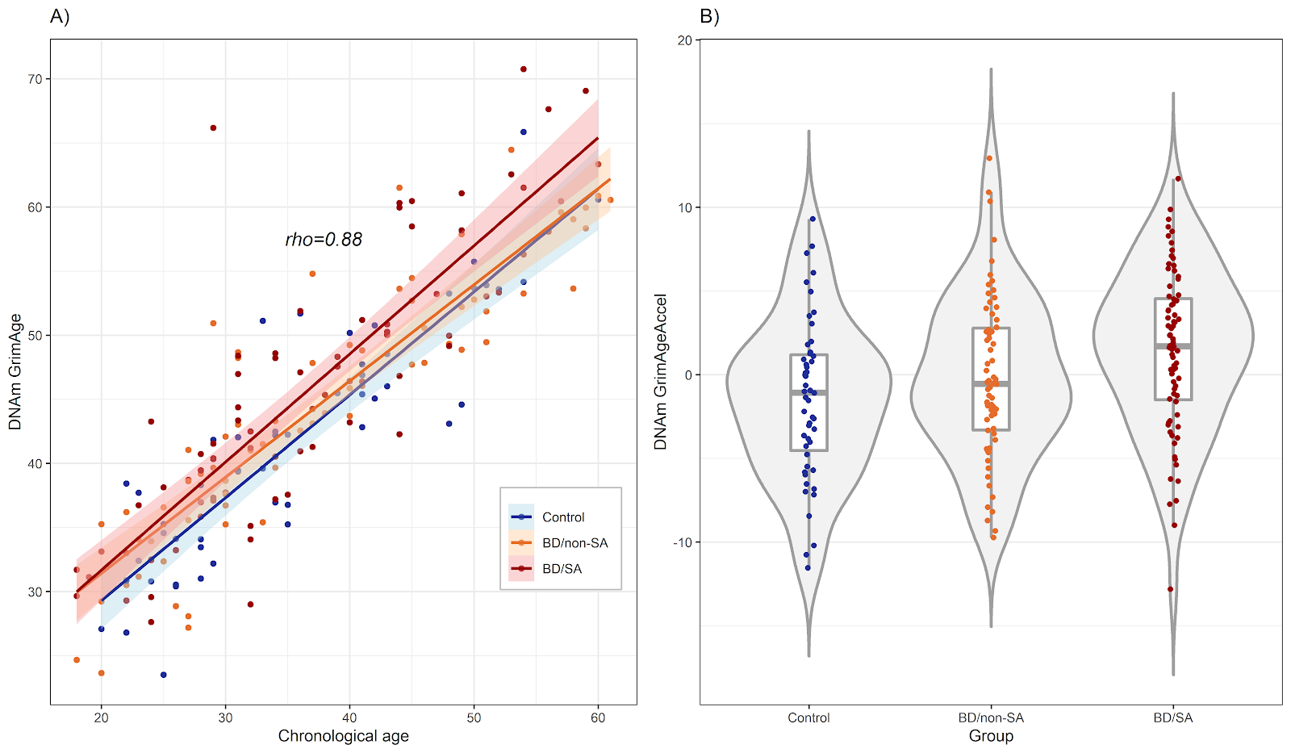
GrimAge is accelerated with SA
P = 0.055
P = 0.004
*controlled for age, sex, years of education, GWAS PCs, BMI, white blood cells, and smoking
Lima CNC, Kovács E, Mirza S, Favero-Campbell AD, Diaz AP, Quevedo J, Argue BMR, Richards JG, Williams A, Wemmie JA, Magnotta VA, Fiedorowicz JG, Soares JC, Gaine ME, Fries GR. Association between the Epigenetic Lifespan Predictor GrimAge and History of Suicide Attempt in Bipolar Disorder. Neuropsychopharmacology. 2023. In press.
Notes:
-

Slide 16
GrimAge is accelerated with SA
Lima CNC, Kovács E, Mirza S, Favero-Campbell AD, Diaz AP, Quevedo J, Argue BMR, Richards JG, Williams A, Wemmie JA, Magnotta VA, Fiedorowicz JG, Soares JC, Gaine ME, Fries GR. Association between the Epigenetic Lifespan Predictor GrimAge and History of Suicide Attempt in Bipolar Disorder. Neuropsychopharmacology. 2023. In press.

Slide 17
Lima CNC, Kovács E, Mirza S, Favero-Campbell AD, Diaz AP, Quevedo J, Argue BMR, Richards JG, Williams A, Wemmie JA, Magnotta VA, Fiedorowicz JG, Soares JC, Gaine ME, Fries GR. Association between the Epigenetic Lifespan Predictor GrimAge and History of Suicide Attempt in Bipolar Disorder. Neuropsychopharmacology. 2023. In press.

Slide 18
GrimAge acceleration cannot be fully explained by
clinical severity
Lima CNC, Kovács E, Mirza S, Favero-Campbell AD, Diaz AP, Quevedo J, Argue BMR, Richards JG, Williams A, Wemmie JA, Magnotta VA, Fiedorowicz JG, Soares JC, Gaine ME, Fries GR. Association between the Epigenetic Lifespan Predictor GrimAge and History of Suicide Attempt in Bipolar Disorder. Neuropsychopharmacology. 2023. In press.

Slide 19
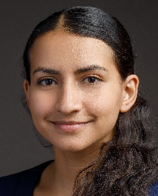

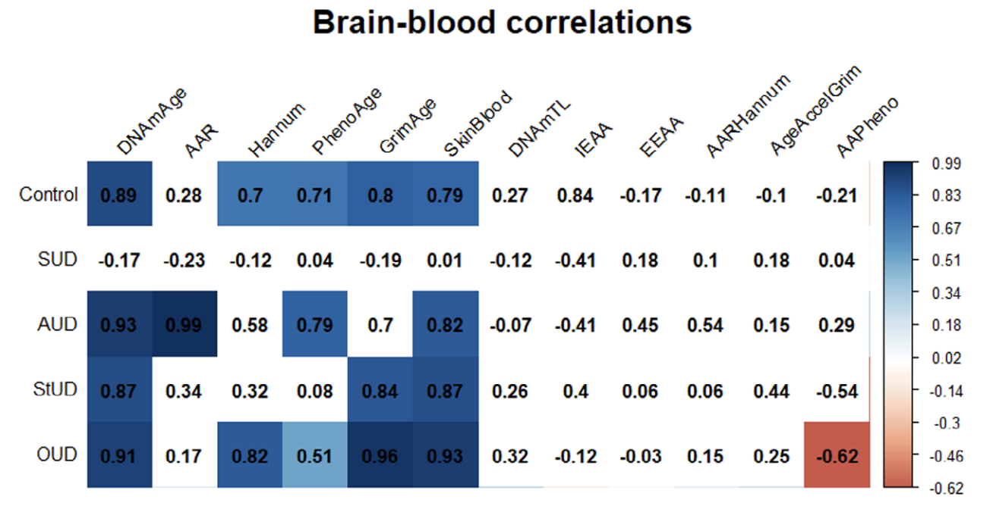
GrimAge correlation between blood and brain
Dr. Brenda Cabrera-Mendoza
Dr. Consuelo Walss-Bass
DLPFC (BA9 area)
N = 11
Cabrera-Mendoza B, Stertz L, Najera K, Selvaraj S, Teixeira AL, Meyer TD, Fries GR, Walss-Bass C. Within subject cross-tissue analyzes of epigenetic clocks in substance use disorder postmortem brain and blood. Am J Med Genet B Neuropsychiatr Genet. 2023 Jan;192(1-2):13-27.

Slide 20
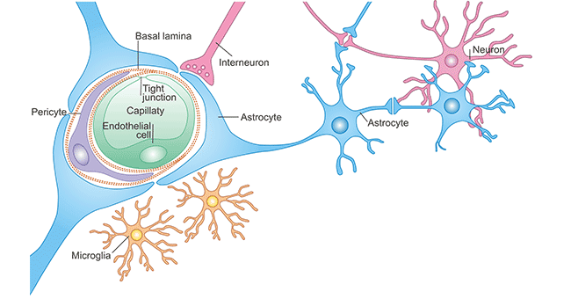
Implications
What are the biological consequences of having accelerated aging processes associated with a history of suicide attempt?

Slide 21
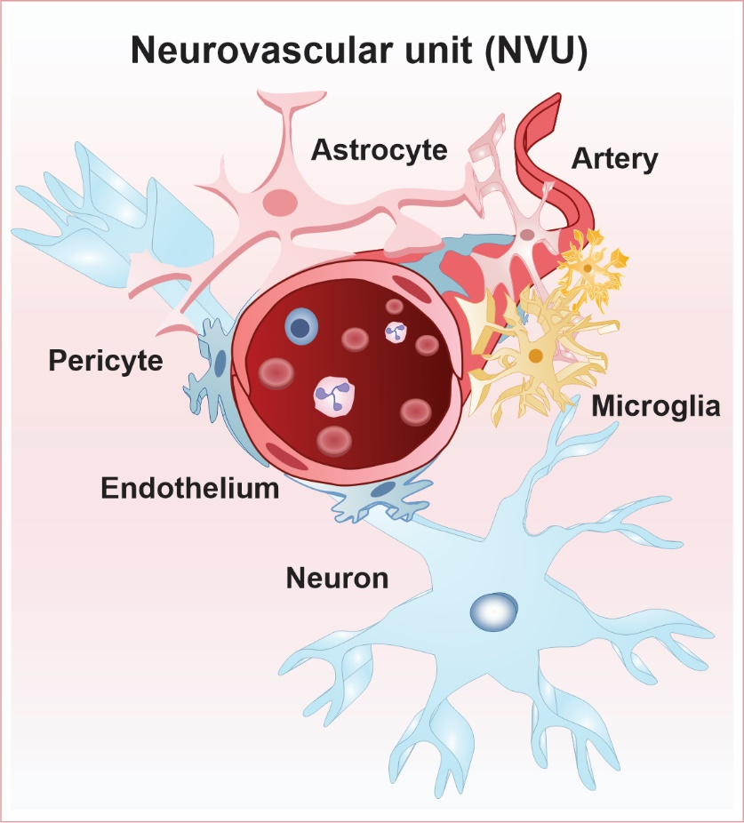
Hypothesis: The blood-brain-barrier (BBB)
Regulate the entry of most blood-derived factors into the brain;
Selective uptake of oxygen, various ions, nutrients, and chemicals to supply the CNS;
Tightly controlled to protect the CNS from outside infectious agents;
Neurovascular unit (NVU): central unit of the BBB.
Zhao NO, Topolski N, Tusconi M, Salarda EM, Busby CW, Lima CNNC, Pillai A, Quevedo J, Barichello T, Fries GR. Blood-brain barrier dysfunction in bipolar disorder: Molecular mechanisms and clinical implications. Brain Behav Immun Health. 2022 Mar 5;21:100441.

Slide 22
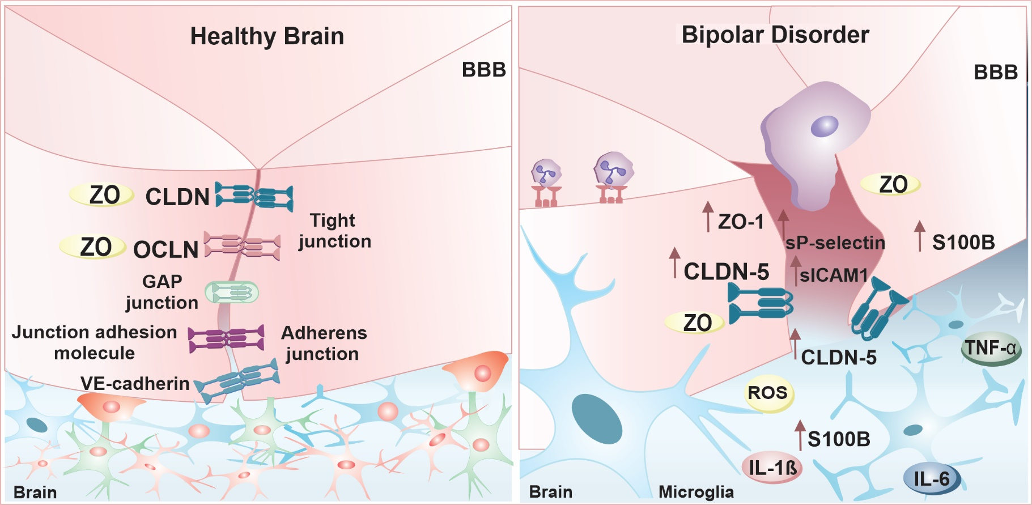
The blood-brain-barrier (BBB)
Zhao NO, Topolski N, Tusconi M, Salarda EM, Busby CW, Lima CNNC, Pillai A, Quevedo J, Barichello T, Fries GR. Blood-brain barrier dysfunction in bipolar disorder: Molecular mechanisms and clinical implications. Brain Behav Immun Health. 2022 Mar 5;21:100441.

Slide 23
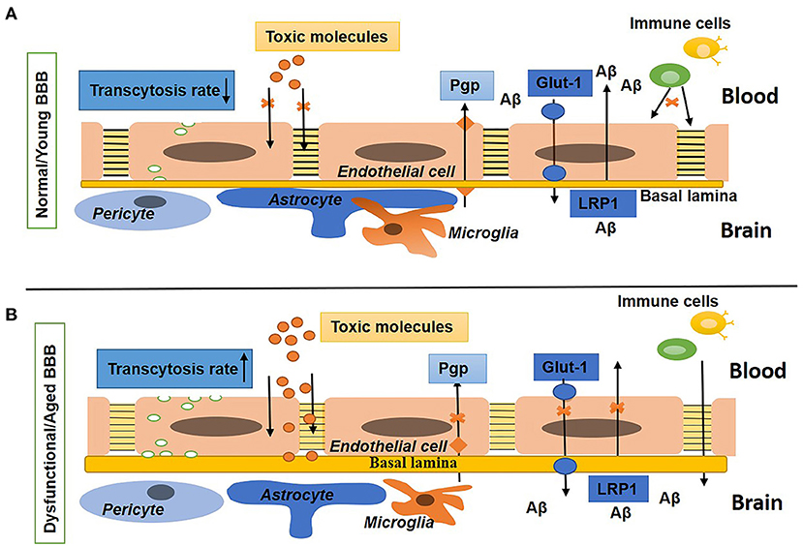
Aging and BBB dysfunction
AGING
Hussain et al. Blood-Brain Barrier Breakdown: An Emerging Biomarker of Cognitive Impairment in Normal Aging and Dementia. Front Neurosci. 2021 Aug 19;15:688090.

Slide 24
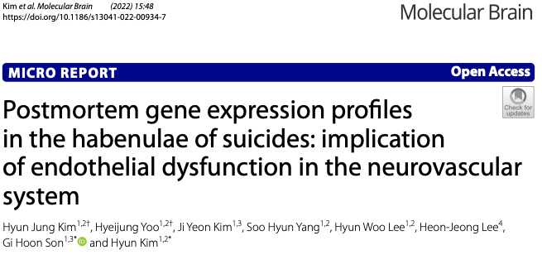
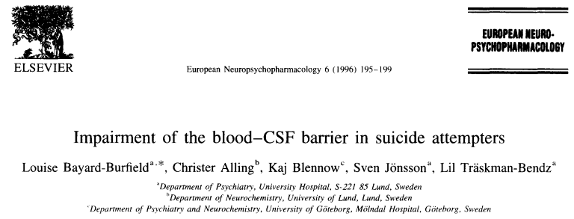
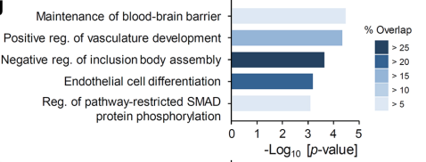
BBB dysfunction and suicide

Slide 25
BBB dysfunction and neuroinflammation
- AFSP 2018 Linked Standard Research Grant (Dr. J. John Mann & Dr. Nadine Melhem)
- AFSP 2022 Distinguished Investigator Grant (Dr. Emil Coccaro)
[and many more…]

Slide 26
Working model
Epigenetics
Genetics
Oxidative stress
Inflammation
Metabolic dysfunction (insulin resistance)
HPA axis activation
…
Bipolar Disorder
Suicide attempt
Accelerated aging
BBB breakdown
Neuroinflammation
…
Premature mortality

Slide 27
Working model
Epigenetics
Genetics
Oxidative stress
Inflammation
Metabolic dysfunction (insulin resistance)
HPA axis activation
…
Bipolar Disorder
Suicide attempt
Accelerated aging
Accelerated aging
BBB breakdown
Neuroinflammation
…
Premature mortality

Slide 28
Ongoing studies
Molecular mechanisms underlying epigenetic GrimAge acceleration in BD and suicide (NARSAD YI, Camila Lima, 2023)
Replication in larger samples (looking for collaborations) and brain analyses (Funded by NIMH K01 and AFSP)
In vitro cell model of epigenetic aging and search for anti-aging drugs (Funded by the Milken Institute)
Blood-brain barrier alterations in postmortem brains of individuals who died of suicide and in peripheral blood of suicide attempters

Slide 29





Department of Psychiatry (UTHealth)
Jair Soares
Consuelo Walss-Bass
Joao Quevedo
Camila N. de Carvalho Lima
Salahudeen Mirza
Alexandre Rubinstein
Apurva Kumar
Alexandra Del Favero-Campbell
Christopher Busby
Rodrigo Machado-Vieira
Giselli Scaini
Laura Stertz
Emily Mendez
Robert Suchting
Scott Lane
Baylor College of Medicine
Jun Wang
Max Planck Institute of Psychiatry
Theo Rein
NIMH Human Brain Collection Core (HBCC)
Stefano Marenco
University of Iowa
Marie Gaine
Emese Kovács
University of Sao Paulo
Diego Rovaris
Yale University
Hilary Blumberg
Brenda Cabrera-Mendoza
Gabriel.R.Fries@uth.tmc.edu
@FriesGabriel
Funding Sources:

Slide 30
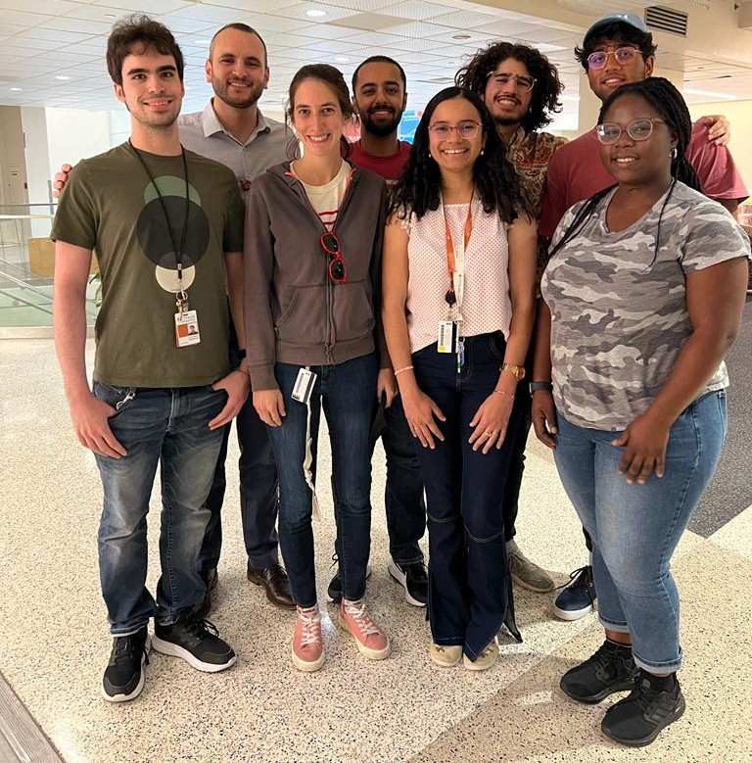
Gabriel.R.Fries@uth.tmc.edu
@FriesGabriel

