Slide 1
Congressionally Directed Medical Research Programs Peer Reviewed Medical Research Program (PRMRP) and Traumatic Brain Injury and Psychological Health Research Program (TBIPHRP)
Presented by
Cecilia Dupecher, Ph.D., and Michelle Lane, LCSW-C
Program Managers
Webinar for the American Foundation for
Suicide Prevention
6 April 2023

Slide 2
Outline
Overview of CDMRP, Program Cycle, and Review Process
Peer Reviewed Medical Research Program (PRMRP) Overview and Funding Opportunities
Traumatic Brain Injury and Psychological Health Research Program (TBIPHRP) Overview and Anticipated Funding Opportunities
Resources and Strategies for Success

Slide 3
Vision and Mission
Vision
Transforming health care through innovative and impactful research
Mission
Responsibly manage collaborative research that discovers, develops, and delivers health care solutions for Service Members, Veterans, and the American public

Slide 4
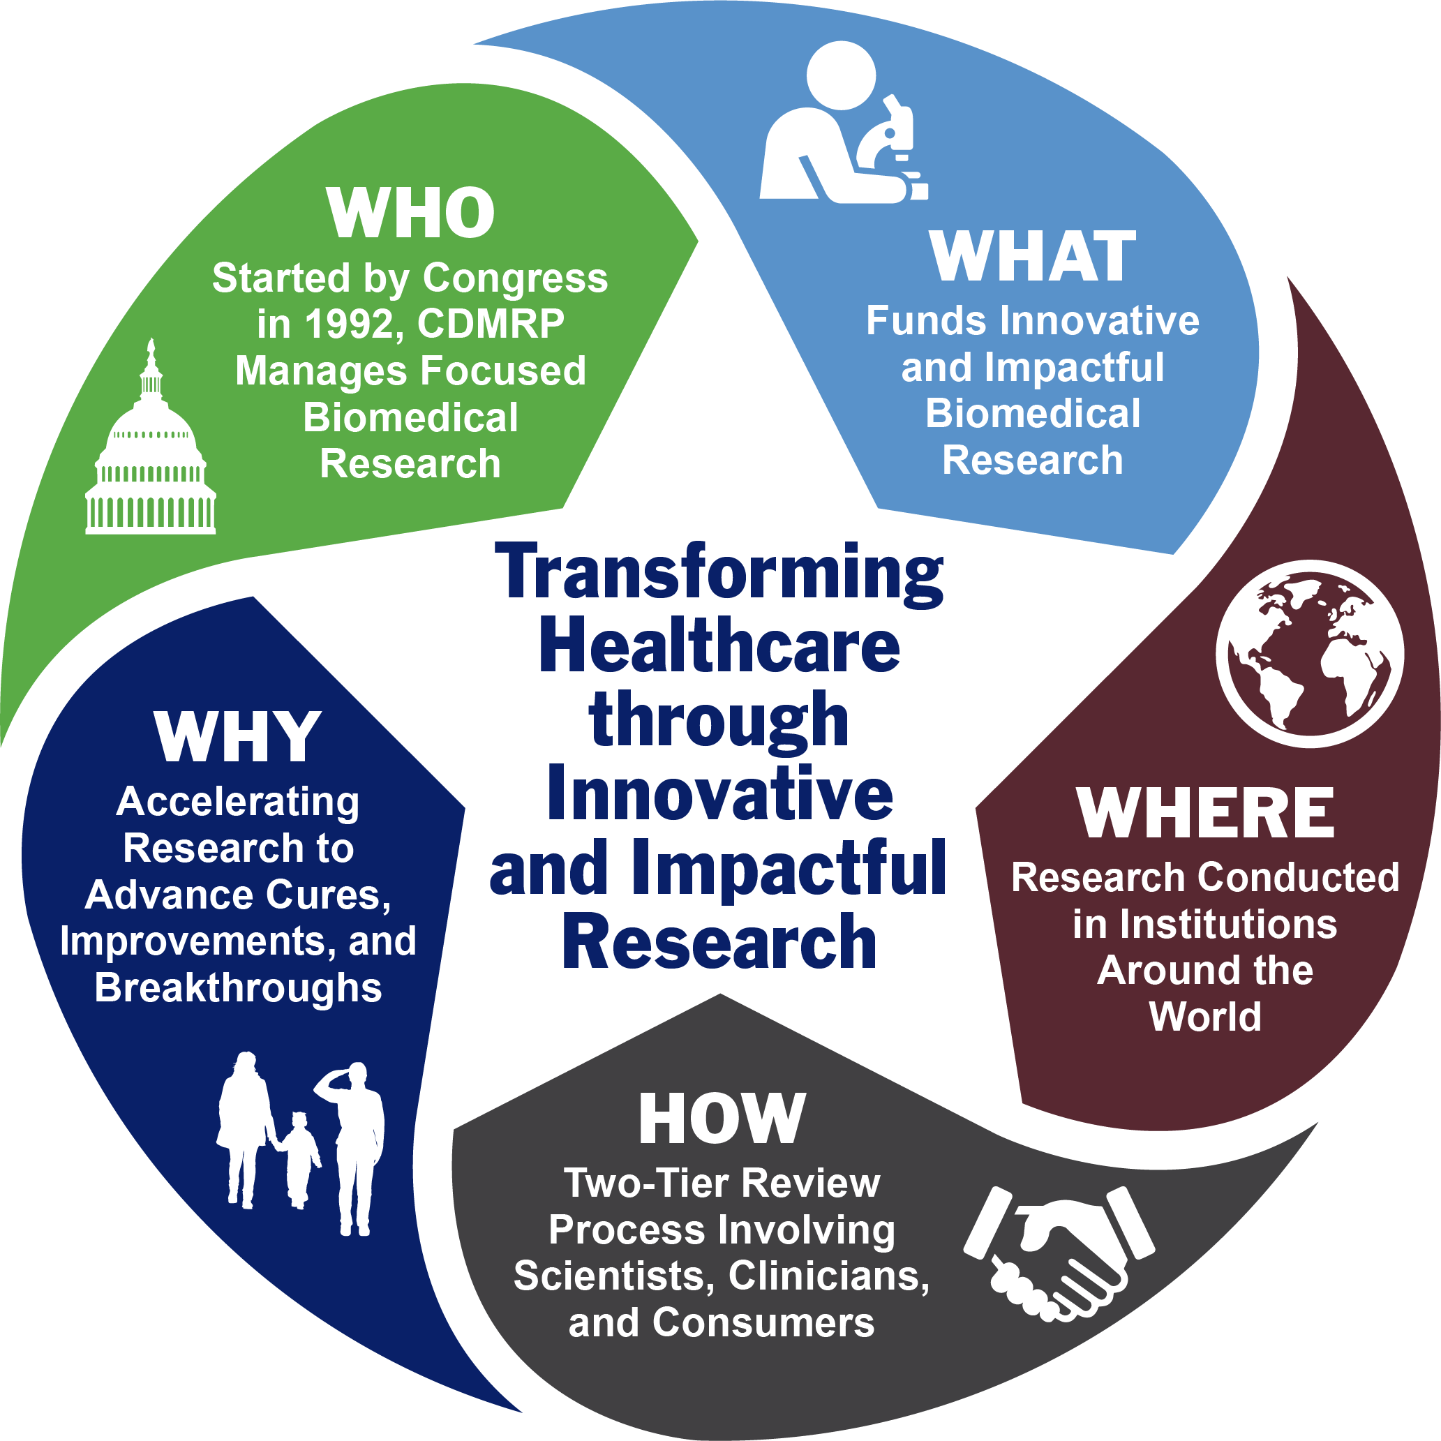
About CDMRP
https://cdmrp.health.mil

Slide 5
CDMRP FY23 Appropriations
Research Program | FY23 $M |  | Research Program | FY23 $M
Alcohol and Substance Use Disorders | $4.0 |  | Orthotics and Prosthetics Outcomes | $15.0
Amyotrophic Lateral Sclerosis | $40.0 |  | Ovarian Cancer | $45.0
Autism | $15.0 |  | Pancreatic Cancer | $15.0
Bone Marrow Failure | $7.5 |  | Parkinson’s | $16.0
Breast Cancer | $150.0 |  | Peer Reviewed Alzheimer’s | $15.0
Chronic Pain Management | $15.0 |  | Peer Reviewed Cancer (20 Topics) | $130.0
Combat Readiness Medical | $5.0 |  | Peer Reviewed Medical (50 Topics) | $370.0
Duchenne Muscular Dystrophy | $10.0 |  | Peer Reviewed Orthopaedic | $30.0
Epilepsy | $12.0 |  | Prostate Cancer | $110.0
Hearing Restoration | $5.0 |  | Rare Cancers | $17.5
Joint Warfighter Medical | $25.0 |  | Reconstructive Transplant | $12.0
Kidney Cancer | $50.0 |  | Spinal Cord Injury | $40.0
Lung Cancer | $25.0 |  | Tick-Borne Disease | $7.0
Lupus | $10.0 |  | Toxic Exposures | $30.0
Melanoma | $40.0 |  | Traumatic Brain Injury and Psychological Health | $175.0
Military Burn | $10.0 |  | Tuberous Sclerosis Complex | $8.0
Multiple Sclerosis | $20.0 |  | Vision | $20.0
Neurofibromatosis | $25.0 | TOTAL = $1.52B
Notes:
Here are the CDMRP appropriations for FY23 – 35 programs total

Slide 6
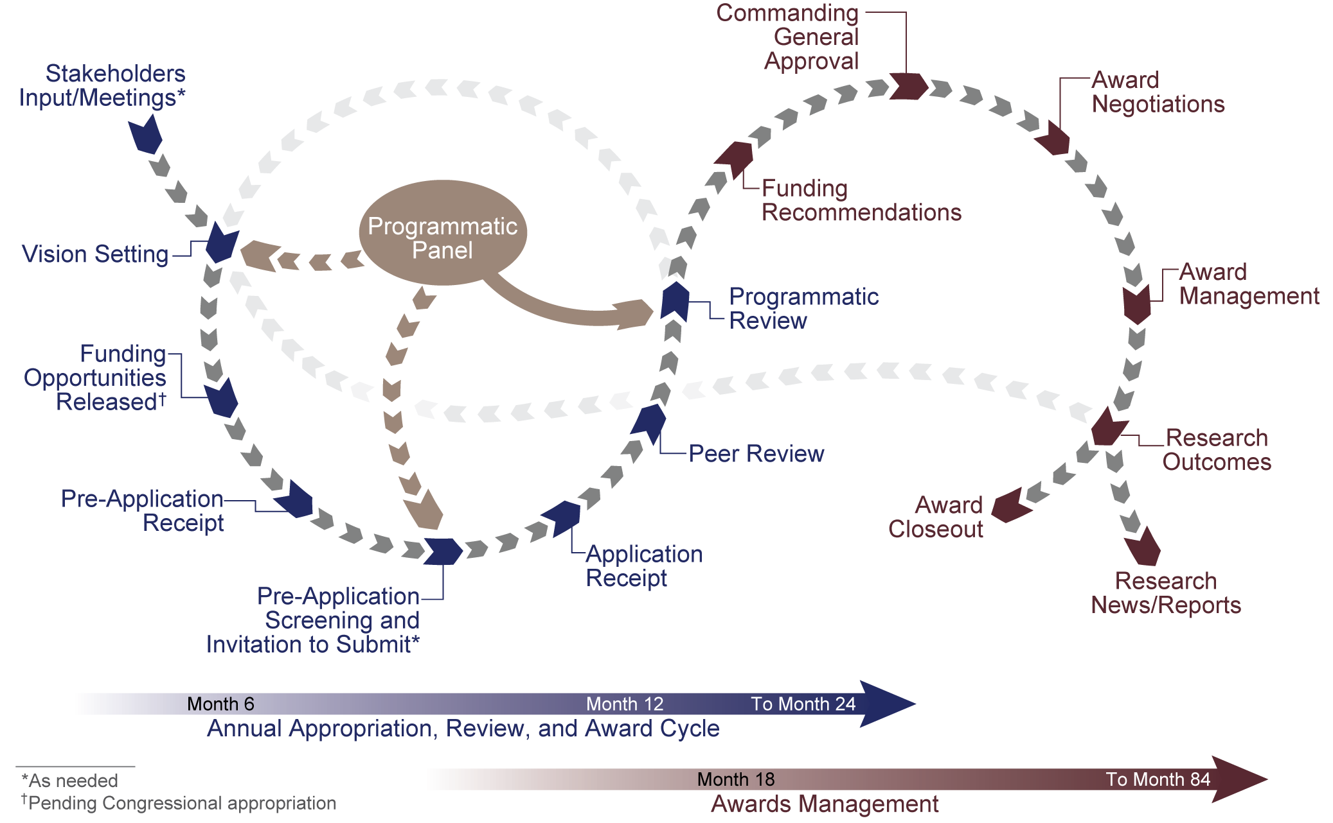
Program Cycle
Notes:
Note overall timeline - from submission to award - PIs
The CDMRP has developed and uses common program management approaches, yet each program has individually tailored goals and a unique vision to enable it to meet the specialized needs of their research and advocacy communities.
The CDMRP uses a flexible program cycle for each Congressional appropriation to accommodate all stages of the process, from the development of investment strategies to the completion of research grants.
The first major milestone in the cycle is the Vision Setting meeting during, which the program assesses the research landscape and develops an investment strategy that is implemented through program-specific funding opportunities.
Funding opportunities can be released after receipt of a Congressional fiscal year appropriation.

Slide 7
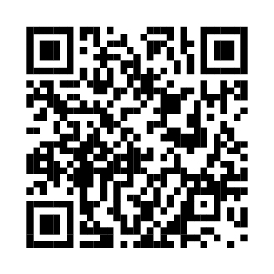
Goal of the Two-Tier Review Process
To develop funding recommendations that balance the most meritorious science across many disciplines and offer the highest promise to fulfill the programmatic goals set forth in the funding opportunity
PARTNERSHIP
Programmatic
Review
Peer Review
Video and additional information available at: https://cdmrp.health.mil/about/2tierRevProcess
Notes:
Overall, the goal of the two-tier review process is to develop funding recommendations that balance the most meritorious science across many disciplines and offer the highest promise to fulfill the programmatic goals set forth in the relevant funding opportunity. To meet this goal, the CDMRP manages partnerships between the two levels of review, and each level has its own dedicated objectives and outcomes.
Consumers serve as full voting members at both peer and programmatic review and play a major role in maintaining the focus of the respective program on research that is relevant and has the potential to make a significant impact on the community affected.

Slide 8
Peer Review Criteria – Listed in the Funding Opportunities
II.E.1.a. Peer Review
To determine technical merit, all applications will be evaluated according to the following scored criteria, which are listed in decreasing order of importance:
Example Peer Review Criteria
Scored | Unscored
Research Strategy and Feasibility | Environment
Impact | Budget
Transition Plan and Regulatory Strategy | Application Presentation
Personnel
Impact
To what extent the project impacts a critical problem or question in one of the FY23 PRMRP Topic Areas.
To what extent the proposed research project addresses one of the FY23 PRMRP Strategic Goals.
How the proposed research project, if successful, will make important scientific advances in the relevant field of research.
To what extent the proposed research has potential for impact, both short-term and long-term, on the field of study and/or patient care.
Notes:
As you may suspect, the criteria to be used in the peer review of your full application are also provided in the PA. You absolutely want to read these before preparing your full application submission.
The criteria may be listed in decreasing order of importance, or all criteria may be considered of equal importance. Pay attention to the specific language in the PA to which you are applying.
The scored criteria are the most important and WILL definitely affect your overall peer review score. Unscored criteria are aspects of the application that peer reviewers are asked to address, and they may affect the overall score, especially if any major issues are noted.
These criteria guide the peer reviewers in their evaluation, so it’s in your favor to write your application to clearly address all of the points under each review criterion. If we are asking the peer reviewers to evaluate something, then there is a corresponding component of the application package where you should be addressing it. Make it easy for the peer reviewers to find the info they need to evaluate your application.

Slide 9
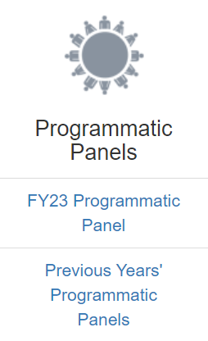
Programmatic Review Criteria – Listed in the Funding Opportunities
II.E.1.b. Programmatic Review
To make funding recommendations and select the application(s) that, individually or collectively, will best achieve the program objectives, the following criteria are used by programmatic reviewers:
Ratings and evaluations of the peer reviewers
Relevance to the mission of the DHP and FY23 PRMRP, as evidenced by the following:
Adherence to the intent of the award mechanism
Relevance to the FY23 PRMRP Topic Areas
Relevance to the FY23 PRMRP Strategic Goals
Relevance to military health
Program portfolio composition
Programmatic Panel membership lists are available on the CDMRP website
Notes:
Programmatic Panel membership lists are available on the CDMRP website
Consist of scientists, clinicians, consumers, and program staff from a wide variety of representative organizations
Like the peer review evaluation criteria, the programmatic review criteria are also outlined in the PA.
Intent of the award mechanism
Portfolio composition—programs will not fund poor applications, but if there’s a choice between two applications of equal scientific merit and one is in a topic area that already has a lot of strong projects, and one is in a less well supported topic area, that can be a factor in the funding recommendation.
Military relevance—be sure that you clearly document the potential implications of your research on the military as requested in the PA.
Relative impact—again for two projects of equal scientific merit, if one could have more of an impact on the target populations, this can be a factor.
The majority of feedback to the applicants comes from the peer review summary statement, but in the funding status letters there is minimal programmatic review feedback provided as well based on the programmatic review criteria. If applicants have additional questions those can be directed to the CDMRP helpdesk. Programmatic review is also confidential, however, the each program’s panel roster is published on its page on the CDMRP website.

Slide 10
Peer Reviewed Medical Research Program (PRMRP)

Slide 11
Peer Reviewed Medical Research Program (PRMRP)
Vision: Improve the health, care, and well-being of all military Service Members, Veterans, and beneficiaries
Mission: Encourage, identify, select and manage medical research projects of clear scientific merit that lead to impactful advances in health care of Service Members, Veterans, and beneficiaries
History
Initiated in 1999 to address diseases and conditions with relevance to military health
Direction from congress to support research of “clear scientific merit” and “direct relevance to military health” in specified topic areas
https://cdmrp.health.mil/prmrp/default

Slide 12
PRMRP’s FY23 Portfolio-Driven Approach
Autoimmune Disorders and Immunology
Cardiovascular Health
Infectious Diseases
Internal Medicine
Celiac Disease
Eczema
Food Allergies
Guillain-Barre Syndrome
Inflammatory Bowel Disease
Neuroinflammatory Responses to Emerging Viral Diseases
Proteomics
Rheumatoid Arthritis
Scleroderma
Familial Hypercholesterolemia
Hypercholesterolemia
Proteomics
Vascular Malformations
Hepatitis B
Malaria
Neuroinflammatory Responses to Emerging Viral Diseases
Proteomics
Tuberculosis
Endometriosis
Focal Segmental Glomerulosclerosis
Interstitial Cystitis
Lymphatic Disease
Lymphedema
Nephrotic Syndrome
Pancreatitis
Polycystic Kidney Disease
Pressure Ulcers
Proteomics
Hemorrhage Control and Blood Products
Hemorrhage Control
Proteomics
Trauma
Orthopaedic Medicine
Arthritis
Orthopaedics
Proteomics
Trauma
Respiratory Health
Proteomics
Pulmonary Fibrosis
Respiratory Health
Trauma
Neuroscience
Eating Disorders
Maternal Mental Health
Myalgic Encephalomyelitis/ Chronic Fatigue Syndrome
Neuroactive Steroids
Neuroinflammatory Responses to Emerging Viral Diseases
Non-Opioid Therapy for Pain Management
Peripheral Neuropathy
Proteomics
Sleep Disorders and Restriction
Suicide Prevention
Trauma
Rare Diseases and Conditions
Dystonia
Ehlers-Danlos Syndrome
Epidermolysis Bullosa
Fibrous Dysplasia/ McCune-Albright Syndrome
Fragile X
Frontotemporal Degeneration
Hereditary Ataxia
Hydrocephalus
Mitochondrial Disease
Myotonic Dystrophy
Proteomics
Sickle-Cell Disease
Von Hippel-Lindau Syndrome Benign Manifestations

Slide 13
FY23 PRMRP Funding Opportunities Available
Discovery
Investigator-Initiated
Technology/Therapeutic
Direct cost max: $200K
POP: 2 years
Eligibility: Post-docs, clinical fellows and above
LOI/Invite: Letter of Intent
Supports the exploration of highly innovative concepts or untested theories
Direct cost max: $1.6M/ $2.0M (PPIO)
POP: 4 years
Eligibility: PIs at or above Assistant Professor
LOI/Invite: Letter of Intent
Supports basic through translational research that will improve and impact the field of research or patient care
Direct cost max: $2.0M (FL1)/$4.0M (FL2)
POP: 4 years
Eligibility: PIs at or above Assistant Professor
LOI/Invite: Letter of Intent
Supports translation of preclinical findings into impactful products for clinical application
Letter of Intent is required for these mechanisms

Slide 14
FY23 PRMRP Funding Opportunities Available
Focused Program
Direct cost max: $7.2M
Eligibility: PIs at or above Full Professor
Clinical Trial
Direct cost max: $500K (PP)/no limit (full trial)
Lifestyle and Behavioral Health Interventions
Direct cost max: $3M
POP: 4 years
Supports synergistic, multidisciplinary research program of at least four distinct but complementary projects addressing an overarching goal
Eligibility: PIs at or above Assistant Professor
Planning Phase: Supports regulatory costs for trial planning to include IND/IDE submission; must have FDA approval before trial may be funded
Eligibility: PIs at or above Assistant Professor
Supports clinical research and/or clinical trials using a combination of scientific disciplines including behavioral health, psychology, psychometrics, biostatistics and epidemiology, surveillance, and public health
LOI/Invite: Pre-proposal submission is required; application submission is by invitation only
LOI/Invite: Pre-proposal submission is required; application submission is by invitation only
LOI/Invite: Letter of Intent
POP: 18 months (PP)/ 4 years full trial)
Clinical Trial: Supports rapid implementation of trials of novel interventions with the potential to have impact on patient care. May range from small through large-scale
POP: 4 years
Pre-proposal submission is required; application submission is by invitation only
Letter of Intent is required

Slide 15
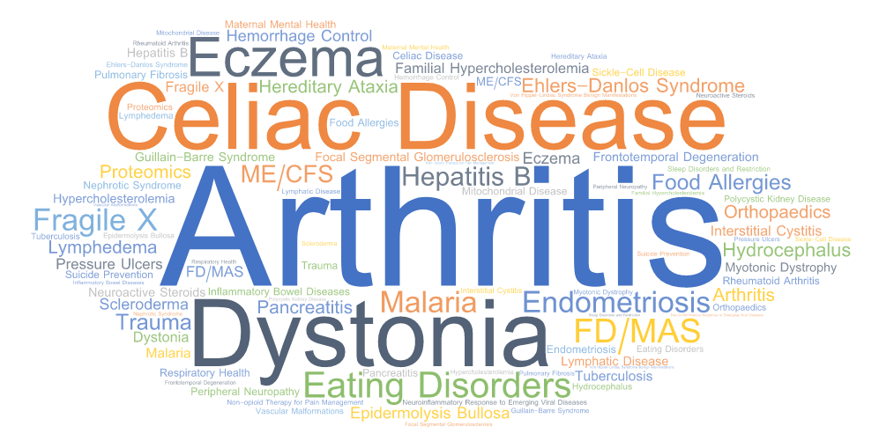
Required for All Funding Opportunities
Military Health Statement
Is the proposed research relevant to the health care needs of Service Members, Veterans, Military Beneficiaries, and/or the American Public?
EXAMPLES INCLUDE:
Dual-use capacity to benefit the civilian population and a need related to military health
Aspects of the target disease/condition with direct relevance to military heath
Contribution to family readiness of Service Members (mission readiness)
Support for the Warfighter and requirement for use in deployed setting
Proposals must address one:
FY23 PRMRP
Topic Area
FY23 PRMRP Portfolio-Specific
Strategic Goal
Autoimmune Disorders
and Immunology
Hemorrhage Control and Blood Products
Infectious Diseases
Orthopaedic Medicine
Respiratory Health
Internal Medicine
Cardiovascular Health
Rare Diseases and Conditions
Neuroscience
Notes:
Select examples of incidence in the military:
SMs are at a 50% greater risk for ALS
Substance abuse responsible for ~30% of Army’s suicide deaths
Female active duty SMs have a 20-40% higher incidence of breast cancer
Post-traumatic epilepsy affects ~2,187 Iraq/Afghanistan Veterans, with a 5 times higher mortality
1.8-fold SM increased risk of Parkinson’s
Commitment to the health and wellbeing of DoD families also directly contributes to the readiness of Service Members by allowing them to focus on their military mission

Slide 16
PRMRP Submission Deadlines
Award Mechanism | LOI | Pre-Proposal | Dates | Invitation to Submit | Full Application Deadline
Discovery Award (DA) |  |  | 29 March 23 |  | 26 April 23
Investigator-Initiated Research Award (IIRA) |  |  | 19 April 23 |  | 31 May 23
Technology/Therapeutic Development (TTDA) |  |  | 19 April 23 |  | 31 May 23
Lifestyle and Behavioral Health Interventions (LBIRA) |  |  | 19 April 23 |  | 31 May 23
Focused Program Award (FPA) |  |  | 12 April 23 | 17 June 22 | 19 July 23
Clinical Trial (CTA) |  |  | 12 April 23 | 17 June 22 | 19 July 23

Slide 17
Traumatic Brain Injury and Psychological Health Research Program (TBIPHRP)
Notes:
Dwayne PM, Michelle PH portfolio lead

Slide 18
FY23 TBIPHRP Vision and Mission
Vision
Optimize the prevention, assessment, and treatment of psychological health conditions and/or traumatic brain injuries
Mission
Fund research to understand, prevent, and treat psychological health conditions and/or traumatic brain injuries that accelerates solutions to improve the health and health care of Service Members, their Families, Veterans, and the American public
History
Initiated in fiscal year 2007 (FY07) in response to the traumatic brain injuries (TBIs) sustained and psychological health issues experienced by U.S. Service Members deployed to Iraq and Afghanistan
https://cdmrp.health.mil/tbiphrp/
Notes:
Highlight that TBIPHRP funds research focused on PH, TBI, OR research that addresses both.
Current program complements ongoing Department of Defense efforts toward promoting a better standard of care for psychological health and TBI in the areas of prevention, detection, diagnosis, treatment, and rehabilitation
From FY09-20 the appropriation was managed by USAMRDC-based research program areas aligned with the Office of the Assistant Secretary of Defense for Health Affairs and the Defense Health Agency
In FY07 and FY21-23, CDMRP was assigned to manage the appropriation

Slide 19
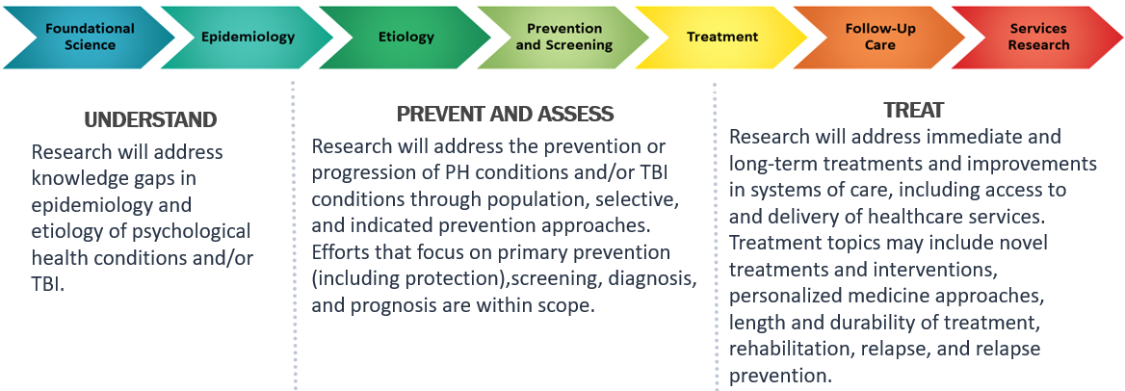
TBIPHRP Strategic Goals

Slide 20
FY23 TBIPHRP Anticipated Focus Areas
UNDERSTAND
Understanding of risk, protective, and biological factors contributing to an individual’s vulnerability to, response to, and long-term outcomes of psychological health conditions and/or TBI. Studies with an objective biomarker component are allowed.
Understanding sexual harassment and assault prevention, perpetration, victimization, and response. Methodologies that ensure anonymity for participants are strongly encouraged.
PREVENT AND ASSESS
Identification and validation of biomarkers or other objective markers for diagnosis, prognosis, or monitoring of psychological health conditions and/or TBI, repetitive exposures, and associated sequelae (e.g., chronic migraine, dizziness, neurocognitive symptoms, sleep, post-traumatic headache, secondary complications).
Approaches or tools to prevent or reduce risk of psychological health conditions and/or TBI.
Development of injury thresholds and exposure standards for TBI.
Development, evaluation, and implementation of crosscutting prevention approaches targeting upstream factors or leveraging communities and peers to address multiple adverse outcomes such as suicide, multiple forms of violence, and alcohol and substance use disorders.
Development of solutions to increase readiness and psychological resilience in individuals, small teams, families, and communities to ameliorate the potential negative impacts of specific military and life stressors.
Development of solutions to address aspects of workplace culture and climate (e.g., leadership attitudes, group characteristics, group identification factors) that are associated with increases in harmful behaviors.
TREAT
Interventions that promote sustained functional recovery, including interventions administered acutely, during the post-acute phase, or during the chronic phase of injury.
Validated methods for reducing barriers to care for psychological health conditions and/or TBI challenges (e.g., PTSD, suicidal ideation or behaviors, alcohol and substance use, anxiety, depression) and informing processes that lead to increases in help-seeking behavior.
Implementation, follow-up, and services research to increase provider adoption and availability of evidence-based treatments, as well as treatment engagement, follow-up care, and understanding of long-term outcomes.
Effective postvention strategies to address social connectedness during reintegration of individuals into workplace or community environments following a sexual assault, suicide event, or other severe trauma. Proposed research should also consider preventing subsequent suicides or other counterproductive behaviors among individuals and community members.
Major Focus Areas
Applications must address one or more of the Focus Areas, not all of which will be applicable to every award mechanism
See TBIPHRP Pre-Announcement for full text of focus areas (https://cdmrp.health.mil/pubs/press/2023/23tbiphrppreann).
Notes:
PRMRP is slightly further along than TBIPHRP in program cycle – TBIPHRP funding opportunities not yet released, but pre-announcement posted with anticipated focus areas and funding mechanisms.

Slide 21
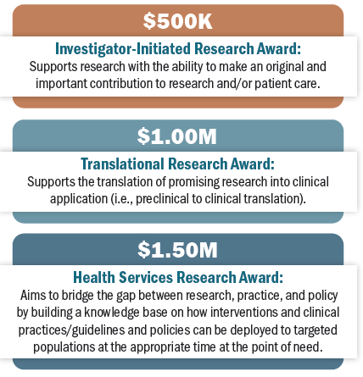
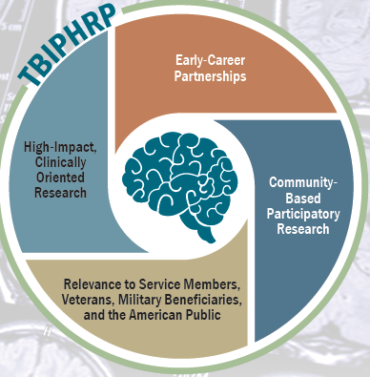
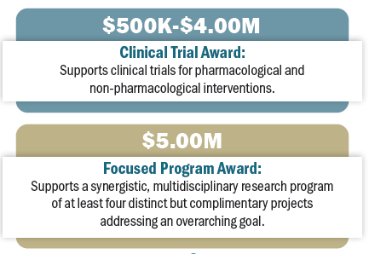
Anticipated FY23 TBIPHRP Funding Opportunities
$175M FY23 Appropriation
Notes:
Anticipated funding mechanisms span the research continuum – maturing ideas (IIRA), translational research (TRA, HSRA), clinical trials (CTA; TRA, HSRA and FPA also support CTs), and team science (FPA).

Slide 22
FY23 TBIPHRP Anticipated Funding Opportunities
Investigator-Initiated
Translational
Health Services
Direct cost max: $500K
POP: 3 years
Eligibility: Investigators at the level of Assistant Professor and above (or equivalent)
LOI/Invite: Letter of Intent
Supports research with the ability to make an original and important contribution to research and/or patient care.
Early Career Partnering PI Option is available.
Clinical trials will not be supported.
Direct cost max: $1M
POP: 4 years
Eligibility: Investigators at the level of Assistant Professor and above (or equivalent)
LOI/Invite: Letter of Intent
Supports the translation of promising research into clinical application (i.e., preclinical to clinical translation). May support small-scale pilot clinical trial when necessary to inform the next step in clinical development.
Early Career Partnering PI Option is available.
Direct cost max: $1.5M
POP: 4 years
Eligibility: Investigators at the level of Assistant Professor and above (or equivalent)
LOI/Invite: Letter of Intent
Bridges the gap between research, practice, and policy by building a knowledge base on how interventions and clinical practices/guidelines and policies can be deployed to targeted populations at the appropriate time at the point of need.
Clinical trials are allowed as long as they meet the intent of the mechanism.
Letter of Intent will be required for these mechanisms
Notes:
Pre-application and application deadlines will be available when the announcements are released.

Slide 23
FY23 TBIPHRP Anticipated Funding Opportunities
Clinical Trial
Focused Program
Direct cost max: $500K (FL1); $2M (FL2); $4M (FL3)
POP: 3 years (FL1); 4 years (FL2, FL3)
Eligibility: Investigators at the level of Assistant Professor and above (or equivalent)
LOI/Invite: Preproposal submission required; application submission by invitation only
Supports clinical trials for pharmacological (e.g., biologics, drugs) and non-pharmacological (e.g., devices, psychotherapy) interventions.
Different funding levels, based on the scope of research, are available. It is the responsibility of the Principal Investigator (PI) to select the funding level that is most appropriate for the research proposed.
Direct cost max: $5M
POP: 4 years
Eligibility: Investigators at the level of Full Professor and above (or equivalent)
LOI/Invite: Preproposal submission required; application submission by invitation only
Supports a synergistic, multidisciplinary research program of at least four distinct but complementary projects addressing an overarching goal.
Projects should work together to answer critical questions, resolve differing hypotheses, and translate laboratory findings to clinical applications.
Projects may range from exploratory to hypothesis-developing through small-scale clinical trials that together address the overarching goal/question.
Research team of highly qualified, multidisciplinary project leaders should be led by a PI with demonstrated success in directing large, focused projects.
Pre-proposal submission will be required; application submission by invitation only for these mechanisms
Notes:
For CTA - Different funding levels, based on the scope of research, are available. It is the responsibility of the applicant to select the funding level that is most appropriate for the research proposed. The funding level should be selected based on the scope of the research project, rather than the amount of the budget.

Slide 24
Tips, Resources, and Strategies for Success

Slide 25
CDMRP Website
Information available:
Program pages
Strategic Plans
Program booklets, summary sheets, information papers, etc.
Other program-specific resources
Pre-announcements and Funding Opportunities
Research and Consumer Highlights
Search awards
Annual reports
Webinar series and videos
Other guides and resources
cdmrp.health.mil

Slide 26
Applying for Funding
Understanding the goals of the program, intent of the award mechanism, and review criteria is critical for a successful application
The funding opportunity announcement contains information on:
Program Goals
Focus Areas/Topics
Award Intent
Required Elements, Eligibility, and Funding
Review Criteria
Deadlines
Single most important tip: Read the announcement carefully
Notes:
Final tip – simple but crucial: read the PA carefully.
Contains information on…
Contains detailed instruction on what to include in each application file
Contains not only review criteria but also questions that reviewers will use to evaluate the proposal against each criteria

Slide 27
Strategies for Success
Relevance
Address program-specific goals
Align the proposed work with specific guidance from the announcement
Impact
Propose solutions to important problems or gaps
Clearly articulate translatability – how will this work make a difference?
Innovation
Provide clear rationale if proposing to test new, potentially high-risk ideas or use novel approaches
Feasibility
Justify a technically sound plan with clear approaches for contingencies
Include evidence of appropriate expertise (collaboration, consultants, etc.)
Ensure the study is appropriately powered for the proposed research outcome
Demonstrate availability and access to critical resources, reagents, and/or subject populations

Slide 28
Strategies for Success
Planning/Timelines
Include and allow adequate time in project plan for regulatory approvals if required
For multi-organizational efforts, show a clear plan for coordination and communication
For DOD collaborations, understand rules and plan for differences in funding process
Grantsmanship
Explain the proposed work with clarity and unburdened by jargon
Understand the different audiences of the peer and programmatic reviews and communicate effectively
Review application documents carefully before submission – Enlist experienced colleagues to help
Don’t break the rules for deadlines or requirements – be compliant

Slide 29
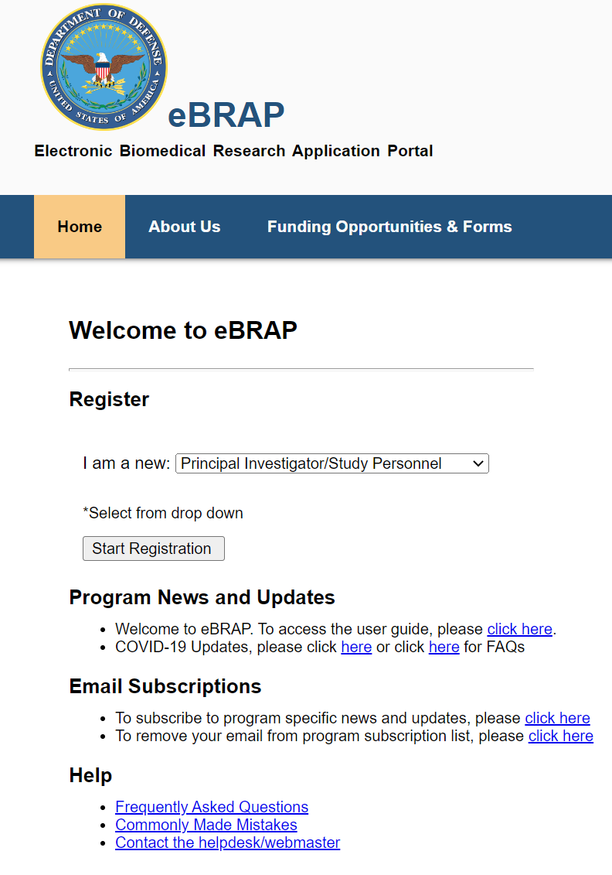
Subscribe to Email Notifications
Sign up for listserve through CDMRP website or in eBRAP
Notes:
But, rather than looking at these individual sites hoping to find an applicable funding announcement, you can simply subscribe to one of the CDMRP list serves. Signing up for our emails will put you on the list to be directly notified about upcoming funding opportunities making you one of the first people learn about them.
You can access the sign-up from either ebrap or the CDMRP website and once there you will be able to select specific programs or research areas so that you only receive updates about topics that match your areas of interest.

Slide 30
Questions? For more information, please visit: cdmrp.health.mil
Notes:
Thank you for your interest in the CDMRP. For more information, please visit us at cdmrp.health.mil.

