Slide 1
Patient-centered Outcomes Research Institute PCORI
Els Houtsmuller, Associate Director, Science
AFSP/AISR Funders Panel 4/6/2023

Slide 2
Overview
About PCORI
Comparative Effectiveness Research
PCORI Suicide Prevention Research
PCORI Funding Opportunities
Information for Applicants

Slide 3
1.
About PCORI

Slide 4
About Us
An independent research institute authorized by Congress in 2010, reauthorized in 2019, and governed by a 23-member Board of Governors representing the entire healthcare community
Funds comparative effectiveness research (CER) that engages patients and other stakeholders throughout the research process
Seeks answers to real-world questions about what works best for patients based on their circumstances and concerns

Slide 5
Our Mission
PCORI helps people make informed health care decisions, and improves health care delivery and outcomes, by producing and promoting high integrity, evidence-based information that comes from research guided by patients, caregivers and the broader health care community.

Slide 6
Who are our Stakeholders?
Clinician
Caregiver/ Family Member of Patient
Patient/ Caregiver Advocacy Org
Hospital/ Health System
Purchaser
Payer
Industry
Policy Maker
Training Institution
Patient/ Consumer
PCORI Community

Slide 7
2.
Comparative Effectiveness Research

Slide 8
Comparative Effectiveness Research (CER)
CER:
Studies that compare health outcomes and the effectiveness, risks, and benefits of two or more approaches to healthcare
Approaches may include: treatments, diagnostics, protocols, care delivery strategies, patient support options, treatment settings, organization of care, other
Measures benefits in real-world settings and populations
Describes results in subgroups of people (Heterogeneity of Treatment Effects)
Helps consumers, clinicians, purchasers, health systems, and policy makers make informed decisions that will improve care and health outcomes for individuals and populations
Informs a specific clinical or policy decision

Slide 9
PCORI CER Portfolio
AS OF MARCH 2022

Slide 10
3.
PCORI Suicide Prevention Research
Notes:
Presenter: Els

Slide 11
Funded Studies
Suicide Prevention
Arnold | “Preventing Suicide among Sexual and Gender Diverse Young Adults in Primary Care in Texas” N=592
Asarnow | “Youth Partners in Care for Suicide Prevention (YPIC-SP)” N=1516
D’Amico | “Comparative Effectiveness of Two Culturally Centered Suicide Interventions for Alaska Native Youth” N=370
Maddox | “A Comparison of Two Brief Suicide Prevention Interventions Tailored for Youth on the Autism Spectrum” N=1500
Clark | “Large pragmatic trial to prevent suicide attempts, deaths in moderate-to-high risk youth” N=9800
Radin | “The SPARC Trial: Comparing Safety Planning Plus Structured Follow-Up from a Suicide Prevention Hotline (SP+SFU) to Usual Care (Safety Planning without Follow-Up) for Suicide Prevention Among Adult & Adolescent Recipients of Care in Emergency Departments & Primary Care Settings” N=1460
Barzman | “A Multi-Site Study to Compare the Outcomes of Psychiatric Treatment of Suicidal Adolescents in Different Treatment Settings” N=1000

Slide 12
4.
PCORI Funding Opportunities

Slide 13
Broad Pragmatic Studies
Investigator-initiated applications for CER projects in the following priority area
3 cycles/year
Up to 5 years
Up to $10M
Existing Interventions and Emerging Innovations in Health Advance the Science of Dissemination, Implementation, and Health Communication (DIHC)
Accelerate Progress Toward an Integrated Learning Health System Achieve Health Equity
Improving Methods for Conducting Patient-Centered Outcomes Research

Slide 14
Phased Large Awards for CER (PLACER)
PLACER Funding Announcement:
Requires a Data Coordinating Center (DCC)
MUST be a randomized design
“Phased” Contract: Feasibility period (18 months) followed by full scale trial (5 years)
Max. total direct costs: 2M for feasibility, 20M for full scale trial
3 cycles/year

Slide 15
Targeted Funding Announcement
Topic-specific
Up to 5 years
Variable funds available
Example: Suicide Prevention: Brief Interventions for Youth (C3 2020)
4 studies funded

Slide 16
5.
Information for Applicants

Slide 17
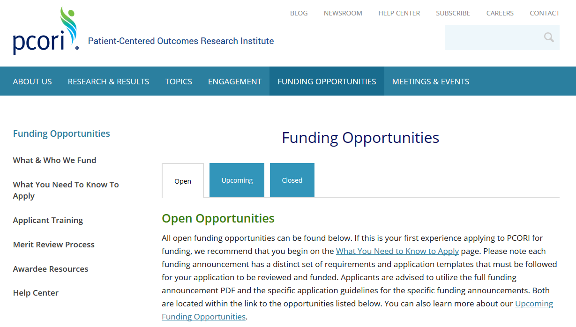
PCORI Funding Opportunities
Our research funding is awarded through PCORI Funding Announcements.
Open opportunities are posted at pcori.org/apply.

Slide 18
Free Resources to Support Multi-Stakeholder Research Teams
Research Fundamentals
Building Effective Multi-Stakeholder Research Teams
Provides foundational knowledge in PCOR/CER to
partners on research and other projects.
For new and experienced researchers and stakeholder partners, offers practical guidance and resources to support multi-stakeholder teams in effectively working together.
Available at: pcori.org/research-fundamentals
Available at: pcori.org/research-teams
28

Slide 19
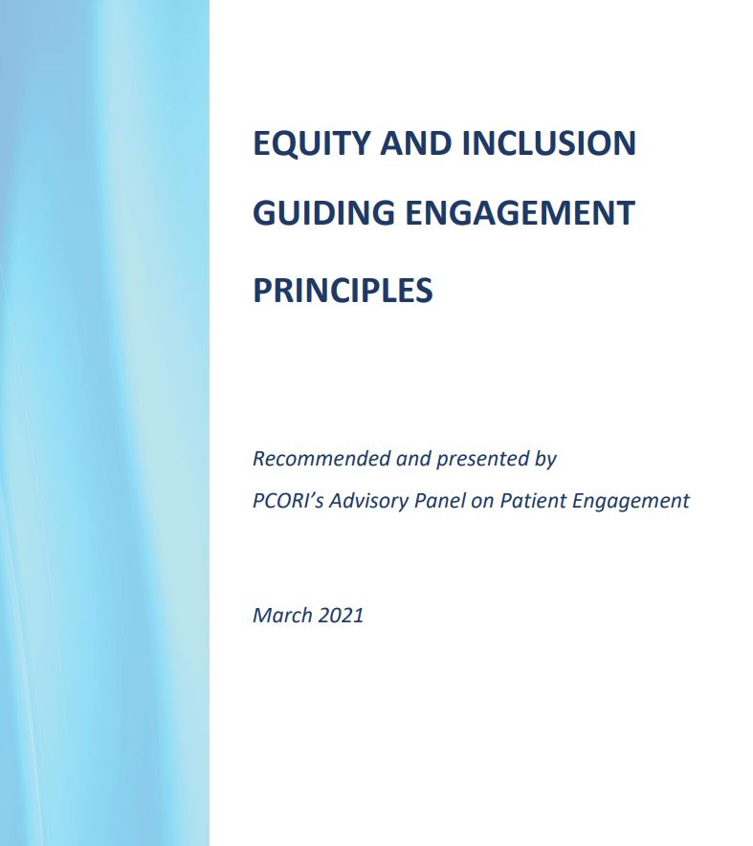
New Resources to Support Engagement in Research
Equity and Inclusion Guiding Engagement Principles
Guide for Engaging with Research Partners about Data and Analysis
Building Effective Multistakeholder Research Teams
Research Fundamentals
Digital Strategies for Returning Value to Research Participants
Strategies for Improving Representativeness in Research Governance
Value Proposition Playbook for Participant-Driven Research in Health Care
More can be found on PCORI’s Engagement Resources page

