Slide 1


Suicidal Behavior across the adult life-span: Changes in clinical and cognitive risk factors
Katalin Szántó, MD
University of Pittsburgh szantok@upmc.edu gsuicide.pitt.edu

Slide 2
Levels of investigations to suicidal behavior
Systems Neuroscience
Genetics /
Molecular Neuroscience
Neuropathology / Neurochemistry
Intra-Psychic Mechanisms / Temperament
Cognitive Neuroscience
Family / Environmental Factors
Socio-Cultural Processes

Slide 3
Do clinical and cognitive risk factors change during the adult life-span? Lifespan developmental effects
Is late-onset suicidal behavior a distinct subtype?
Age at first suicide attempt is useful for:
understanding the clinical/cognitive & broader biological heterogeneity of suicidal behavior
giving information about subtypes of attempters that may need different treatment

Slide 4
Stress-Diathesis Model of Suicide (J. Mann)
Is the diathesis unchanged?
Same biomarkers for all attempters, or there are distinct subtypes?
Stressor
Diathesis
Psychiatric disorder
Hopelessness
Suicidal behavior
Psychosocial crisis
Impulsivity or aggression
Notes:
According to the influential stress-diathesis model states (depression, intoxication, psychosis) interact with trait predispositions that facilitate suicidal behavior (e.g., impulsivity, tendency to ruminate, to have hopeless thinking). However, this model as all the other models of suicide, do not consider age-specific changes in vulnerabilities. For example, cognitive deficits are common and often co-occur with depression in late-life, and impair decision-making, while as I will show impulsive-aggression decline with age.

Slide 5
AFSP Lifespan Study PI-s: Keilp, Bridge, Szanto
To assess adult lifespan developmental effects on clinical and cognitive risk factors for suicidal behavior.
Attempter/non-attempter differences, age interactions, and their relative contributions of attempter classification
Participants: aged 16 – 80, unipolar, non-psychotic MDD
Attempters (recent history of suicide attempt)
Non-Attempters
Non-psychiatric controls

Slide 6
Key constructs in multiple theories of suicide
Neurocognitive abilities
Executive function,
Memory
Impulsivity
Aggression
Borderline traits
Social Problem Solving
Impulsive/Careless,
Avoidant, Rational,
Positive problem solving
Rumination
Entrapment

Slide 7
(Buerke et al., 2022)

Slide 8
(Buerke et al., 2022)

Slide 9
(Wang, 2023)

Slide 10
Conclusions: Risk factors for suicidal behavior evolve differently with increasing age
Borderline traits, aggression, and trait impulsivity are mitigated, in contrast to neurocognitive deficits that worsen with age
Borderline traits, aggression, trait impulsivity, impulsive problem-solving style, deficits in memory and category fluency are predictors of suicide attempt across the adult lifespan
Rumination and entrapment do not distinguish attempters at younger ages, but become significant predictors in older age

Slide 11
Suicidal behavior is heterogeneous
One dimension of heterogeneity may be age of onset of first lifetime attempt.
Is late-onset suicidal behavior a distinct subtype?

Slide 12
Longitudinal Research Program in Late-Life Suicide
Participants with unipolar depression followed to prospectively identify risk factors (total sample N ~ 500 depressed older adults)
Clinical, neurocognitive assessments, game theory experiments to understand how cognitive abilities, decision making, personality characteristics contribute to suicide risk in the elderly.
Case-control design to separate the effects of:
  depression (healthy-aging controls vs depressed groups)
  contemplation of suicide (ideators vs attempters)
  Within the attempters: medical seriousness, age-of onset of suicidal behavior

Slide 13
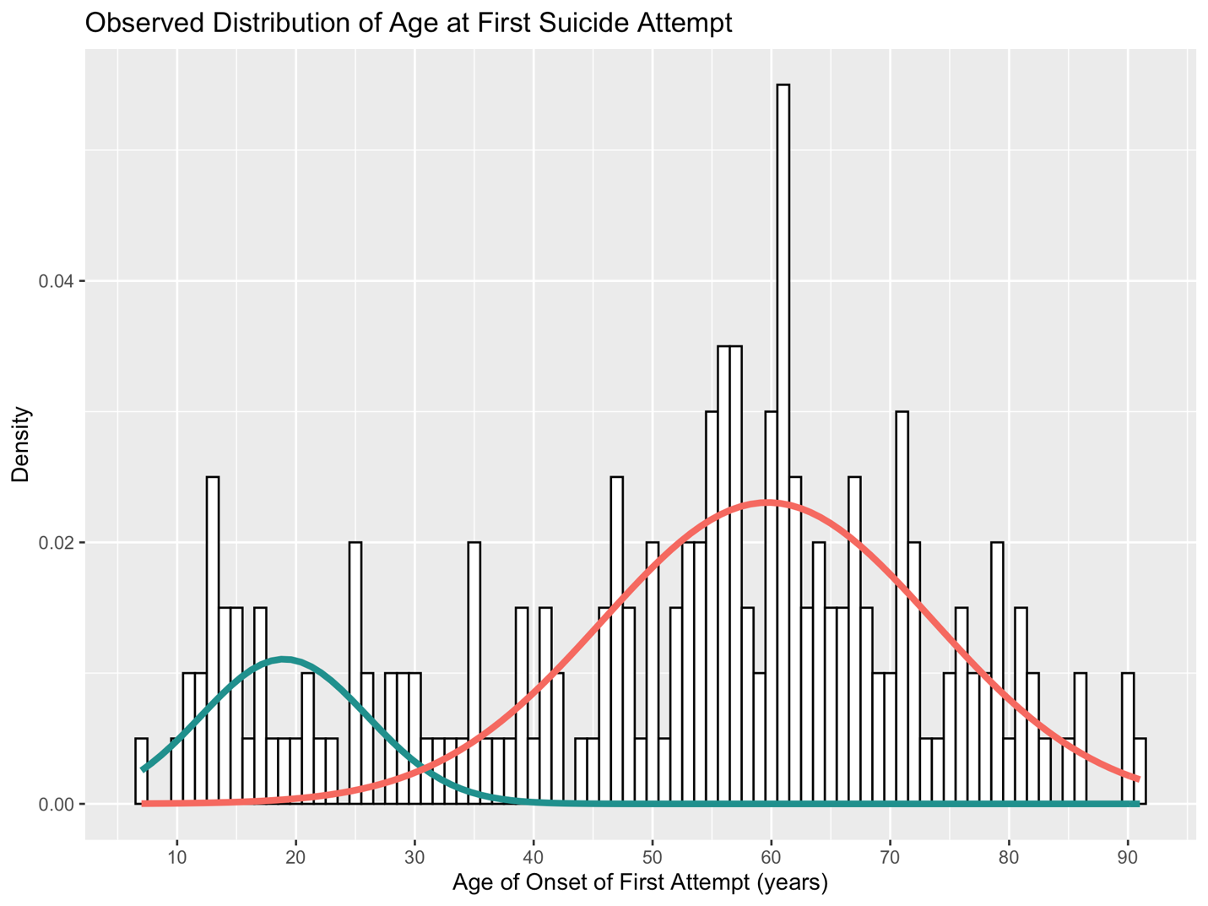
Chang et al., 2023

Slide 14
Age at first suicide attempt is a marker for different subtypes of suicidal behavior findings from the Pittsburgh longitudinal studies
Attempters
Early-Onset
Late-Onset
Family aggregation of suicide attempt and suicide, Social transmission
Personality traits
(neuroticism, introversion, and cluster B traits)
Childhood trauma
Real-life negative decision-making, financial, legal, interpersonal
Worse cognitive functions
(global cognition, processing speed, and memory)
High orderliness, Rigidity, Need for control, Autonomy
(Kenneally et al., 2019)
(Szücs et al., 2020; Chang et al., 2023)
(Perry et al., 2021)
(Gujral et al., 2020)
(Szücs, in preparation)

Slide 15
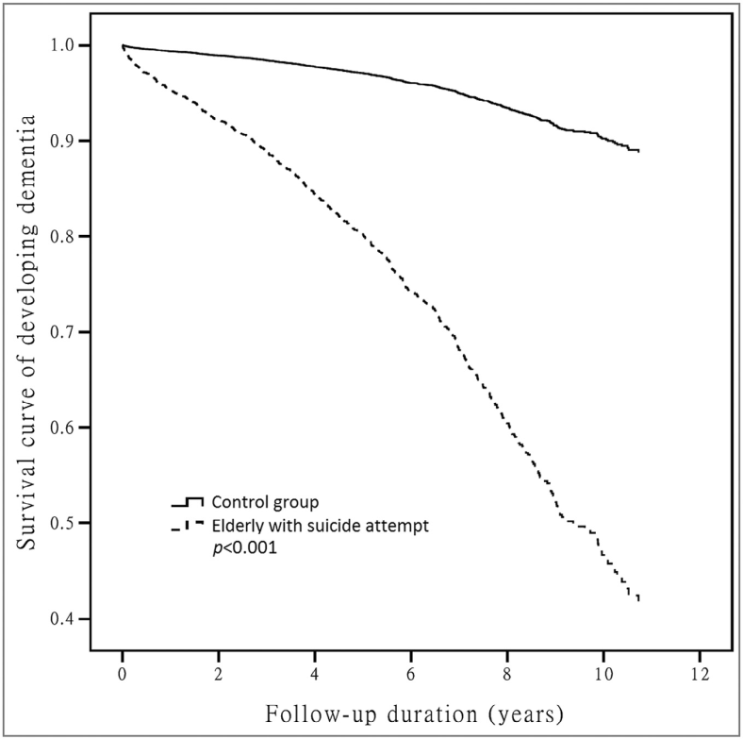
Elderly who attempted suicide were prone to developing dementia (Tu, 2016).
Late-onset attempters had a seven-fold increased risk for subsequent dementia compared to older adults without a late-life suicide attempt.

Slide 16
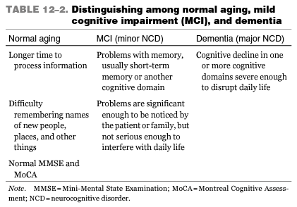
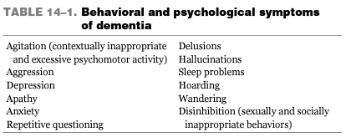
With age comes wisdom - and cognitive changes.
Late-onset depression often behavioral symptom dementia
Depression
Dementia
From Dunn & Cassidy-Eagle, Eds (2020)

Slide 17
Conclusions
Accumulating evidence that cognitive deficits are trait biomarkers of suicidal behavior, that worsen with aging
Cognitive deficits and DM give information about subtypes of attempters that may need different treatment
Age at first suicide attempt is useful for understanding the clinical/cognitive and broader biological heterogeneity of suicidal behavior.
Cognitive and decision-making deficits may contribute to the accumulation of stressors and the perceived inability to solve them.

Slide 18
Clinical Implications
Assess cognitive function
Late-onset suicidal behavior may be the prodrome for dementing illness
Cognitive control deficits impair complex DM
Those with cognitive/DM impairment experience more stressful life events and more likely to perceive it as unsolvable
Consider suicide attempters as a heterogeneous group regarding cognition, personality traits, decision making abilities.

Slide 19


Acknowledgments
PROTECT Staff
Hanga Galfalvy
John Keilp
Jeff Bridge
Anna Szucs
Morgan Buerke
Akira Wang
Swathi Gujral
Yama Chang
gsuicide.pitt.edu

