Slide 1



Using human brain imaging and
Genetics/epigenetics to identify therapeutic targets for suicide prevention
The MIND-MB team
Ramiro Salas, PhD
rsalas@bcm.edu

Slide 2
Outline
1. Genetics/epigenetics and brain imaging interactions in suicidality (not all patients are the same)
2. Two examples: AKAP7/subiculum and NFIA/callosum-amygdala
3. MicroRNA-124 and brain structure in borderline
4. The future

Slide 3
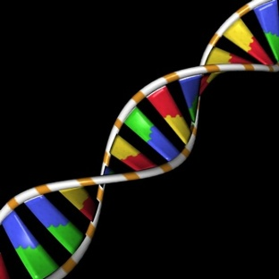
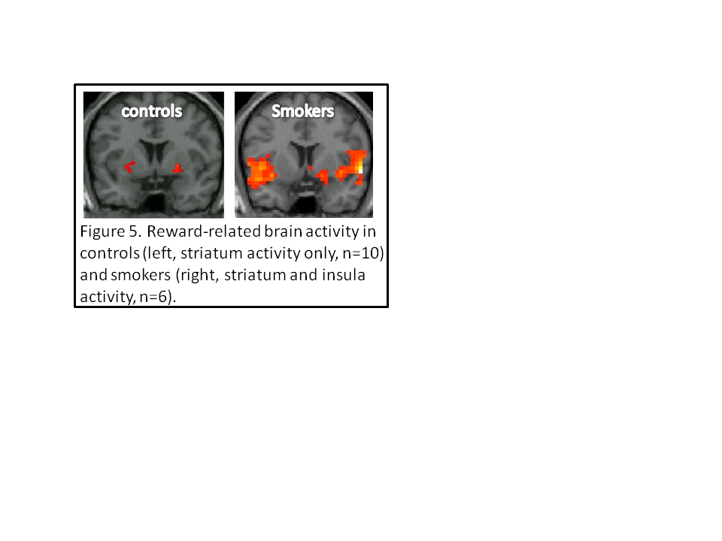
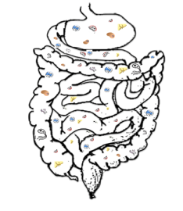
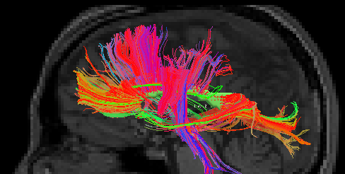
The McNair Initiative for Neuroscience Discovery – Menninger/Baylor
MIND-MB Project
Brain Activity
Genetics
Epigenetics
Microbiome
DIAGNOSES
RESEARCH
DIAGNOSIS
Brain Connectivity
Brain Connecti
PERSONALIZED TREATMENT
(for future patients)
PERSONALIZED TREATMENT
(future)
The MIND-MB team
Ramiro Salas, PhD
rsalas@bcm.edu

Slide 4
Psychiatric diagnoses in MIND-MB patients
N = 518
Notes:
Here is an overview of psychiatric diagnoses in our patient sample. Major depression, anxiety, and substance use disorders were most common. But as you can see our patients had a wide range of psychiatric problems. You can see from the graph that over 50% of patients had either major depression, substance use, or an anxiety disorder and if your wondering why these numbers don’t add up to 100 its because this is population of patients is representative of a real clinic population in which most patients have at least co-occurring disorders. We believe its very important for the generalizability of our findings to study a realistic population of psychiatric individuals and not one that has been pruned for comorbidities like in the majority of previous research.
Point to those I list

Slide 5
ProcessGeneLists: PGL
Genetics explores the question “which genes are associated with a phenotype?”
Human brain imaging explores the question “which areas of the brain are associated with a phenotype?”
We want to explore the question “which genes, by affecting function where in the brain, are associated with a phenotype?”
Poblete et al,
J Neurosc Methods 2020

Slide 6
ProcessGeneLists: PGL
Our novel method to combine human brain imaging and genetic data.
Create a list of genes (in this case, genes possibly associated with suicidality)
Study where in the brain are these genes most co-expressed (Allen Brain Atlas for human mRNA)
Study those areas in a sample of suicidal and non-suicidal patients
Find which genes in the relevant areas interact with suicidality

Slide 7
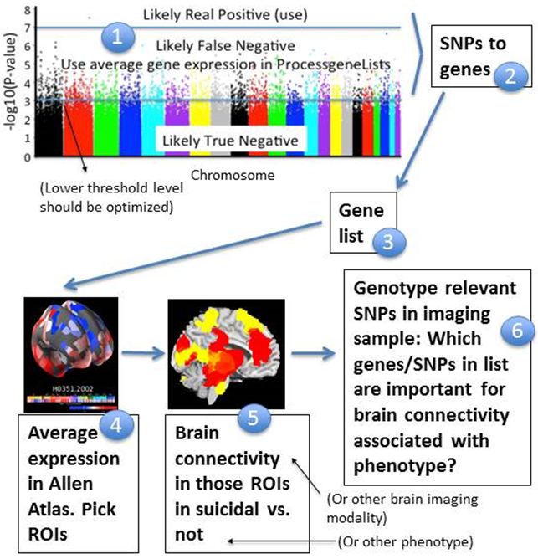
ProcessGeneLists
Poblete et al, J Neurosc Methods 2020

Slide 8
Outline
1. Genetics/epigenetics and brain imaging interactions in suicidality (not all patients are the same)
2. Two examples: AKAP7/subiculum and NFIA/callosum-amygdala
3. MicroRNA-124 and brain structure in borderline
4. The future

Slide 9
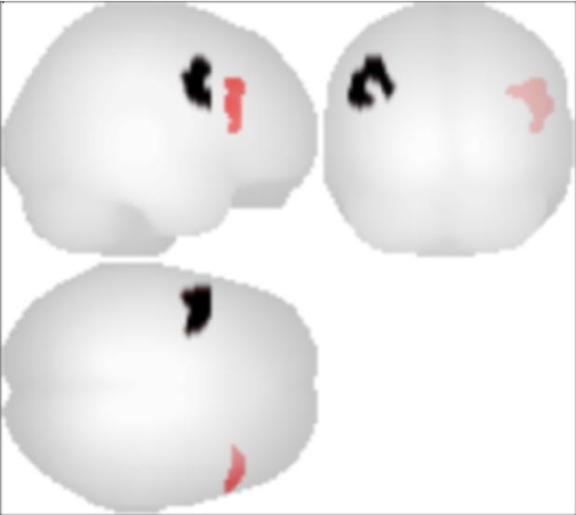
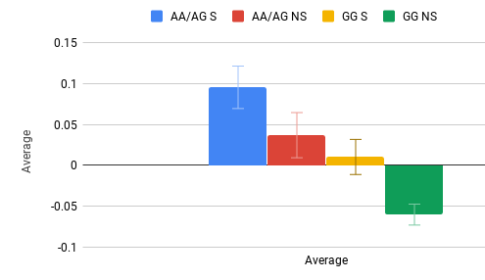
AKAP7 genotype, past suicide attempt, and subiculum connectivity
Subiculum/dlPFC resting state functional connectivity
AKAP7 rs3777487
RSFC
Poblete et al, 2022

Slide 10
AKAP7 genotype, past suicide attempt, and subiculum connectivity
Subiculum/dlPFC resting state functional connectivity
AKAP7 rs3777487
RSFC
TMS?
Poblete et al, 2022

Slide 11
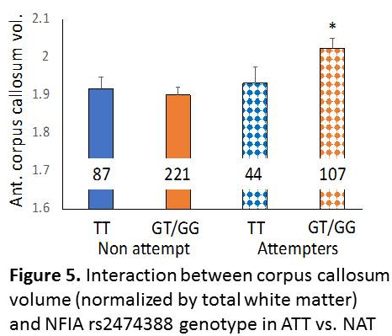
Corpus callosum, amygdala and NFIA
NFIA important in astroglia
in callosum, hippocampus, amygdala
The callosum, one of eight past attempt PGL highlighted regions, was larger (anterior part) in ATT patients.
NFIA (one of the 5 top genes “pointing” to the callosum) interacted with that effect.
Next: Study NFIA in suicide amygdala in human ex-vivo.

Slide 12
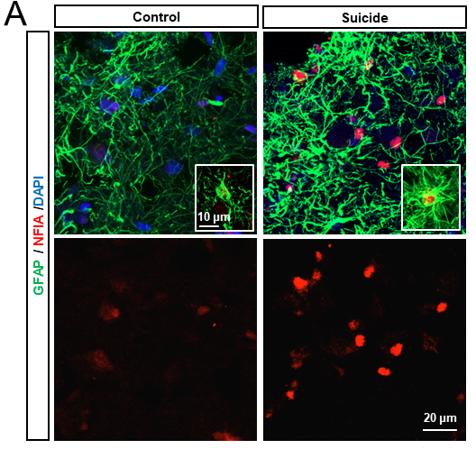
Corpus callosum, amygdala and NFIA, human ex-vivo
Humans who died of suicide had higher NFIA expression in amygdala

Slide 13
Corpus callosum, amygdala and NFIA, mouse
Mice overexpressing NFIA in amygdala behaved as more depressed.
The mechanism is through higher MAO-B in astrocytes.

Slide 14
Corpus callosum, amygdala and NFIA, mouse
Mice overexpressing NFIA in amygdala behaved as more depressed.
The mechanism is through higher MAO-B in astrocytes.
Selegiline?

Slide 15
Outline
1. Genetics/epigenetics and brain imaging interactions in suicidality (not all patients are the same)
2. Two examples: AKAP7/subiculum and NFIA/callosum-amygdala
3. MicroRNA-124 and brain structure in borderline
4. The future

Slide 16
MicroRNAs and brain structure in borderline
1. MicroRNAs (miRNA) affect the expression level of large (commonly hundreds) groups of genes.
2. miRNAs are promising therapeutic targets.
3. miRNA-124 was previously associated with borderline personality disorder (BPD).
4. We studied the top genes most likely modulated by miRNA-124 using PGL to obtain hypotheses of brain function in BPD.

Slide 17
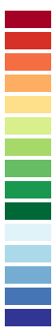
Targets of miR-124-3p used in PGL identify the Globus Pallidus as the top region of interest
miR-124-3p
Prados, et.al.
TargetScan
v8.0
93 genes
Aggregate P_{CT} >0.99
A
PGL
B
C
Structure Name | Ranking | Freq
globus pallidus, external segment, left | 0.61666667 | 5
globus pallidus, internal segment, left | 0.6 | 6
substantia nigra, pars reticulata, left | 0.5 | 5
corpus callosum | 0.43333333 | 6
zona incerta, left | 0.16666667 | 5
middle temporal gyrus, left, inferior bank of gyrus | 0.15 | 6
putamen, left | 0.11666667 | 6
superior temporal gyrus, left, lateral bank of gyrus | 0.11666667 | 6
vestibular nuclei, left | 0.11666667 | 6
long insular gyri, left | 0.1 | 5
superior olivary complex, left | 0.1 | 5
reticular nucleus of thalamus, left | 0.06666667 | 5
substantia nigra, pars compacta, left | 0.06666667 | 5
lateral group of nuclei, left, ventral division | 0.05 | 5
cingulate gyrus, frontal part, left, inferior bank of gyrus | 0.01666667 | 6
Aloi et al, 2023

Slide 18
Levels of miR-124 are increased in BPD patients, who have a lower Globus Pallidus volume
A
B

Slide 19
Agreeableness negatively correlates with Pallidum volume
in Borderline only
Better
Agreeableness
Left Pallidum Vol/eTIV
Notes:
Suicide ideation al entrar v L pall vol.

Slide 20
Suicidal ideation recovery in BPD only is correlated with
left pallidum volume
A
B
C
Get better
Δ Ideation Intensity
Left Pallidum Vol/eTIV

Slide 21
Suicidal ideation recovery in BPD only is correlated with
left pallidum volume. Effect of Age
A
B
C
D
Get better
Age
Δ Ideation Intensity
Left Pallidum Vol/eTIV
Left Pallidum Vol/eTIV

Slide 22
Outline
1. Genetics/epigenetics and brain imaging interactions in suicidality (not all patients are the same)
2. Two examples: AKAP7/subiculum and NFIA/callosum-amygdala (not all patients are the same)
3. MicroRNA-124 and brain structure in borderline (not all patients are the same)
4. The future (not all patients are the same)

Slide 23
The future
Our novel method can study genetics and brain function together.
Now we have targets that span both genetic variants and the brain regions to be modulated.
Hopefully we will be able to keep separating types of suicide patients to find biomarkers specific for each sub-group.

Slide 24
The future
Our novel method can study genetics and brain function together.
Now we have targets that span both genetic variants and the brain regions to be modulated.
Hopefully we will be able to keep separating types of suicide patients to find biomarkers specific for each sub-group. (not all patients are the same)

Slide 25
The team
Peter Bolin, Vanessa Heredia, Mianjel Jack, Cassie Jennings, Tien Nguyen, Nitin Srinivasan; undergraduate students
Guillermo Poblete MS
Dr. Savannah Gosnell PhD
Drs. Elisa Ambrosi, David Molfese, Hyuntaek Oh
Asasia Carter, Kaylah Curtis, Chris Frazier, Mark Harding, Danna Ramirez, Kenia Velasquez, Humsini Viswanath; research coordinators
Dr. Charles Neblett; McNair Foundation
Drs. Philip Baldwin, Gabriel De Erausquin, Chris Frueh, Chris Fowler, Igor Zwir, Tom Kosten, Dave Nielsen, John Oldham, Michelle Patriquin, Rocio Romero, Katrina Rufino,
AFSP, NIDA, NARSAD, McNair Foundation,
Veteran Health Administration

