Slide 1
Implicit Associations with Death / Suicide and Suicidal Behavior Across the Adult Lifespan
Jeffrey A. Bridge, PhD

Slide 2
Collaborators
Donna Ruch, Ph.D.
John Keilp, Ph.D.
Katalin Szanto, M.D.
Hanga Galfalvy, Ph.D.
Marianne Gorlyn, Ph.D.
Arielle Sheftall, Ph.D.
Laura Kenneally, B.A.
Jacki Tissue, B.A.
Sean Madden, M.S.
Navya Singh, Psy.D.
Morgan Buerke, B.A.
Chenyang Wang, B.S.
Ainsley Burke, Ph.D.
J. John Mann, M.D.

Slide 3
Collaborators
Donna Ruch, Ph.D.
John Keilp, Ph.D.
Katalin Szanto, M.D.
Hanga Galfalvy, Ph.D.
Marianne Gorlyn, Ph.D.
Arielle Sheftall, Ph.D.
Laura Kenneally, B.A.
Jacki Tissue, B.A.
Sean Madden, M.S.
Navya Singh, Psy.D.
Morgan Buerke, B.A.
Chenyang Wang, B.S.
Ainsley Burke, Ph.D.
J. John Mann, M.D.

Slide 4
Disclosures
Dr. Bridge receives research grant funding from the National Institute of Mental Health (NIMH), the Centers for Disease Control and Prevention (CDC), and the Patient-Centered Outcomes Research Institute (PCORI).
Study funded by Linked Grant from AFSP.
Dr. Bridge is a member of the Scientific Advisory Board of Clarigent Health.

Slide 5
Overview
Screening for suicide risk
Death/Suicide Implicit Association Test (d/s-IAT)
Lifespan study and d/s-IAT Analysis

Slide 6
Screening for Suicide Risk
Screening for suicide risk allows us to identify individuals at risk and provide or connect them to necessary mental health resources.
While many will disclose suicidal thoughts and behaviors when asked directly through self-report screening, some may be reluctant to discuss thoughts or plans.
Franklin et al., 2017; Kleiman et al., 2017; Carter et al., 2017

Slide 7
Opportunities
Given this reluctance and the transient nature of suicidal thoughts and behaviors, our almost exclusive reliance on self-report measures limits our ability to effectively assess suicide risk.
Opportunities exist to improve screening by incorporating additional measures that do not rely on self-report.
Franklin et al., 2017; Kleiman et al., 2017

Slide 8
Death/Suicide Implicit Association Test
Detection of implicit associations with self and death/suicide can provide a complementary approach to patient self-report.
A widely studied measure of implicit associations is the Death/Suicide Implicit Association Test (d/s-IAT).
Glenn et al., 2017; Barnes et al., 2016; Nock et al., 2010

Slide 9
Death/Suicide Implicit Association Test
The d/s-IAT is a computerized task that examines implicit self-identification with “death/suicide” or “life”.
Participants categorize words to the left or right based on the categories at the top of the screen (“ME” vs. “NOT ME” and “LIFE” vs. “DEATH”).

Slide 10
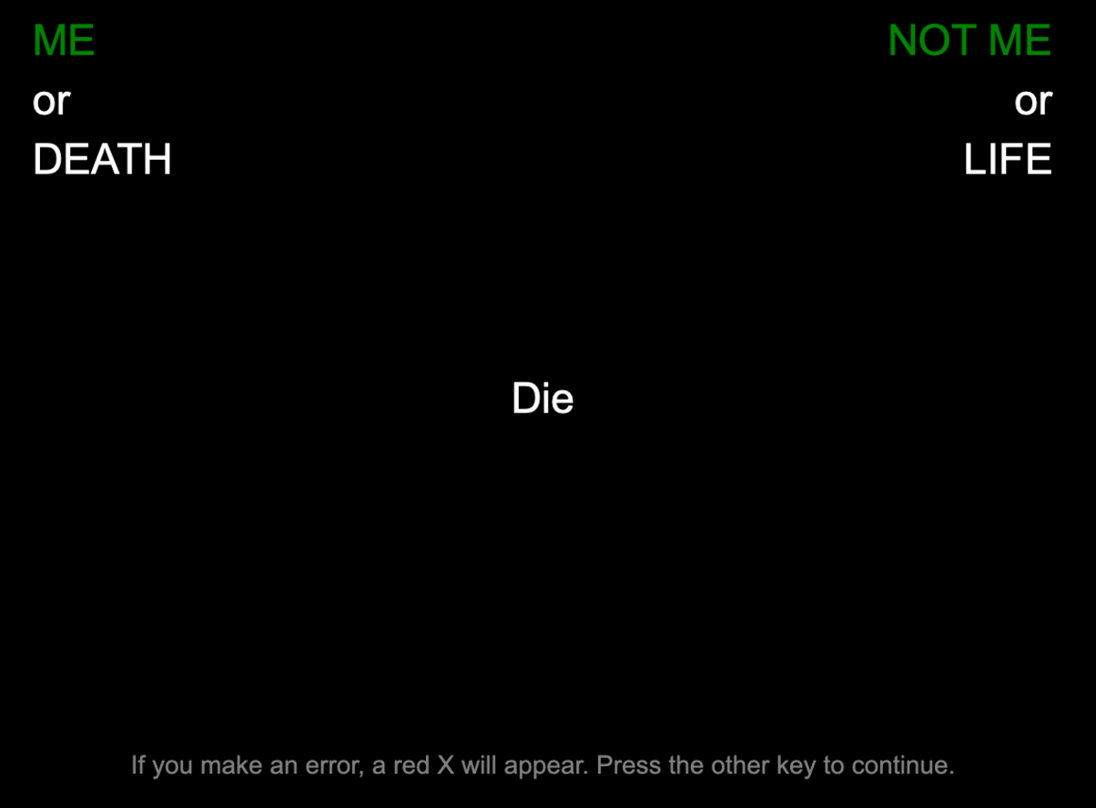
Death/Suicide Implicit Association Test

Slide 11
Death/Suicide Implicit Association Test
For each participant, a standardized difference or D-score is calculated for blocks of trials, with both test and practice trials.
Based on difference in reaction times between blocks of word associations with “me” and “death” compared to “me” and “life”.
Prior research shows individuals at risk for suicide respond more quickly to stimuli related to “me” and “death”, and slower when “me” and “life” are represented.
Glenn et al., 2017; Barnes et al., 2016; Nock et al., 2010

Slide 12
Death/Suicide Implicit Association Test
Higher D-Scores
(faster responding to the “death/me” blocks relative to “life/me” blocks).
Stronger association between self and death/suicide.
Lower D-Scores
(slower responding to the “death/me” blocks relative to “life/me” blocks).
Stronger association between self
and life.

Slide 13
AFSP Lifespan Study: d/s-IAT Analysis
Prior research with selective samples show strong implicit associations of death/suicide with self detects and predicts future suicidal behavior.
Unclear if these effects extend through adulthood.
Barnes et al., 2016; Nock et al., 2010; Tello et al., 2020

Slide 14
AFSP Lifespan Study: d/s-IAT Analysis
Examined if implicit association with death/suicide distinguishes suicide attempters, depressed non-attempters, and healthy controls across the adult lifespan.
Further assessed if age modified the association between group status and d/s-IAT performance.
Additional analyses looked at group differences and age effects in mean median response times for specific test and practice blocks of the d/s-IAT.

Slide 15
AFSP Lifespan Study: d/s-IAT Analysis
Initial sample comprised participants aged 16 to 80 years (N=309).
61 participants (19.7%) were excluded from analyses because d/s-IAT computer tasks did not meet established quality control criteria.
Final sample (N=248)
Those who failed were evenly distributed from among the clinical groups.
Excluded subjects were older, less educated, and had poorer estimated intelligence.
Greenwald et al., 2003

Slide 16
Sample Demographics
HC – Healthy Controls; NON – Depressed Non-Attempters; ATT - Depressed Attempters

Slide 17
Sample Clinical Characteristics
HC – Healthy Controls; NON – Depressed Non-Attempters; ATT - Depressed Attempters

Slide 18
d/s-IAT Performance
 | Healthy Controls (N=86) |  | Depressed Non-Attempters (N=80) |  | Depressed Attempters (N=82) |  | P-Value
 | Mean | SD | Mean | SD | Mean | SD
IAT D-Score | -0.95 | 0.32 | -0.71 | 0.36 | -0.68 | 0.46 | <.001 | HC< NON,ATT
HC – Healthy Controls; NON – Depressed Non-Attempters; ATT - Depressed Attempters
Group differences on D-scores driven by significantly higher scores in depressed groups compared to healthy controls.
Statistical significance maintained beyond the effect of study site and demographics that differed significantly between groups including age, race, and ethnicity.

Slide 19
d/s-IAT Measures Across the Lifespan
Depressed attempters were significantly more likely to associate with death/suicide compared to healthy controls (b = -.01, p<.044), but this association diminished with age.

Slide 20
d/s-IAT Response Time
 | Healthy Controls (N=86) |  | Depressed Non-Attempters (N=80) |  | Depressed Attempters (N=82) |  | P-Value
 | Mean | SD | Mean | SD | Mean | SD
IAT CRT | 1081.3 | 263.2 | 1000.6 | 305.5 | 1101.0 | 308.1 | .001 | HC, NON<ATT
HC – Healthy Controls; NON – Depressed Non-Attempters; ATT - Depressed Attempters; CRT, Composite Response TIme
Group differences on the composite response time measure driven by significantly slower reaction times in suicide attempters
  *results consistent across IAT blocks (e.g., long Death, Suicide/Me, short Life/Me).
Statistical significance maintained beyond the effect of study site and demographics that differed significantly between groups including age, race, and ethnicity.

Slide 21
d/s-IAT Response Times Across the Lifespan
Age and group effects on total mean median reaction time were significantly different between depressed attempters and healthy controls (b = 4.99, p<.023), with group differences increasing at older ages.

Slide 22
Exploratory Analyses: Age and Recency of Attempts
 | Healthy Controls (N=86) |  | Depressed Non-Attempters (N=80) |  | Depressed Attempters (N=82) |  | P-Value
 | Mean | SD | Mean | SD | Mean | SD
IAT D-Score | -0.75 | 0.34 | -0.57 | 0.31 | -0.34 | 0.49 | .02 | HC, NON<ATT
HC – Healthy Controls; NON – Depressed Non-Attempters; ATT - Depressed Attempters
Suicide attempters < age 30 who made their most recent attempt within 6 months had significantly higher D-scores compared to depressed non-attempters and healthy controls.
If the age range was expanded to > age 30, attempters were no longer significantly different than non-attempters, nor if the time since the most recent attempt was > than 6 months.

Slide 23
What Did We Learn . .
The D-Score did not discriminate suicide attempters across the lifespan.
Association with death/suicide in all groups was stronger at younger ages, but not in later adulthood.
Diminishing IAT effects in later adulthood, possibly due to reduced self-attributions toward death at older ages, or possibly due to psychometric factors.

Slide 24
What Did We Learn . .
Developmental effects appear to have an impact on the sensitivity of behavioral tasks to suicidal behavior across the lifespan.
Computerized tasks relying on the computation of difference scores may not function well in older age groups.
Particularly true for tasks based on subtle reaction time differences between conditions.

Slide 25
Thank you!!

