Slide 1
Emotion-based impulsivity, emotion regulation, and suicidal ideation and behavior in schizophrenia spectrum disorder
By: Matthew J. Hoptman, PhD

Slide 2
This project was supported by Grant SRG-0-064-17 awarded to Matthew Hoptman from the American Foundation for Suicide Prevention. The content is solely the responsibility of the authors and does not necessarily represent the official views of the American Foundation for Suicide Prevention.
Disclosures

Slide 3
Outline
Outline
Impulsivity
Findings on emotion-related impulsivity in schizophrenia (urgency)
Suicidality in schizophrenia
Treatment implications
Broader implications

Slide 4
Dimensions of Impulsivity
Impulsivity in schizophrenia
Disagreement about what constitutes impulsivity
Delayed discounting, response inhibition, lack of planning, sensation seeking
Decoupling of emotion from impulsivity (BIS; Barratt, 1993)
Subscales: motor, attentional, and nonplanning impulsivity
Development of newer scales to measure impulsivity (Whiteside and Lynam, 2001)
Subscales of urgency, lack of premeditation, lack of planning, and sensation seeking (UPPS)
Urgency: rash action in the context of strong emotions
Example: “When I feel bad, I will often do things I later regret in order to make myself feel better now.”
Addition of positive urgency (Cyders and Smith, 2007) – UPPS-P

Slide 5
Newer Findings on Impulsivity
IMPULSIVITY IN SCHIZOPHRENIA
Urgency is elevated in numerous psychiatric disorders
Specificity in bulimia
ADHD + ODD
Alcohol and substance use disorders
Schizophrenia is characterized by reduced affective expression, but experience of emotion is equivalent to healthy individuals (Green & Lee, 2012)

Slide 6
Urgency in Schizophrenia
Impulsivity in schizophrenia
Study of impulsivity and aggression in schizophrenia (Hoptman et al., 2014)
33 patients with schizophrenia or schizoaffective disorder
31 healthy controls
Patients were administered the UPPS-P, the Aggression Questionnaire, the Impulsive/ Premeditated Aggression Scale, and the Life History of Aggression
MRI scanning: resting-state fMRI and cortical thickness

Slide 7
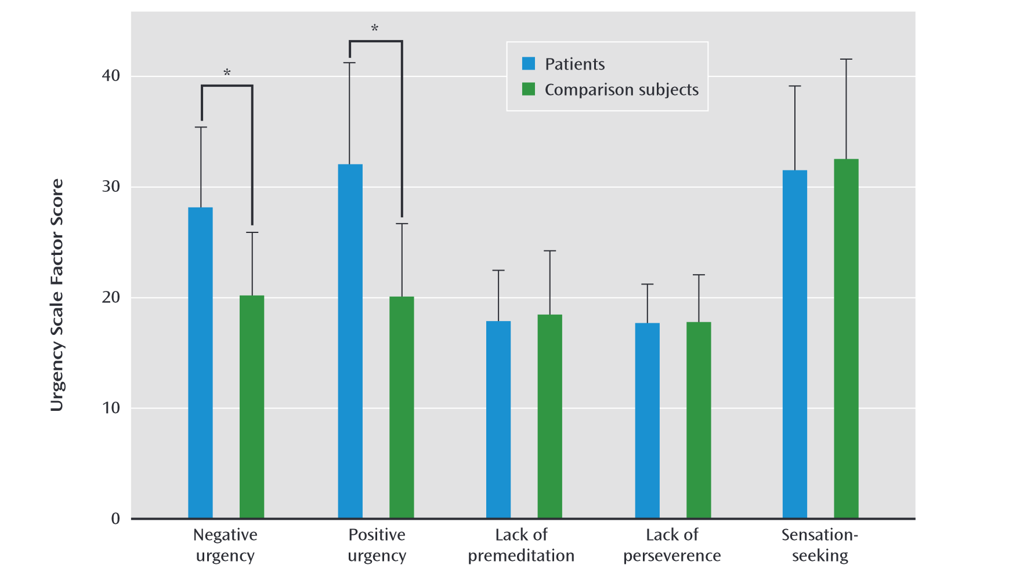
Impulsivity in schizophrenia
Urgency was selectively increased in schizophrenia
Hoptman et al. 2014

Slide 8
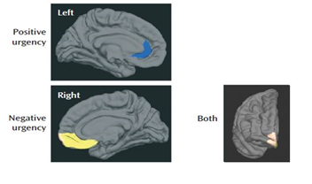
Reduced cortical thickness in ventral prefrontal regions was associated with urgency, as was their functional connectivity with limbic and other frontal regions
Impulsivity in schizophrenia
Hoptman et al., 2014

Slide 9
Urgency and Suicidality

Slide 10
Suicidality in Schizophrenia
Urgency and suicidality
Suicidal ideation and behavior (SIB) is highly elevated in schizophrenia, with up to 40% having at least one attempt and 5-10% of patients dying by suicide
Rate of death from suicide is higher than in major depressive disorder
The mechanisms underlying SIB in schizophrenia are poorly understood, but we have hypothesized that it may relate to poor emotion regulation, which may in turn be related to urgency
Psychotic symptoms may also associate with SIB, particularly those related to command auditory hallucinations and paranoid delusions

Slide 11
AFSP funded study
Urgency in suicidality
Enrolled 35 people with schizophrenia spectrum disorder
Inclusion: ages 18-60 years
Exclusion: recent alcohol or substance use disorder, significant, unstable medical illness, score of 2 on the Columbia-Suicide Severity Rating Scale (C-SSRS; Posner et al., 2011) for both lifetime and the past year
Eligibility determined by CSSR-S
High SIB group (n=18)
2+ attempts AND/OR
Score of 3-5 on C-SSRS in the past 12 months
Low SIB group (n=17)
No attempts
Score of <2 on C-SSRS lifetime
Hoptman et al., 2023

Slide 12
Assessments
Urgency in suicidality
UPPS-P – Urgency, (Lack of) Premeditation, (Lack of Perseverance), Sensation Seeking scale (Whiteside & Lynam, 2001; Cyders & Smith, 2007)
Beck Scale for Suicidal Ideation (BSSI; Beck and Steer, 1991)
Provides ratings for suicidal ideation (past week)
Positive and Negative Syndrome Scale (PANSS; Kay et al., 1987)
Rates psychopathology (Positive, Negative, Excited Mood, Cognition, and Depression symptoms) for past-week
Hoptman et al., 2023

Slide 13
Behavioral Results
Urgency in suicidality
Positive and Negative Urgency correlated positively with BSSI total scores (r_{s} > .38, ps < .025). Negative urgency also correlated with lifetime suicide attempts (r_{s} = .48, p = .003).
Negative urgency correlated positively with Excitement and Depression Scale (r_{S} > .41, ps = .015)
Excitement and Depression symptoms correlated positively with BSSI Scores (r_{S} > .61, p < .001).
Likewise, lifetime suicide attempts correlated with PANSS Excitement (r_{s} = and Depression (r_{s} > .36, p = .031) factors.
Hoptman et al., 2023

Slide 14
Prediction of Group Membership
Urgency in suicidality
To examine which of the interrelated measures were most important in predicting group membership, we conducted a binary logistic regression analysis
Negative urgency was the significant variable, discriminating groups (OR = 1.12, p = .045)
Group membership was predicted with 77% accuracy
Hoptman et al., 2023

Slide 15
Urgency in suicidality
Quantile multiple regression and mediation analyses showed that only Negative Urgency mediated the relationship between the BSSI total scores and the PANSS Excitement and Depressions factor.
This mediation effect for Depression accounted for 46% of the total effect in BSSI scores
The reverse was not true for Depression, but was for Excitement
Hoptman et al., 2023

Slide 16
Neuroimaging
Imaging and suicidality in SSD
Participants completed a task where they saw emotionally negative or neutral pictures from a standardized set (Foti & Hajcak, 2008; Wang et al., 2017)
Half of the emotionally negative pictures were preceded by a neutral spoken sentence (NeutNeg), and half were preceded by a negative sentence (NegNeg). All neutral pictures were preceded by a neutral sentence
After each picture, participants rated the unpleasantness of the picture
The neutral statement for negative pictures is meant to render the negative picture as less unpleasant than when the negative sentence is presented
Unpublished results, do not cite

Slide 17
Imaging and suicidality in sSD
Task Schematic
Unpublished results, do not cite

Slide 18
Neuroimaging Results
Imaging in suicidality in SSD
Participants reliably related NegNeg pictures as more unpleasant than NeutNeg pictures (p = 10⁻⁵)
An fMRI comparison (NeutNeg-NeutNeut) on the emotion regulation task was associated with higher activation in left and right superior frontal gyrus, right middle cingulate gyrus, right dorsolateral prefrontal cortex (DLPFC), left medial frontal gyrus, and right superior temporal gyrus in the low SIB than the high SIB group (TFCE threshold p = .05, corrected).
Across groups, activation in most of these regions correlated negatively with SIB on multiple measures on the C-SSRS.
Activation in several of these regions correlated negatively with negative urgency (r_{s} < -.41, ps < .023).
Unpublished results, do not cite

Slide 19
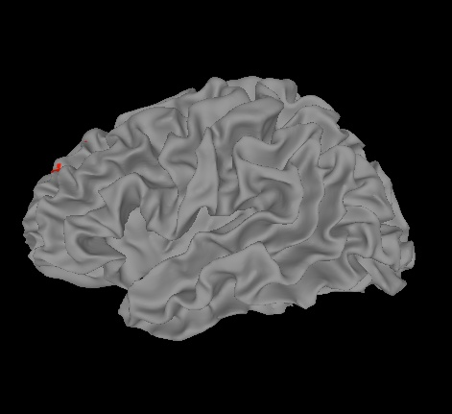
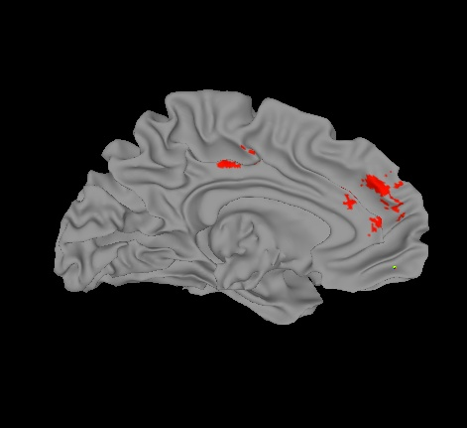
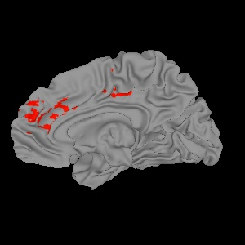
Imaging in suicidality in SSD
Lateral
Medial
LH
RH
Unpublished results, do not cite

Slide 20
Conclusions
conclusions
Results also support the idea that negative urgency – rash action in the context of strong negative emotions – is an important predictor of SIB in schizophrenia.
Project supports the hypothesis that there is a deficit in activation of emotion regulation circuitry in people with schizophrenia who have high levels of SIB compared to those with low levels of SIB that is related to negative urgency.
Critical questions for the future have to do with the dynamics of emotion regulation and/or urgency and what the situation is in those in early psychosis
Unpublished results, do not cite

Slide 21
Thank you

Slide 22
@afspnational

