Slide 1
Preparing pharmacists to communicate with and refer individuals with suicide warning signs
Delesha Carpenter, PhD, MSPH
Associate Professor & Executive Vice Chair
Division of Pharmaceutical Outcomes and Policy
United States

Slide 2
Objectives
Describe the development of a suicide prevention
gatekeeper program for pharmacy staff (Pharm-SAVES)
Present data on the impact of Pharm-SAVES on
outcomes for practicing community pharmacists in
the U.S.

Slide 3
Define
problem | Pharmacy staff interact with suicidal patients
Review
literature | Existing pharmacy suicide trainings
Identify
gaps & unmet needs | Lack of communication training
Conduct
stakeholder survey | Surveyed NC pharmacists
Identify
stakeholder preferences | Conducted formative study
Work
with stakeholders to develop training | Pharm-SAVES
Carpenter et al (2018). A review of suicide prevention programs... JAPhA, 58(5), 522-529.
Carpenter et al (2020). Community pharmacy staff interactions... RSAP, 16(3), 349-359.
Carpenter et al (2021). Gatekeeper training needs of community pharmacy staff. SLTB, 51(2), 220-228.
Pothireddy et al (2022). Developing and evaluating a module…. Curr Pharm Teach Learn, 14(4), 449-456.
Stover et al (2023). Development of the Pharm‐SAVES educational module... Health Expectations, 26(3), 1246-1254.

Slide 4
Stakeholder Panel
4 pharmacists and pharmacy technicians
Pt-provider communication specialist
Suicide prevention expert
Educational design specialist
Website designer

Slide 5
Iterative Training Development Process
Present Results
Analyze data
Prioritize Content
Draft Content
Module
Video scripts
Share findings
Review & Revise
Share drafts
Revise
Select barriers to address

Slide 6
Iterative Training Development Process
Present Results
Analyze data
Prioritize Content
Draft Content
Module
Video scripts
Share findings
Review & Revise
Share drafts
Revise
Select barriers to address

Slide 7
Iterative Training Development Process
Present Results
Analyze data
Prioritize Content
Select barriers to address
Draft Content
Module
Video scripts
Share findings
Review & Revise
Share drafts
Revise

Slide 8
Module Objectives
30 minutes

Slide 9
Module Topics
Why me?
What can I do? (SAVES)
How does it work?
Resources
Notes:
Why me discusses the important role of pharmacists in suicide prevention
Presents pharmacy-specific suicide interaction data

Slide 10
What Can I Do? (SAVES)
Defines each step of the SAVES acronym
Example quotes about each step from pharmacy staff
Notes:
Meat of the module

Slide 11
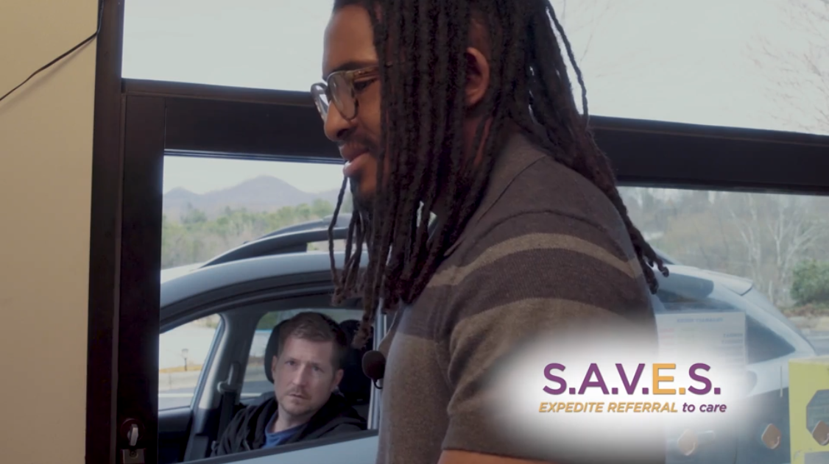
How Does It Work?
Short videos that model:
phone interaction
in-person interaction with a Veteran
drive-through interaction
Carpenter DM, Roberts CA, Lavigne JE, Cross W. (2021). Gatekeeper training needs of community pharmacy staff. SLTB, 51(2), 220-228.

Slide 12
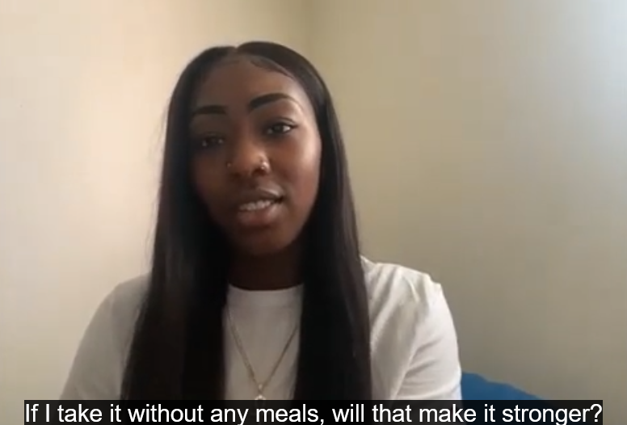
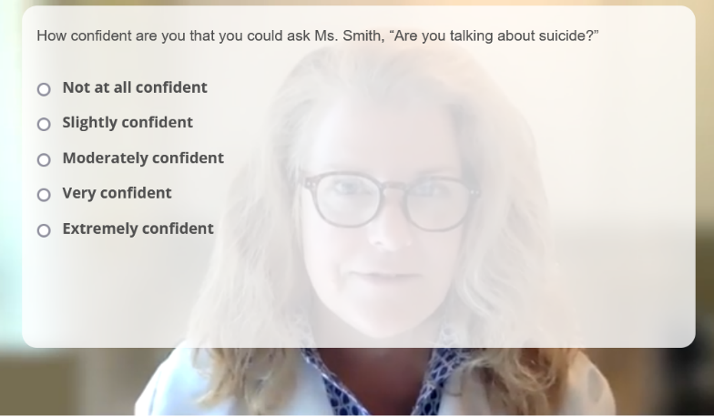
Interactive Video Cases (Intervention Group)
Carpenter DM, Roberts CA, Lavigne JE, Cross W. (2021). Gatekeeper training needs of community pharmacy staff. SLTB, 51(2), 220-228.
Notes:
A second case depicts an upbeat, female patient “Ms. Smith” who asks about how much it would take to overdose on her medication. In each case, the trainee watches the video and types of responses to several questions, which are interspersed throughout the video. Example questions include: “Does Mr. Jones show any signs of suicide?” or “How confident are you that you can ask Ms. Smith about suicide?”. Questions are a combination of free text response and multiple choice where the participant is provided feedback after their response is submitted.

Slide 13
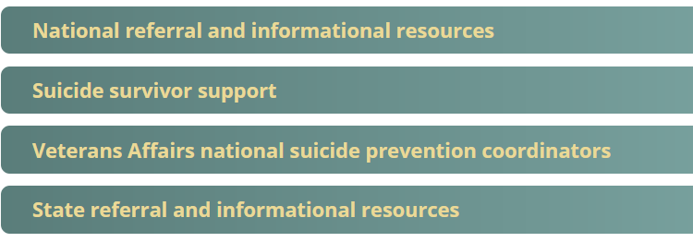
Resources
Online resources
Written resources
Flyers
Wallet card
Printable flowchart
Local resource referral tool

Slide 14
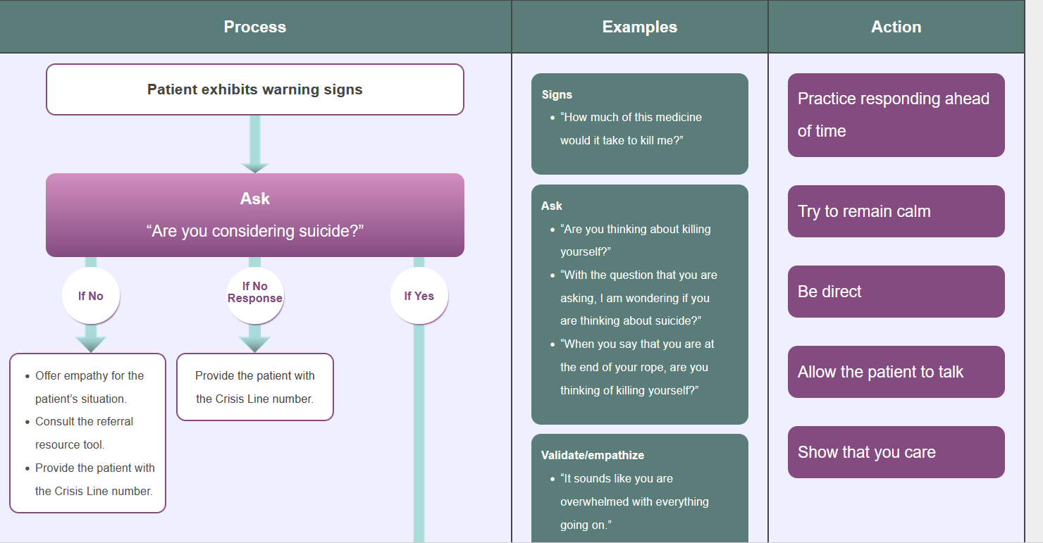

Slide 15
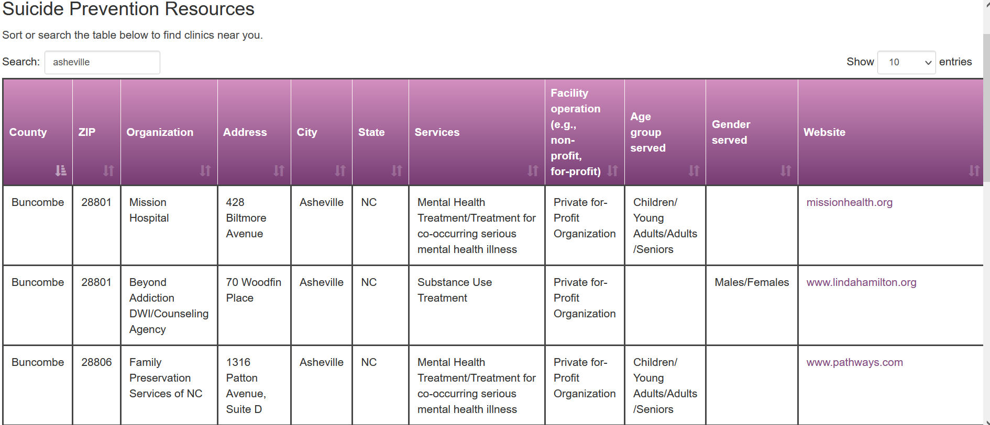

Slide 16
Randomized Controlled Trial
Objective
Determine whether Pharm-SAVES improves pharmacy staff members’ suicide prevention knowledge, gatekeeper self-efficacy, gatekeeper preparedness, and responses to a hypothetical patient case
Population
120 community pharmacy staff in GA, NC, SC, and TN
Procedures
Consent obtained, randomized to intervention vs control, online training completed, immediate posttest
Notes:
Intervention group had access to the two interactive video cases and the control group did not

Slide 17
Measures
Suicide
prevention knowledge
9 multiple choice questions
Range 0-9
Gatekeeper
self-efficacy
6 items
Response scale: 1=not at all confident 5=extremely confident
Gatekeeper
preparedness
6 items
Response scale 1=not prepared 5=quite well prepared
Referral and communication behavior
Written case
Behaviors coded by 2 independent coders
Notes:
Knowledge based on training content
Gatekeeper self-efficacy: how confident pharmacy staff were that they could perform various suicide prevention tasks (based on validated Wyman measure)
Gatekeeper preparedness: how well-prepared they feel to perform various gatekeeper activities (based on Wyman et al measure)

Slide 18
Sample Characteristics (N=87) | N (%)
Age in years 18-29 30-39 40-54 55+ | 17 (20%) 25 (29%) 31 (36%) 14 (16%)
Female | 61 (70%)
Race/ethnicity White Non-White | 78 (90%) 9 (10%)
Role Pharmacist Technician | 71 (82%) 15 (17%)
Had previous suicide prevention training | 12 (14%)
Close to someone who had died by suicide | 15 (17%)
No significant effects for intervention group
Notes:
Of the 120 who enrolled, 87 completed the immediate post-training survey (73% completion rate)
Older people, men, and pharmacists were more likely to complete the follow up.

Slide 19
Suicide Prevention Knowledge (n=87)
Mean knowledge scores increased from 5.3 at pretest to 7.2 at posttest
(p<0.001)
 | N (%) Incorrect Pretest | N (%) Incorrect Posttest
One in 5 community pharmacy staff in NC have been asked to advise on a fatal dose of medication | 55 (63%) | 4 (5%)
What is the best way to respond to someone who states, “I want to go to sleep and never wake up?” | 51 (59%) | 16 (18%)
It is within your scope of practice to call the Crisis Line and provide information for patient without liability. | 33 (38%) | 4 (5%)
Notes:
87 people completed immediate post-training post-test
Those who completed training were (add diffs)

Slide 20
Gatekeeper Self-efficacy
Mean gatekeeper self-efficacy significantly increased from 2.57 to 3.68 (p<0.001)
How confident are you in your ability to… | Pretest (Mean, SD) | Posttest (Mean, SD)
Identify the signs of suicide | 2.33 (0.82) | 3.49 (0.75)
Listen without judgment to someone talking about suicide | 3.34 (1.06) | 3.84 (0.76)
Respond appropriately to patients who have suicidal thoughts | 2.32 (0.90) | 3.51 (0.76)
Give reassurance to someone with thoughts of suicide | 2.51 (0.98) | 3.56 (0.80)
Provide resources for suicide prevention | 2.39 (1.05) | 3.84 (0.81)
Refer a patient with thoughts of suicide to other resources | 2.52 (0.99) | 3.82 (0.76)
How confident are you in your ability to… | Pretest (Mean, SD) | Posttest (Mean, SD)
(S) Identify the signs of suicide | 2.33 (0.82) | 3.49 (0.75)
(V) Listen without judgment to someone talking about suicide | 3.34 (1.06) | 3.84 (0.76)
Respond appropriately to patients who have suicidal thoughts | 2.32 (0.90) | 3.51 (0.76)
(E) Give reassurance to someone with thoughts of suicide | 2.51 (0.98) | 3.56 (0.80)
(E) Provide resources for suicide prevention | 2.39 (1.05) | 3.84 (0.81)
(E) Refer a patient with thoughts of suicide to other resources | 2.52 (0.99) | 3.82 (0.76)
Responses ranged from 1=not at all confident to 5=extremely confident

Slide 21
Gatekeeper Preparedness
How prepared do you feel to perform the following… | Pretest (Mean, SD) | Posttest (Mean, SD)
Communicate with a patient at risk of suicide to help put them at ease. | 2.79 (1.10) | 4.94 (1.24)
Persuade a patient at risk of suicide to seek help. | 2.93 (1.24) | 5.05 (1.21)
Contact the Crisis Line about a patient who is at risk of suicide. | 2.92 (1.30) | 5.51 (1.19)
Convince a patient who is at risk of suicide to contact the Crisis Line. | 2.94 (1.36) | 5.10 (1.13)
Make a follow-up phone call to a patient who you are concerned may be at risk of suicide. | 3.31 (1.57) | 5.59 (1.26)
Ensure a follow-up phone call is made to a patient who you are concerned may be at risk of suicide. | 3.25 (1.52) | 5.63 (1.25)
How prepared do you feel to perform the following… | Pretest (Mean, SD) | Posttest (Mean, SD)
(V) Communicate with a patient at risk of suicide to help put them at ease. | 2.79 (1.10) | 4.94 (1.24)
Persuade a patient at risk of suicide to seek help. | 2.93 (1.24) | 5.05 (1.21)
(E) Contact the Crisis Line about a patient who is at risk of suicide. | 2.92 (1.30) | 5.51 (1.19)
(E) Convince a patient who is at risk of suicide to contact the Crisis Line. | 2.94 (1.36) | 5.10 (1.13)
(second S) Make a follow-up phone call to a patient who you are concerned may be at risk of suicide. | 3.31 (1.57) | 5.59 (1.26)
(second S) Ensure a follow-up phone call is made to a patient who you are concerned may be at risk of suicide. | 3.25 (1.52) | 5.63 (1.25)
Mean gatekeeper preparedness significantly increased from 3.02 to 5.30 (p<0.001)
Responses ranged from 1=not prepared to 7=quite well-prepared

Slide 22
Written Case Responses
 | N (%) Pre | N (%) Post
Recognized suicide warning signs (n=87) | 86 (99%) | 87 (100%)
Asked the question (n=86)*** | 6 (7%) | 61 (71%)
Validated the patient’s feelings (n=86)** | 45 (52%) | 26 (30%)
Expedited a referral to the Crisis Line (n=87)** | 43 (54%) | 64 (74%)
** p<0.01; *** p<0.001
Notes:
Bob is a middle-aged white male Gulf-War veteran with hypertension. Recently he has been having trouble sleeping. He is a regular customer at the pharmacy and usually he is polite and mild-mannered.
Bob: Hi, I'm here to pick up my prescription. Pharmacist: Good to see you again, Bob. I have your zolpidem ready for you, is that right? Bob: That's it. I'm just hoping these can help me sleep forever. Pharmacist: I feel that way too after a few nights of bad sleep. Do you have any questions about these? Bob: Yeah, would a few of these pills be strong enough so I wouldn’t have to wake up in the morning? Pharmacist: (pauses) Bob, is everything ok? Bob: Oh. I was just joking. I’m actually in a hurry today, so can I just get my medication. Pharmacist: Okay, I know you're in a hurry and you're just kind of joking, but is there anything more you wanted to tell me? Bob: No, no, after tonight, it really won't be a problem.

Slide 23
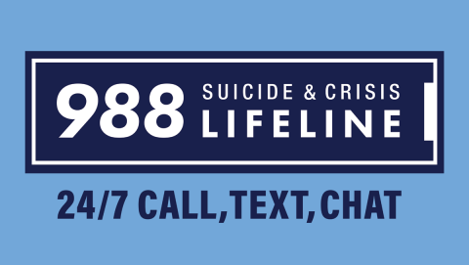
Conclusions
A brief suicide prevention training improved pharmacy staff outcomes
Online training can be delivered synchronously or asynchronously
Written case assessments have limitations

