Slide 1
The Surviving Traumatic Loss Project: Review of Key Findings and Lessons Learned
By: Jamison Bottomley, Ph.D.
May 9, 2024

Slide 2
Outline:
1. Suicide and Overdose Loss
2. The Surviving Traumatic Loss (STL) Project
3. Selected Findings a. Mental Health Outcomes b. Bereavement-related Needs c. Conclusions d. Future directions
4. Lessons Learned

Slide 3
Prevalence of Suicide and Overdose Loss
Suicide and Overdose Loss
Magnitude of suicide and OD deaths are considerable
Prevalence of suicide and OD bereavement:
  135 people exposed to each suicide death¹
    About half report being personally affected²
  Two in five US adults experience OD loss³
    4.2% of the population → “significant of devastating effect that I still feel”³
¹Cerel et al., 2018; ²Cerel et al., 2013; ³Athey et al., 2024

Slide 4
Suicide and OD Loss: MH Correlates
Suicide and Overdose Loss
Suicide Loss:
  Vulnerability:
    PTSD¹, PGD², Depression¹, Risky Substance Use/SUD³, Suicide⁴
Overdose Loss:
  Vulnerability:
    Largely unknown
    Shared themes with suicide loss: stigma, guilt, shame, human volition (intentionality gradient), sudden or violent qualities
¹Bottomley et al., 2022; ²Djelantik et al., 2020; ³Pitman et al., 2020; ⁴Molina et al., 2019

Slide 5
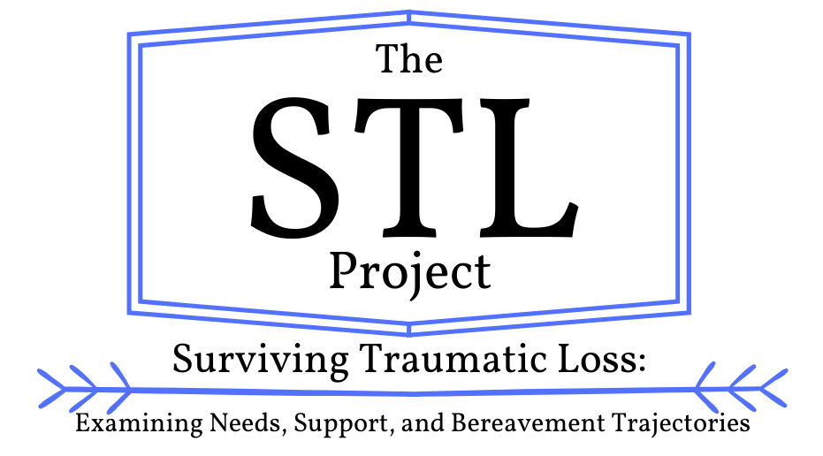
The Surviving Traumatic Loss Project
The STL Project
To develop information on:
  The distinctions and commonalities between suicide and OD loss
  Challenges among a growing and vulnerable group
    Many of whom have heightened risk for suicide
  To understand what helps survivors most as they recover

Slide 6
Study Aims
The STL PRoject
To compare/contrast suicide and OD loss
  Mental health & suicide risk
  Thematic elements
  Coping strategies and support utilization
To understand bereavement-related needs
  Similarities and distinctions
To understand how needs, support, and outcomes relate over time

Slide 7
Design, Development, & Implementation
The STL PRoject
Baseline (T1)
6-month (T2)
12-month (T3)
Online, longitudinal survey design
Informed by CBPR approach
  Produced needs assessment instrument
  Informed development of longitudinal survey and incentive structure
Employed comparison group of sudden-bereaved adults
Obtained support from AFSP in late 2018

Slide 8
Design, Development, & Implementation
The STL PRoject
Measures at each timepoint
12-month (T2)
PGD, PTSD, Dep sx
Suicide Risk
Needs
Support Utilization
Coping Strategies
Grief themes
Baseline (T1)
Demographics
Loss Characteristics
PGD, PTSD, Dep sx
Suicide Risk
Needs
Support Utilization
Coping Strategies
Grief themes
6-month (T2)
PGD, PTSD, Dep sx
Suicide Risk
Needs
Support Utilization
Coping Strategies
Grief themes

Slide 9
Sample
The STL PRoject
Data collection began in 2019*
Baseline (T1):
N = 403 adults bereaved by traumatic loss
M_{age} = 42.31 (17.17)
M_{TSL} = 25.12 (18.09) months
Gender: 84.1% female (n = 339)
Race: 71.0% White (n = 286)
Suicide Loss (n = 185)
Overdose Loss (n = 115)
Sudden-Natural (n = 103)
Retention rates: 68-74%
*Experienced setbacks early that required multiple starts and stops on recruitment

Slide 10
Mental Health Among OD and Suicide Loss
Selected findings: mh Outcomes
KEY TAKEAWAY #1
OD and SL: Significantly higher rates of PGD, PTSD, and Depression relative to SN
  χ² (2, N = 346) = 48.89, p < .001
  χ² (2, N = 351) = 23.04, p < .001
  χ² (2, N = 403) = 13.72, p = .001
No sig. differences between OD and SL for PGD, PTSD, and Depression
SL experienced elevations in anxiety and suicide risk
Bottomley et al., 2022

Slide 11
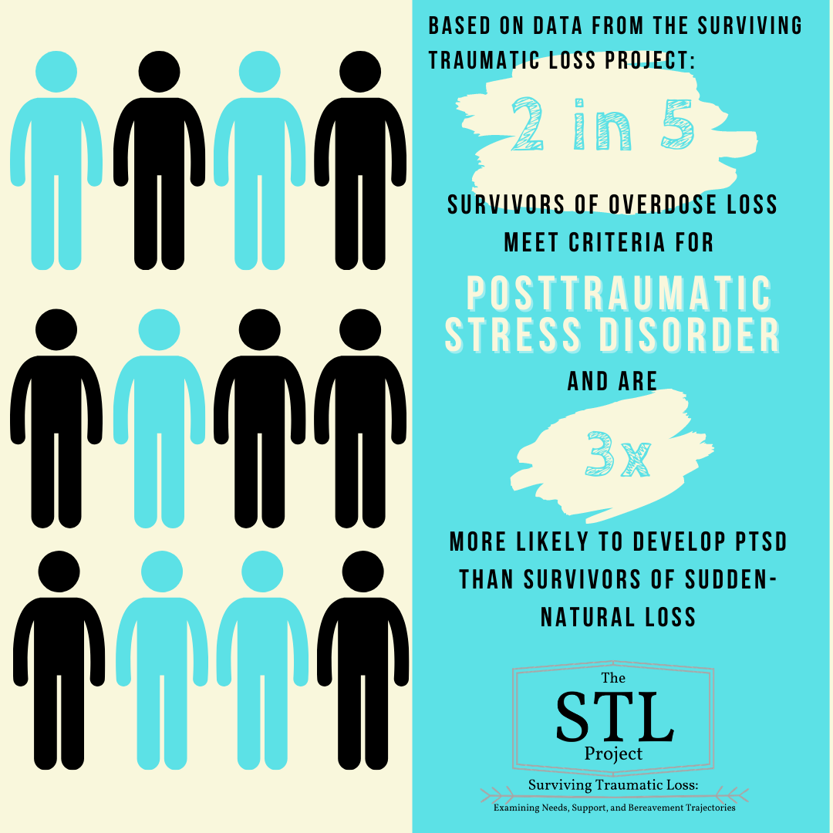
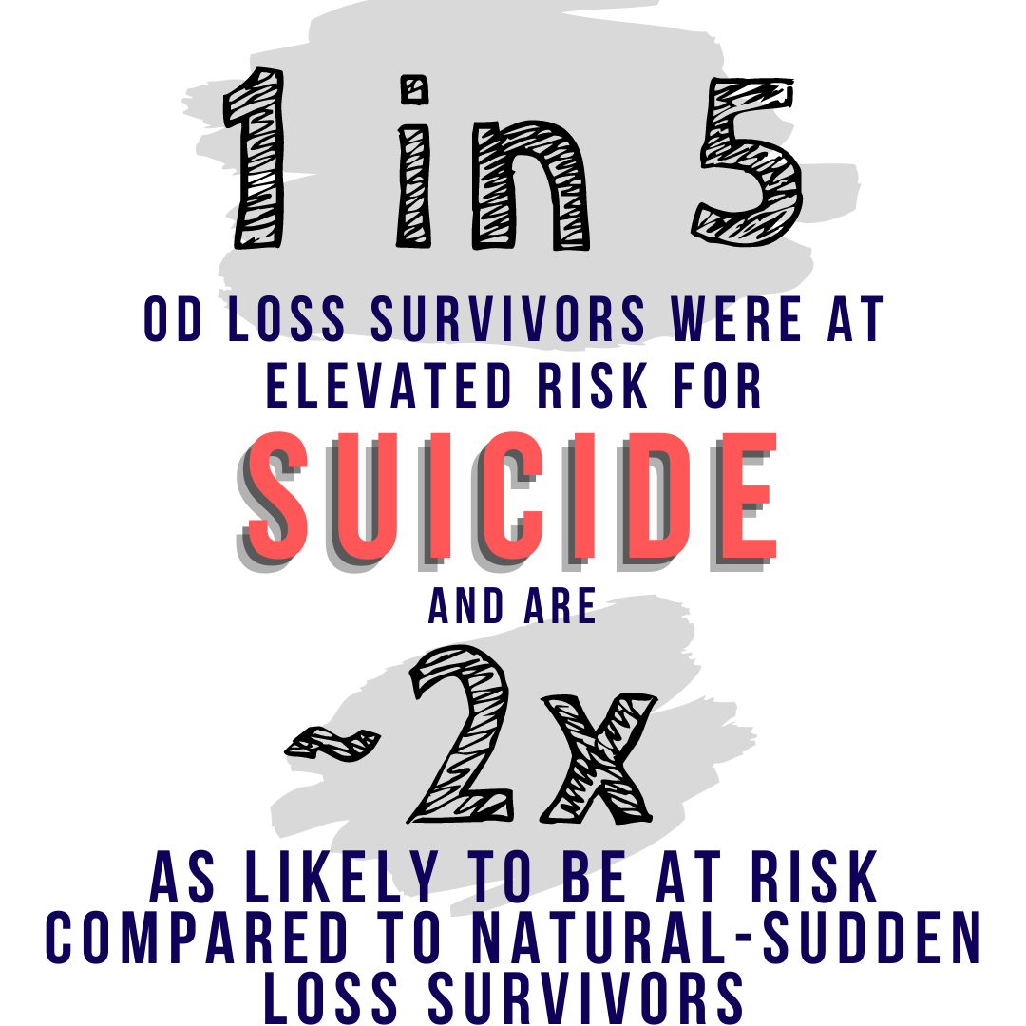
Mental Health Among OD and Suicide Loss
Selected findings: mh Outcomes
KEY TAKEAWAYS #2
Adults bereaved by suicide or overdose were 2.3-3.8x as likely to meet criteria for PGD, PTSD, or MDD compared to SNL
 | B | SE | OR | 95% CI | p
PGD Dx
Gender (F) | -0.05 | 0.33 | 0.95 | [0.49, 1.81] | .875
Respondent Age | 0.01 | 0.01 | 1.01 | [0.98, 1.02] | .761
Ethnicity (W) | 0.14 | 0.29 | 1.14 | [0.64, 2.06] | .645
# R Psy Dx | 0.19 | 0.11 | 1.21 | [0.98, 1.48] | .073
TSL | -0.01 | 0.01 | 0.99 | [0.98, 1.01] | .518
Closeness | 0.04 | 0.02 | 1.04 | [0.99, 1.09] | .082
Nuclear Family | 1.26 | 0.31 | 3.50 | [1.89, 6.47] | <.001
COVID-19 | 0.38 | 0.36 | 1.47 | [0.73, 2.95] | .281
Suicide Loss | 1.01 | 0.33 | 2.74 | [1.44, 5.19] | .002
Overdose Loss | 1.03 | 0.37 | 2.79 | [1.36, 5.74] | .005
Bottomley et al., 2022

Slide 12
The Sudden-Bereavement Needs Inventory (SBNI)
Selected findings: needs
  Based on CBPR approach
  Six need categories
      Pragmatic Needs – “To sleep well”
      Informational Needs – “To better understand the grief journey”
      Spiritual Needs – “To have an ongoing connection with God”
      Relational Needs – “To be with those who experienced similar loss”
      Meaning Needs – “To make sense of the loss”
      Emotional Needs – “To be emotionally supported”
    Good psychometric properties
      Internal reliability, concurrent validity, discriminant validity
Bottomley & Smigelsky, 2022

Slide 13
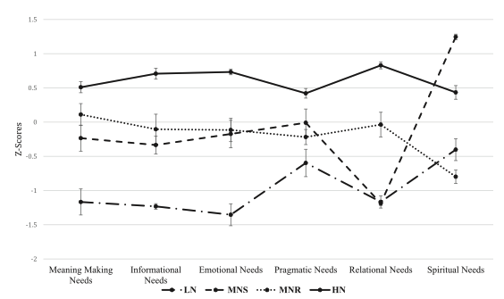
Latent Class Analysis of Need Profiles
Selected findings: needs
    Person-centered analysis to understand relation between needs and outcomes
  4-class solution best fit data
      Low Needs (LN)
      Moderate Needs – Spiritual (MNS)
      Moderate Needs – Relational (MNR)
      High Needs (HN)
Bottomley, Campbell, & Neimeyer, 2022

Slide 14
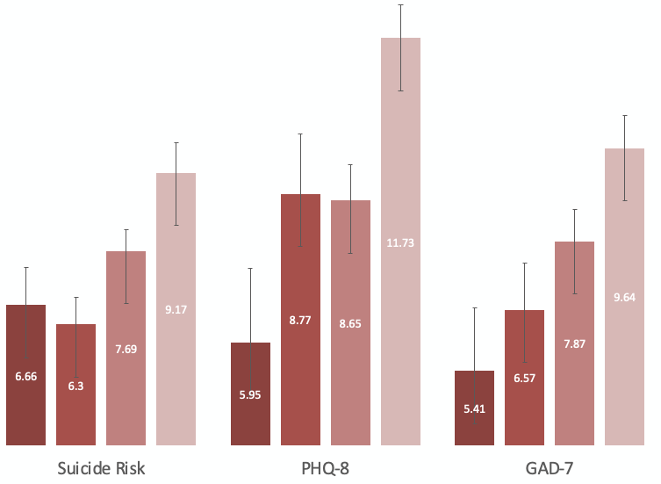
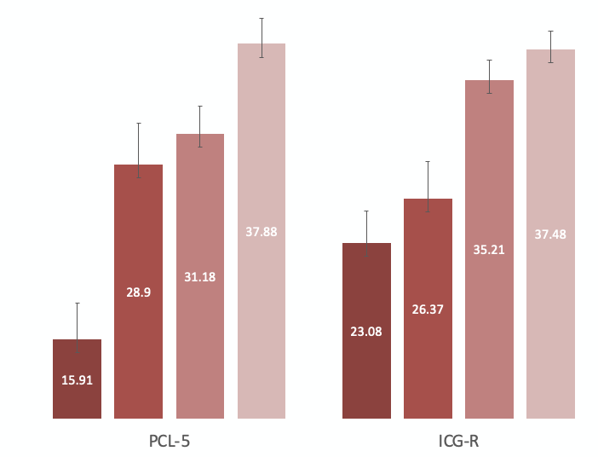

Latent Class Analysis of Need Profiles
Selected findings: needs
Bottomley, Campbell, & Neimeyer, 2022

Slide 15
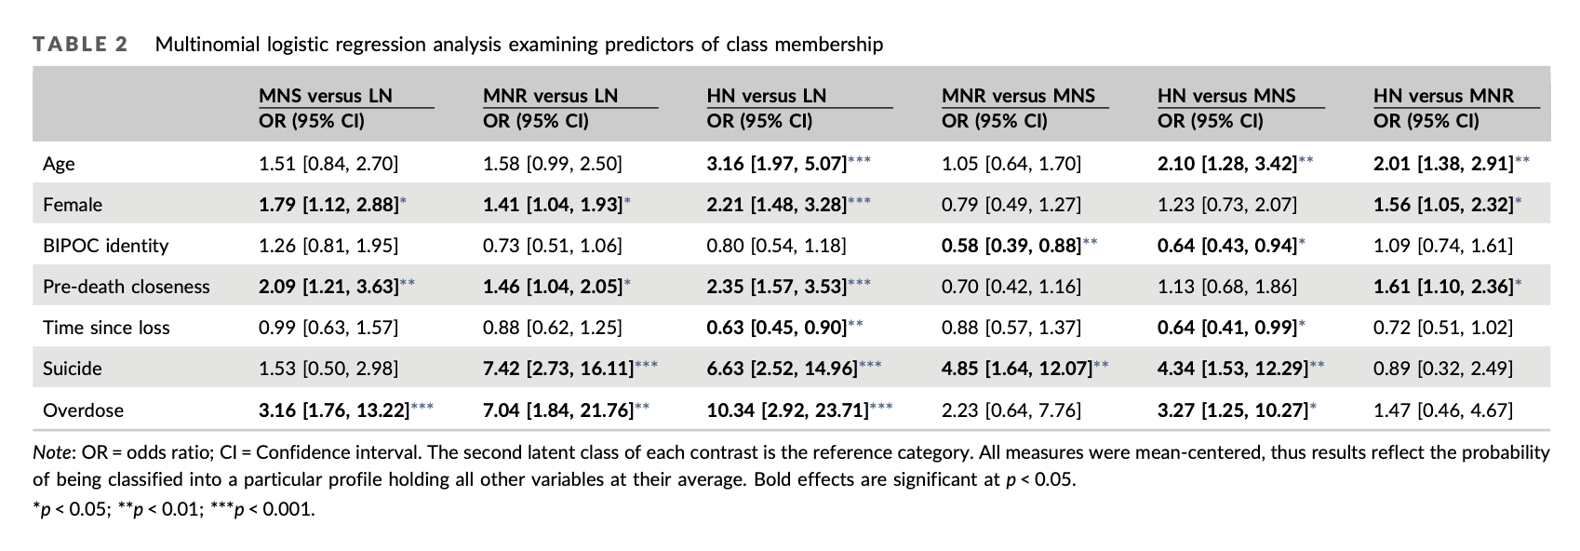
Latent Class Analysis of Need Profiles
Selected findings: needs
KEY TAKEAWAYS
High needs class comprised of elevated and impairing MH sx
High needs class mostly comprised of suicide and overdose loss
Evidence suggesting possibility of similar needs across suicide and OD loss
Bottomley, Campbell, & Neimeyer, 2022

Slide 16
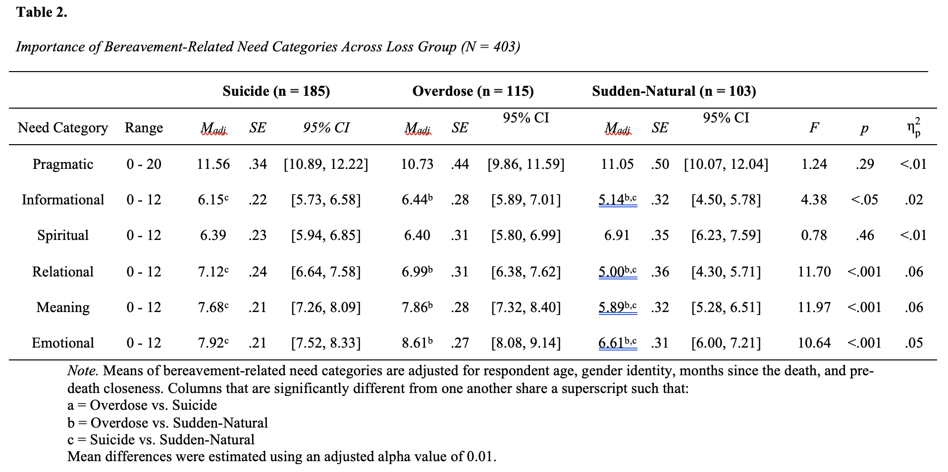
Direct Comparison of Needs and Mental Health
Selected findings: needs
    Aim 1: Following the 2022 LCA → directly compare needs across loss
Bottomley, Smigelsky, Campbell, Neimeyer, & Rheingold, in press

Slide 17
Direct Comparison of Needs and Mental Health
Selected findings: needs
    Aim 1: Following the 2022 LCA → directly compare needs across loss
KEY TAKEAWAYS
Similar Pragmatic and Spiritual Needs across traumatic loss groups
Bottomley, Smigelsky, Campbell, Neimeyer, & Rheingold, in press

Slide 18
Direct Comparison of Needs and Mental Health
Selected findings: needs
    Aim 1: Following the 2022 LCA → directly compare needs across loss
KEY TAKEAWAYS
Similar Pragmatic and Spiritual Needs across traumatic loss groups
Suicide and OD loss rated Informational, Relational, Meaning, and Emotional Needs as sig more important
Non-sig differences between suicide and OD loss
Bottomley, Smigelsky, Campbell, Neimeyer, & Rheingold, in press

Slide 19
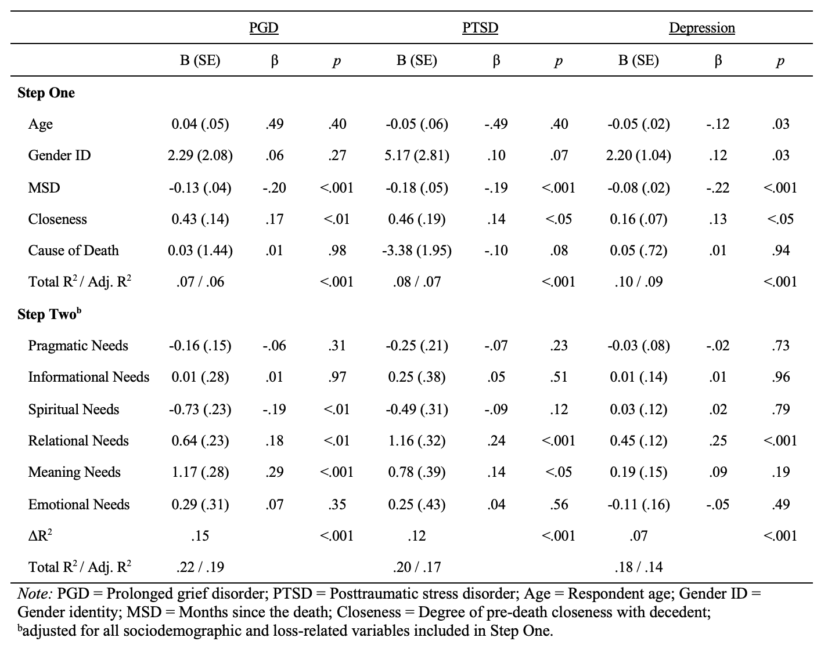
Direct Comparison of Needs and Mental Health
Selected findings: needs
    Aim 2: Examine relations between importance of needs and MH
Bottomley, Smigelsky, Campbell, Neimeyer, & Rheingold, in press

Slide 20
Direct Comparison of Needs and Mental Health
Selected findings: needs
    Aim 2: Examine relations between importance of needs and MH
KEY TAKEAWAYS
After accounting for demographic and loss characteristics: Relational and Meaning Needs emerged as having the strongest relation with PGD, PTSD, and depression
Bottomley, Smigelsky, Campbell, Neimeyer, & Rheingold, in press

Slide 21
Conclusions
Stl project: future directions
  OD loss appears to confer risk for deleterious MH outcomes
  Suicide and OD loss share many things
      Loss characteristics and themes
      Mental health challenges
      Importance of Informational, Meaning, Relational, and Emotional Needs
  Addressing Meaning and Relational Needs may promote adaptation and attenuate negative MH outcomes

Slide 22
Future directions
Stl project: future directions
    Investigate the temporal impact of meeting needs on MH and suicide risk
    Investigate temporal associations to understand mechanisms:
      Stigma, guilt, and shame
      Coping strategies and meaning making
      Sources and utilization of support
    Two manuscripts currently under review:
    Multigroup path of the impact of stigma, guilt, and shame⁵
    Coping, meaning making, and outcomes⁶
⁵Bottomley, Campbell, Smigelsky, Neimeyer, & Rheingold, 2024; ⁶Bottomley, Neimeyer, & Rheingold, 2024

Slide 23
Lessons Learned
Lessons learned
As a junior researcher:
AFSP wants to support you and can propel your career
Understand and harness your strengths as a researcher
Surround yourself with experts to fill gaps of expertise
About the methods and population:
Be thoughtful about recruitment
    Include those with lived experience and blend info with content experts
Consider the use of panels (crowdsourcing)
Get creative with compensation and dissemination of findings

Slide 24
Thank you:
Participants
Mentors
AFSP

