Slide 1
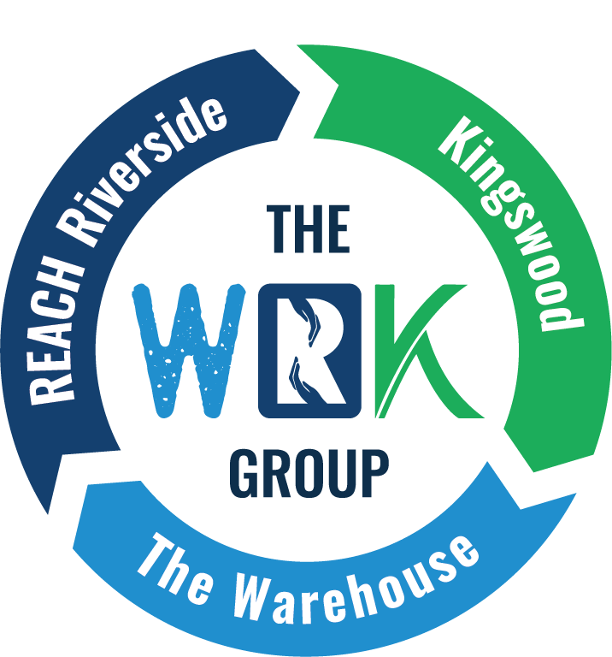

FROM IDEAS TO IMPACT:
Designing Community-Based HealthInitiatives through Cross-Sector Collaboration
Laura D Mood, CFO​
The WRK Group / REACH Riverside

Slide 2
WHAT DOES COMMUNITY HEALTH REALLY MEAN?​
  Safe Neighborhoods​
  Access to Healthcare​
  Quality Education​
  Economic Opportunity​
  Access to Healthcare​
  Strong social connections
We quickly realized that no single organization couldaddress all of these factors.​

Slide 3
THE CHALLENGE​
Traditional systems work in silos.​
  Healthcare​
  Housing​
  Education​
  Workforce Development​
  Food Access
Residents experience them all at once.​

Slide 4


Slide 5

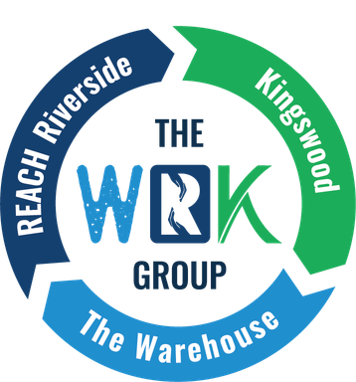


WE TOGETHER
REACH removes barriers to prosperity by serving as the community quarterback and managing partner for The Warehouse and Kingswood Community Center.
The Warehouse, a service provider of The WRK Group, was developed "For Teens, By Teens" and serves as an innovative, one-stop center serving youth ages 13 to 24.
Founded in 1946, Kingswood, a service provider of The WRK Group, provides an Early Learning Academy, Senior Center, and community outreach services.

Slide 6
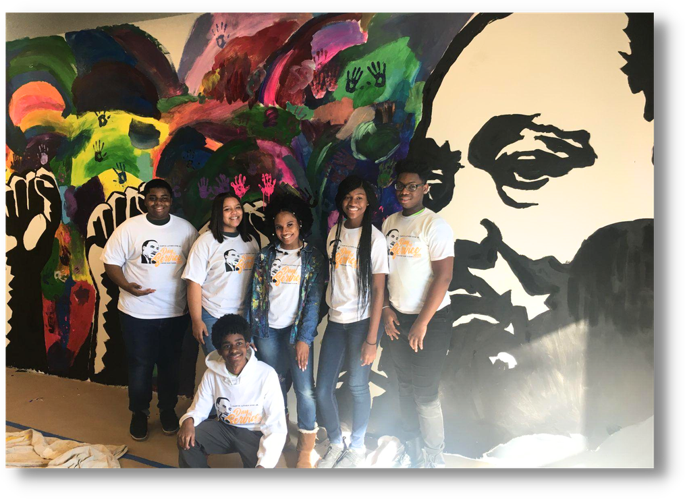
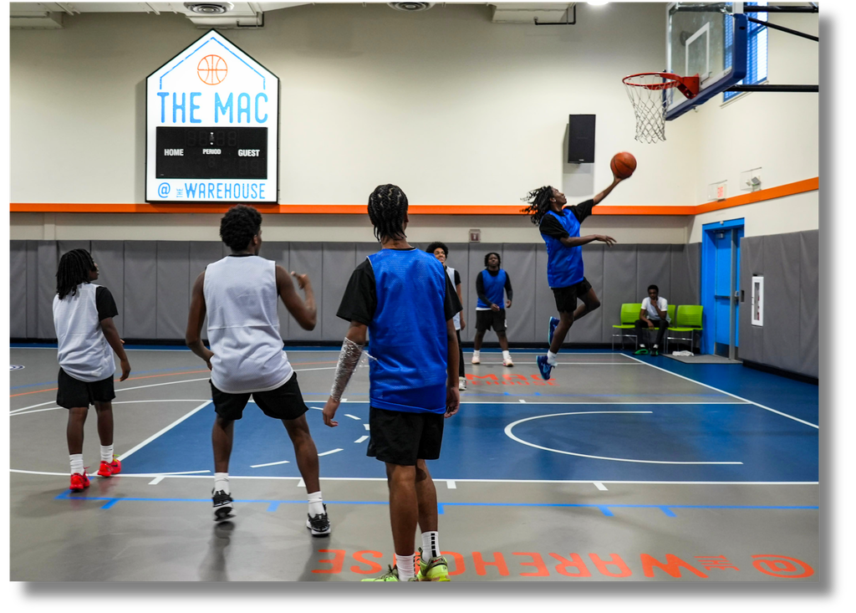

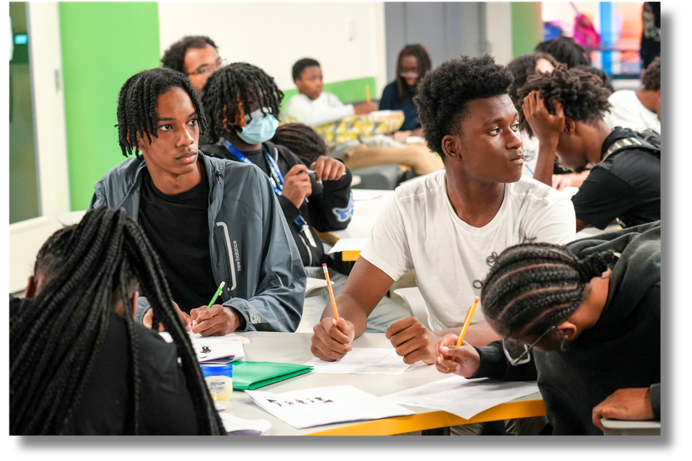
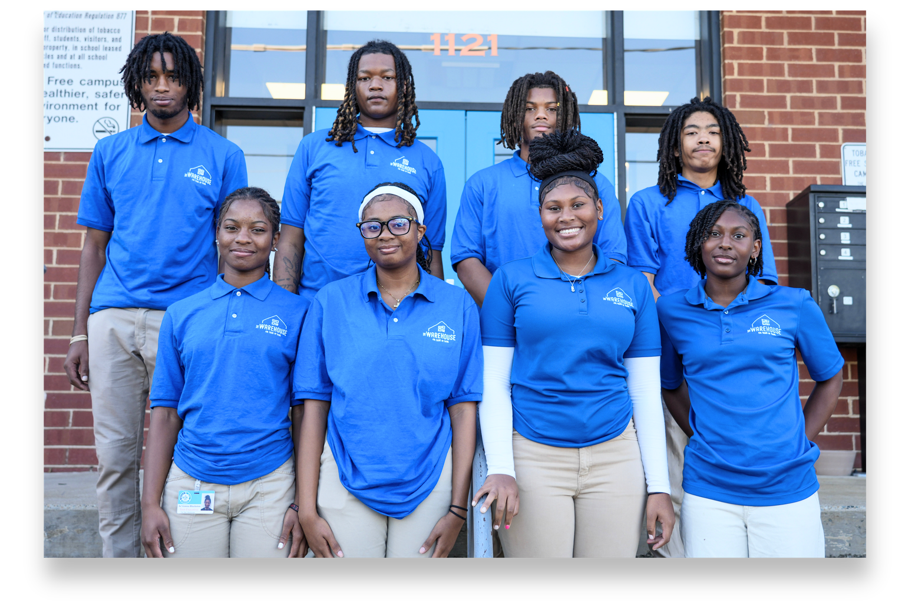

Slide 7
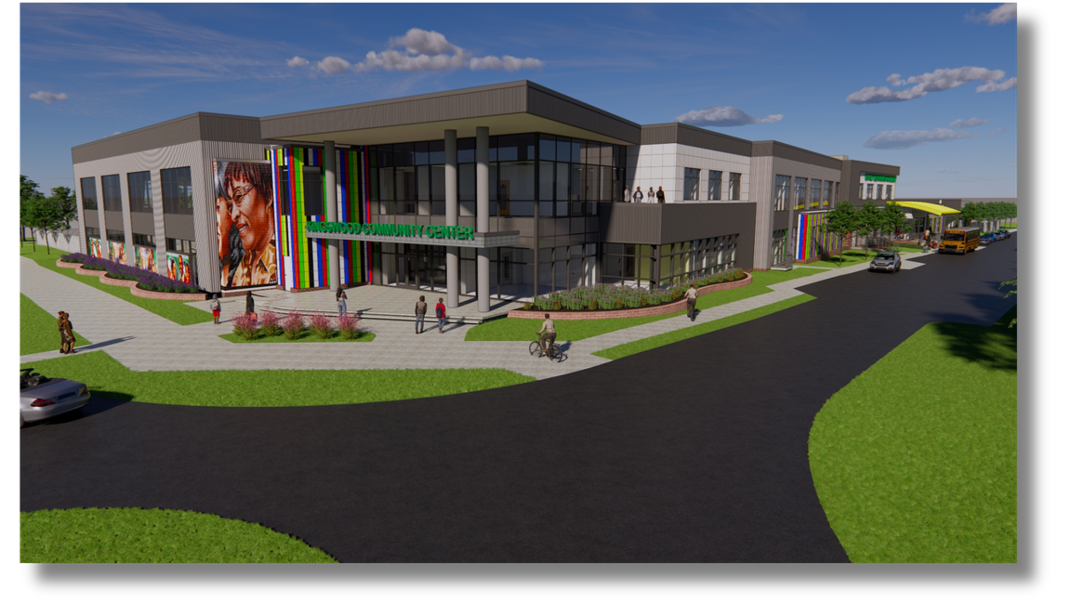
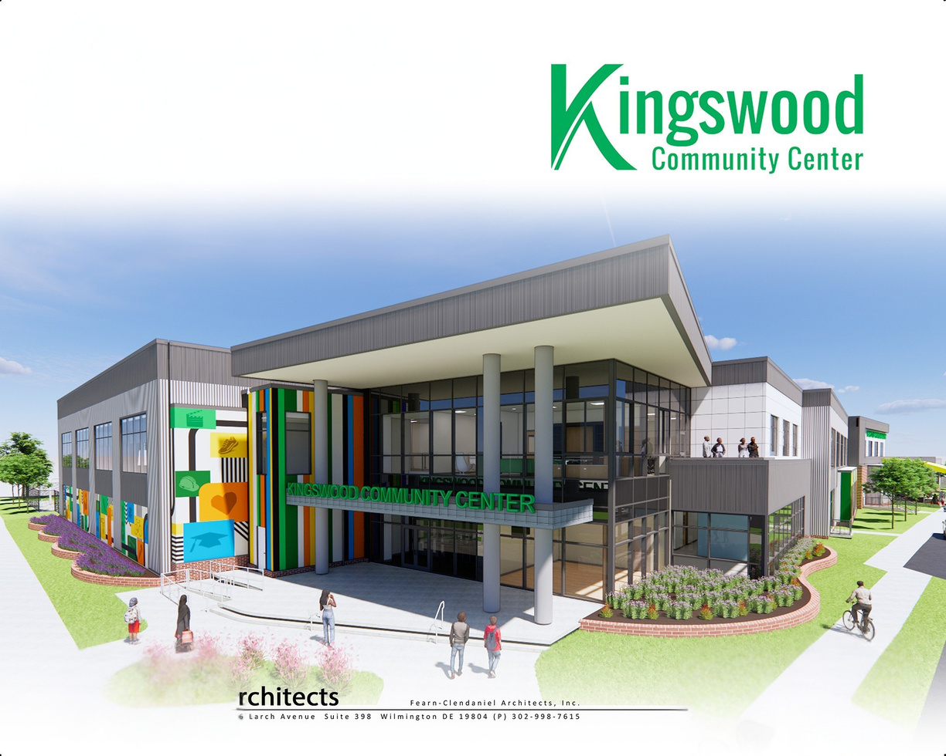
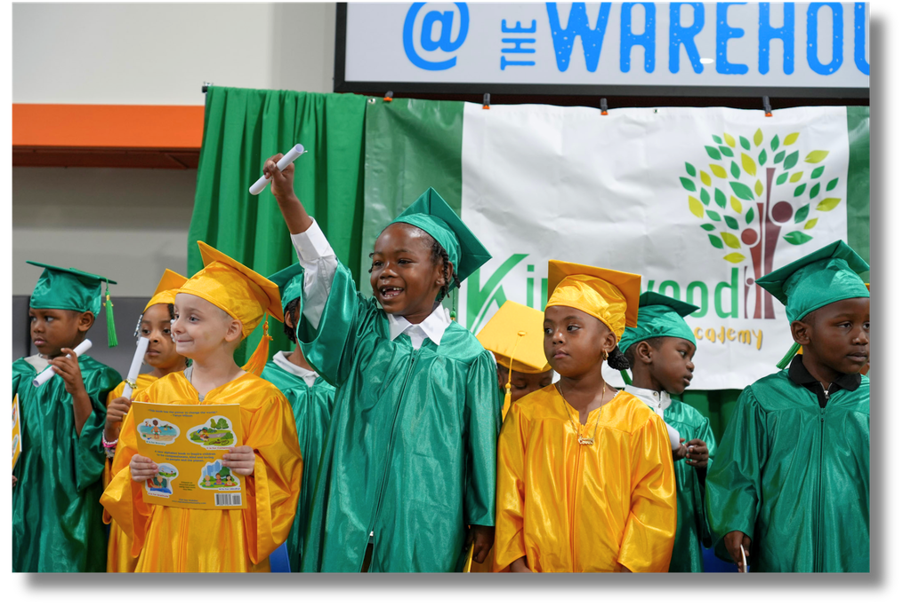
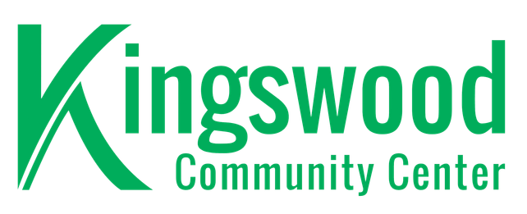
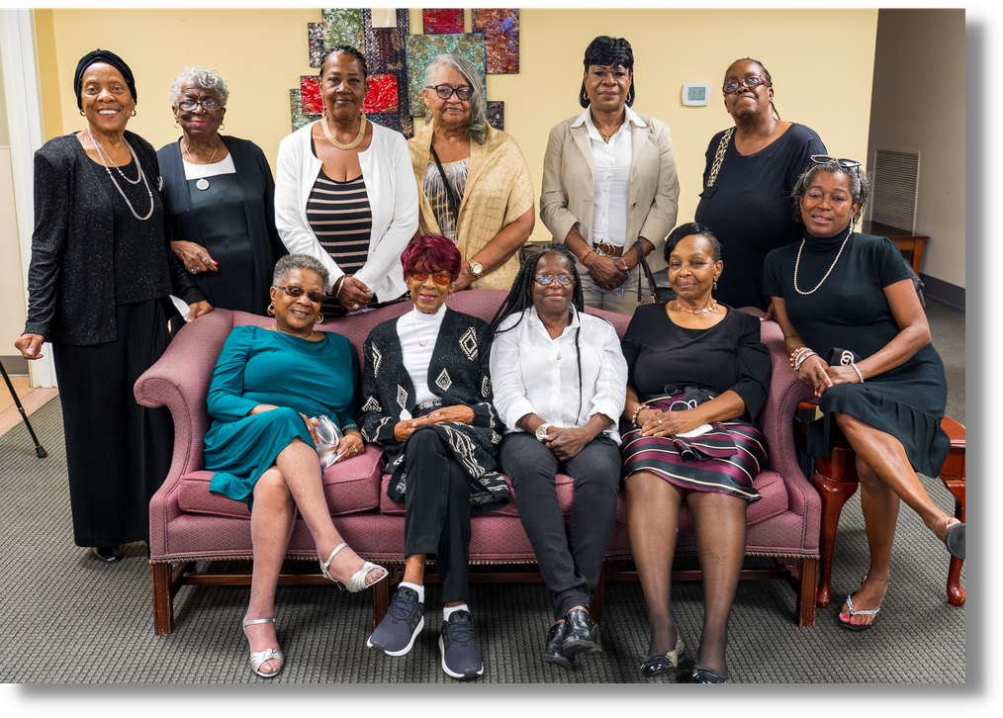
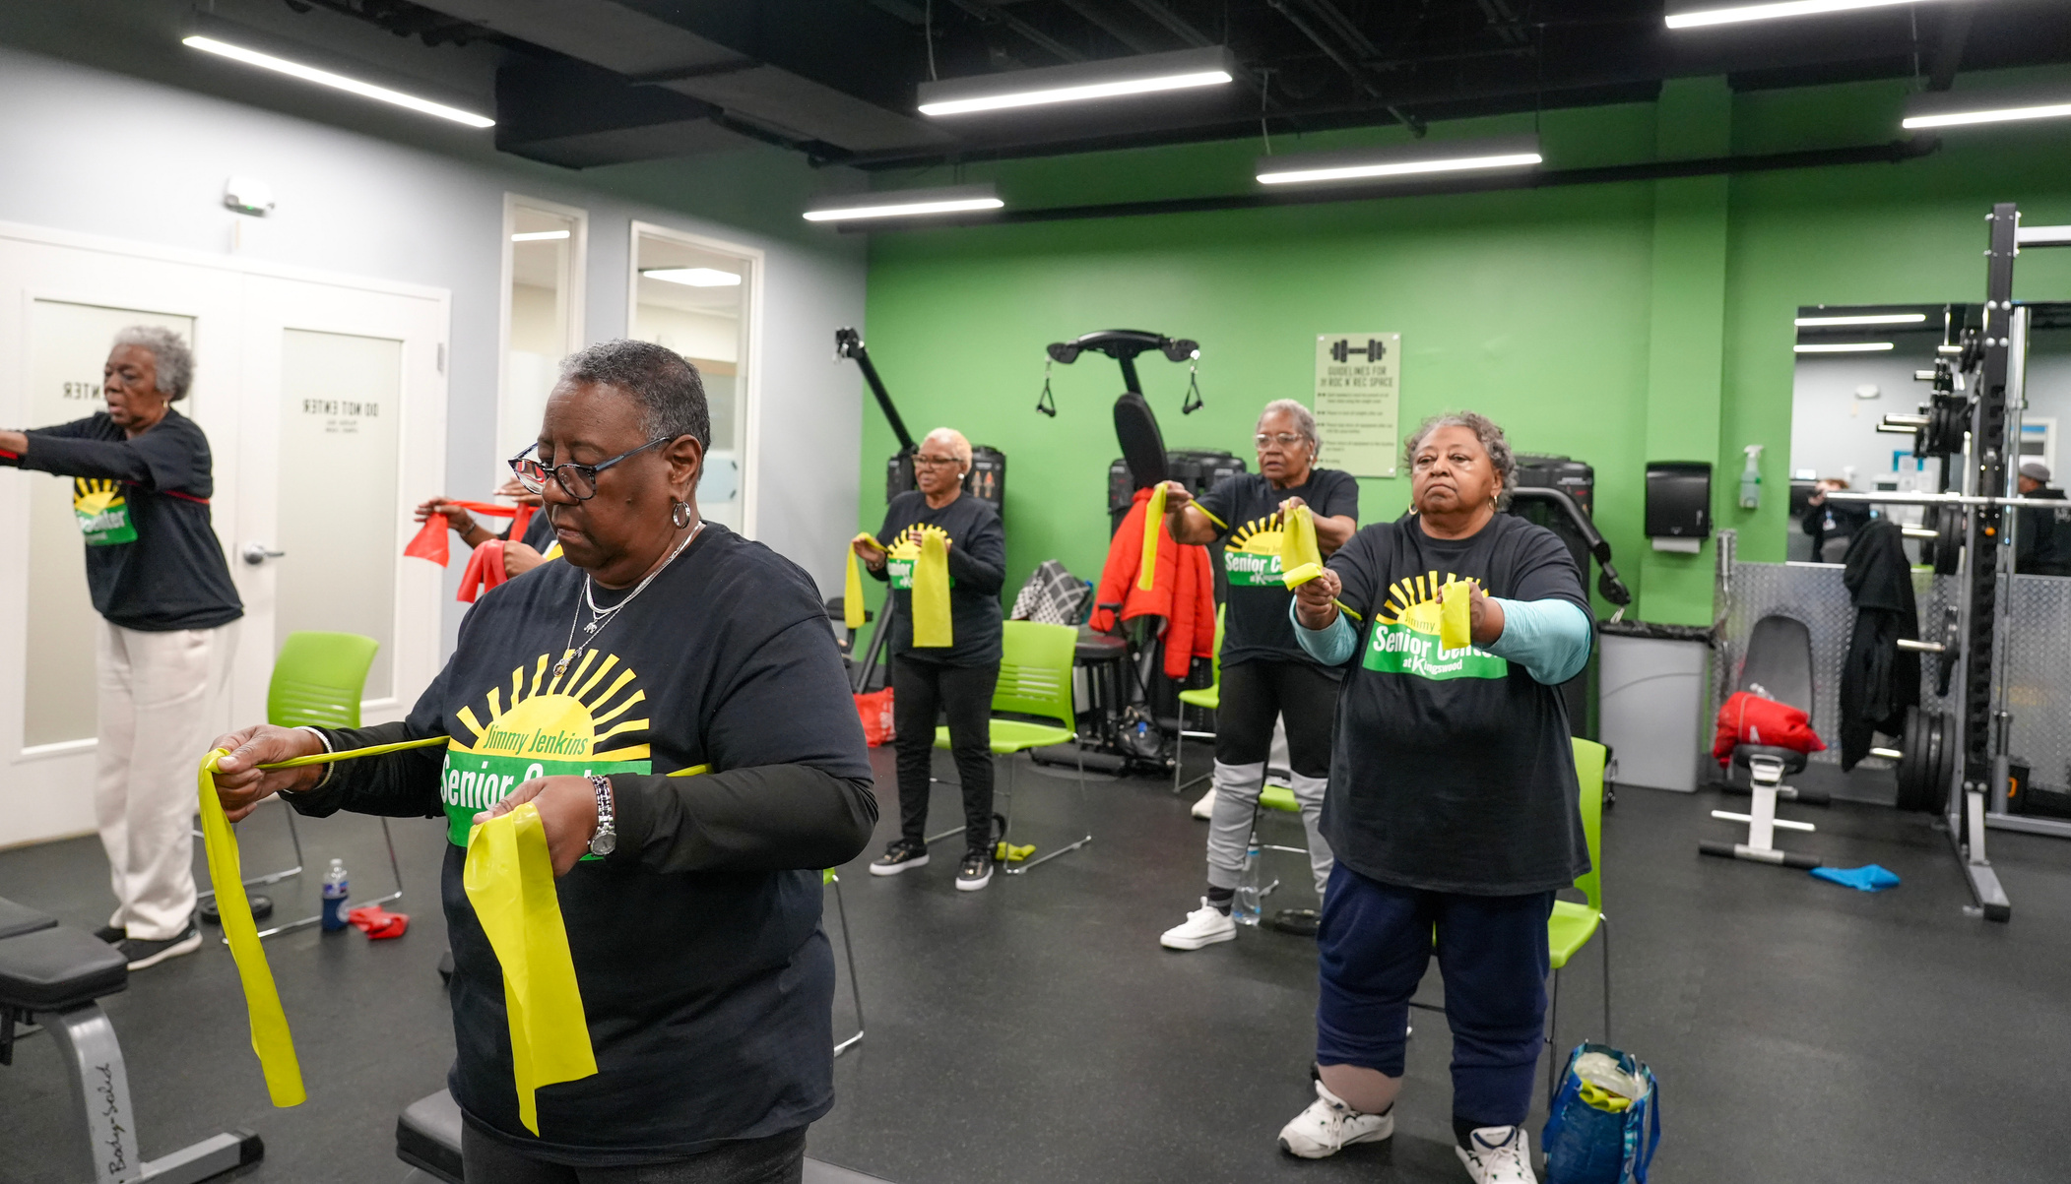
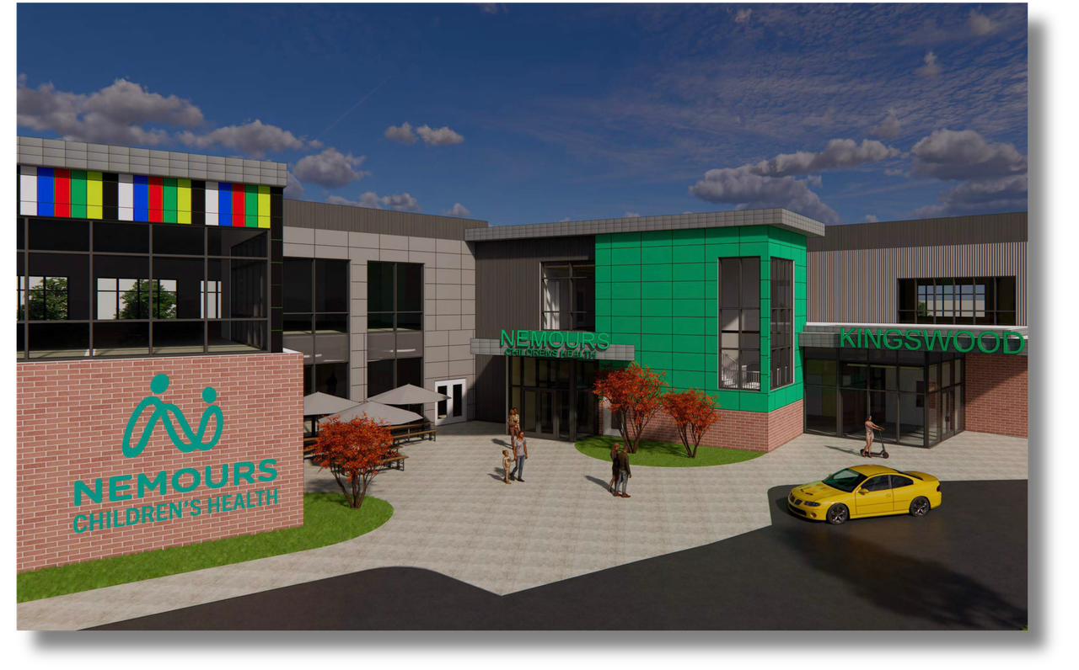

Slide 8
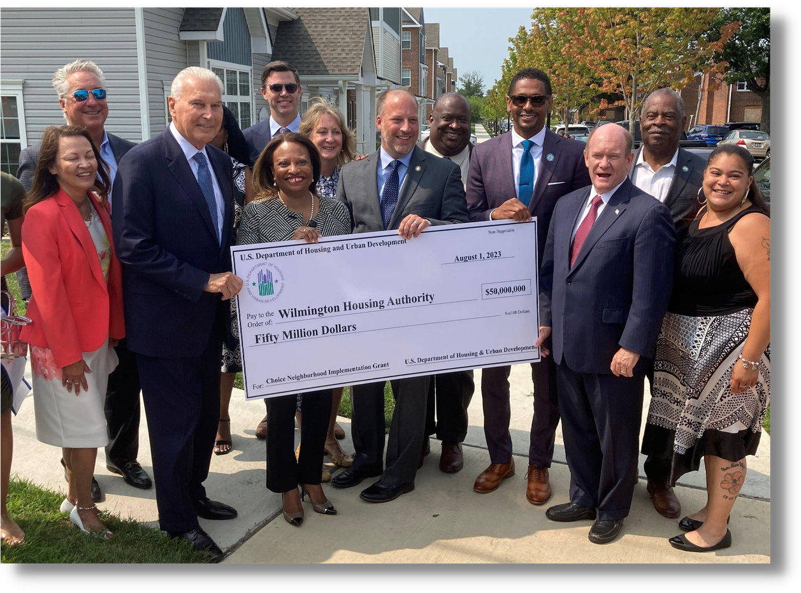
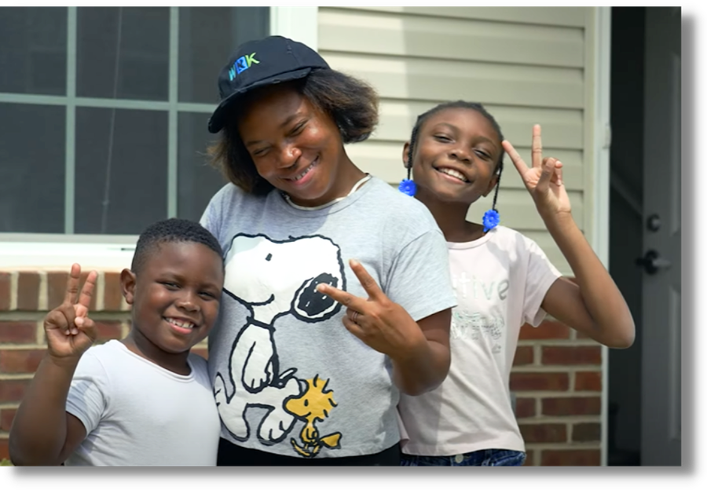

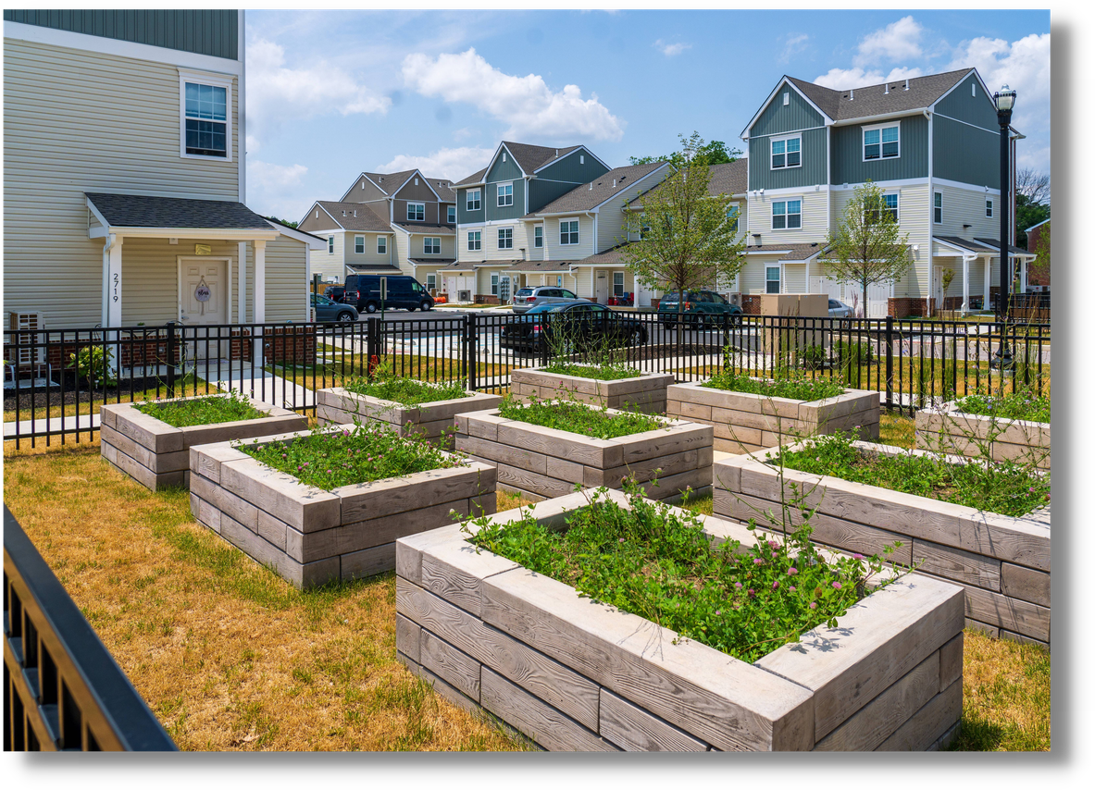
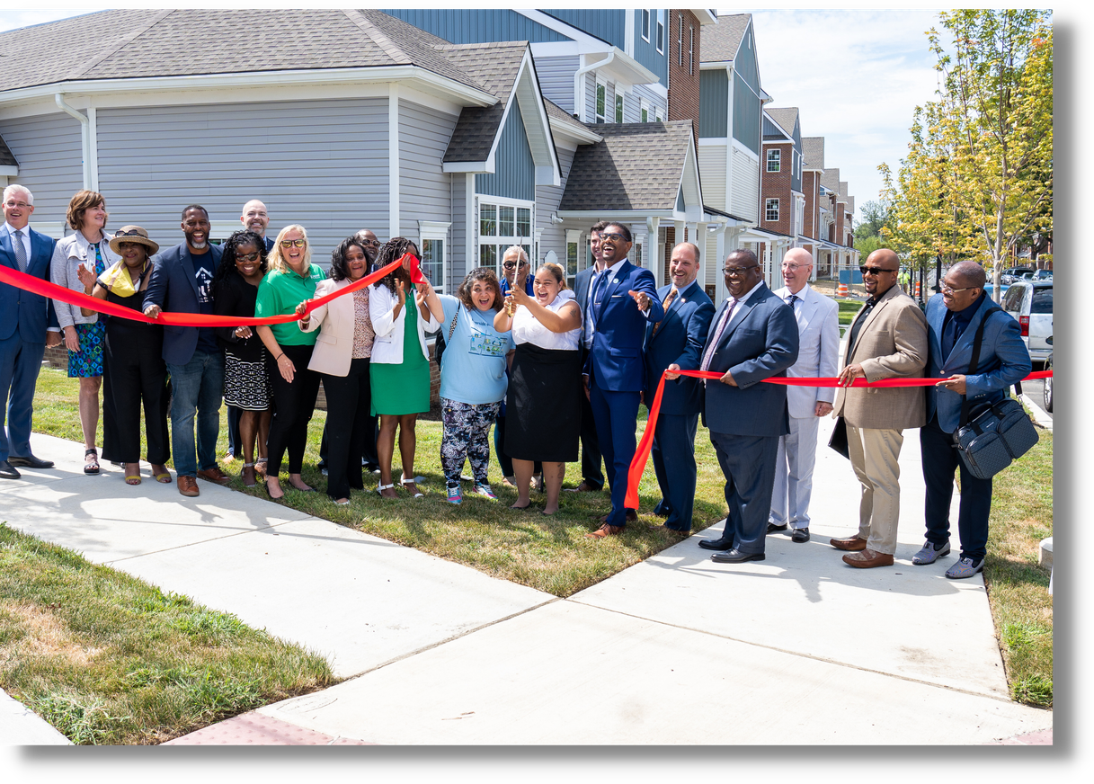

Slide 9
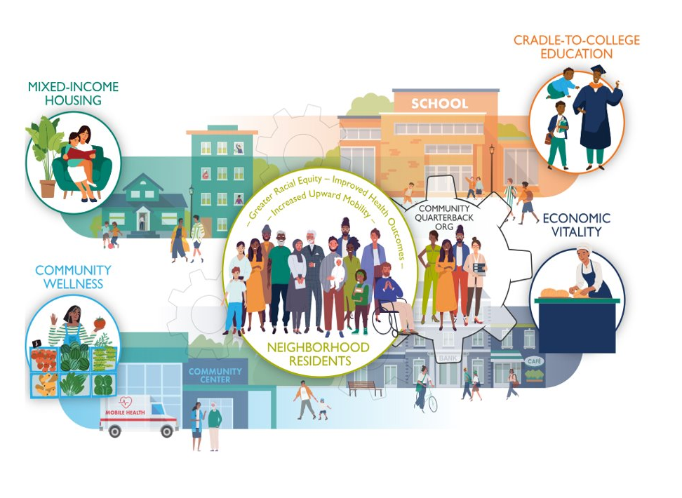
OUR ROLE​
  Convening partners​
  Coordinating resources​
  Aligning goals​
  Tracking outcomes​
  Keeping residents at the center

Slide 10
Designing WITH the Community​
  Process: Listen​
  Co-Design: Partner​
  Implement: Measure
  Community Meetings​
  Community Surveys​
  Board Governance​
  Village Impact Promoters
HOW?​

Slide 11
HOUSING AS A PREVENTATIVE
HEALTH STRATEGY​
In partnership with Philadelphia-based Pennrose, a widely acclaimed builder of affordable housing, and the Wilmington Housing Authority, REACH Riverside is developing 700 units of high-quality, mixed-income rental homes in the community.

Slide 12
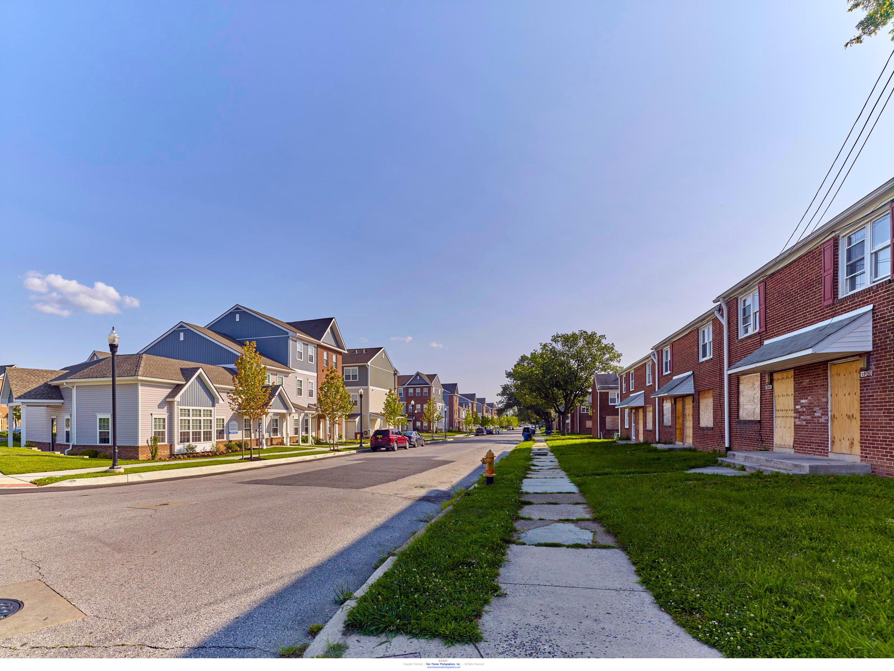
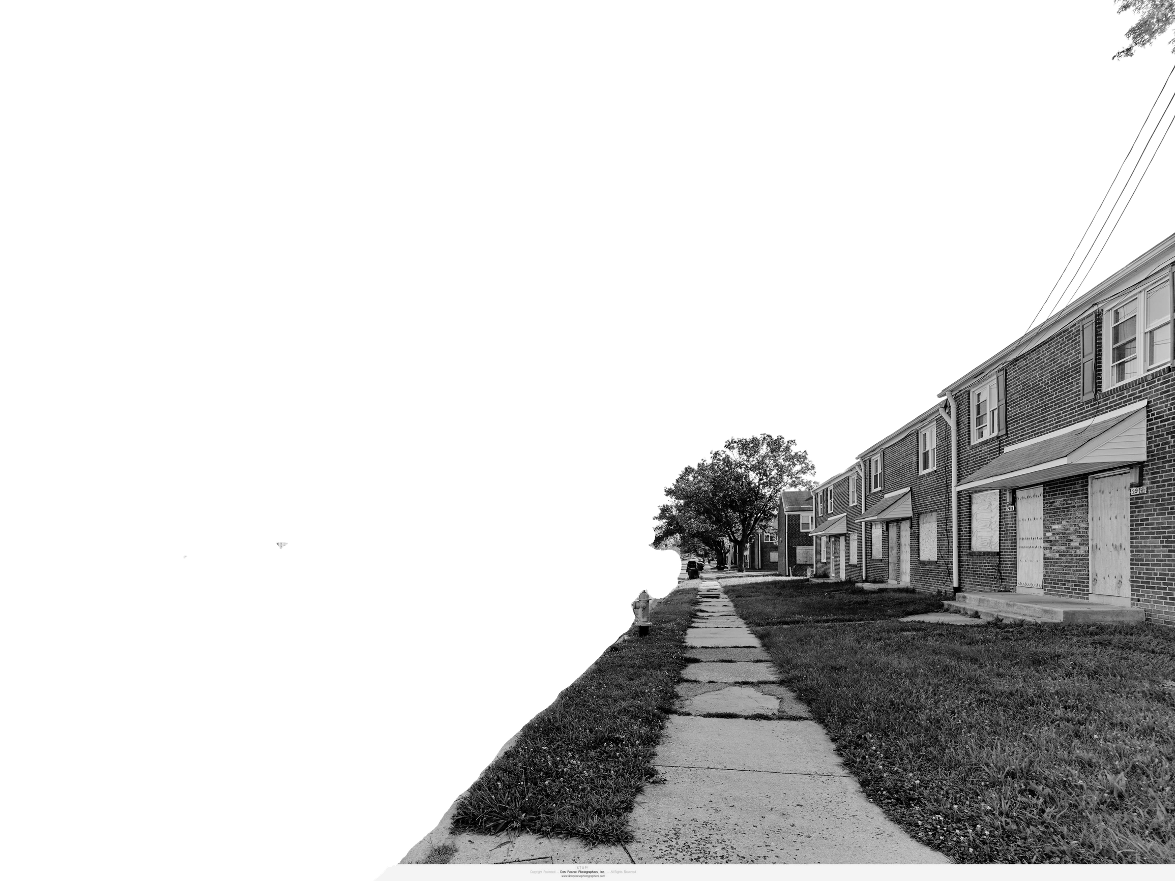
Photo Courtesy of: Don Pearse Photography

Slide 13
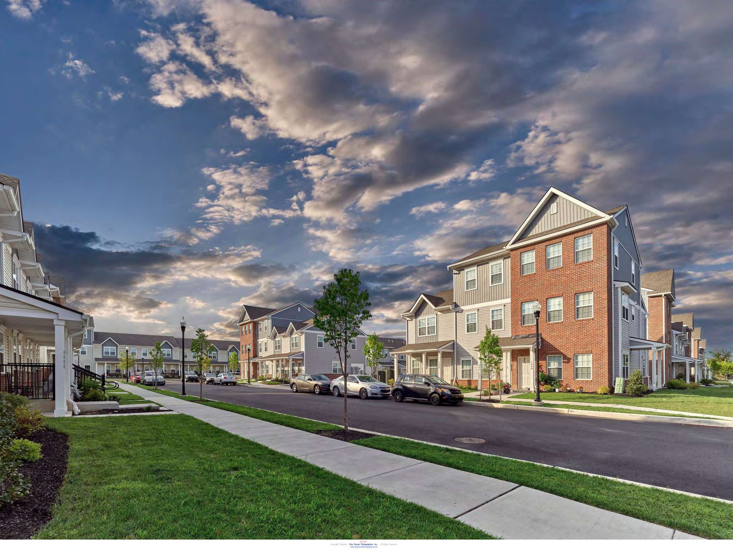
Photo Courtesy of: Don Pearse Photography

Slide 14
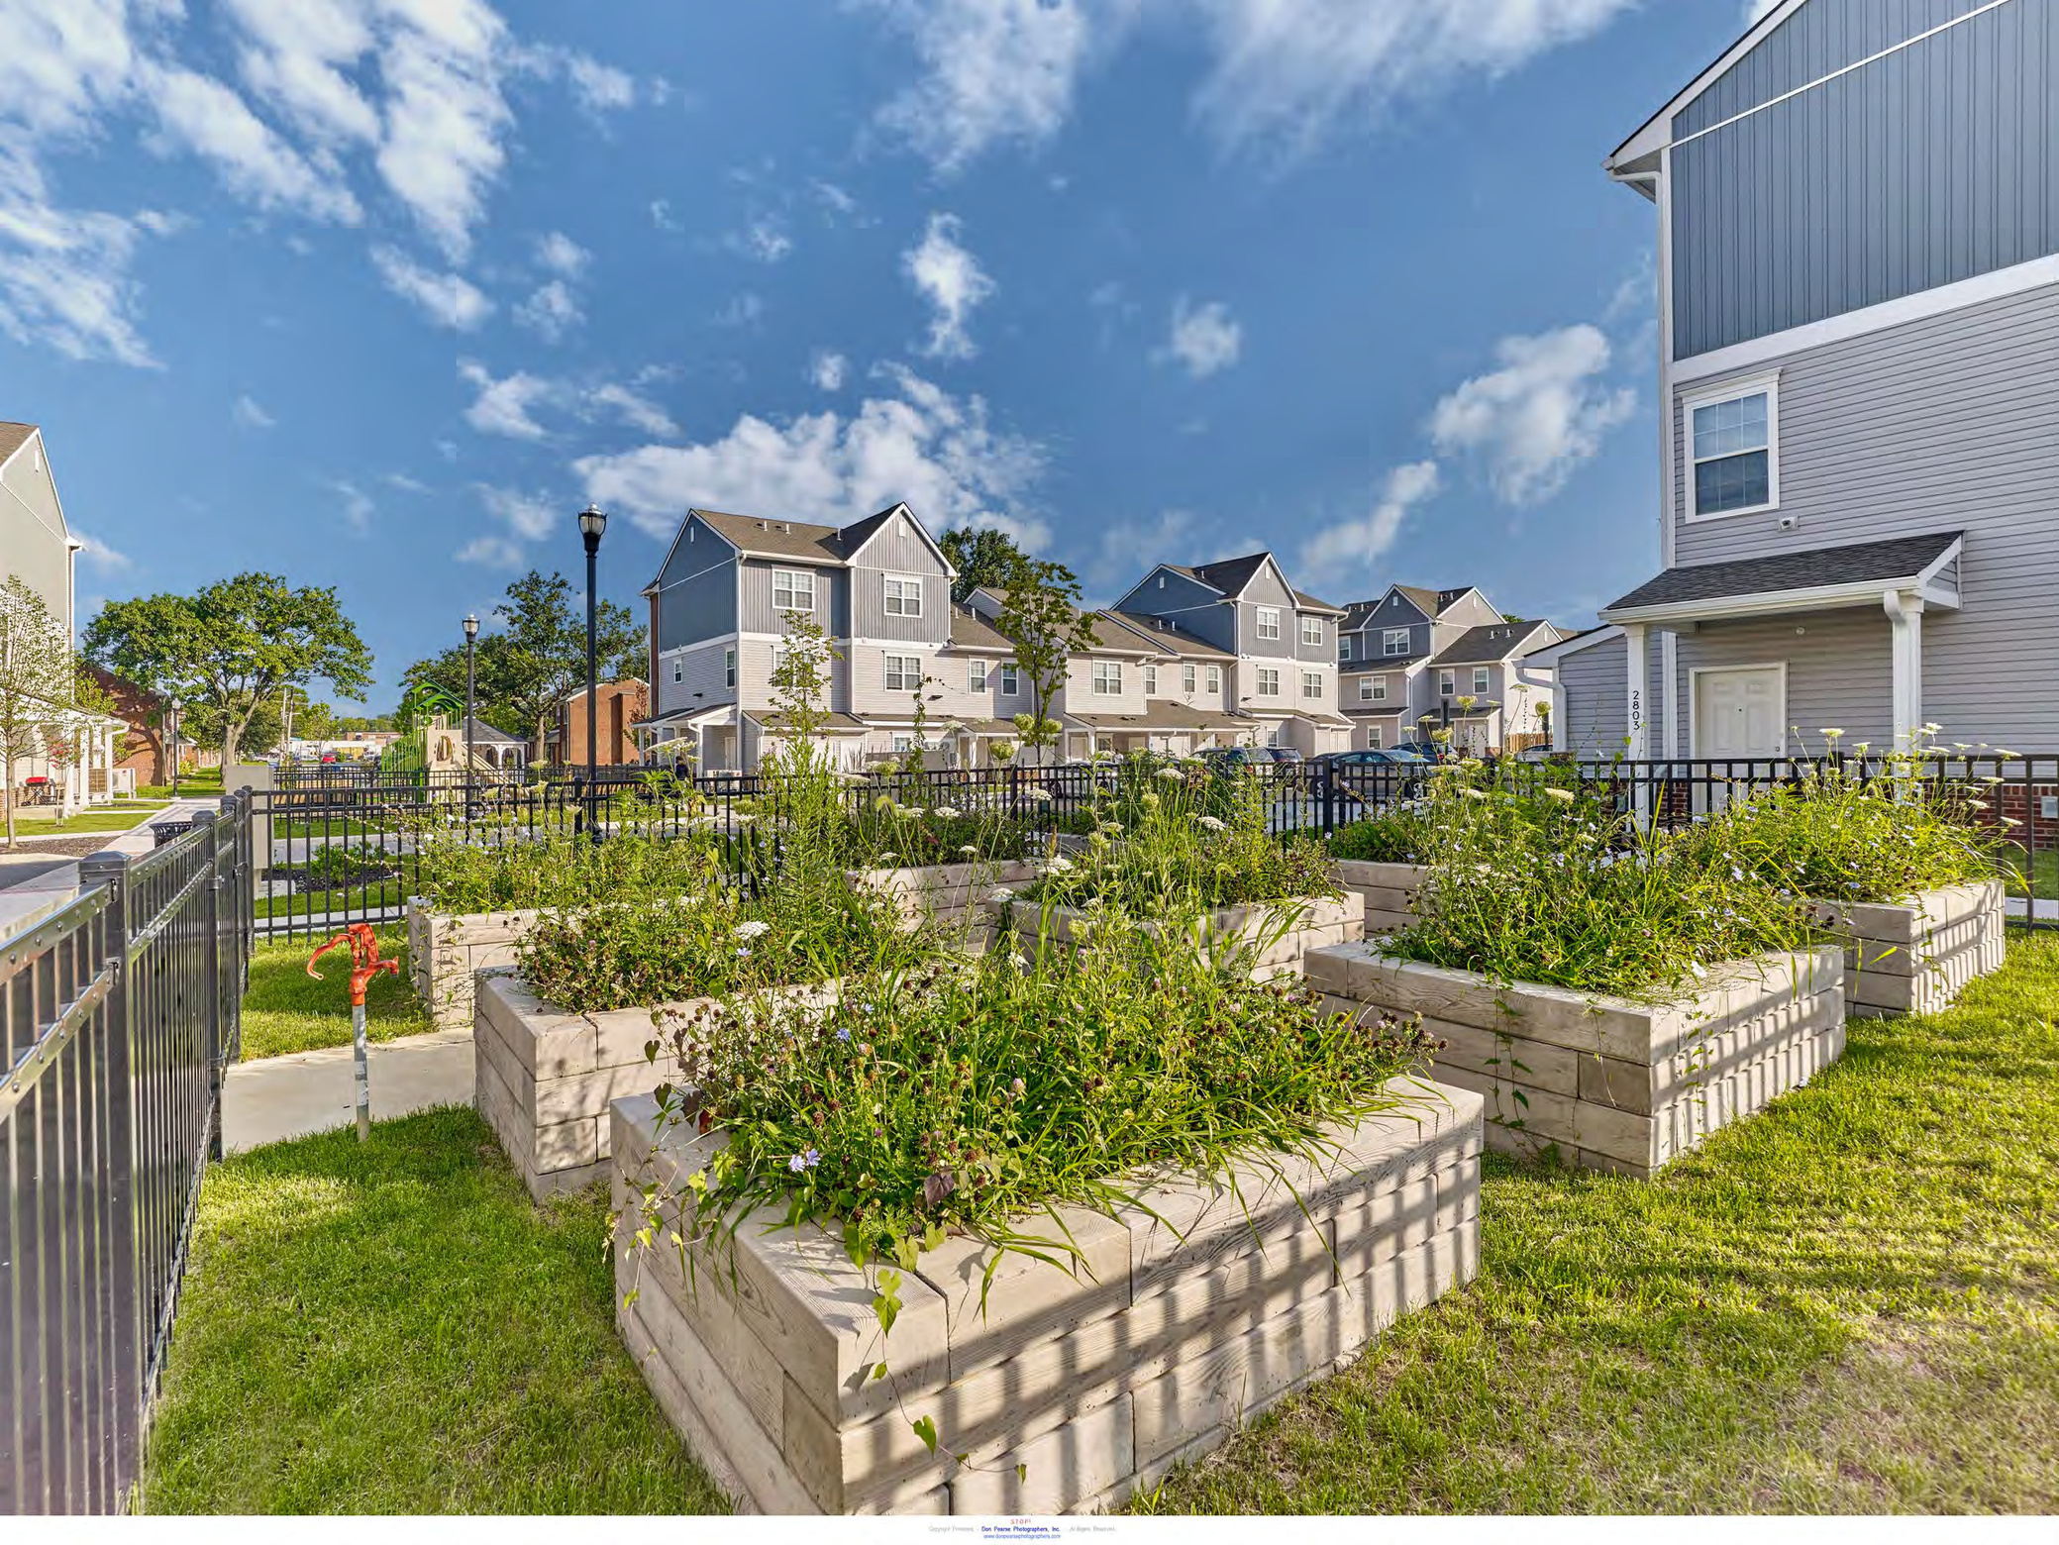
Photo Courtesy of: Don Pearse Photography

Slide 15
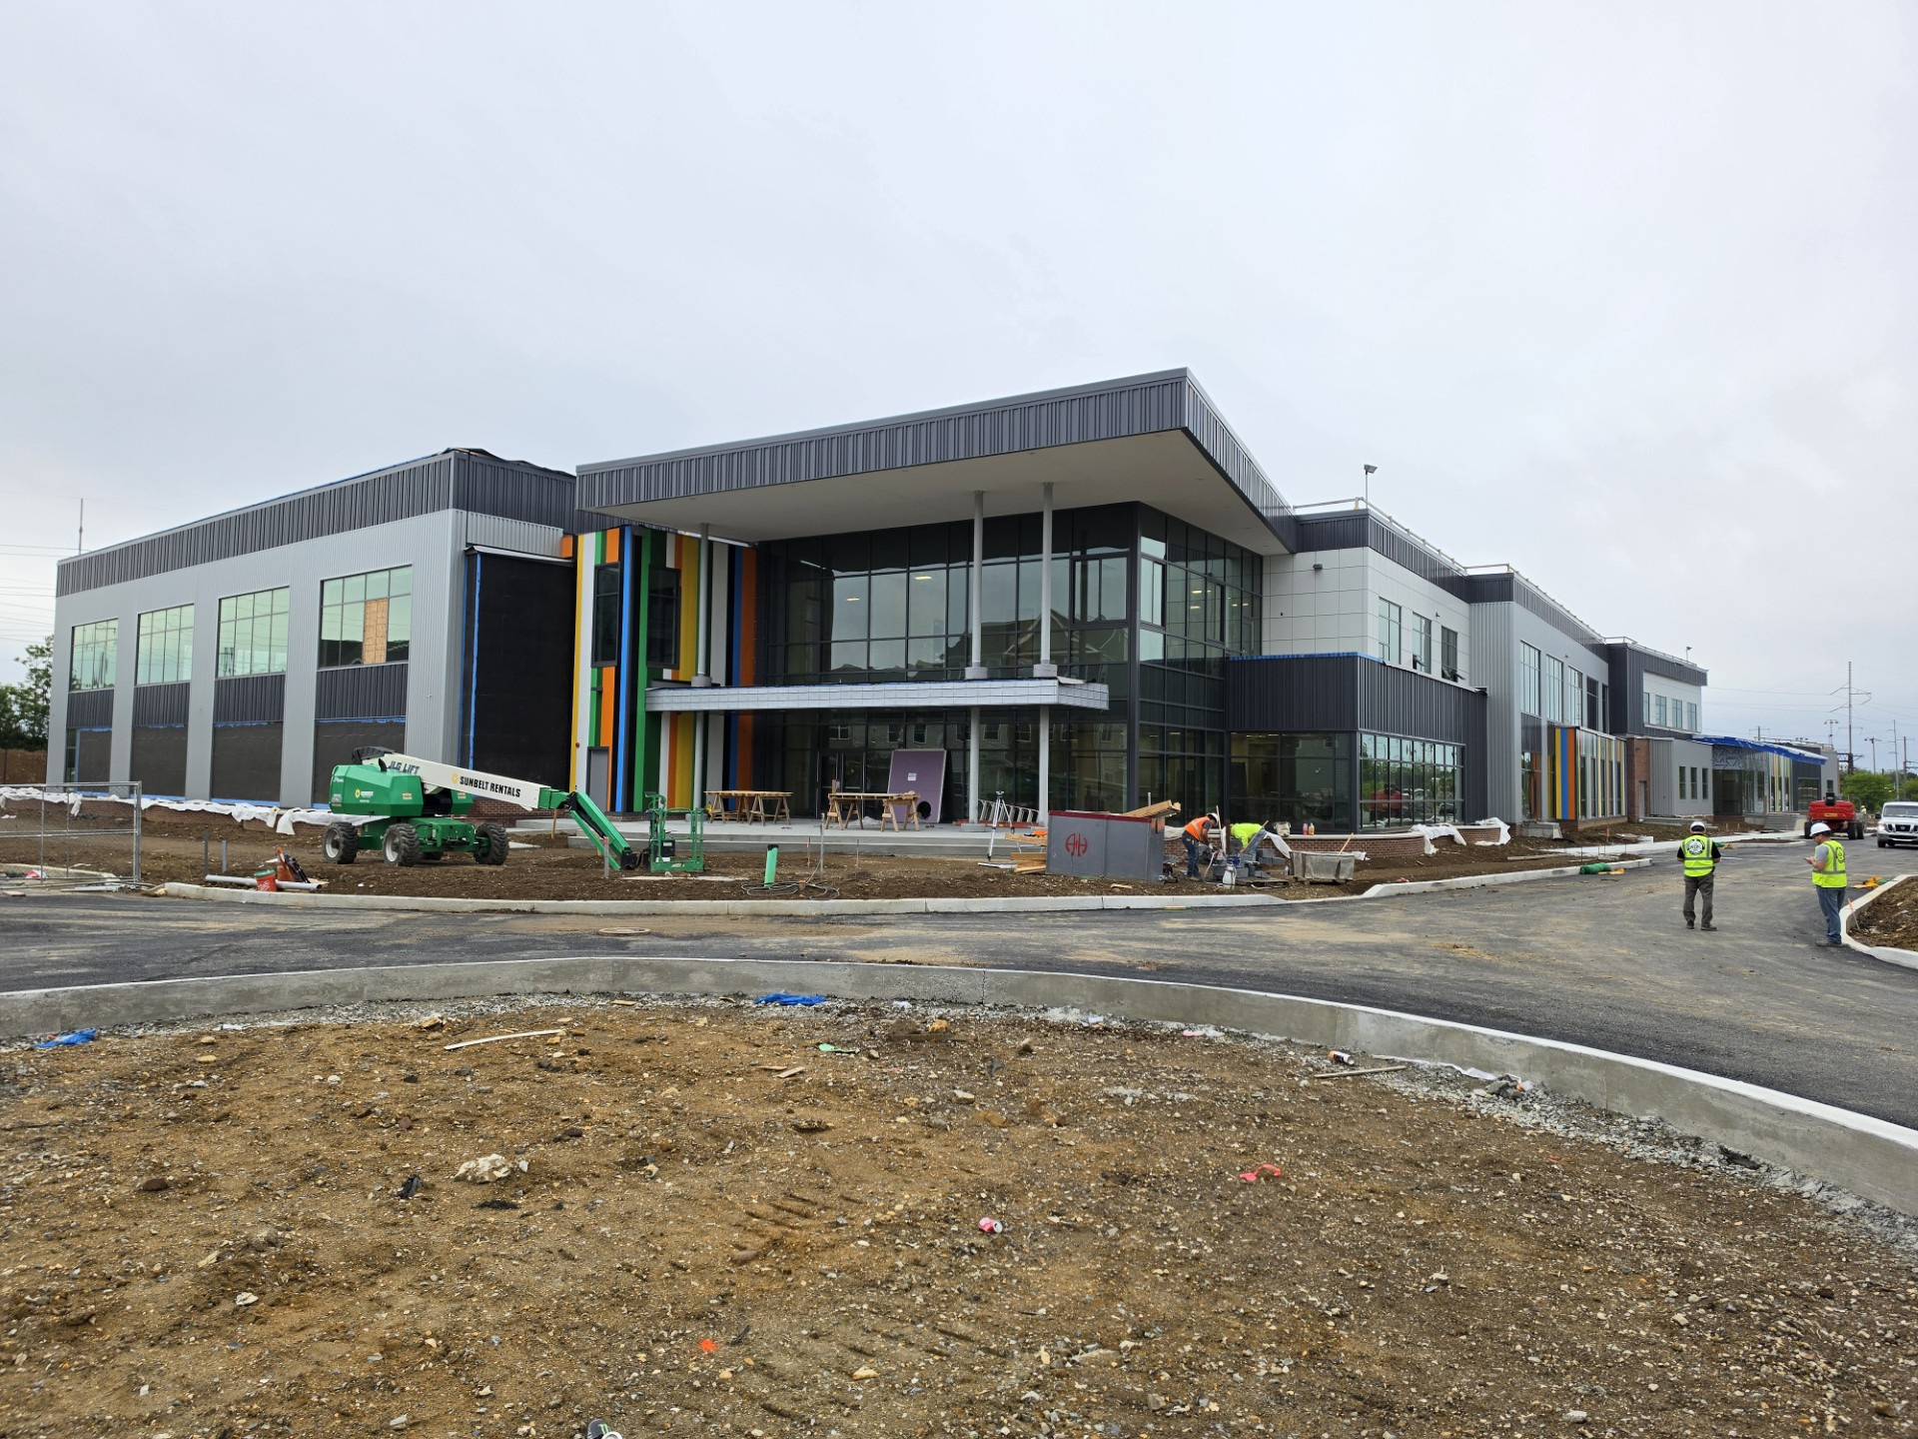

Slide 16
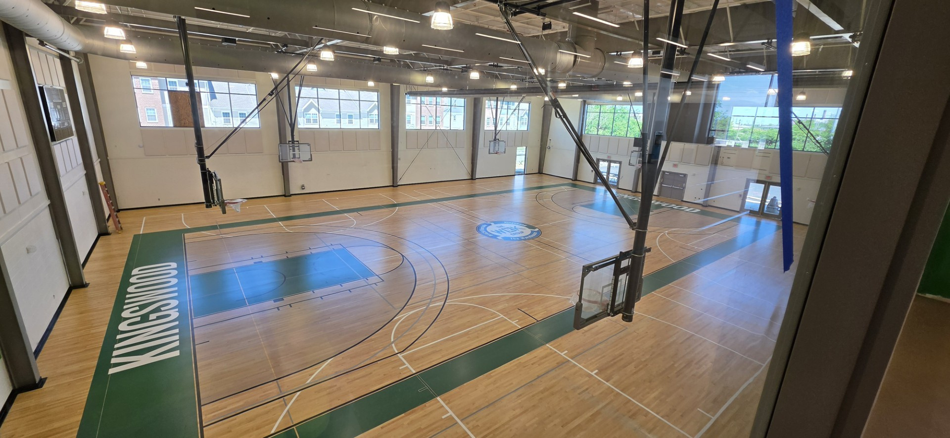

Slide 17
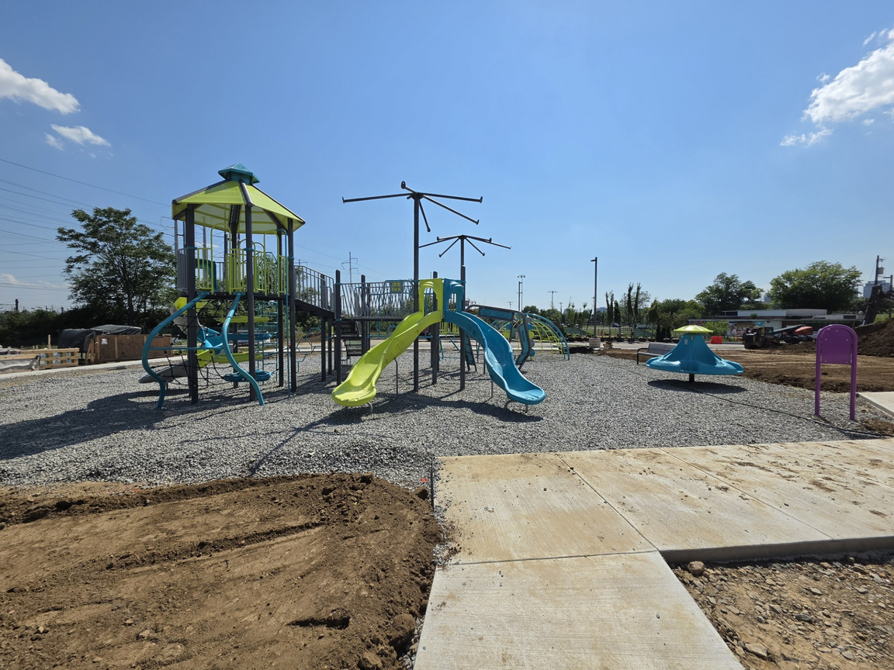
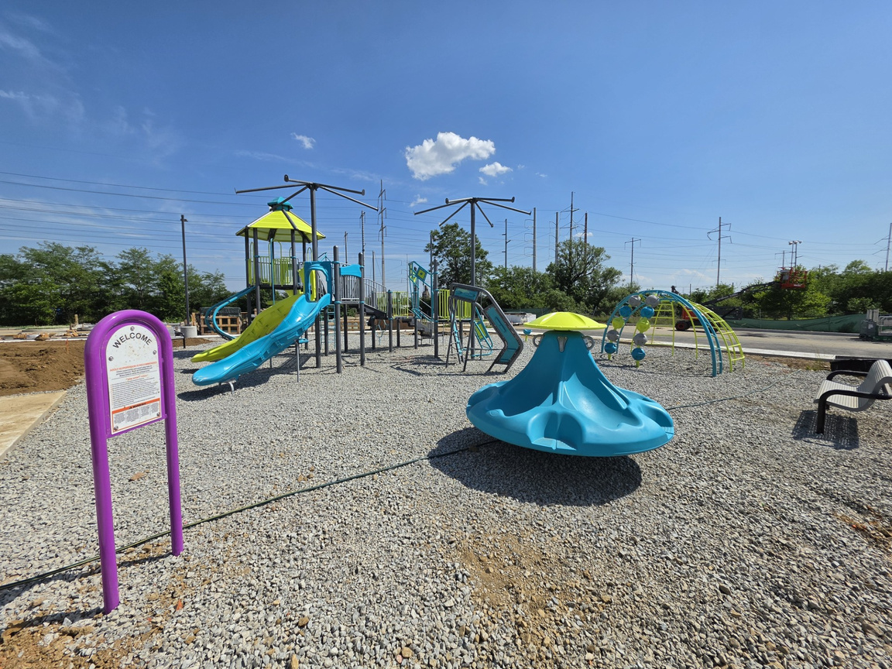

Slide 18
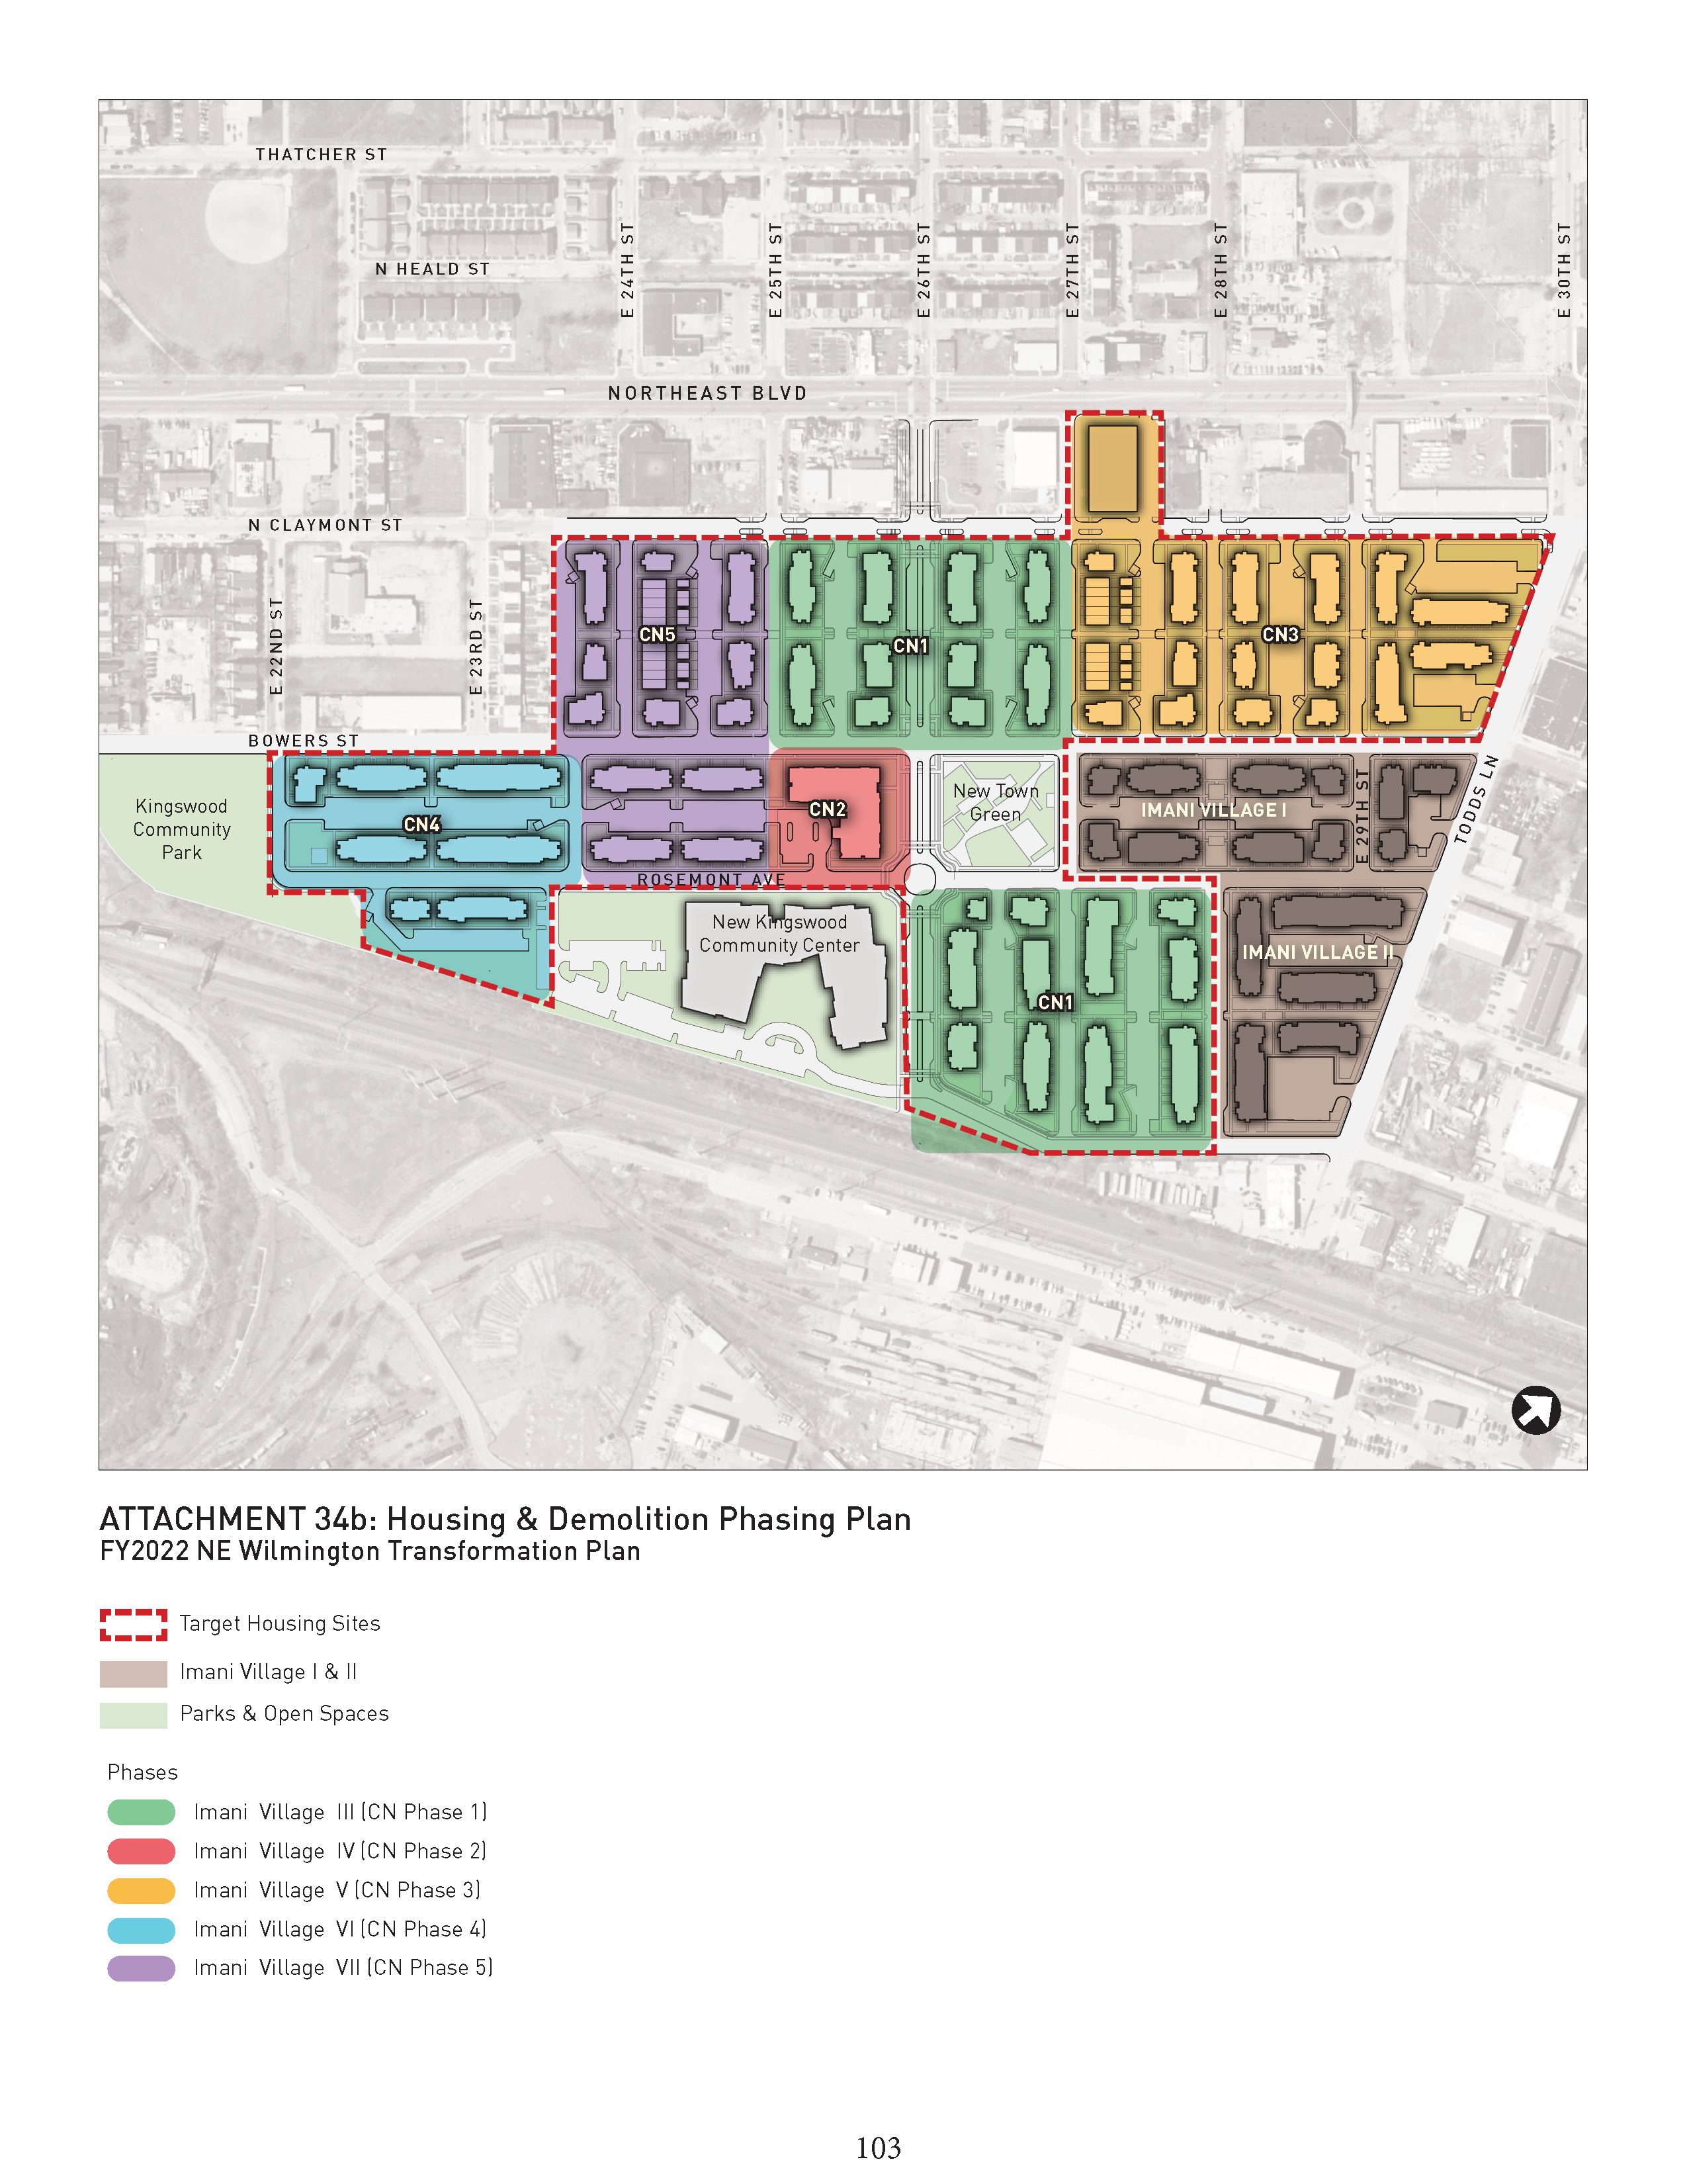
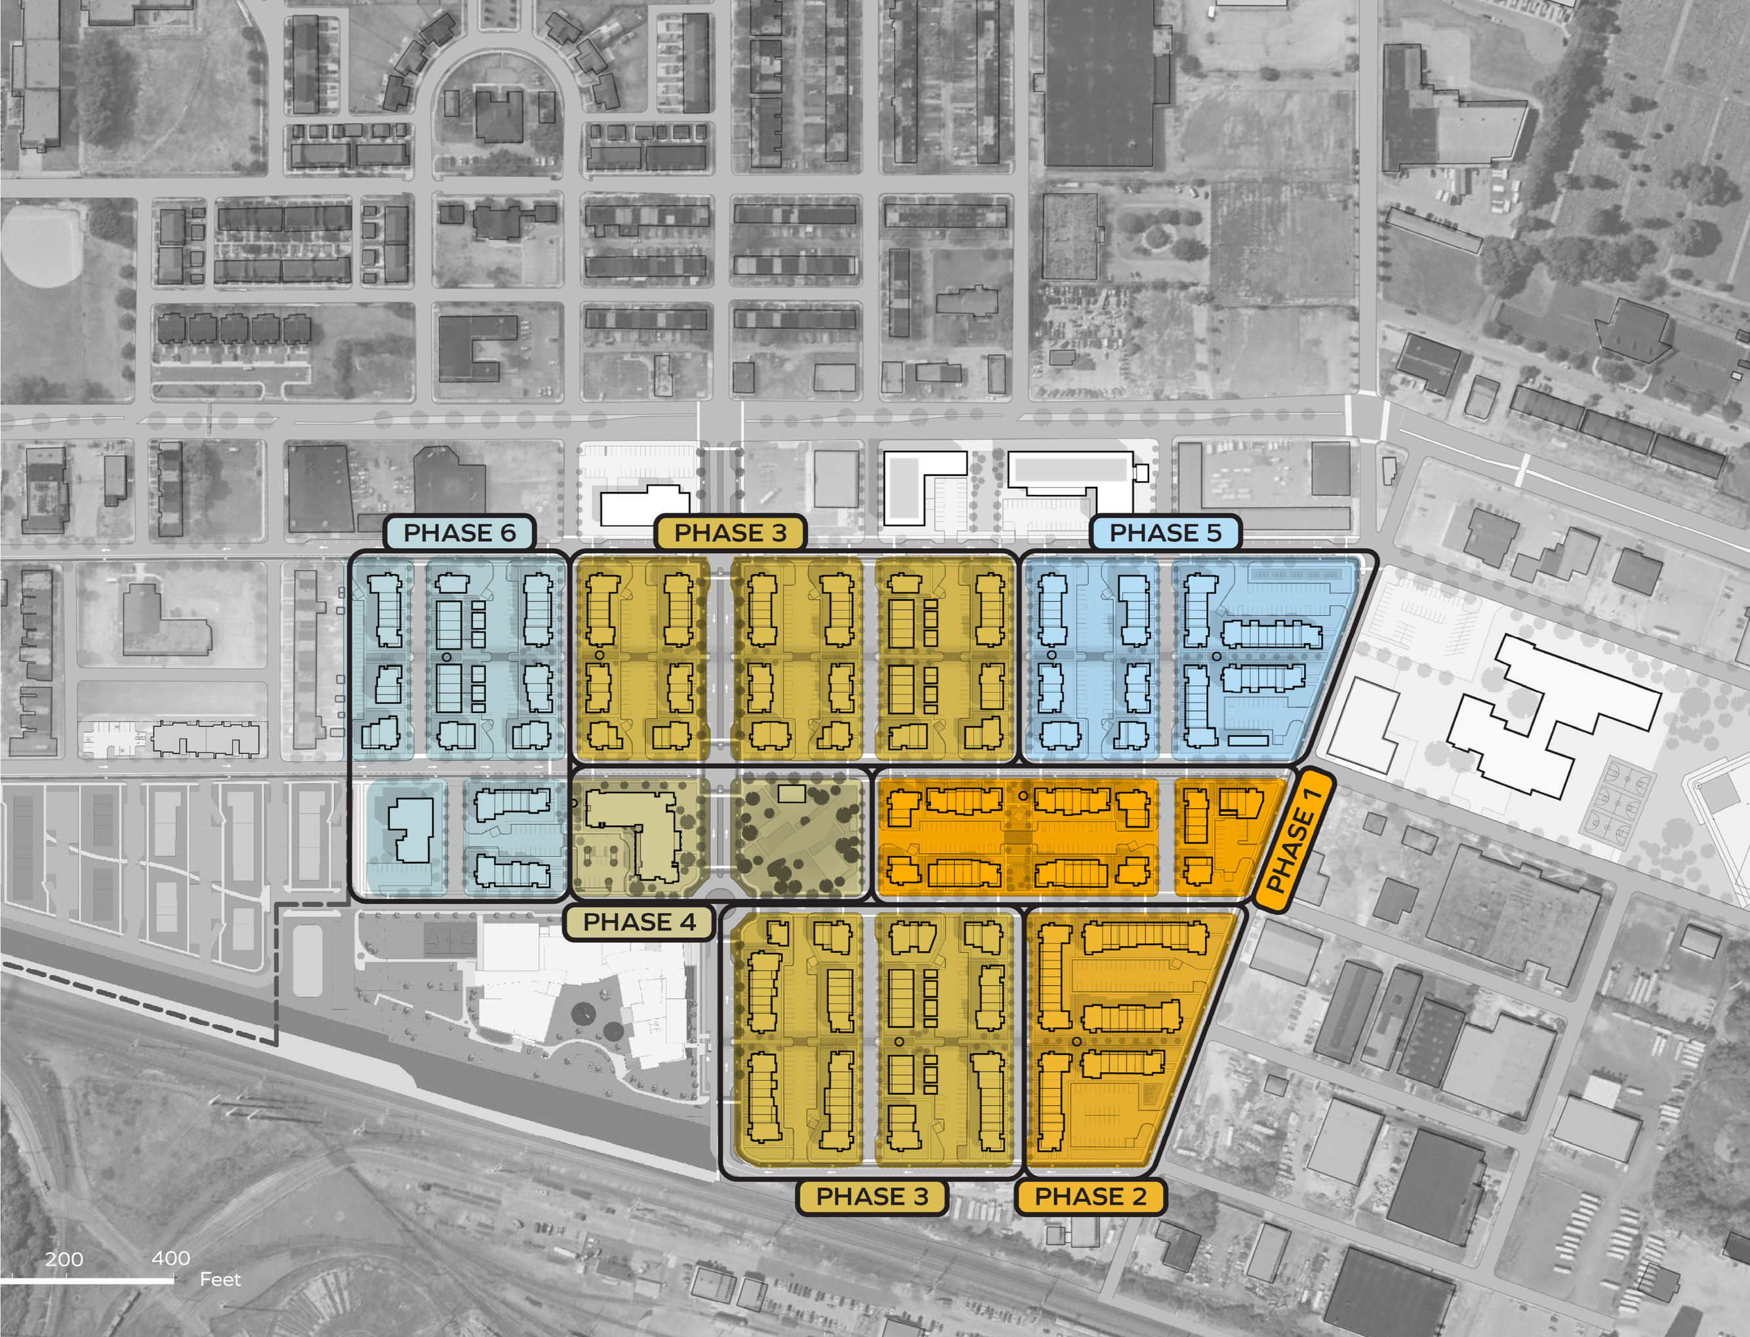
IMANI VILLAGE MASTER PLAN
EASTSIDE CHARTER
SCHOOL
HOME
OWNERSHIP
OPPORTUNITIES
NEW KINGSWOOD COMMUNITY CENTER

Slide 19
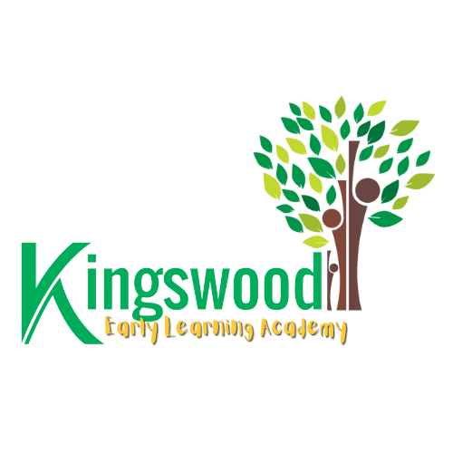
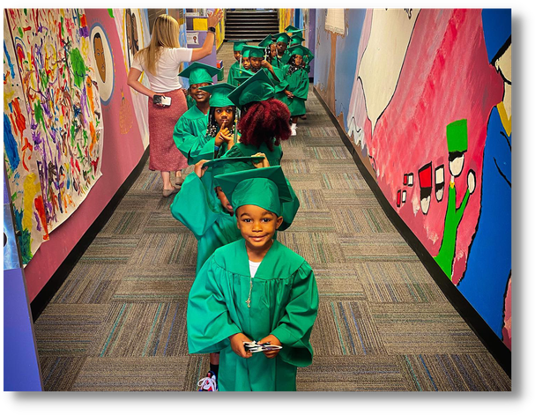
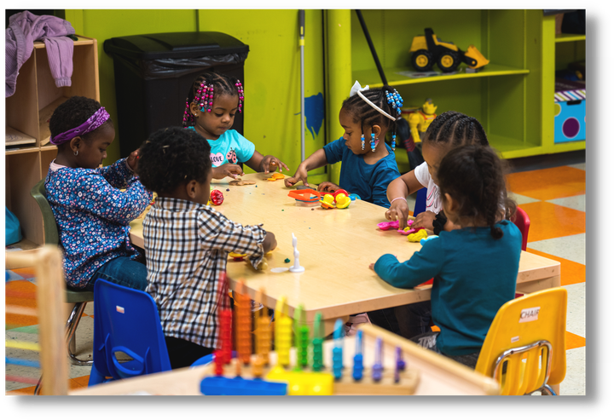
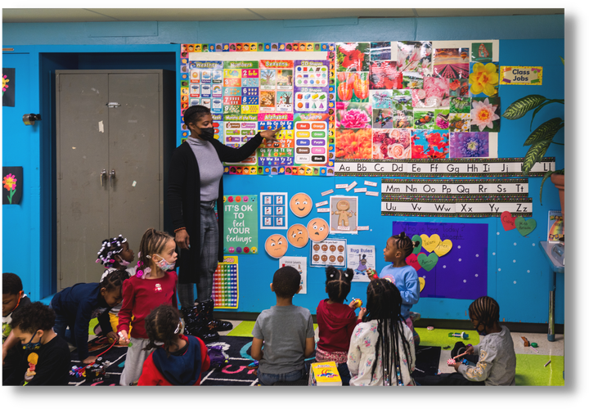
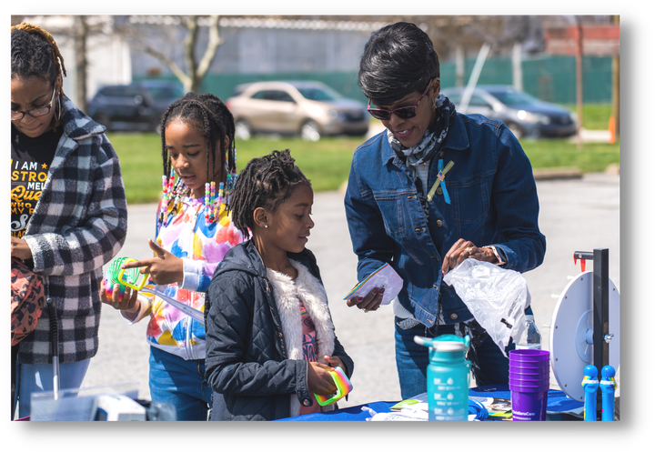
The Kingswood Early Learning Academy is
an Early Head Start program providing
high-quality pre-k education and
after-school support to Riverside residents
100% Kindergarten
Readiness
4 Years Running!
Early Head Start accredited, serving ages 12 months
to 5 years​
95% of children from
low-income families​ and over half of our children live in
Riverside public housing​
ELA features The Creative Curriculum by Teaching Strategies, Conscious Discipline, and Ready Rosie by Teaching Strategies
Parent & Family Services including community events, parent programs, primary care health services,
case management, and workforce development

Slide 20
WORKFORCE DEVELOPMENT AS A PREVENTATIVE HEALTH STRATEGY​
Economic mobility is a health intervention.​

Slide 21

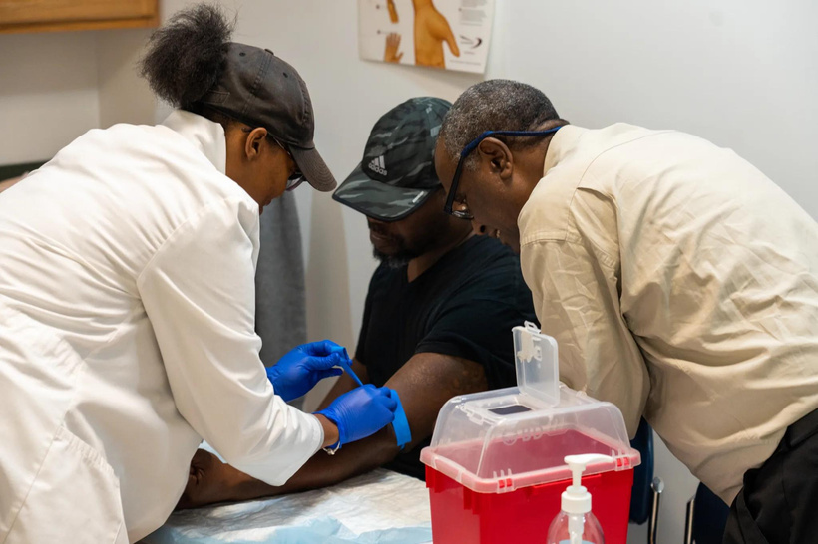
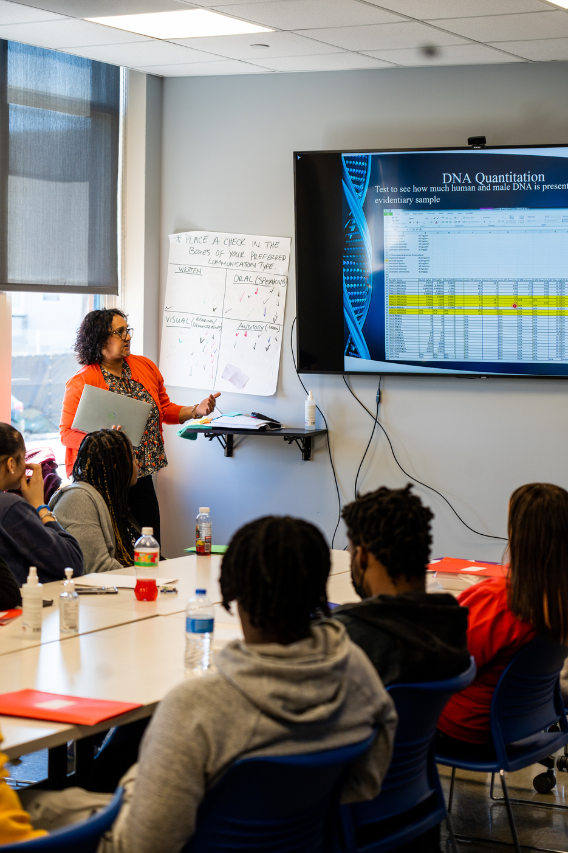
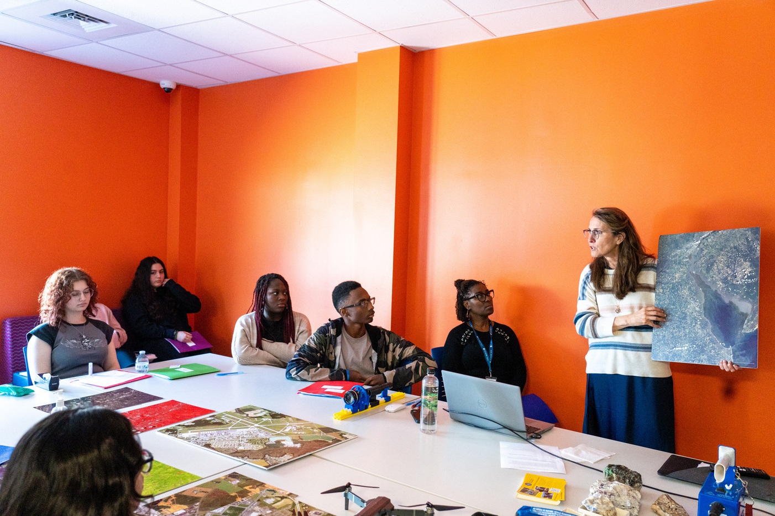
Reaching and Investing in Youth
for Sustainable Employment
Ages 14-18 & Enrolled in School
Career pathways offered:
  Entrepreneurship
  Clothing Design & Retail
  Culinary Arts
  Early Childhood Education
  Energy Conservation
  Digital Marketing
  And much more!
Ages 16-24 & Not Enrolled in School
Certifications offered:
  Nursing Assistant (CNA)
  Clinical Medical Administrative Assistant (CCMAA)
  Patient Care Tech
  Phlebotomy
  Commercial Driver’s License (CDL)
  Forklift Operator
  HVAC
  CompTIA A+ (Information Technology)
  Culinary Arts
  Hotel & Restaurant Management
  Customer Service
  GED Preparation and Testing
8 Week Workforce & Life Skills Training
  Workplace Safety & Ethics
  Teamwork
  Diversity, Equity & Inclusion
  Problem-Solving/Conflict Resolution
  Time Management
  Public Speaking
  Job Interviewing
  Community Service
  Financial Literacy
  Mindfulness & Meditation

Slide 22

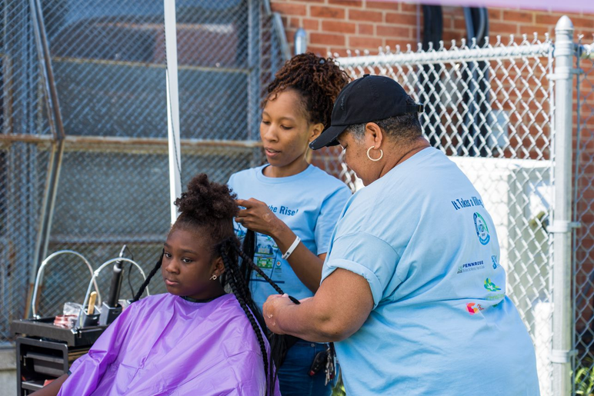
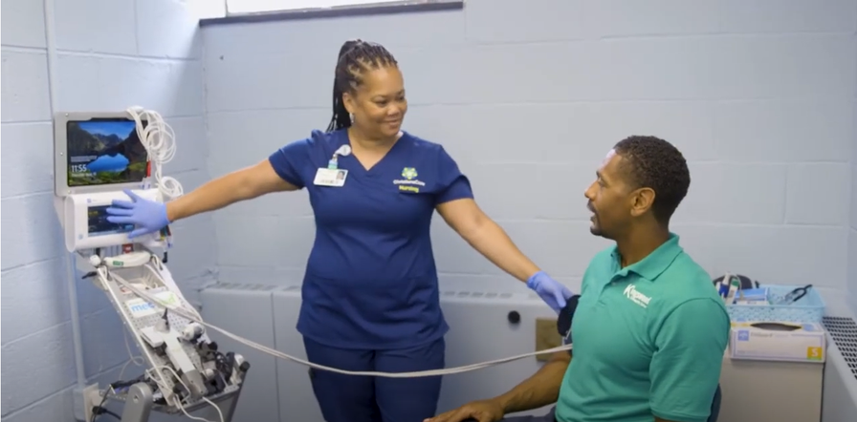

Economic Mobility Places Ownership Within Everyone's REACH
Financial Literacy
Family Support Services
  Banking/credit union services
  Credit building programs & low-interest loans
  Financial management workshops
  One-on-one financial coaching and assessments
  Savings strategies
  Assessment and goal setting
  Transportation Assistance
  Emergency Food and Clothing
  Childcare
  Coordination of benefits and access to care
  Expungement services
Health & Wellness
  Behavioral & mental health service referrals
  Food/nutrition programs
  Health screenings, assessments, & improvement strategies
  Primary Care Services
Economic Independence
  Career readiness workshops
  Connection to GED, higher educations, & training programs
  Homeownership preparation programs & services
  Individual job search, application, placement, & retention
  Employment coaching & resume writing

Slide 23
FOOD ACCESS AS A PREVENTATIVE HEALTH STRATEGY​
Food security improves community wellness.​

Slide 24
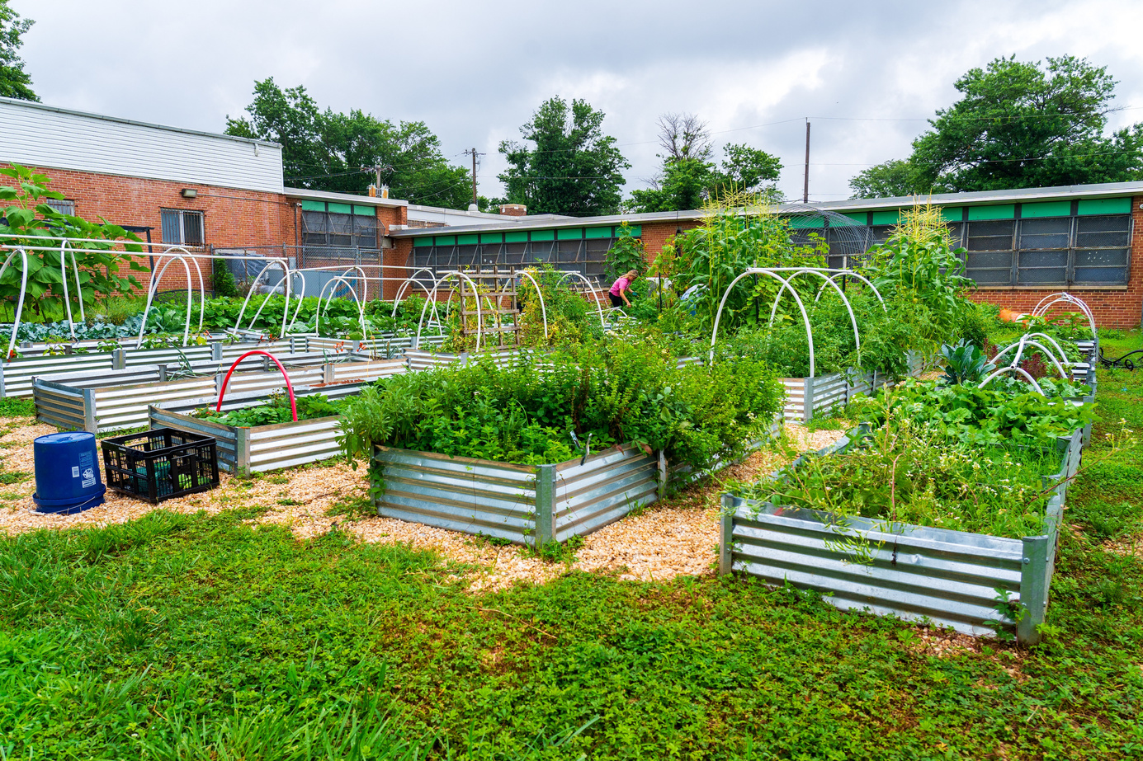
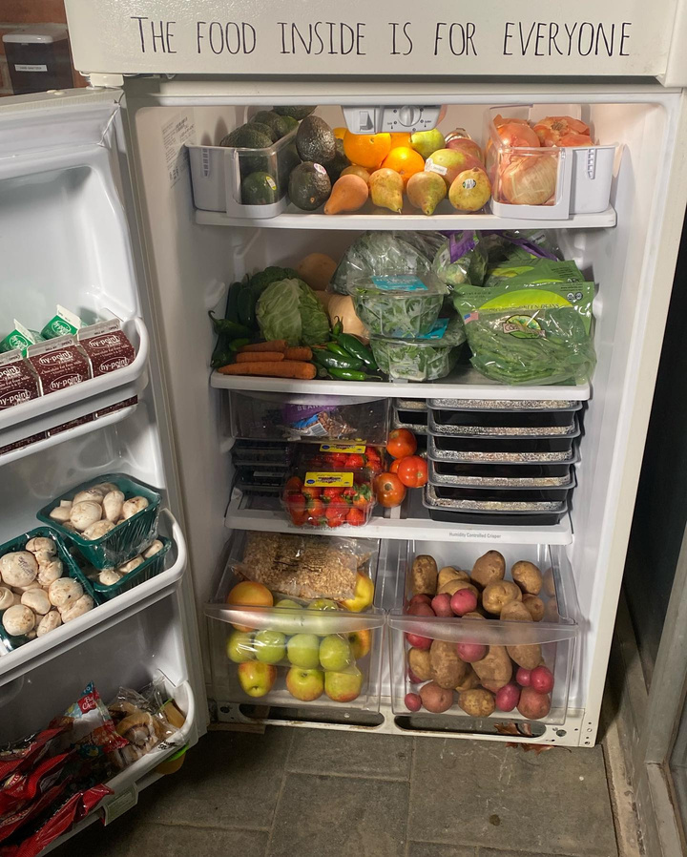


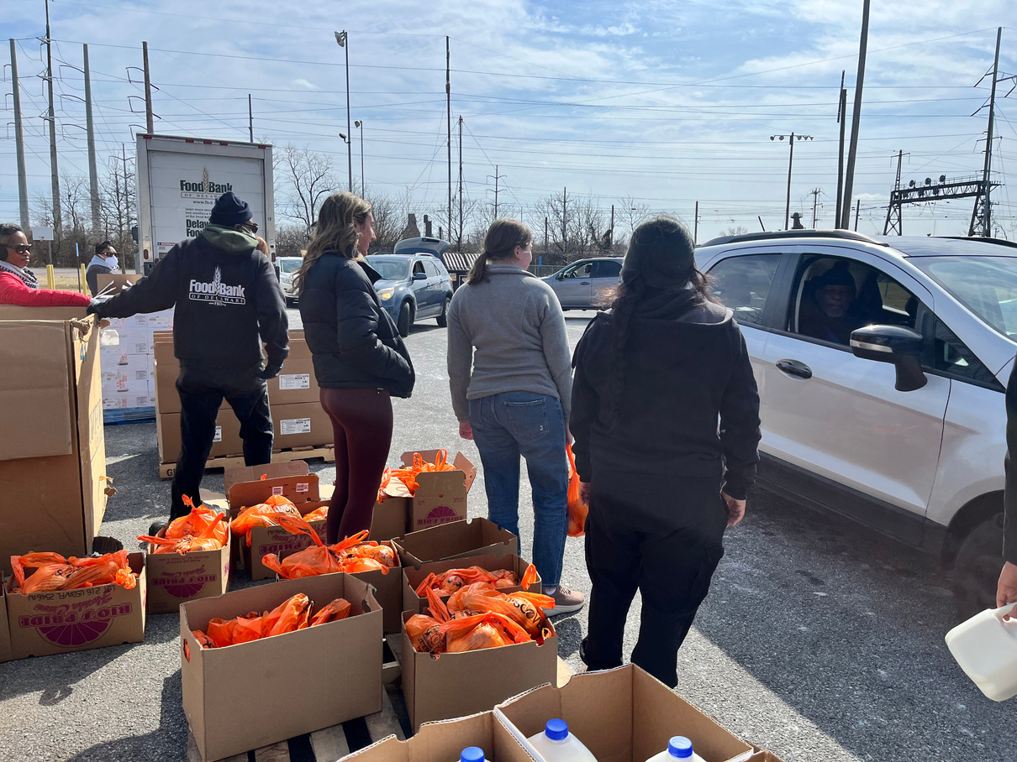
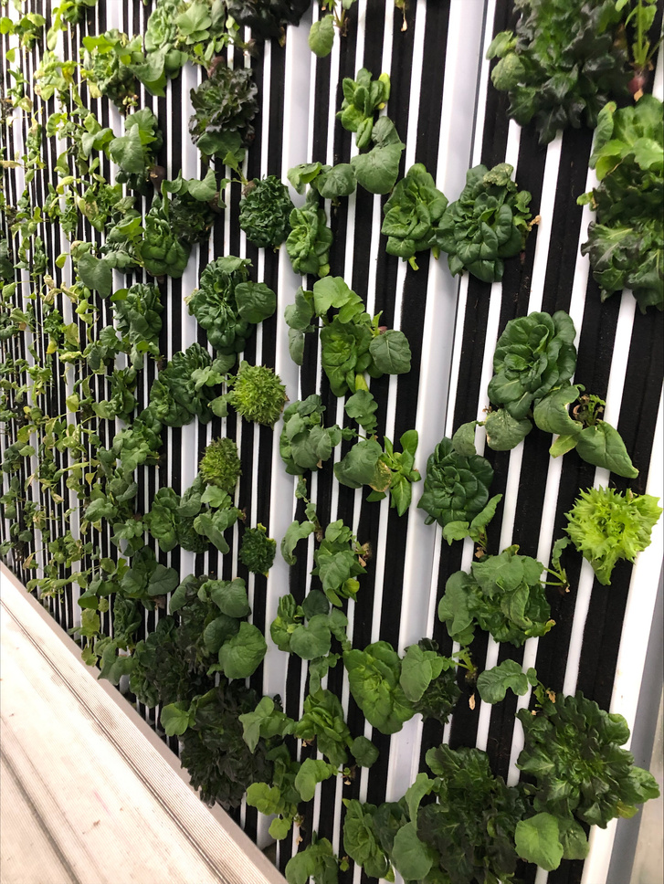



Food Bank Partnership
  Kingswood Community Center hosts a free, monthly drive-thru food distribution
  Plenty Pantry is a free weekly food pantry for Riverside residents located at The Warehouse
Planting to Feed Partnership
Kingswood Garden & Community Refrigerators
  Two community refrigerators and pantries are located outside both The Warehouse and outside of Kingswood Community Center
  These community refrigerators and pantries are free and open to the public, 24/7
  Refrigerators are stocked weekly with fresh produce from the Kingswood garden, The Greenery, & local donors
The Greenery
  'A sustainable, hydroponic, indoor, vertical farm that produces an average of 100 pounds of veggies like kale, collards, radishes, lettuce a week.
Snack Bags
  Our newest program is FED-UP's Snack Bags! Modeled on the amazing Backpack Program from the Food Bank of Delaware, this new initiative will provide meals and snacks daily for all the youth in The Warehouse.

Slide 25
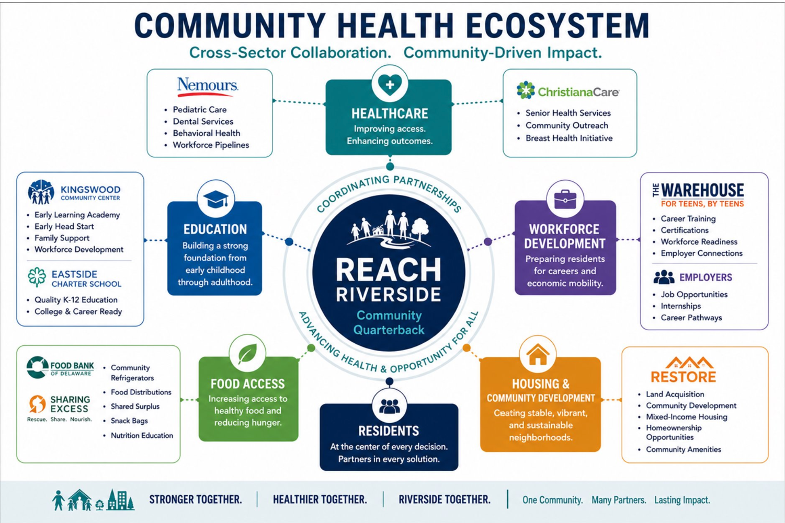
WHY PARTNERSHIPS MATTER​

Slide 26

PARTNERSHIP SPOTLIGHT: ​
Lead tenant in the new 80,000sq ft Early Learning Center – 16Ksquare feet​
Services:​
  General Pediatric Services​
  Dental​
  Ophthalmology​
  Behavior Health ​
Workforce Development​
  Work Advance- Placing in High Turnover/High demand roles​
New Building Capital​
Leveraging their balance sheet for a $13M Bridge Loan in a New ​Market Tax Credit deal to garner $9.2M in equity (20% of the Capital)

Slide 27

PARTNERSHIP SPOTLIGHT: ​
Lead tenant in the new 65K sq ft Senior High Rise Building – 10k Square Foot
Community Outreach​
Services:​
  General Services​
  Specializing in Senior Care​
Breast Cancer Initiative

Slide 28
WHAT WE’VE LEARNED​
  Design with community​
  Trust takes time​
  Partnerships require stewardship​
  Health is interconnected​
  Sustainability requires alignment

Slide 29
Community health isn't created by a single program or organization. It's created when residents, partners, and institutions work together around a shared vision for community well-being.​

Slide 30
THANK YOU!

