Slide 1



From Ideas to Impact
Expansion Powered by Cross-Sector Partnerships
Tami C. Saunders, CNP
Executive Director, The Harvest Outreach People's Project
AHL Conference | June 4, 2026 | Delaware Room
Welcome everyone. I'm Tami Saunders. Today we aren't just talking about food distribution; we are talking about a community-powered movement. I’m here to share how intentional partnerships have fueled our jump from a local idea to a statewide health initiative.

Slide 2



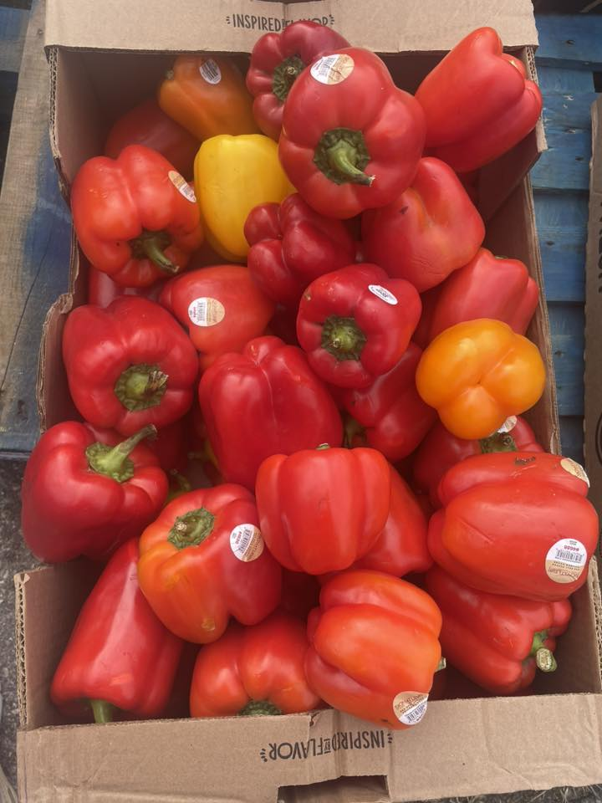
The HOPP at a Glance
Fresh Produce. Lasting Hope.
The Harvest Outreach People's Project (The HOPP) is a community-powered movement ensuring equitable access to fresh nutrition.
Produce-Focused: 100% fresh fruits & veggies.
Dignity First: No registration or ID required.
Statewide Reach: Hubs in New Castle, Kent, and Sussex.
The HOPP is more than a food pantry. We decided in 2022 to serve exclusively fresh produce because we believe nutrition is a right, not a privilege. We operate with zero barriers—no IDs, no registration—to ensure every neighbor is served with dignity.

Slide 3
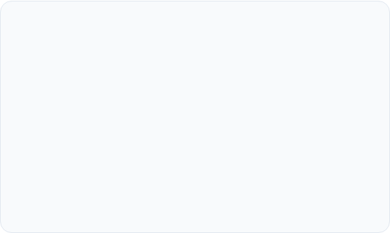
The Challenge
Access Inequity
Health Disparities
Thousands of families across Delaware live in areas with high caloric density but zero nutritional access. This gap isn't just about hunger; it's about the lack of life-sustaining food.
Food insecurity is a primary driver of chronic, nutrition-related conditions. Without a stable supply of fresh produce, communities face disproportionate rates of diabetes and hypertension.
We are facing two distinct challenges: access and outcome. In many zip codes, it's easier to find a bag of chips than a bunch of kale. This nutritional desert directly fuels the chronic illnesses that healthcare leaders in this room fight every day.

Slide 4






Why Partnerships Matter
Trusted Entry
Scale Efficiently
Localized Reach
Collective Impact
Leveraging existing community trust.
Sharing infrastructure and logistics.
Going where the traditional model can't.
Combining strengths for a common goal.
"Meaningful, scalable impact is not achieved in isolation."
No organization can scale effectively alone. Partnerships allow us to borrow trust from local leaders and share the heavy lifting of logistics. It turns a single organization's effort into a collective community impact.

Slide 5
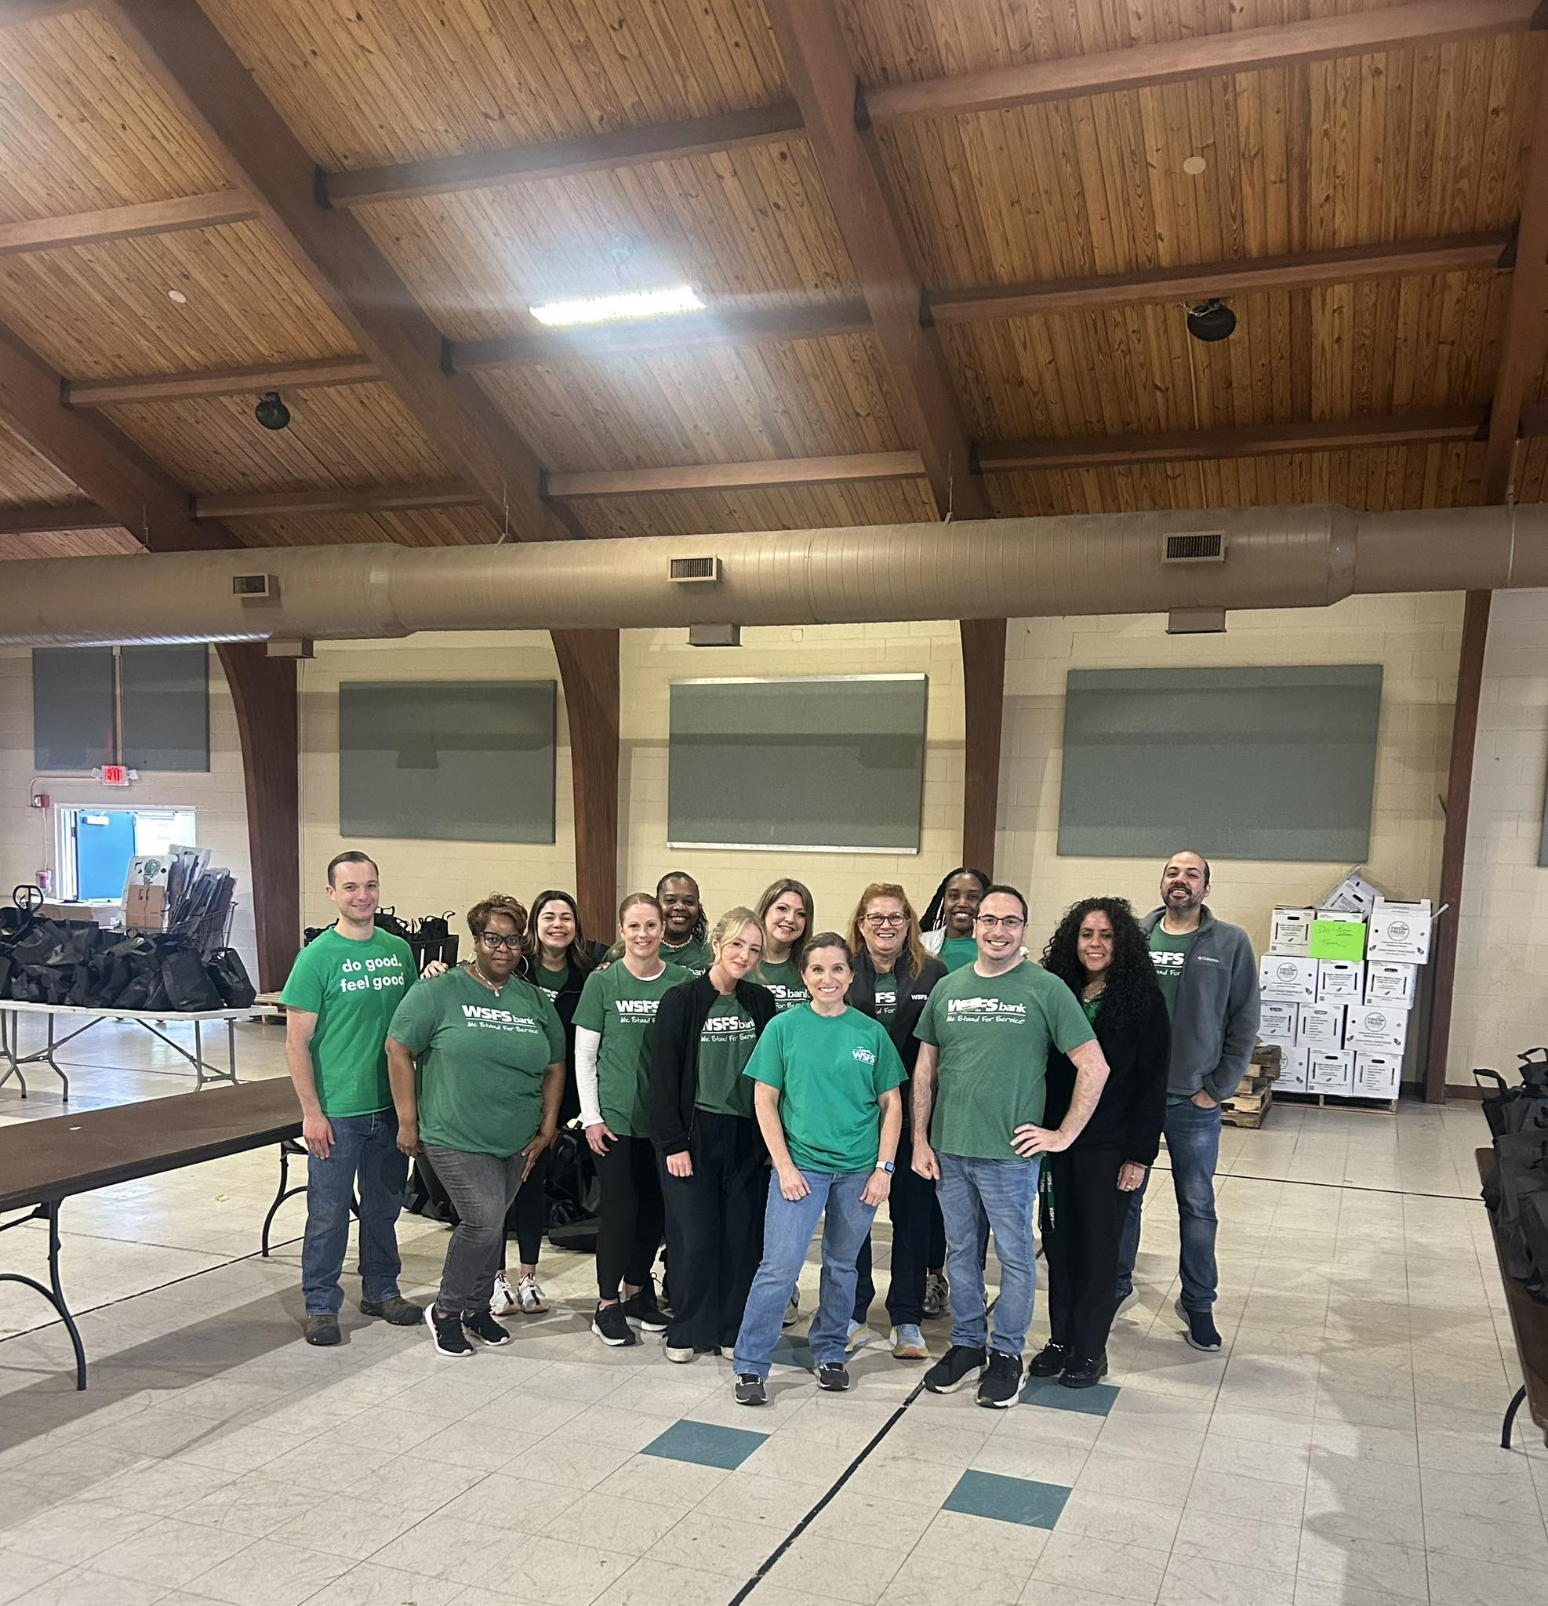

Our Partnership Ecosystem
Faith-Based & Nonprofits
Serving as trusted, community-embedded distribution sites.
Healthcare & MCOs
Aligning fresh food access with clinical health strategies.
Corporate & Civic
Providing operational support, volunteers, and growth capital.
Our ecosystem is a coordinated front. Faith communities are the "heart" where neighbors gather; MCOs are the "brain" aligning food with care; and our corporate partners are the "engine" providing the resources to keep the trucks moving.

Slide 6
“
"Our partners are not participants; they are essential operators in our network. This is a model of shared ownership and strategic growth."
— Tami C. Saunders
I want to be clear: partners aren't "extra" for us. They are the distribution network. When we partner with a church in Sussex, they own that distribution. That shared responsibility is the secret to our rapid, stable growth.

Slide 7
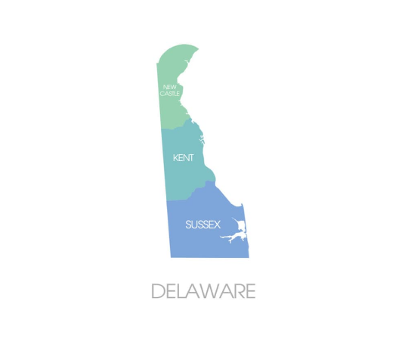
Scaling Across Delaware
Statewide Completion
The HOPP model has successfully expanded to provide full coverage across the First State:
New Castle County: Established 2022.
Kent County: Hub launched 2024.
Sussex County: Completed Fall 2025.
As of late 2025, we achieved full Delaware coverage. We didn't do this by building three separate warehouses; we did it by replicating the Hub model with local partners in each county, ensuring we meet families where they live.

Slide 8
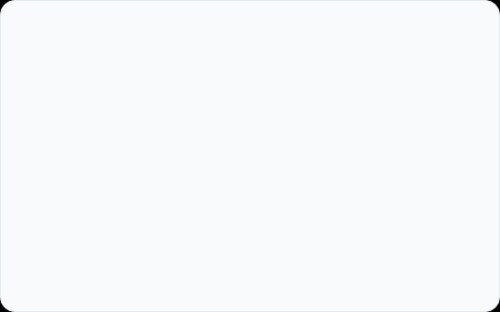
Bridging Food Access and Health
Alignment with Health Focus
Addressing Chronic Needs
By prioritizing fresh produce, our partnerships support broader efforts to address nutrition-related chronic conditions and improve long-term health outcomes in underserved populations.
We work with health-focused organizations and Managed Care Organizations (MCOs) to align fresh food access with community wellness and preventative care strategies.
This is where the 'outreach' meets the 'health'. We align our produce distributions with the goals of health-focused partners. It's about strategic alignment—making sure fresh nutrition is a standard part of the preventative care conversation for chronic conditions.

Slide 9
Community Impact
80K+
100%
4
Families Served Yearly
Fresh Produce Focused
Regional Hubs
Sustainable Impact powered by community presence.
The numbers speak to the scale: over 80,000 families served annually. But the real impact is that every single bag is fresh. We aren't just giving food; we are fueling communities with the high-quality nutrition they deserve.

Slide 10
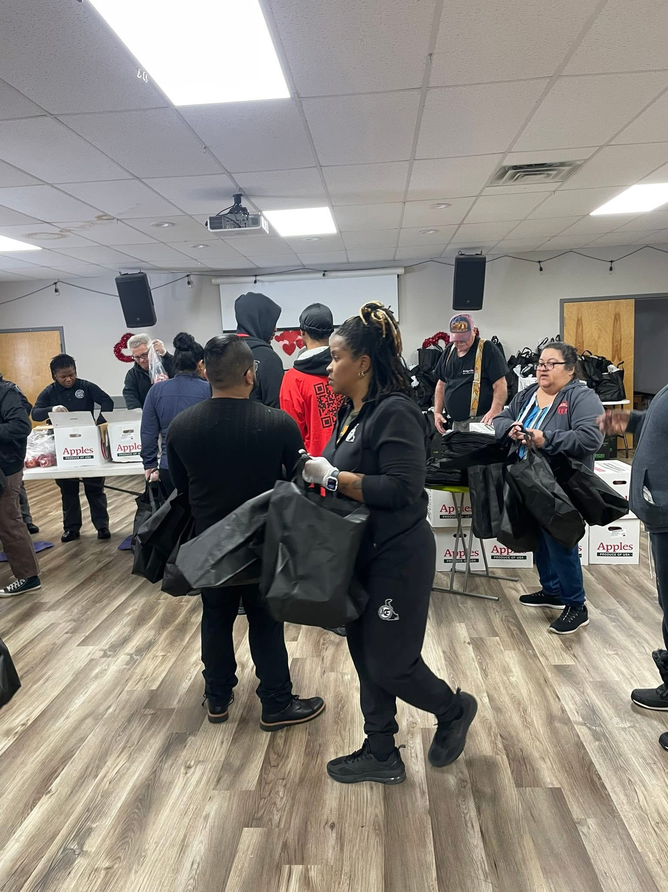
A Replicable Ecosystem Model
Replication in Lower Sussex
The success of the "Pack & Pray" Hub model in New Castle and Kent counties provided the blueprint for expansion into Lower Sussex County.
Adaptable framework for any geography.
Rooted in local leadership and trust.
Shared responsibility model.
Our model is a "business in a box" for community impact. What worked in Wilmington was adapted and successfully replicated in Lower Sussex County. This proves the framework is implementable in any community seeking sustainable solutions.

Slide 11
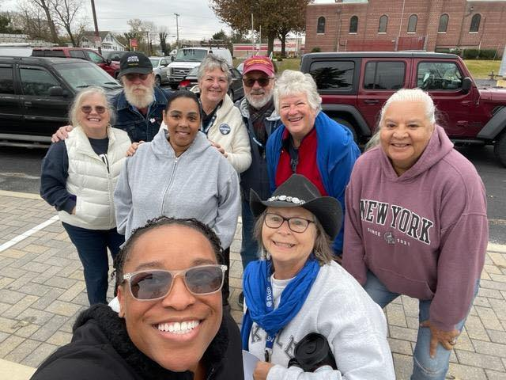
Key Lessons Learned
Design WITH, Not FOR
Elevate community voices in every stage of planning and decision-making.
Shared Incentive Alignment
Ensure healthcare and community goals are mutually reinforcing.
Trust as the Foundation
Presence and consistency are non-negotiable for long-term partnership success.
We’ve learned that design must be inclusive. We don't build *for* Lower Sussex; we build *with* them. Aligning health incentives with community needs requires a deep foundation of trust and consistent physical presence.

Slide 12
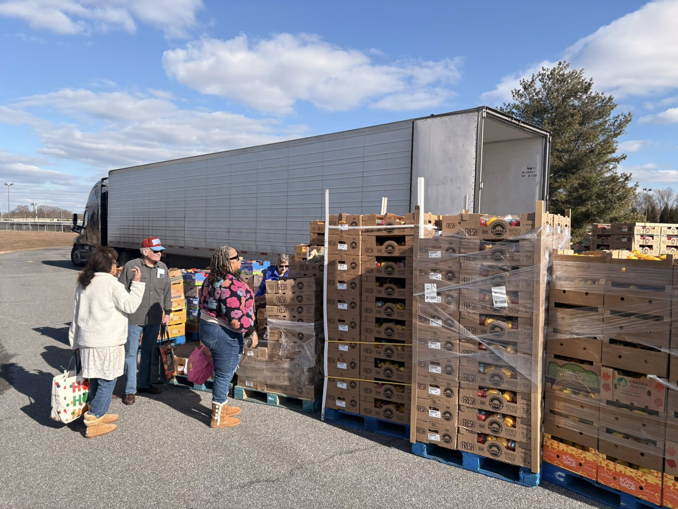
Future Expansion
Scaling Sustainably
Our goal is to deepen the reach of the ecosystem through technological and logistical innovation:
HOPP DROPP: 18-wheeler distribution.
HOPPdash: Direct delivery for seniors.
Regional Growth: Beyond Delaware borders.
Looking ahead, we are moving from vans to 18-wheelers. Our "HOPP DROPP" initiative is a massive step in scale, and "HOPPdash" ensures that even those who are housebound in Lower Sussex aren't left out of the movement.

Slide 13






Call to Action
Collaborate
Host
Invest
Connect
Align your care incentives with our produce network.
Become a "Pack & Pray" hub in your local zip code.
Sponsor a HOPP DROPP to reach 1,000+ families at once.
Introduce us to leaders in your community ecosystem.
How will your organization help power the next stage of growth?
I invite you to find your place in this ecosystem. Whether you're aligning clinical goals, hosting a hub, or investing in our logistics, your partnership is the engine of our shared success. Let’s build together.

Slide 14
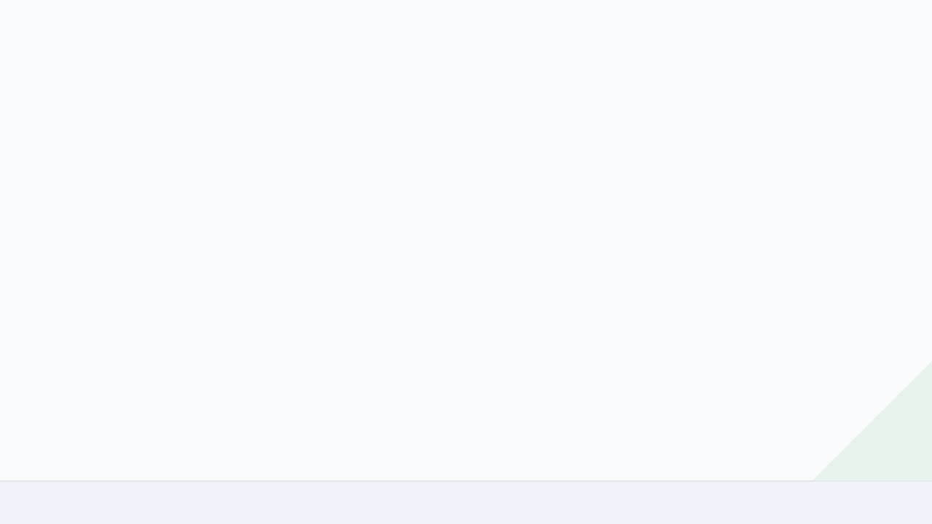


Thank You
Time for Q&A
Tami C. Saunders, CNP
hope@thehopp.org | 888‑323‑HOPP
www.thehopp.org
Thank you for your time and your attention. I’m now happy to open the floor for any questions you might have about our partnership model, our growth in Lower Sussex, or how we align with health outcomes.

