Slide 1
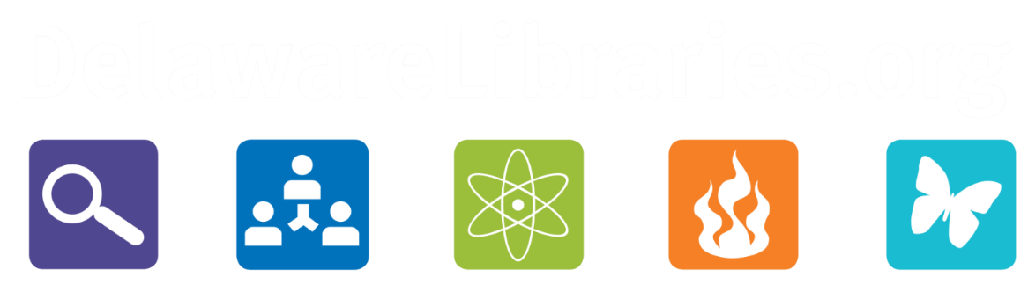
2026 AHL Conference
Technology
Bridging Health Accessibility Gaps

Slide 2
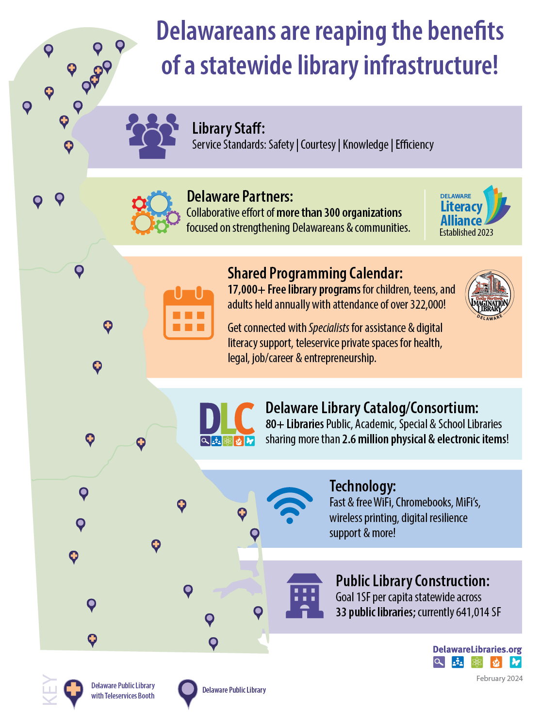
Telehealth & Teleservices in Delaware Libraries Makes Sense
Proximity of libraries vs Healthcare facilities
Delawareans live within 7 miles of a Delaware Public Library
Internet and technology - Availability and affordability
Delaware Libraries offer FREE high-speed internet
Patrons can borrow a chromebook, Hotspot or use
Private Spaces/booths for appointments
Libraries are valued for accessing health information
Libraries promote Literacy in all subjects: Health, digital, financial, communication, etc.
Health education programming for public & staff
Wellness programming- yoga classes, nutrition, meditation

Slide 3
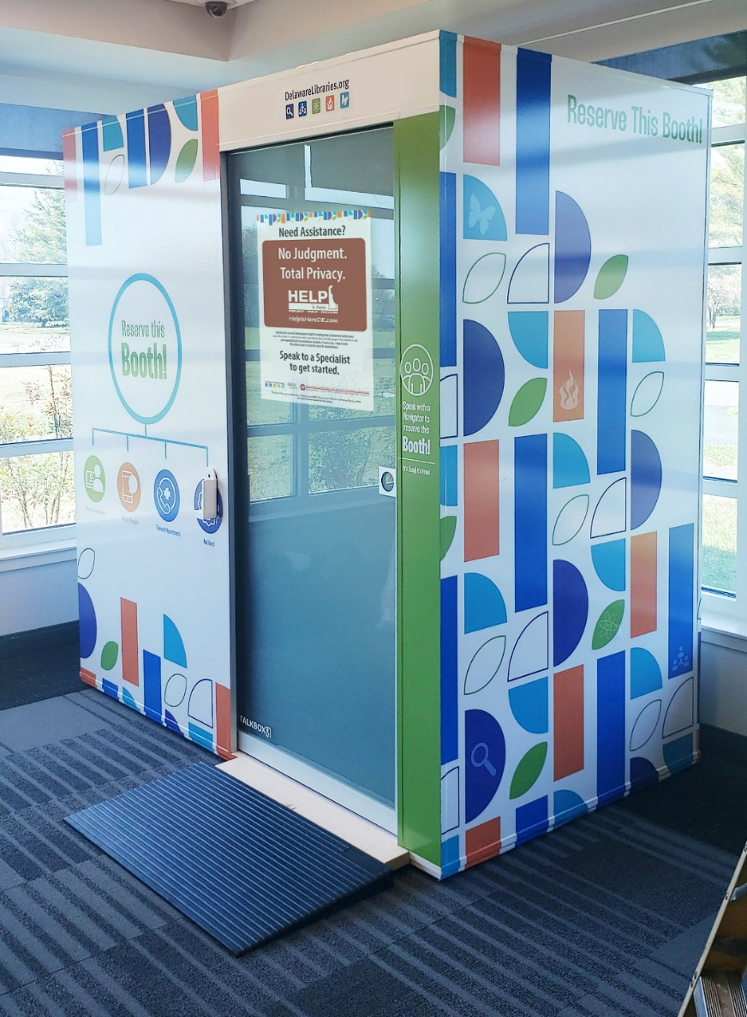
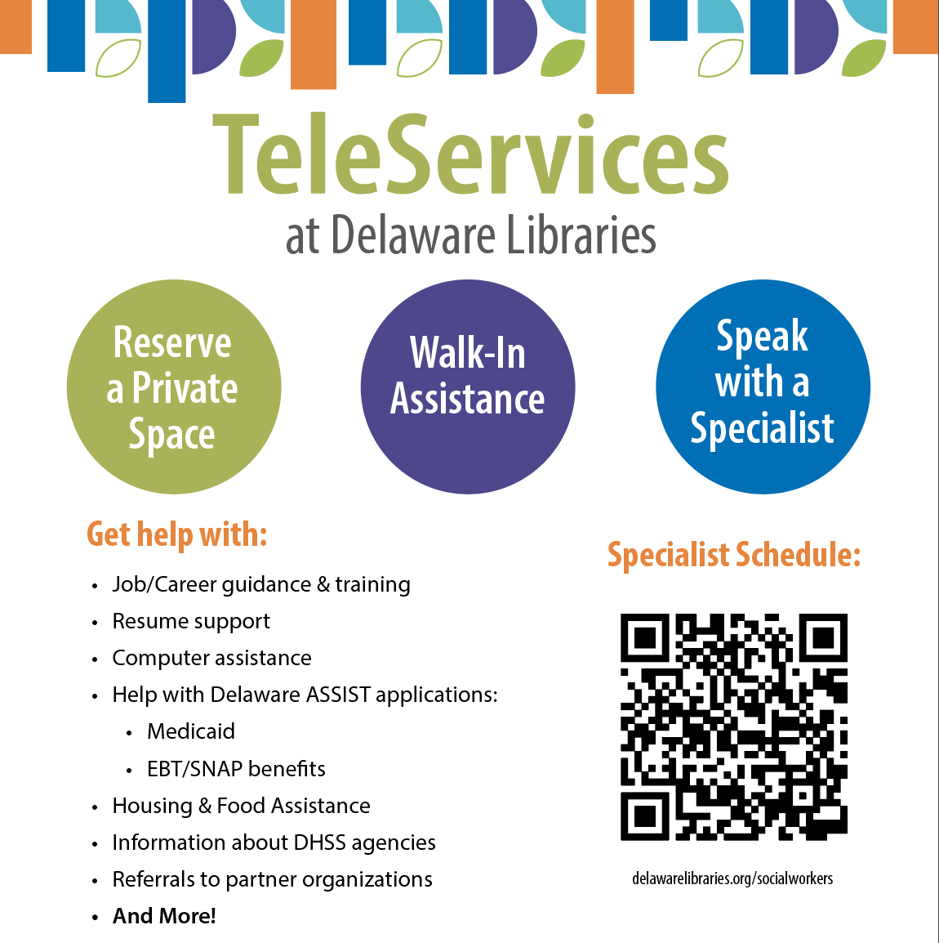
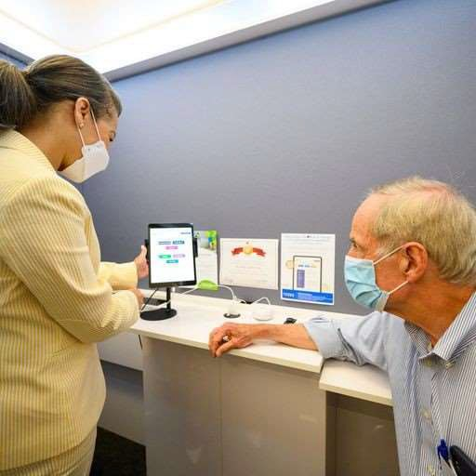
Telehealth & Teleservices in Delaware Libraries Makes Sense
“Nearly 36 percent of adults in the U.S. have low health literacy, with disproportionate rates found among lower-income Americans
eligible for Medicaid.”
~Center for Healthcare Strategies
Delawarelibraries.org/getconnected

Slide 4
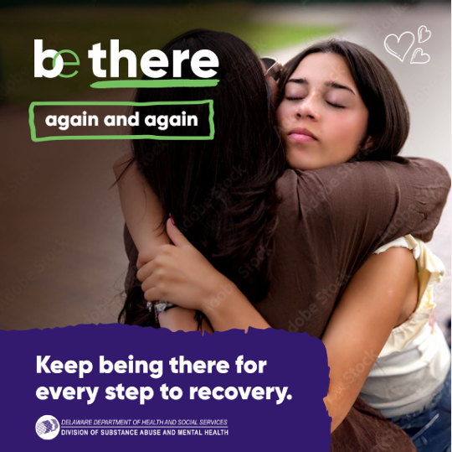

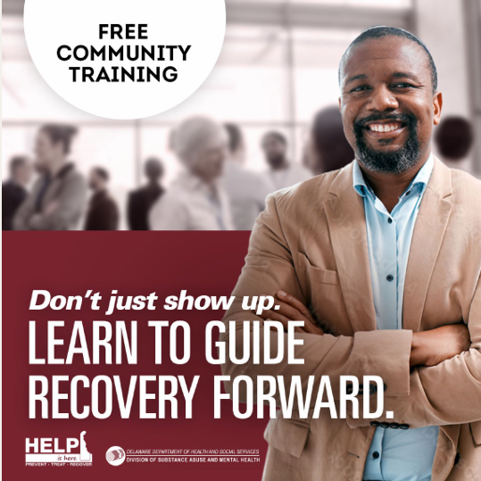

HRSA RCORP-
Behavioral Health Care Support Grant
Major Activities:
  Training: Address Stigma through Educational Workshops
  Integration: Partnership with Primary Care Providers
  Connection to Care: Established a Mobile Peer Support Team
  Promotion: Media Campaign to promote Teleservices and Grant Goals
  Reduce Barriers to Treatment
Notes:
In 2025, there were 290 suspected overdose deaths in Delaware. Addiction can affect anyone, and recovery can be challenging. In Rural Communities connecting to care can be challenging given Stigma, lack of providers, awareness and transportation. Libraries are often found in every community and are accessible. Because of this and the amazing booths DSAMH via HRSA/RCORP sought to partner with the libraries to promote use of the booths to increase access to care, educate the community and address Stigma and promote mental health well bring via community training workshops.

Slide 5
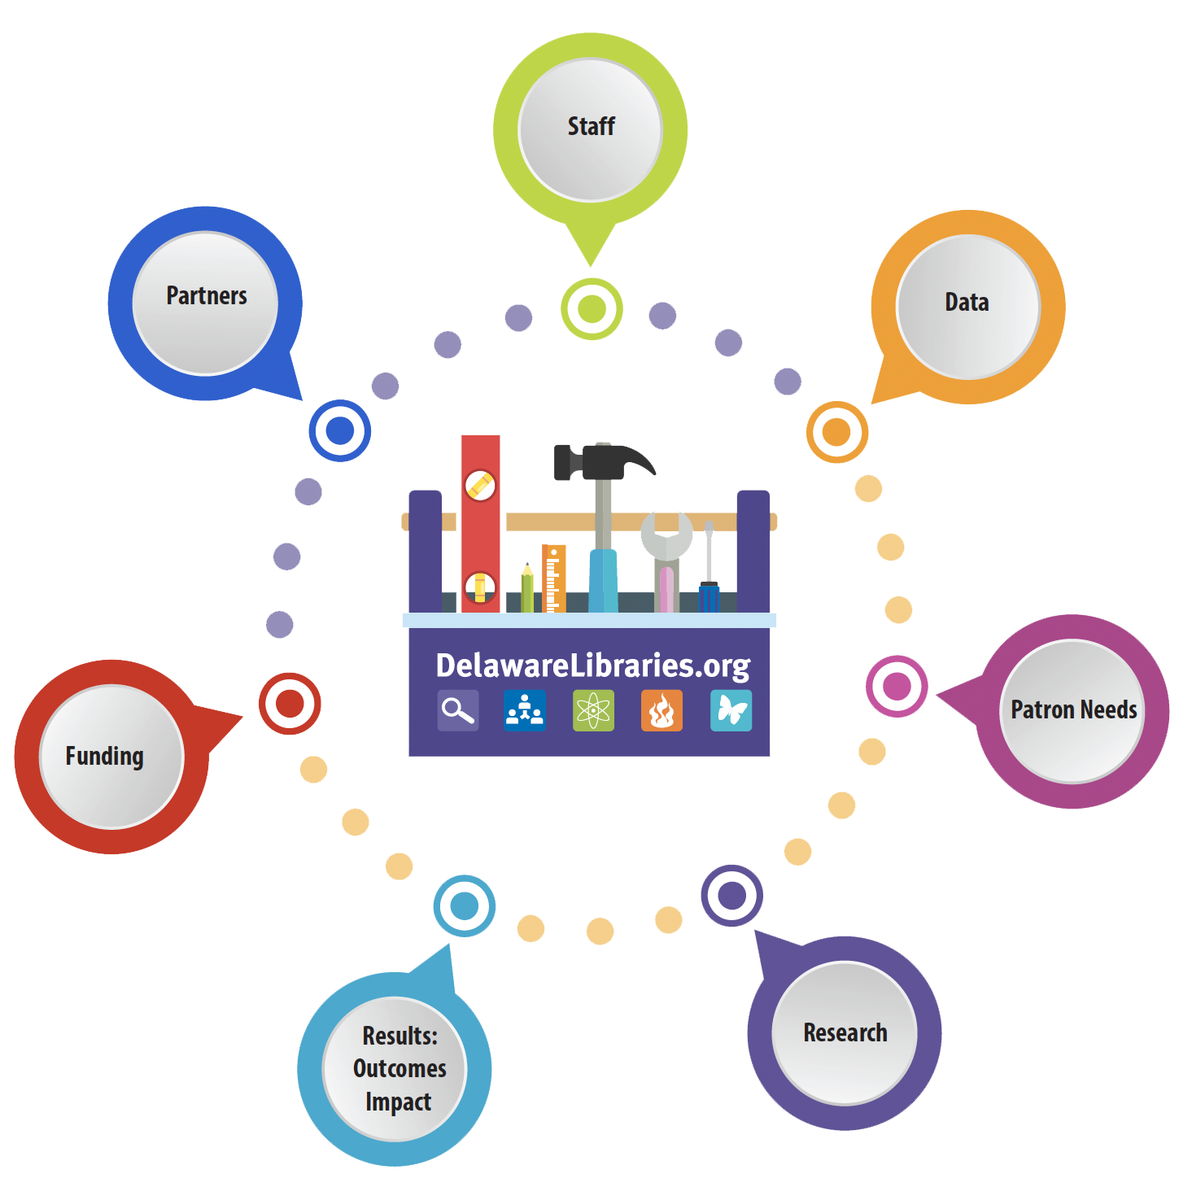
The “Secret Sauce” Systems Thinking
    Statewide Consortium infrastructure
Partners listserv (since 2008)
DDL Social Innovation Team embedded in libraries
Data
Just in time needs
Various funding streams
Pilots, experimentation, action research

Slide 6









Thank you for your support

