Slide 1
Geography of Health: Leveraging GIS for Healthier Delaware Communities
2026 AHL Conference: Technology Bridging Health Accessibility Gaps
Nicole Minni
University of Delaware, Institute for Public Administration
June 4, 2026

Slide 2
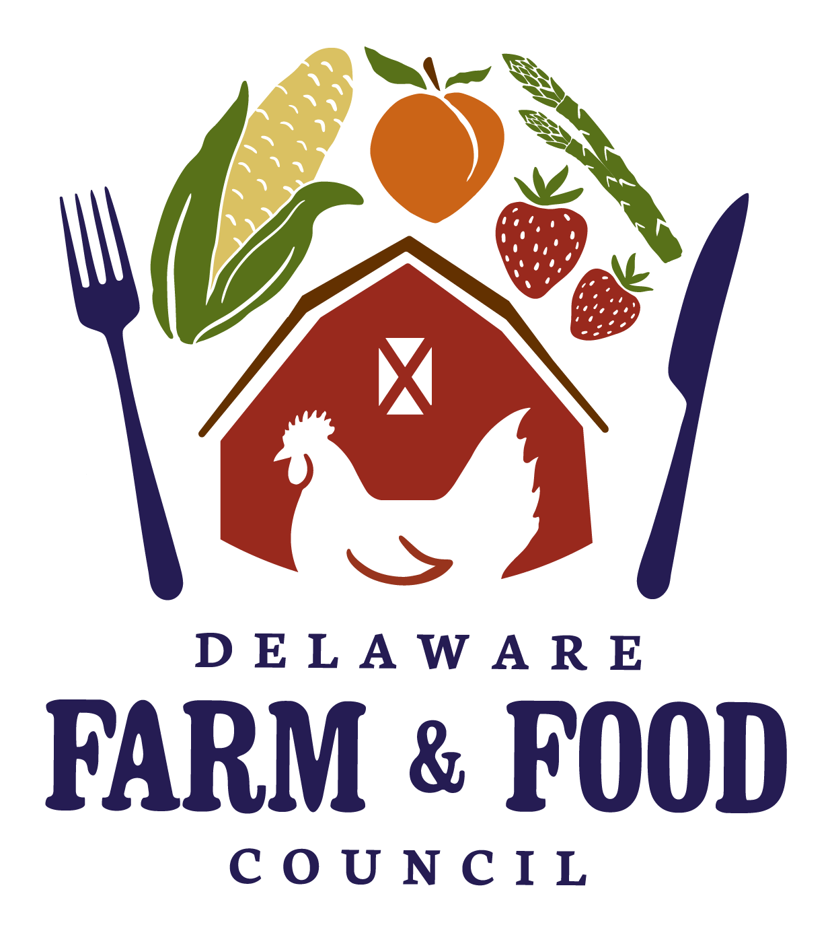
Presentation Outline
Projects
  Delaware Farm & Food Council
  Julia O’ Hanlon
  Delaware Planning for Local Adaptation
  Needs (DE-PLANs)
  Danielle Swallow and Julia O’Hanlon
Notes:
My presentation today will discuss two projects that my colleagues Julia O’Hanlon, Danielle Swallow, and I have been working on over the past six years. Both of these projects leverage GIS data to understand and promote healthier and more resilient communities.
Geographic Information Systems (GIS) tools are central to data analysis and project development, enabling state, local, and community members to visualize and identify vulnerabilities and opportunities within our communities.
Utilizing GIS data infrastructure is crucial to developing and communicating clear, actionable narratives that lead to tangible solutions and evidence-based policy decisions.

Slide 3
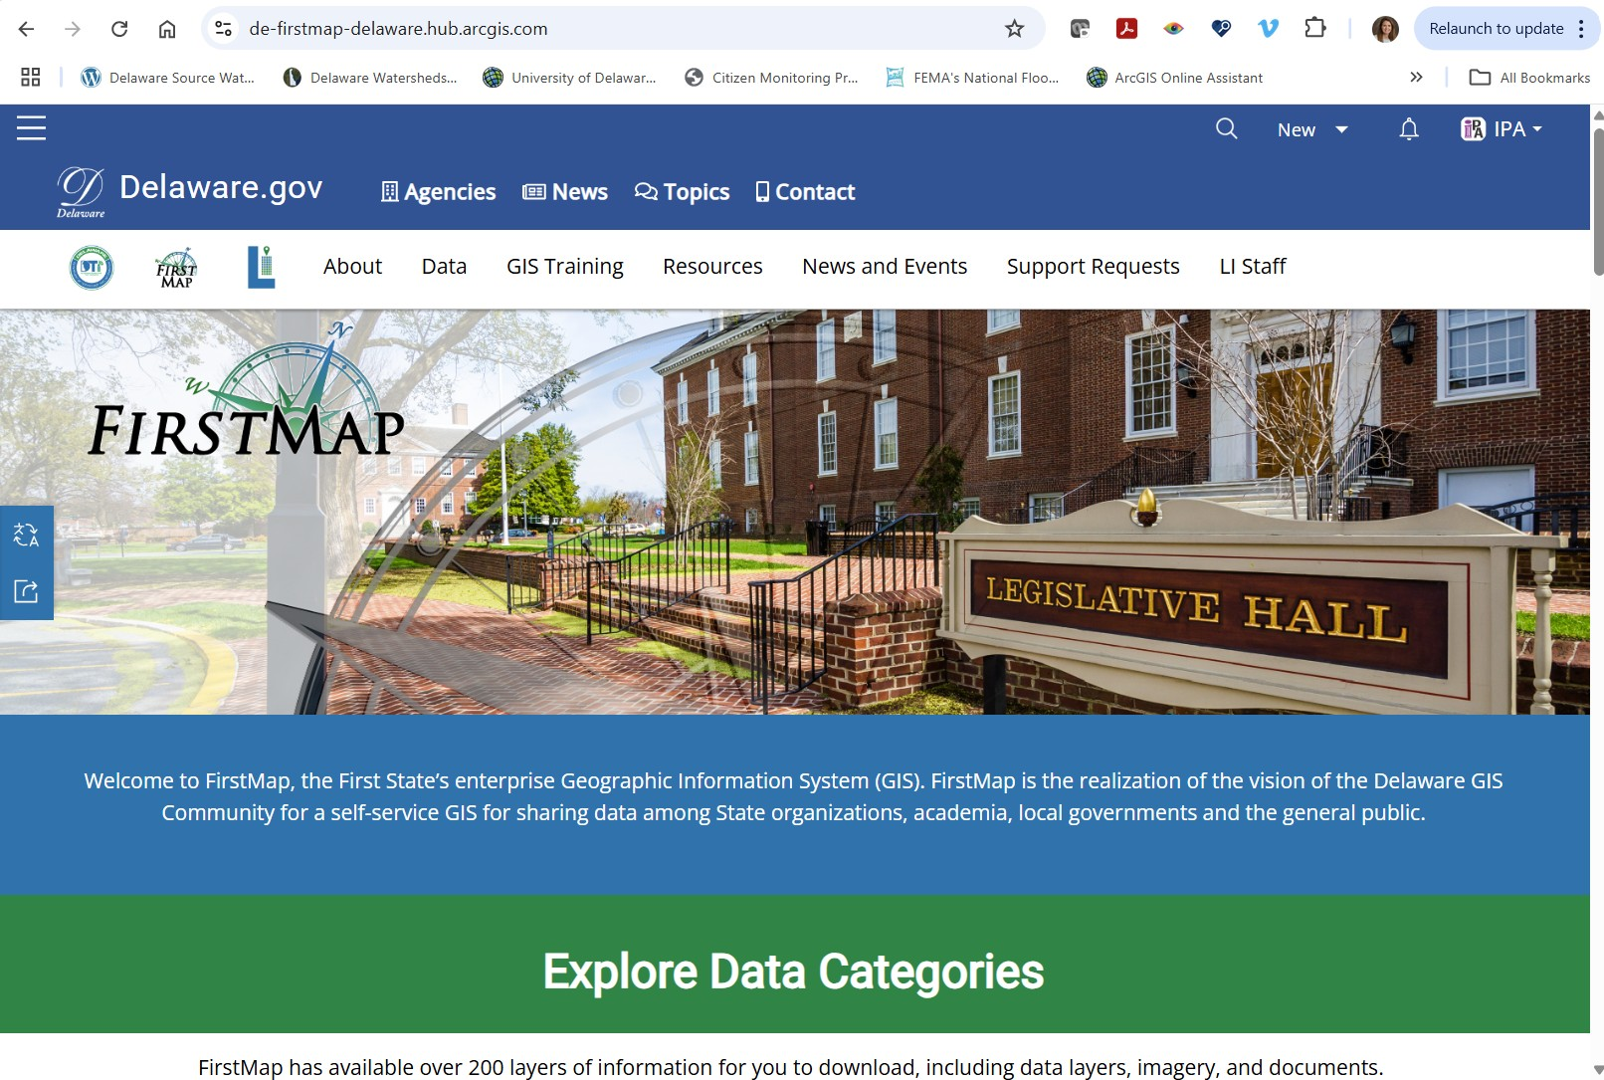
Data Sources: National, State and Local
  American Community Service (ACS) 2020-2024
  Feeding America
  Centers for Disease Control and Prevention (CDC) Population Level Analysis and Community Estimates (PLACES)
  Delaware FirstMap
    Local statewide data:
    transit, sidewalks
Notes:
There is a lot of data available across many agencies and platforms. Bringing this data together and overlaying it with each other is where the story of a community begins and change can start to occur.

Slide 4
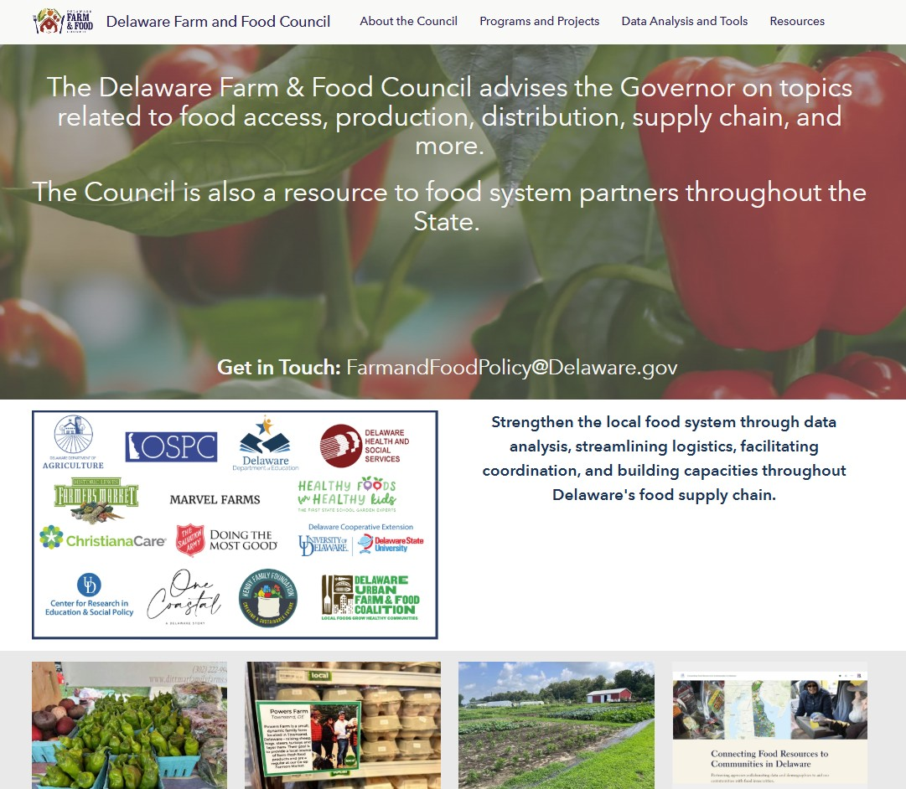
farm-and-food-delaware.hub.arcgis.com
Notes:
Delaware Farm and Food Council HUB site https://farm-and-food-delaware.hub.arcgis.com/ which is a HUB site
The Delaware Farm & Food Council advises the Governor on topics related to food access, production, distribution, supply chain, and more.
The Council is also a resource to food system partners throughout the State.

Slide 5
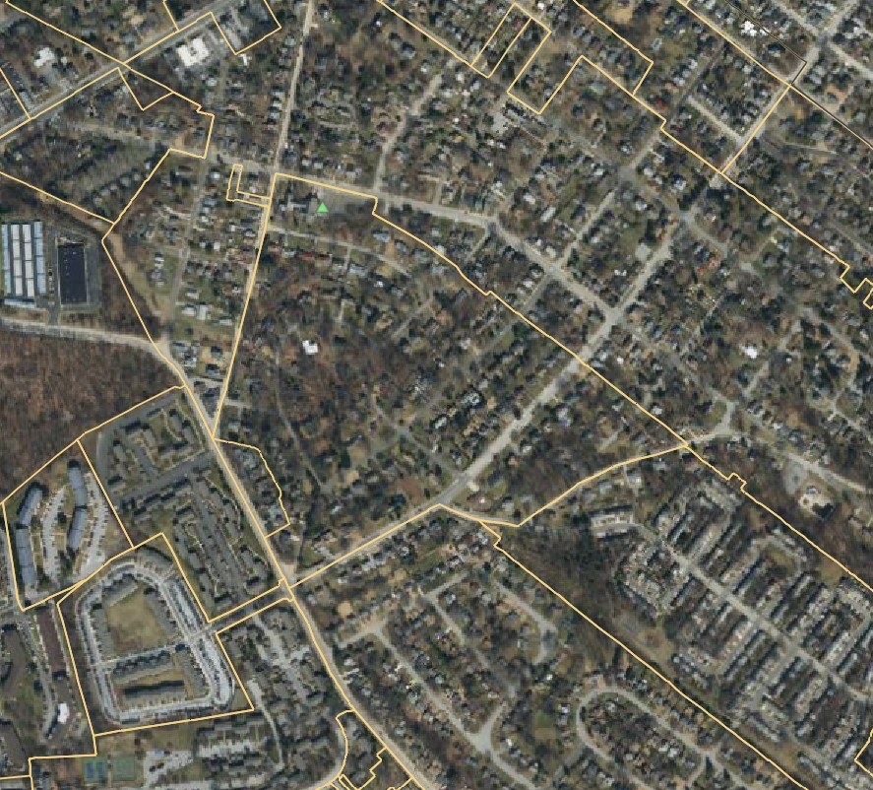
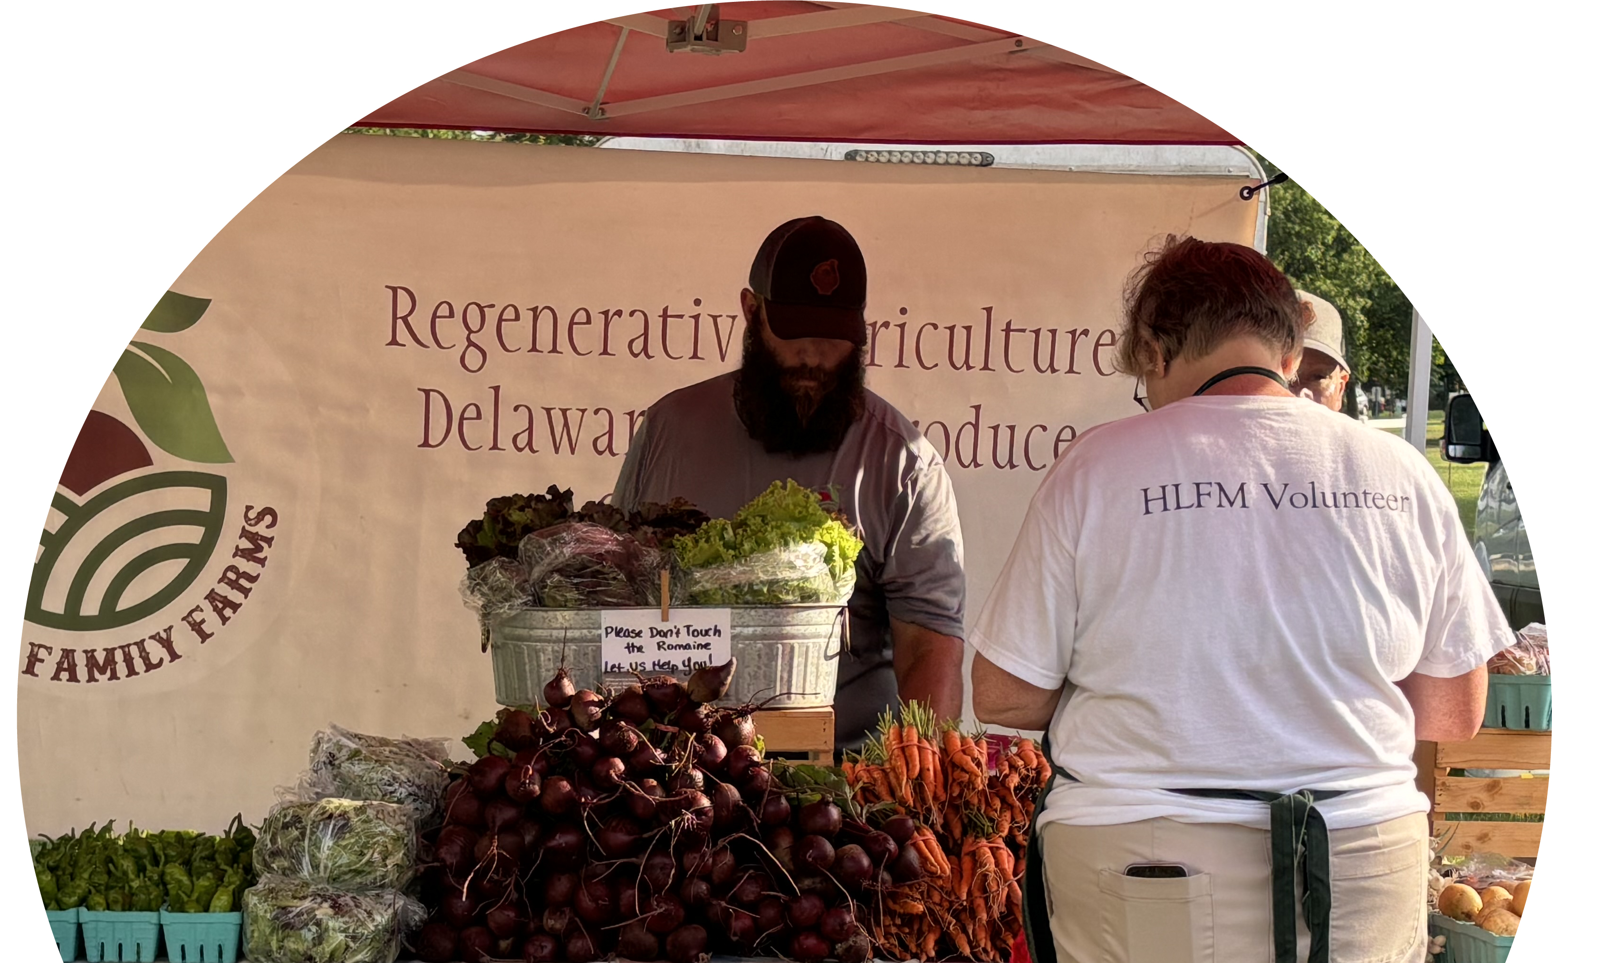
Community Challenges
Knowing where to access Food Resources
Language barriers
Technology (broadband, internet)
Transportation
Notes:
Some of our community’s challenges may be.

Slide 6
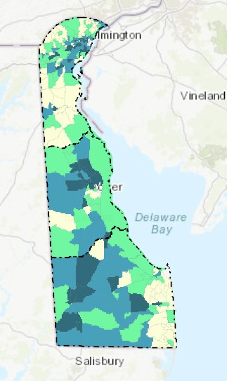
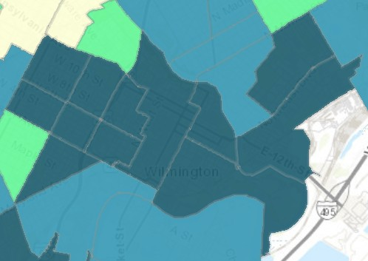
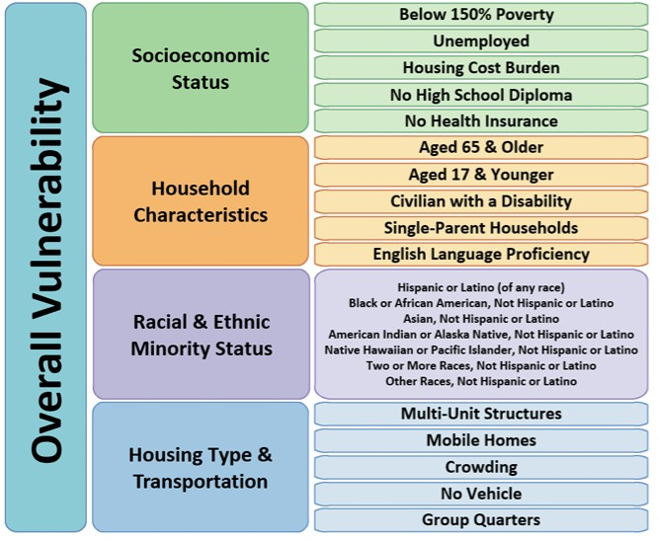
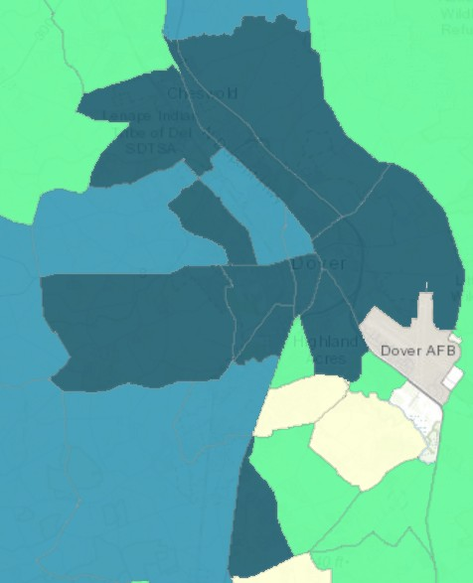
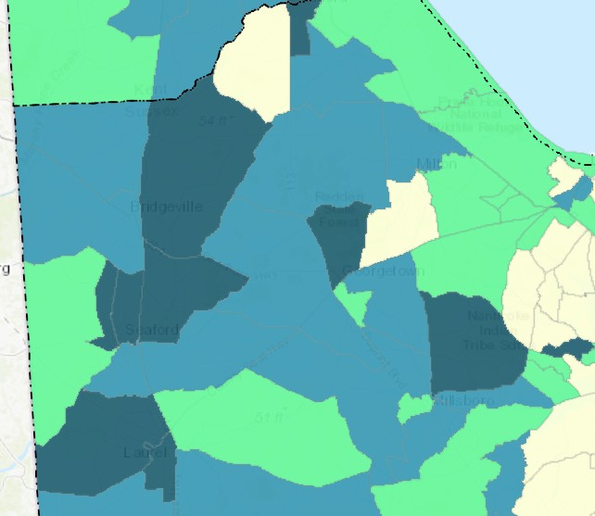
New Castle County
CDC Overall Social
Vulnerability Index 2022 Areas at Highest Risk
Sussex County
Kent County
Notes:
Our partners keep a close eye on our most vulnerable communities.
As a base for our country and states, the CDC developed the Social Vulnerability Index.
It comprises of 16 categories that are grouped into four themes. Those four themes are then grouped into
an overall SVI. There are areas that stand out within each of our counties.
https://www.atsdr.cdc.gov/place-health/php/svi/svi-data-documentation-download.html

Slide 7
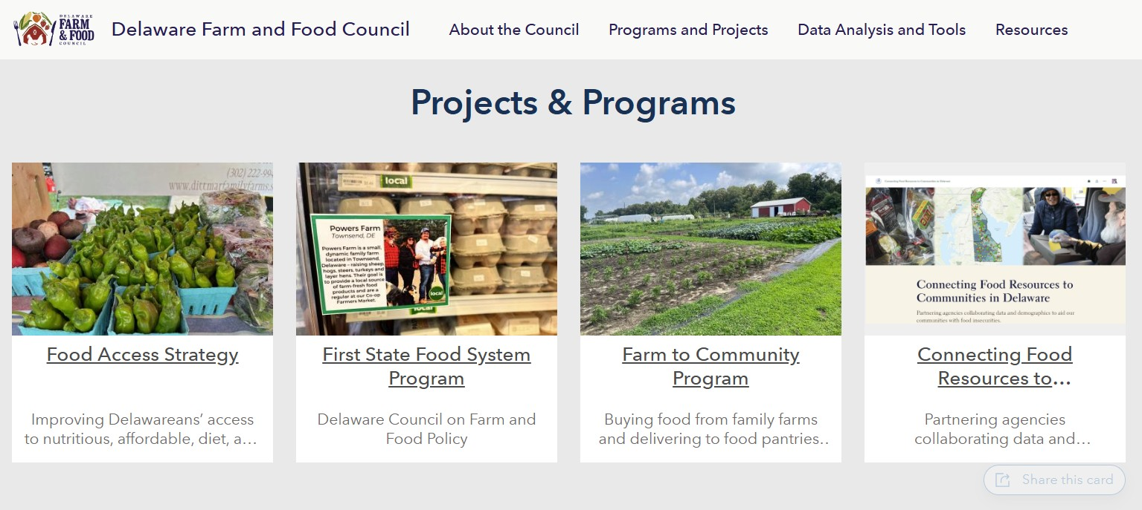
Projects and Programs
Notes:
Food Resource Connection
Improving coordination among our partners to understand where the gaps are in food insecurity – for example; transportation gaps
Farm to Community – Scott Schultzer
Agricultural community, pantries, schools
Food is Medicine – Michelle Axe of Christiana Care
People with Chronic Health Conditions, healthy food options, and recipes

Slide 8
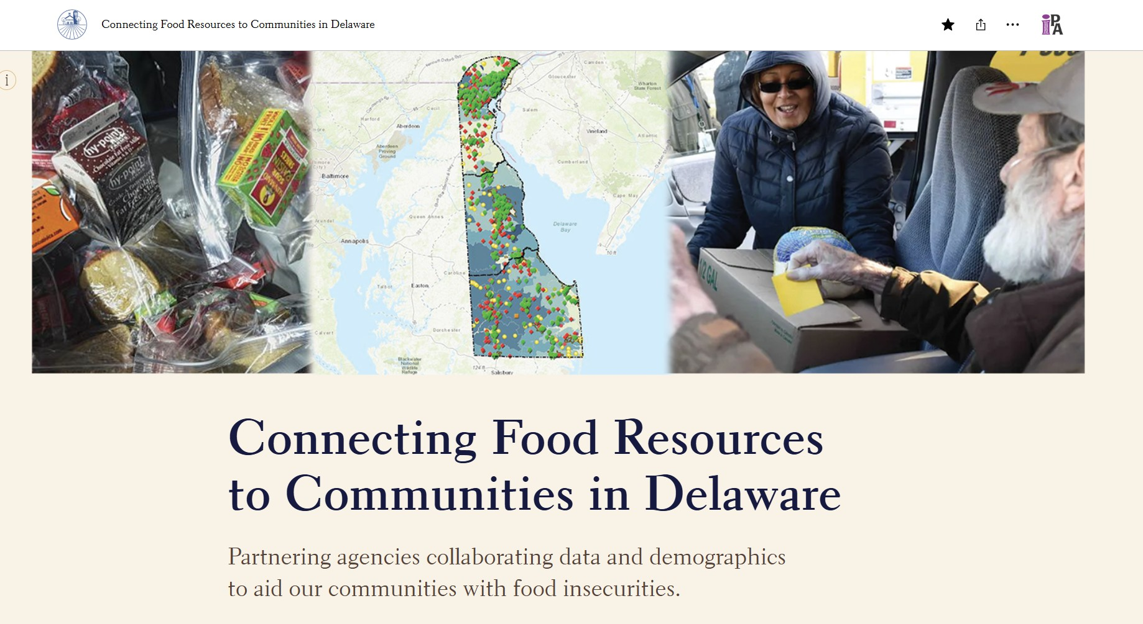
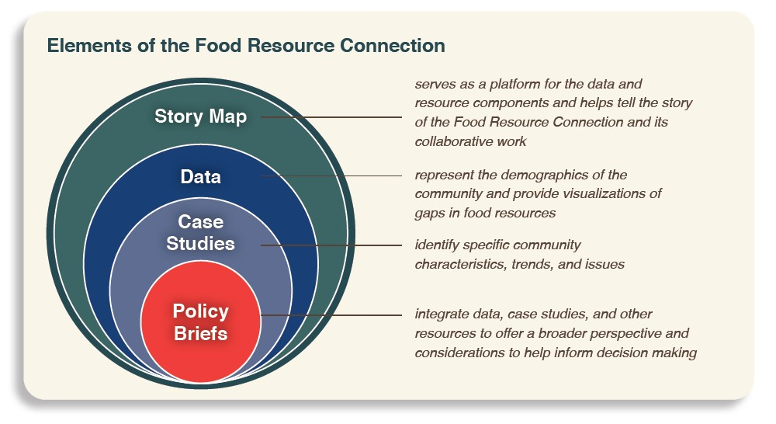
How Data Aids in Understanding Our Communities
Notes:
https://arcg.is/0nuHH9
The data represents the demographics of Delaware’s communities and provides food resource locations, as well as visualizations of our partners’ data, allowing us to identify potential gaps.
Case Studies – Using all this data has become the basis for case study analysis
Policy Briefs – Through the integration of these case studies, along with research and data sources, policy briefs offer a broader perspective and important considerations to help inform decision-making

Slide 9
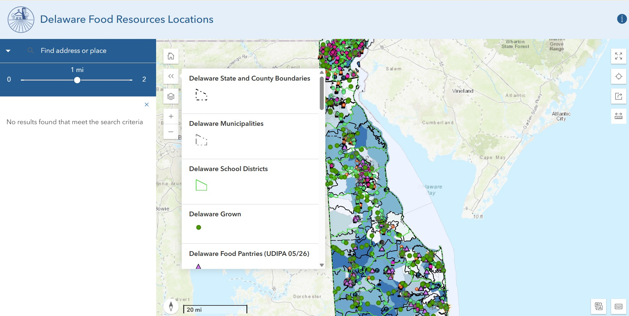
Delaware Food Resources Locator
Notes:
Let’s search an address in close proximity to where we are today.
https://arcg.is/0zDjGL0
1300 S. Farmview Drive, Dover, Delaware 19904
What information can we learn about this area?
1 Food Pantry, 1 Food Pantry with cold storage
1 community garden, 1 HFHK garden
1 SNAP retail location
1 FBD Mobile Pantry
1 Delaware 211 Food pantry
1 public school, Capital SD
1 transit route and 1 bus stop, 1 evacuation route
Estimated percent of all people 18 and under in poverty 44%
Zoom in closer, turn layers off to see the aerial view. Can people walk to the bus stop safely on sidewalks to get to the food pantry? Are their access barriers?
How can we deal with the gaps that we see?
The data represent the demographics of Delaware’s communities and provide food resource locations, along with visualizations of our partners’ data, allowing us to identify potential gaps.

Slide 10
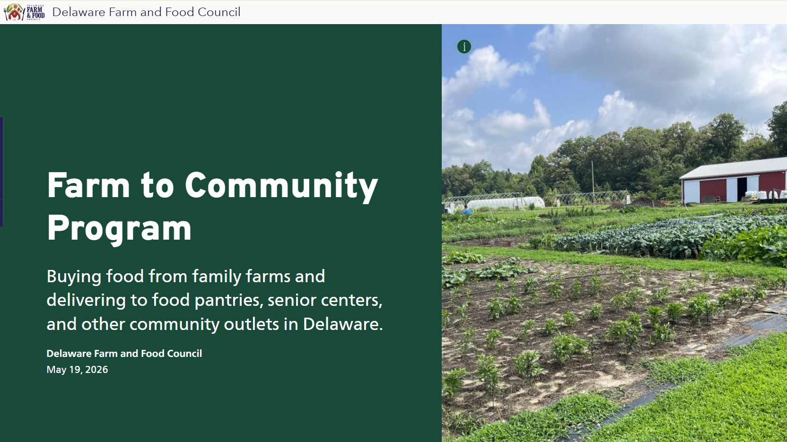
Notes:
https://farm-and-food-delaware.hub.arcgis.com/apps/d485dbf7e47041ae833554ee684f252d/explore

Slide 11
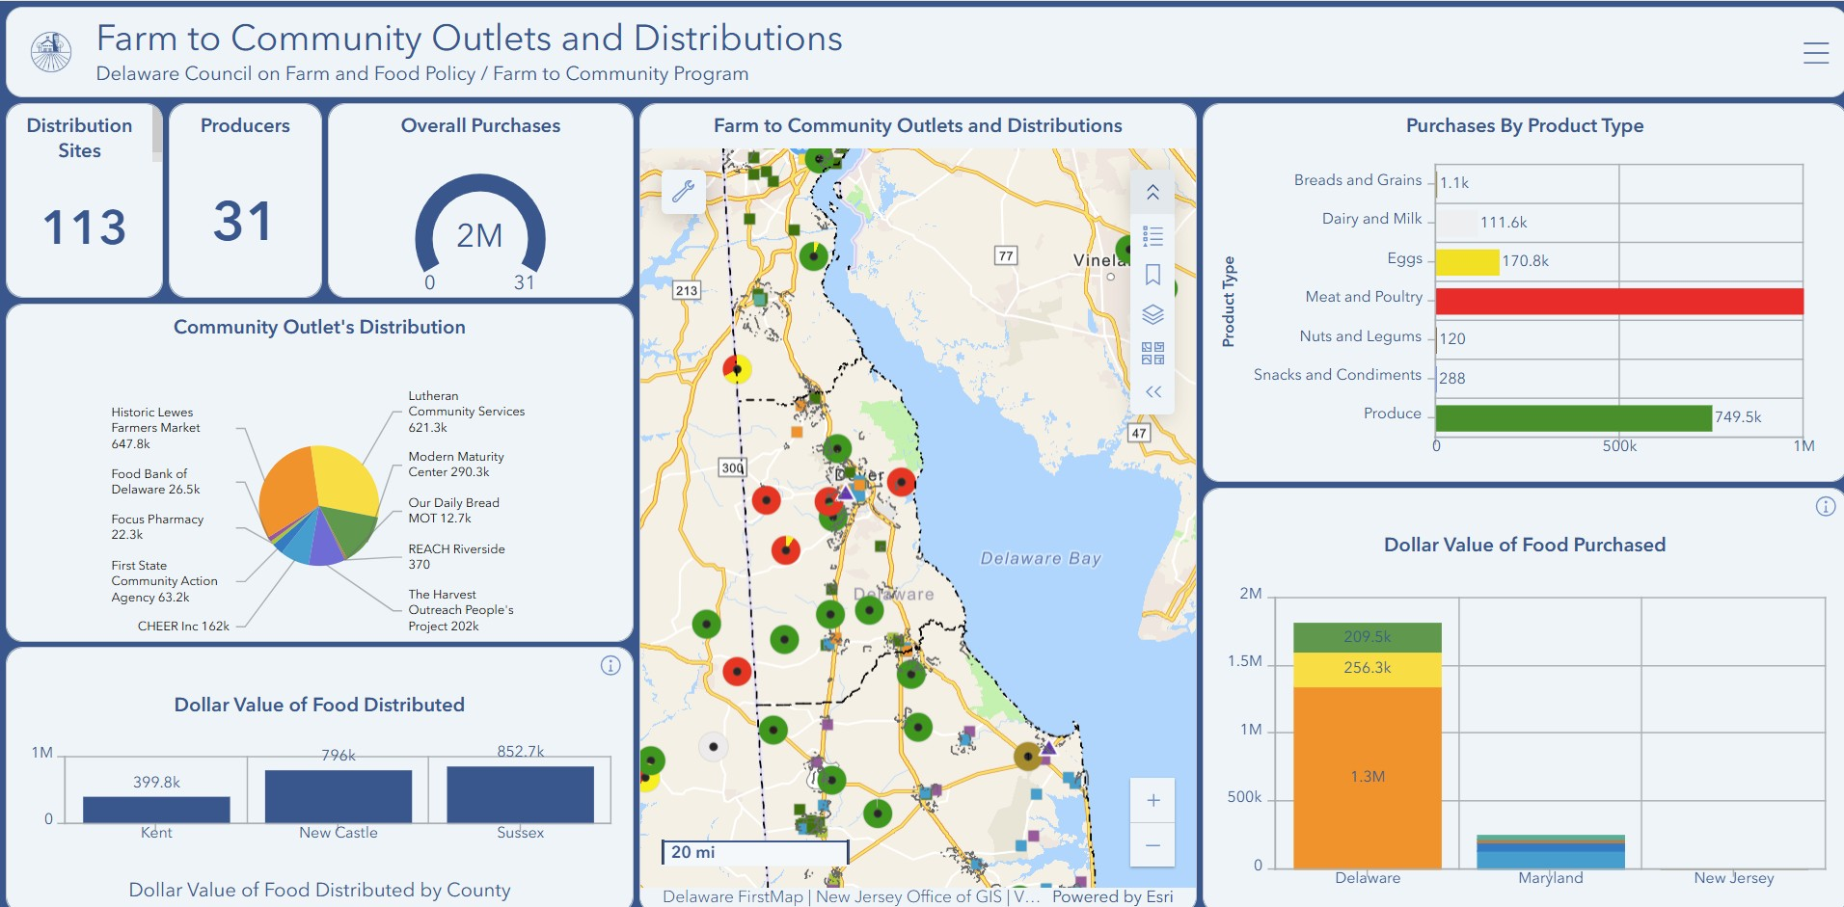
Notes:
In 2022, the Farm to Community Pilot was established by the Delaware Council on Farm and Food Policy, with funding provided under the USDA’s Local Food Purchase Program Cooperative Agreements.
The goal is to facilitate and increase direct-to-market sales of food products grown by Delaware and regional farmers to Delaware community members. As a result, it will increase the economic viability of farmers and improve the health of Delaware community members.

Slide 12
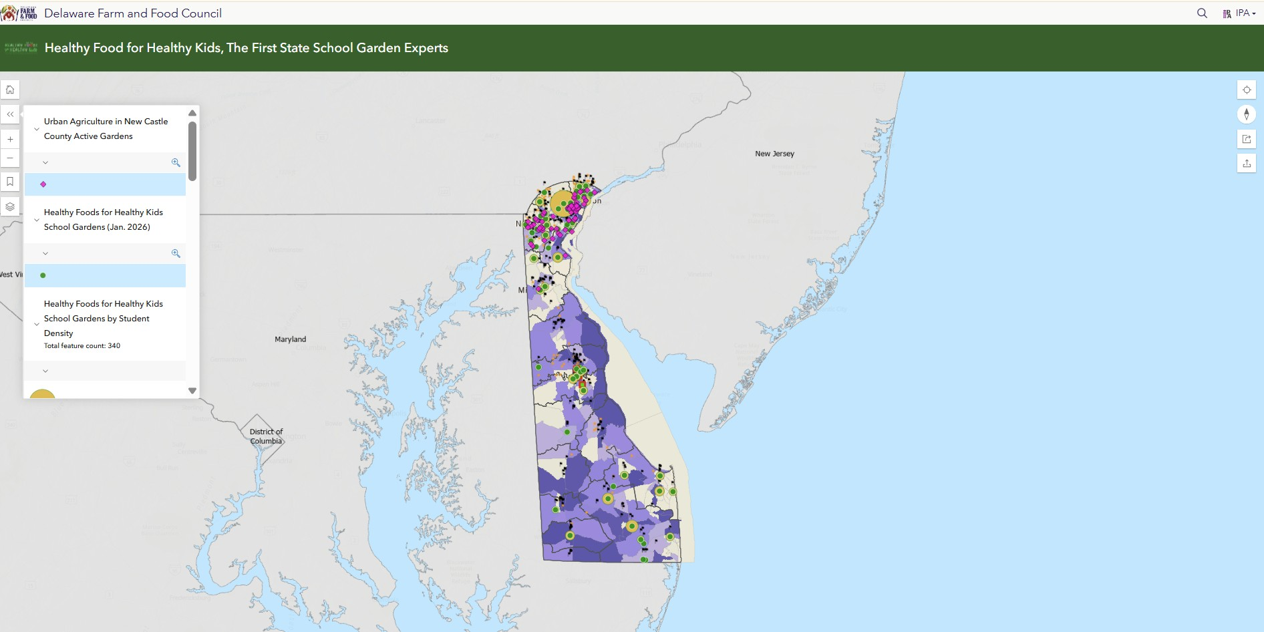
Healthy Foods for Healthy Kids and Community Gardens
Notes:
In addition to our agricultural community, we have partners such as the Healthy Food for Healthy Kids who are working with schools to add gardens as part of their education to help the kids grow, learn and Form Healthy Habits.
They currently support 68 schools throughout the State of Delaware and over 28,000 students participate in our “Education Cultivation” program.

Slide 13
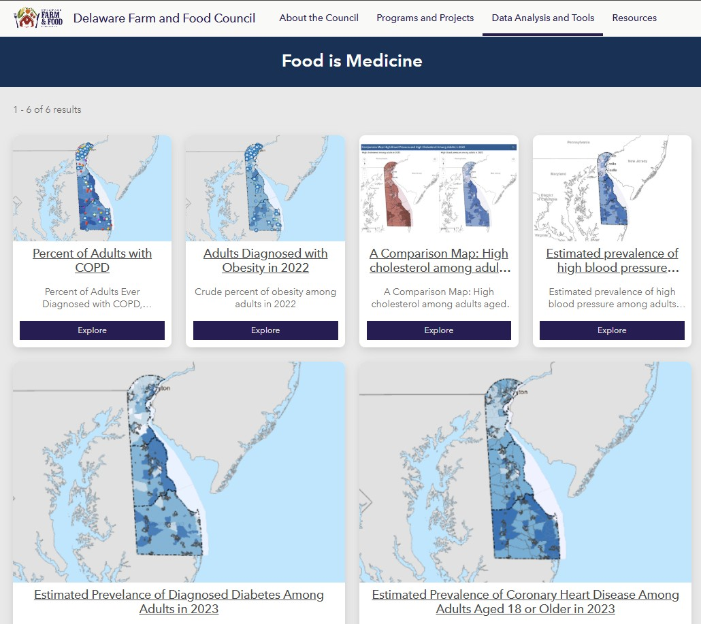
Food is Medicine

Slide 14
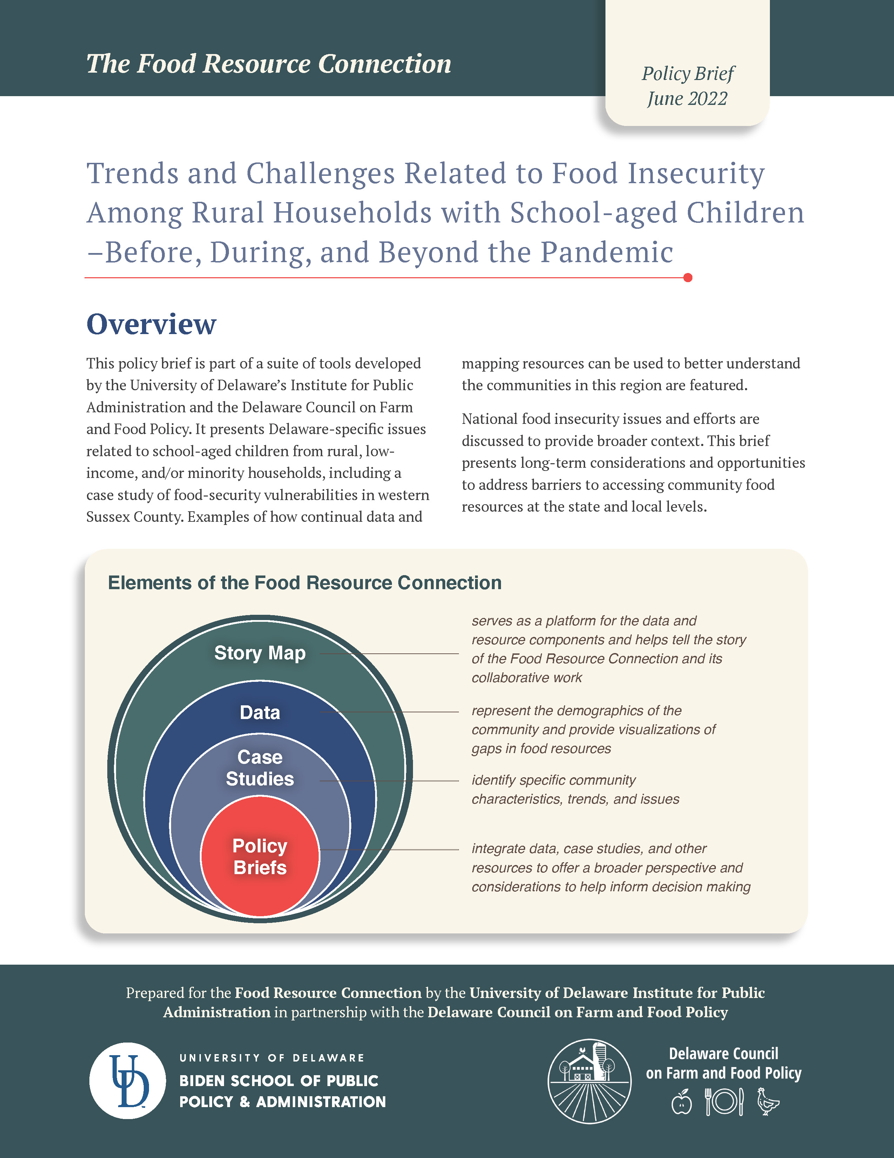
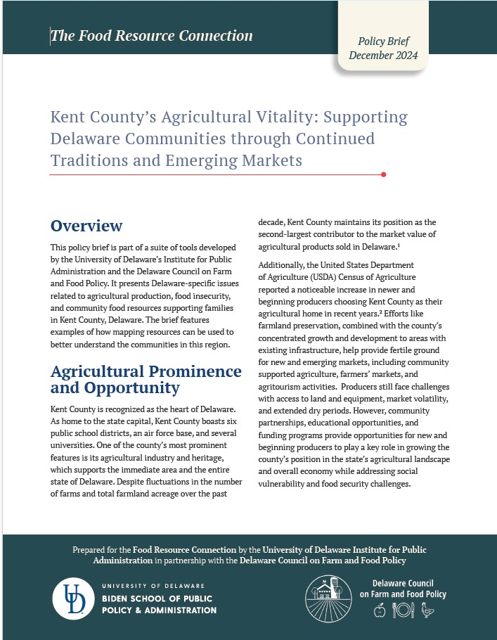
Notes:
We have completed two policy briefs so far, which can be found in the back of the room.

Slide 15
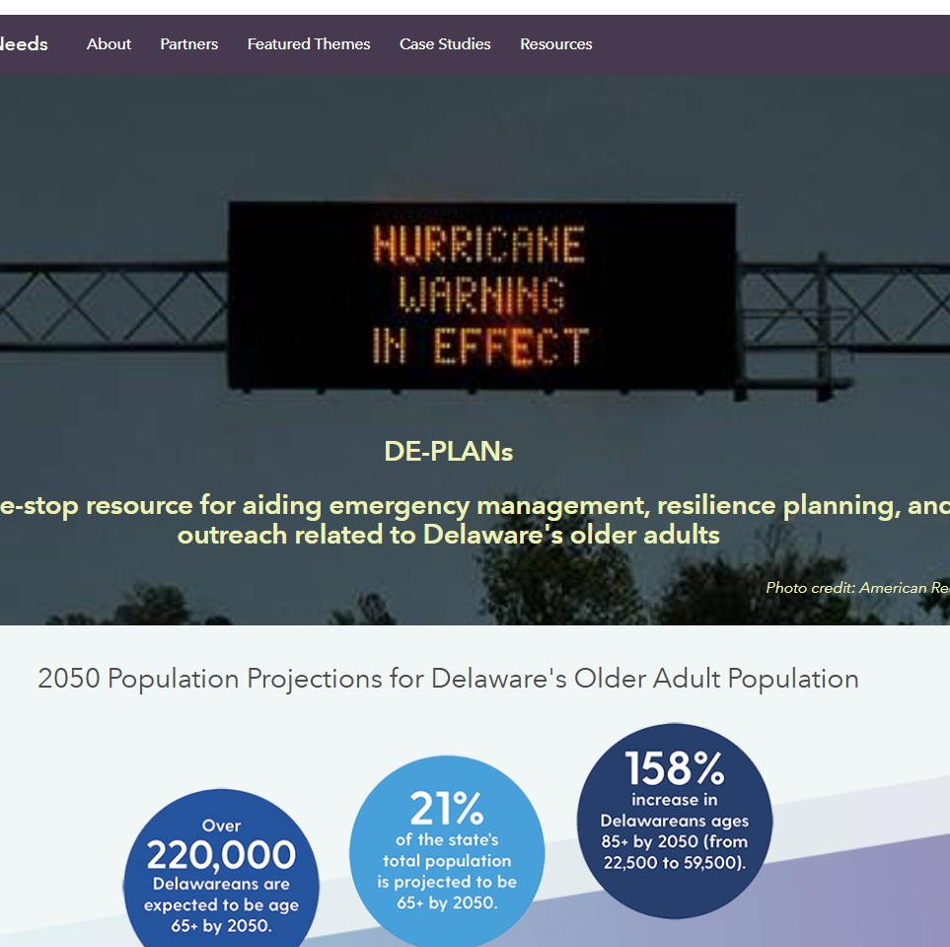
DE-PLANs
Delaware Planning for Local Adaptation Needs
Aging in Place and Emergency Preparedness and Resilience
Notes:
The second project that I’d like to share with you is the Delaware Planning for
Local Adaptation Needs
The targeted population is our 65 and older communities and how can we understand their needs of aging in place, emergency preparedness and resiliency

Slide 16
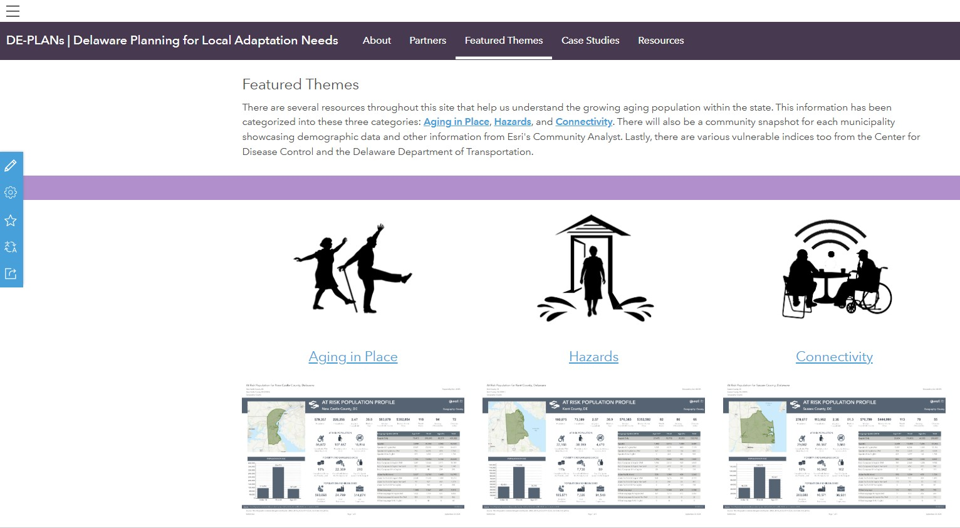
Featured Themes
Notes:
The site is organized into three featured themes:
Aging in Place
Hazards
Connectivity
There is a lot of data on this site that is getting ready to be updated to the ACS 2020-2024 Census data over the next several months. I encourage you to especially take a look at the infographics for each county and municipality in the state as well as our Case Studies.

Slide 17
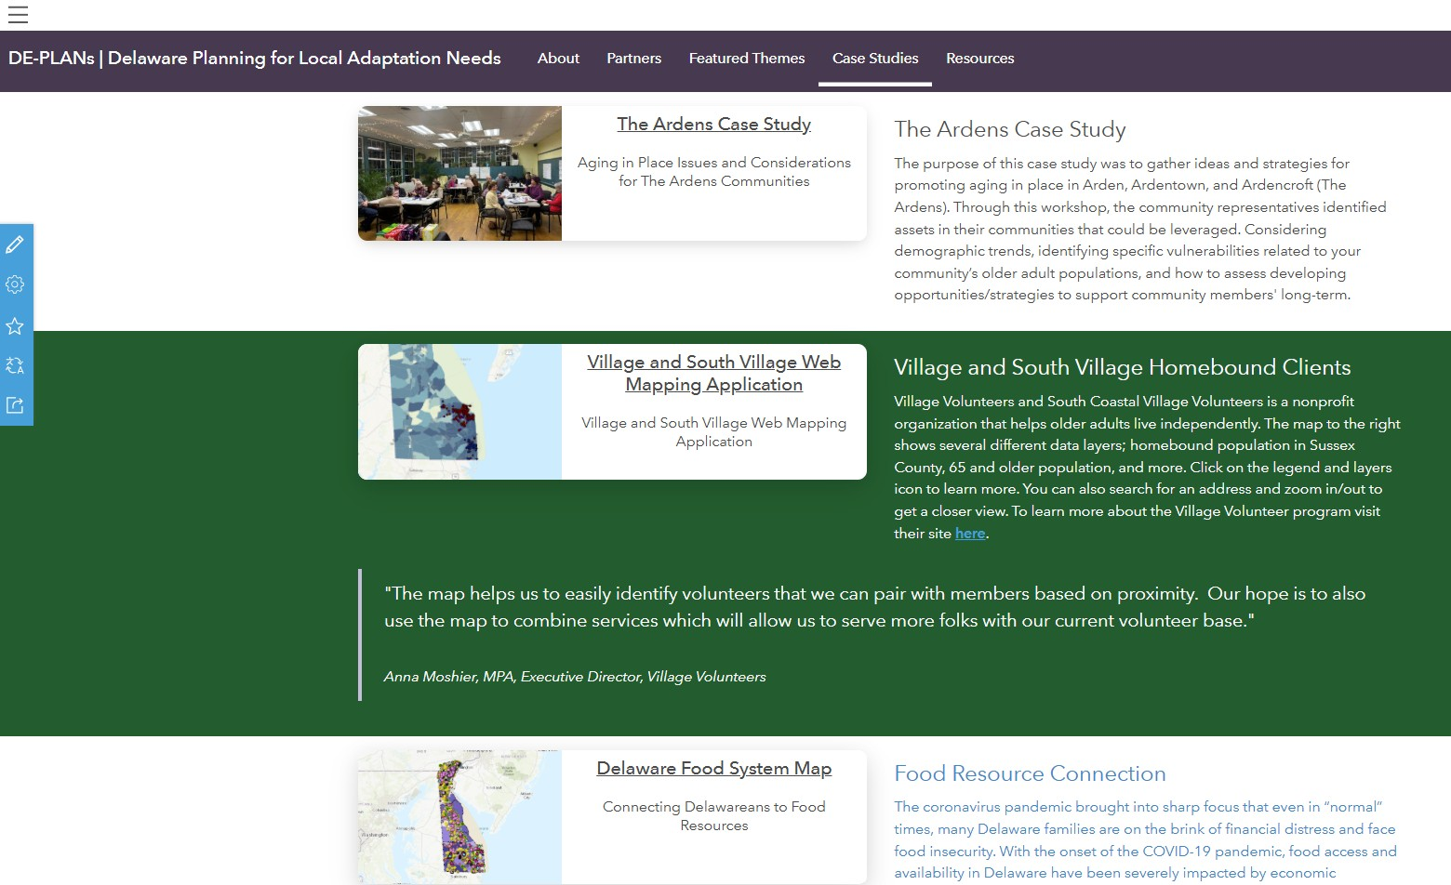
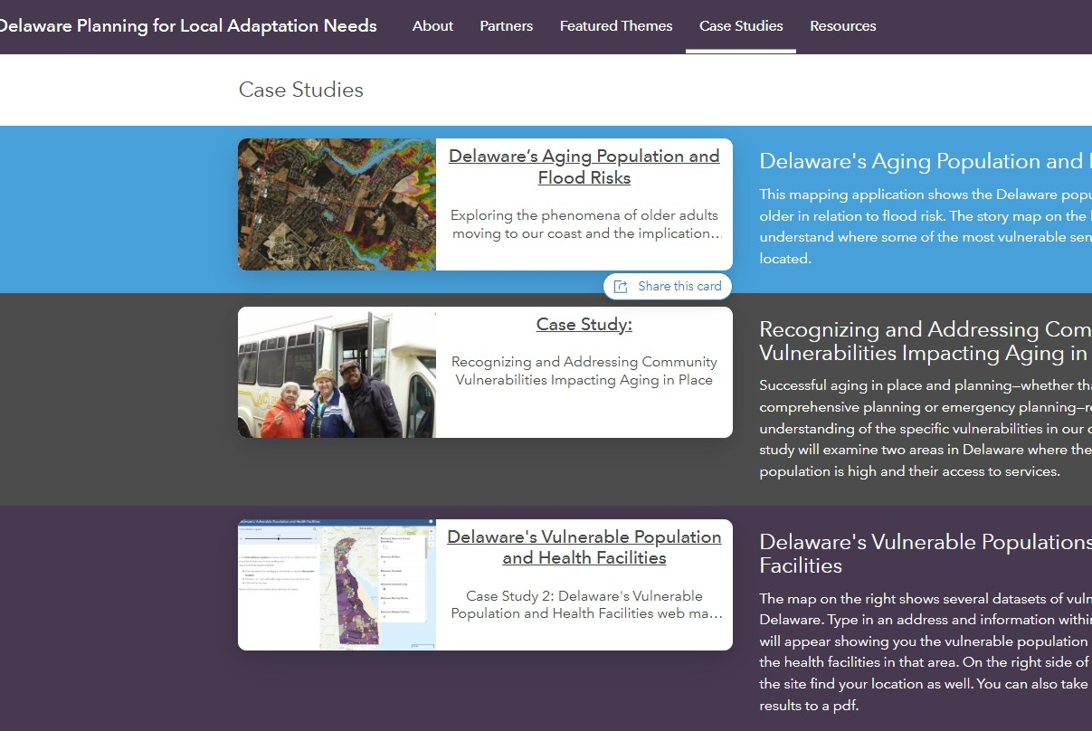
Case Studies
Notes:
Using the data and connecting with different partners throughout the state, we have had the pleasure of creating Case Studies.

Slide 18
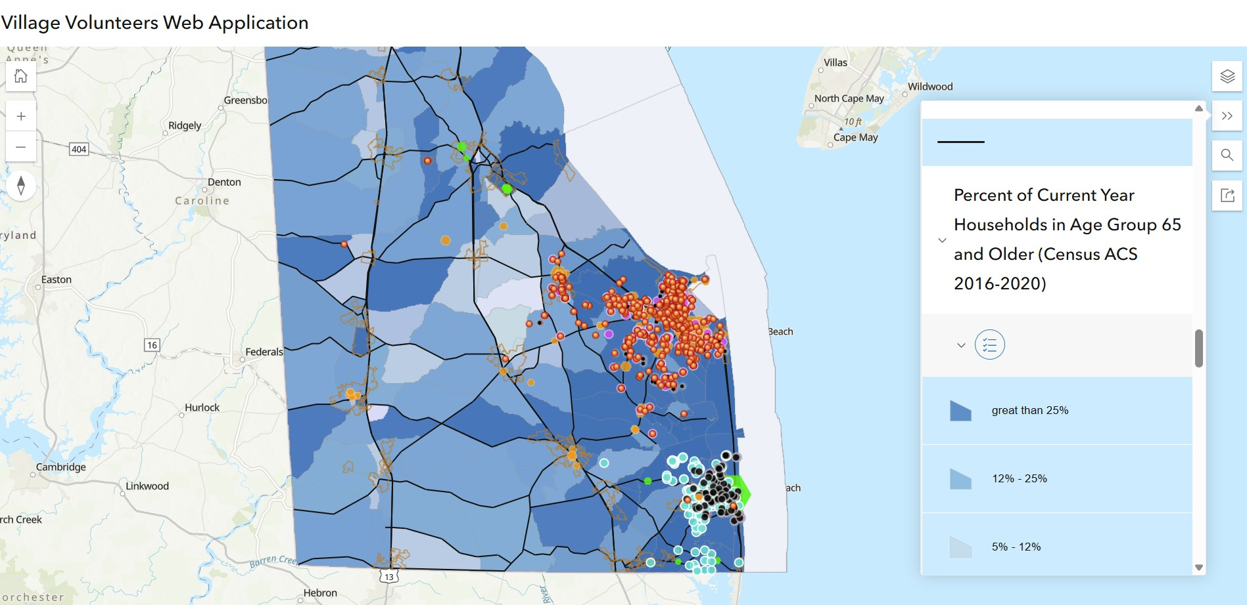
Village Network

Slide 19
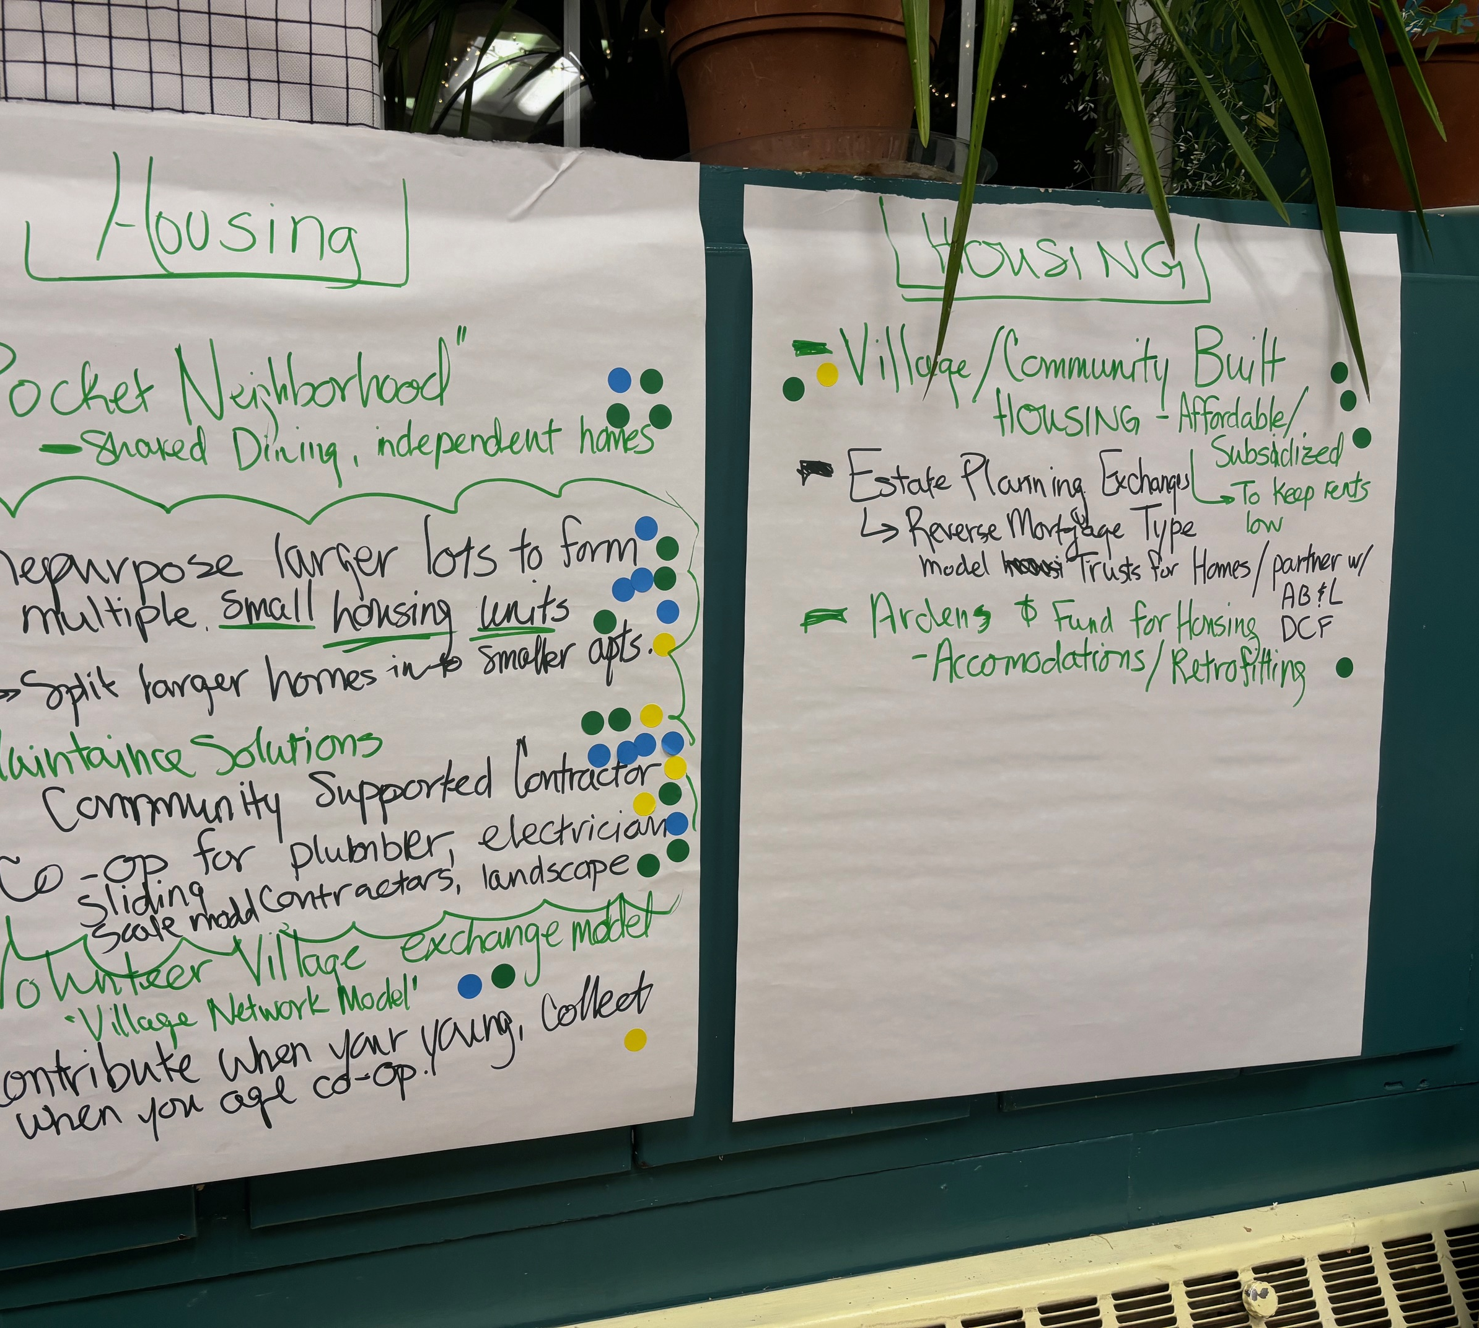
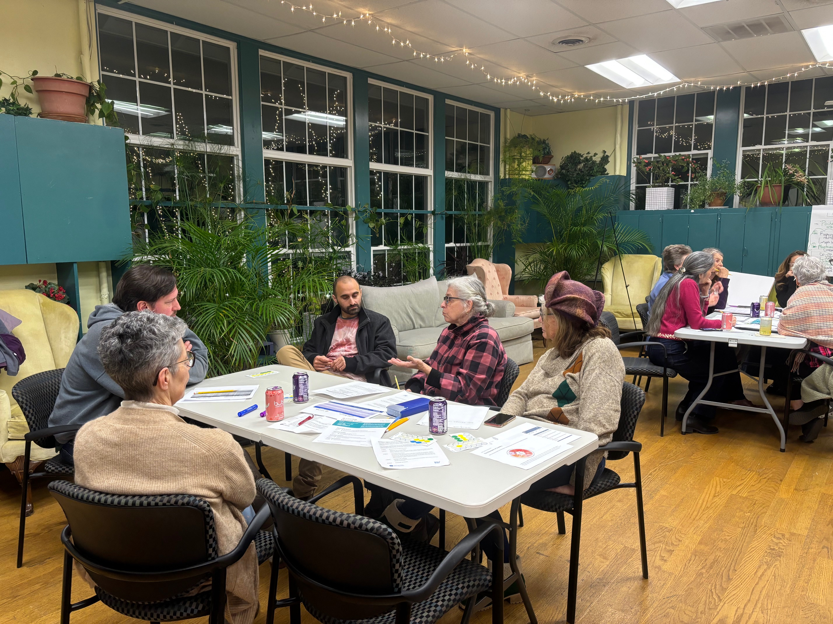
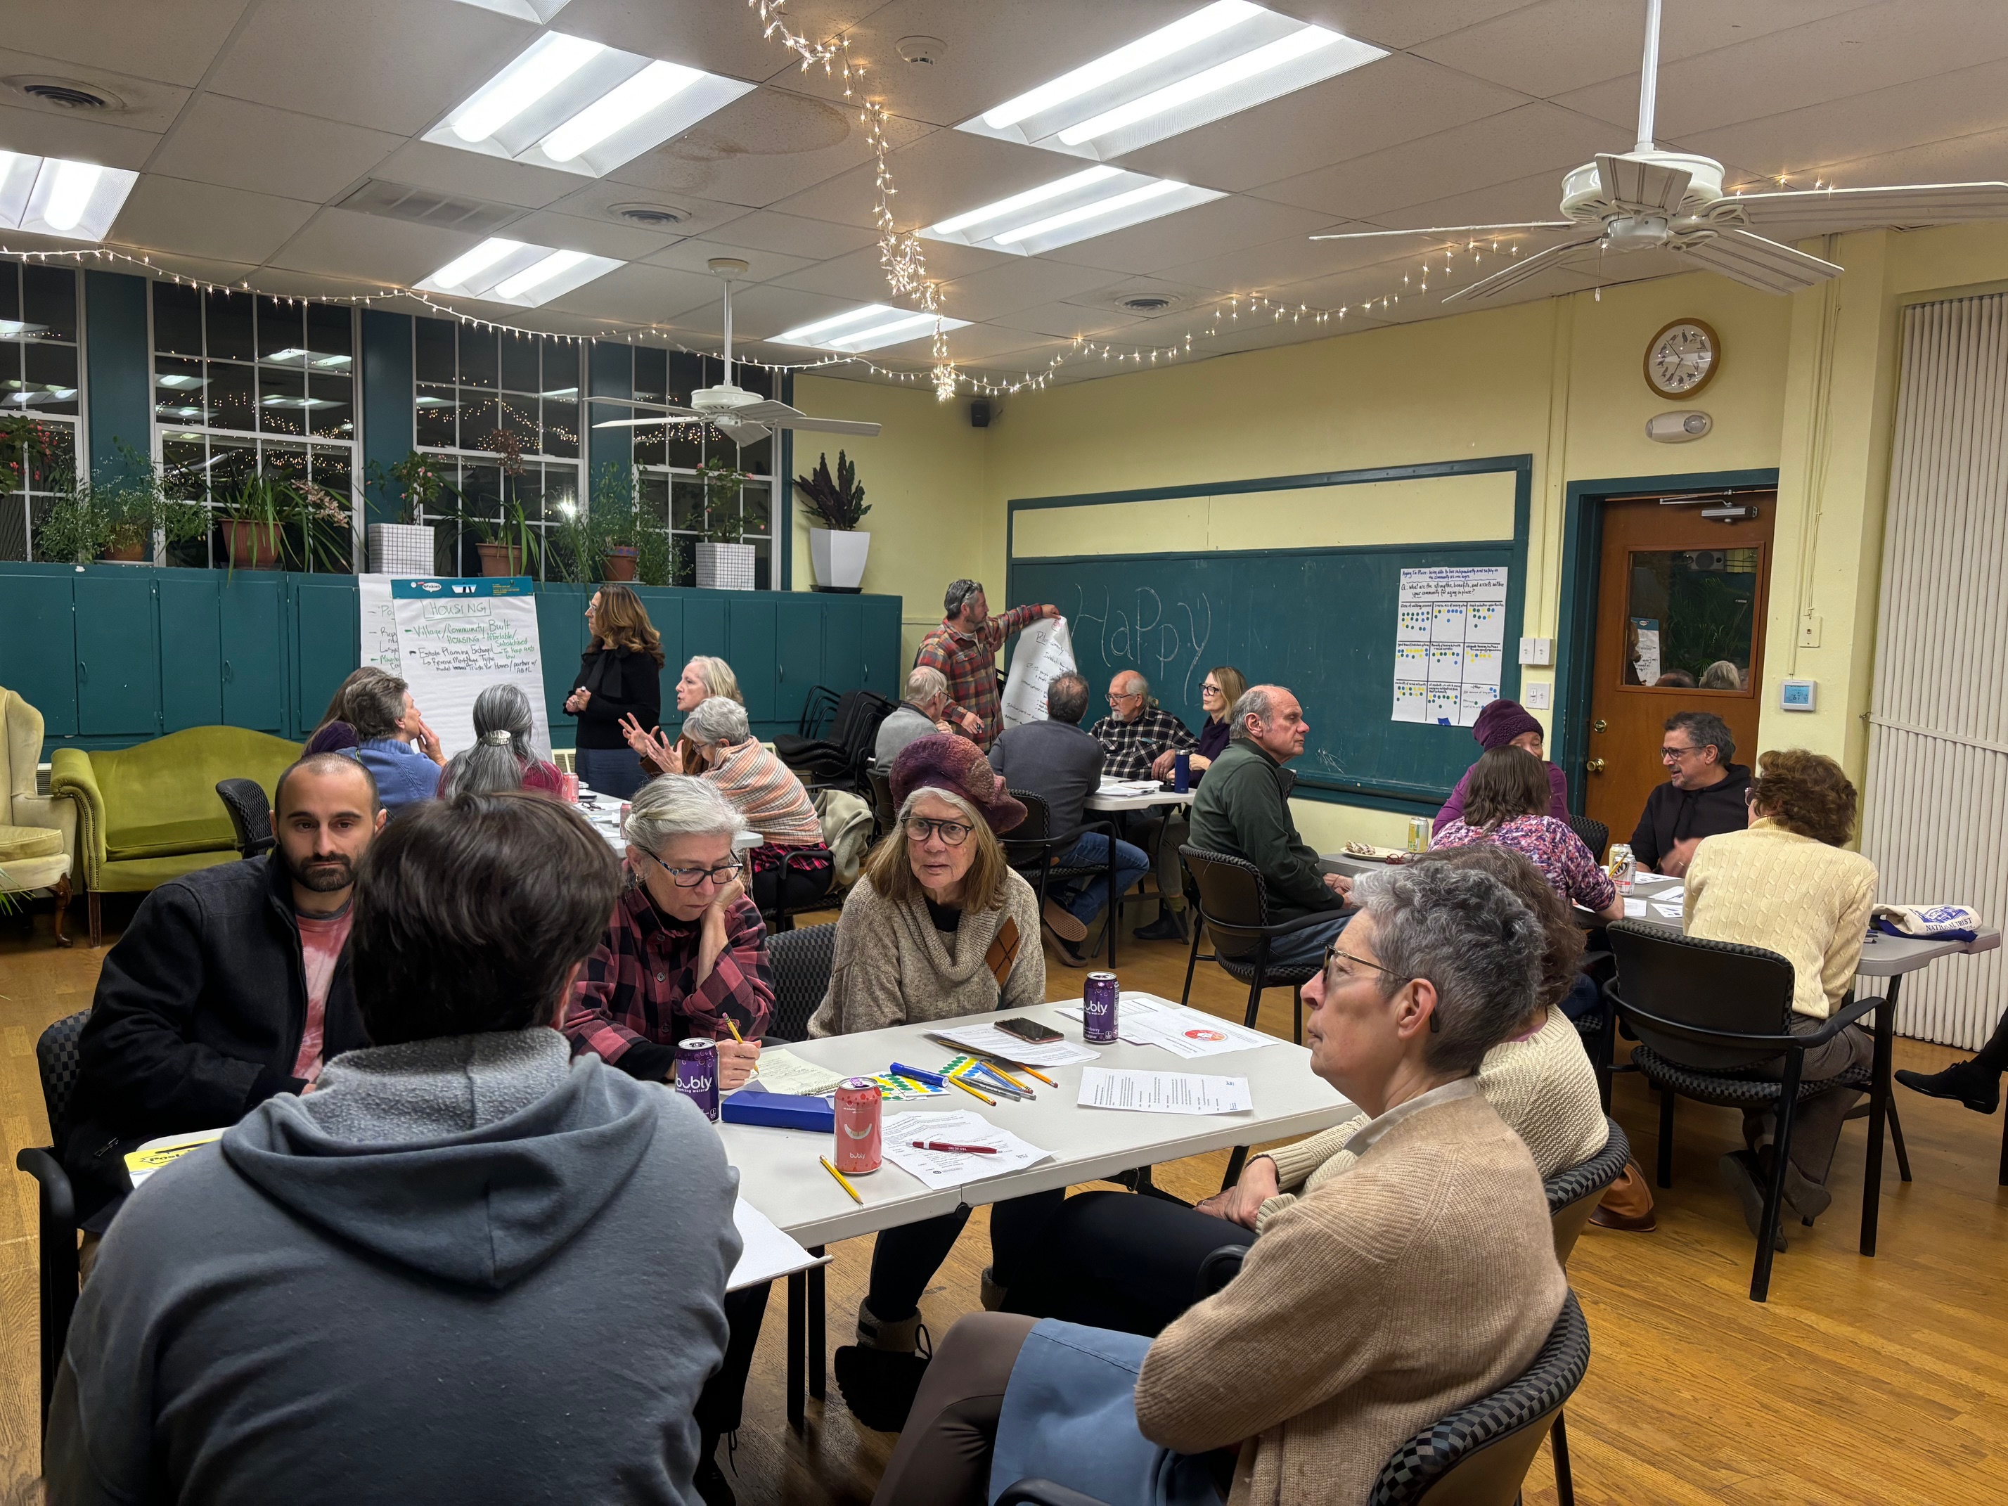
The Ardens
Housing
Transportation
Emergency Preparedness
Reducing Social Isolation
Notes:
Aging-in-place materials were shared and community feedback was gathered on local strengths and challenges. Julia and Danielle walked the participants through asset-mapping and strategic planning activities focused on housing, transportation, emergency preparedness, and reducing social isolation. Key discussions included home maintenance support, transportation options, and the use of community spaces for programs and workshops for older adults. A major theme was the need for a centralized directory of residents who need assistance and those willing to provide support. Representatives from the three Arden communities will use the findings to identify and implement a practical aging-in-place project and action plan.

Slide 20
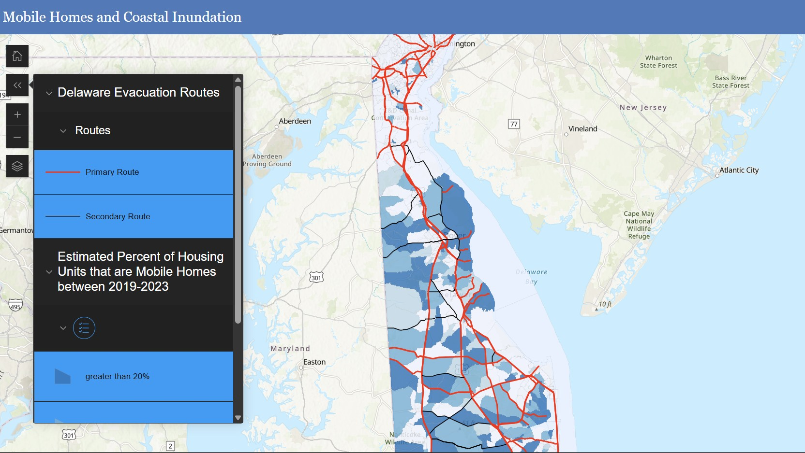
Mobile Homes: Angola / Long Neck
Notes:
Other social vulnerabilities persist in the coastal region of Sussex County despite its reputation for affluence and leisurely life. According to the Delaware Manufactured Homeowners Association, two-thirds of all manufactured homes in Delaware are in Sussex County, with the coastal region being dotted by manufactured home communities located next to traditional subdivisions of stick-built homes. The dark blue areas on this map show the estimated percentage of housing units that are manufactured homes exceeds 20 percent.

Slide 21
Thank you!
Nicole Minni
University of Delaware
Institute for Public Administration
nminni@udel.edu
Special thank you to my colleagues:
Danielle Swallow (UD Sea Grant) and Julia O’Hanlon (UD IPA)

