Slide 1


Designing and Testing a Care Model to Promote Healthy Lifestyles for Southern Delaware Families
Alejandra Perez Ramirez, MPH, Kelsey Higgins, BS, Thao-Ly Tam Phan, MD, MPH
June 2026
Notes:
Thank you so much. It’s always hard being the presentation standing in the way between everyone and lunch, but I appreciate having the opportunity to speak about a project that highlights how engaging early with community partners can really transform a research study.

Slide 2
Conflicts of Interest
No conflicts of interest.
Research reported in this presentation is supported by the National Institute of General Medical Sciences of the NIH under grant number P20GM144270. The content is solely the responsibility of the authors and does not necessarily represent the official views of the National Institutes of Health.
NIH Center of Biomedical Research Excellence (COBRE): Focuses on developing, evaluating, and implementing innovative stakeholder-engaged technology-enhanced interventions and models of care to overcome the complex factors that negatively impact access to healthcare and child health.
Notes:
I have no conflicts of interest.
This project was funded by the REACH Center at Nemours, which is a NIH-funded Center of Biomedical Research Excellence.

Slide 3
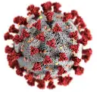
Childhood Obesity Rates are Increasing
Notes:
So as a brief background - Obesity rates in children continue to rise, despite decades of work trying to reverse this trend.
And the problem just got worse with the pandemic.
Currently, more than 1 in 5 children in the US have obesity.
And there are clear disparities, driven by complex socioecological factors – with nearly 1 in 4 children from Black and Hispanic communities and communities with fewer resources having obesity.

Slide 4
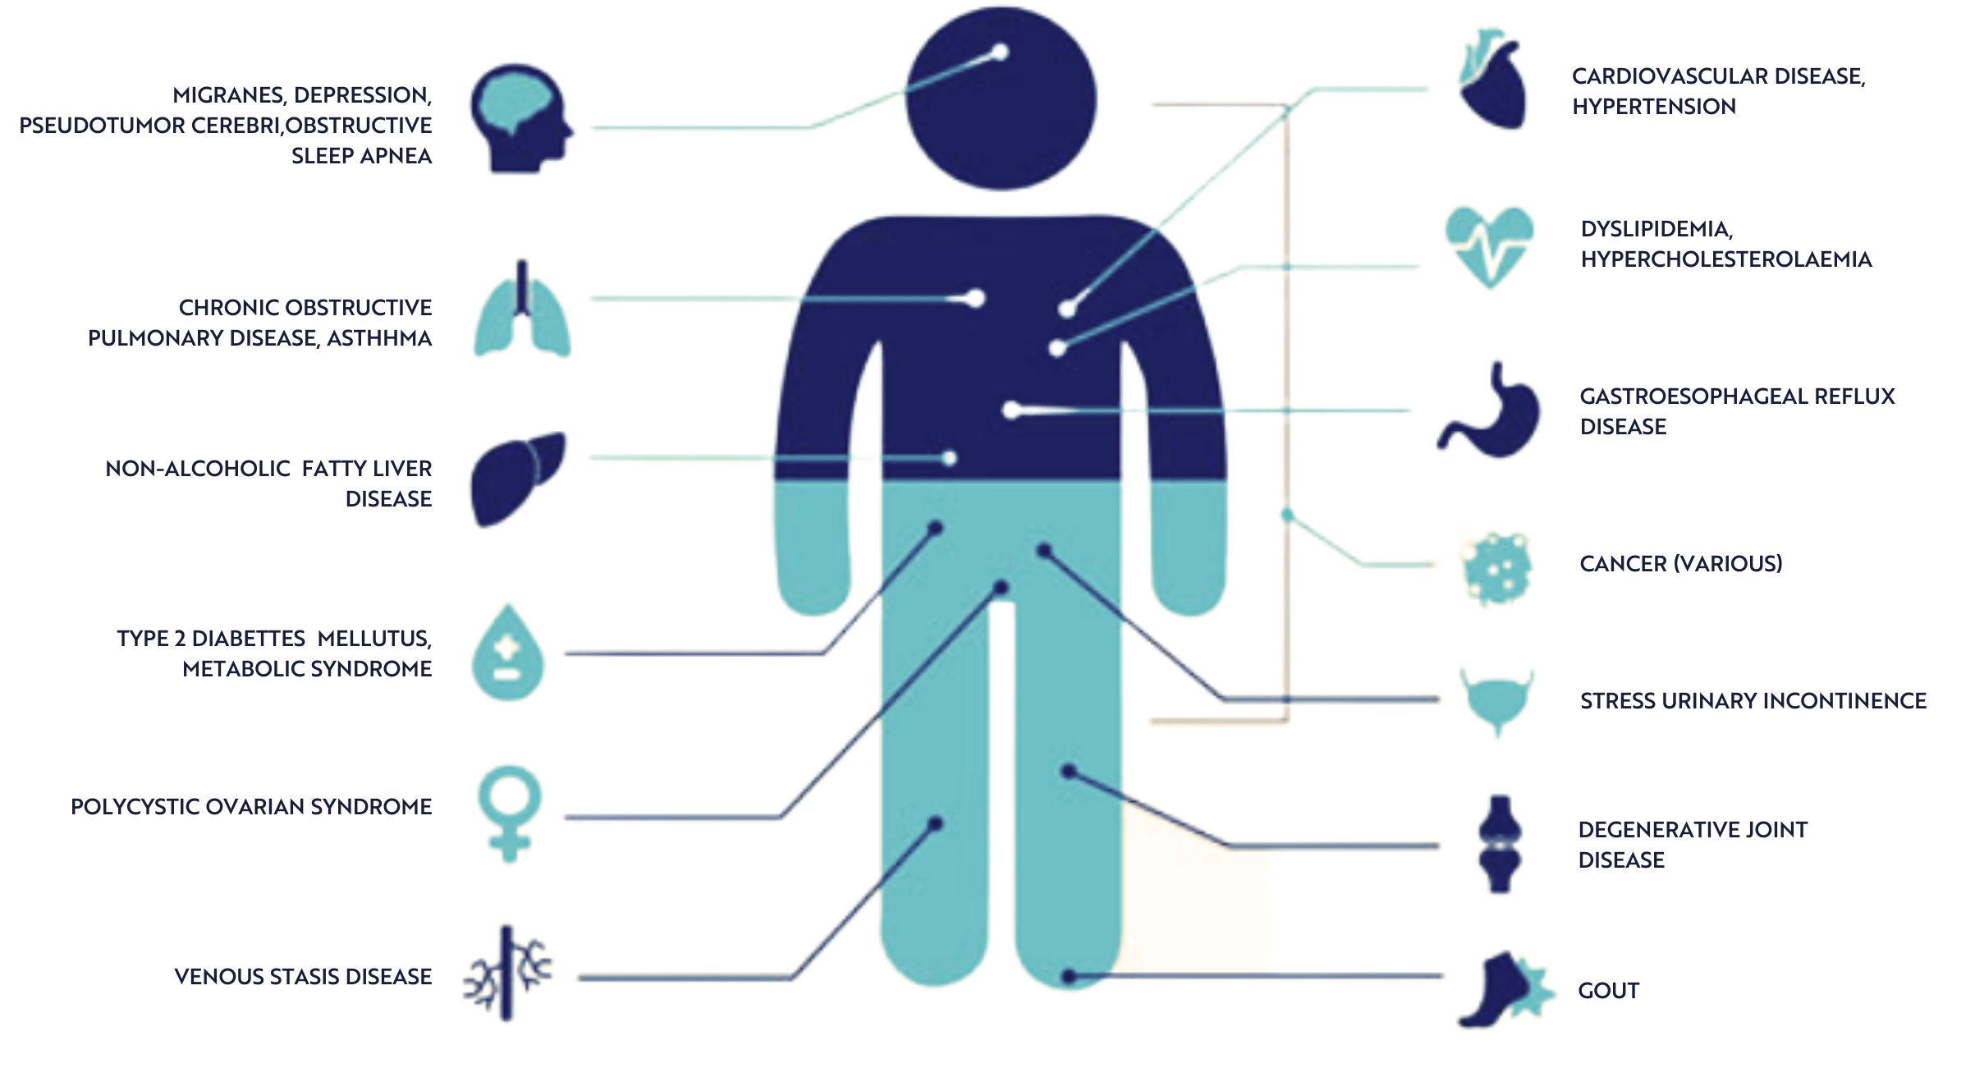
Childhood Obesity Impacts Health
$1.3 billion in annual healthcare costs
Notes:
This leads to disparities in health outcomes, not just related to conditions like cardiovascular disease and diabetes, but also related to a child’s mental health and psychosocial functioning.

Slide 5
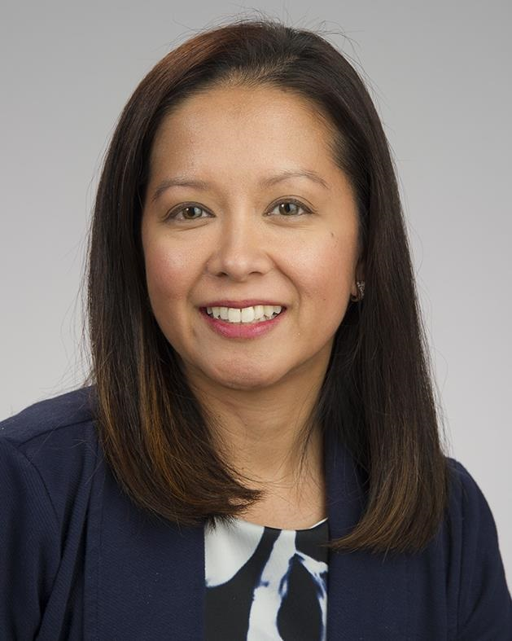

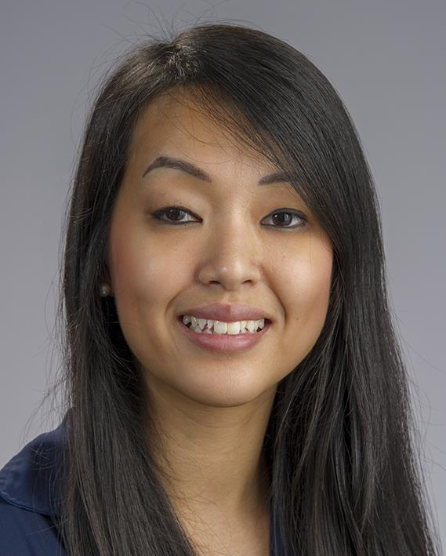

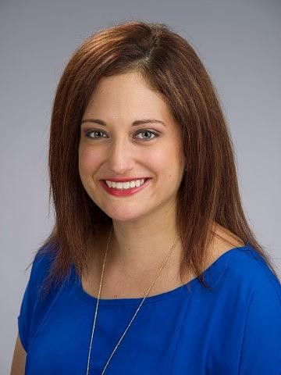
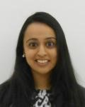
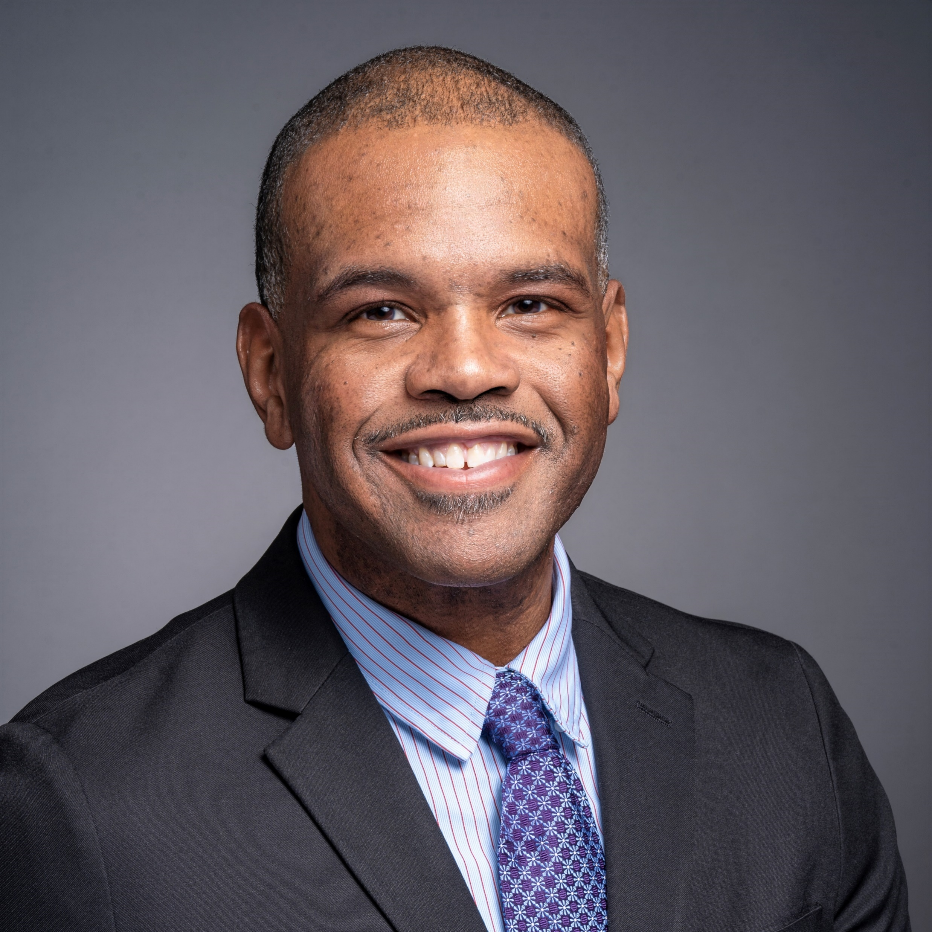

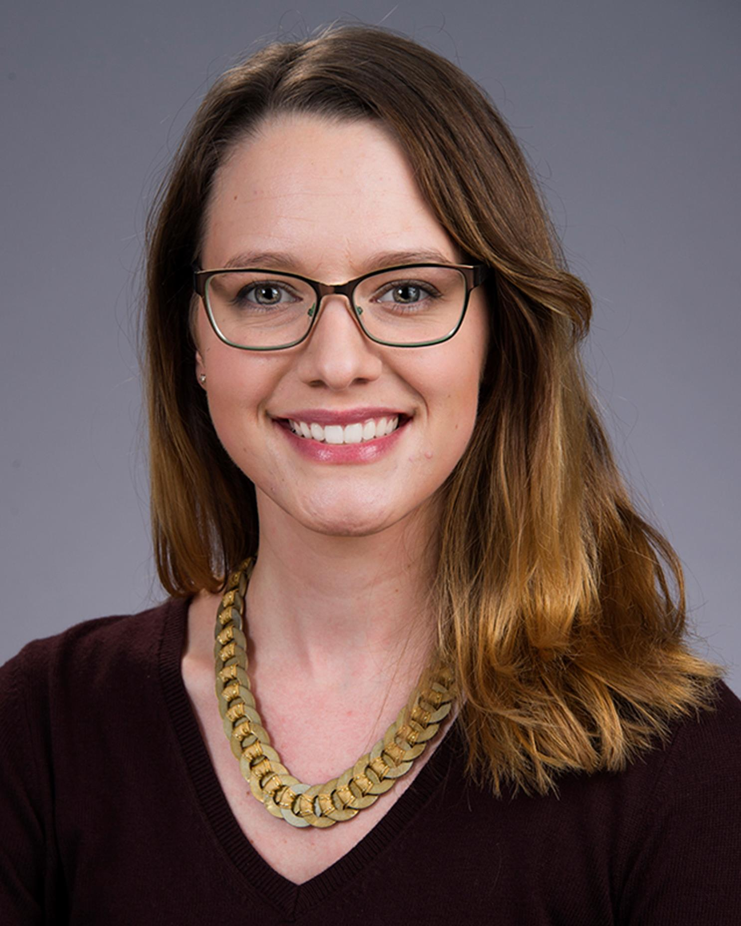
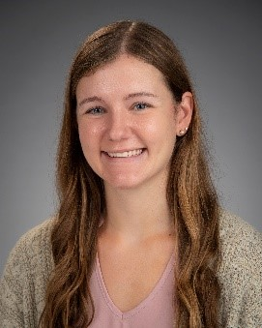
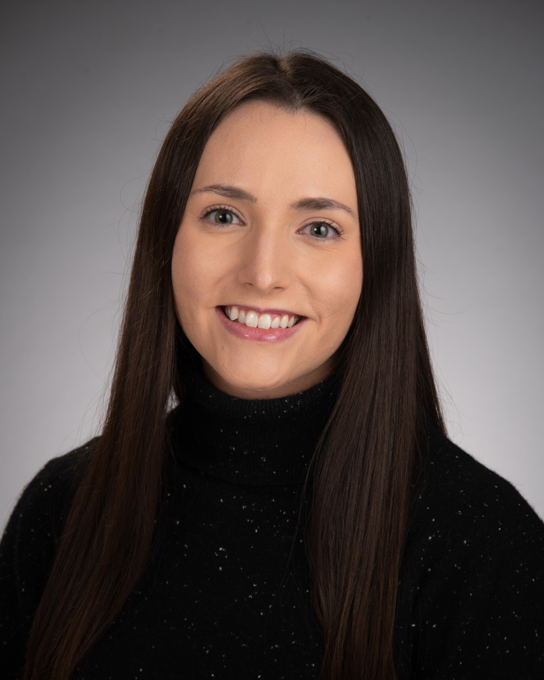
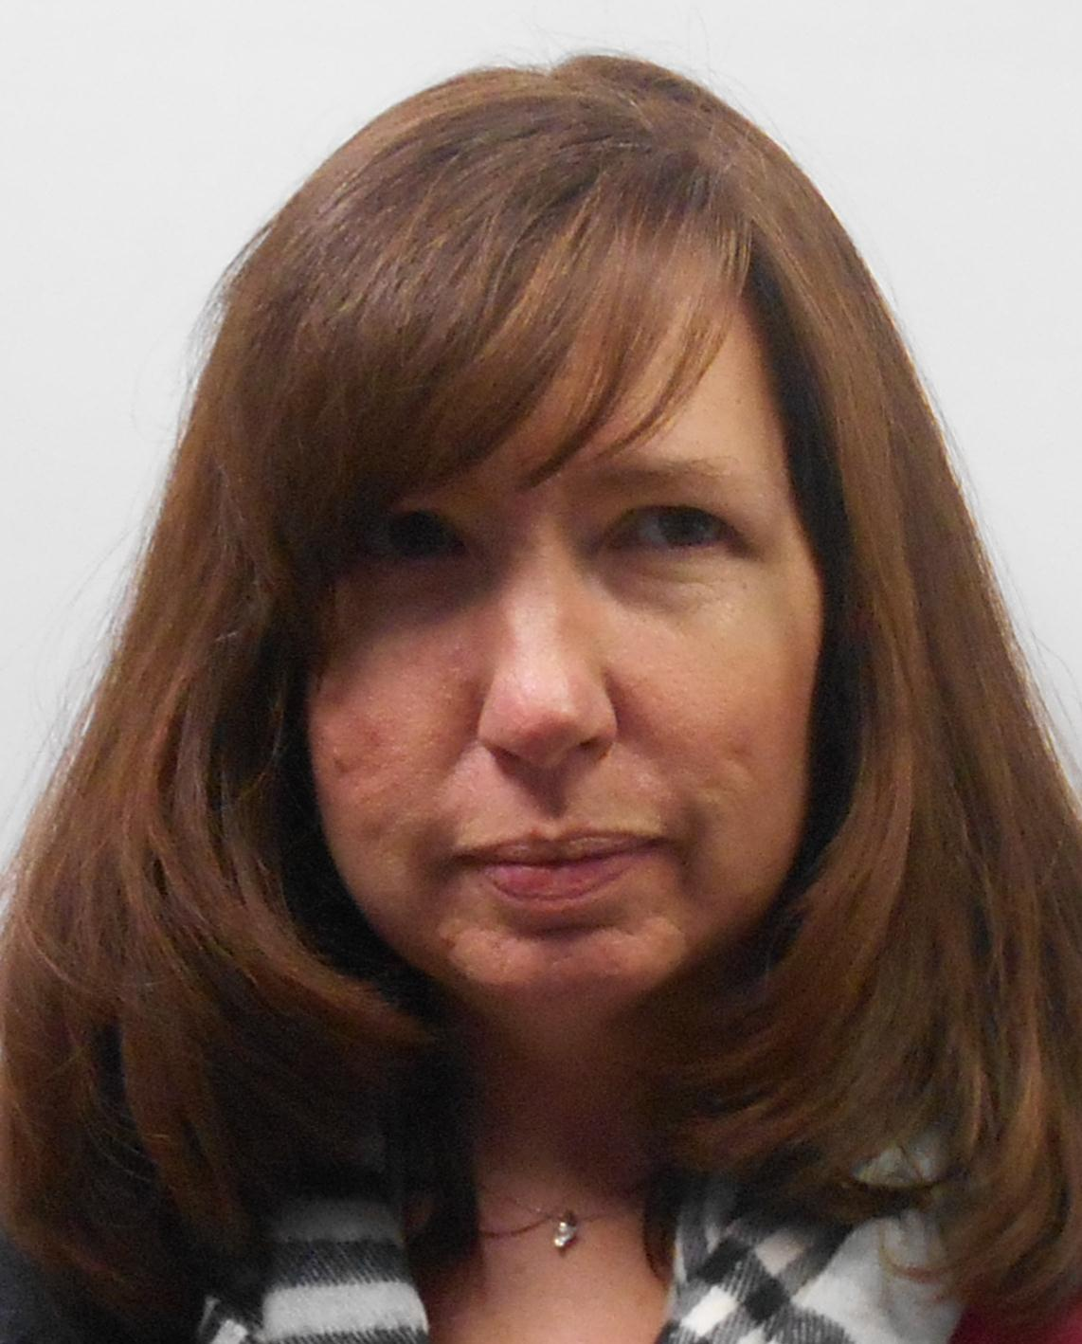
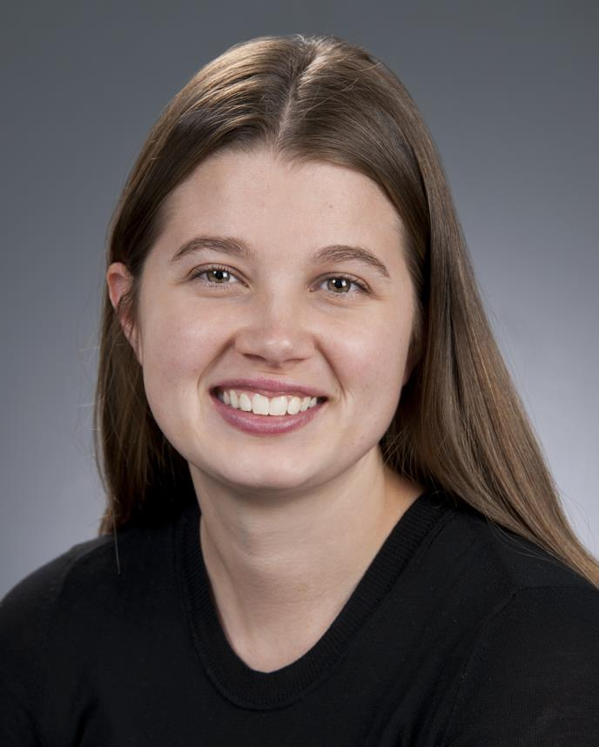
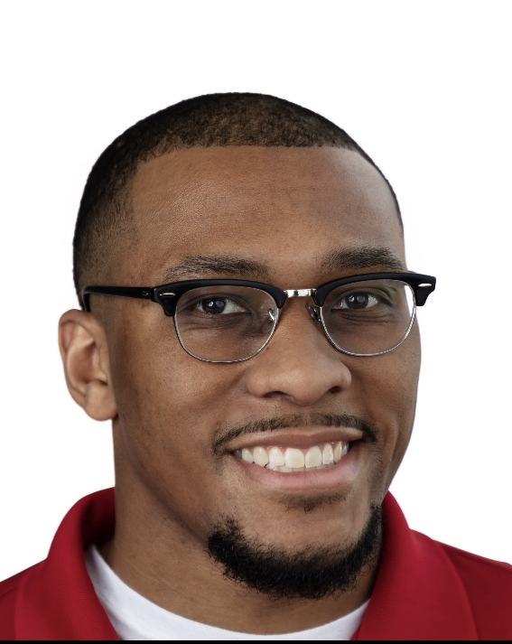
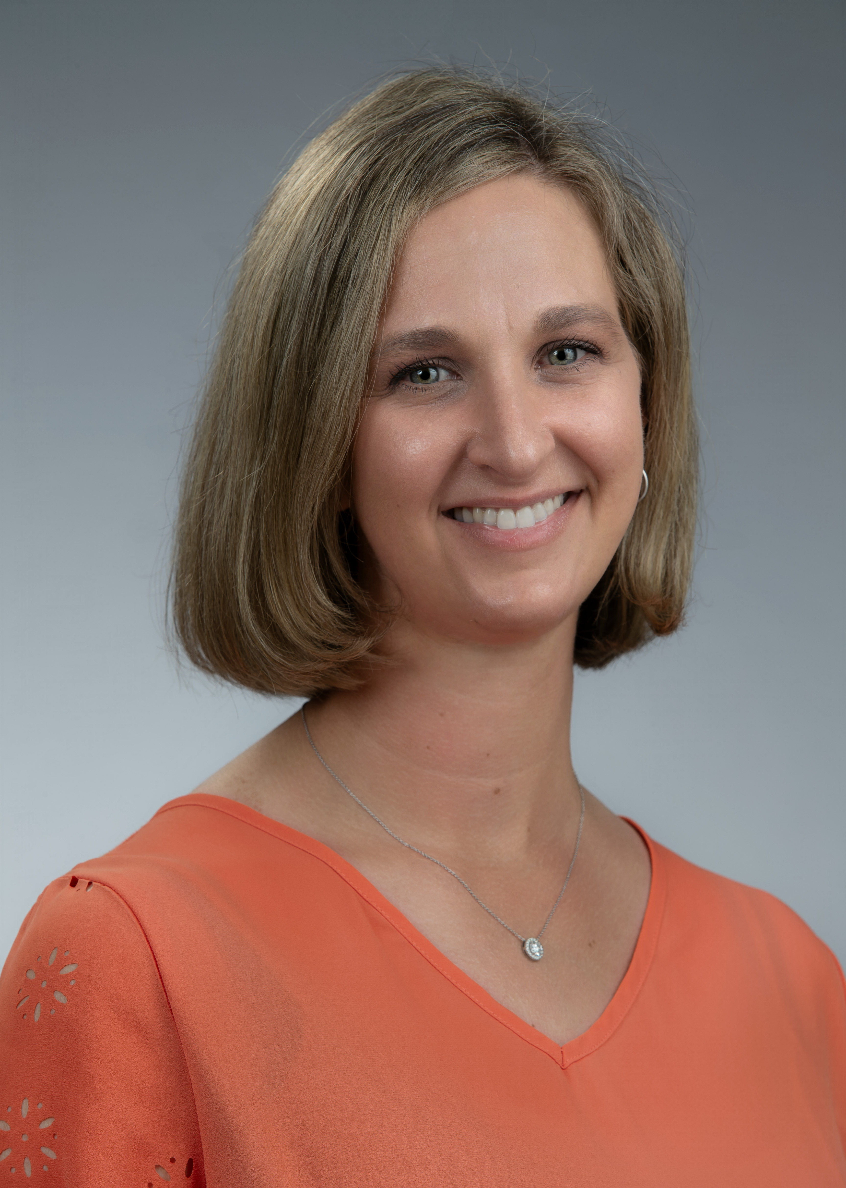

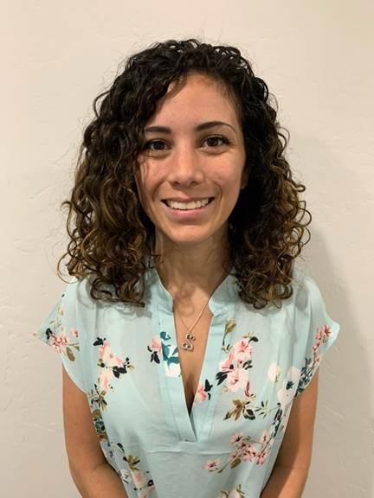
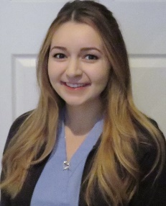
Nemours Healthy Weight and Wellness Clinic
Comprehensive
Evidence-based
Interdisciplinary
Notes:
Because of this, the AAP recommends that children with obesity receive comprehensive, evidence-based, interdisciplinary treatment.
And we actually have a team that provides this in Delaware, putting a shameless plug in for our amazing team of medical providers, psychologists, nutritionists, and exercise physiologists at the Nemours Healthy Weight and Wellness Clinic.

Slide 6
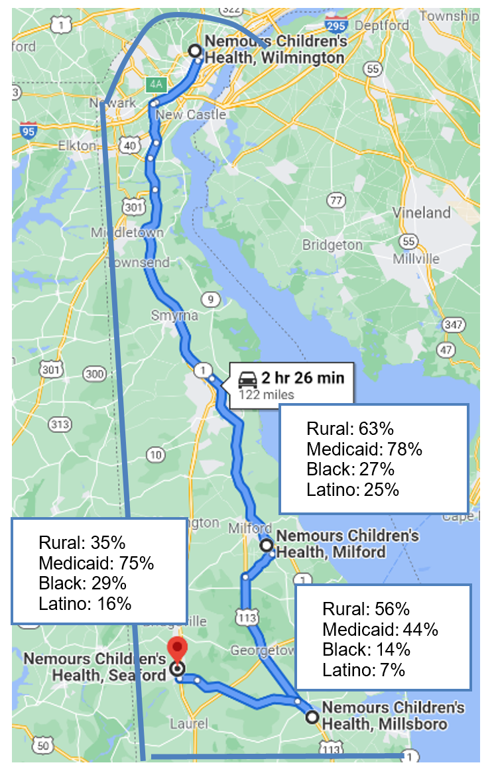
Access to Obesity Care is an Issue
500+ young children with obesity receiving care at three primary care clinics in Southern Delaware
  Less than 20% referred to Healthy Weight Clinic
  Less than 10% had a visit to Healthy Weight Clinic
  Hispanic children less likely to be referred
Goal: Improve access to obesity care for families of children in Southern Delaware
Notes:
But we know that access is an issue – and this is especially the case for children in Southern Delaware who live more than 2 hours from our clinic in Wilmington.
When we looked at the data, less than 20% of young children with obesity receiving care at one of our primary care offices in Seaford, Milford, and Millsboro were referred to our clinic and less than 10% ended up having a visit. Hispanic children were less likely to be referred.
So the major goal of this project was to improve access to obesity care for families in Southern Delaware.
But we knew to do that we’d have to refine our care model to ensure that it aligned with the resources, strengths, and values of the community.

Slide 7






Partnerships Formed
Providers and care coordinators from each primary care clinic
Parents of children with obesity of diverse backgrounds
Representatives from community organizations
Notes:
And to do that, we knew that partnership was critical.
So we met routinely throughout the course of the entire project – from start to finish – with three sets of stakeholders.
The first was a group of medical providers and care coordinators at each of the 3 primary care clinics in Southern Delaware.
The second was a group of what ended up being primarily Latina mothers of children with obesity from Southern Delaware.
And the third group were representatives from the community organizations listed here – [name]

Slide 8





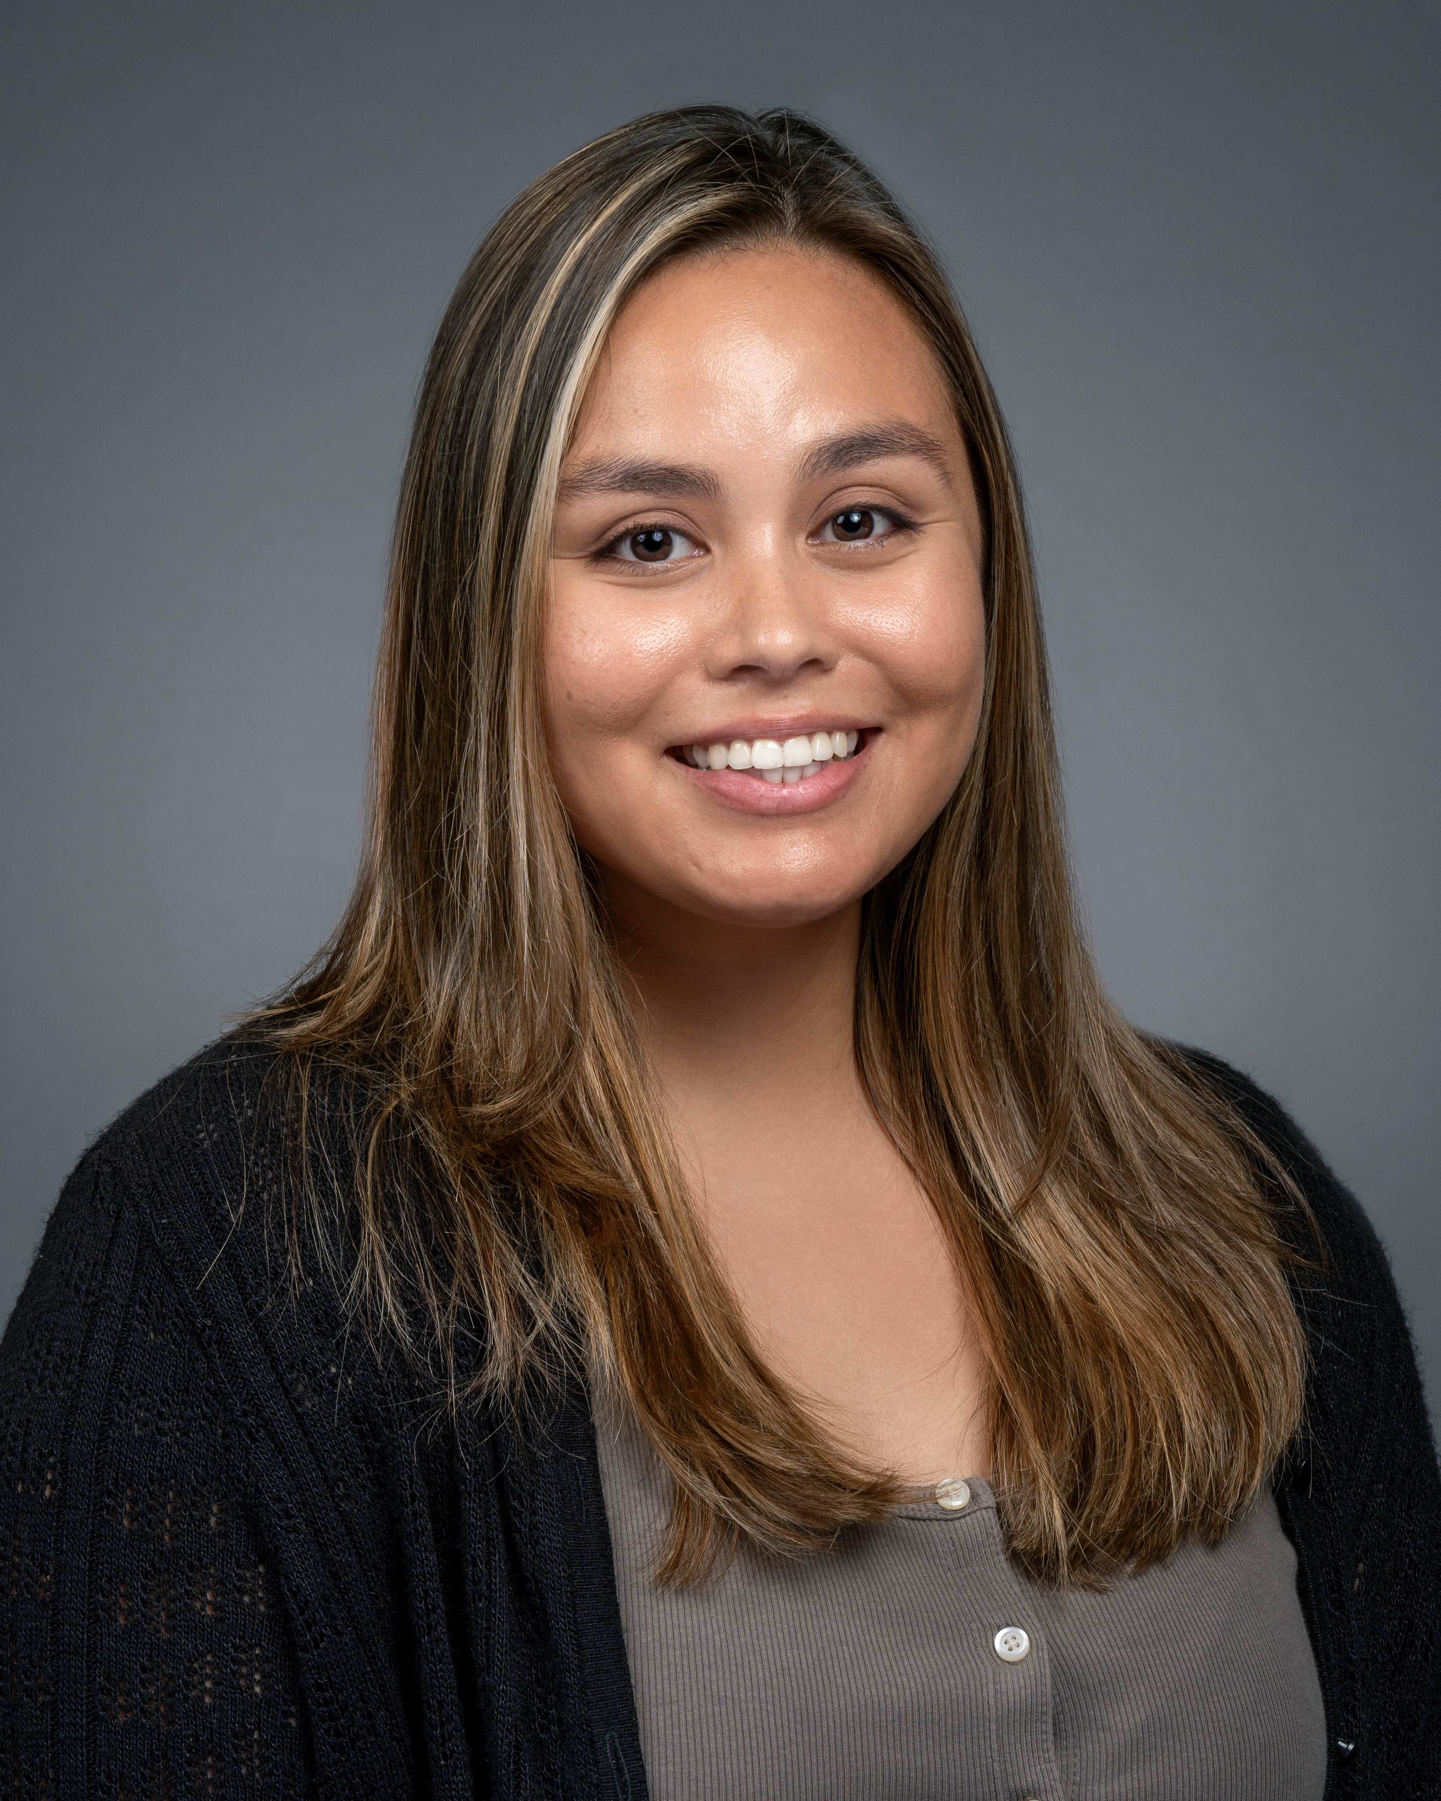

Resulting Community-Tailored Care Model
Integrated Health Care
Healthy lifestyle visits
Healthy lifestyle goal tracking
Healthy lifestyle resources
Integrated Community Care
Community lifestyle program
Community social services
Community health worker
via mobile App
Notes:
At the very first meeting with our partners, we presented the initial concept for our care model - visits with our Healthy Weight and Wellness team and healthy lifestyle resources - all through a mobile app.
But after the very first meeting, we realized this wasn’t enough. We realized that the best way to build rapport with families in Southern Delaware was to be in person. We realized we needed to promote healthy lifestyles outside the clinical setting and out in the community. And we realized we needed to make sure we were addressing any social needs that families might have.
Shout out here to the 2 community health workers, Wanda Flores and Latisha Tolbert, and the 2 research coordinators, Alejandra Perez-Ramirez and Kelsey Higgins, who were instrumental in helping families to navigate their care.
And so our resulting care model was truly an integration of both health care and community care.

Slide 9
Support from Interdisciplinary Care Team
Biweekly visits with care team
Using motivational interviewing
Targeting lifestyle behavior goals
Addressing social barriers to adherence
Latisha Tolbert
Community Health Worker
Wanda Flores
Community Health Worker
Lauren Falini, MS
Exercise Physiologist
Marlene Rafferty, RD, LDN, CSOWM
Dietitian
Joanna Smith, PhD
Psychologist
Thao-Ly Phan, MD, MPH
Physician

Slide 10
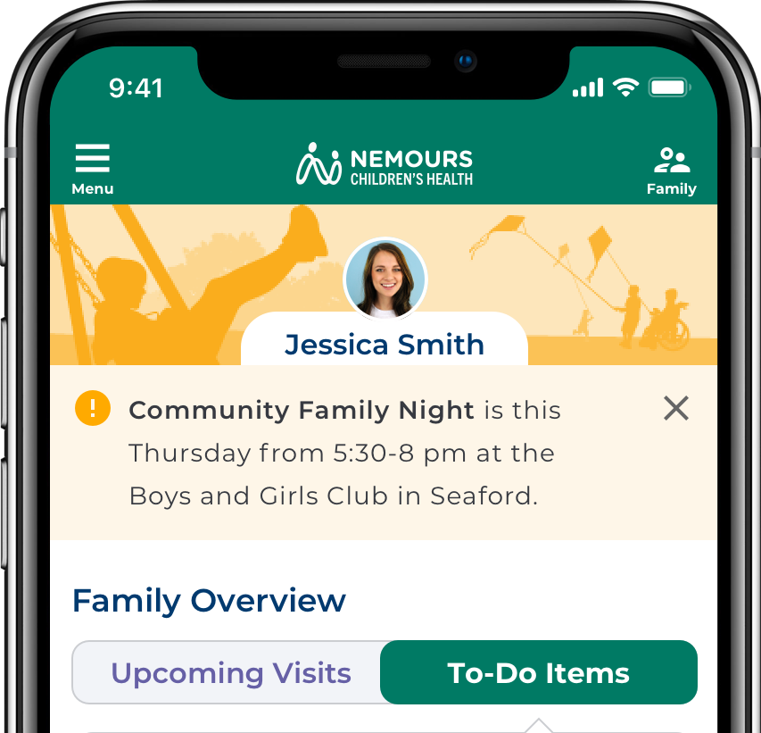
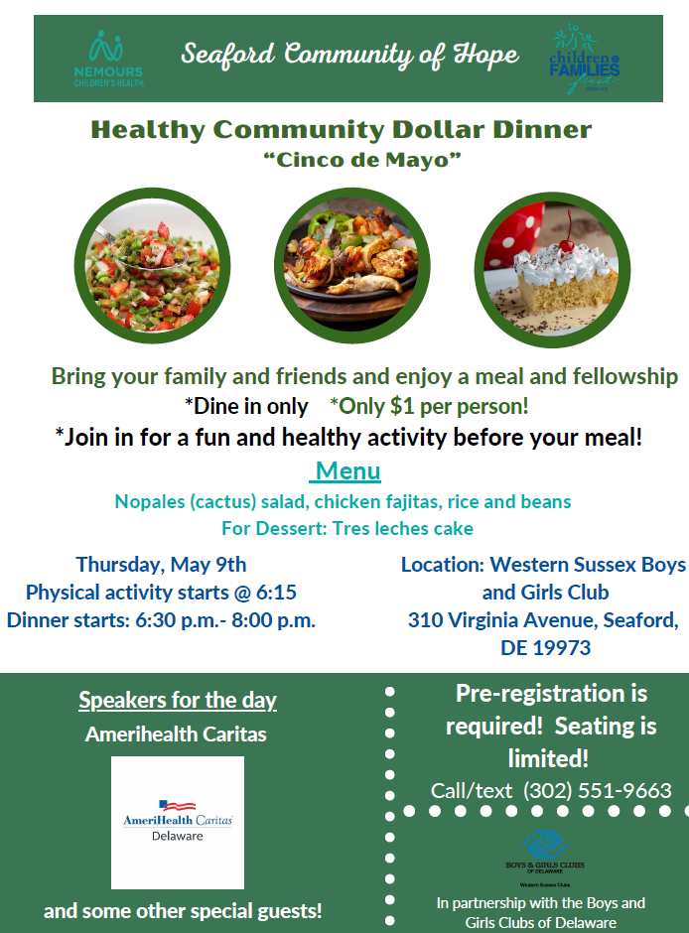
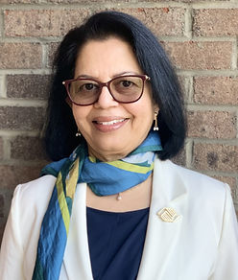
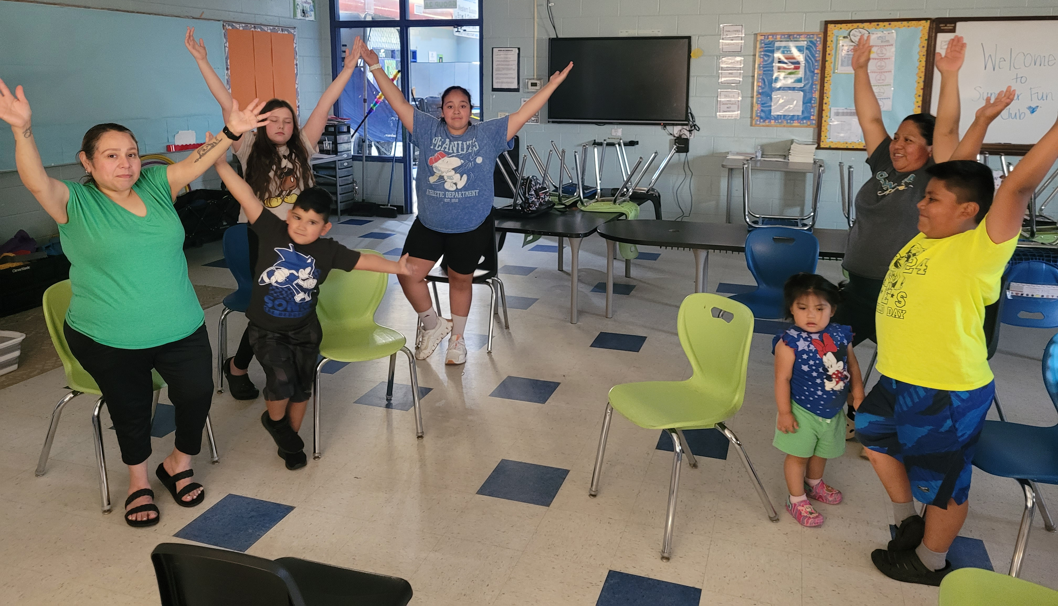

Access to Community Programs
Notes:
As I mentioned, one thing that came across clearly in our discussion with community partners was that they felt like there needed to be a way to promote healthy lifestyles in the community. So, I’m going to spotlight here how we accomplished this in this study.
During one of the first meetings, Suchi from Boys and Girls Club and Midline from Children’s and Families First had a great idea – which, if you know these two amazing women, you know that connecting dots is what they do best.
But they said hey, we already have a program in Southern Delaware called Dollar Dinner where we provide a nutritious meal to families for just a dollar per person at the local Boys and Girls Club. Why don’t we leverage that?
And so we got creative.
We found some funds to support the cook volunteering her time at the dollar dinners and to bring fitness instructors to the event. You can see here some families doing yoga at one of the events.
And we advertised the Dollar Dinner to our families as a component of our care model.

Slide 11
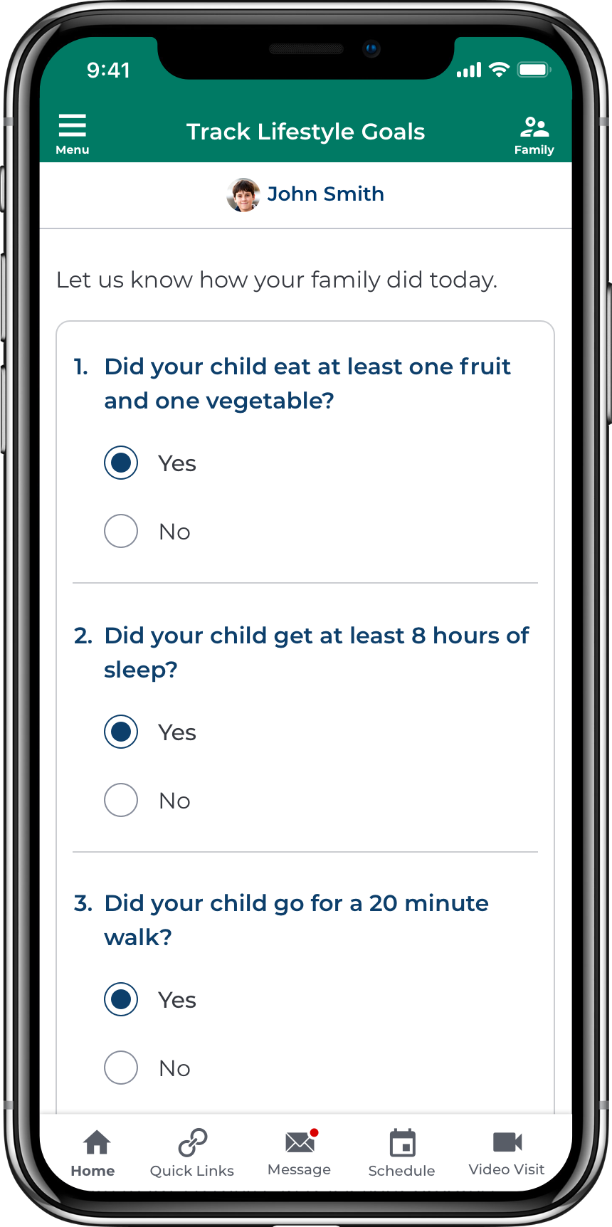
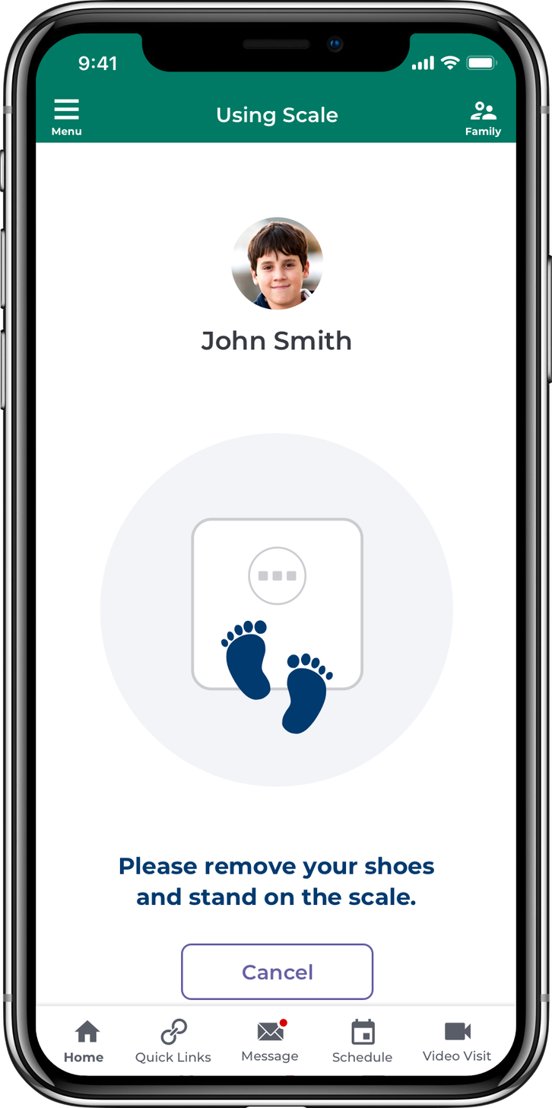
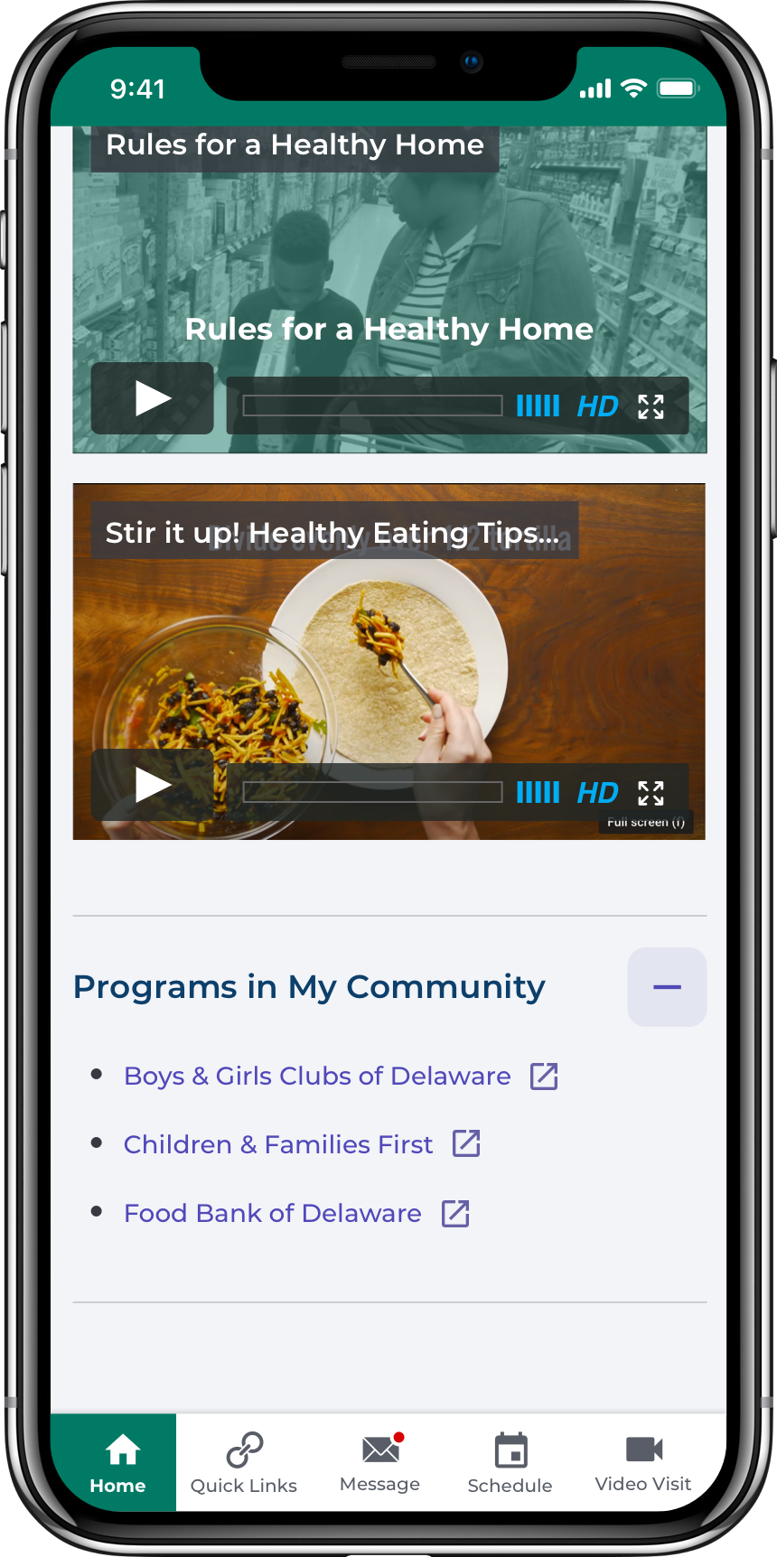
User-Friendly App, Refined with Family Input
JMIR Formative Research - mHealth App to Promote Healthy Lifestyles for Diverse Families Living in Rural Areas: Usability Study
Notes:
You’ll notice that one of the ways we promoted the dollar dinner was through a mobile app notification.
And we did develop a mobile app as part of this study to help families track healthy lifestyle goals and access resources, as you can see in these screenshots.
One important thing we did was conduct in-depth testing of the App with families of children with obesity, incorporating their feedback so it would be more user-friendly. The paper describing this process is linked here for those interested.

Slide 12
Pilot RCT of Care Model
Families of children 4-12 years of age with obesity from Southern Delaware
Recruited by text or from referrals from primary care providers
Healthy Lifestyle Group
(Expected N = 46)
Stratified by race/ethnicity
Active Control Group
(Expected N = 46)
Stratified by race/ethnicity
Healthy Lifestyle Care Model (6 months)
Access to community programs
Biweekly visits with interdisciplinary team
App tools (goal setting, resources)
Standard Care (6 months)
Bimonthly lifestyle counseling with primary care provider per new AAP Clinical Practice Guidelines
Outcomes
Change in BMI percentile
Days in study and attrition
Engagement with components
Outcome
Change in BMI percentile
Days in study and attrition
Notes:
Once we had the care model in place, we tested it in a pilot randomized controlled trial.
We recruited families of children 4-12 years of age with obesity from one of the 3 primary care clinics in Southern Delaware.
Families were randomized to either receive the Healthy Lifestyle care model or standard care for 6 months and our main outcomes were change in BMI percentile, attrition, and days in study.

Slide 13
Participant Characteristics (N = 59)
Child Race and Ethnicity, N (%)
Black, non-Hispanic | 21 (35.6)
Hispanic | 16 (27.1)
White, non-Hispanic | 22 (37.3)
Caregiver Preferred Language, N (%)
English | 47 (79.7)
Spanish | 12 (20.3)
Child Gender, N (%)
Male | 31 (52.5)
Female | 28 (47.5)
Child Age and BMI Percentile, mean (SD)
Age | 8.6 (2.6)
BMI Percentile | 98.0 (1.6)
Socioeconomic Indicators, N(%)
Public insurance | 45 (76.3)
Social driver of health screen positive | 10 (17.0)
Notes:
We enrolled 59 families of diverse backgrounds, including 36% Black, 27% Hispanic, and 37% White families. 20% of the caregivers enrolled were Spanish-speaking. 76% had public insurance.
18% enrollment – 10-20% typical
30-40% attrition is common (currently, 27% in both groups)

Slide 14
Engagement of Hispanic Families
Change in BMI percentile
  No significant differences
Attrition and days in study
  Hispanic families stayed longer in the study if they were in the Healthy Lifestyle group (222 vs. 129 days)
Notes:
While we did see a trend in that participants in the Healthy Lifestyle group on average lost weight, whereas those in the Standard Care group gained weight, we didn’t achieve a sample size large enough to detect a significant difference.
But we did find that Hispanic families were more engaged if they were receiving the Healthy Lifestyle care model, staying nearly 100 days longer in the study if they were in that group.
The interaction of group and time and the interaction of each socio-demographic variable of interest with group and time were modeled in mixed-effects regression analyses. The interaction of socio-demographic variables and group on days in study were modeled in multiple regression analyses.

Slide 15
Qualitative Feedback from Hispanic Families
El programa fue lo que esperaba. Mucho mas digo yo… [child name] esta mejorando mucho su actitud, sus calificaciones… yo creo que las citas con la psicóloga lo han ayudado mucho. Lo han ayudado entender su cambio de vida y pues nos ha ayudado mucho sentirse uno más tranquilo ver lo cambiando su actitud.
The program was what I expected. I would say much more... [Child name]’s attitude is improving a lot, his grades... I think that the appointments with the psychologist have helped him a lot. They have helped him understand this change in his life and it has helped us feel calmer to see his attitude change.
Conseguir que mis hijos comieran verduras. Eso es algo con lo que me costó mucho. Pero las noches les motivaban mucho porque veían la comida que había y querían comer lo mismo. Y eso es lo que más me gustaba de ellos. Aprendieron a comer cosas que antes no les gustaban. Y ahora les gustan.
Getting my children to eat vegetables. That is something that I struggled with a lot. But the nights really motivated them because they saw the food that was there, and they wanted to eat the same. And that’s what I liked the most for them. They learned to eat the things that they didn’t like before. And now they do like it.
[Me inscribe] porque quería motivar a mi hijo para que su autoestima subiera y también cuando dijeron que también iban a dar ayuda de sobrepeso – la forma correcta – me llamo mucho la atención … Nos motivaba a nosotros también…especialmente a mí. Me ayudo enfocar a ayudar a mi hijo en el proceso y estar más conectado con él.
[I signed up] because I wanted to motivate my son to increase his self-esteem and also when they said that they were going to give help for losing weight – the right way – it caught my attention … It motivated us too… especially me. It helped me focus on helping my son in the process and being more connected to him.
Notes:
Finally, we conducted exit interviews with 21 of the families who completed the Healthy Lifestyle care model – which I think is another important way to make sure the voices of families are heard in research. And their words showed an appreciation for the way this care model addressed the psychosocial needs of families and the importance of the rapport families built with the care team.
This is just a snippet of the quotes from the interviews, but for the sake of time I’m going to read the one in blue.

Slide 16
Next Steps
In February 2025, added a clinic in Milford
  Research study’s psychologist and dietitian became part of interdisciplinary clinical team
Developing tailored intervention for Hispanic communities
  Partners recommended innovative funding sources to continue to support a community-based care model
Notes:
I’m really happy to report that in large part due to this study, we saw a need to provide services in-person in Delaware and now operate a Healthy Weight and Wellness Clinic in Milford. And in fact, the psychologist and dietitian who were part of our research study are now providing care to our patients in that location.
Given the success of this care model with Hispanic families, we are working on tailoring it even further and on the recommendation of our community partners are working on finding innovative funding sources to continue to support a community-based care model to address the psychosocial needs of families.

Slide 17
Research Team and Partners
Research Project Leader
Thao-Ly Phan, MD, MPH
Scientific Mentorship Team
Anne Kazak, PhD, ABPP
Ann Davis, PhD, MPH
Ihouma Eneli, MD, MS
Allison Karpyn, PhD
Research Coordinators
Alyssa Decino
Kelsey Higgins
Angel Munoz Osario
Alejandra Perez-Ramirez
REACH Cores
Kimberly Canter, PhD
Tony Collins
JJ Cutuli, PhD
Center for Health Delivery Innovation
Steve Battisti
Adrienne Gallo
Sarah Hendy
Jenna MacPherson
Natalie Stephenson
Vivek Tayal
Healthy Weight & Wellness Care Team
Lauren Falini, MS
Marlene Rafferty, RD, CSP, CSOWM, LDN
Joanna Smith, PhD
Latisha Tolbert
Wanda Flores
Value-Based Services Organization
Hope Bleyer, LMSW
Deborah Burchett
Gina Hamilton, BSN, RN
Primary Care Partners
Milford (Suzanne Bagas, Megan Smith, Kelli Thomas)
Millsboro (Katie Burris, Melissa Long, Michelle Mitchell)
Seaford (Patti Greene, Rebecca Long)
Community Partners
Boys & Girls Club of Delaware
Childrens & Families First Delaware
Delaware YMCA
DHHS PANO Program
Sussex County Health Coalition
Parent Partners
Josefina Mendez-Lopez
Cecelia Andrade-Garcia
Justina Alday-Ascencio
Elvia Puac-Ramirez
Notes:
This project really took a village. I’d like to thank my research team and collaborators at Nemours, but especially the partners, highlighted in the blue box for their time and valuable insights that truly made this project a success.

