Slide 1

Advancing Healthy Lifestyles Conference
Thursday, June 4, 2026
Healthy Kids Training Series Pilot Project
Diane Frentzel, Program Manager
Delaware Readiness Teams

Slide 2

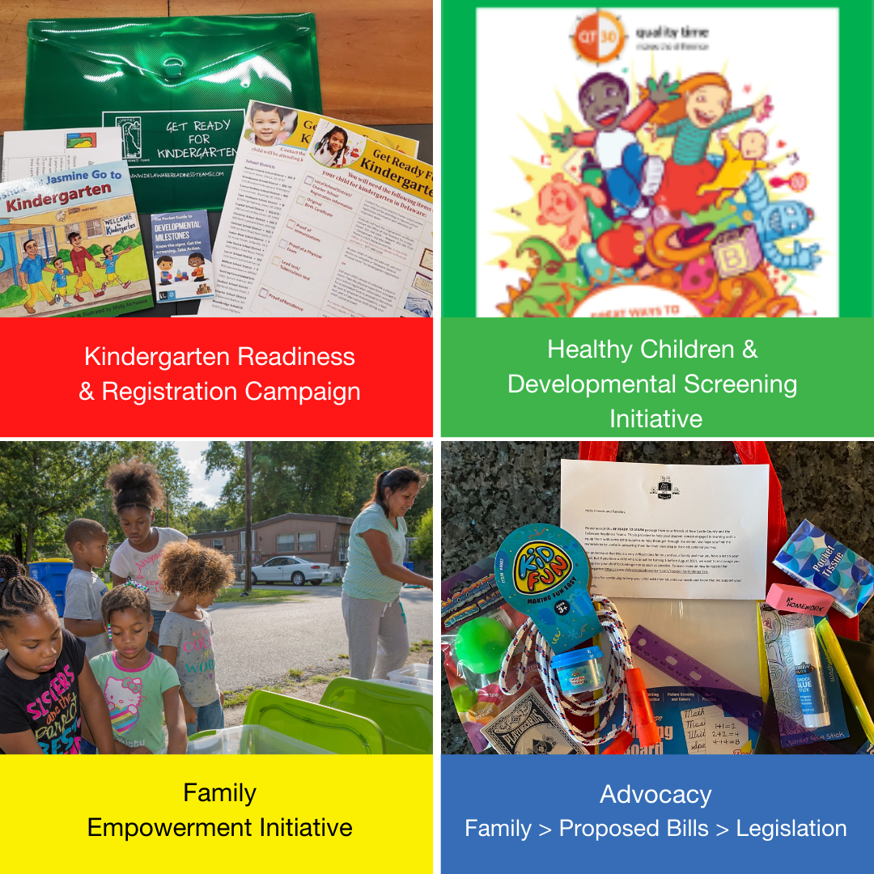
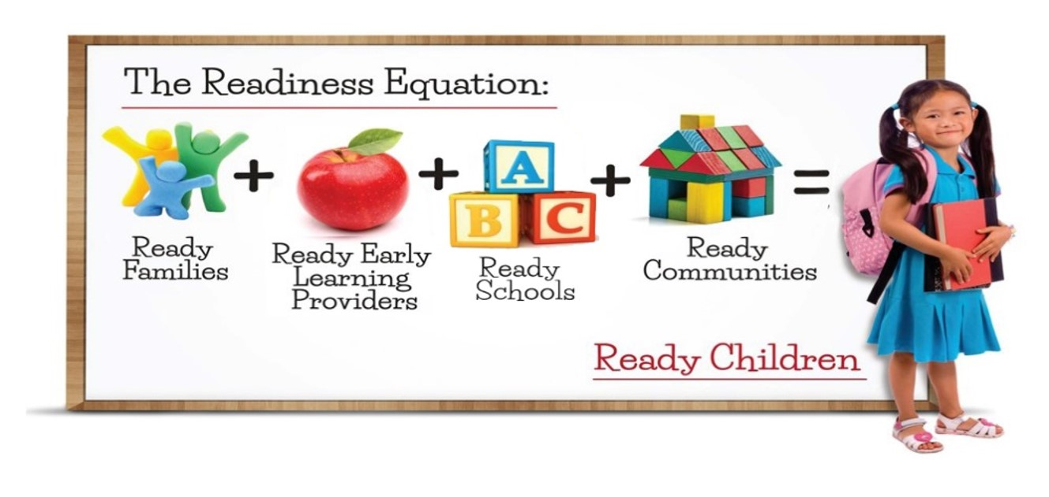
Delaware Readiness Teams
Notes:
Slide 2- Community Outreach and Information Sessions
Delaware Readiness Teams
An organization that convenes families, early learning providers, school representatives, and community members to ensure that children ages birth to 8 are ready for school and life.
Areas of Focus
Kindergarten Readiness and Registration Campaign
Children will be enrolled on time and ready to learn on the first day of kindergarten.
Healthy Children and Developmental Screening Initiative
Increase screening and, according to results, provide families with resources and services to support.
Family Empowerment Initiative
Families will increase knowledge of child development and implement activities that will support learning and growth.
Advocacy
Family Voice -> Proposed Bills -> Legislation

Slide 3

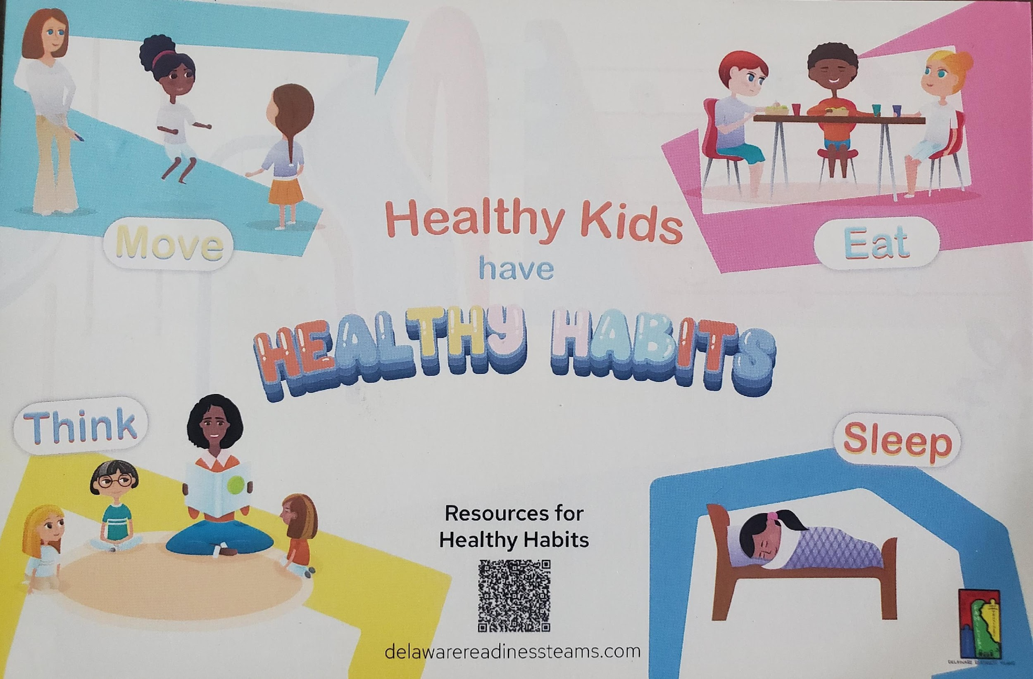
Healthy Kids Healthy Future Project
Convened a working group focusing on healthy eating and physical activities and developed outreach materials to connect families to additional health and nutrition resources.
Integrate healthy eating and physical activity into the rollout of the statewide developmental screening initiative through a pilot outreach program providing Developmental Screening Resource Bags.
Early Childhood Outdoor Learning Environments Course
Conducted a survey to identify strengths and needs of EC providers and families related to health and nutrition.
Gardening with Young Children Certificate Course
IPHI Equity Training and TA.
Hosted a Physical Activity Learning Session Training for EC Providers (PALS)
Nemours Podcast- Spotlight on Delaware
Hosted Physical Activity Learning Session (PALS) Train the Trainer
Healthy Kids Training Series Pilot for early learning providers and families in their programs. We hosted a multi-part Healthy Kids Training for EC providers and families that focused on the Physical Activity Learning Session (PALS), nutrition, and health promotion resources. The goal was to provide resources that can be taken back and use in programs and homes as well as strengthen knowledge and communication between families and providers around healthy children.

Slide 4





Healthy Kids Training Series Pilot
    Pilot Details
    Provide Training for Families and Early Learning Providers
    Based on Feedback from Previous Surveys
    Planning Meeting with EC Providers to Discuss Content and Plan Training Series
    Incorporating Health and Safety Requirements from the DE Office of Child Care Licensing
    Option to Join the First Two Sessions Virtually on Zoom or View the Recording
    Follow-up Survey After Each Session
    Honorarium for Participation
    Resource Bags for Families and EC Providers
    Follow-up Meeting with EC providers
    Community Partner Engagement
    # of Participants
    50 families
    12 family child care providers

Slide 5
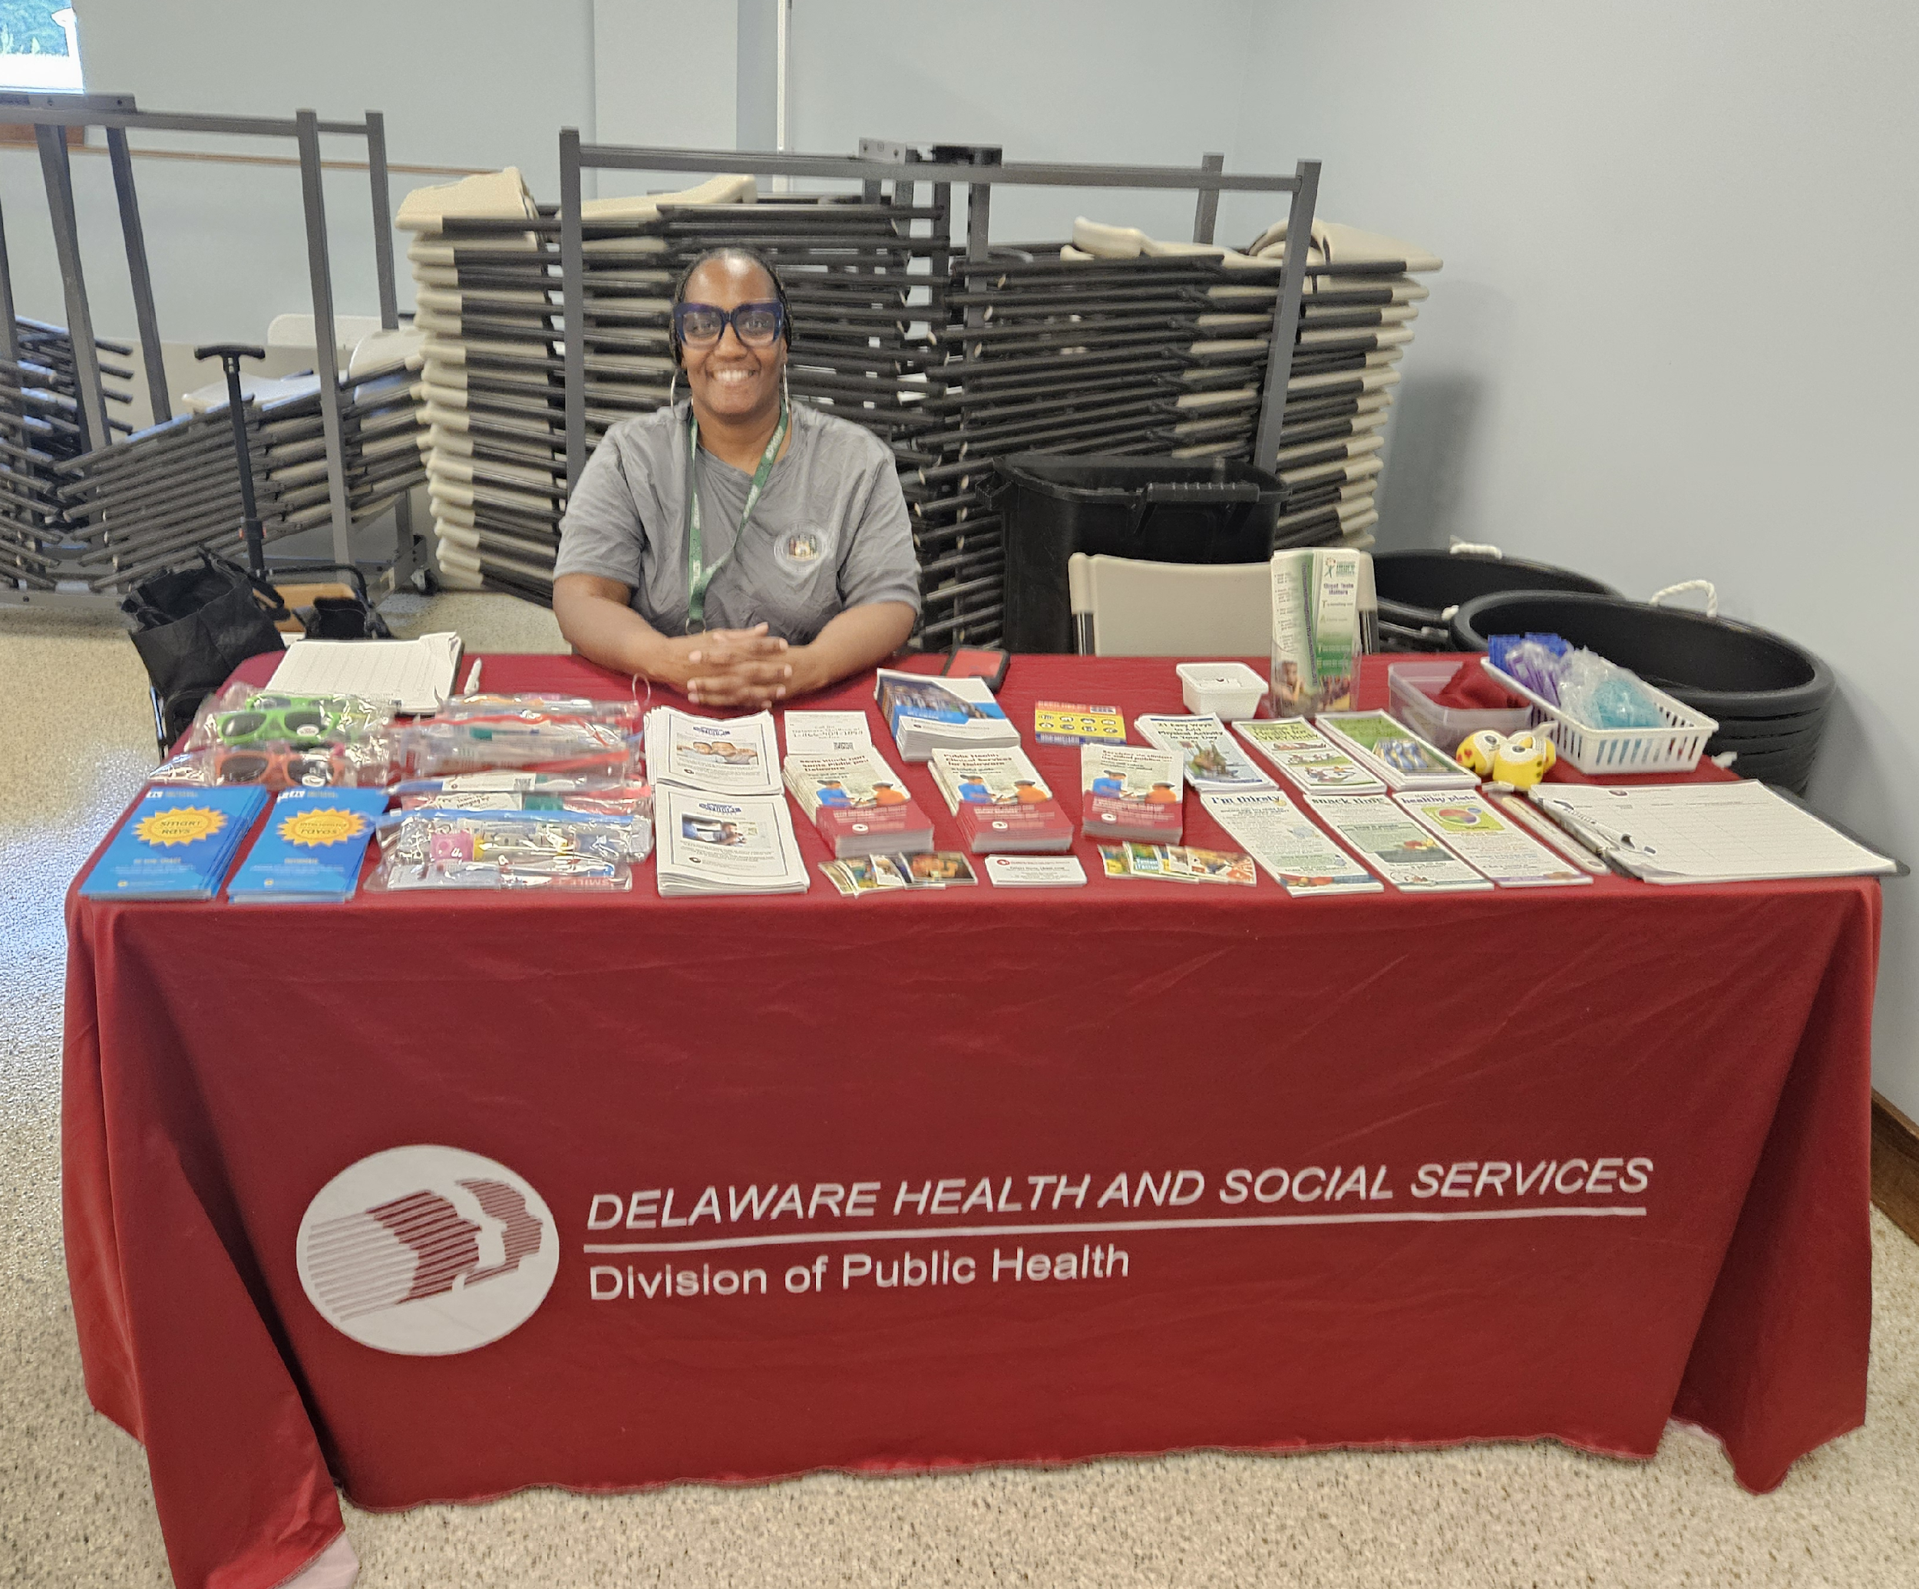
Healthy Kids Training Series Pilot
    Timeline
Planning Meeting with Family Child Care Providers
Hosted In-person Session and Follow-up Meeting with Providers
Hosted Virtual Training Sessions
_________________________________________________________________________________
May
June
July
    Schedule
Session 1 | Mental Health, Mindfulness, Self Care, and Sleep | Virtual
Session 2 | Nutrition, Active Play, and Health Requirements and Recommendations | Virtual
Session 3 | In-person- Whole Family Event- 6 Activity Stations | Bridgeville Library

Slide 6
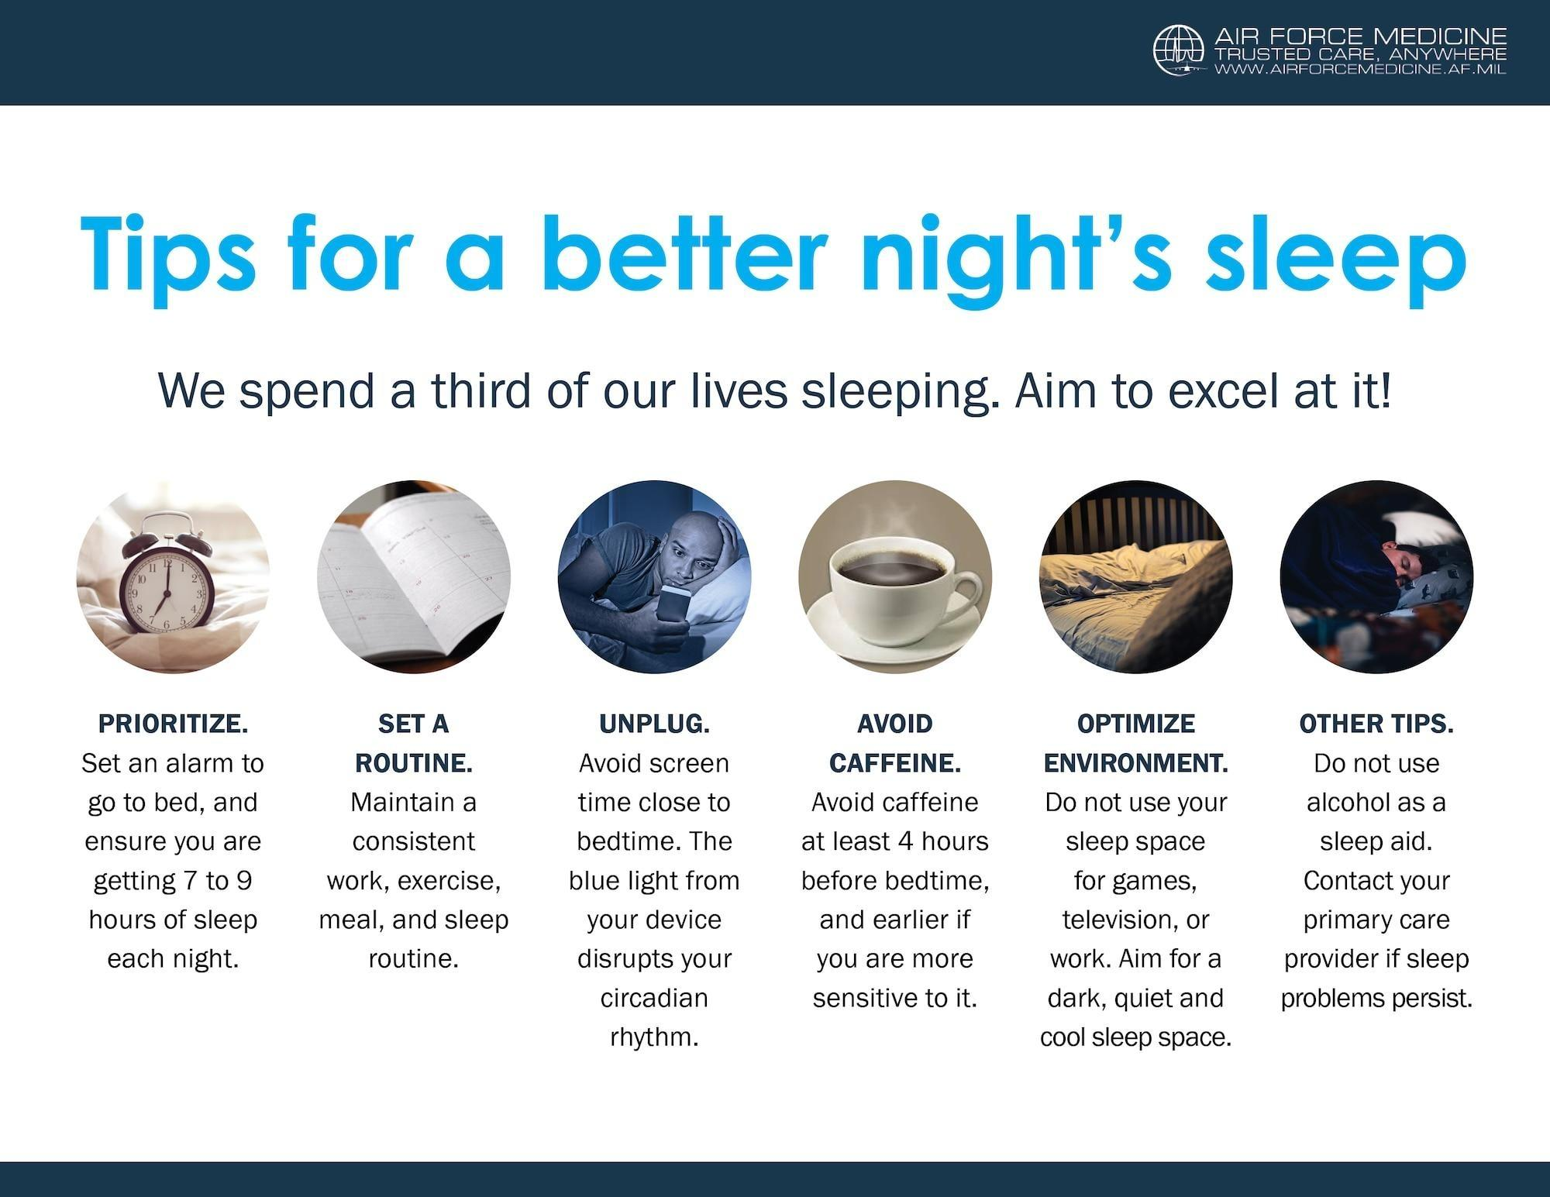
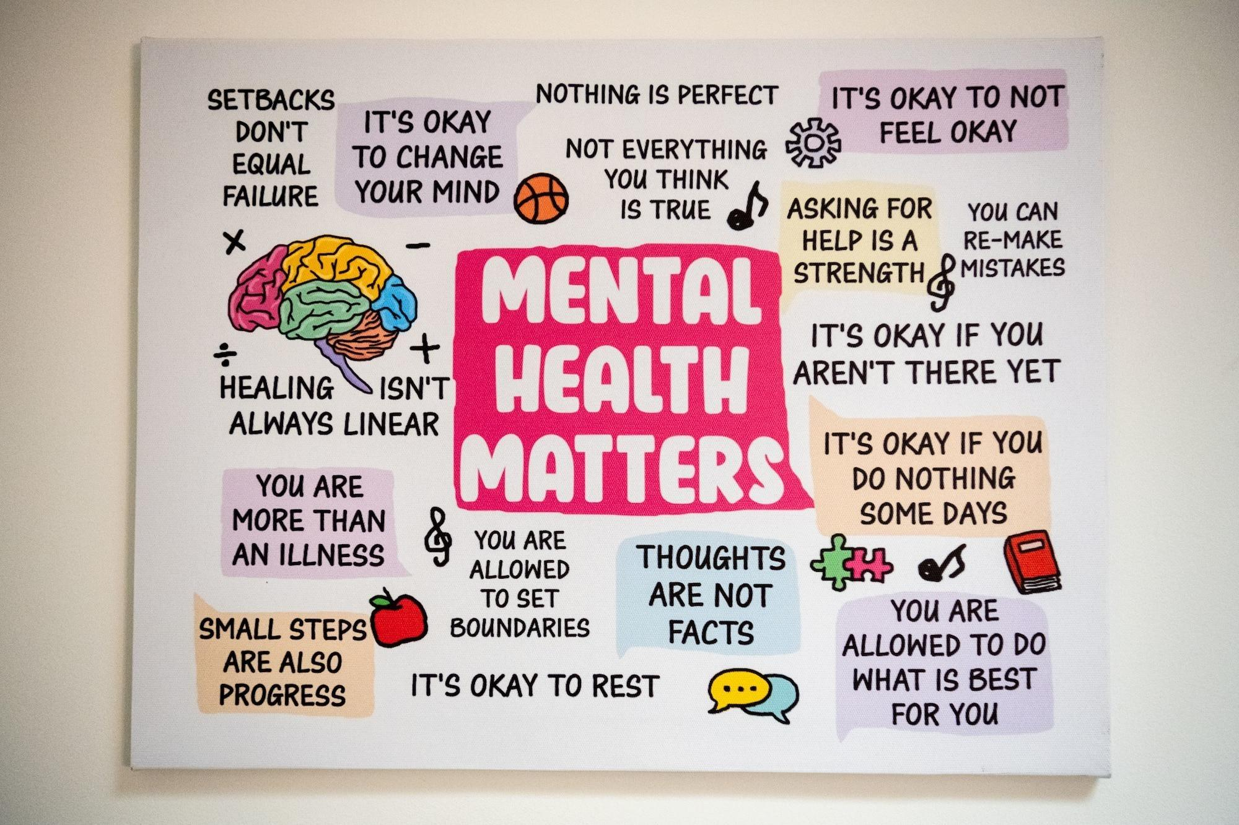
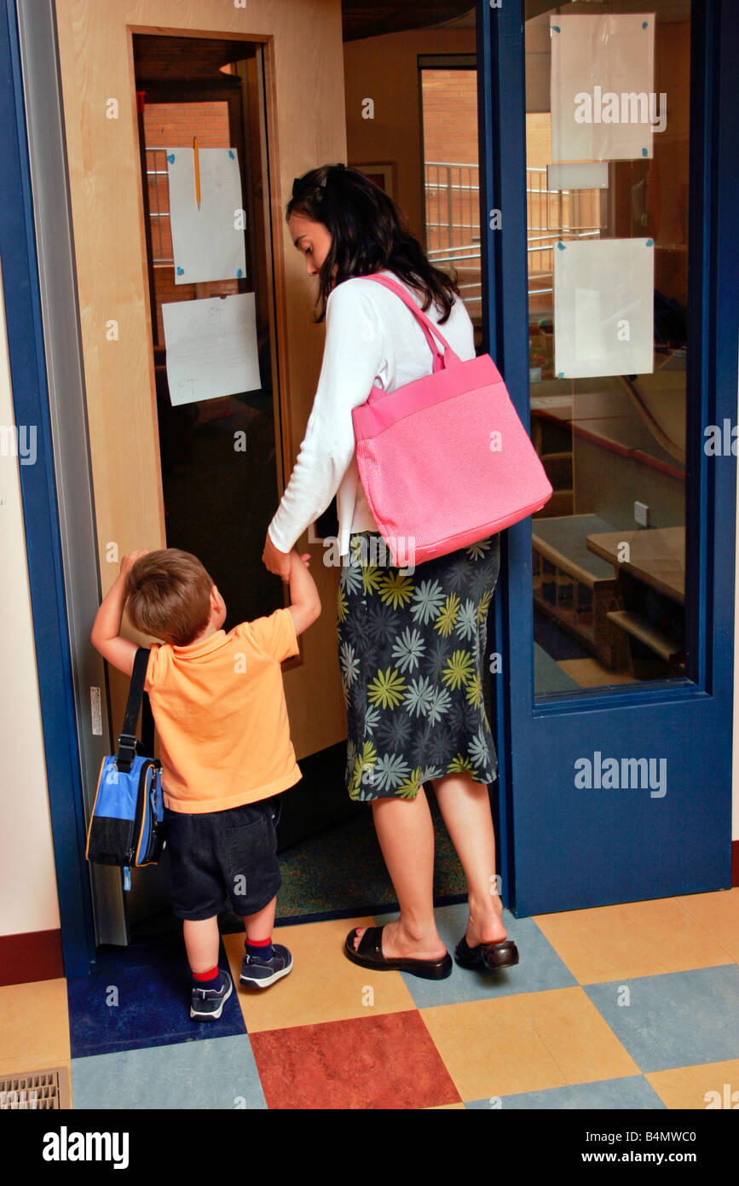
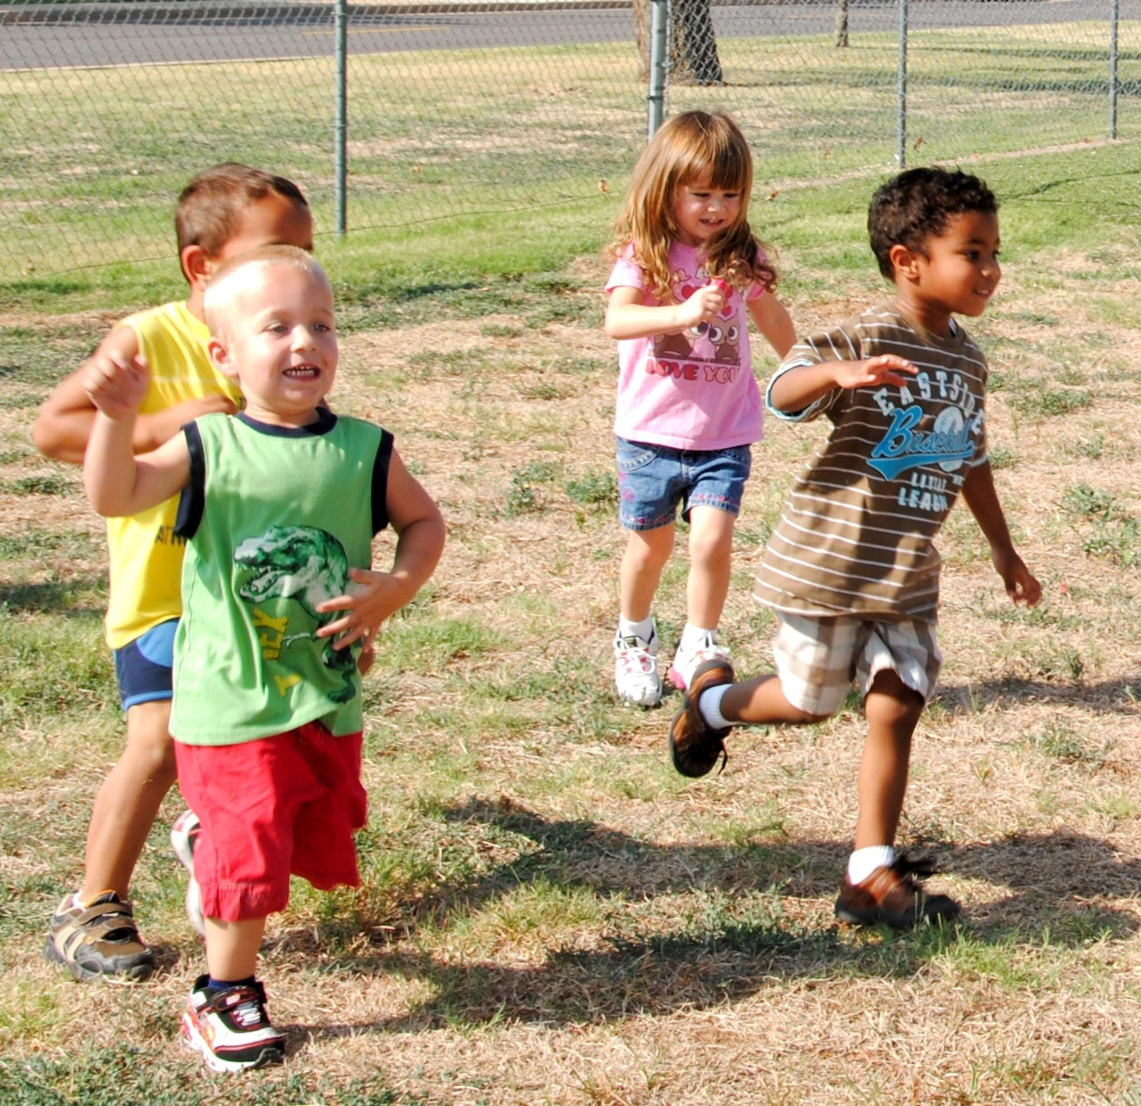
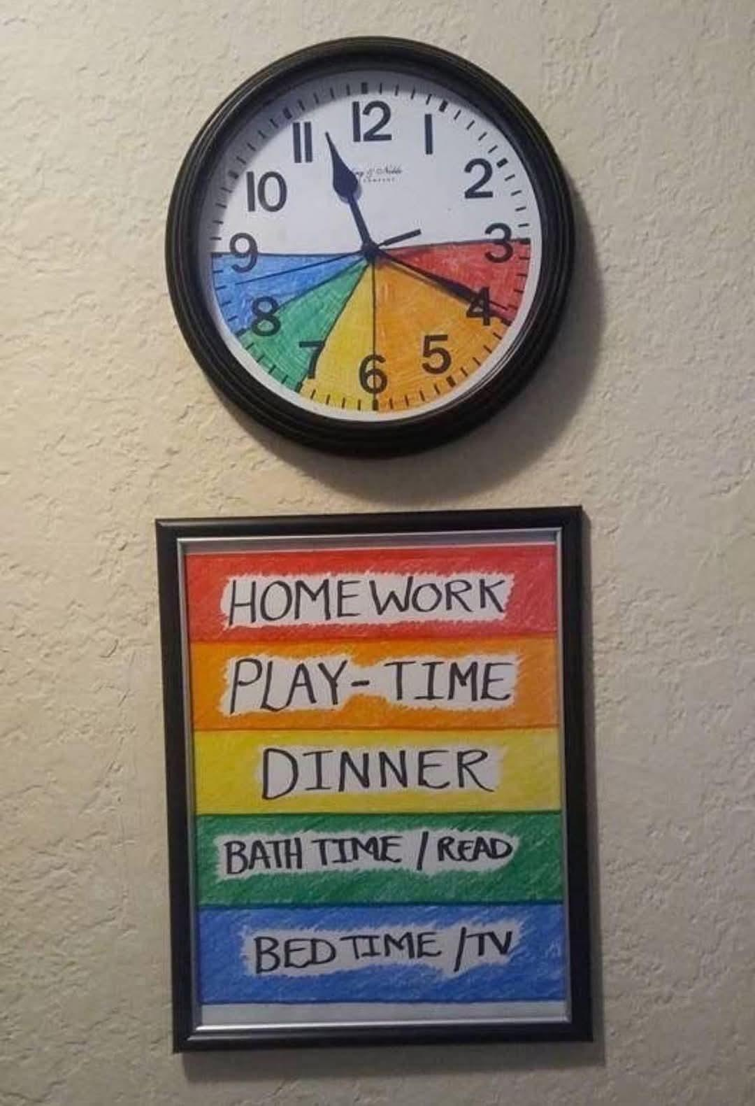
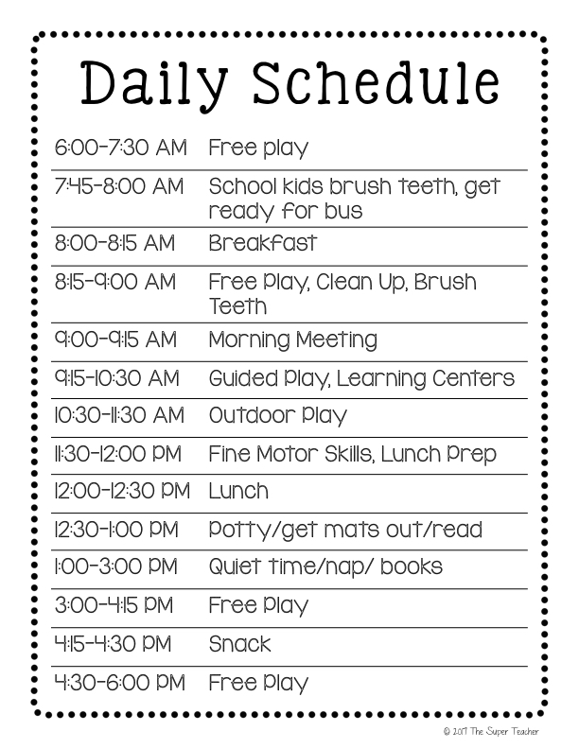
Session 1- Virtual
Physical Health
Mental Health
Sleep
Exercise
Managing Stress and Anxiety
Healthy Kids Training Session #1 Recording
https://us02web.zoom.us/rec/share/KGwdpQSxdtSBxRaaVu4YwqX-V4fr9KYvP6KxFHh-XJc-Z1jQ_ho5TZQfno6giTou.puIZERCrRYb2pHhk
Passcode: =hvVurK6
Training Session #1 Slide Show
https://docs.google.com/presentation/d/1xfeqOTvE2MJCYNx4vaoH3jXbrxvdDdXCC1LaM5t0qmA/edit?usp=sharing

Slide 7

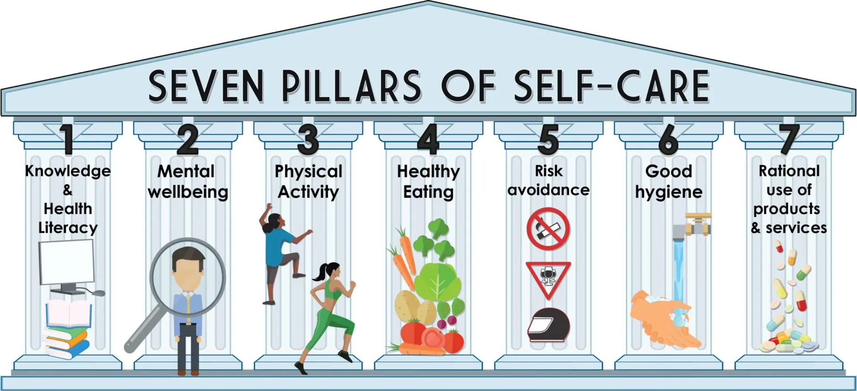
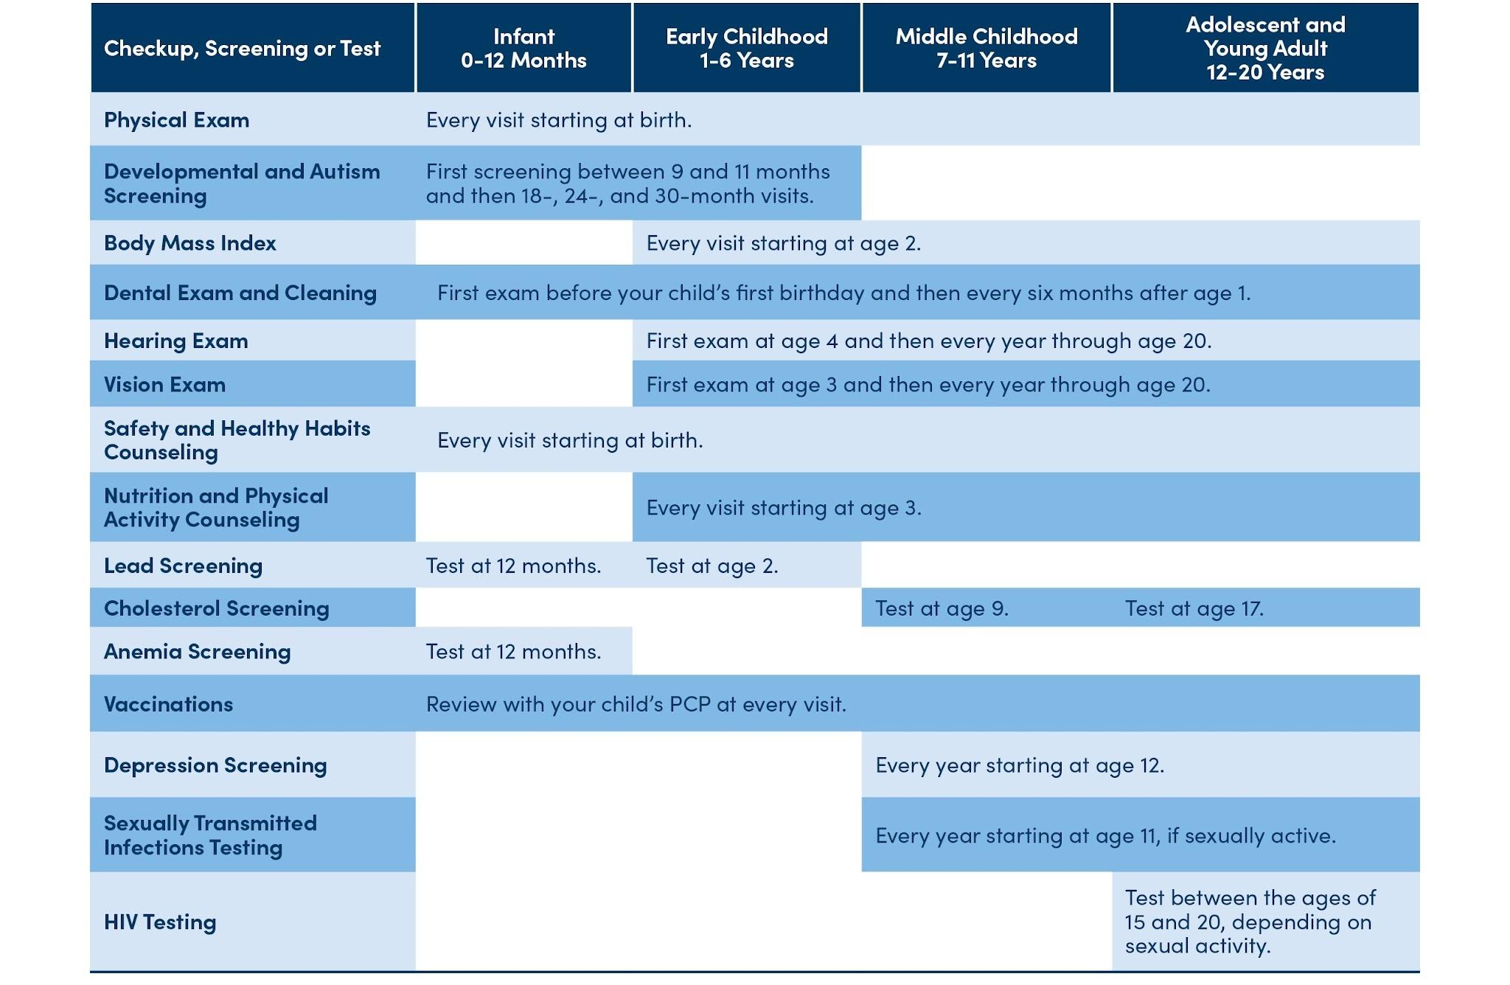
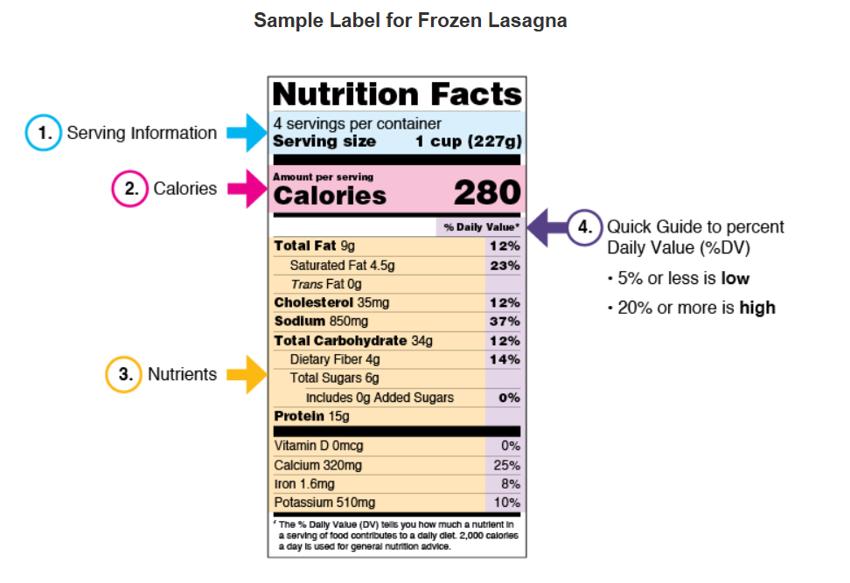

Session 2- Virtual
Nutrition (guidelines, reading nutrition labels, planning healthy meals on a budget, nutrition resources, family style meals)
Physical Activity and Movement
Preventative Care
Healthy Kids Training Session #2 Recording
https://us02web.zoom.us/rec/share/xqphYHXaqCZmfLjuyOe86l2wI1hG94KATluaMKXvgGAyTuokHAZi1g0fiwoZ0MR9.xn1F6cz1vwAQetI3
Passcode: SP7zb@21
Training Session #2 Slide Show
https://docs.google.com/presentation/d/1d0kNNiJ2B6ywriSPaMN8_8_PSagDvgiZpwbezuJfM08/edit?usp=sharing

Slide 8
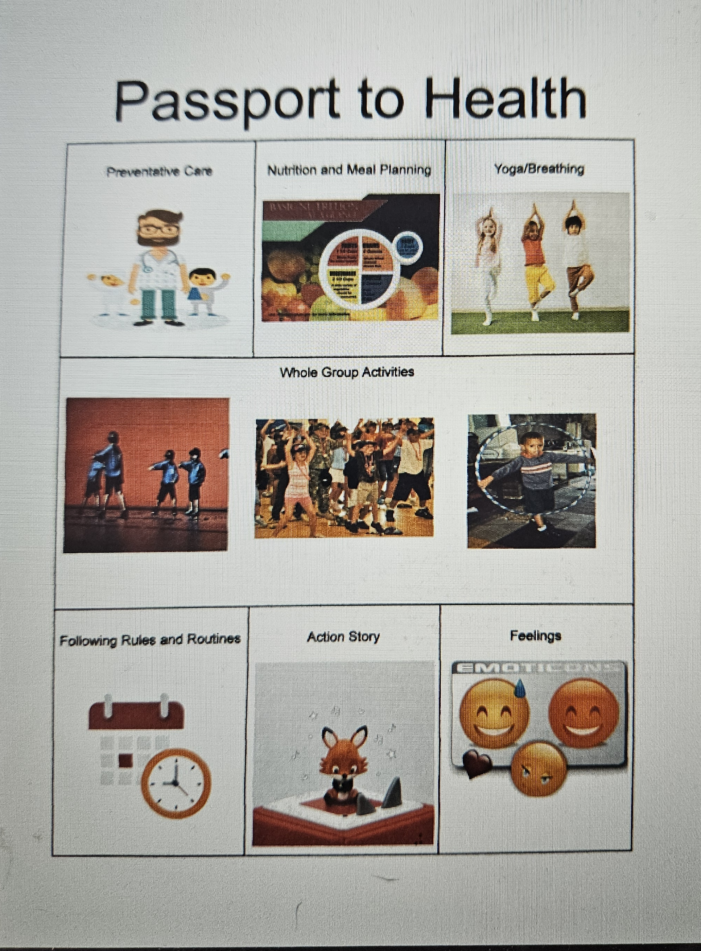
In person Event – Bridgeville Library - 6:00- 7:00
Children, Parents/Caregivers, Child Care Providers
Schedule
Check-in/Passports/Gross Motor Activities
Group Activity- Movement Activities
6 Learning Stations- Passport/Take Home Material Instructions
Closing and Check Out- Surveys and Take-home Bags
Healthy Kids Healthy Future Project
Station 1 | Preventative Care Station- Activity and Resources with preventative care information including a game with the child’s journey to the doctors office for their well visit.
Station 2 | Nutrition- Planning a menu (Meal Template) Fake Food
Station 3 | Yoga/Breathing/ Meditation- Yoga Mats and Posing Cards
Station 4 | Routine sequence daily schedule (Things to do before bed, how to get ready for your day)
Station 5 | Book with Movement Activity (Head to Toe))
Station 6 | Feelings- Happy Sad Cards, Emoji Ball. Movements related to feelings

Slide 9
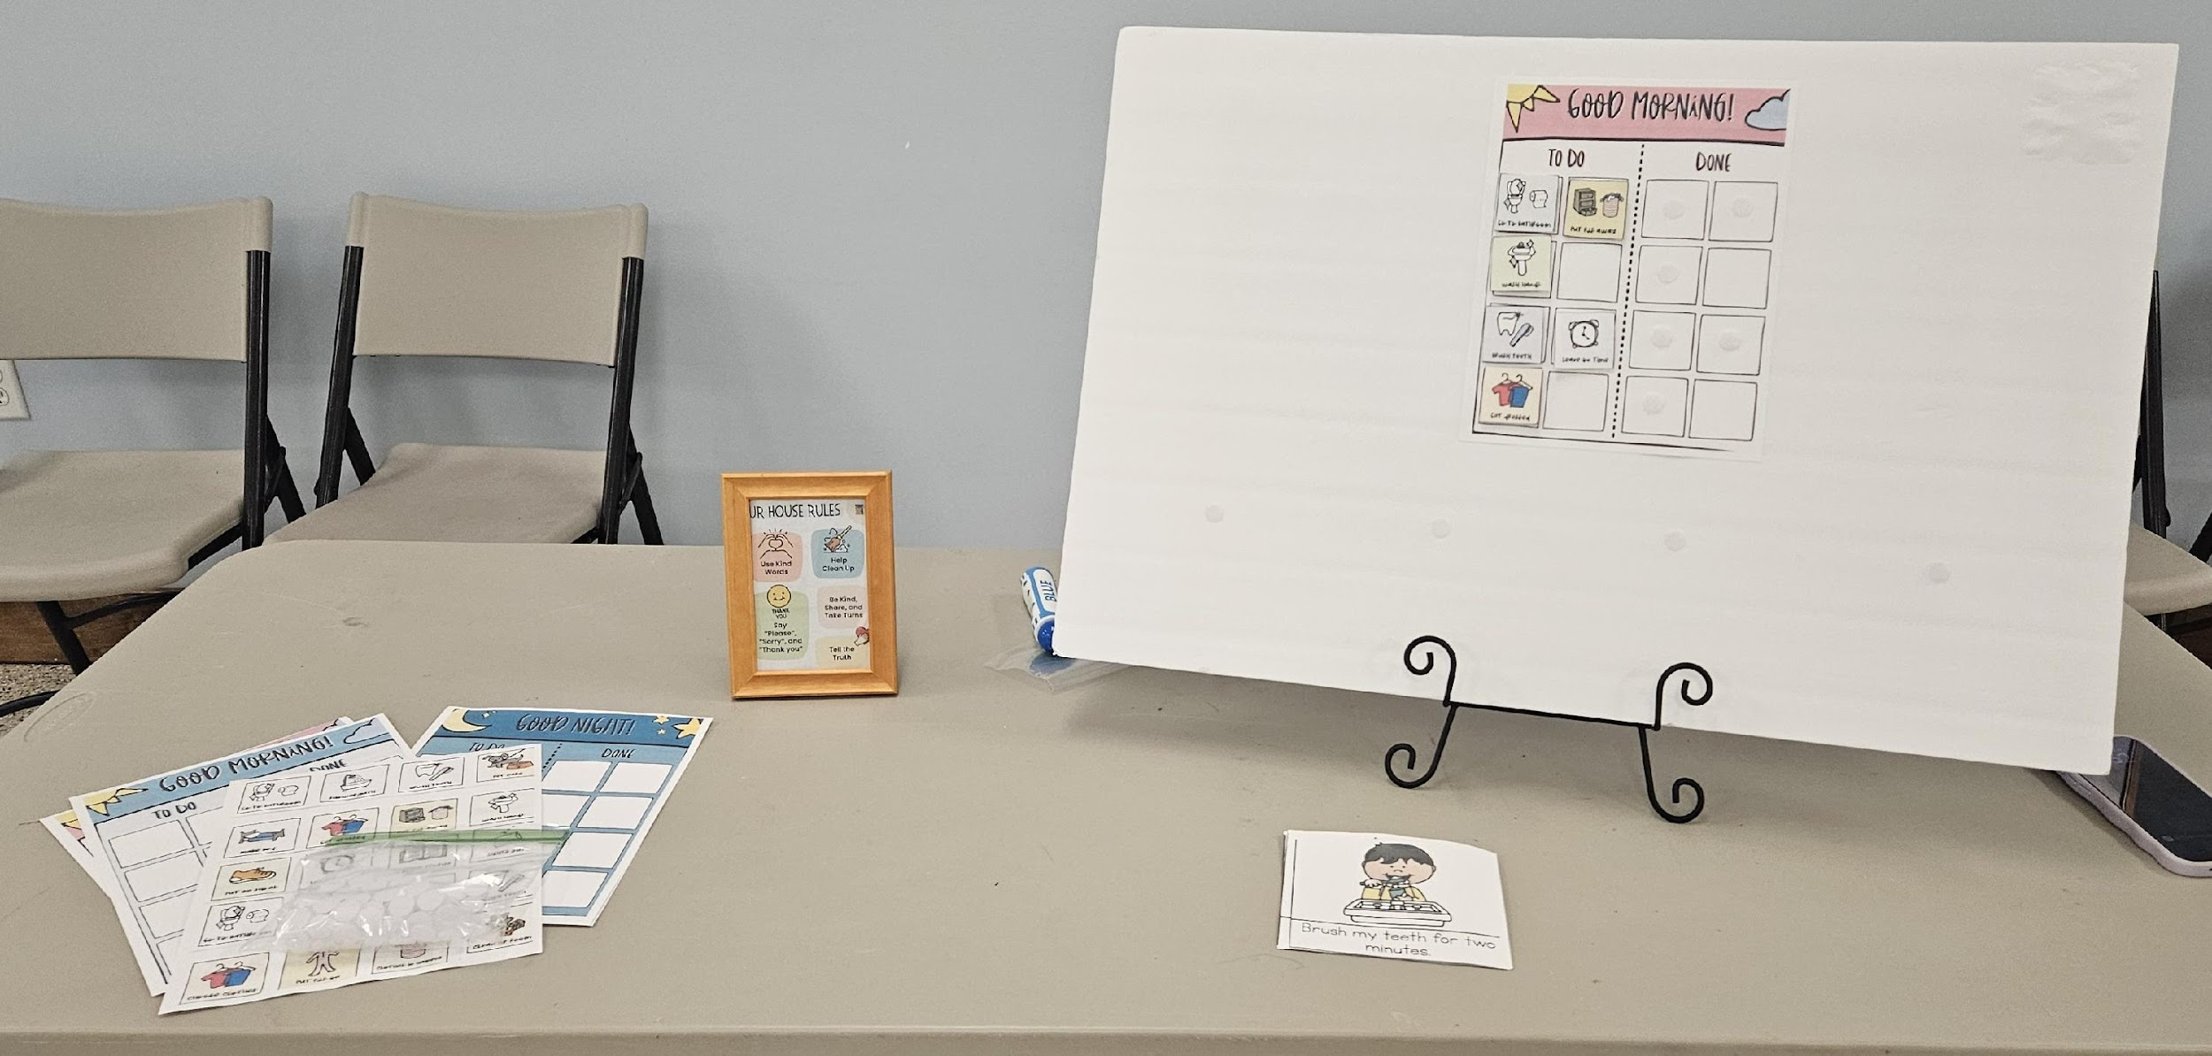
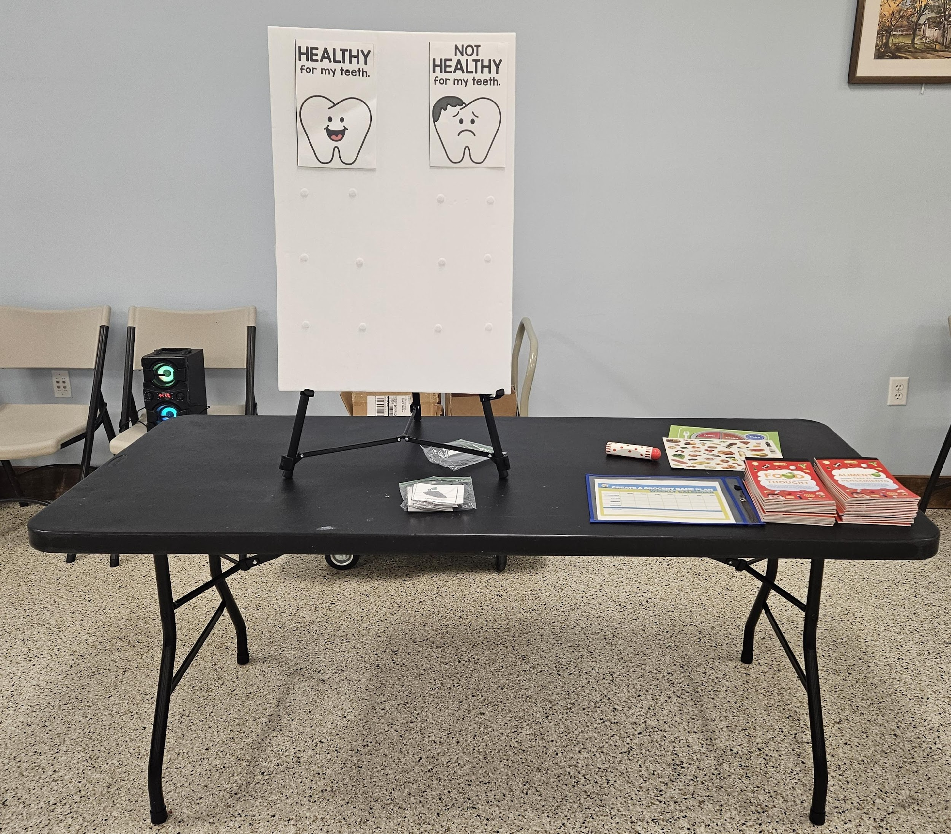
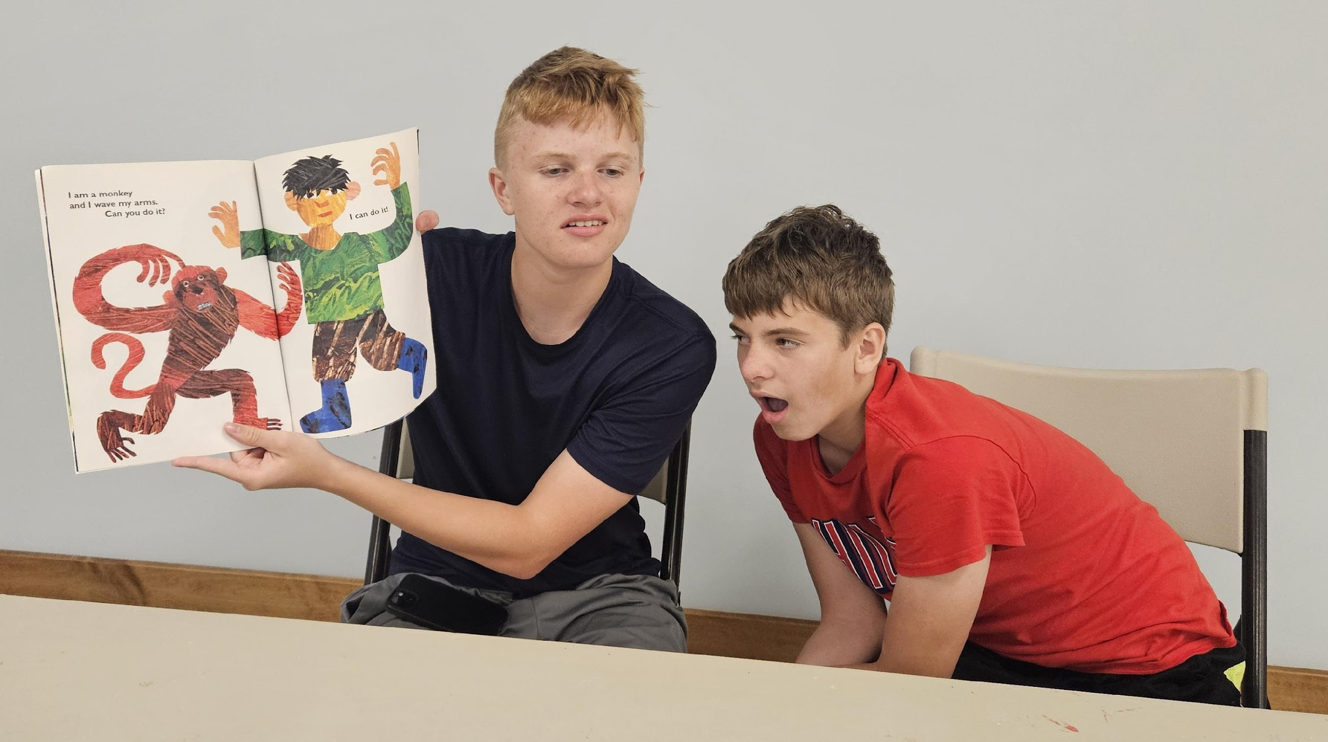
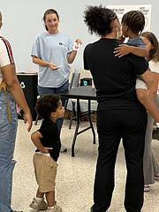
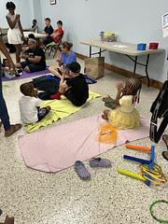
Healthy Kids Healthy Future Project
  Outcomes and Next Steps
    Event Survey Results
    Follow up Meeting with EC Providers
    Session Recordings
    Family Follow-up Email
    Ongoing Engagement with Community Partners
    Recommendations on Future Topics.
    Sharing with the Early Childhood Community

Slide 10
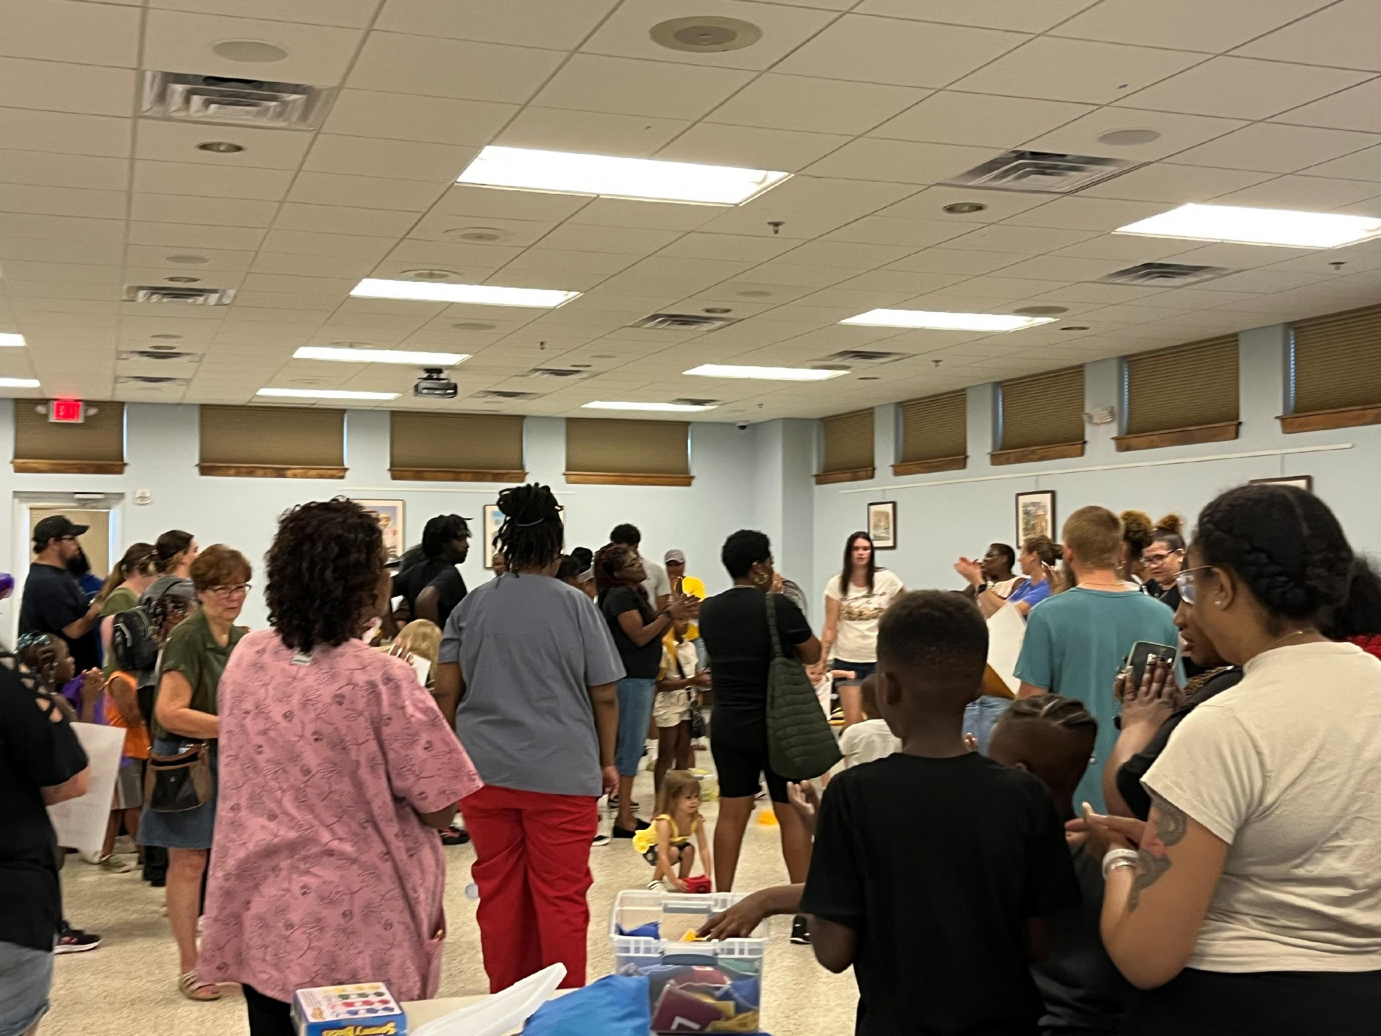
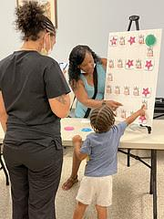
Healthy Kids Training- Family Feedback
100% Participation in the Family Survey
“This was a great event for me and my child. It was great to see the other side of what is implemented in child care facilities. I didn’t know they had so many rules to follow.”
“Fun and informative”
“Great activity stations”
“We can’t wait to try these activities at home.”
100% of families said they would use 2 or more of the activities they participated in.
List 2 things you will put into practice.
Routines | 43
Nutrition | 41
Preventive Care | 40
Books with Movement | 40
Group Movement Activities | 39
Feelings | 39
Yoga/Breathing | 36
Screentime | 12

Slide 11
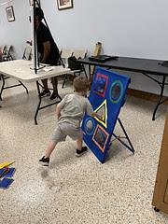
Healthy Kids Training- Child Care Provider Feedback
100% Participation in the Child Care Provider Survey
Positive Parent Engagement
10 out of 10 for this event
Nice to have parents and children involved
Registration table was helpful
Great activities
Participants were engaged and having a good time
Follow up materials were helpful (materials, quick recipes)
The timing of each session was perfect.
Suggestions- microphone to help with transitions, activities for older kids
Additional topics- challenging behaviors, manners, tantrums
Learned a lot- the 6 learning stations were great and the group activity
Want to know what’s next and can we do this again.
Professional- helped me meet the needs – appreciate all the information
Nice to have parents involved and a great opportunity for them to interact with other families.
100% of child care providers said they would use 2 or more of the activities in their program.

Slide 12
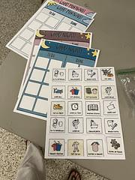
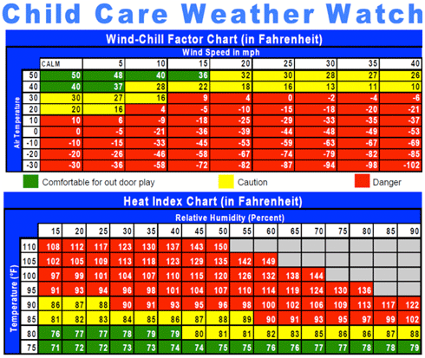
Healthy Kids Training Pilot
EC Provider Bags
Dice
Dry erase marker
Menu in wipe off pouch
Frisbee
Yoga cards
Healthy/not healthy food activity
My plate and stickers
Food groups activity
Emotions game
2 breathing activity cards
Nutrition activity book
Topics you would like to get additional information about
Routines- 6
Routines for various ages- 2
Healthy Foods= 2
Challenging Behaviors- 3
Potty Training- 1
Milestones- 1
Parenting- 1
Toddler Development- 2
Breathing Yoga- 21
Feelings-6
Preventative Care- 12
Family Bags
Menu in wipe off pouch
Dry erase marker
Frisbee
Breathing activity card
My plate and stickers
Yoga poses poster
Nutrition activity book
Morning and evening activity charts with Velcro stickers
Ongoing Collaboration with Community Partners
Sharing Project Information at the Readiness Team Meeting and Delaware Early Childhood Council Meeting

Slide 13

Questions & Thank You!

