Slide 1

Advancing Healthy Lifestyles Conference

Slide 2


About Me:
Over 17 years of experience in the field of nutrition in both community and clinical settings.
Clinically, specialized in pediatric endocrinology and adult metabolic health.
Public health nutrition and has created and implemented several nutrition education programs in a variety of settings, including: farmers’ markets, corner stores, grocery stores, senior centers and food pantries, including co-authoring Heart Smarts, which is an evidenced-based curriculum written for small retail settings.
Oversee The Food Trust’s local, regional, and national community nutrition programming which includes Cooking Matters, Heart Smarts, Healthy Corner Store Initiative and Inside Out (Reentry and Recovery) programming.
Professor of Nutrition for over 6 years at Camden County College.

Slide 3
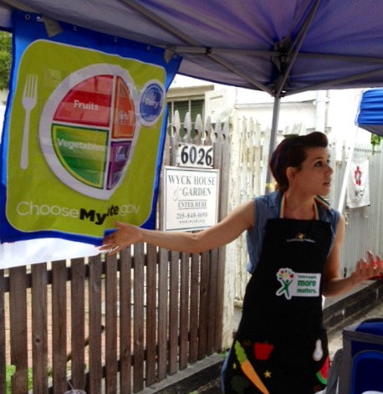
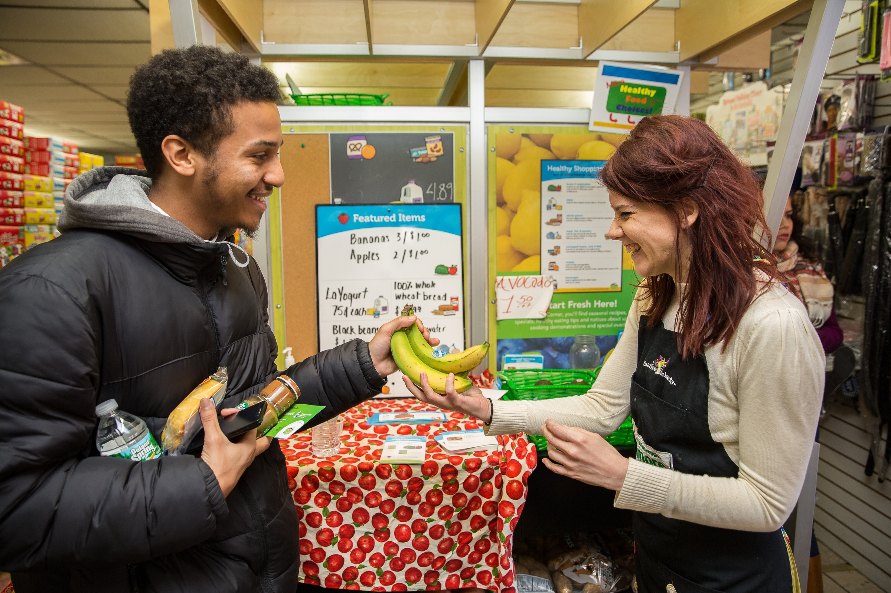
Through the years

Slide 4
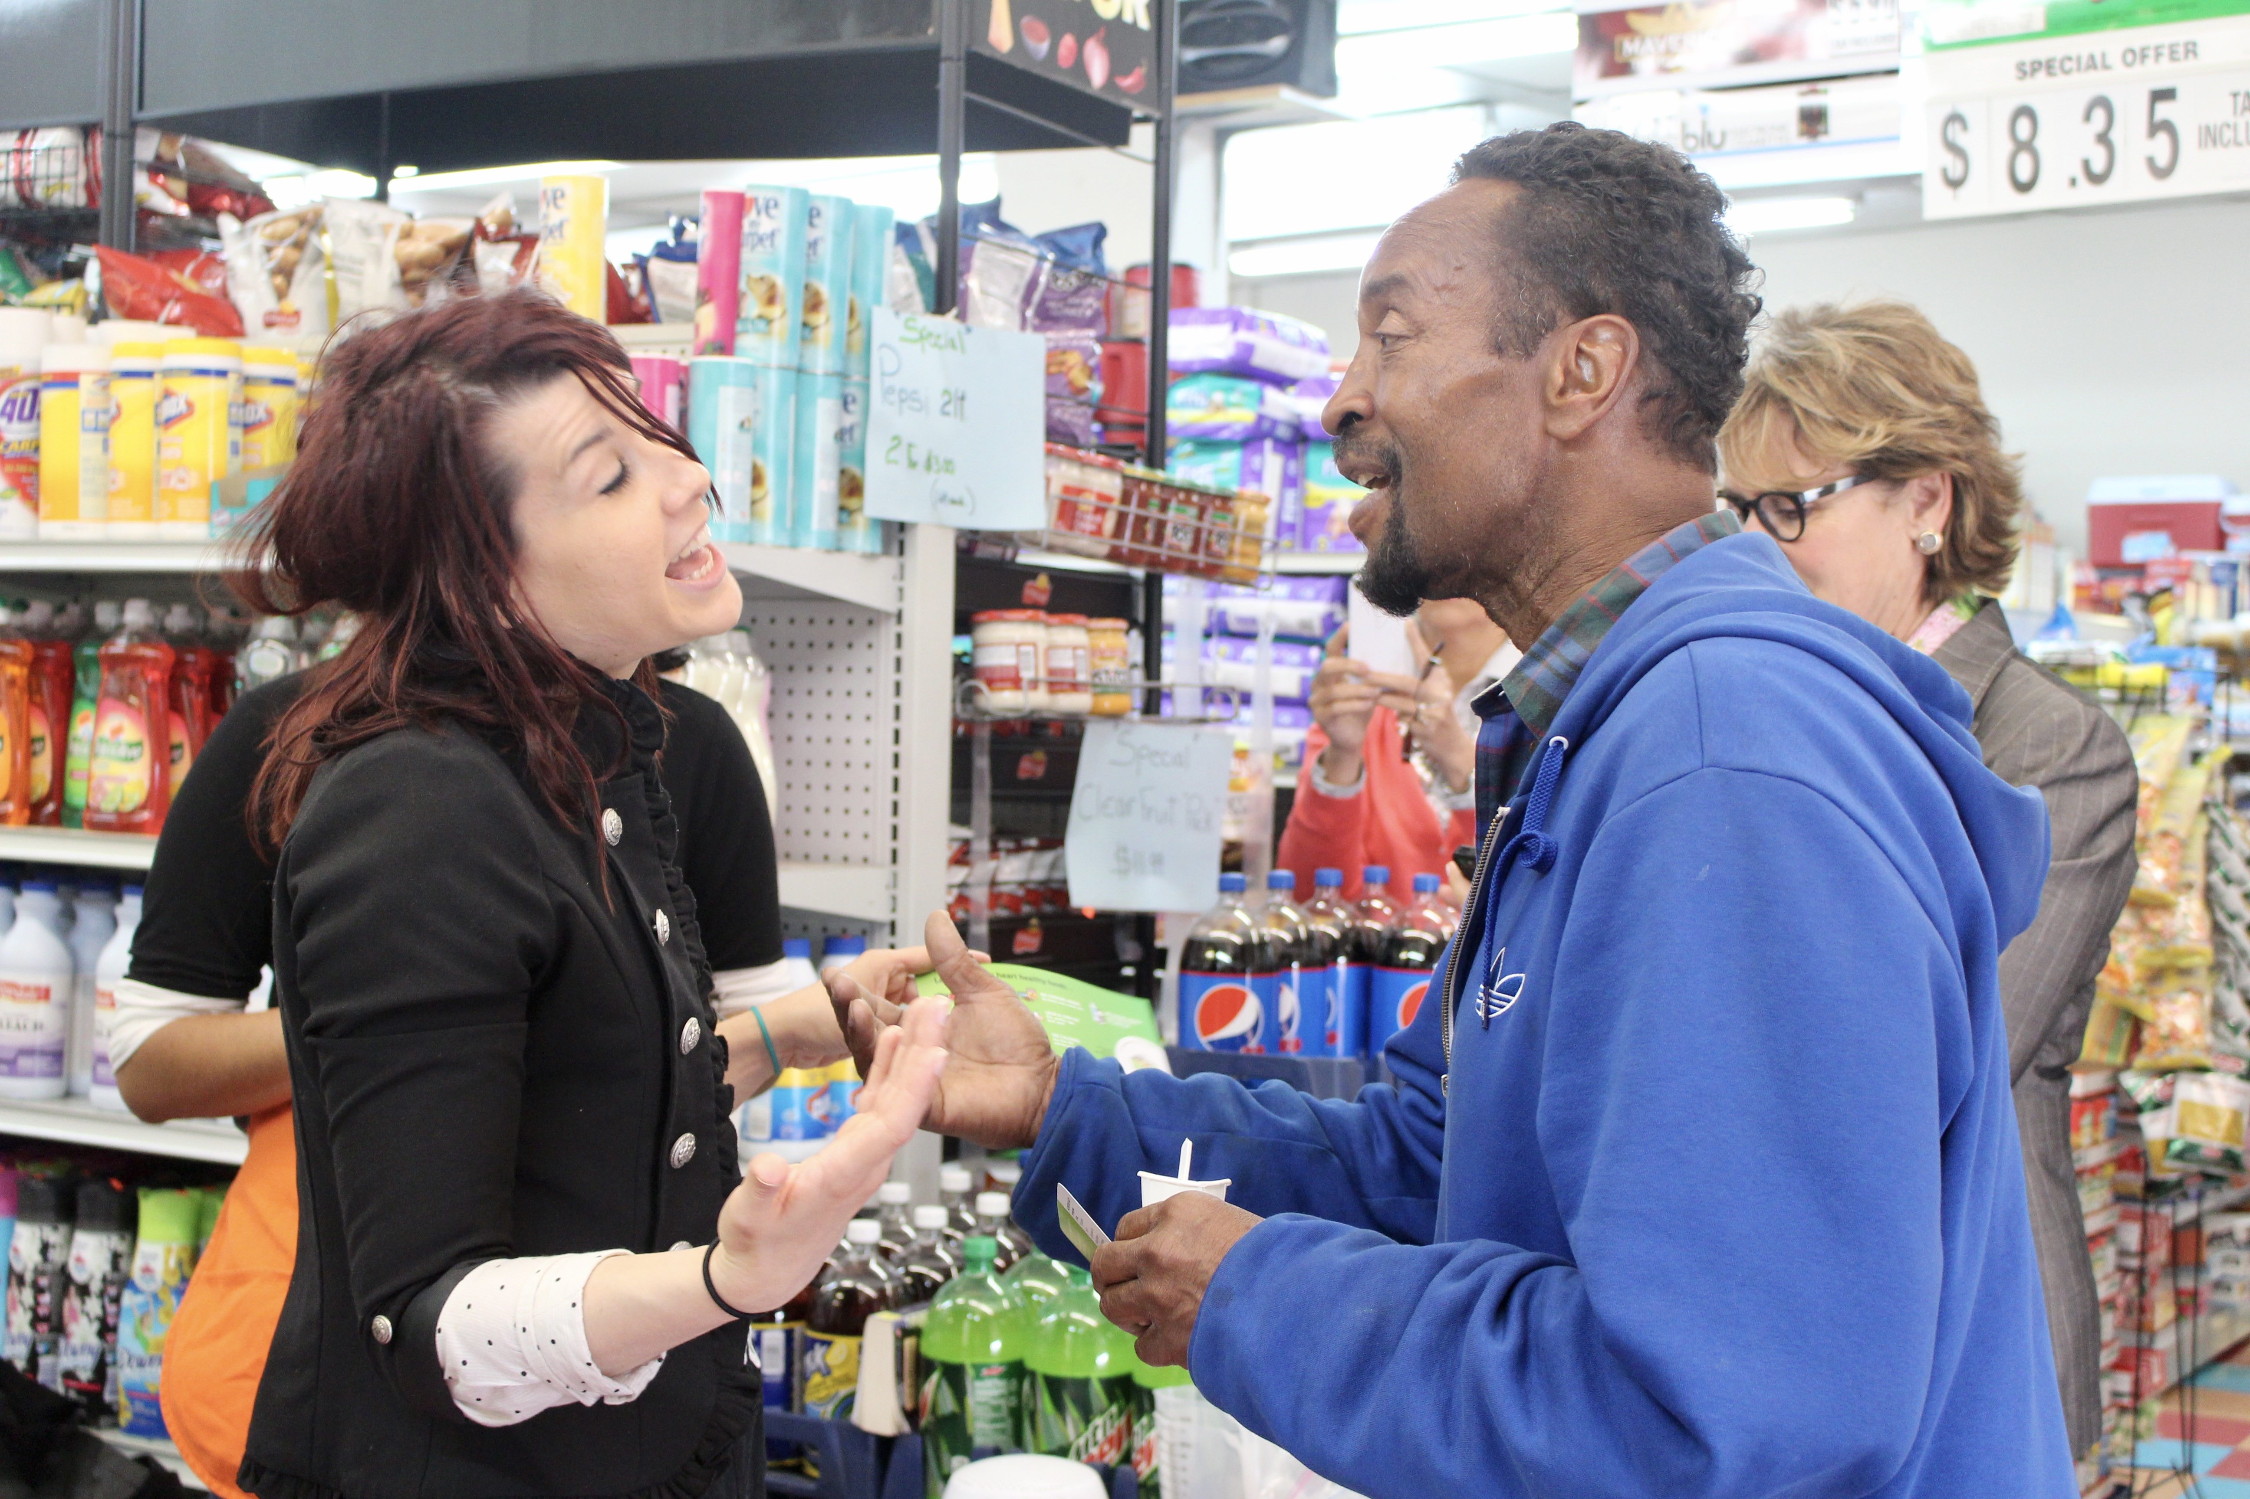
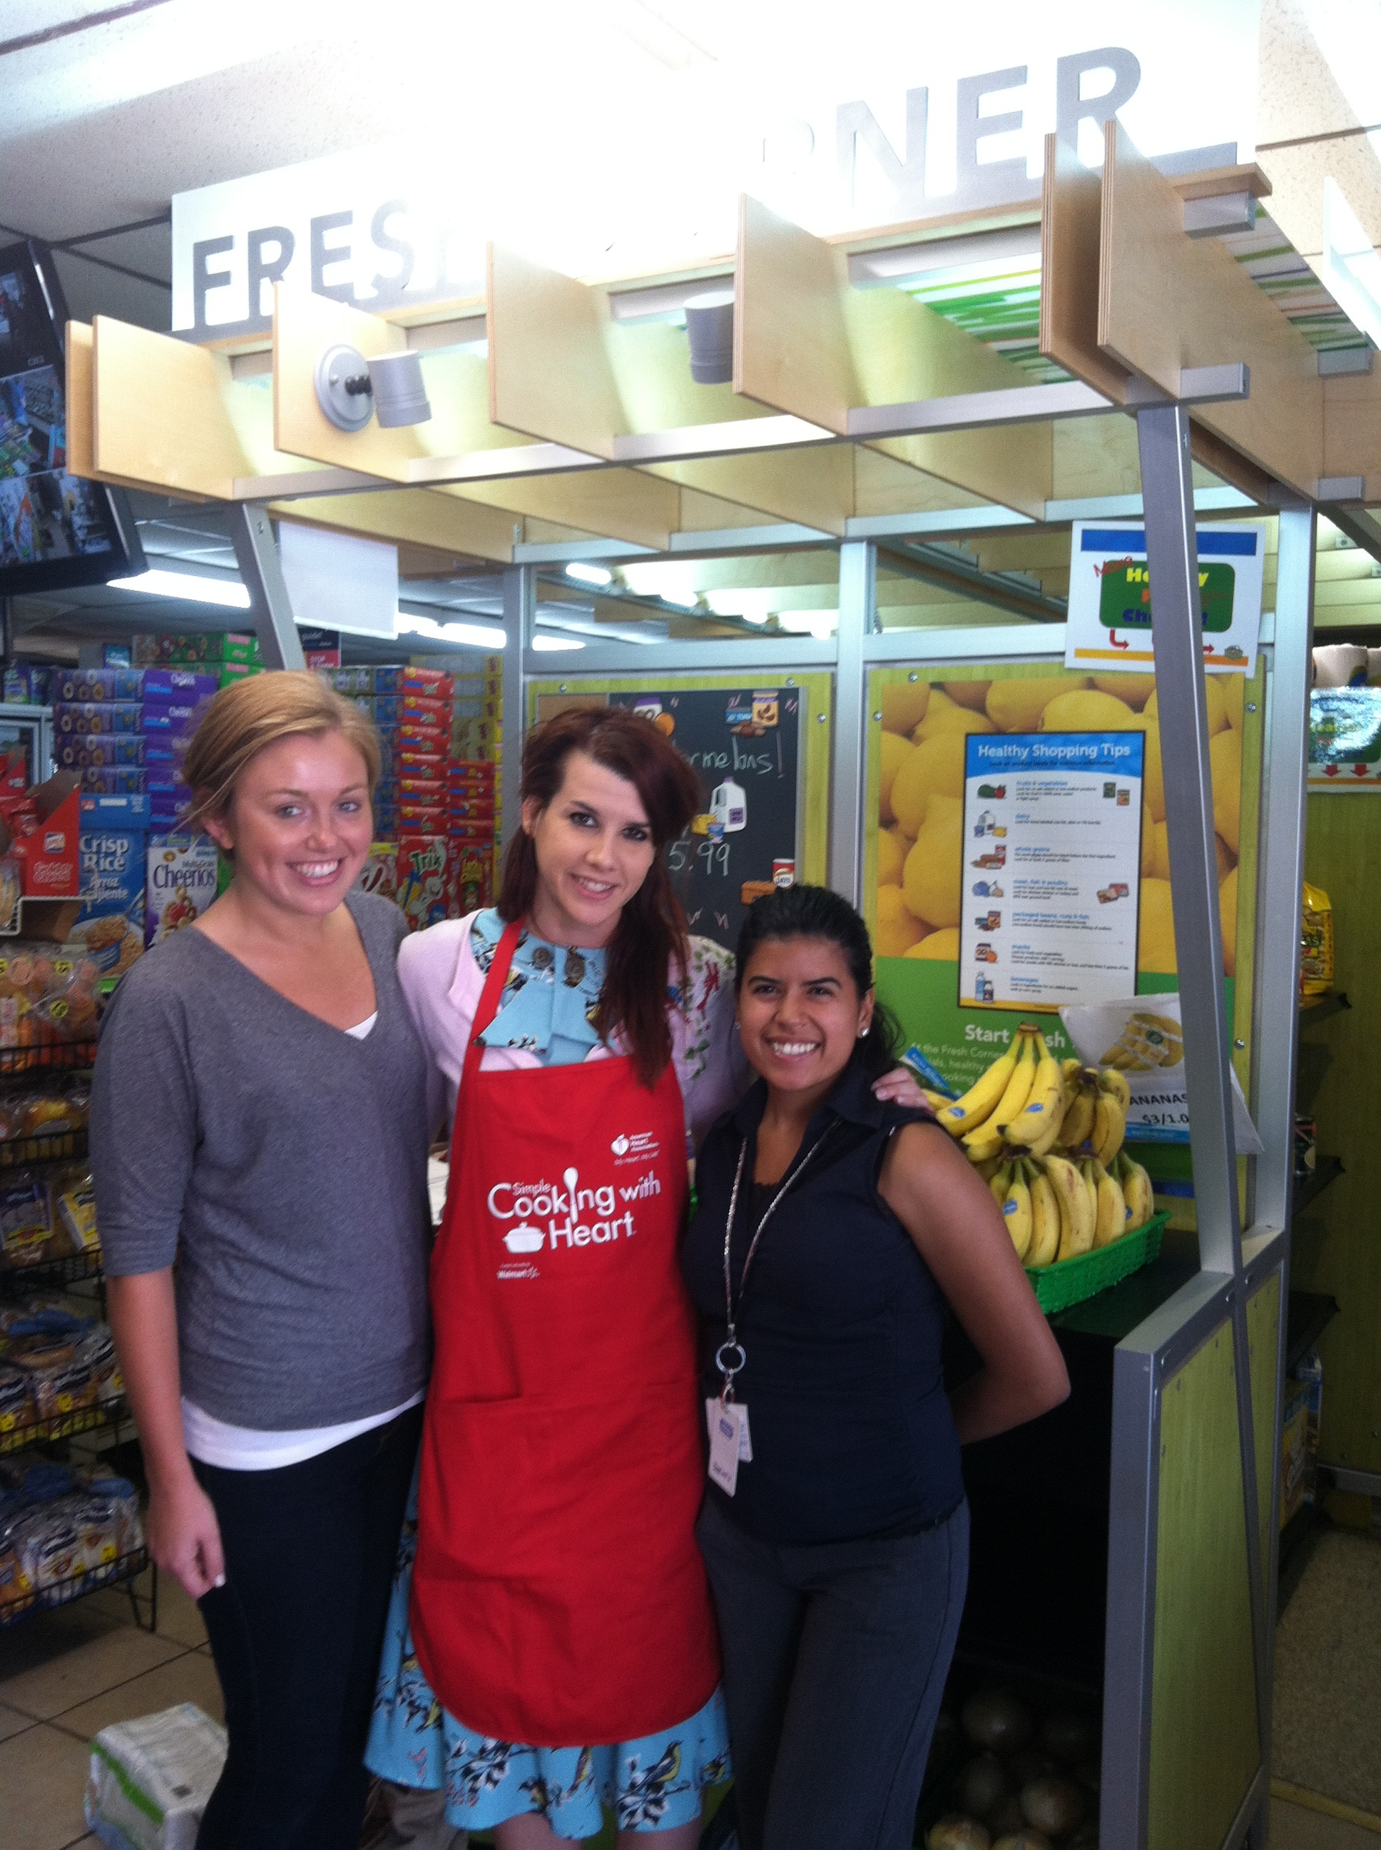
Through the years

Slide 5
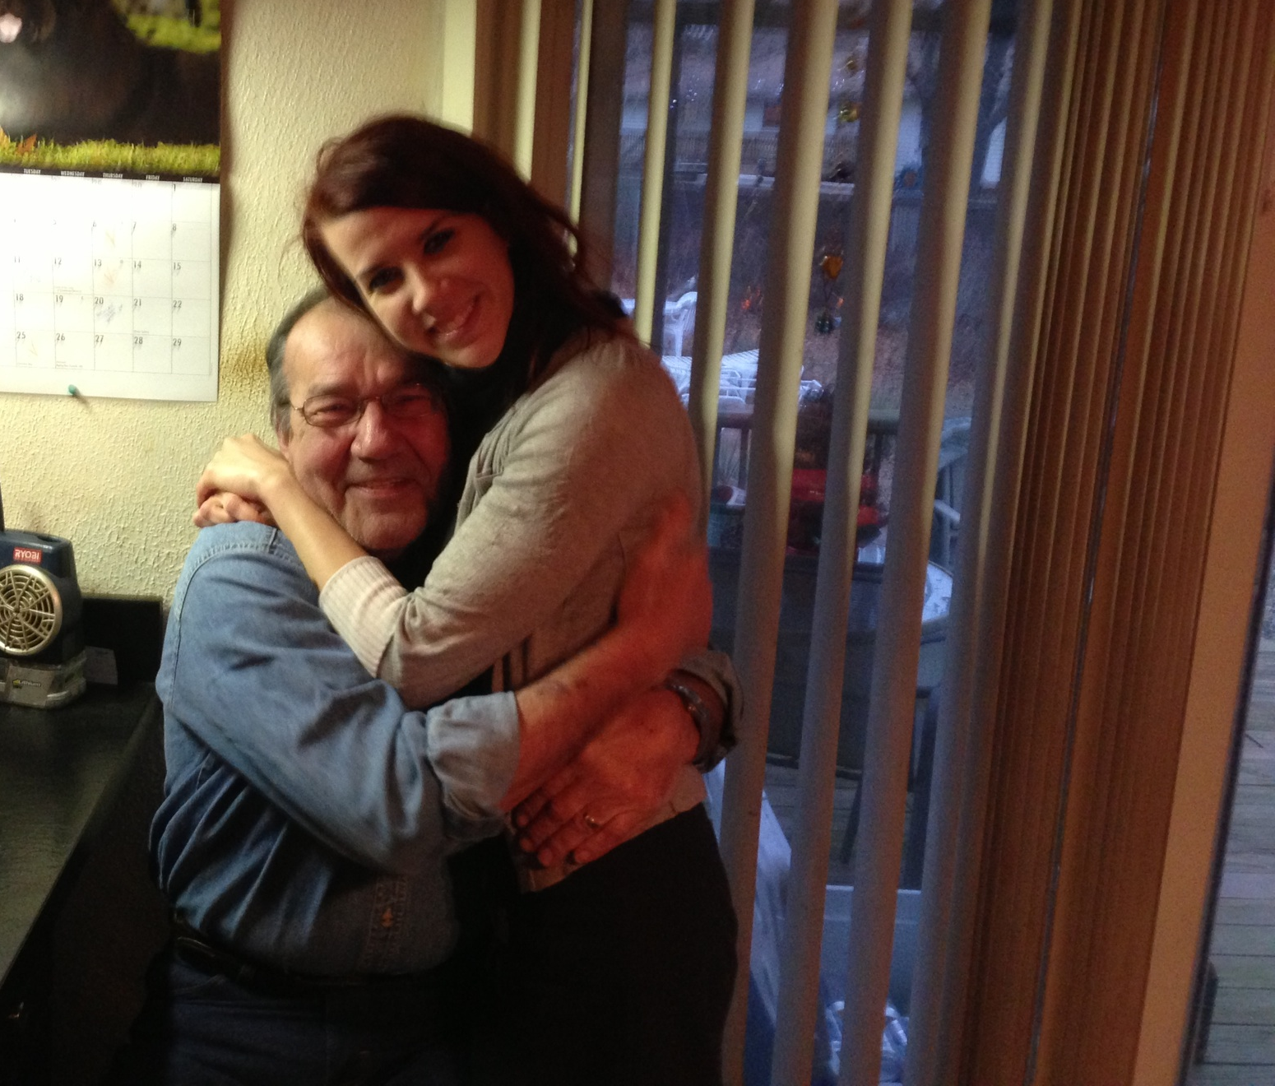
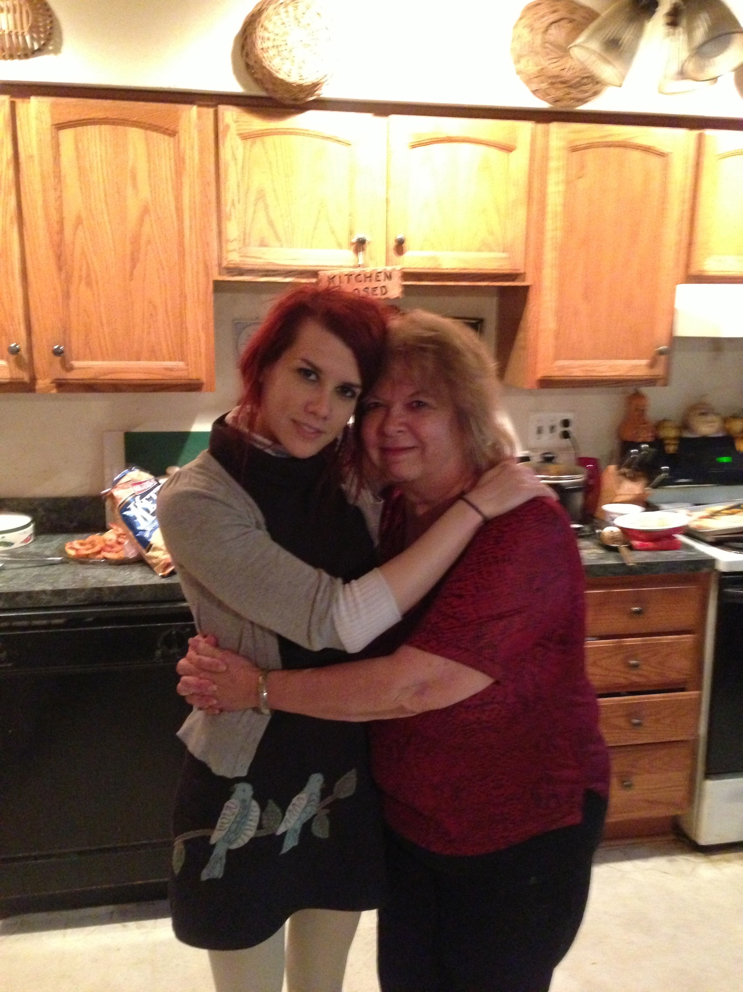
The reason I landed where I did:
Steve, Rita & my disappointment in nutrition within the medical system:

Slide 6
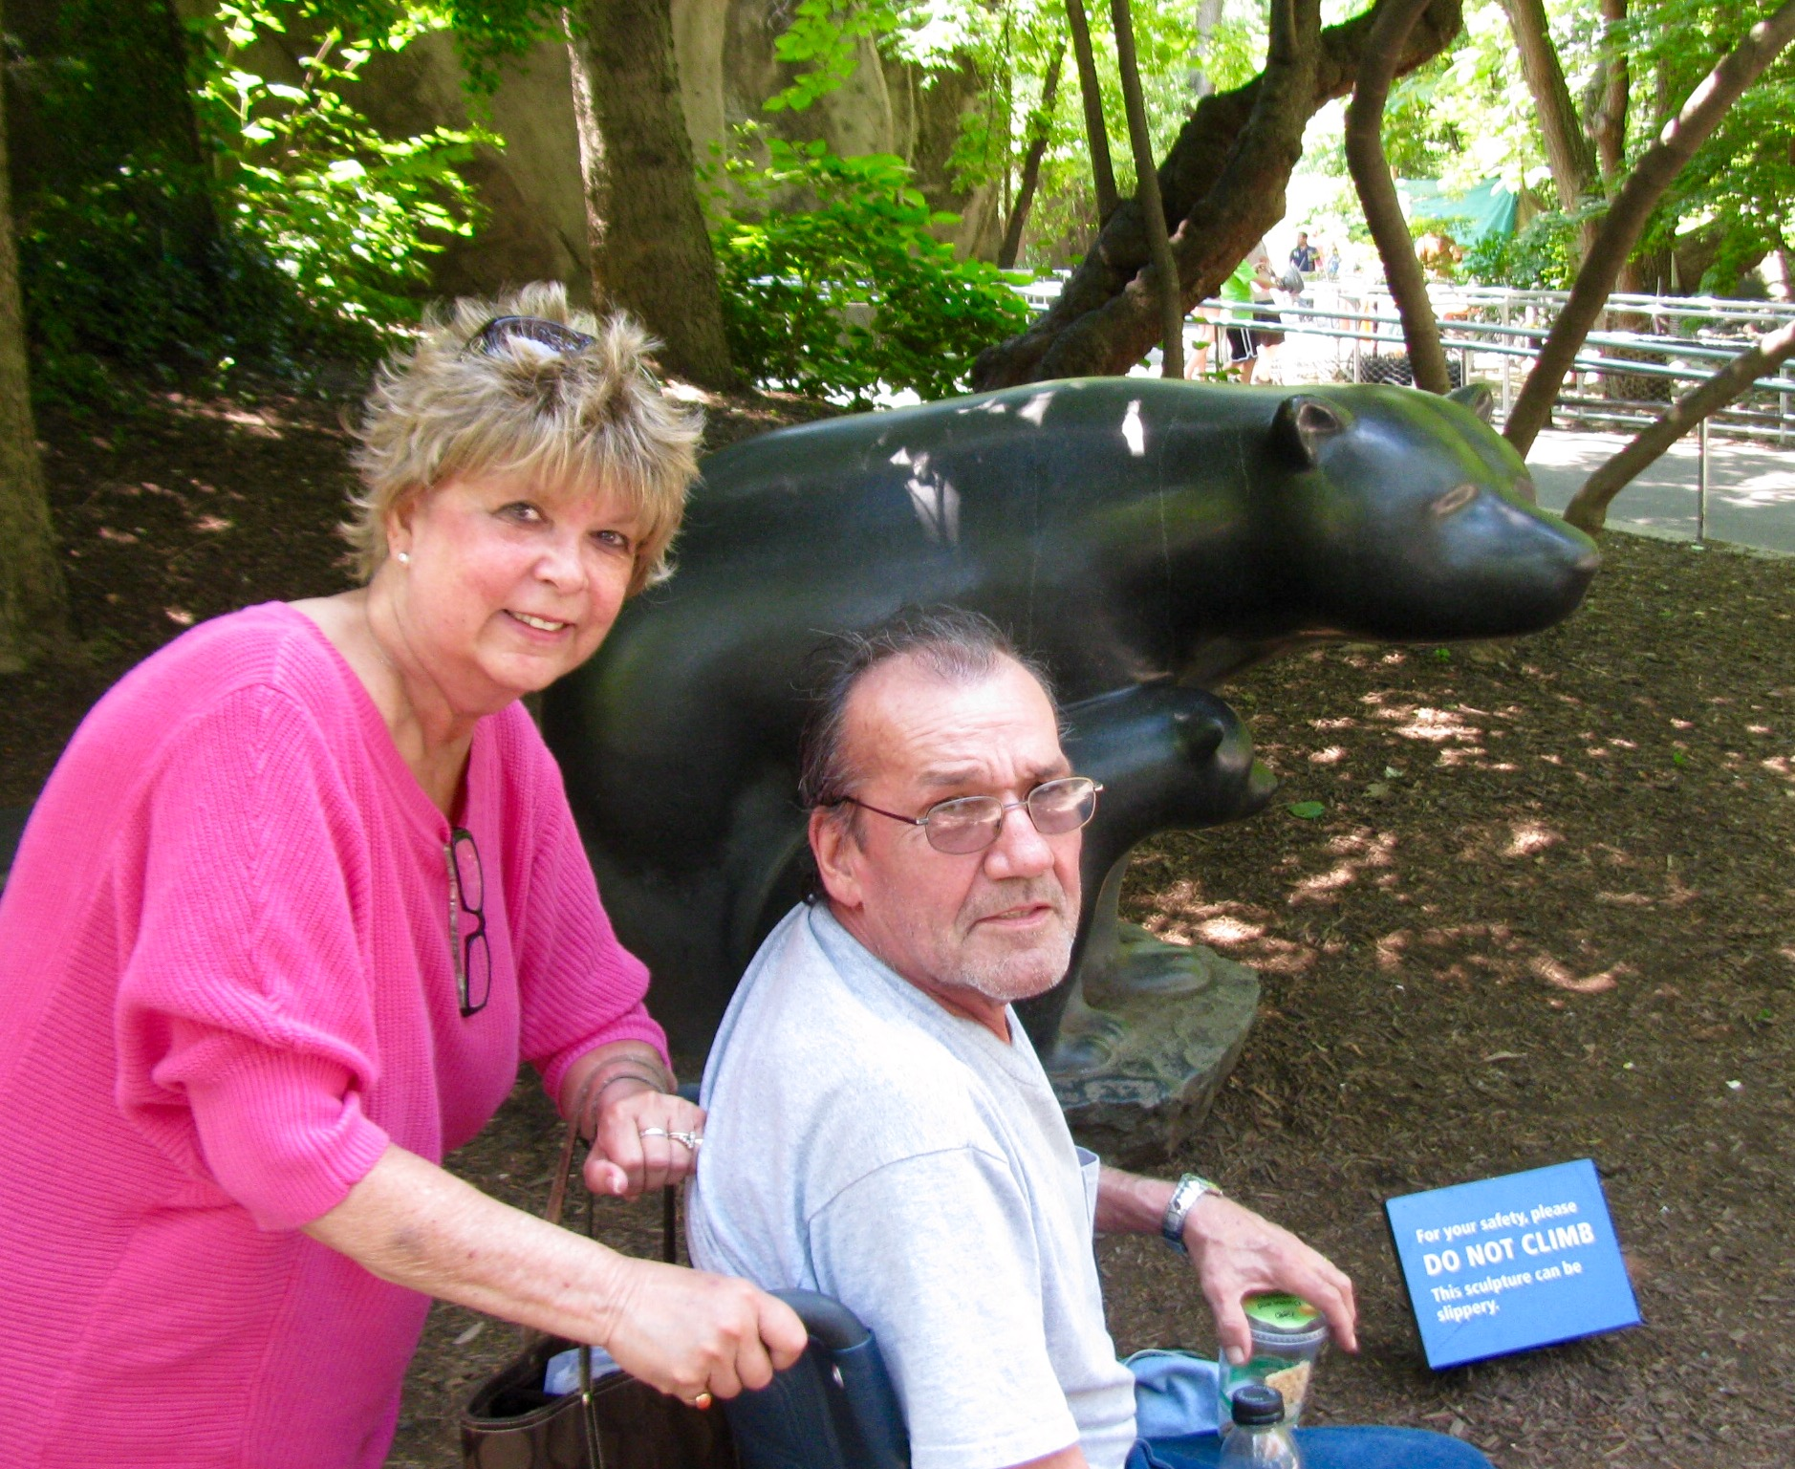
The reason I landed where I did:
Steve:
My dad had his first heart attack in 2003, when I was in high school. Even as a high school student, I didn’t understand why they were doing nutrition education on heart health while he was still in the ICU.
He ate fruits, vegetables, whole grains, lean proteins and exercised more than anyone I ever met.
He started smoking at 11. There was just a trigger in the system, because he had coronary artery disease, and he had to listen to the most boring lecture on fats imaginable.

Slide 7
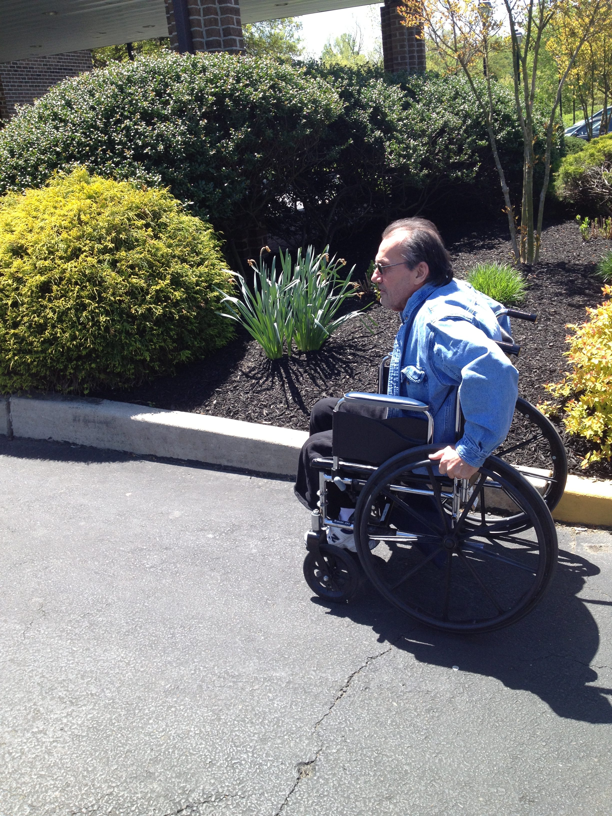
The reason I landed where I did:
Steve:
In 2013, he had an injury at work that became infected. In the ER, the lab work which showed a sodium level of 103. Same thing. Diagnosis of peripheral artery disease so automatic low-sodium diet with a nutrition consult, while in the ICU, for “heart health” education.
He stopped eating after he had a below-the-knee amputation because the food tasted awful. They wouldn’t allow sodium packets, but gave him sodium pills.
They got angry at me for bringing him his favorite foods that were higher sodium.

Slide 8
The reason I landed where I did:
Rita:
  My mom was diagnosed with Stage 1 or 3 Cancer in 2009. The stage depended on the doctor she spoke to. She had surgery and made the decision, after an allergic reaction, to not do chemotherapy.
  By 2013 it was everywhere. By 2015, she had lost about 100#. There was no nutrition guidance, recommendations or support from anyone except me.
  When she was being transitioned to hospice care, I brought her a Big Mac, her favorite food. The nurse tried to take it away from me because she was on a texture adjusted diet due to swallowing issues. I gave it to her anyway. She died about a week later.
  These experiences made me realize that I am not a clinical dietitian.
  They forgot my parents were people.

Slide 9
The Food Trust

Slide 10

Our mission:
Delicious,
Nutritious
Food for All

Slide 11




CORE PROGRAMMING ELEMENTS
Supporting Community Health Through a Holistic Approach
Access
Affordability
Education
Advocacy

Slide 12
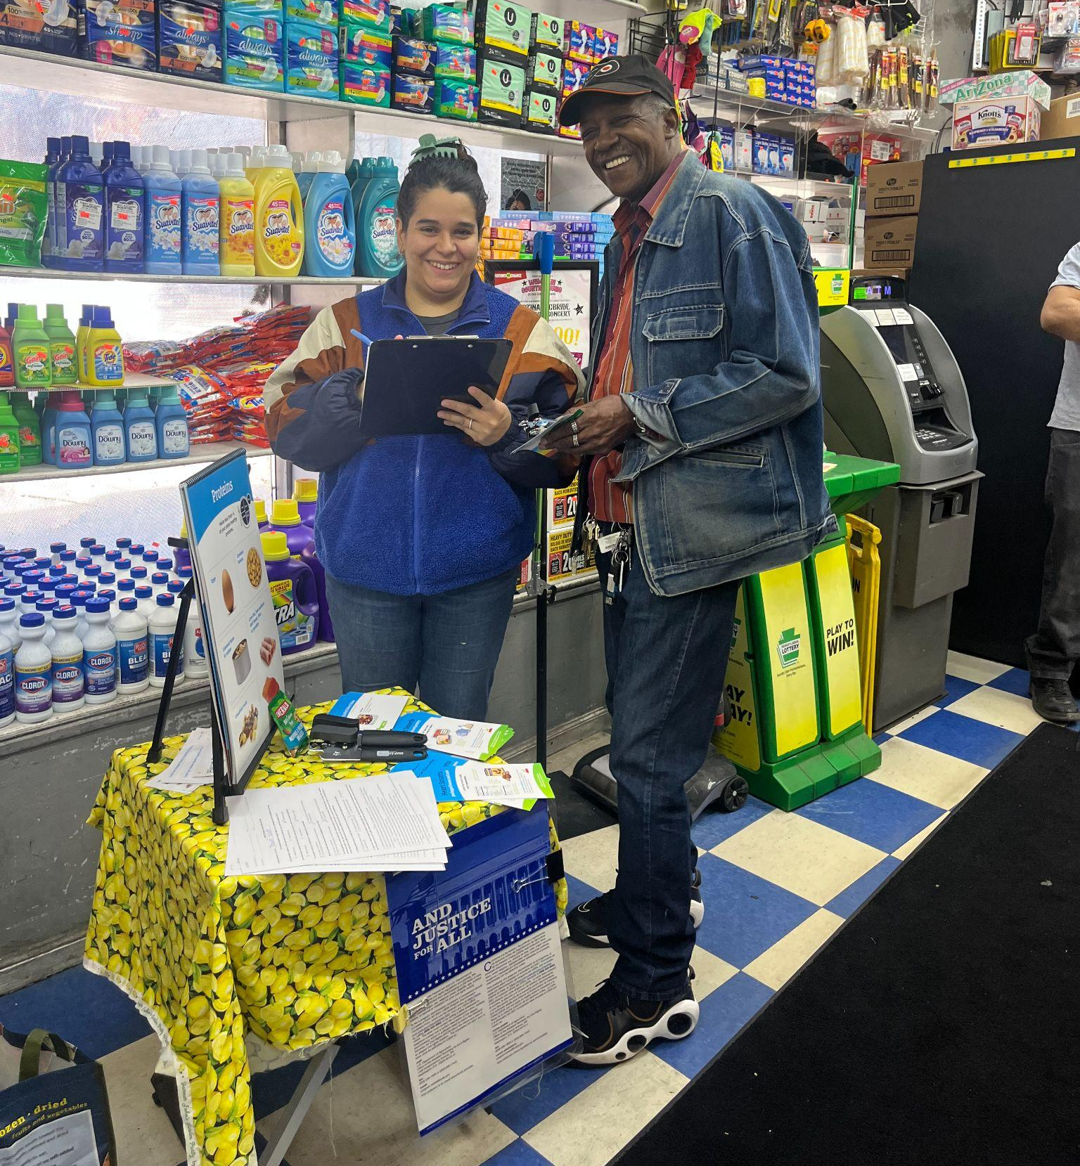
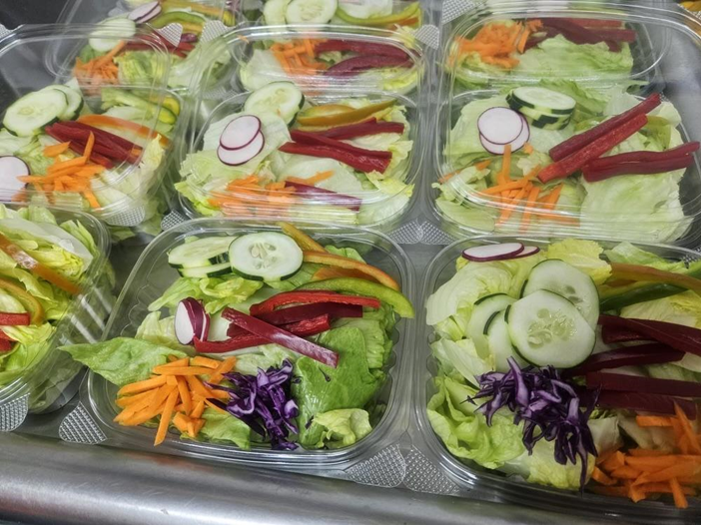
Healthy Food Access:
Corner Stores
  Store owner trainings focused on sourcing, marketing, merchandising- Over 250 stores in 2025
  Provide equipment to increase healthy food options: produce racks, refrigerators, shelving, blenders
  Install marketing materials: price tags, signage, shelf talkers, murals, window clings
  Nutrition education and store tours (Heart Smarts)
  Distribute incentives for heart healthy items (Heart Bucks)- Over $100,000 in 2025
  Partnerships: health screenings and resource sharing

Slide 13
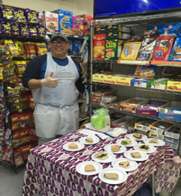
Healthy Food Access:
Corner Stores
Why small stores?
Small businesses, including corner stores are the economic engine of many communities. However, there are individual, structural and systemic challenges that they may face:
  Infrastructure limitations
  Language & technology barriers
  Lack of time/skills
  Supplier & retailer gaps

Slide 14
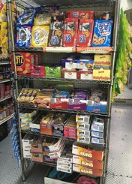
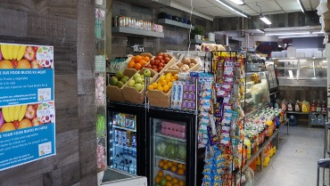
What it looks like
BEFORE
AFTER

Slide 15
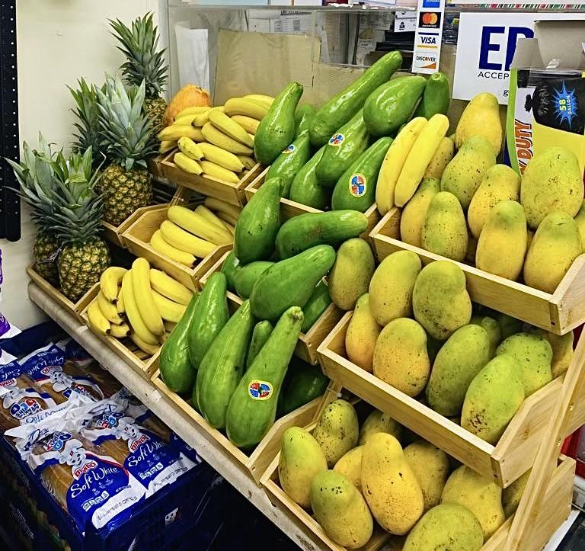

What it looks like

Slide 16
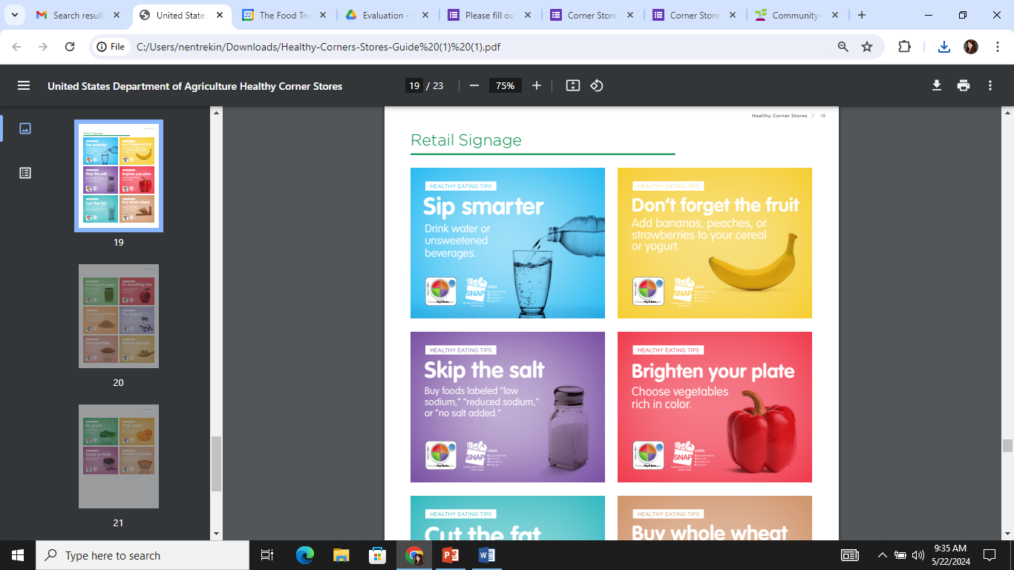
Marketing Materials

Slide 17
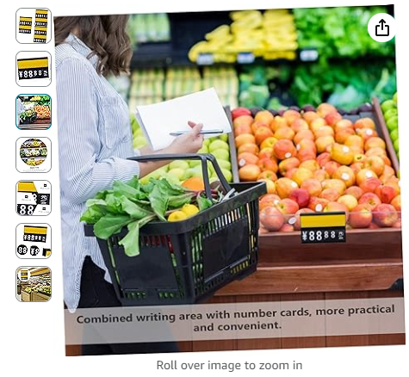

Price Tags

Slide 18
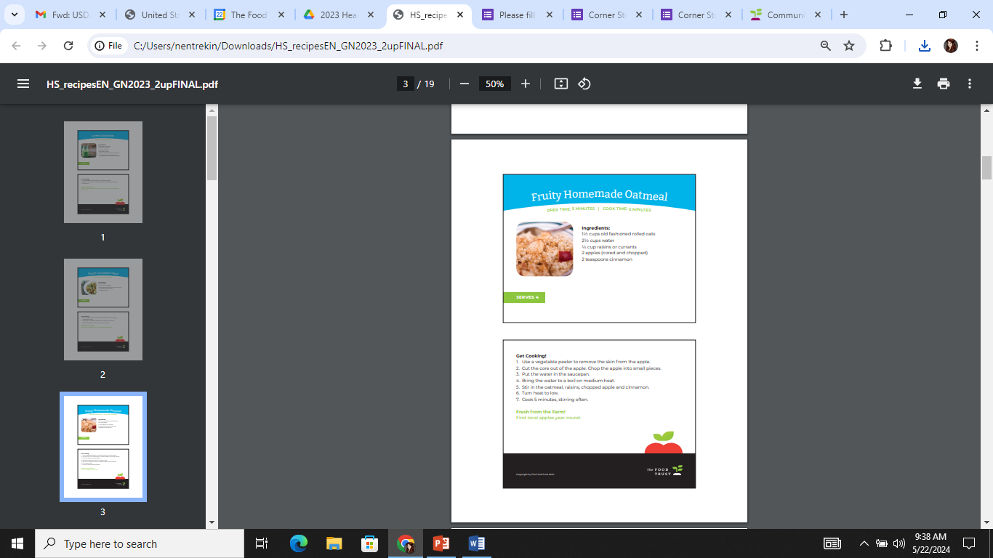
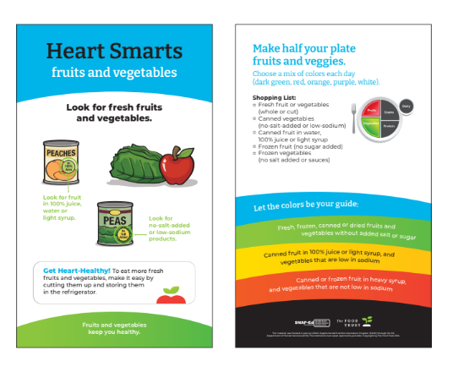
Lesson Handouts

Slide 19
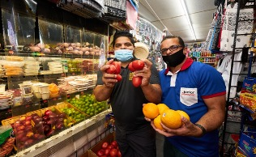
In their own words
“Our relationship with TFT is like we are a family. In these hard times, they have helped us, understanding the laws that we don’t have time to stay up to date on.”

Slide 20
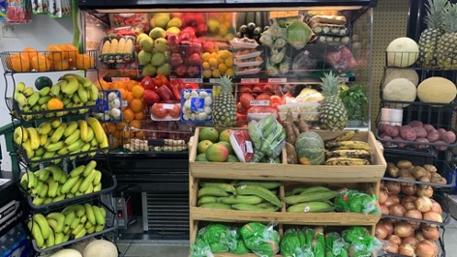
What customers are saying
"I send all my friends to come to my corner store. There is such a variety of produce now and I really like how he promotes healthy eating. I can go to the grocery store for WIC but I come here. I like his selection and I don’t feel rushed. They are such nice people I call them my family.“

Slide 21
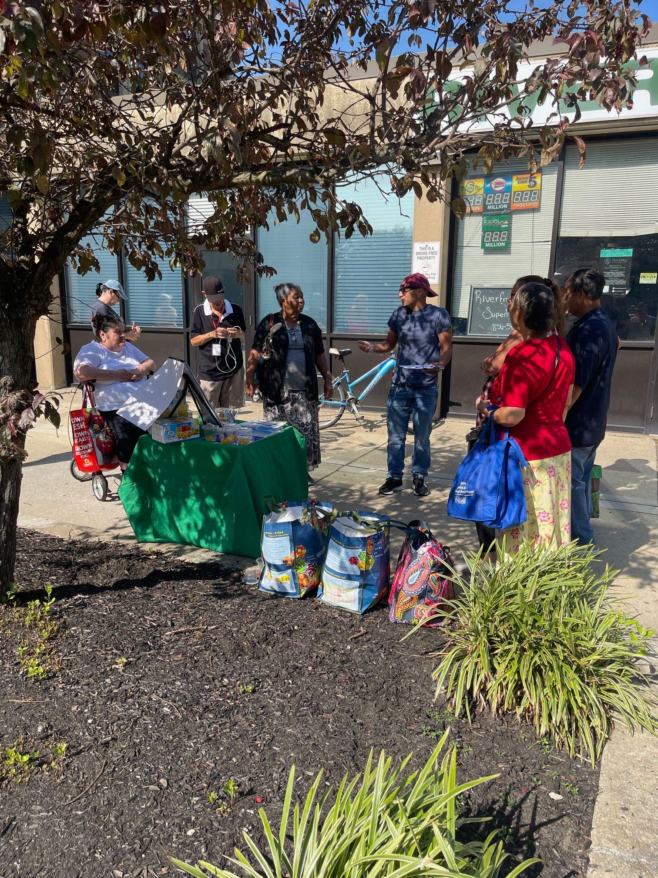
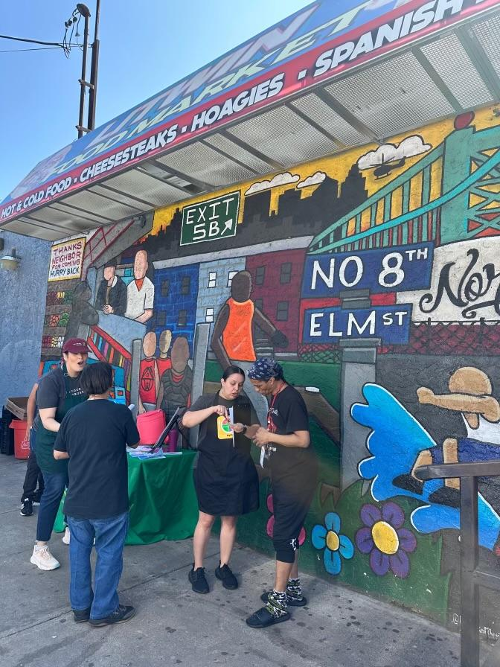
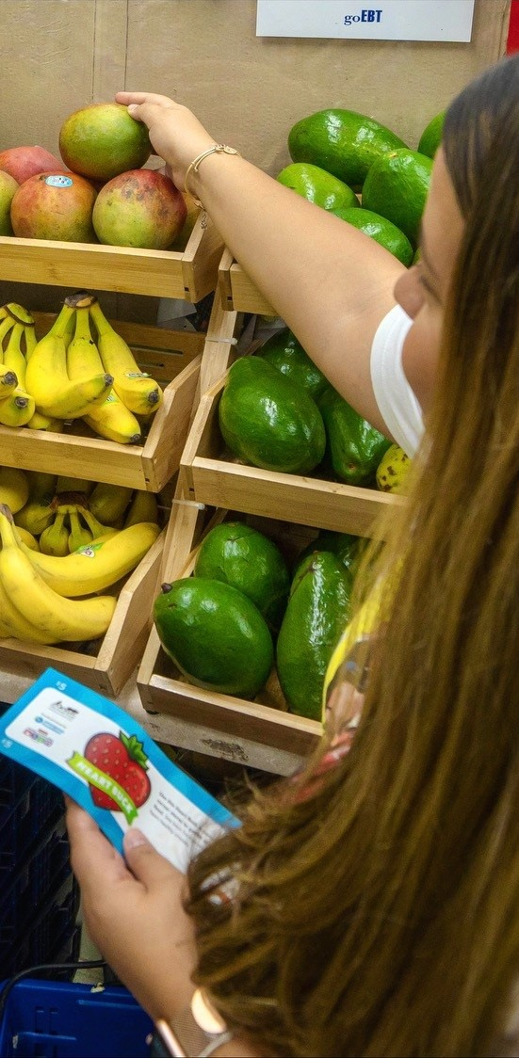

Slide 22
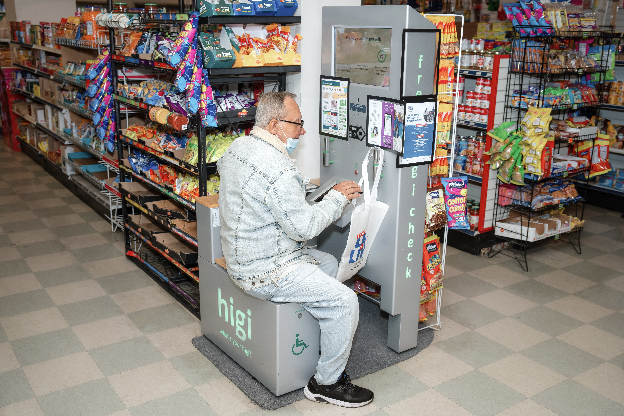
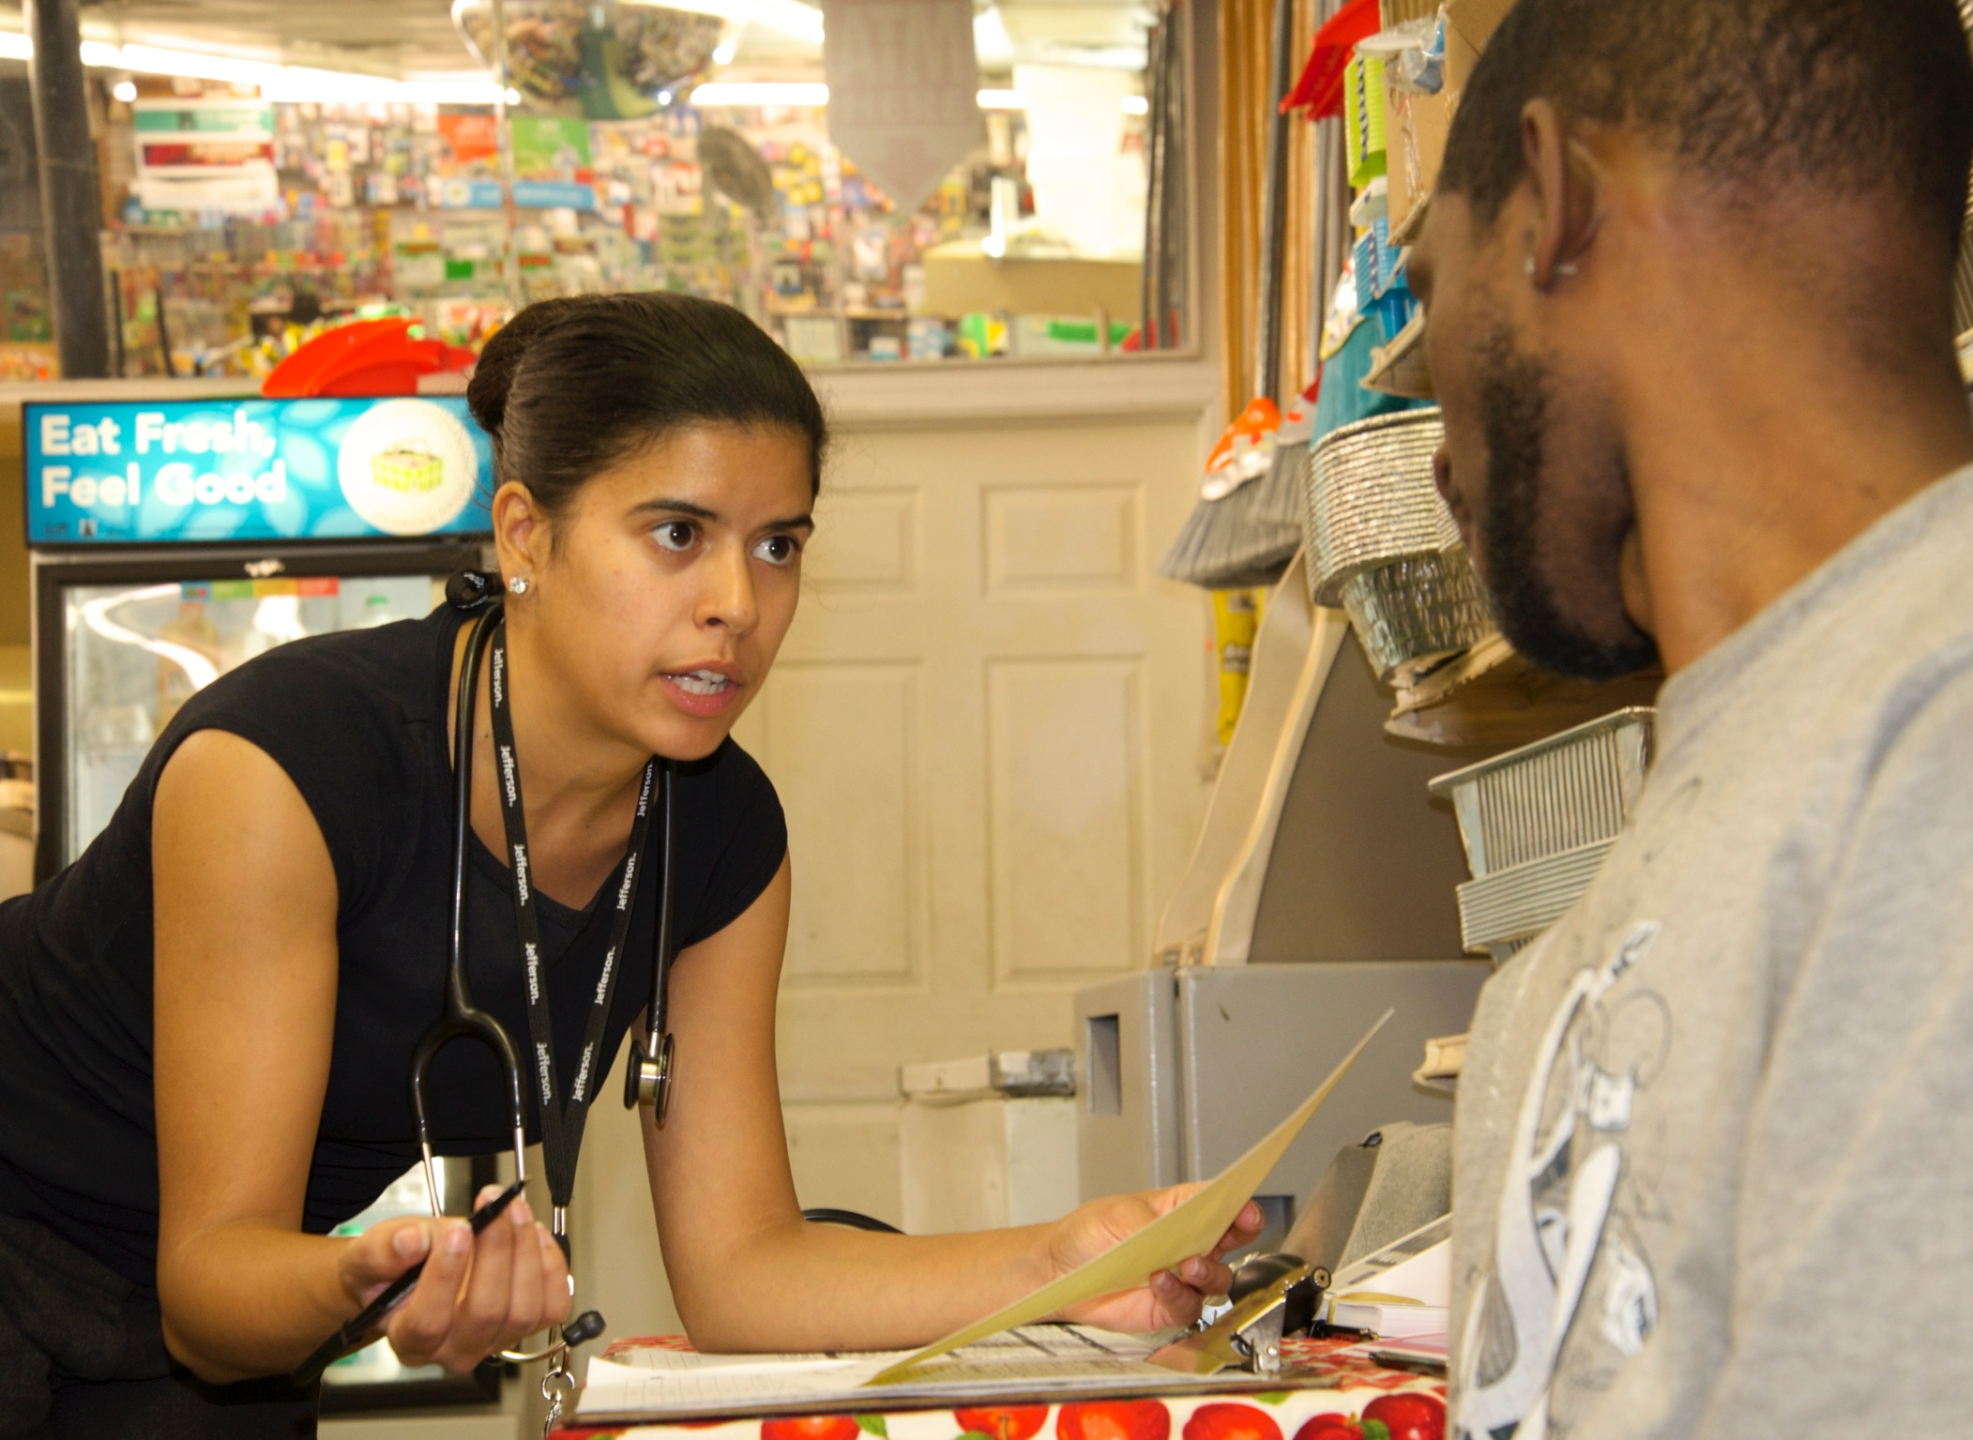
Community Clinical Linkages

Slide 23
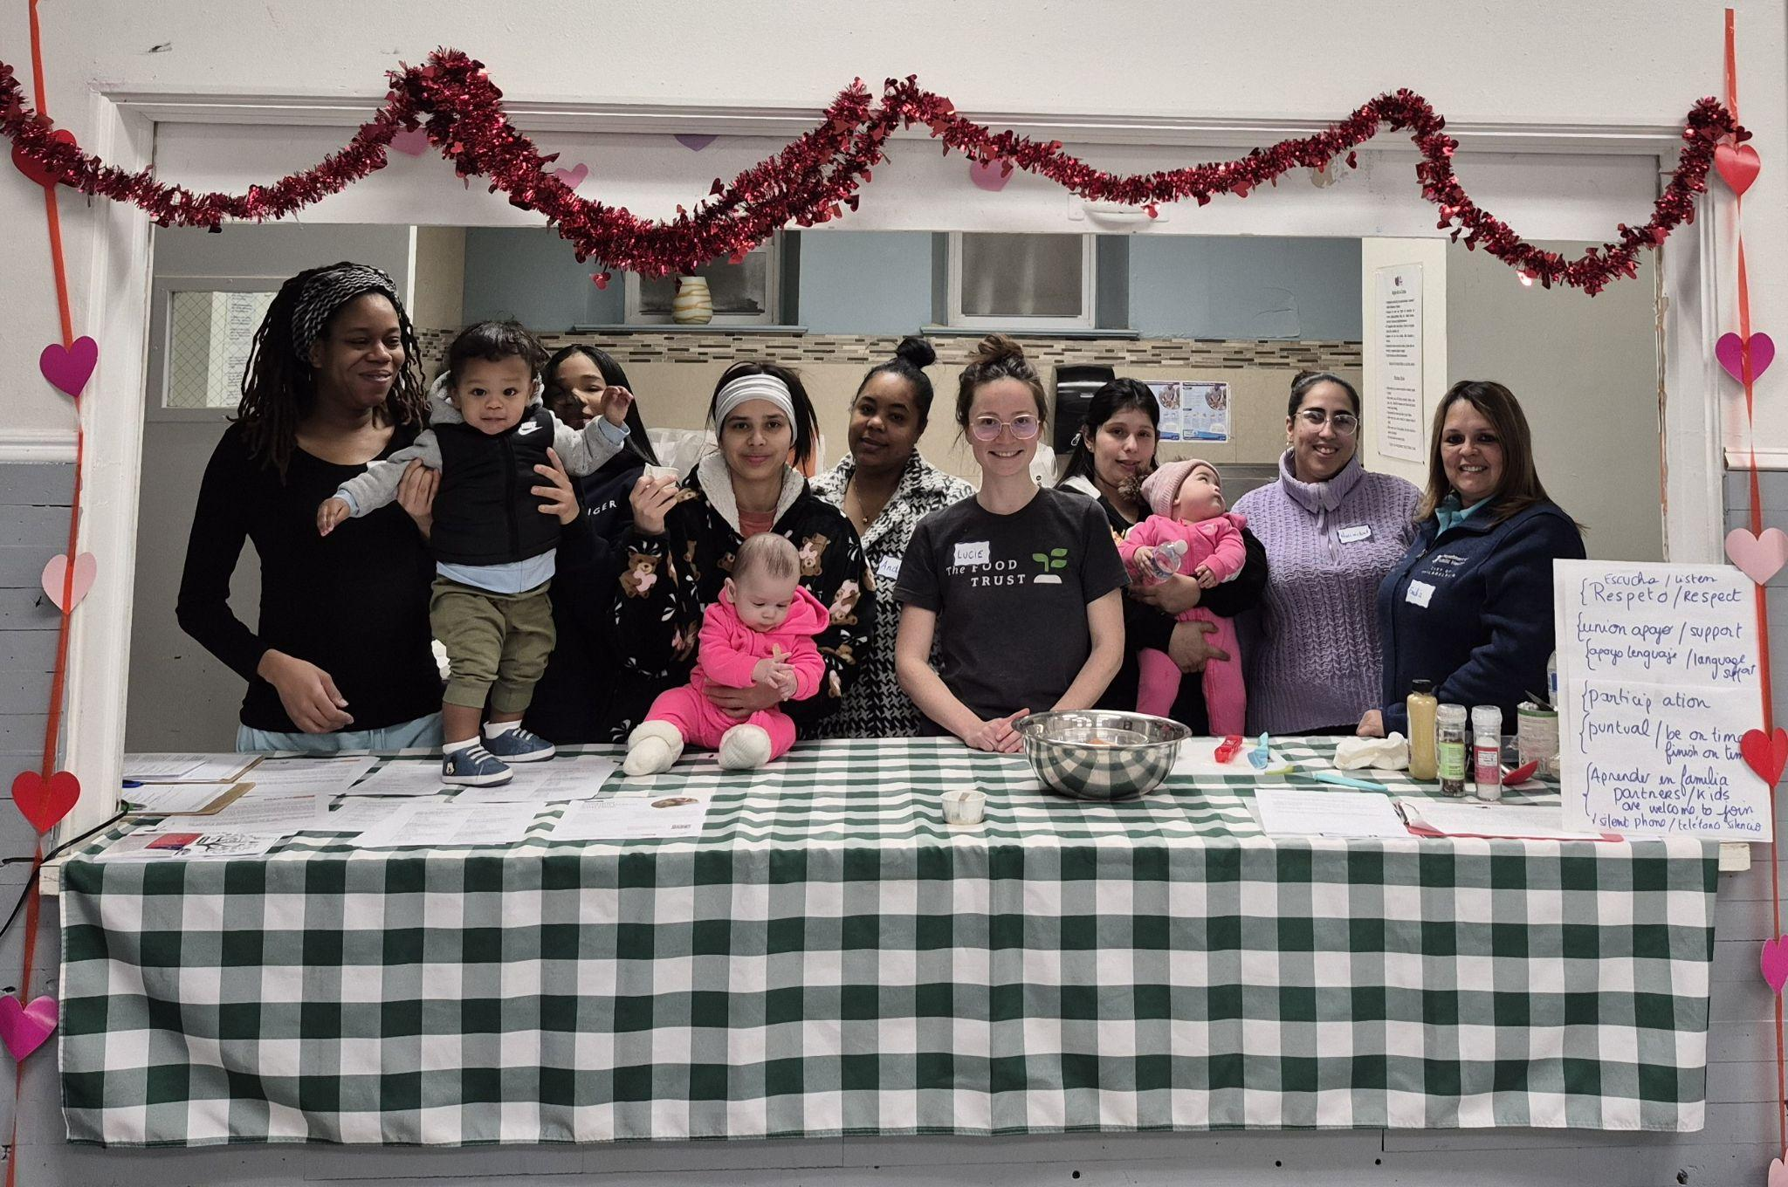
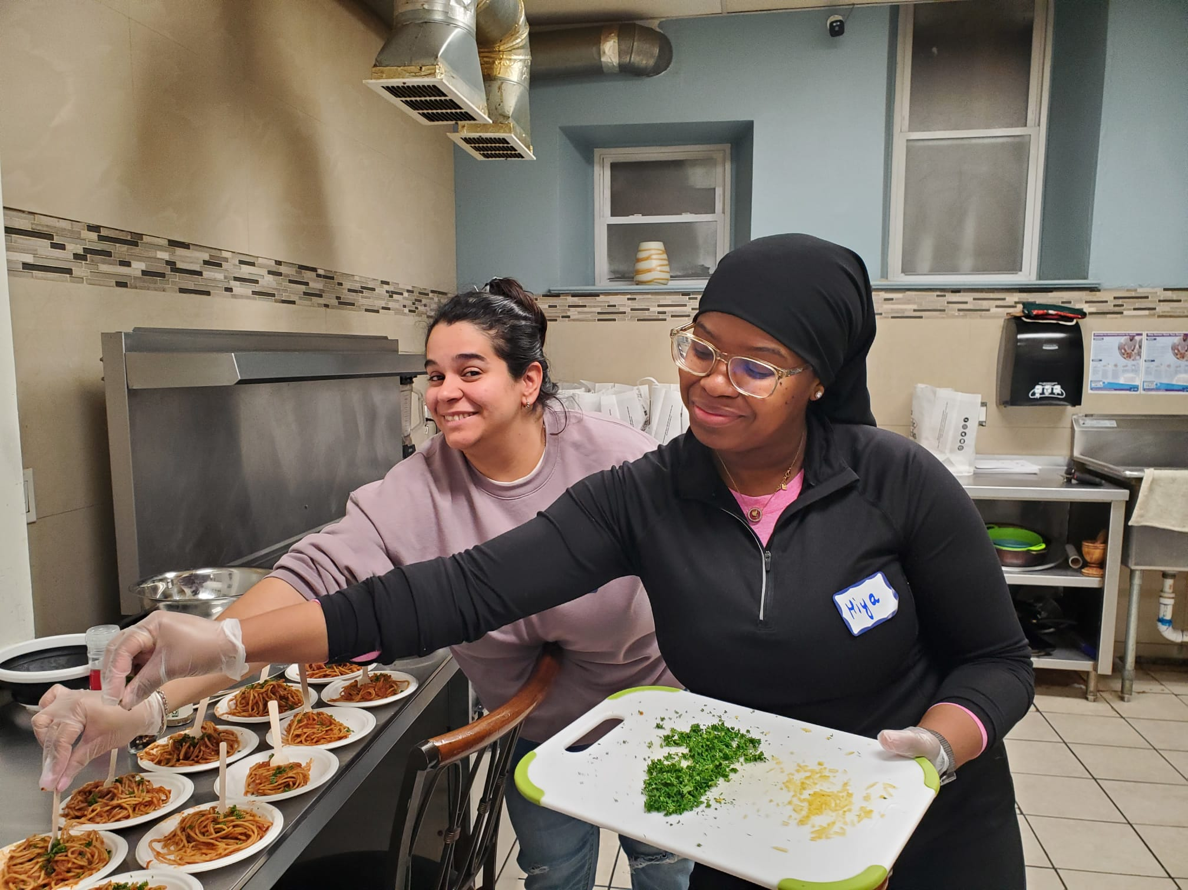
Nutrition Education: Cooking Matters and Beyond!

Slide 24
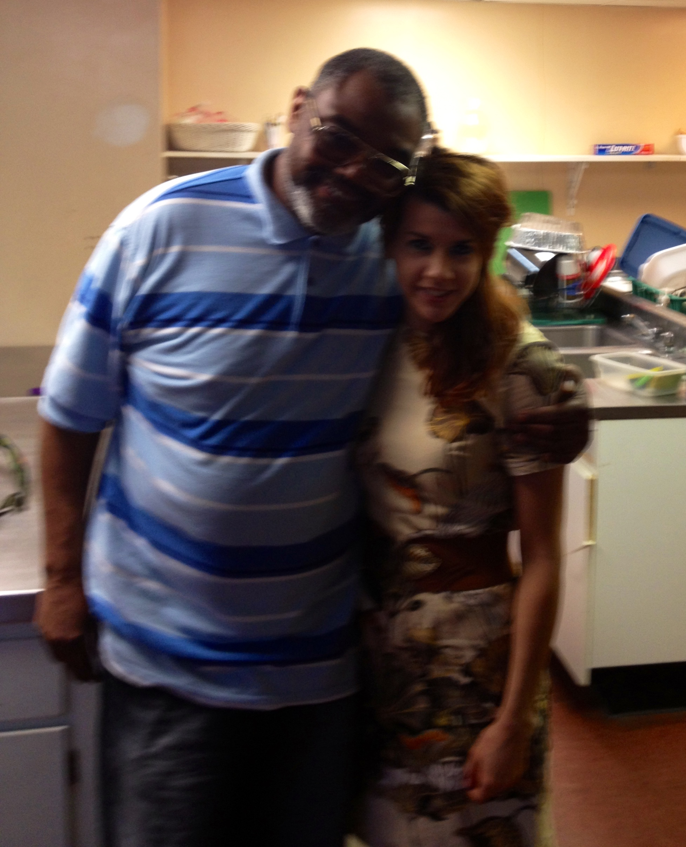
The Petester
Met in 2011 and texted me every Sunday until he died in 2020– GBYAY (God Bless You and Yours).
He was there for me while my parents were sick and supported my classes in Chester, PA.
Had diabetes and hypertension and asked me nutrition-related questions for a decade.
Showed me the importance of relationship building.

Slide 25
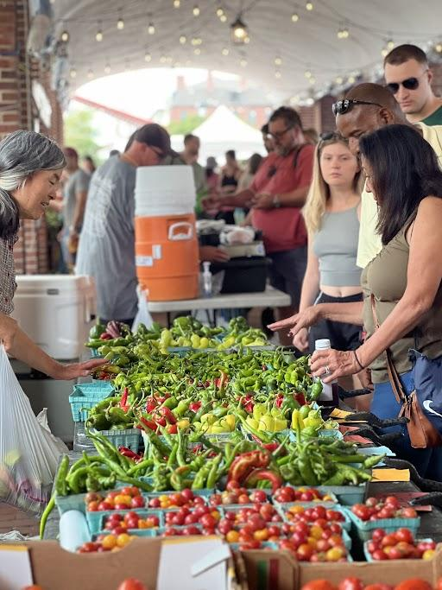

Healthy Food Access:
FARMERS MARKET PROGRAM
Notes:
The Farmers Market Program is the flagship program of The Food Trust. It’s where everything began back in 1992.
Since, TFT has operated a network of farmers markets across the city of Philadelphia, including Clark Park Farmers Market, Philly’s oldest year-round market, and Headhouse Farmers Market, one of the city’s largest outdoor markets
Today, TFT operates 6 markets across the city, 3 YR and 3 seasonal which open from July to November each year
With access being core to our mission, all of our markets accept SNAP/EBT, WIC and Senior Farmers Market Nutrition Program (FMNP) checks, and Food Bucks (fruit and vegetable coupons)
Additionally, our markets are host to nutrition lessons, cooking demonstrations, and more opportunities for people to stay informed about ways to bring healthy options home
With over 400,000 customers on average per year and 75+ vendors/small businesses, you can see how the FMP is a community keystone where local agriculture, local small business development, civic engagement, and food access intertwine

Slide 26
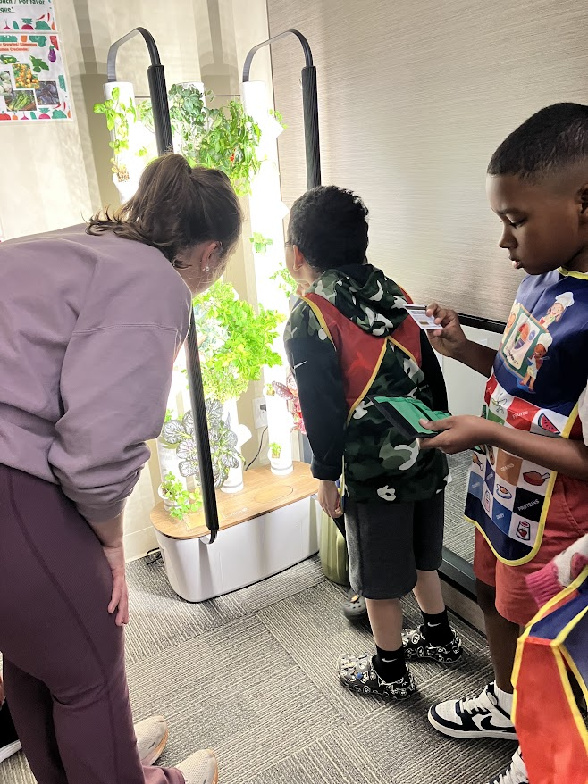
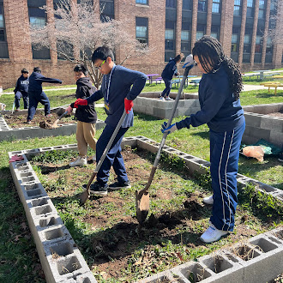
Healthy Food Access & Education
Farm to School

Slide 27



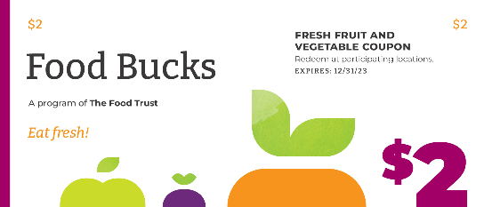
Affordability: Food Bucks
Food Bucks
Fruit and vegetable “incentives”
Active at farmers markets, corner stores, supermarkets in neighborhoods throughout PA & NJ
SNAP program model: Spend $5, Earn $2 for F/V
Paper and digital coupons
Over $715,000 redeemed in 2025
Food Bucks Rx
“Produce Prescription”
Distributed by healthcare provider
Redeemed at participating retail sites
$50-100/household distributed monthly
Over $247,000 redeemed in 2025

Slide 28
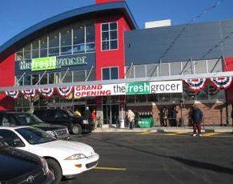
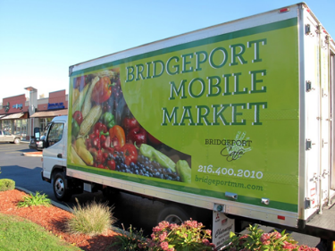
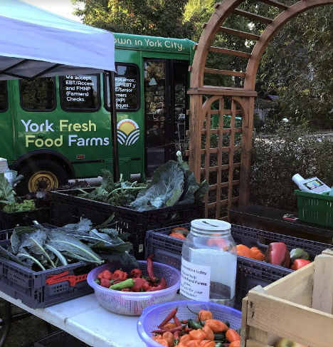
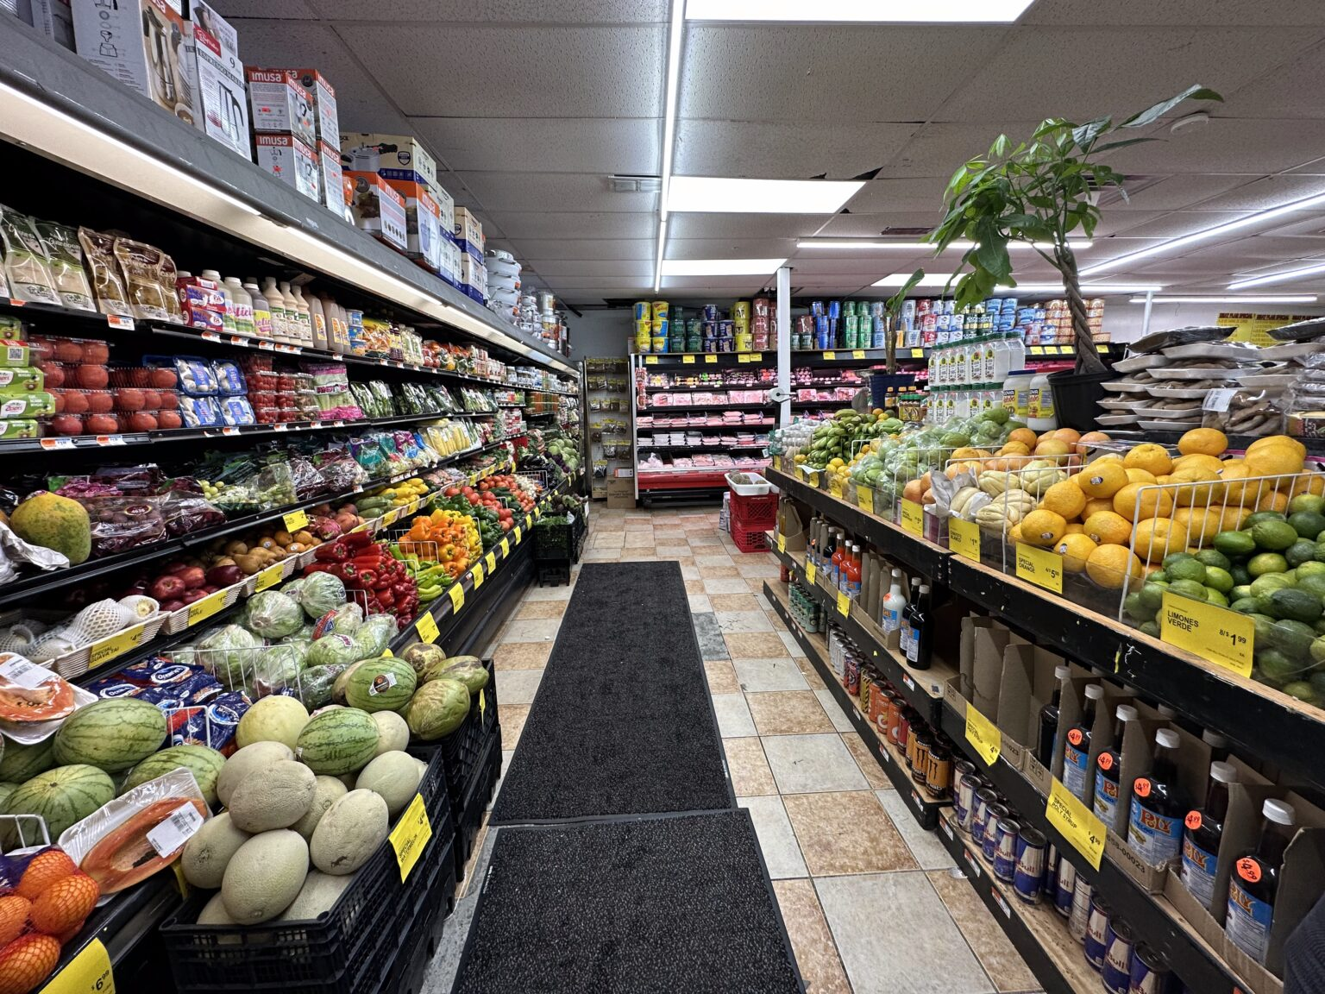
Healthy Food Access:
Fresh Food Financing
Support retail sites and small businesses in low-income areas
Promote further economic development
Increase access to healthy and affordable foods
Grocery stores
Mobile Markets
Program Impacts 2018-2025
92 Businesses funded
$4 Million in grants
1,968 Jobs created
Corner Stores & Superettes
Farmers Markets & Local Aggregators
Notes:
Healthy Food Financing Initiatives (HFFIs) are grocery financing programs designed to improve access to healthy food and expand economic opportunity in underserved areas.
Our goal as HFFI administrators to promote the programs’ mission:
To support small businesses in low-income areas
To create economic opportunities, further development, and support the creation and retention of jobs,
And to increase access to healthy and affordable foods for underserved communities.

Slide 29
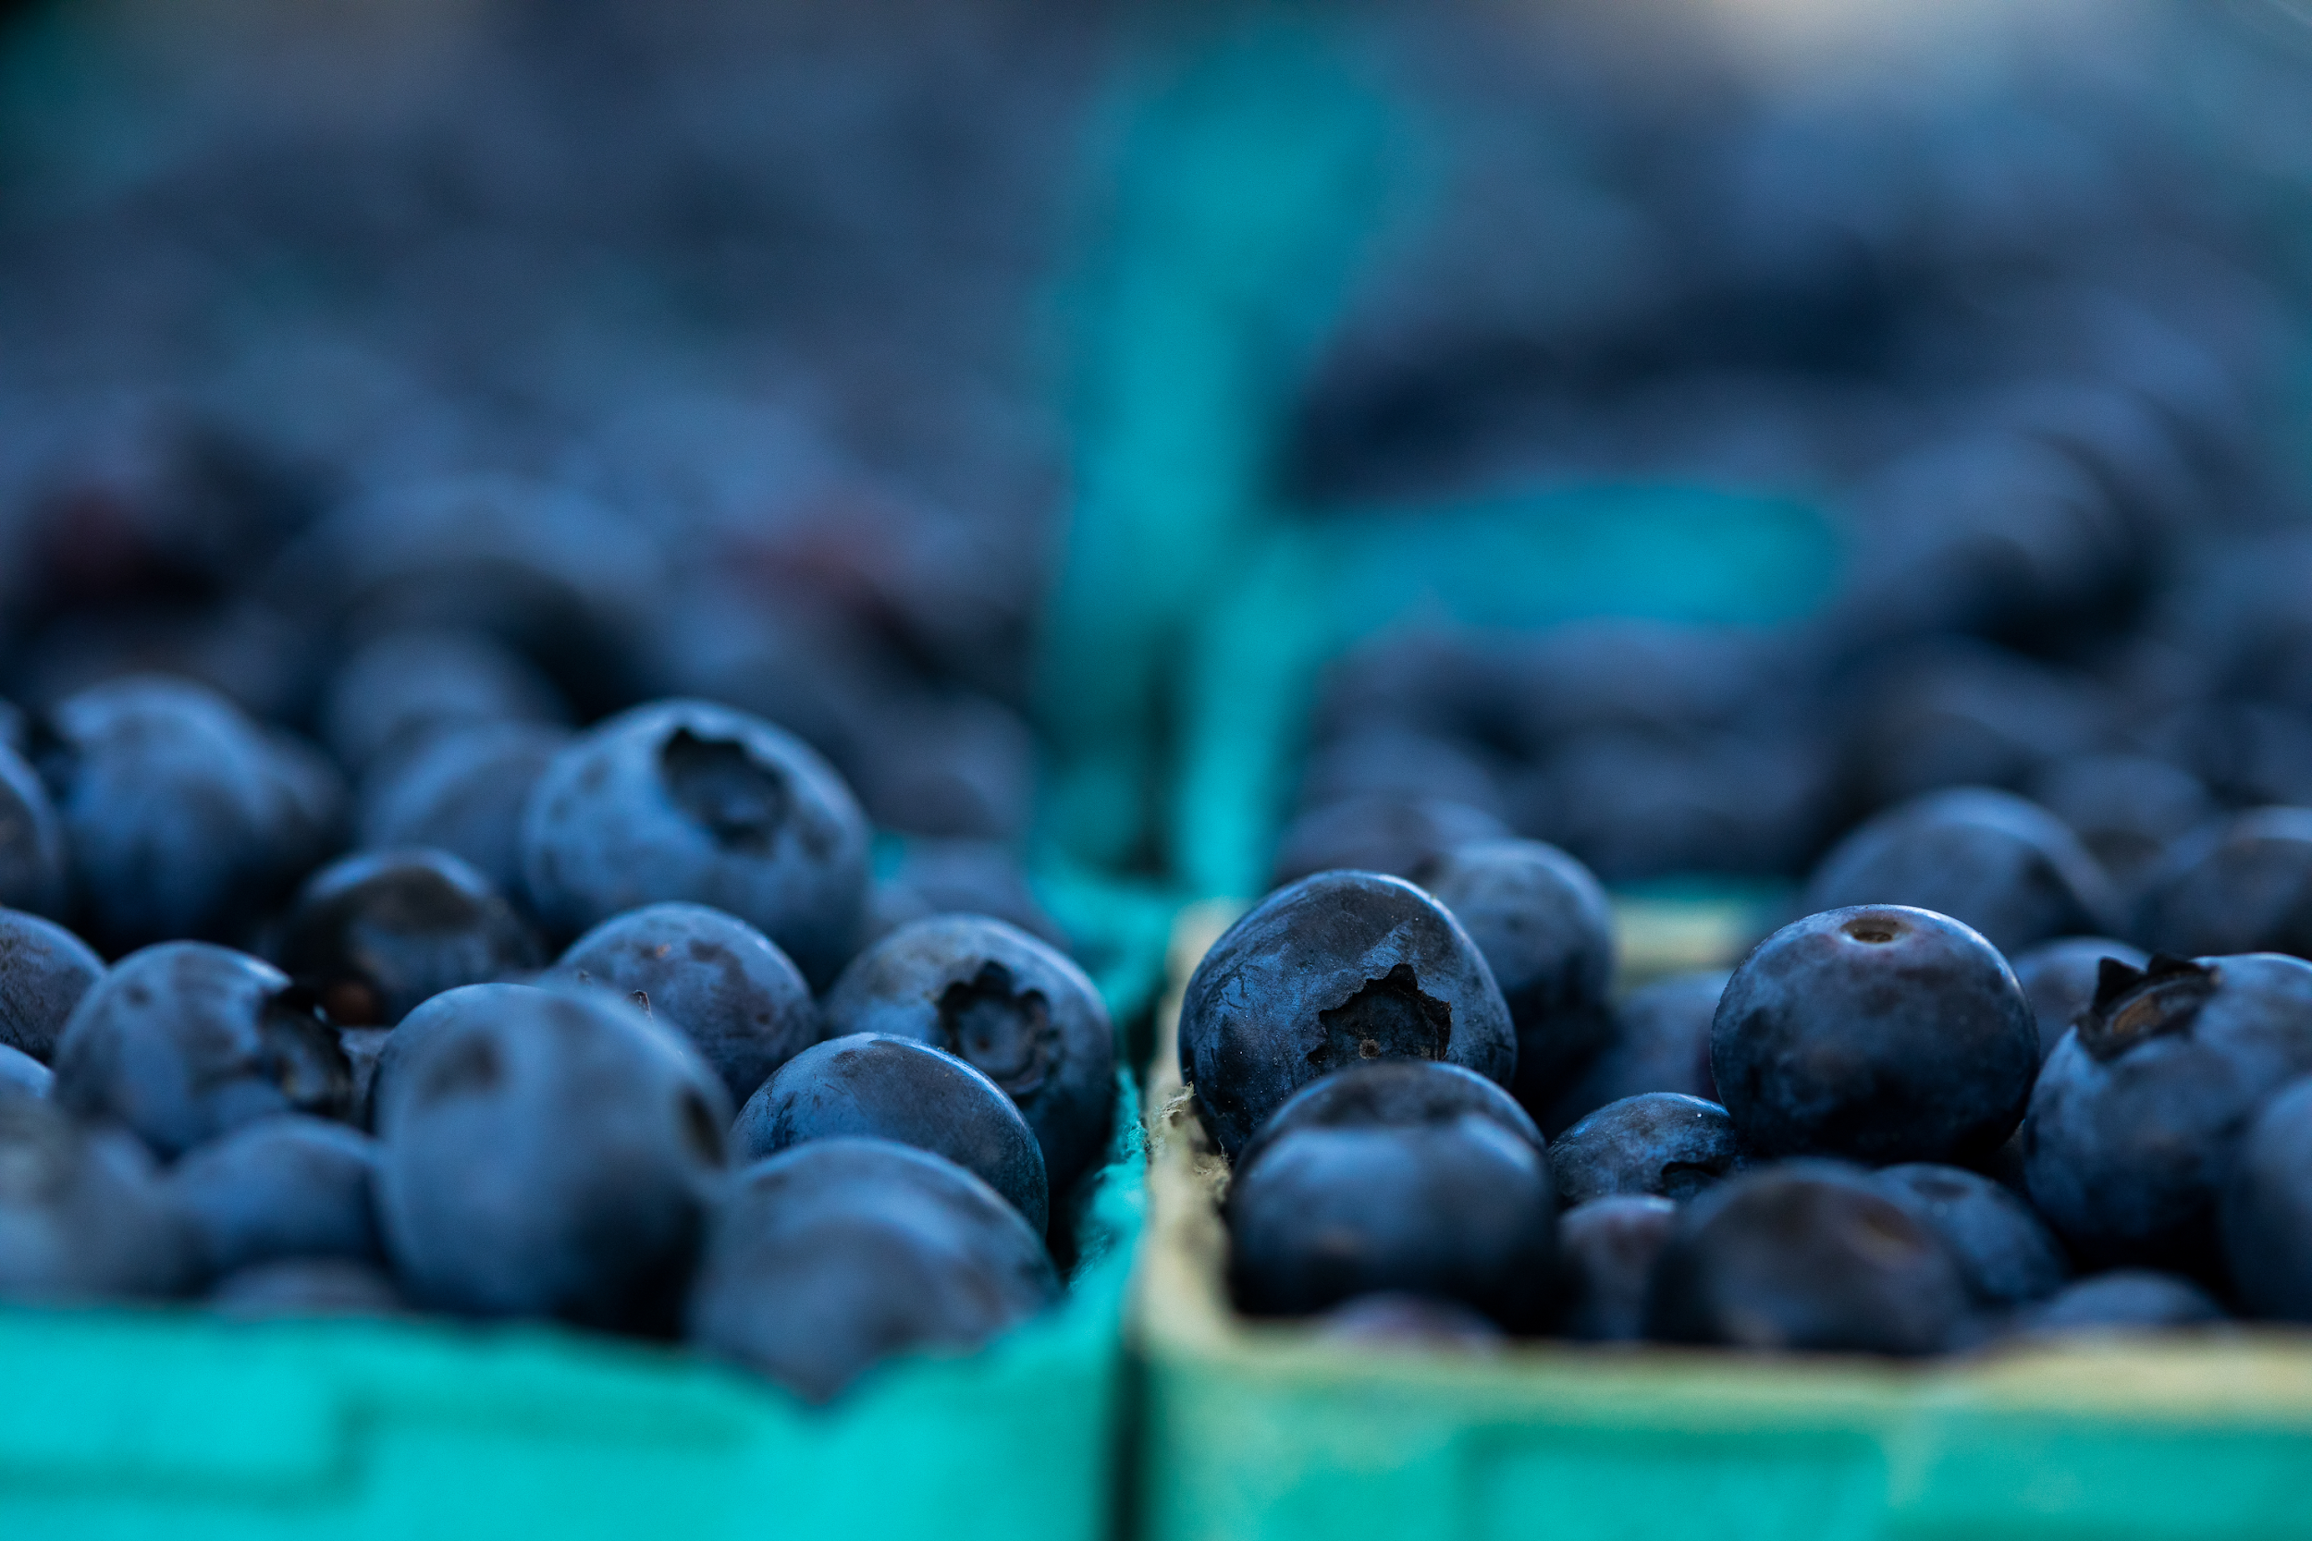
Thank you!

