Slide 1

Movement as Permission
The Missing Link to Lifelong Physical Activity

Slide 2
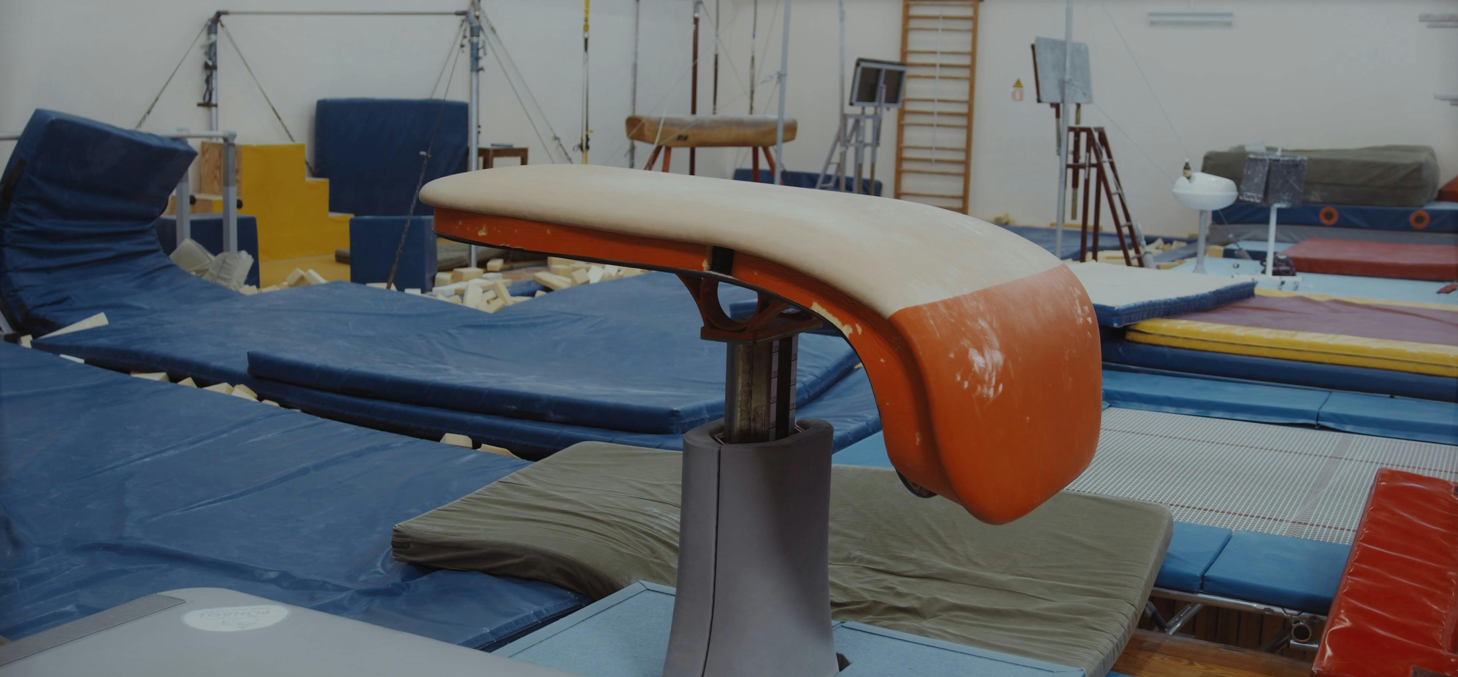

Slide 3
Do I Belong Here?

Slide 4
Safe
Supported
Connected

Slide 5
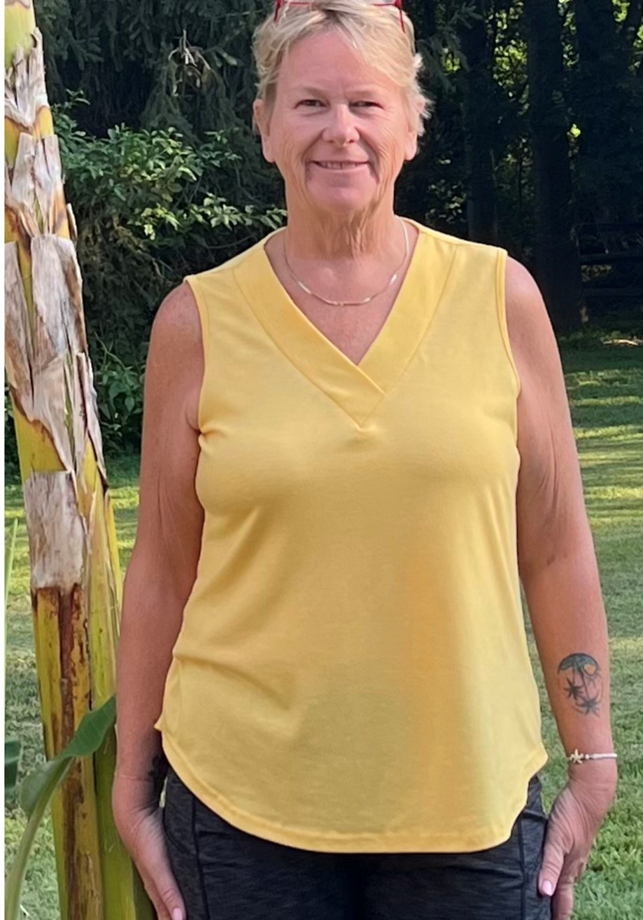
Sally

Slide 6
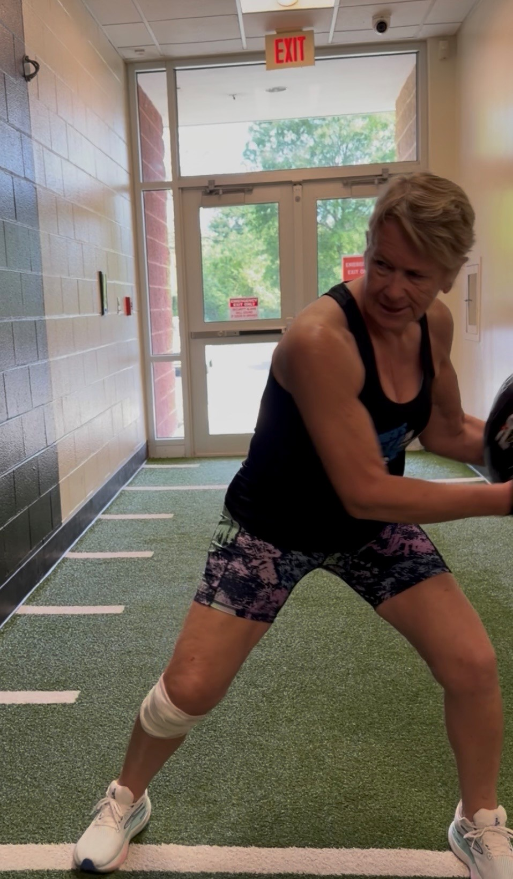

Slide 7
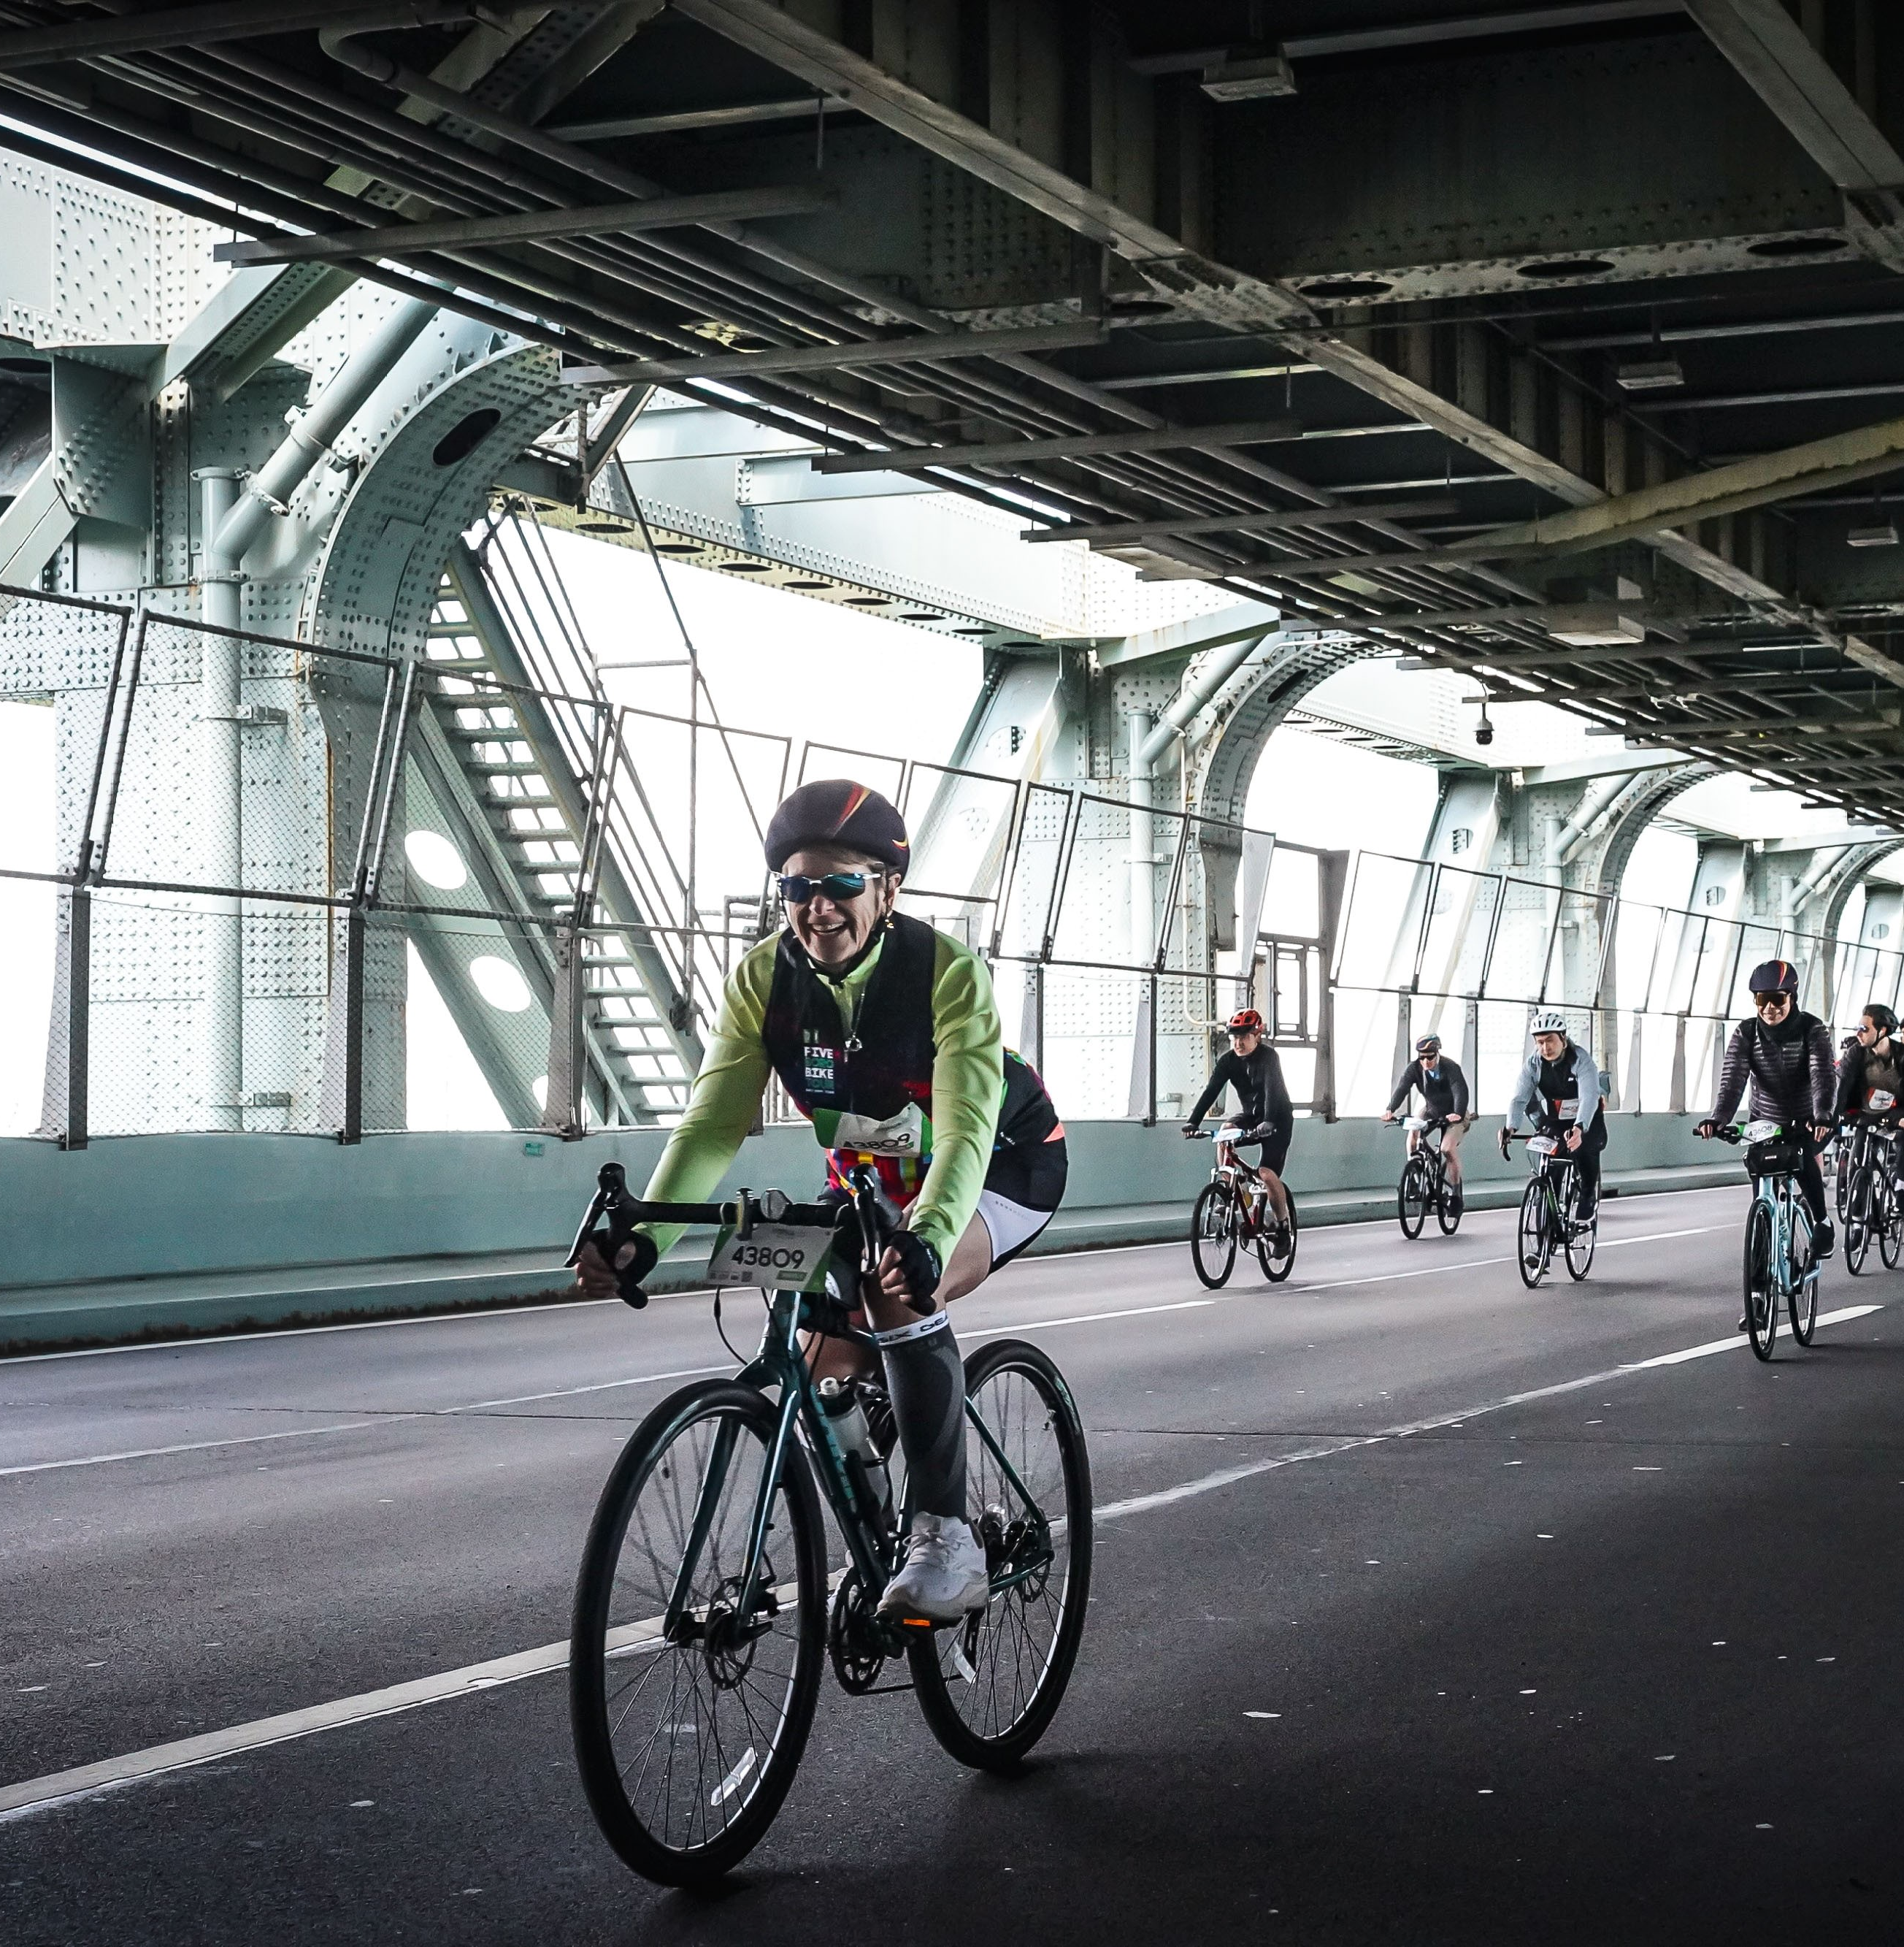
“I felt like a complete badass."

Slide 8
Movement doesn't start with motivation.
It starts with permission.

Slide 9


Thank You

