Slide 1


Communities and collaboration:
key components to healthy people
Gina Crist, MS, CHES
Community Health Specialist
University of Delaware

Slide 2

What will we cover?
  What creates a healthy individual and a healthy community
  Importance of partnerships for community and individual health

Slide 3
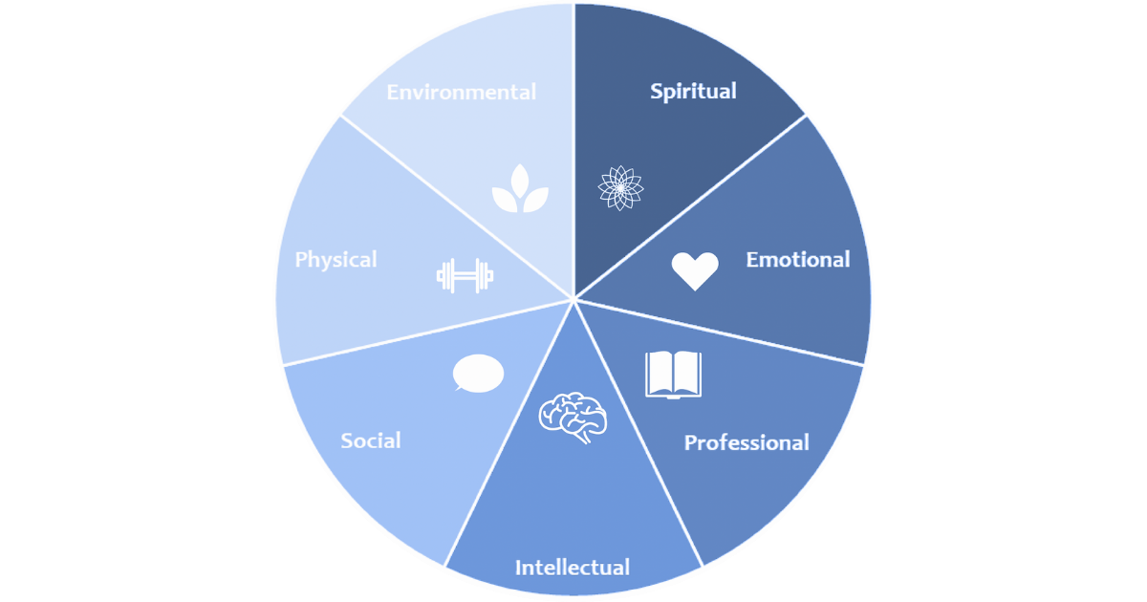
Individual health :
Dimensions of health and wellness
Figure 1: Dimensions of Wellness. University of Delaware Cooperative Extenion

Slide 4
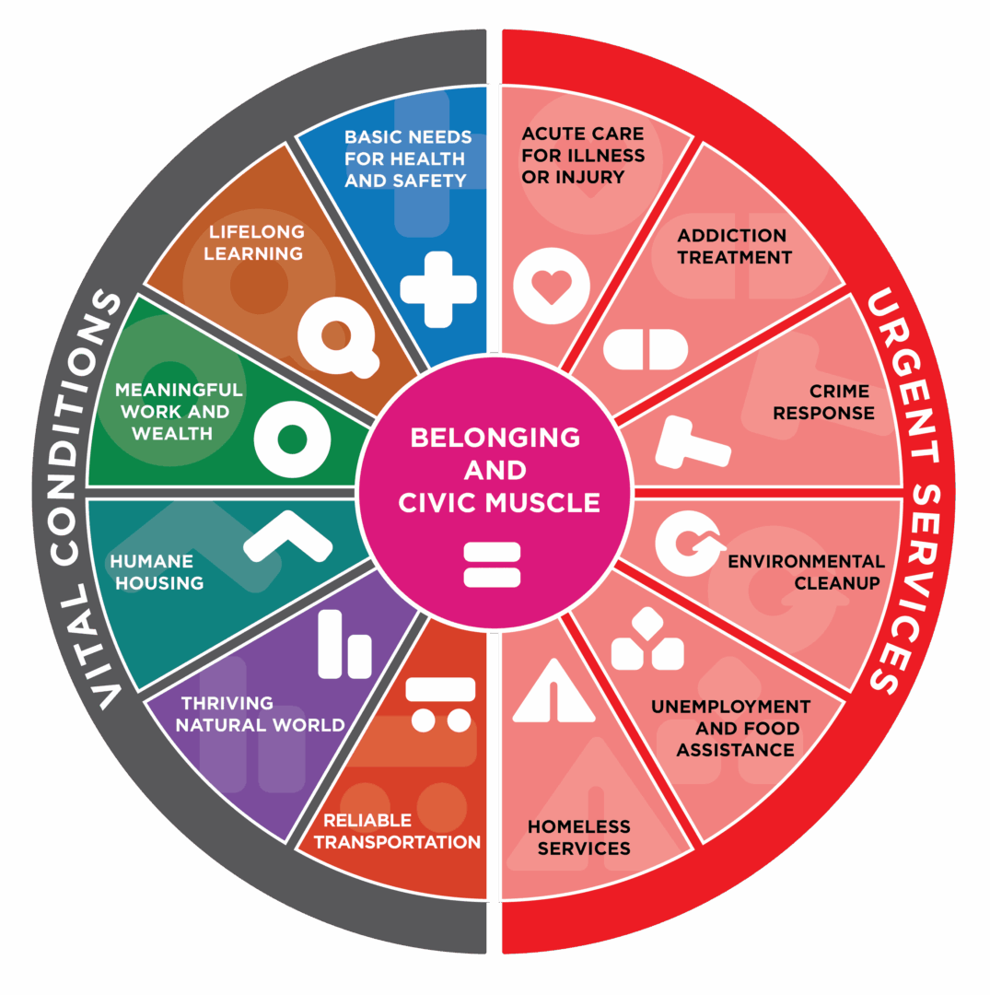
Community Health:
Vital Conditions Framework
Figure 2: Vital Conditions Framework. Rippel Foundation https://rippel.org/vital-conditions/

Slide 5
Health is a combination of the behaviors we engage in and the policy, systems, and environments that influence these behaviors

Slide 6


I have recently been diagnosed with diabetes and need to change some things about my health to help me manage.
I need to change my shopping and eating habits, decrease my stress, and I need to have access to insurance and a pharmacy for my medicaitons

Slide 7





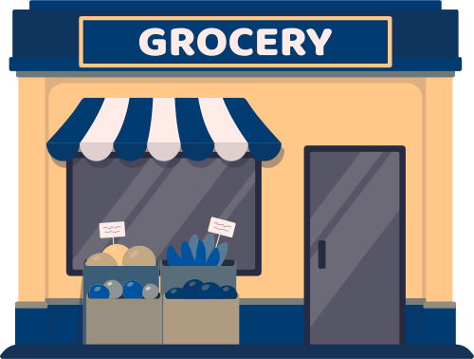
A diabetes diagnosis, may appear clinical and individual, but what if we looked a bit deeper? How would a person diagnosed with diabetes reach their full wellness potential?

Slide 8
Delawareans are experiencing collaboration in real time...
Food is Medicine
Delaware Farm and Food Council
Advancing Healthy Lifestyles
Cardiovascular Learning Collaborative
Route 9 Monitoring Committee
Sussex County Health Coalition
Delaware Diabetes Coalition
Partnership for Healthy Communities

Slide 9
Working together, we create communities where residents can reach their fullest potential, we change the culture, we all succeed
Alignment of mission, goals, and outcomes creates opportunities for funding, collective storytelling, and most importantly...

Slide 10
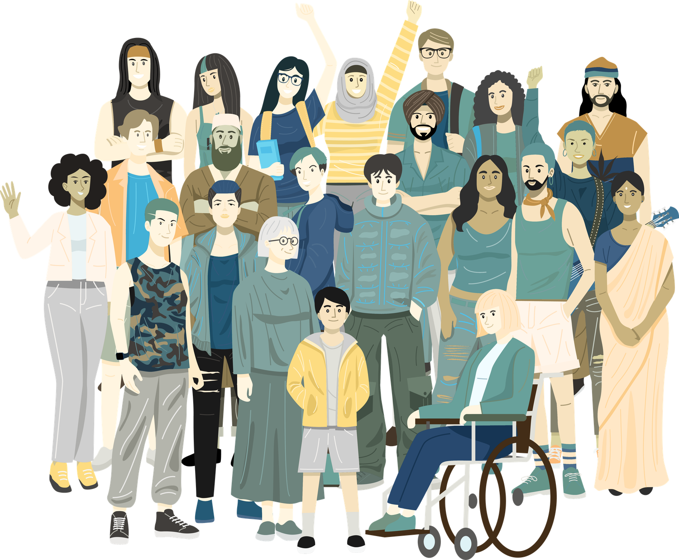
collaborations create communities that support healthy people

