Slide 1
Cardiovascular Health in Delaware
Shebra Hall
Chief, Bureau of Chronic Diseases
Delaware Division of Public Health
March 26, 2025

Slide 2
Background
CDC Award
CVH Learning Collaborative

Slide 3
Background
Delaware Health and Social Services (DHSS)
Division of Public Health
(DPH)
Asthma Program
Bureau of Chronic Diseases
Self-Management Programs
Diabetes and Heart Disease Prevention and Control Program
(DHDPCP)
Tasked with decreasing the emotional, physical, and financial burden of diabetes and heart disease among all Delawareans
Program activities target Delaware’s most vulnerable populations, including Black/African American Delawareans, Hispanic Delawareans, older adults, those with low SES, people with disabilities, and those with diabetes and heart disease risk factors

Slide 4
Background
Delaware Health and Social Services (DHSS)
Division of Public Health
(DPH)
Asthma Program
Bureau of Chronic Diseases
Self-Management Programs
Diabetes and Heart Disease Prevention and Control Program
(DHDPCP)
DHDPCP Receives Federal Funding to Support Diabetes and Heart Disease Activities:
In Spring 2023, applied for and received federal funding through CDC Cooperative Agreement 2304 – National Cardiovascular Health Program (2023-2028)
Goal is to implement and evaluate evidence-based and evidence-informed strategies to prevent and manage cardiovascular disease (CVD) for priority populations.
Notes:
Since 2013, DHDPCP has received CDC funding for activities to address both diabetes and CVD.
However, In 2023, we received CDC funding from 2 separate awards.
In Spring 2013, applied for and received federal funding through CDC Cooperative Agreement 1305 (2013 – 2018)
In Spring 2018, applied for and received federal funding through CDC Cooperative Agreement 1815 (2018-2023)

Slide 5
Priority Populations
Notes:
To identify the priority populations, we are to focus on, we use a national Social Vulnerability Index (SVI) which is a place-based index, database, and mapping tool designed to identify and quantify communities experiencing social vulnerability.
Social vulnerability refers to the demographic and socioeconomic factors (such as poverty, lack of access to transportation, and crowded housing) that adversely affect communities that encounter hazards and other community-level stressors.

Slide 6
Priority Census Tracts: New Castle County
Hypertension Prevalence
Social Vulnerability Index
21 priority CTs
Wilmington
New Castle
Route 9 Corridor
Eastside
Adams Four
62,023 residents
Data Source: Centers for Disease Control and Prevention, National Center for Chronic Disease Prevention and Health Promotion, Division of Population Health. PLACES: Local Data for Better Health, Census Tract Data 2023 release. https://data.cdc.gov/500-Cities-Places/PLACES-Local-Data-for-Better-Health-Census-Tract-D/cwsq-ngmh. Accessed on December 6, 2023

Slide 7
Priority Census Tracts: Kent County
Hypertension Prevalence
Social Vulnerability Index
6 priority CTs
Dover
Leipsic
Little Creek
Camden-Wyoming
Woodside
Viola
Bowers
22,125 residents
Notes:
The Centers for Disease Control and Prevention and Agency for Toxic Substances and Disease Registry Social Vulnerability Index (CDC/ATSDR SVI or SVI) is a place-based index, database, and mapping application designed to identify and quantify communities experiencing social vulnerability. Social vulnerability refers to the demographic and socioeconomic factors (such as poverty, lack of access to transportation, and crowded housing) that adversely affect communities that encounter hazards and other community-level stressors.

Slide 8
Priority Census Tracts: Sussex County
Western Sussex County
Hypertension Prevalence
Social Vulnerability Index
7 priority CTs
Bridgeville
Seaford
Bethel
Laurel
Millsboro
Selbyville
30,163 residents

Slide 9
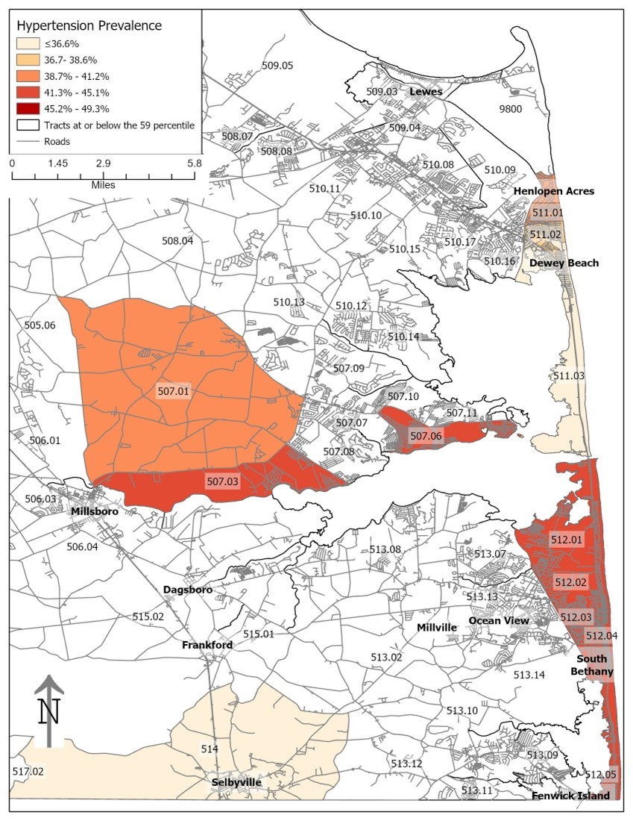
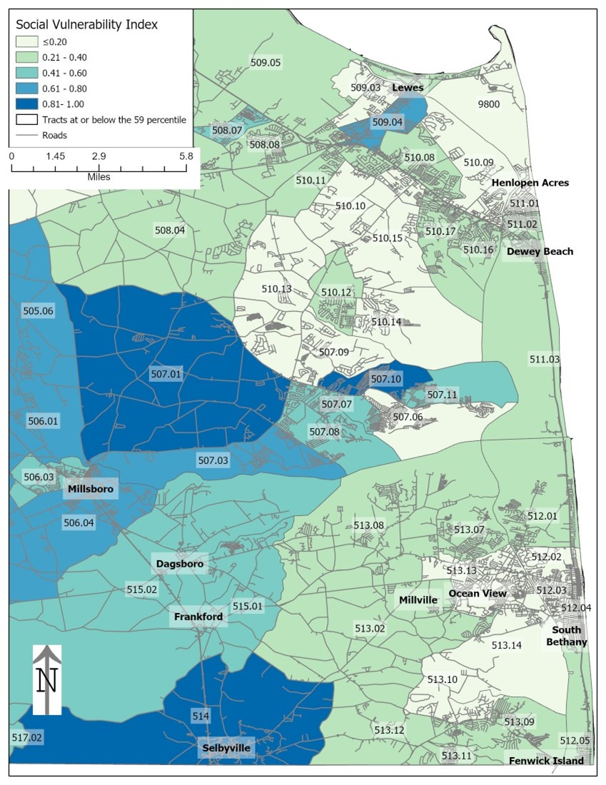
Priority Census Tracts: Sussex County
Central and Eastern Sussex County
Hypertension Prevalence
Social Vulnerability Index
7 priority CTs
Bridgeville
Seaford
Bethel
Laurel
Millsboro
Selbyville
30,163 residents

Slide 10
The National Cardiovascular Health Program
3 Strategies
8 Sub-Strategies

Slide 11
The National Cardiovascular Health Program
Strategy 1: Track and monitor clinical and social services and support needs measures to improve health and wellness, health care quality, and identify individuals at the highest risk of cardiovascular disease (CVD) with a focus on hypertension and high cholesterol.
Substrategy 1A: Advance the adoption and use of electronic health records (EHRs) or health information technology (HIT)
Substrategy 1B: Promote the use of standardized processes or tools to identify social services and support needs

Slide 12
The National Cardiovascular Health Program
Strategy 2: Implement team-based care to prevent and reduce CVD risk with a focus on hypertension and high cholesterol prevention, detection, control, and management through mitigation of social support barriers to improve outcomes.
Substrategy 2A: Advance use of health information systems that support team-based care
Substrategy 2B: Assemble or create multidisciplinary teams
Substrategy 2C: Build and manage a coordinated network of multidisciplinary partnerships

Slide 13
The National Cardiovascular Health Program
Strategy 3: Link community resources and clinical services that support bidirectional referrals, self-management, and lifestyle change to address social determinants that put the priority populations at increased risk for CVD with a focus on hypertension and high cholesterol.
Substrategy 3A: Create and enhance community-clinical linkages
Substrategy 3B: Identify and deploy dedicated Community Health Workers
Substrategy 3C: Promote use of self-measured blood pressure monitoring programs
Notes:
The team is working with a variety of partners to respond to these strategies through multiple activities, all with the goal of connecting those at highest risk to evidence-based programming.

Slide 14
The National Cardiovascular Health Program
New in this funding cycle!
3 Strategies
8 Sub-Strategies
Each recipient (state) must align with an existing Learning Collaborative or create a new Learning Collaborative

Slide 15
Cardiovascular Health Learning Collaborative (CVH LC)

Slide 16
Cardiovascular Health Learning Collaborative (CVH LC)
CVH LC Defined
A group of public health entities, health systems, health care providers, and community leaders and their partners with experience working to address and implement evidence-based or evidence-informed practices for CVD prevention, detection, control, and management among approved priority populations of focus.
May be an alliance of public health entities, housing, commerce, and transportation agencies, health systems, health care providers, clinical quality improvement organizations, health information technology experts, public and private payers, pharmacists, mental and behavioral health professionals, community-based health care professionals, community organizations, safety net providers, health departments, and others.

Slide 17
Cardiovascular Health Learning Collaborative (CVHLC)
Goals of the CVHLC
Prioritize populations and communities with the highest prevalence of CVD, with a focus on advancing health equity for individuals with hypertension and high cholesterol.
Serve populations and communities disproportionately affected by CVD, specifically hypertension, high cholesterol, or stroke, due to unfair opportunity structures or social determinants (e.g., limited access to care, inadequate or poor quality of care, or economic instability).
Achieve optimal health outcomes for priority populations through culturally informed program services that use focused strategies to advance universal health equity goals that are mindful of the social determinants.
Notes:
Thinking back to the National Cardiovascular Health Program, the CDC cooperative agreement award that we received, these 3 goals certainly align, fit in with all of the strategies we have been charged with.

Slide 18
Cardiovascular Health Learning Collaborative (CVHLC)
Requirements of the CVHLC
Partnerships must strengthen efforts to expand care teams to include health care providers, community health workers, social workers, patient navigators, pharmacists, and other members of the care team in community settings outside of health care facilities to enhance follow-up, communication, and coordination among identified communities and populations.
Members of the CVHLC must examine existing policies that are barriers to optimal health outcomes and engage in mitigation strategies aimed at system-level changes that reduce health and health care disparities and improve community conditions.
Increase the percentage of patients aged 18-85 who have been given a hypertension diagnosis and among those diagnosed, blood pressure was adequately controlled during the measurement year.
Examine and implement models for collaboration between public health, health care, and community partners.

Slide 19
Cardiovascular Health Learning Collaborative (CVHLC)
CVHLC
Steering Committee
Awareness Workgroup
Availability and Coverage Workgroup
Equity Workgroup
Notes:
In the Fall of 2024 the DHDPCP launched the CVH LC. We have structured the LC by having a Steering Comm to lead the initiative and help organize the process, and we also have 3 workgroups to focus our efforts.

Slide 20
Cardiovascular Health Learning Collaborative (CVHLC)
CVHLC
Steering Committee
Awareness Workgroup
Dedicated to increasing public knowledge and understanding of cardiovascular health. This includes raising awareness of risk factors, prevention strategies, early detection, and importance of regular checkups.
Works on developing and implementing public education campaigns, community outreach programs, and partnerships to disseminate key messages on CVH.

Slide 21
Cardiovascular Health Learning Collaborative (CVHLC)
CVHLC
Steering Committee
Availability and Coverage Workgroup
Focuses on ensuring comprehensive access to CVH services by addressing physical availability of care and affordability of coverage.
Works to ensure that health care facilities, resources, and trained personnel are adequately distributed, especially in underserved areas, while examining insurance policies and programs like Medicaid and Medicare.
Removes barriers to care while advocating for policies that expand access to affordable preventive services, medications, and treatments that promote CVH.

Slide 22
Cardiovascular Health Learning Collaborative (CVHLC)
CVHLC
Steering Committee
Equity Workgroup
Addresses the broader determinants of CVH, including social, economic, and environmental factors.
Focuses on understanding and mitigating the impact of vital conditions like income, education, housing, food security, and social support on CVH.
Collaborates with community organizations, policymakers, and health systems to develop strategies that address underlying factors and promote health equity.

Slide 23
Charting a Path Forward
Shebra Hall
Chief, Bureau of Chronic Diseases
Delaware Division of Public Health
shebra.hall@delaware.gov

