Slide 1


DELAWARE CARDIOVASCULAR HEALTH LEARNING COLLABORATIVE
Community-Engaged
Cardiovascular Health Toolkit
A practical, community-driven resource to help partners build a cardiovascular collaborative and advance rural health transformation — from foundation and partnerships to launch, communication, and measurable impact.
Join Us in Promoting Cardiovascular Health and Health Equity

Slide 2


A WORD BEFORE YOU BEGIN
Foreword
Heart disease remains the leading cause of death in the United States, and its weight falls hardest on rural and underserved communities, the places where care is furthest away and where a single screening can change the course of a life.
Closing that gap will not come from any one hospital, agency, or grant. It comes from collaboratives: hospitals, public health agencies, community and faith-based organizations, funders, and residents themselves, working from a shared playbook.
This toolkit is that playbook. It helps partners move from intention to impact, establishing the foundation for a cardiovascular collaborative, bringing the right players to the table, defining cardiovascular health in measurable terms, and designing programming with the community rather than for it.
The method is deliberately simple, because simple methods get used. Define your terms once. Convene before you build. Measure what you said you would. Report back to the people you serve.
Do this consistently, across enough communities, and rural cardiovascular health transformation becomes something you can show.
Community-Engaged Cardiovascular Health Toolkit
2

Slide 3



ORIENTATION
How to Use This Toolkit
The toolkit is one slide deck plus nine fill-in templates. This deck makes the case for the work and orients your partners; the templates are the working documents you complete and reuse. The steps build on one another, but you can enter wherever your collaborative is today.
Use the deck to…
Use the templates to…
Follow the pathway…
Educate partners, frame a convening, and align everyone on the pathway and the goal before any single event is planned.
Do the work — map partners, define metrics, plan a launch, evaluate, and capture data. Fill them in and hand them to the next community.
Each template ends with a “Carry this forward” note linking to the next step, so nine forms work as one connected method.
Community-Engaged Cardiovascular Health Toolkit
3

Slide 4






WHAT THIS IS
Toolkit Overview
The Community-Engaged Cardiovascular Health Toolkit helps organizations, partners, and community leaders plan, launch, and evaluate cardiovascular health initiatives in their local communities.
Whether you are hosting an awareness campaign, a screening event, an educational workshop, or standing up an ongoing service, the toolkit provides the structure, resources, and guidance to make your efforts impactful and measurable.
Plan (as Partners)
Set the foundation and choose where to begin
Launch (with Partners)
Deliver events and services with the community
Measure Success (with Partners)
Capture behavior and outcome change over time
Community-Engaged Cardiovascular Health Toolkit
4

Slide 5


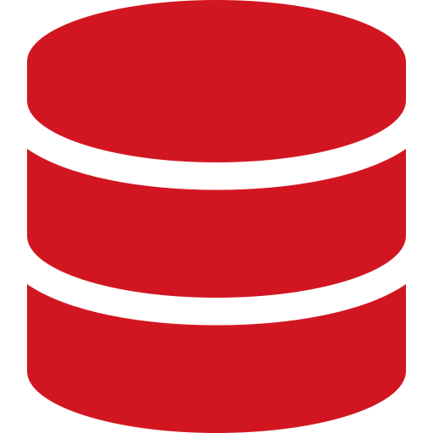
WHY IT EXISTS
Toolkit Goals
Strengthen community partnerships around cardiovascular health.
Provide practical tools for consistent implementation and evaluation.
Support data collection on local cardiovascular efforts and outcomes.
Align local initiatives with statewide cardiovascular health goals.
Community-Engaged Cardiovascular Health Toolkit
5

Slide 6

THE CASE FOR THE WORK
Why Rural Cardiovascular Transformation
Cardiovascular disease is the nation’s leading cause of death, and the burden is not shared equally. Rural communities face higher rates and steeper barriers to care, which is exactly why a coordinated, community-engaged collaborative matters here.
#1
Higher
Fewer
Greater
Cause of death
Rural CVD burden
Access points
Equity gaps
Heart disease is the leading cause of death in the U.S.
Rural residents face higher cardiovascular death rates than urban peers.
Distance, transportation, and provider shortages limit timely care.
Underserved populations carry a disproportionate share of risk.
Sources to localize with your own data: CDC PLACES, County Health Rankings, and your state’s public health reports (see Template 3).

Slide 7





THE FOUNDATION
The Collaborative Ecosystem
A cardiovascular collaborative is convened by a backbone organization and powered by many players. Build your table to reflect the community you serve with residents and trusted messengers at the center, not the margins.
Healthcare &
hospital systems
Community &
faith-based orgs
Public health
& government
Funders &
sponsors
Media &
communications
Residents,
patients & caregivers
Convened by a backbone organization that sets the foundation, holds the relationships, and keeps the table accountable. Map every player in Template 1.
Community-Engaged Cardiovascular Health Toolkit
7

Slide 8






THE METHOD
The Nine-Step Pathway
Nine connected steps take a collaborative from foundation to measurable impact. Each maps to a fill-in template.
1
2
3
Partners
Define CVD Health
Select Communities
Map who is in the space
Choose your metrics
Decide where to start
4
5
6
Convene
Launch
Checklists
Co-design with residents
Events and services
The who, what, why, how
7
8
9
Communicate
Evaluate
Data & Geo
Fill the room
Capture what changed
Measure behavior change
Community-Engaged Cardiovascular Health Toolkit
8

Slide 9
WHAT IS INSIDE
Toolkit Components & Templates
Nine editable templates ship with this deck. Filenames are shown so your team can find each one in the shared resource folder.
1
Partner & Stakeholder List
6
Service & Event Checklists
Template01_Partner List.docx
Template06_Service and Event Checklists.docx
2
Defining Cardiovascular Health
7
Communication Tools
Template02_Defining CVD Health Metrics.docx
Template07_Communication Tools.docx
3
Selecting Your Communities
8
Evaluation Forms
Template03_Selecting Your Communities.docx
Template08_Evaluation Forms.docx
4
Convening the Community
9
Data & Geo Methodology
Template04_Convening The Community.docx
Template09_Data and Geo Methodology.docx
5
Launch Planning
Template05_Launch Planning.docx
Community-Engaged Cardiovascular Health Toolkit
9

Slide 10
STEP 1 · PARTNERS
Collaboration Is Key
Strong partnerships make successful programs. Before launching, identify who you need at the table across all five categories.
01
02
03
04
05
Healthcare &
hospital systems
Community &
faith-based orgs
Public health
agencies
Funders &
sponsors
Media &
communications
First steps to collaboration
Name a backbone
One organization convenes and keeps the table accountable.
→
Map & invite
Use Template 1 to list every partner and role, then surface the gaps to fill.
→
Convene a kickoff
Get the right people in one room and align on purpose first.
→
Set shared goals
Agree on a common aim, clear roles, and a regular meeting cadence.
TEMPLATE Partner & Stakeholder List
Build your roster, name each partner’s role, and surface the gaps you still need to fill.
Community-Engaged Cardiovascular Health Toolkit
10

Slide 11






STEP 2 · DEFINE
Defining Cardiovascular Health
“Improving heart health” means little until you say how you will measure it. Agree on a shared definition and a small set of metrics tracked from baseline through follow-up.
Blood pressure
BMI
A1C
Below 120 / 80 mmHg
18.5 – 24.9
Below 5.7%
Total cholesterol
Tobacco use
Physical activity
Below 200 mg/dL
No current use
150+ min / week
TEMPLATE Defining Cardiovascular Health
Healthy ranges are general screening references — not diagnostic thresholds.
Community-Engaged Cardiovascular Health Toolkit
11

Slide 12
STEP 3 · WHERE TO START
Selecting Your Communities
You cannot serve everywhere at once. Choose where to begin by weighing six criteria then confirm the choice with the community itself.
Burden of disease
Health equity
Where is cardiovascular need greatest?
Which populations face the widest gaps?
Partner presence
Readiness
Where do you have a trusted messenger?
Where is there interest or momentum?
Access gaps
Feasibility
Where do distance and transport limit care?
Where can you realistically deliver and sustain?
TEMPLATE Selecting Your Communities
Includes a candidate scoring matrix and where to find the data.
Community-Engaged Cardiovascular Health Toolkit
12

Slide 13
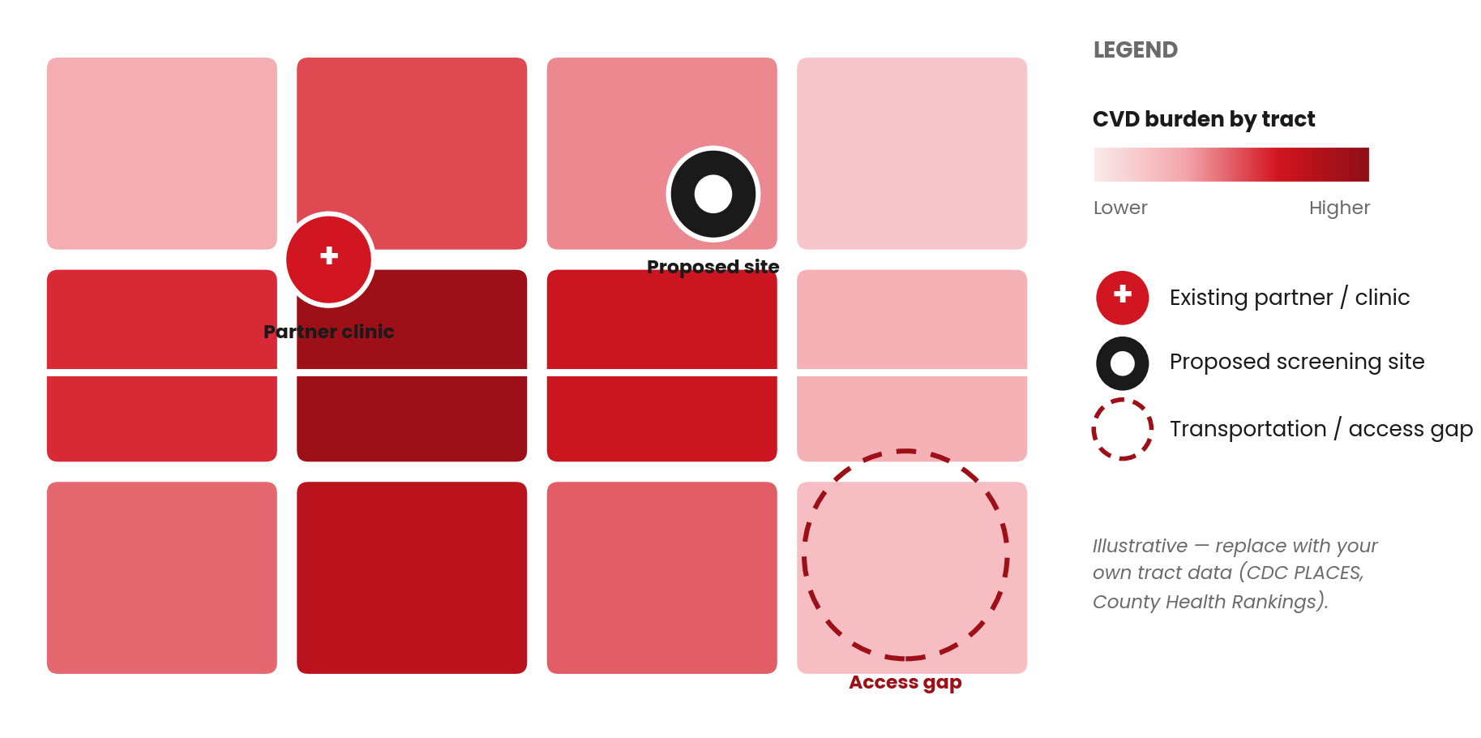
STEP 3 · EXAMPLE
Sample Community Map
Before you commit, picture the place. Mapping burden, partners, and access gaps on one view shows your team where need and opportunity meet — and grounds the scoring matrix in geography.
Community-Engaged Cardiovascular Health Toolkit
13

Slide 14





STEP 4 · CO-DESIGN
Convening the Community
The fastest way to build a program no one attends is to design it in a conference room. Convening brings residents and trusted organizations to the table early to shape what you offer, where, and how.
Listen
Co-design
Commit
Ask open questions and capture residents’ answers in their own words.
Translate what you heard into concrete program decisions, together.
Close with named owners and dates — and a promise to report back.
TEMPLATE Convening the Community
Includes an agenda, listening prompts, and a co-design worksheet.
Community-Engaged Cardiovascular Health Toolkit
14

Slide 15
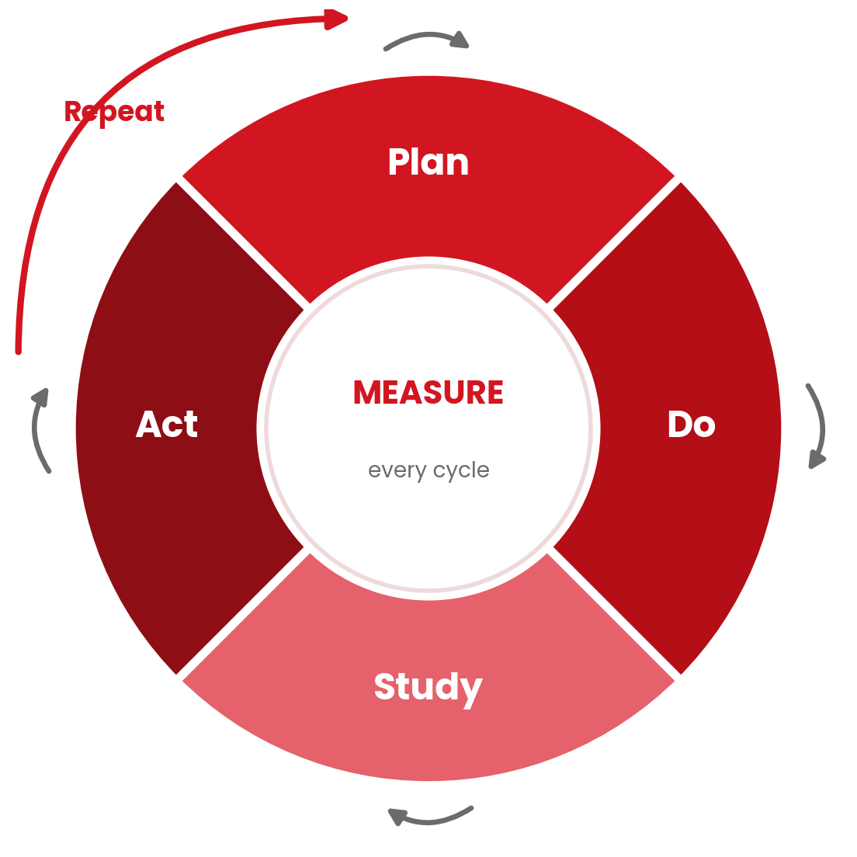
THE METHOD · IMPROVEMENT CYCLE
Plan-Do-Study-Act
Convening the Community is not a one-time kickoff. Its three moves Listen, Co-design, and Commit recur at every turn of this cycle. Here is where each one does its work.
CONVENING THE COMMUNITY Listen · Co-design · Commit
Plan — Co-design + Listen
Set the aim and the measure with residents design the change with the community, not for it.
Do — Trusted messengers
Run it small, with the trusted messengers from your convening carrying it the last mile.
Study — Listen, again
Bring results back to the same partners; read the numbers and the lived experience together.
Act — Commit
Report back the way you promised when you committed, then re-convene to plan the next cycle.
Community-Engaged Cardiovascular Health Toolkit
15

Slide 16

STEP 5 · LAUNCH
Start with Your Goal
Every initiative begins by naming the type of work you are doing. Choose one or more focus areas then decide whether you are launching an event, a service, or both.
Education
Screening
Awareness
Programmatic
Evaluation
Workshops and classes
BP, BMI, cholesterol, A1C
Healthy-habit campaigns
Sustained programs & groups
Track impact and share results
TEMPLATE Launch Planning — plan logistics, roles, timeline, and budget for the option you choose.

Slide 17



STEP 6 · DELIVER
Service vs. Event Checklist
Frame every effort with the who, what, why, and how then run the checklist that matches what you are delivering. An event creates a moment; a service creates a habit.
One-time / recurring EVENT
Ongoing SERVICE
Confirm venue, accessibility, partners
Define hours, cadence, eligibility
Recruit volunteers and clinical staff
Set intake, consent, and tracking
Print forms; promote via Step 7
Build the referral pathway
Collect data and referrals on the day
Re-measure at set intervals
TEMPLATE Service & Event Checklists
Each checklist covers before, during, and after.
Community-Engaged Cardiovascular Health Toolkit
17

Slide 18

STEP 7 · AMPLIFY
Communication Tools
The best program does nothing if no one shows up. Use ready-to-adapt social posts, flyer copy, and a channel plan carried the last mile by trusted messengers. Refer to health literacy guideline
EXAMPLE FLYER
Lead with the benefit “Free heart-health check,” not “cardiovascular screening.”
Anchor the basics Always state what, when, where and that it is free.
Remove barriers Name food, childcare, transportation, interpretation.
Use trusted voices A familiar face outperforms a logo every time.
TEMPLATE Communication Tools
Community-Engaged Cardiovascular Health Toolkit
18

Slide 19

STEP 8 · EVALUATE
Capturing What Changed
Evaluation turns a single event into evidence. Keep forms short, ask only what you will use, and collect them before participants leave.
Knowledge & confidence
Behavior intent
Do participants understand their heart health and know their numbers?
What will they do next — check BP, eat better, move more, quit tobacco?
Satisfaction & reach
Screening results
Was it helpful, and how did they hear about you?
Capture de-identified values and pair every flag with a referral.
TEMPLATE Evaluation Forms
Includes a participant survey, screening card, and partner debrief.
Community-Engaged Cardiovascular Health Toolkit
19

Slide 20
STEP 9 · MEASURE
Data & Geo Methodology
The engine room: capture where you worked, who you reached, what you did, and what changed. A simple logic model connects effort to impact.
Inputs
Activities
Outputs
Outcomes
Impact
Partners, funding, staff, venues
Screenings, classes, services
# reached, screened, referred
Behavior & clinical change
Lower CVD risk in the community
Capture change by comparing the same measure over time:
Pre / post
Retrospective pre/post
Follow-up at 30/60/90 days
Dosage & reach
TEMPLATE Data & Geo Methodology
Includes a geo template, outcome tracker, and data dictionary.
Community-Engaged Cardiovascular Health Toolkit
20

Slide 21
WHAT SHIPS WITH THIS
Resources & Support
Everything you need to run the pathway is editable and ready to adapt to your community’s voice.
Nine fill-in templates
Service & event checklists
From partner mapping to data methodology
The who, what, why, and how of delivery
Communication tools & flyer examples
Evaluation forms & reporting
Social posts, flyer copy, and a channel plan
Surveys, screening cards, and a partner debrief
Annual event calendar
This orientation deck
A year-at-a-glance planning grid
To brief partners and frame a convening
Find every file in the shared resource folder. Add your partner logos and adjust wording — keep the structure that makes results comparable.
Community-Engaged Cardiovascular Health Toolkit
21

Slide 22
THE DISCIPLINE THAT MAKES IT WORK
Define once. Convene first.
Do what you promised.
Measure what you did.
Report back. Do it again.
Do that consistently, across enough communities, and rural cardiovascular health transformation stops being a phrase in a grant application and becomes something you can show.
Delaware Cardiovascular Health Learning Collaborative

Slide 23
Thank You
CONTACT
Email
[email@yourcollaborative.org]
Website
[www.yourcollaborative.org]
Join us in promoting cardiovascular health and health equity across Delaware’s communities.
Phone
[(000) 000-0000]
Social
[@yourcollaborative]
Replace bracketed details with your collaborative’s information.
Delaware Cardiovascular Health Learning Collaborative · Community-Engaged Cardiovascular Health Toolkit

