Slide 2
R.P.C. 1.1
Competence
  A lawyer shall provide competent representation to a client. Competent representation requires the legal knowledge, skill, thoroughness and preparation reasonably necessary for the representation.

Slide 3


Slide 4
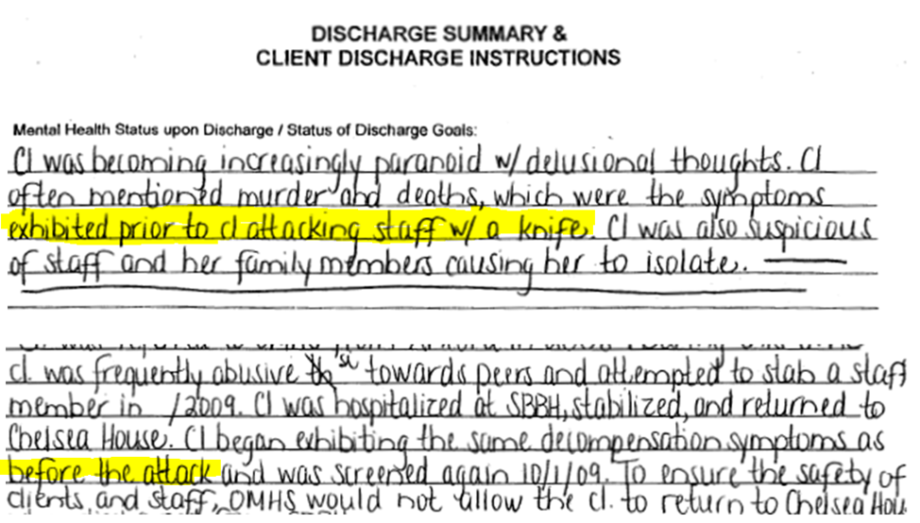

Slide 5


