Slide 2
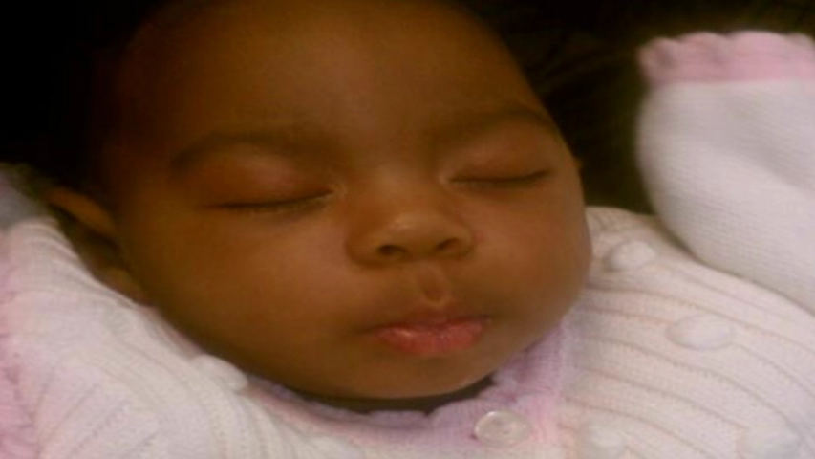

Slide 3
Negligent Acts
Dr. Williams failed to timely order repeat BPP
2. Dr. Hearin and/or Dr. Lipscomb “dropped the ball” in setting up
MFM consult.
3. GMC delayed admission / EFM

Slide 4
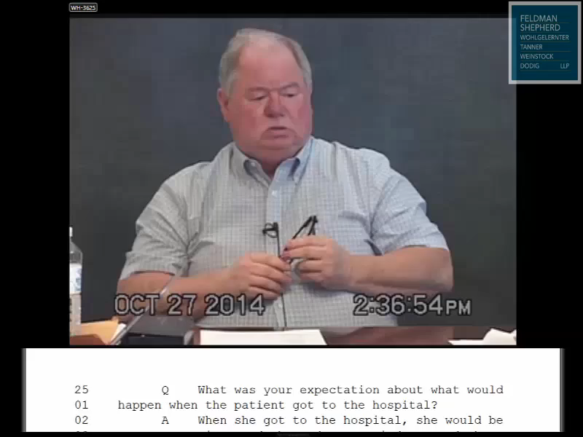
Dr. Hearin

Slide 5
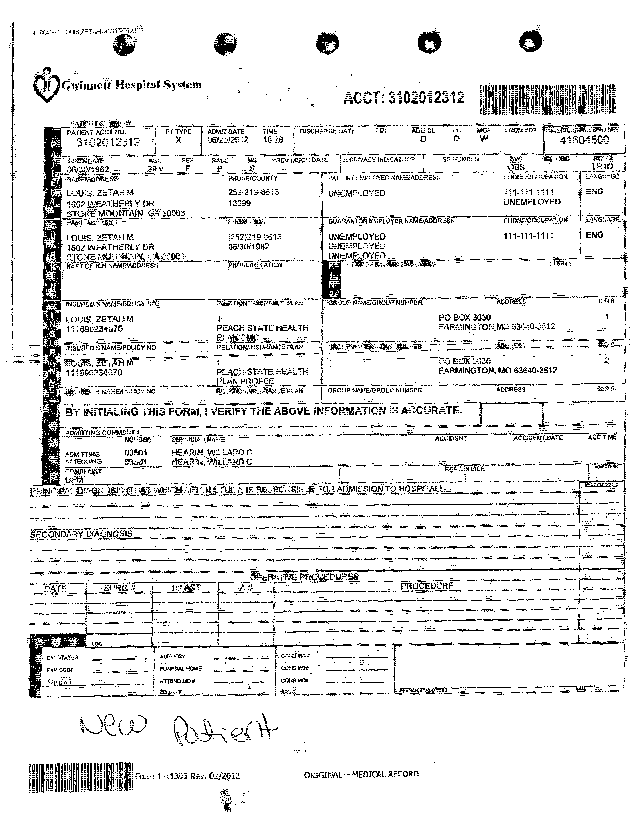
June 25, 2015 GMC Admit Record

Slide 6
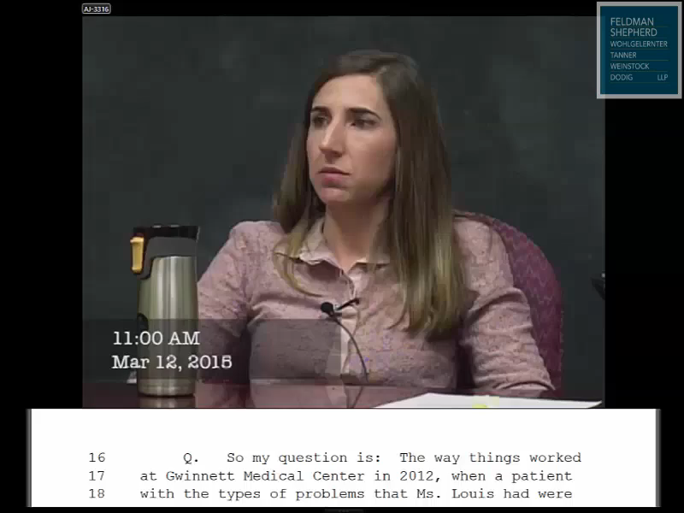
Nurse Johnson

Slide 7
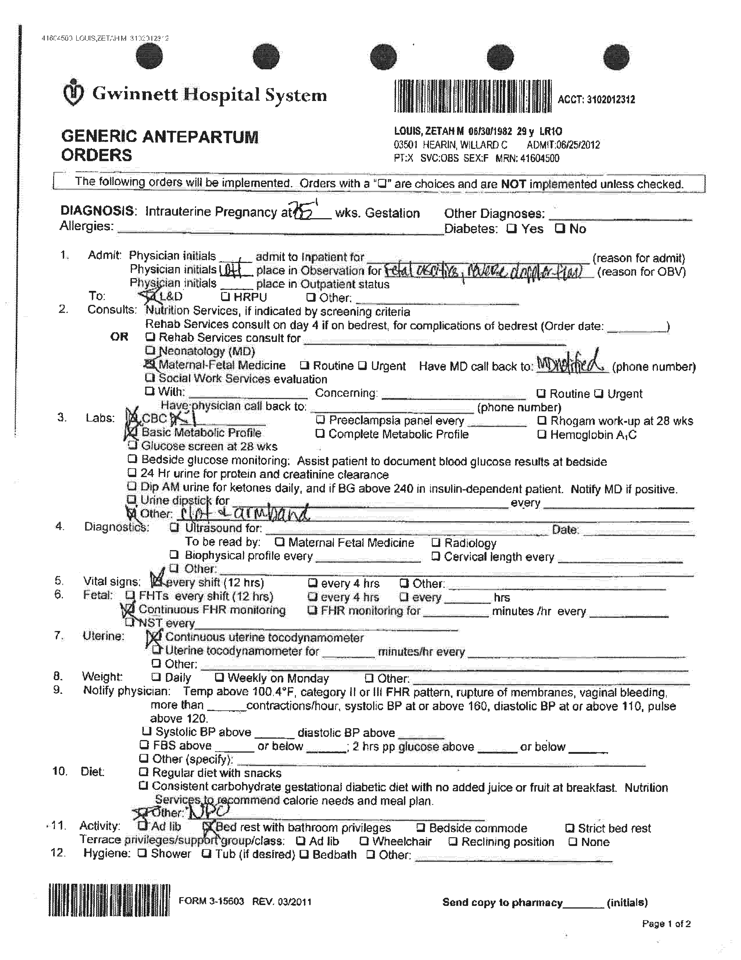
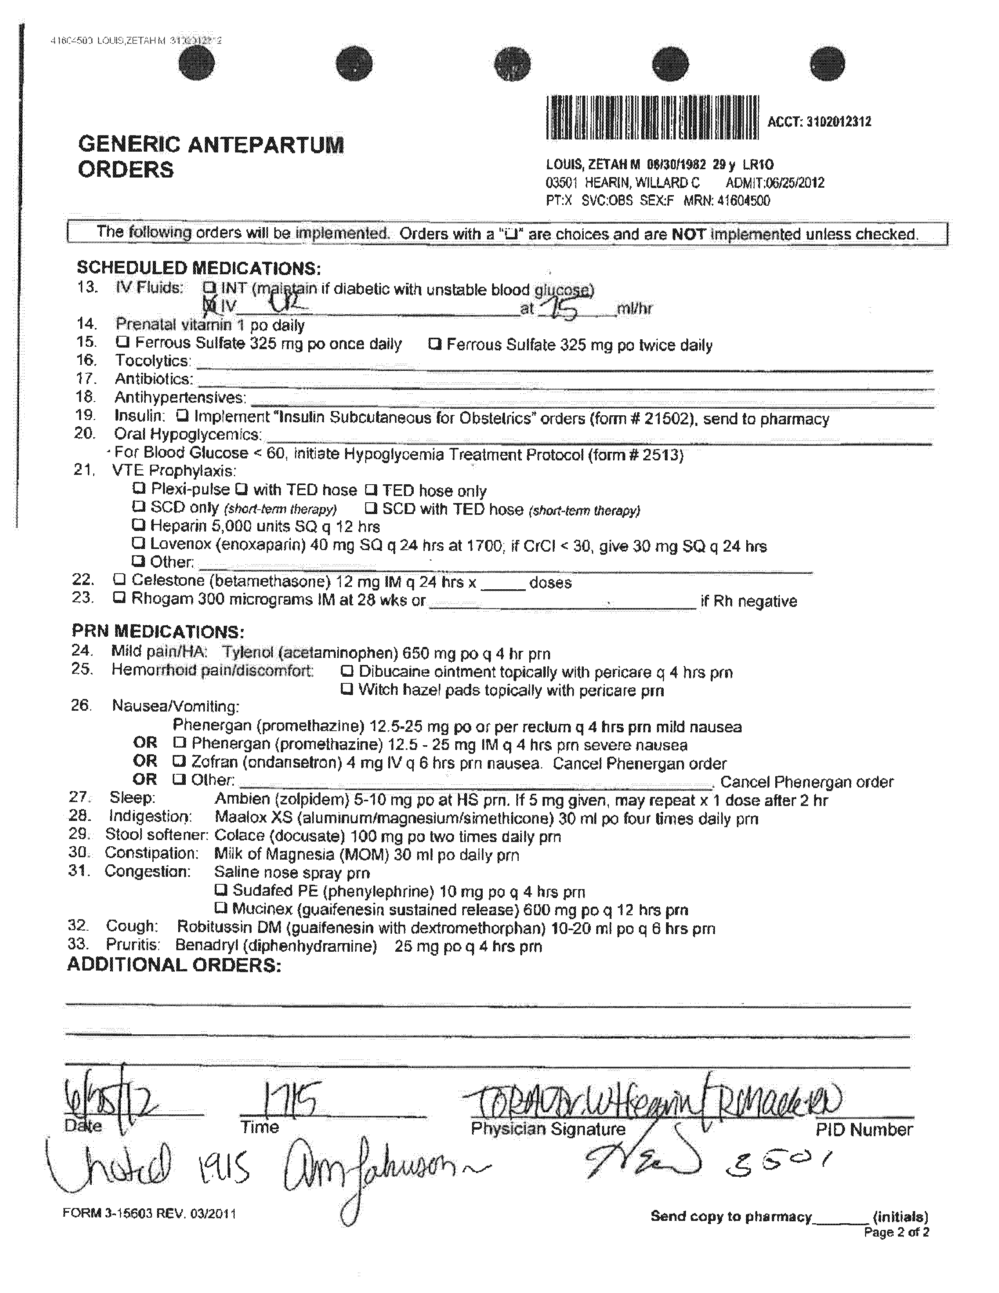
Dr. Hearin’s 5:15 pm Orders
* * *

Slide 8
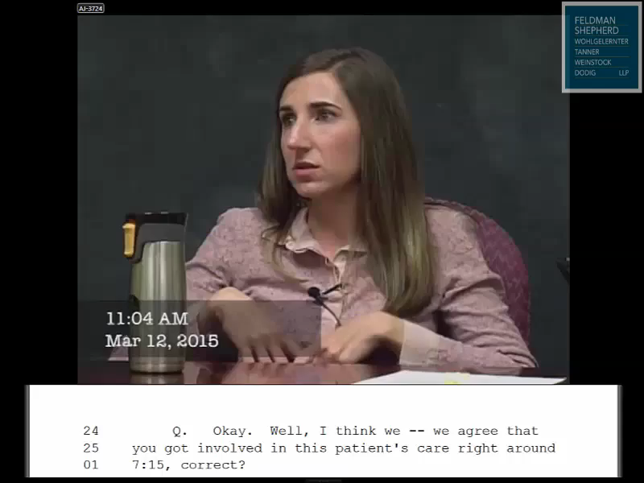
Nurse Johnson

Slide 9
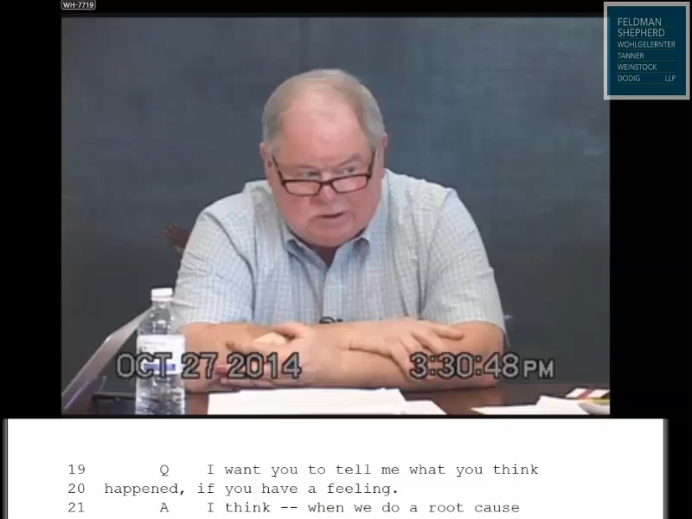
Dr. Hearin

Slide 10
Negligent Acts
Dr. Williams failed to timely order repeat BPP
Dr. Hearin and/or Dr. Lipscomb “dropped the ball” in setting up MFM consult.
GMC delayed admission / EFM
Another miscommunication between Dr. Hearin and Dr. Lipscomb
GMC violated its own policy and delayed BPP

Slide 11
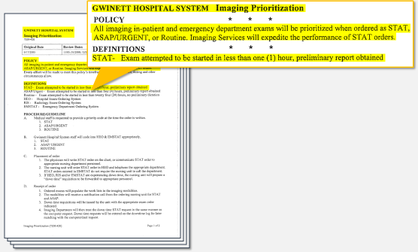
GMC Ultrasound Imaging Prioritization Policy

Slide 12
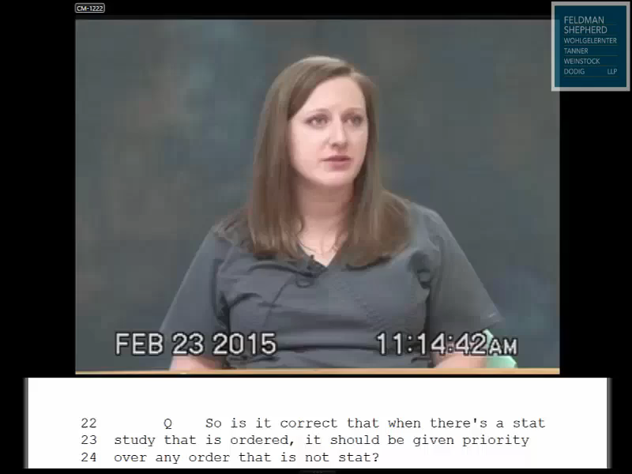
Christina Migliore

Slide 13
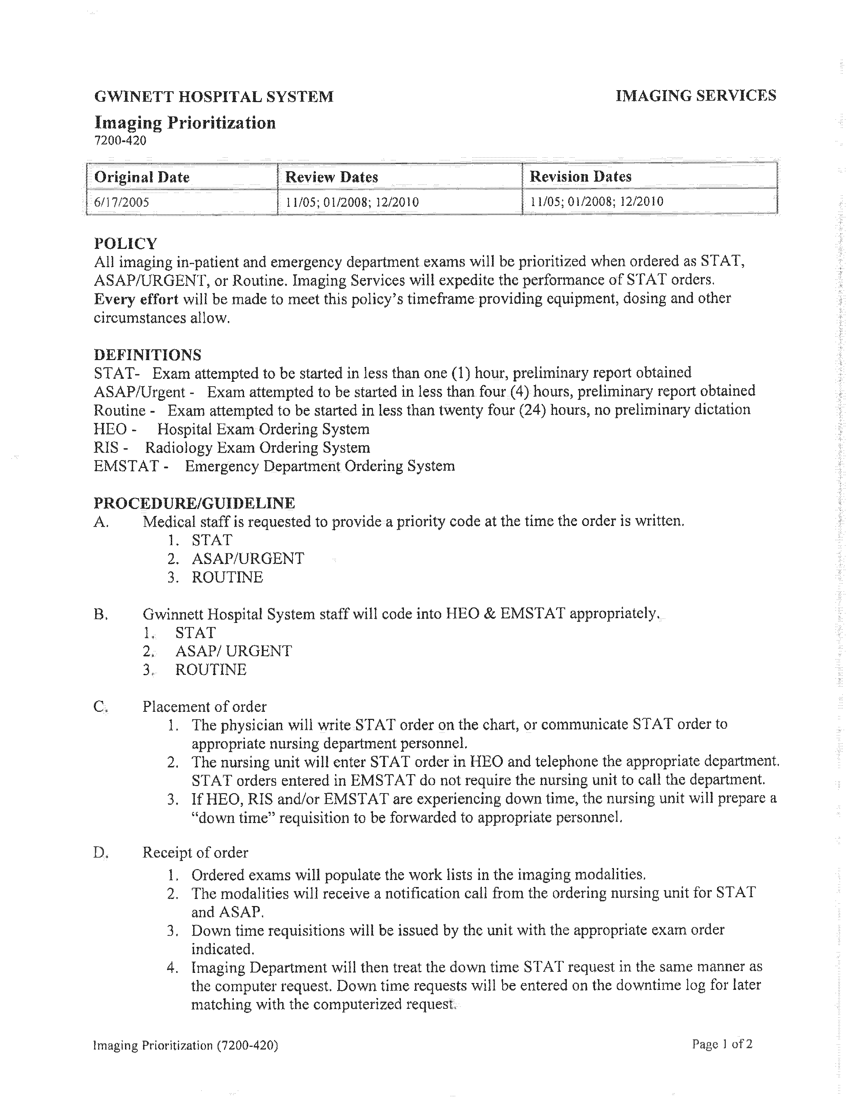
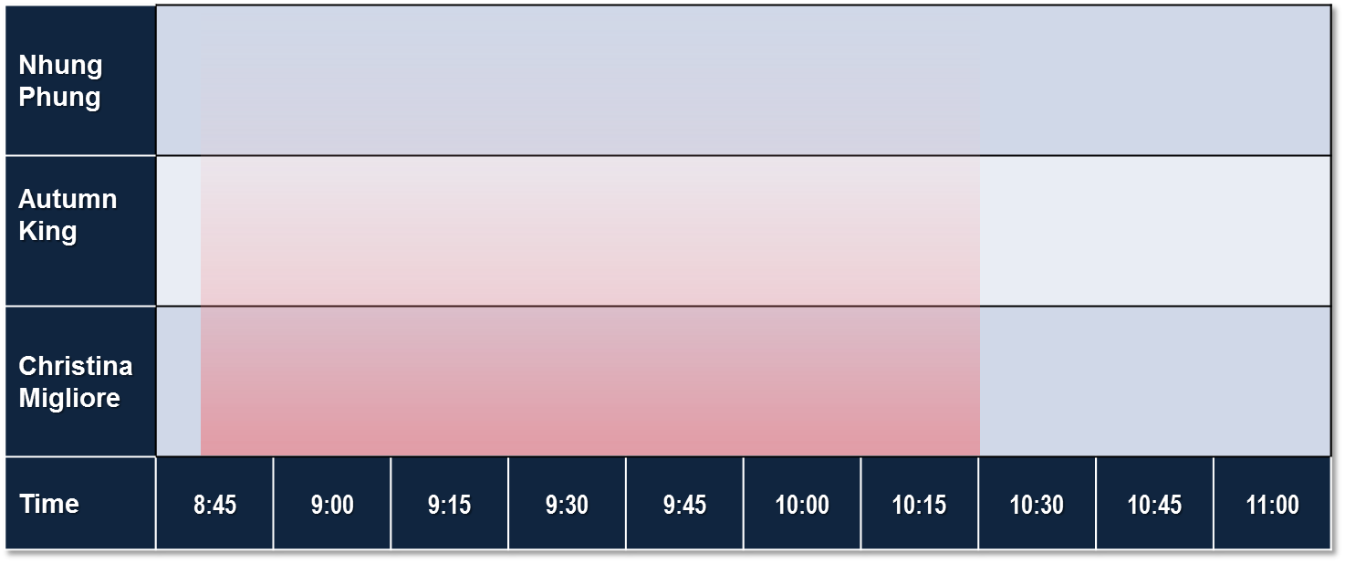
GMC Ultrasound Imaging Prioritization Policy
* * *
* * *
Zetah Louis
STAT BPP ORDERED
8:50 PM
Zetah Louis
STAT BPP STARTED
10:30
Routine
Study
9:10 – 9:29
Routine Study
9:44 – 10:06
Routine Study
9:25 – 9:34
STAT
Study
8:59 – 9:11
Routine
Study
9:22 – 9:40
STAT
Study
10:04 – 10:14
Zetah Louis
STAT BPP
10:30 – 11:06
Time | 8:45 | 9:00 | 9:15 | 9:30 | 9:45 | 10:00 | 10:15 | 10:30 | 10:45 | 11:00

Slide 15
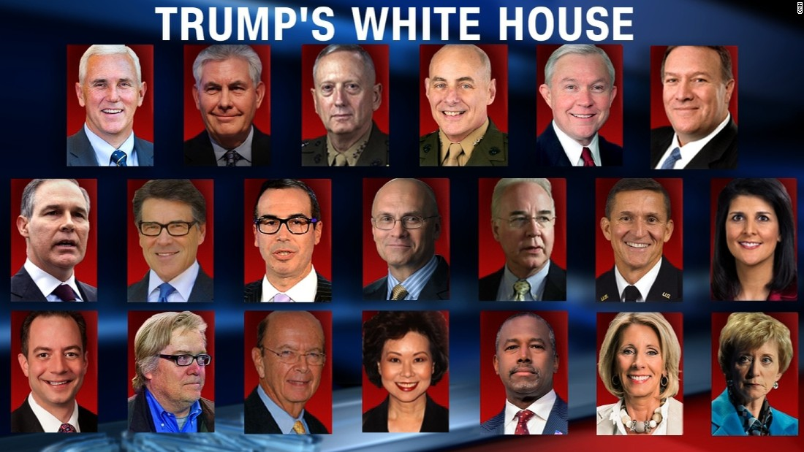

Slide 17
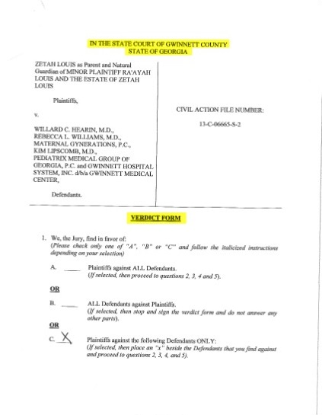
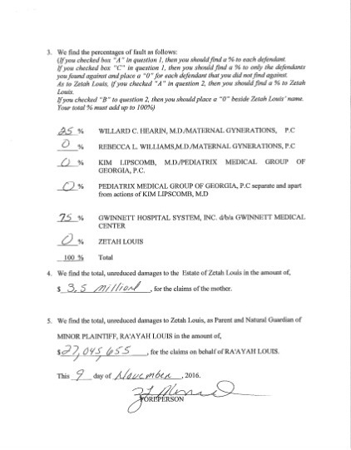
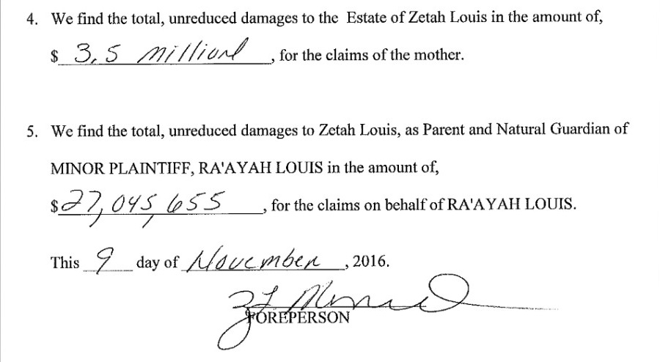
Verdict Form

Slide 18
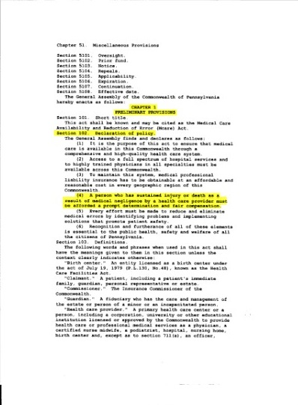
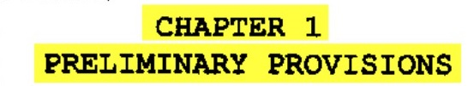
M Care

Slide 19
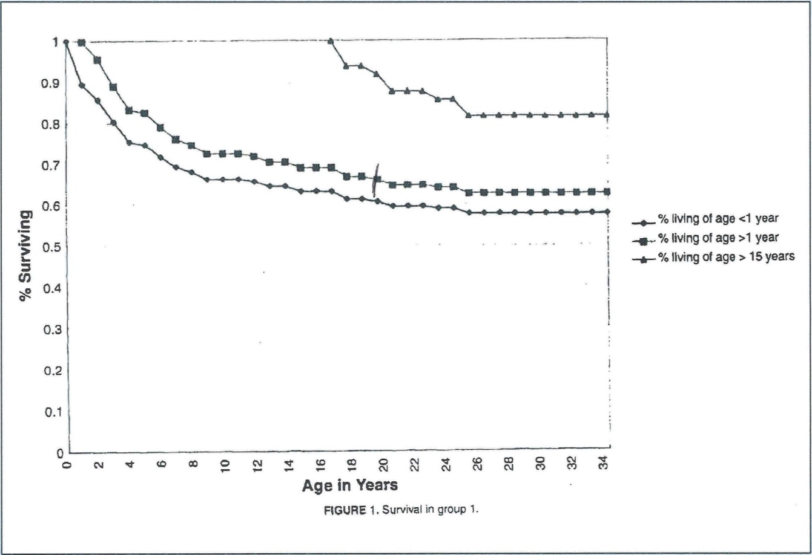
Survival Rates Among Children With Severe Neurologic Disabilities

