Slide 1
Notes:
This segment would be better titled, “Practical Considerations in openings and closings…”

Slide 2
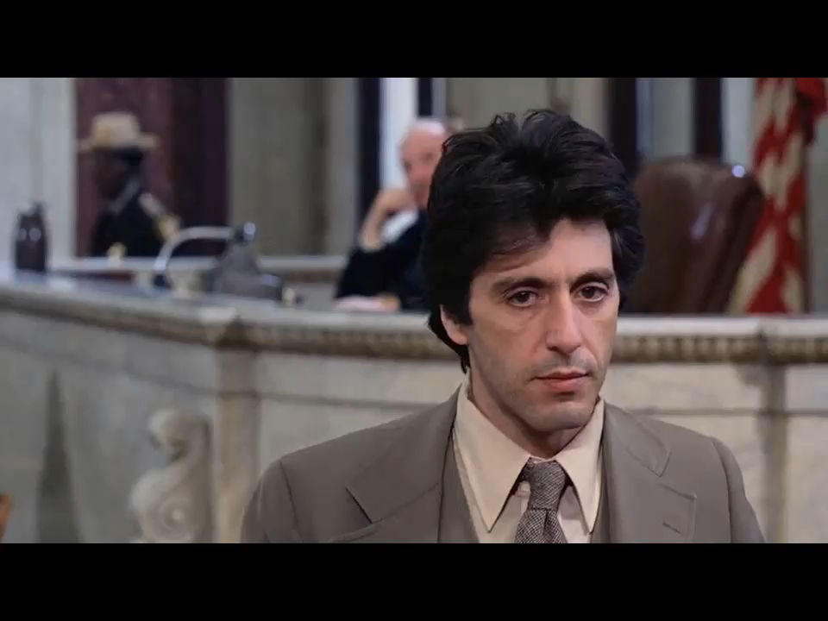

Slide 3
INTRODUCTION
DUTY OF CANDOR;
DUTY TO PROTECT THE INTEGRITY OF THE LEGAL SYSTEM;
BALANCING BOTH DUTIES IN AN ADVERSARIAL SYSTEM;
ANTICIPATE ETHICAL LINE CROSSING
MOTIONS IN LIMINE AS SHIELD AND SWORD
Violations of Orders of Preclusion
Sutch v. Roxborough Memorial Hospital
Notes:
We start with the 2 basic attorney core values. 1. Duty to be a zealous advocate and our ethical duties. These two core values can clash at times.
We all want to win; but at what price? In the Civil Context we will see, that it really takes an egregious act to warrant an ethical charge against you. I think we all here know the rules; and a very safe milquetoast opening or closing that is miles away from an ethical question; may be playing it way too safe. Advocacy requires aggressive handling of adverse witnesses.
Know your adversary….

Slide 4
Trial as a Search for Truth
The defendant-appellant's primary contention is that the very substantial adverse jury verdict and judgment in this personal injury case¹ was fatally infected by the egregiousness of plaintiffs' counsel's final argument. It is indeed clear that the lawyers for both sides, …….engaged in a disgraceful display of unprofessional conduct² which was much more appropriate to *851 a prize fight or, more accurately, to a gladiatorial contest than to a search for truth in the halls of justice.
Borden, Inc. v. Young, 479 So.2d 850, 850–51 (Fla.App. 3 Dist.,1985)

Slide 5
Opening to the Jury
“A properly presented opening statement familiarizes the jury with the evidence, the nature of the case, and each party's theory of recovery and defense. It allows jurors to better understand the evidence as it is introduced and to more accurately discern its force, effect and weight.” Id. (citing 6 Fla. Prac, Personal Injury & Wrongful Death Actions § 24:3 (2008-09 ed.).
30 No. 3 Trial Advoc. Q. 19
Telling the Story…informing the Jury about the case, the evidence they will hear and see in the court room.
Introduce your theme; don’t argue.

Slide 6
Opening to the Jury
The things we learned in grade school:
1. Don’t lie
2. Don’t promise something you can’t or may not deliver
3. When speaking about evidence…make sure you know the evidence is going to be admissible;
4. Introducing evidence you know have been precluded by pre trial orders is improper;
5. If precluded; make your record before the jury enters the courtroom.
6. Civil vs. Criminal Cases
7. Waiver… more likely in civil.

Slide 7
Opening to the Jury
• Further, for an improper argument to form the basis for a motion for new trial absent a contemporaneous objection, the argument must rise to the level of fundamental error: it must be improper, harmful and incurable, and so damaging to the fairness of the trial that the public's interest in our system of justice requires a new trial. Murphy, 766 So. 2d at 1028-1030. The trial court must, in the order granting a new trial, specifically identify “both the improper arguments of counsel and the actions of the jury resulting from those arguments.” Id. at 1031

Slide 8
Rules of Professional Conduct
I. R.P.C. 3.3 Candor Toward the Tribunal
(a) A lawyer shall not knowingly:
(1) Make a false statement of material fact or law to a tribunal;
(2) Fail to disclose a material fact to a tribunal when disclosure is necessary to avoid assisting in a legal, criminal or fraudulent act by the client;
(3) Fail to disclose to the tribunal legal authority in the controlling jurisdiction known to the lawyer to be directly adverse to the position of the client and not disclosed by opposing counsel;
Notes:
The ethical guidelines can be found in R.P.C’s 3.3 and 3.4

Slide 9
Rules of Professional Conduct
(4) Offer evidence that the lawyer knows to be false. If a lawyer has offered material evidence and comes to know of it falsity, the lawyer shall take reasonable remedial measures; or
(5) Fail to disclose to the tribunal a material fact knowing that the omission is reasonably certain to mislead the tribunal, except that it shall not be a breach of this rule if the disclosure is protected by a recognized privilege or is otherwise prohibited by law.
(5)(c) A lawyer may refuse to offer evidence that the lawyer reasonably believes is false.
Notes:
The ethical guidelines can be found in R.P.C’s 3.3 and 3.4

Slide 10
Fairness to Opposing Counsel and Court – 3.4
A lawyer shall not:
….. (e) In trial, allude to any manner that the lawyer does not reasonably believe is relevant or that will not be supported by admissible evidence, assert personal knowledge of facts and issues except when testifying as a witness, or statement a personal opinion as to the justness of a cause, the credibility of a witness, the culpability of a civil litigant…
Notes:
Defense counsel introduced evidence of def. doctor’s mindset… his father had cancer so of course he was sensitive and caring for his patient. PRE; 406…Habit testimony

Slide 11
Fairness to Opposing Counsel and Court – 3.4
Mindset Testimony:
  The Trial Court properly recognized that Geller's medical decisions and his father's cancer are sui generis and bear no relationship to his handling of Rosalind Wilson. The health issues faced by Geller's father are irrelevant as the handling of the lung cancer of parent in no way explains or excuses Geller's failure to comply with the standards of reasonable medical care in the case of Mrs. Wilson. Rather, such evidence would tend to suggest a verdict on the improper bases of sympathy. Pa.R.E. 401, 403
  Based on Pa.R.E. 406; [defendant] failed to provide a sufficient foundation for admissibility based on habit as opposed to his self-serving statement about a mere inclination...
  Rosalind W. SUTCH, as Executrix of the Estate of Rosalind Wilson, Deceased, Appellee, v. ROXBOROUGH MEMORIAL HOSPITAL, et.al., 2015 WL 11578480 (Pa.Super.), 25
  Rosalind W. SUTCH, as Executrix of the Estate of Rosalind Wilson, Deceased, Appellee, v. ROXBOROUGH MEMORIAL HOSPITAL, et.al., 2015 WL 11578480 (Pa.Super.), 24
Notes:
Defense counsel introduced evidence of def. doctor’s mindset… his father had cancer so of course he was sensitive and caring for his patient. PRE; 406…Habit testimony

Slide 12
CLOSING ARGUMENTS
“I BELIEVE” - … during cross-examination of defense expert “My daddy was a preacher, so I know what the truth is ...”).
30 Trial Advoc. Q. 19, 21, 30 NO. 3 Trial Advoc. Q. 19, 21
“THE GOLDEN RULE VIOLATION” [applies to damages, only]
During closing argument, plaintiffs' counsel told the jury that if a “magic button” were placed in front of Mrs. Williams, a juror, and $6 million were placed in front of Mr. Brooks, another juror, the plaintiffs would walk past the money and press the button to bring their son back. Appellants' counsel objected, arguing this constituted an impermissible “golden rule” argument.
Bocher v. Glass, 874 So.2d 701, 703 (Fla.App. 1 Dist.,2004)
Notes:
But are these ethical violations?? Or is this just aggressive and appropriate advocacy?

Slide 13
CLOSING ARGUMENTS
“SEND A MESSAGE”
“I want to go back to the Florida Times Union. About every thirty days they publish an article in section B in the editorial section that has to do with frivolous lawsuits.” Bocher v. Glass, 874 So. 2d 701 (Fla. 1st DCA 2004).
30 Trial Advoc. Q. 19, 20, 30 NO. 3 Trial Advoc. Q. 19, 20
Notes:
But are these ethical violations?? Or is this just aggressive and appropriate advocacy?

Slide 14
RULES OF THE ROAD
WHAT NOT TO SAY!
EXAMPLES:
Are there two sides to every question? And the immediate gut reaction is: Yeah, yeah. You want to be fair and you say: Right, there's two sides to every question. What's the other side to the Holocaust? What is the other side to slavery?
Engle v. Liggett Group, Inc., 945 So.2d 1246, 1273 (Fla.,2006)
In this building, in this building, a temple to the law, they were—there were drinking fountains which said Whites Only.

Slide 15
RULES OF THE ROAD
The Court on Appeal:
There is absolutely no justification for this series of remarks, which appears to compare the tobacco industry with slavery and, by invoking civil rights leaders Rosa Parks and Martin Luther King, appealed to the jury's sense of outrage for the injustices visited upon African–Americans in this country. We condemn these tactics of Mr. Rosenblatt. His attempt to incite racial passions was conduct unbecoming an attorney practicing in our state courts.
Engle v. Liggett Group, Inc., 945 So.2d 1246, 1273 (Fla.,2006)

