Slide 2
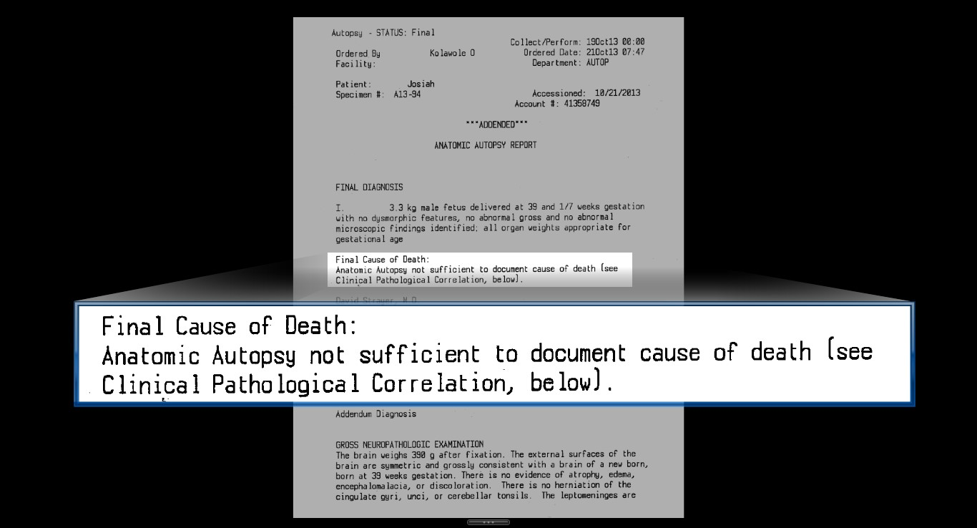


Slide 3
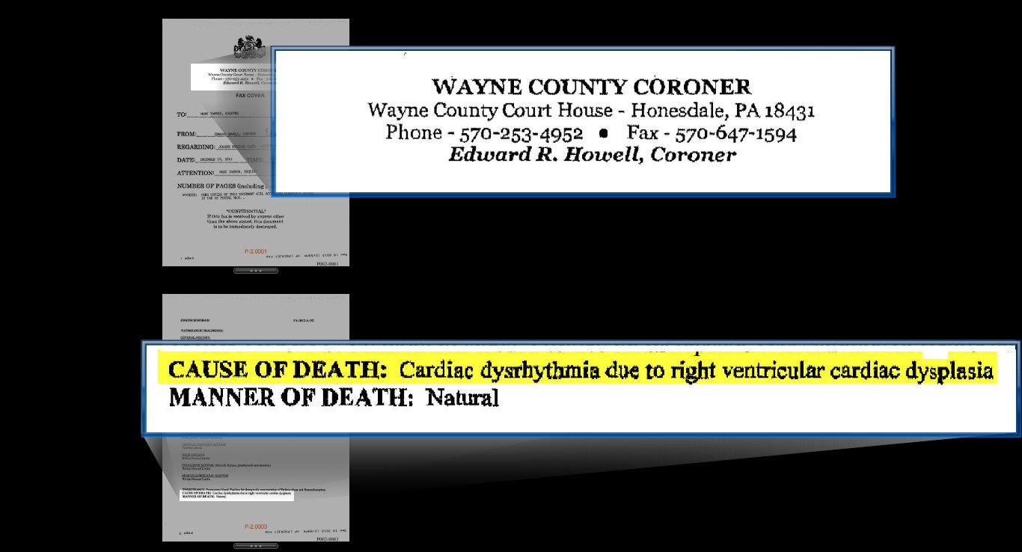

Slide 4
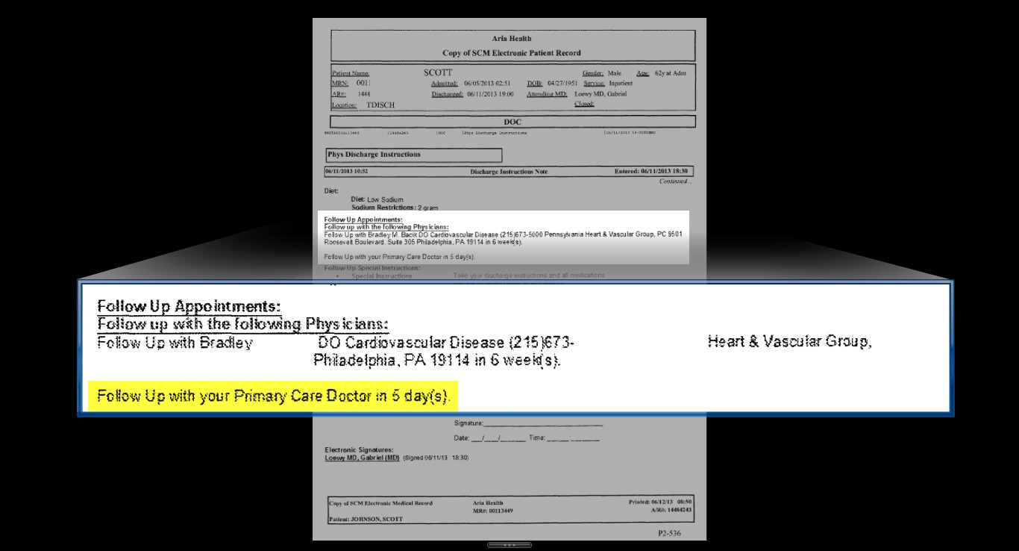

Slide 5
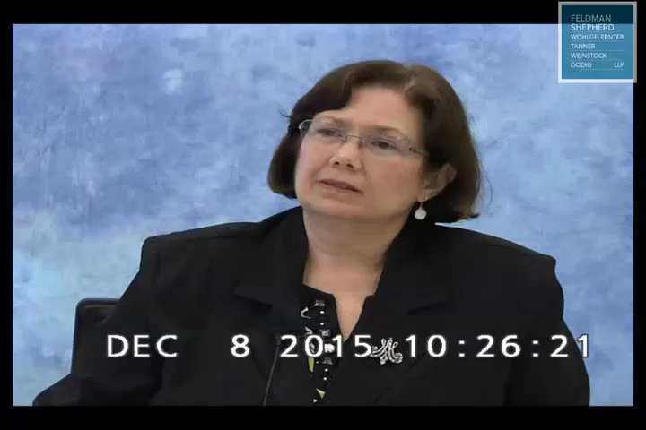
Notes:
Johnson: McCarey 29:13 – 33:21
3min, 26sec

Slide 6
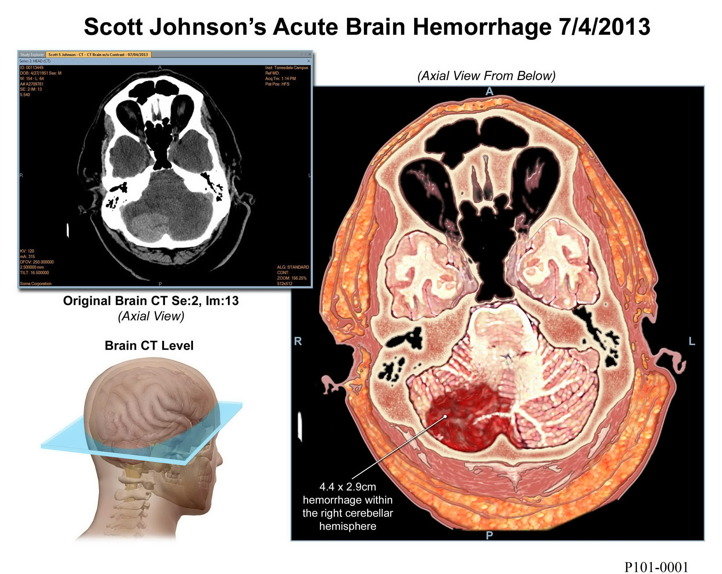

Slide 7
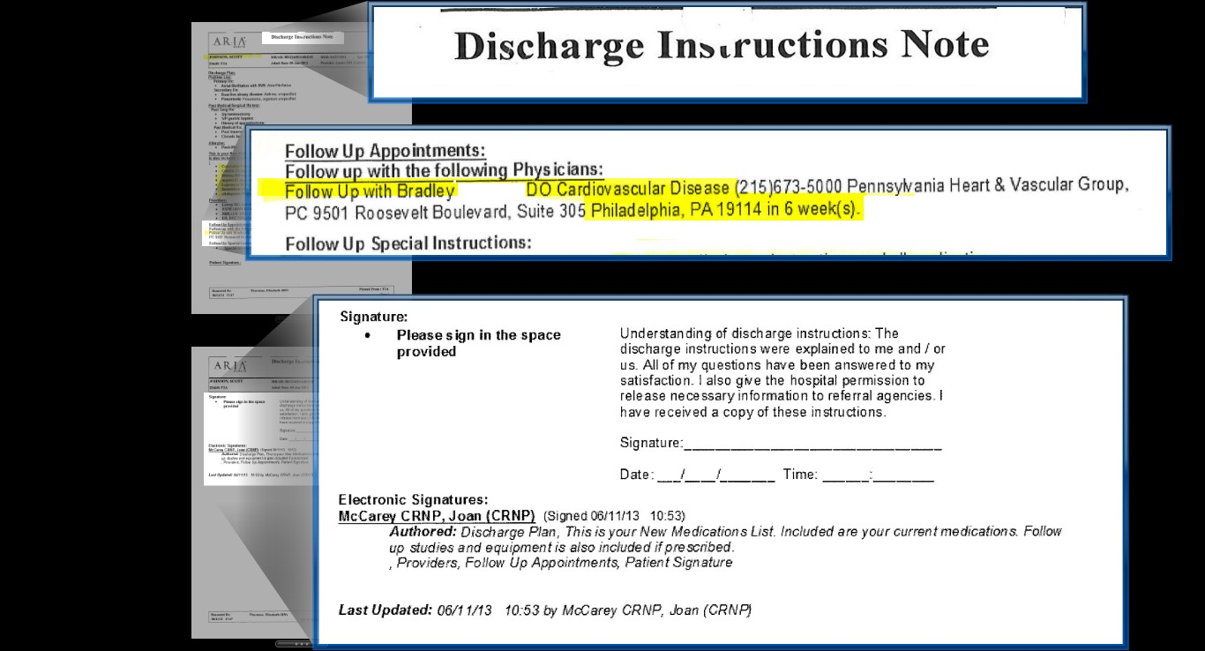


Slide 8
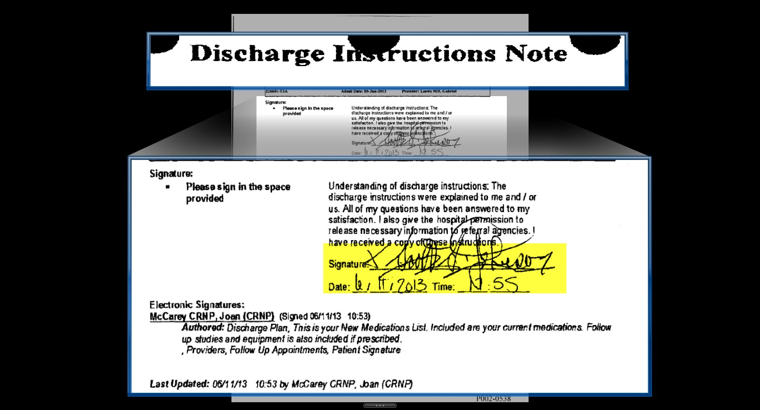

Slide 9
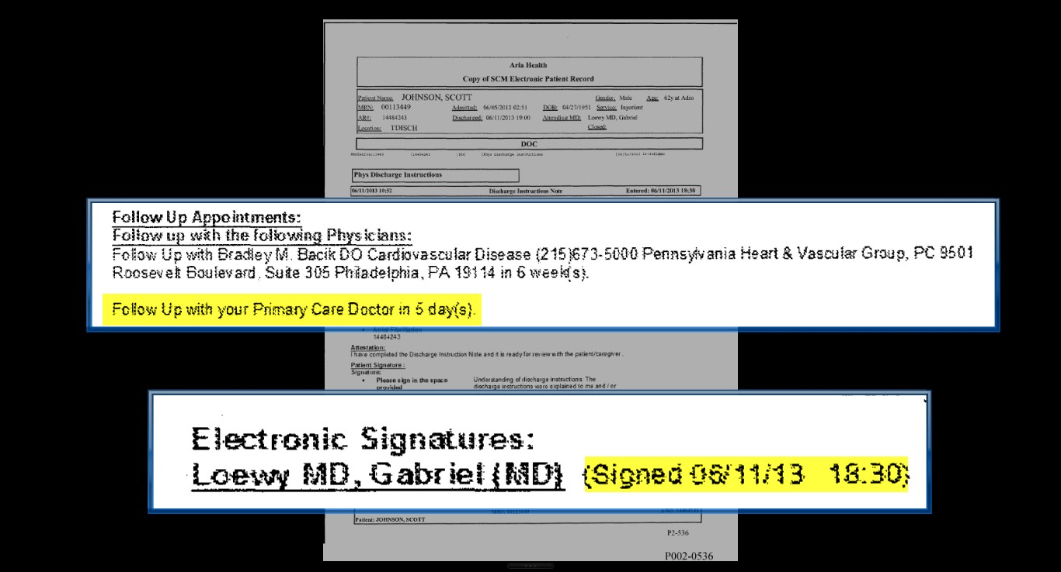

Slide 10
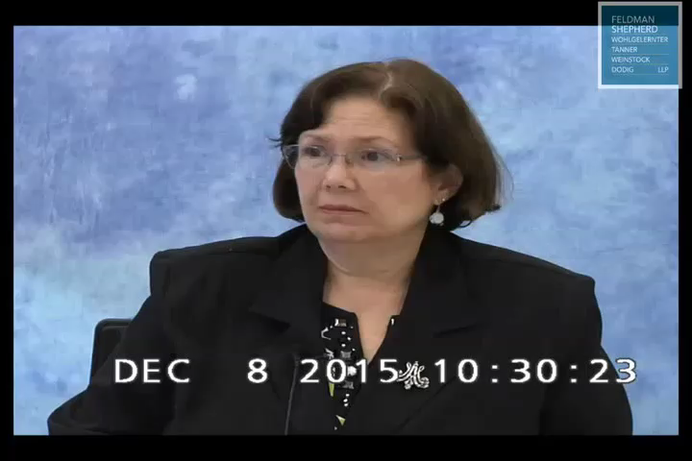
Notes:
mcCarey 34:10 through 36:5
1min 13 sec

Slide 11
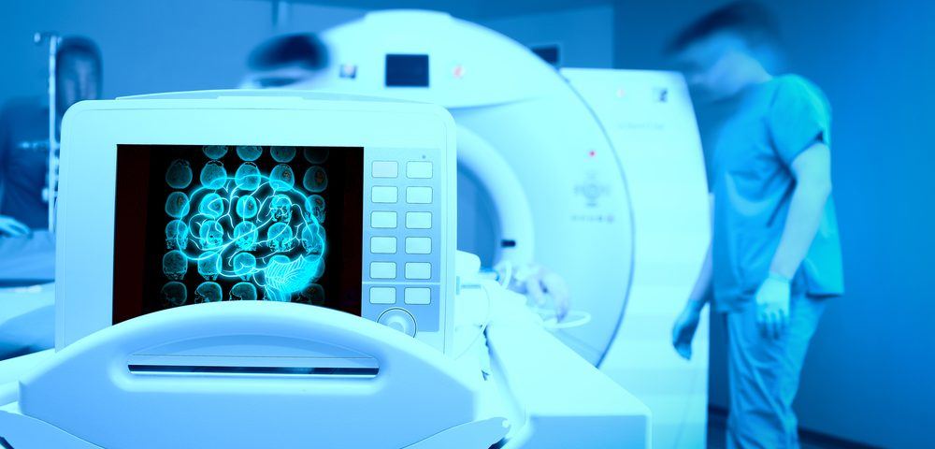
Importance of Reviewing Images

Slide 13
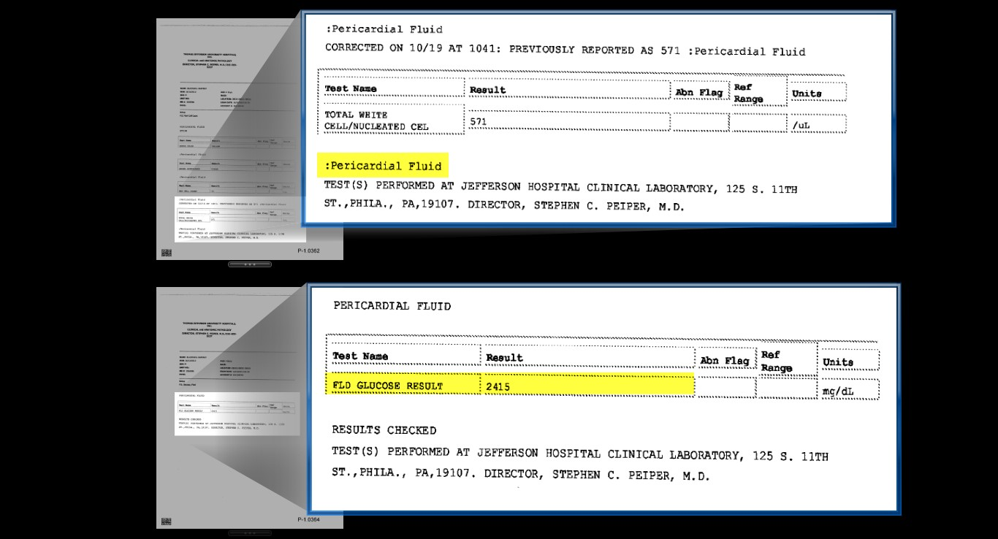

Exposing alternative facts in the medical records

Slide 14
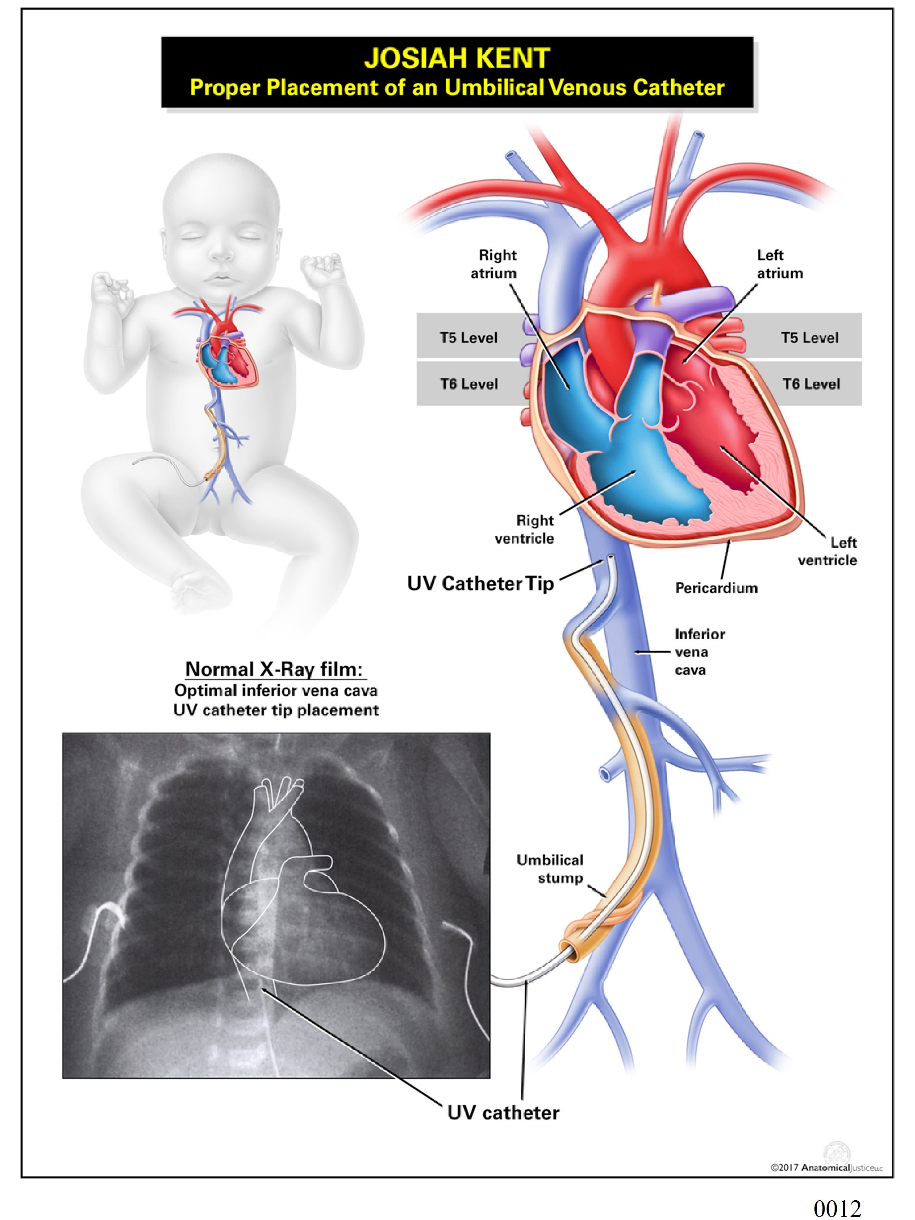

Slide 15
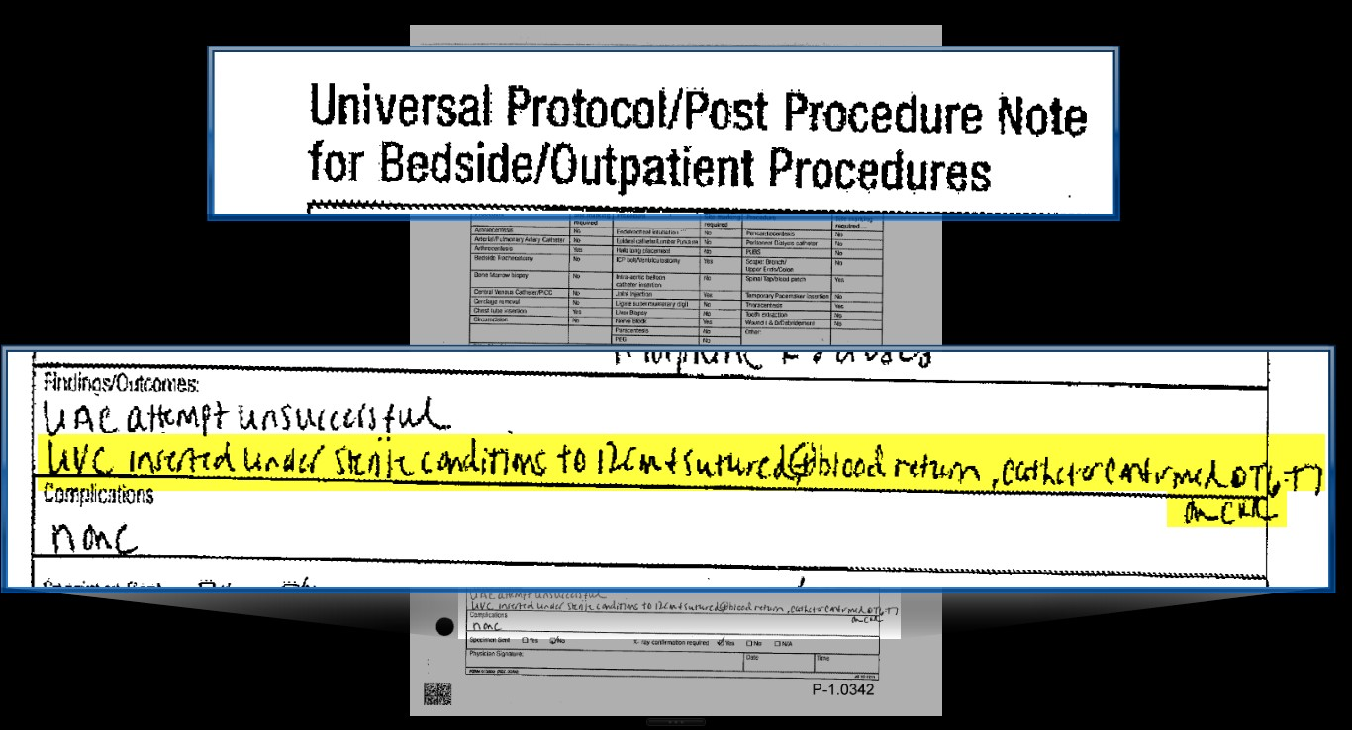

Slide 16
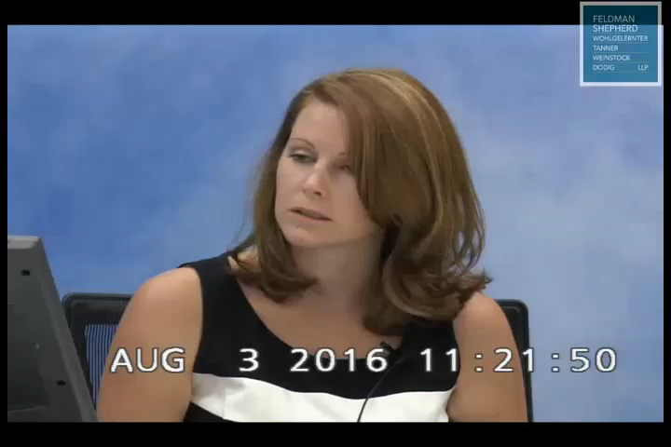
Notes:
Luckenbill clip: 21:11 through 22:11
45 sec

Slide 17
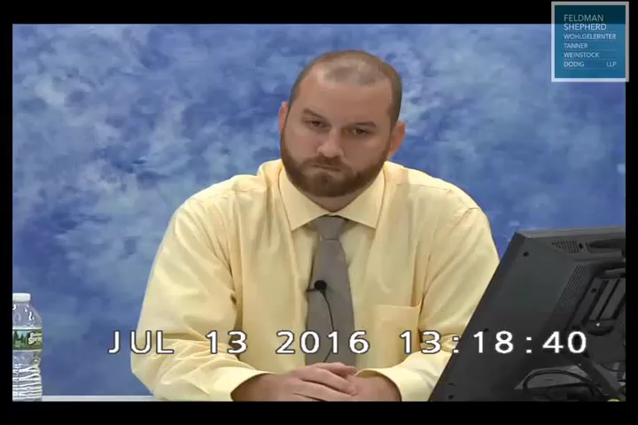
Notes:
Carola clip: 25:2 through 27:13
2 min 50 sec

Slide 18
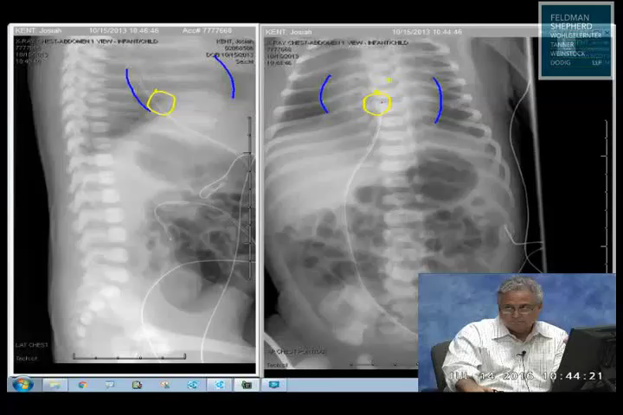
Notes:
Karasick clip: 51:3 through 51:7
12 secs

Slide 19
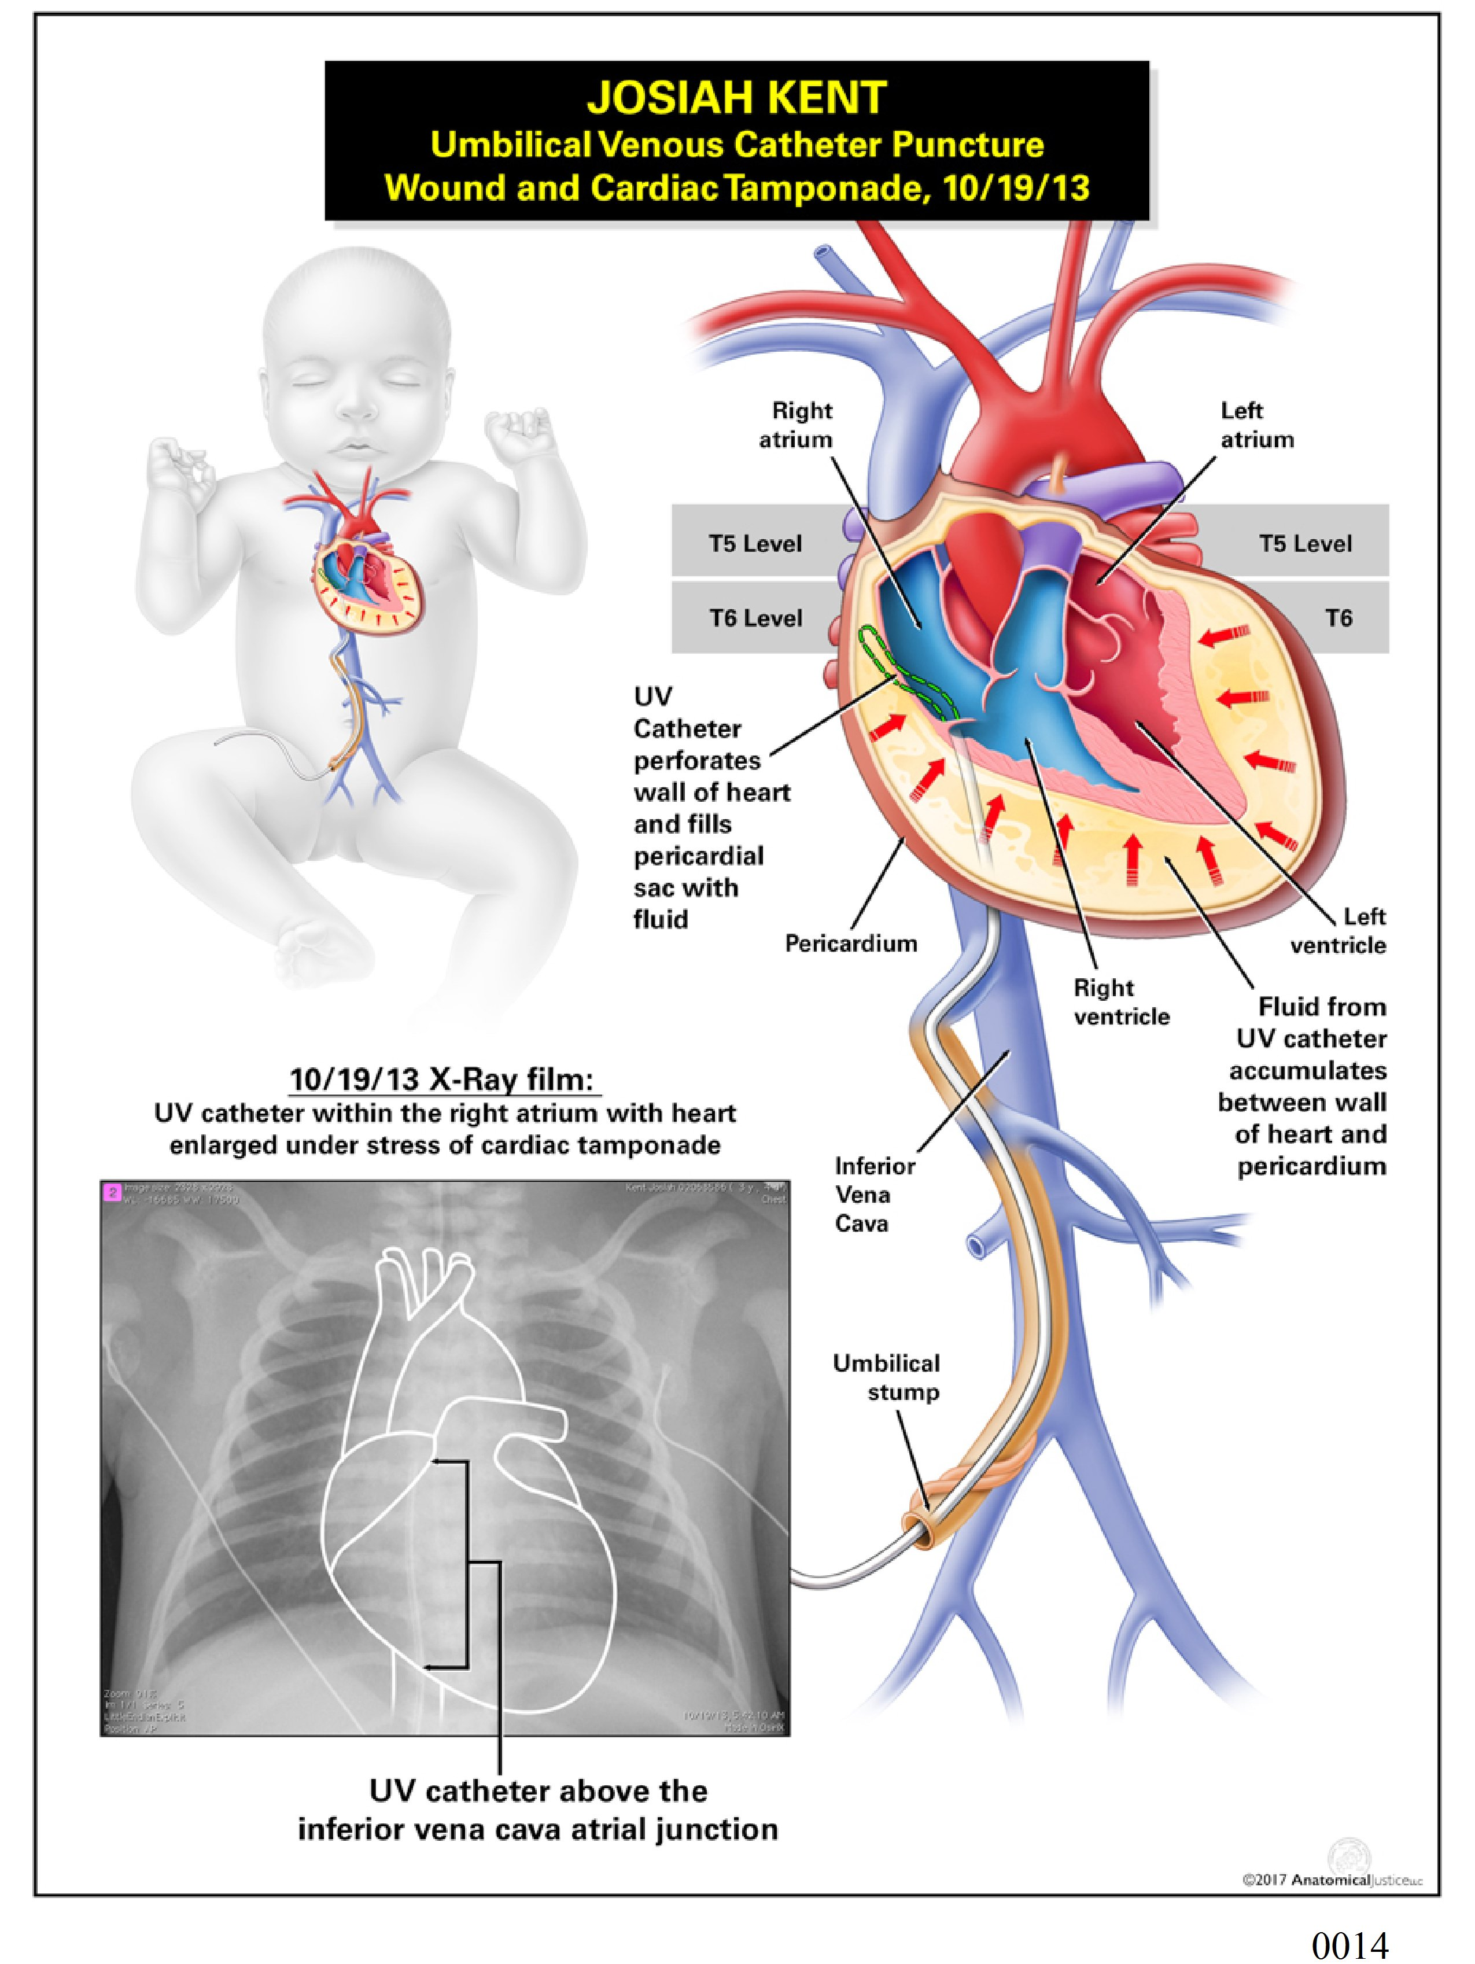

Slide 20
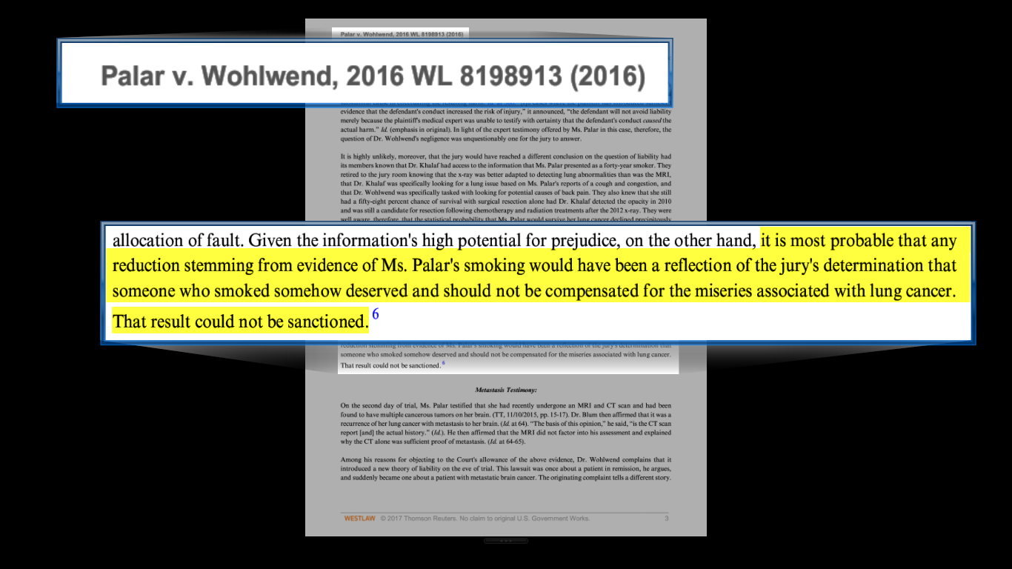
Trial Court Opinion

Slide 21
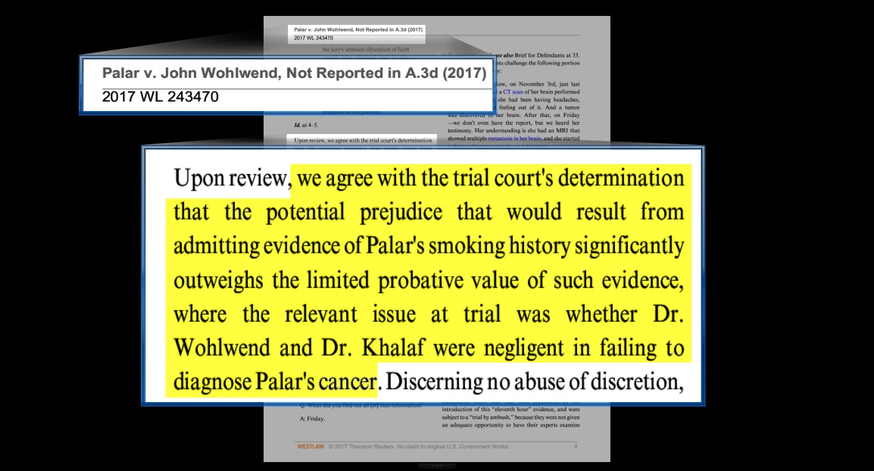
Affirmed on Appeal
appeal denied, 2017 WL 4351303 (Pa. 2017)(“The potential prejudice that would result from admitting evidence of Palar's smoking history significantly outweighs the limited probative value of such evidence, where the relevant issue at trial was whether Dr. Wohlwend and Dr. Khalaf were negligent in failing to diagnose Palar's cancer.”)

Slide 22
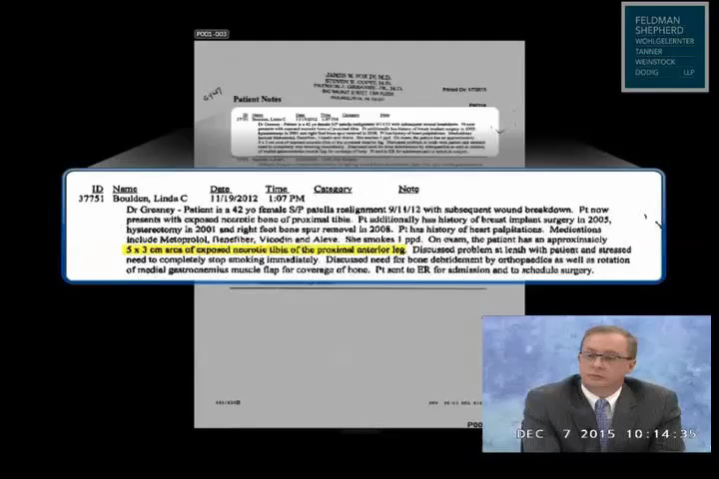
Notes:
Greaney p. 22
33secs

Slide 23
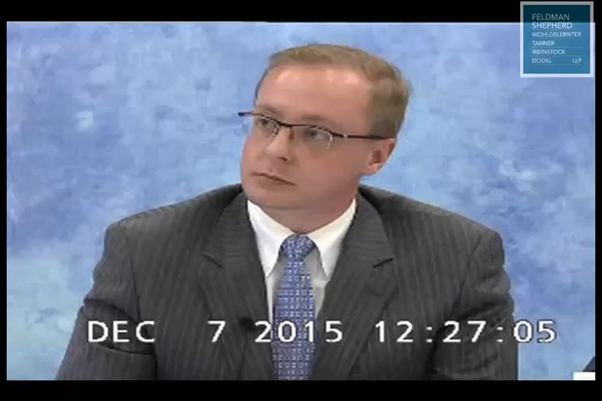
Notes:
Greaney p. 134
1min 6 secs

Slide 24
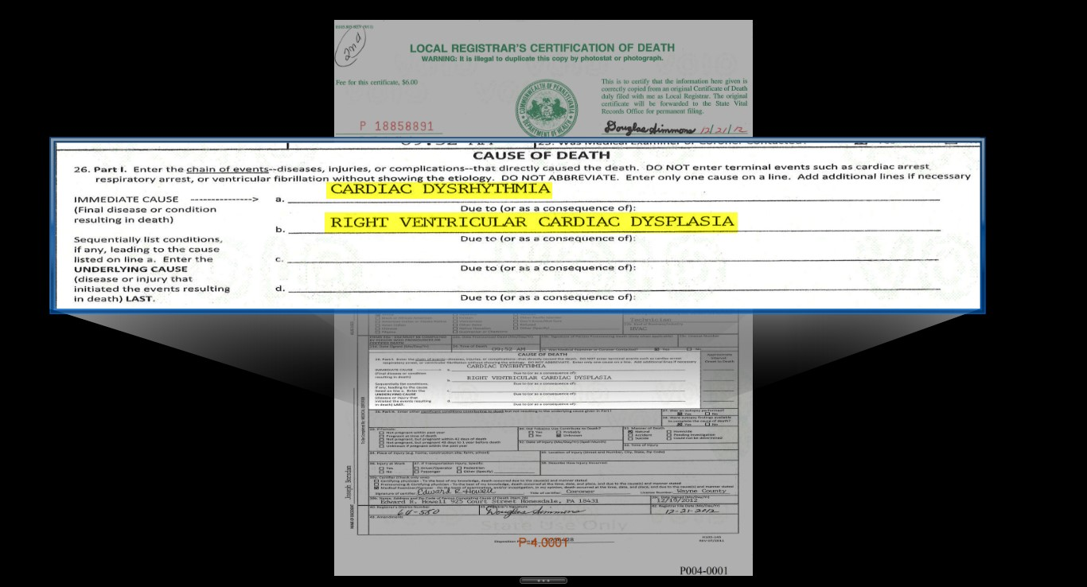

Slide 25
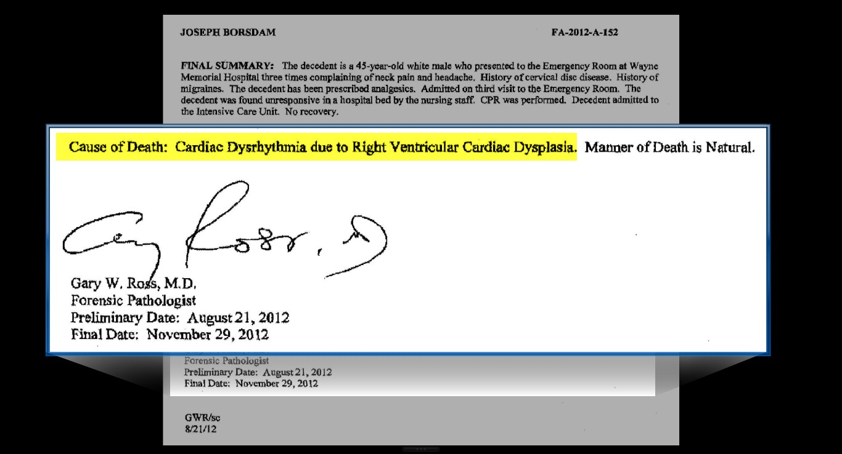

Slide 26
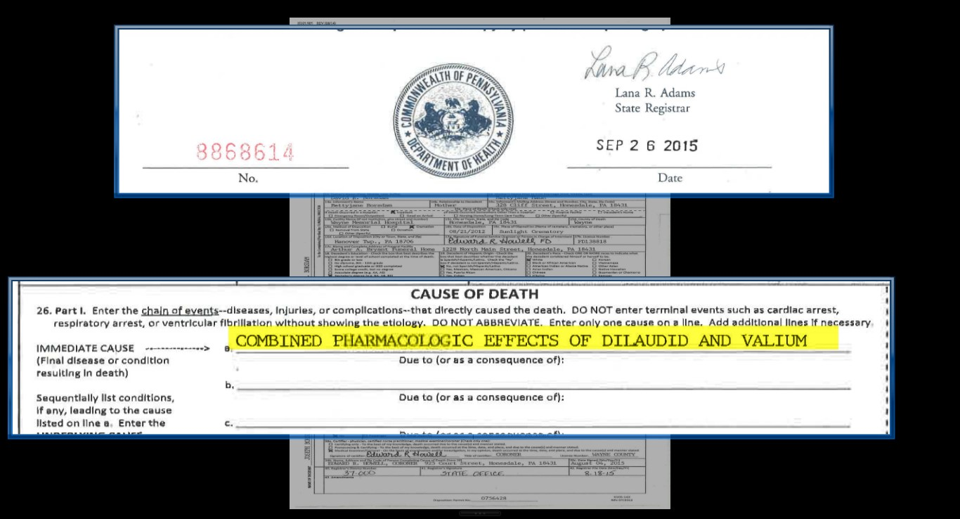

Slide 27
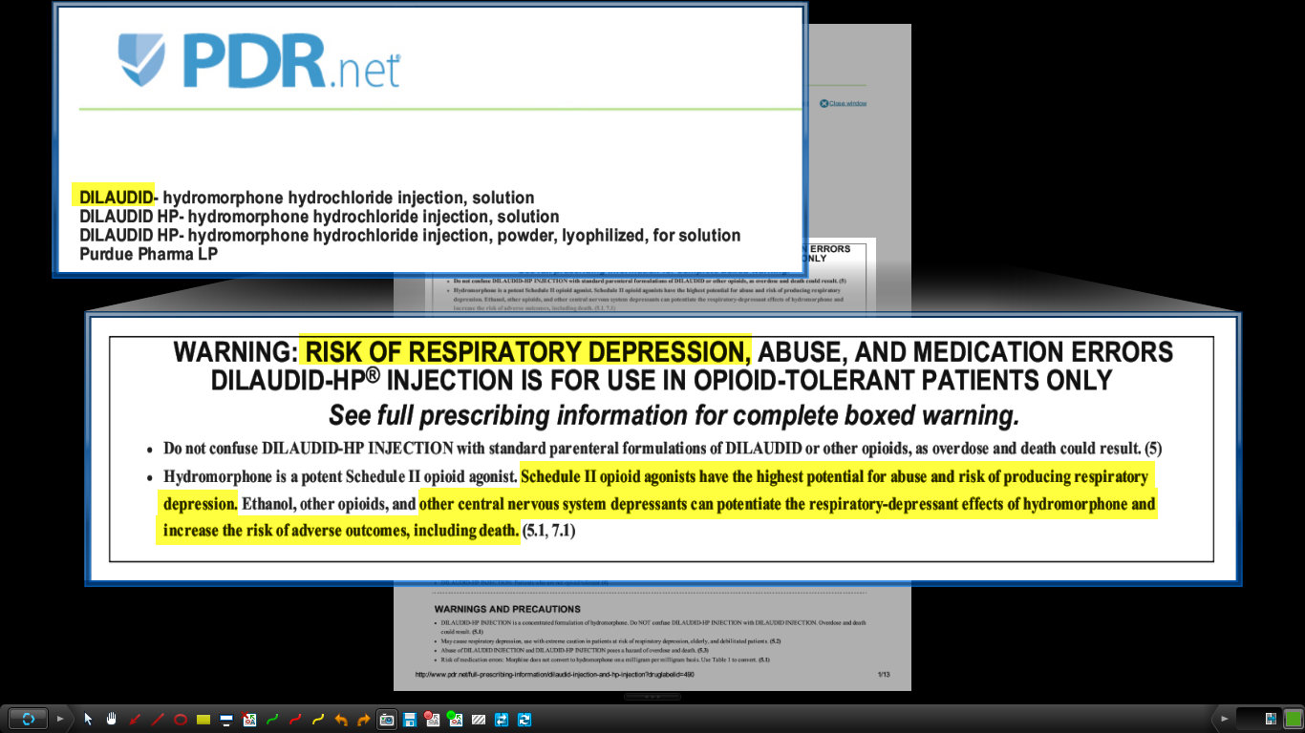
Dilaudid Warning from PDR

Slide 28
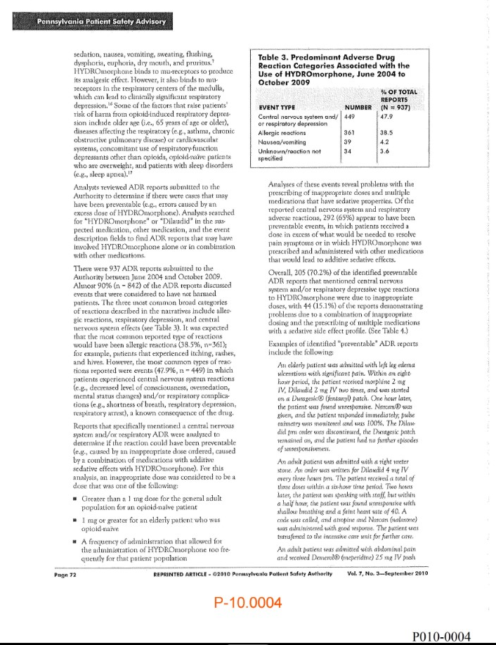
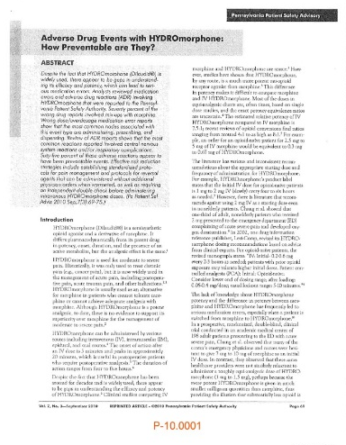
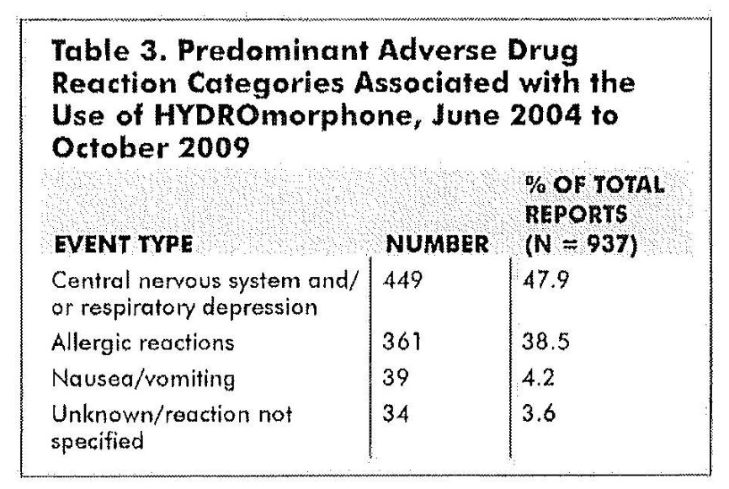
Patient Safety Advisory – 2010

Slide 29
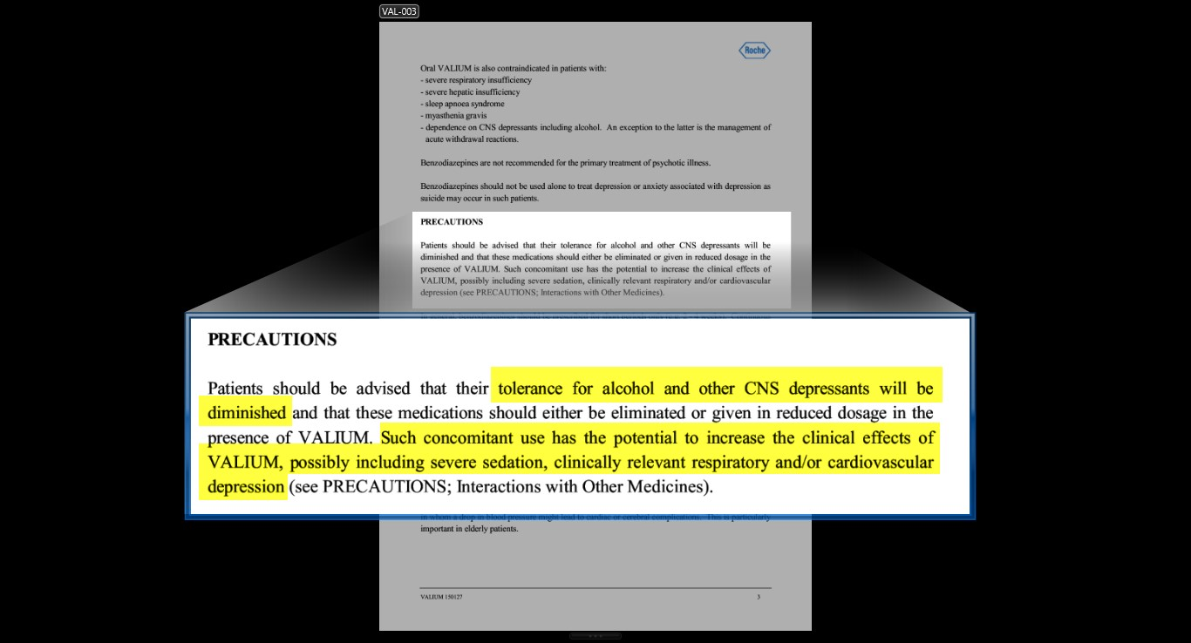
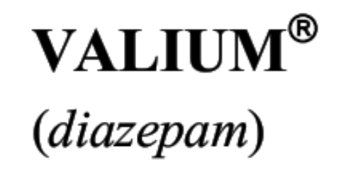
Valium Warning from PDR

Slide 30
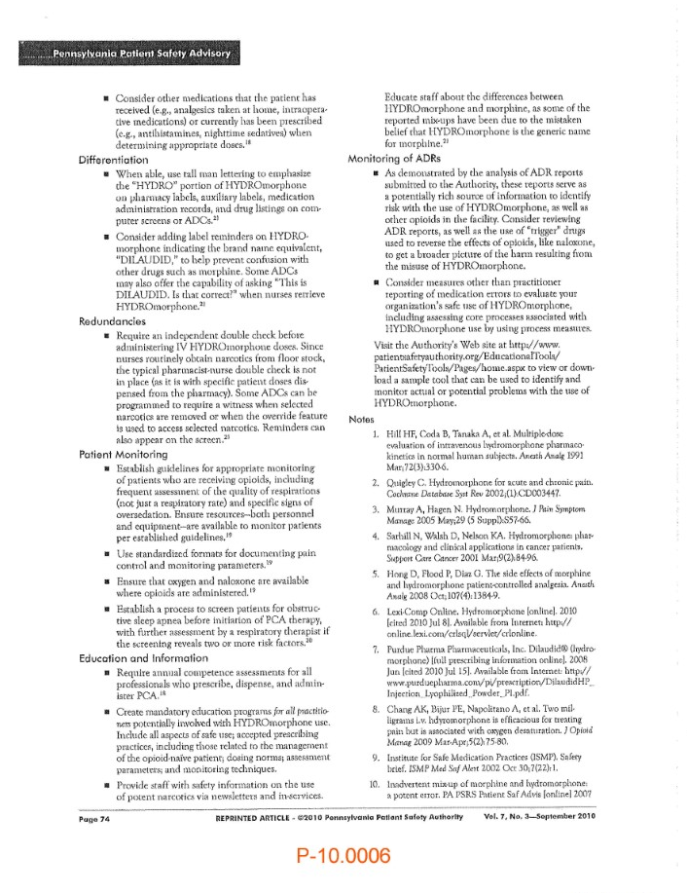
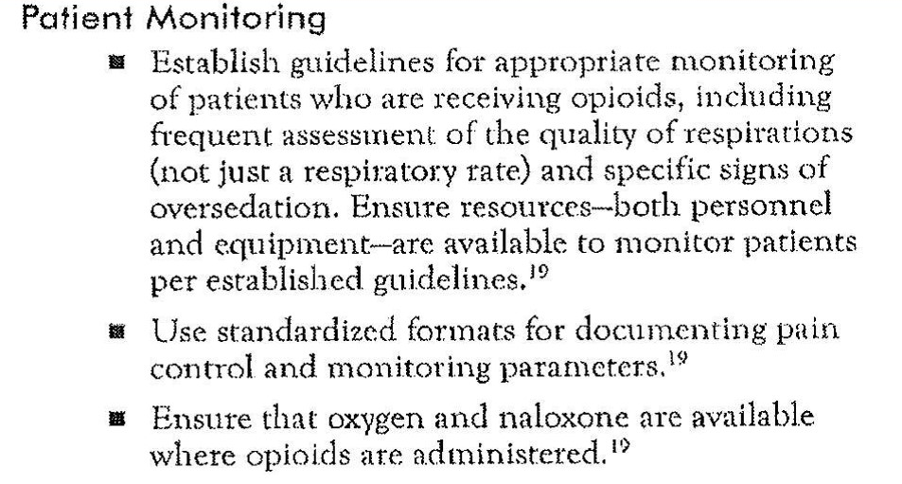
Patient Advisory Recommendations

Slide 31
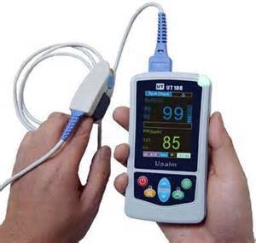
Pulse Oximetry

