Slide 1
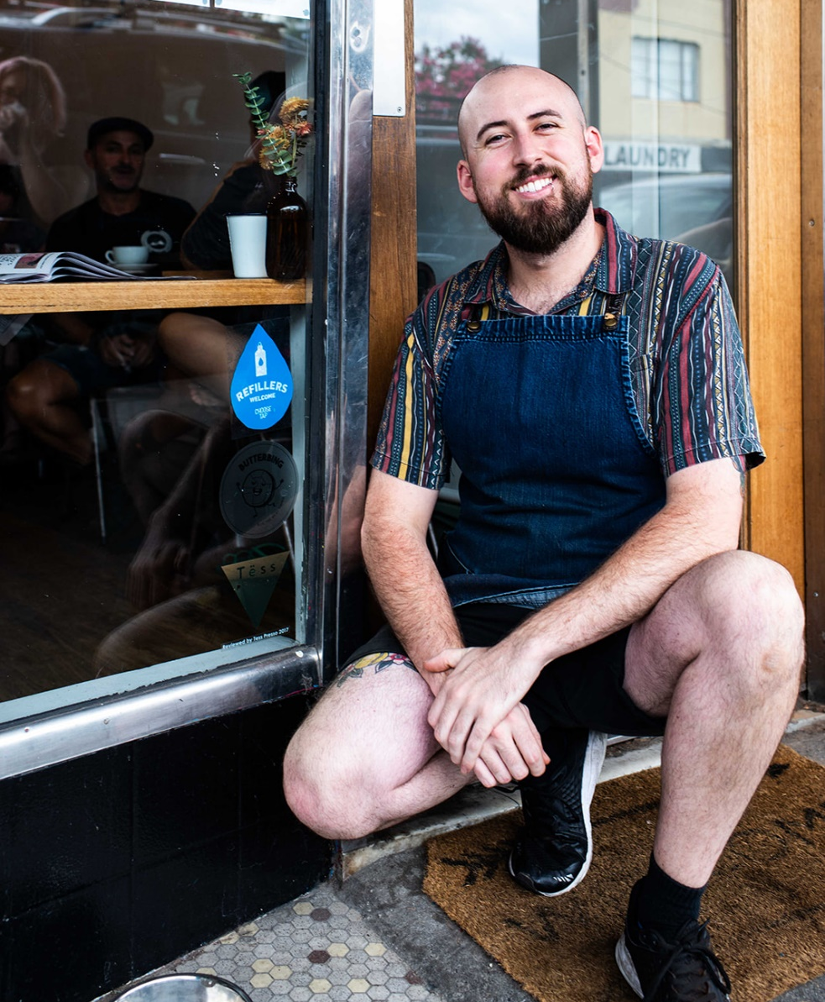
Refillers welcome pilot analysis
APRIL 2020

Slide 2
EXECUTIVE SUMMARY
The initiative was received well by businesses, with high levels of uptake.
A combination of paid advertising and below the line activity worked well to support the program, with a 24% campaign recall. This suggests that we are making gains in brand awareness (YVW & CT) however this cannot be confirmed.
Unfortunately due to COVID-9, the post-campaign survey was cancelled, making it difficult to measure the campaign against the objectives. For this reason, the report focuses on observation and general learnings.
Both social media engagement rates and campaign recall levels indicate the campaign resonated most strongly with our 18-35yo target audience.
The organic social media coverage saw a great spike in new follows, highlighting the campaign and brand benefits of posts via third parties.

Slide 3
BACKGROUND
Choose Tap research revealed that while people buy bottled water for primarily for convenience, they are concerned about the environmental impact.
The research also revealed that people have reservations in using public drinking fountains.
The ‘Refillers Welcome’ program was developed off the back of this research.
A pilot campaign ran in Melbourne’s inner north (Brunswick, East Brunswick, Northcote & Thornbury)*
The campaign consists of a recruitment phase whereby Refill locations are approached, followed by a promotion phase to educate the public.
Social and digital activity was stopped early due to COVID-19.
Post campaign survey was cancelled due to COVID-19 so results are somewhat limited.
*The planned rollout in Echuca and Sunbury were halted due to extenuating circumstances

Slide 4
Campaign overview
Recruitment
Primary Target: Cafés and hospitality businesses
Secondary Target: Local government entities, TAFE’s universities, cinemas, yoga studios and gyms
Duration: 28 Jan – 16 Feb
Promotion
Primary Target: 18-35 year old Non-Thinker Drinkers
Secondary Target: 35+ year old Non-Thinker Drinkers
Duration: 15 Feb – 18 Mar (planned to run until 31 Mar)
Budget: $110,000 (Creative $50,000 / Research $24,000 / Media $29,000 / Printing $7,000)
Location: Brunswick, Brunswick East, Northcote, Thornbury

Slide 5
objectives
Business:
(CT) To drive brand awareness of Choose Tap and increase convenience perceptions of tap water.
(YVW) To increase YVW brand awareness and position YVW as environmentally and community driven.
Campaign:
To increase the convenience of tap water, leading to a decrease in the number of convenience-lead bottled water purchases.

Slide 6
CREATIVE

Slide 7
CREATIVE TESTING
METHODOLOGY
2 creative executions of the concept were tested among 4 groups, including the public and businesses
KEY FINDINGS
The concept was seen as offering genuine value, as without an invitation people were unlikely to ask for a refill.
Businesses saw value in the program as well, and saw it as an opportunity to signal to their customers that they were environmentally minded.
People understood the type of location they would anticipate to see the sticker, and recognised promotional communications as essential.
Blue was identified as the best lead colour as it signals water.
People were very sensitive to the sustainability credentials of any merchandise.
The social media video and the line ‘Be a refiller not a landfiller’ were both very well received.

Slide 8
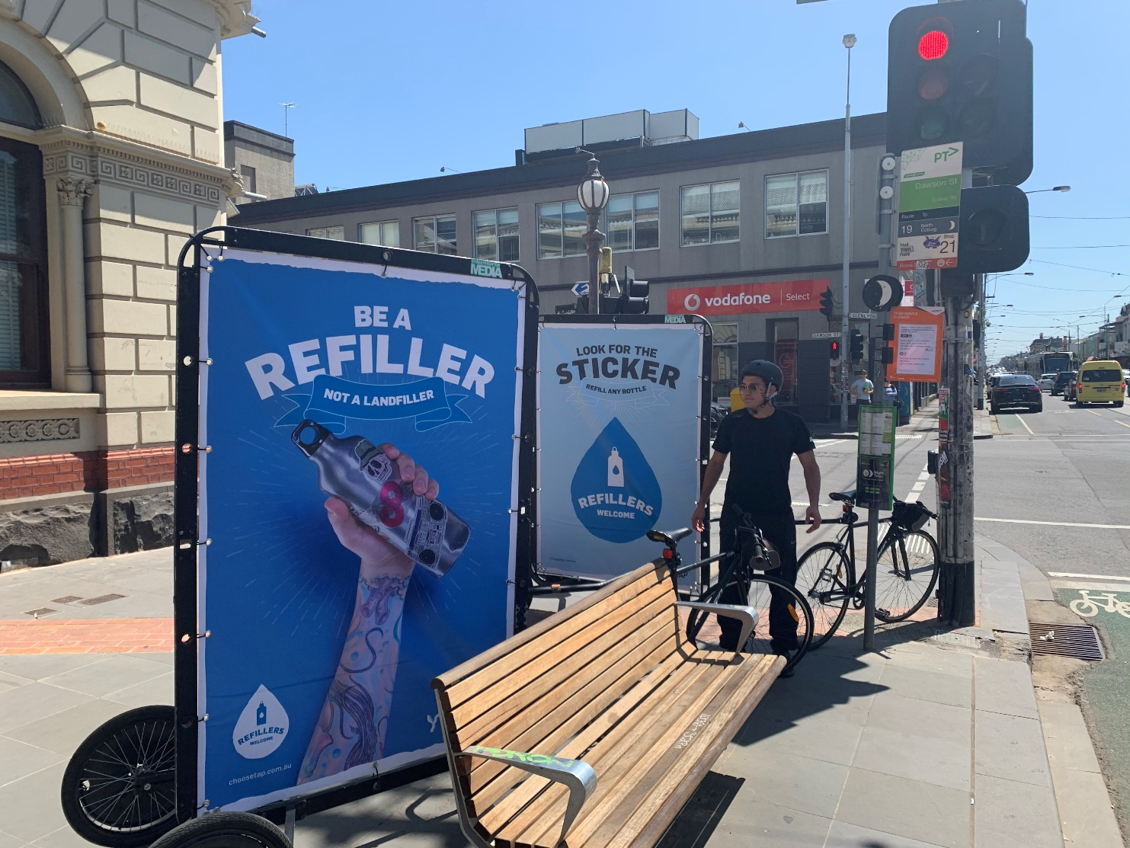
Creative executions
Notes:
Light hearted approach

Slide 9
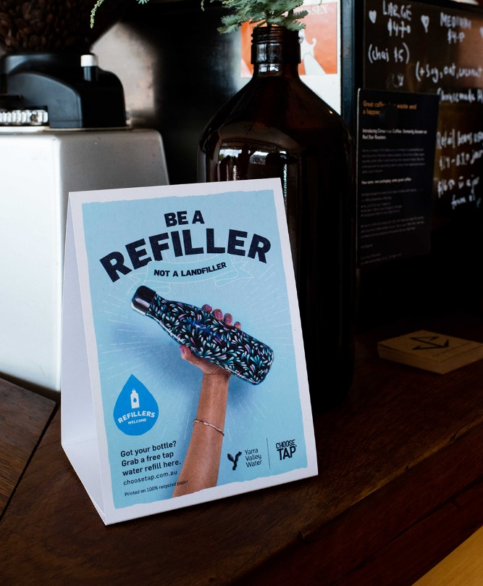
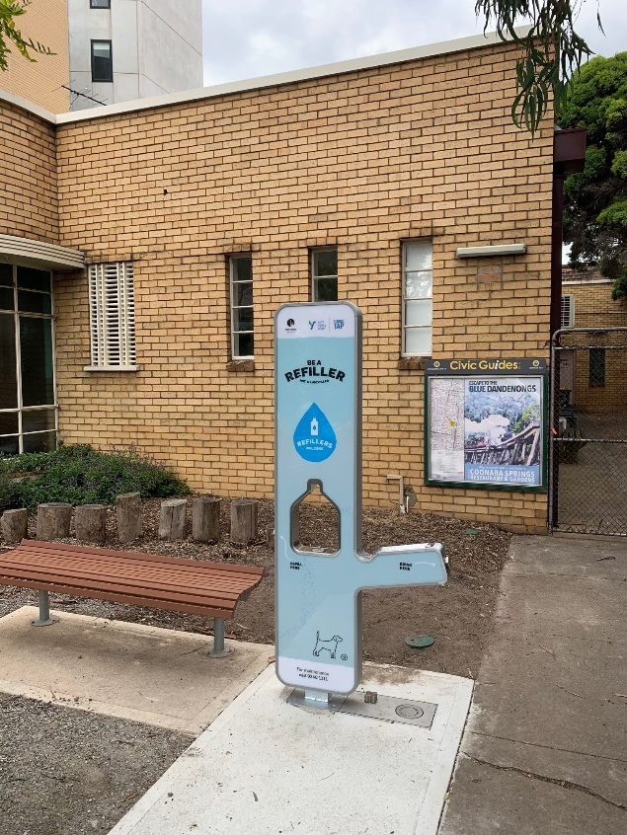
Creative executions

Slide 10
business engagement

Slide 11
Business RECRUITMENT
Traders associations and local councils were engaged at the outset, to assist in reaching businesses and promoting to residents.
All business recruitment was completed via 4 in-person sessions. This was done in pairs with a YVW marketing team member and a commercial services team member.
A recruitment pack was left with interested businesses, containing an information flyer, counter card and sticker.
Business reactions were mostly positive - particularly cafés, with restaurants and take-away shops being less receptive.
Of the 71 approached, 45 businesses signed on to participate.
Select businesses were then contacted for media comments and to participate in a photo shoot. These photos were emailed to the businesses who then often posted it on their own channels.
Businesses could also request a pack via the Choose Tap website. Requests were received from businesses in neighbouring suburbs and a range of community groups.
It is recommended that in-person recruitment be confined to 1-2 areas, and supported by a mass recruitment approach such as direct mail.
Councils proved useful both in terms of recruitment and promotion.
Recruitment can be completed by anyone with a thorough knowledge of the campaign, the Commercial Services teams’ business knowledge was not necessary.

Slide 12
Advertising approach

Slide 13
Tactics
Paid
Digital display
OOH (rock posters & phone boxes)
Paid Social
Bike billboards
Sidewalk stencils
Owned
Social
Website
Earned
Media releases
Social media coverage
Moreland Council newsletter
Notes:
Close to point of purchase - supermarkets

Slide 14
Paid advertising
Media was booked direct.
All media was purchased only within campaign area.
Paid media was supported by a significant amount of earned and owned.
There was a $9,000 underspend due to the campaign finishing early and issues with the social buy.
Channel | Supplier | Spend
Stencil Art | Streetfighter Media | $1,200
Bike Posters | Streetfighter Media | $2,248
Phone Box Posters | JC Decaux | $4,508
Rock Posters - sequential | Rock Posters | $6,500
Social media | Facebook | $4,884
Digital display | News Corp | $1,279
TOTAL |  | $20,619

Slide 15
CHANNEL PERFORMANCE

Slide 16
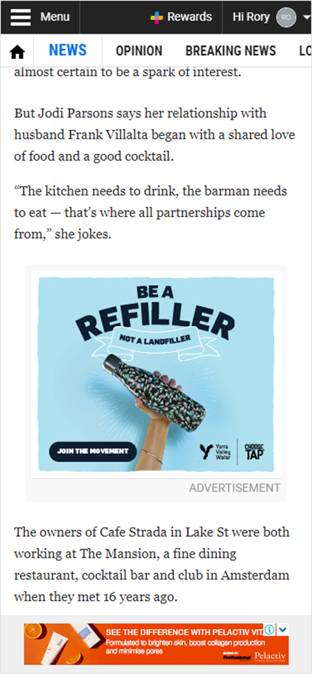
DIGITAL DISPLAY - News Corp
Duration: 17 February – 20 March 2020 (was intended to run until 29 March but stopped early due to COVID)
Execution: MREC
Investment: $1,279 ($1,500 planned)
Whilst there is no way to verify this with data, it is anticipated this placement assisted with driving campaign recall and brand awareness.
Impact however was low, so for future executions a higher impact format should be investigated.
Impressions | 102,336
Clicks | 87
CTR | 0.09%
Notes:
Previous industry standard was 0.05

Slide 17
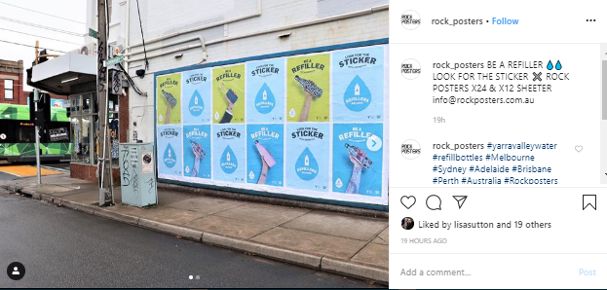
OOH
Duration: 17 February – 15 March 2020
Company: Rock Posters
Execution: Consecutive Street Posters
Investment: $6,500
---------------------------------------------------------------------------------
Duration: 17 February – 29 March 2020
Company: JC Decaux
Execution: Street talk (phone box)
Investment: $7,800
Bonus: 2 weeks bonus filler ($1,400 value)
Rock posters, with the consecutive executions, achieved better impact compared to the Street Talk format, and as such provided better value.
Whilst there is no way to verify this with data, it is anticipated they assisted with driving campaign recall and brand awareness.

Slide 18
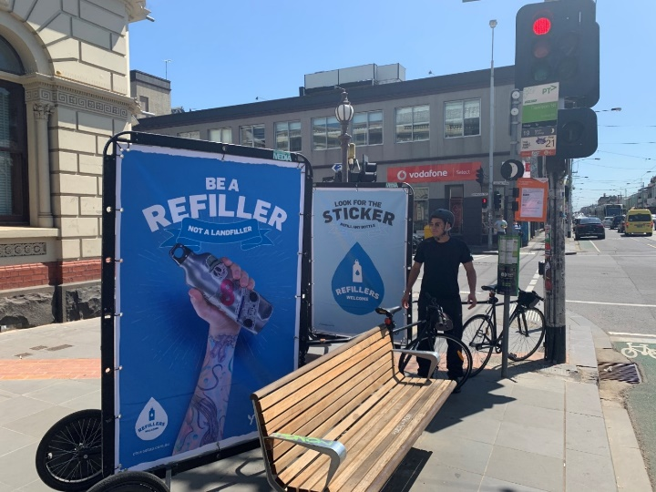
ACTIVATION
Duration: 22 & 29 February 2020
Company: Streetfighter Media
Execution: Bike Billboards (x2) at key shopping strips over 2 Saturdays during peak
Investment: $2,448
---------------------------------------------------------------------------------
Duration: 22 February 2020
Company: Streetfighter Media
Execution: Chalk Stencils (x50) outside of participating businesses
Investment: $1,200
These elements provided theatre, and memorability to support the other channels. Whilst there is no way to verify this with data, it is anticipated they assisted with driving campaign recall and brand awareness.
Both provided good value so would be recommended for future campaigns.

Slide 19
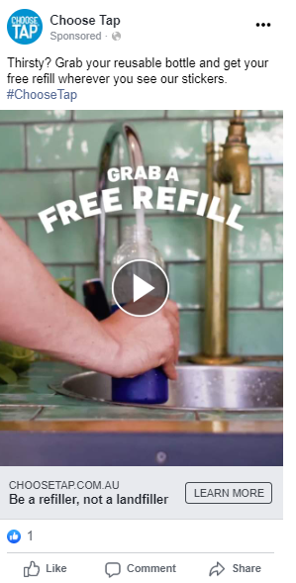
Paid Social
Best performing creative
(in terms of engagement)
Impressions | Reach | Frequency | Views | Engagement | CTR | CPM | CPC | Spend
350,038 | 217,300 | 3.8 | 266,408 | 52,011 | .64%* | $13.70 | $9.95** | $4,884.7
Breakdown by device ENGAGEMENT
Age
ENGAGEMENT
Gender
ENGAGEMENT
Channel
ENGAGEMENT
3.5%
6.5%
90%
18-24
20%
25-34
44%
35-44
13%
45-54
8%
55-64
7%
64+
6%
78%
22%
49%
51%
*Fatberg CTR was .003
**Fatberg CPC was $423

Slide 20
Paid Social
Comments:
Overall comments and shares were very low, however CTR and CPC rates were both significantly better that the recent Fatberg campaign
The video was the best performing piece of campaign content, which performed best on Facebook with the 18-34 audience
Facebook delivered significantly higher engagement compared to Instagram. It is anticipated that this is was a combined result of different user behaviours across the channels (Instagram is primarily image based which makes for quick scrolling, while Facebook tends to have more articles and longer form content) and also the difference in type of content people are looking for across the channels (Instagram is primarily about ‘inspo’ while Facebook people are open to more varied content).
Engagement was significantly higher in the 25-34 age group
Mobile engagement was significantly, higher, supporting the decision to create video in a vertical format
Learnings:
Low budgets being set during the buy (due to needing to use personal credit cards) led to limits being reached quickly and ads then becoming dormant
Mistakes were made in ad set-up, so possibly in-Facebook approvals should be sought before sending ads live for future campaigns
The large difference in engagement between Facebook and Instagram video suggests that video content should be purchased on Facebook only moving forward

Slide 21
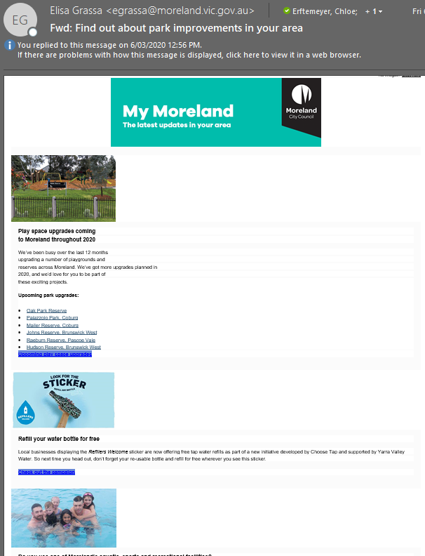
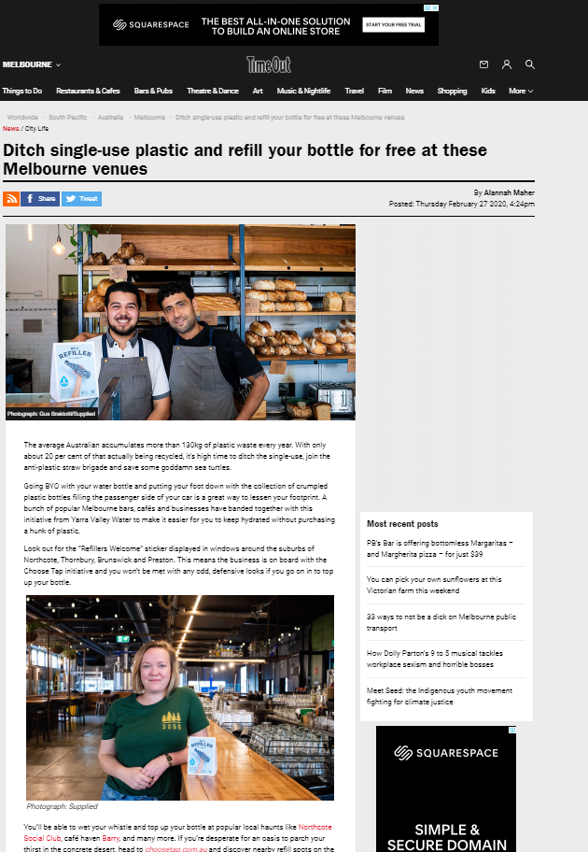
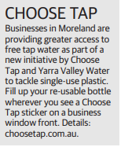
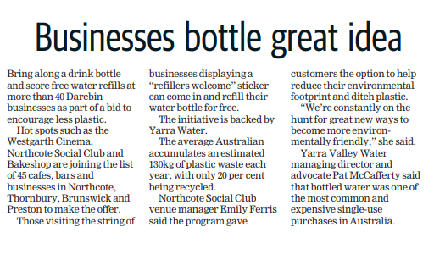
Earned channels
Media Performance
Publication | Date | Audience | ASR
Time Out Melbourne (online) | 27 February 2020 | 781,000 | Unavailable
Preston Leader | 25 February 2020 | 76,000 | Unavailable
Moreland Leader | 24 February 2020 | 77,000 | Unavailable
Sydney Rd Traders Association Newsletter
-------------------------------------------------------------------------------------------------------
Sydney Rd Traders Association Newsletter
A brief overview of the Refillers campaign was captured in the March newsletter. Note: at least one business signed up as a result.
Moreland E-Newsletter
An image tile and brief summary was captured in the March E-newsletter
*Western Water also secured a story in The Moorabool News
Moreland City Council E-newsletter
Moreland Leader
Preston Leader
Time Out Melbourne

Slide 22
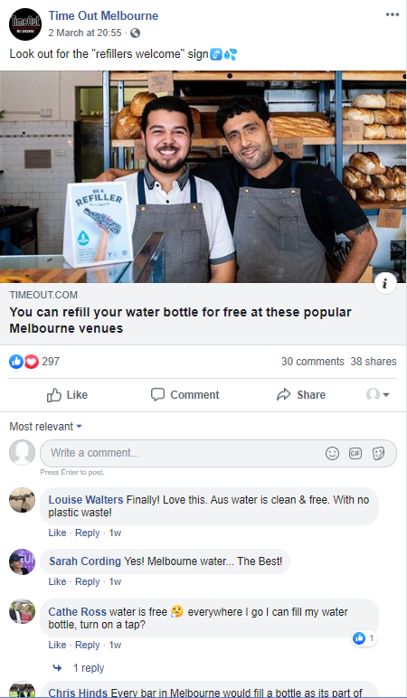
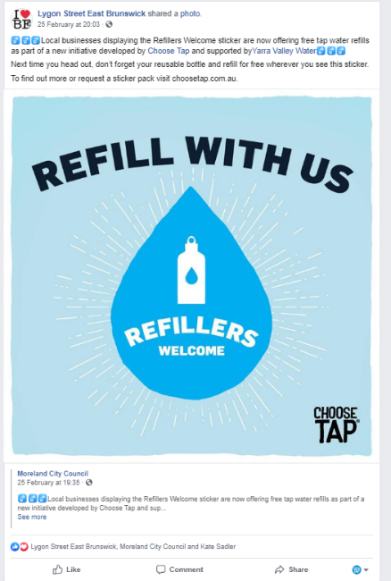
Earned channels
Facebook and Instagram
Social media saw our stakeholders and participating businesses getting behind the campaign on social media, greatly increasing our reach:
Publication | Channel | Audience | Likes | Comments | Shares
Time Out Melbourne | Facebook | 192,000 | 297 | 30 | 38
Lygon St East Brunswick | Facebook | 1,509 | 3 | 0 | 0
Moreland City Council | Facebook | 19,374 | 121 | 5 | 8
Moreland City Council | Instagram Story | 3,480 | NA | NA | NA
Rock Posters | Instagram | 2,274 | 56 | 0 | NA
St Derby | Instagram Story | 2,129 | NA | NA | NA
Mother Melbourne | Instagram | 959 | 23 | 6 | NA
Northcote Social Club | Instagram | 13,000 | 92 | 3 | NA
Brother Alec | Instagram | 2,796 | 130 | 6 | NA
Brother Bon | Instagram | 1,786 | 240 plays | 0 | NA

Slide 23
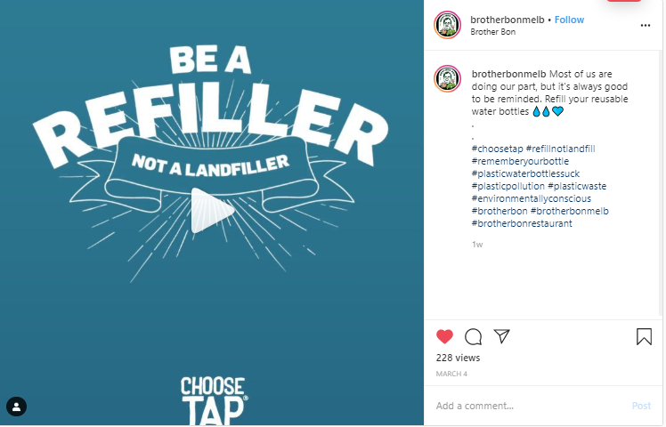
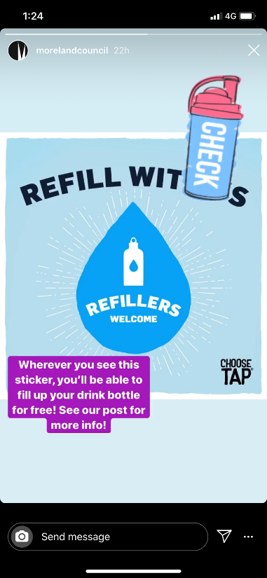
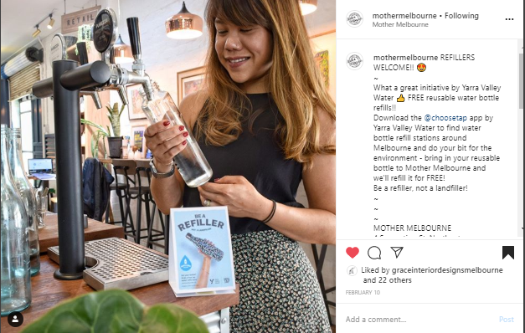
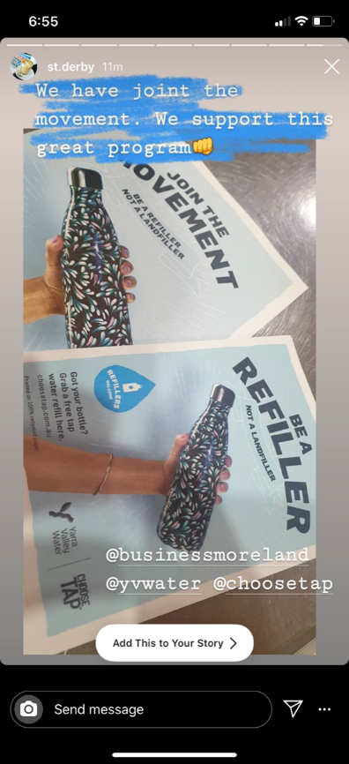
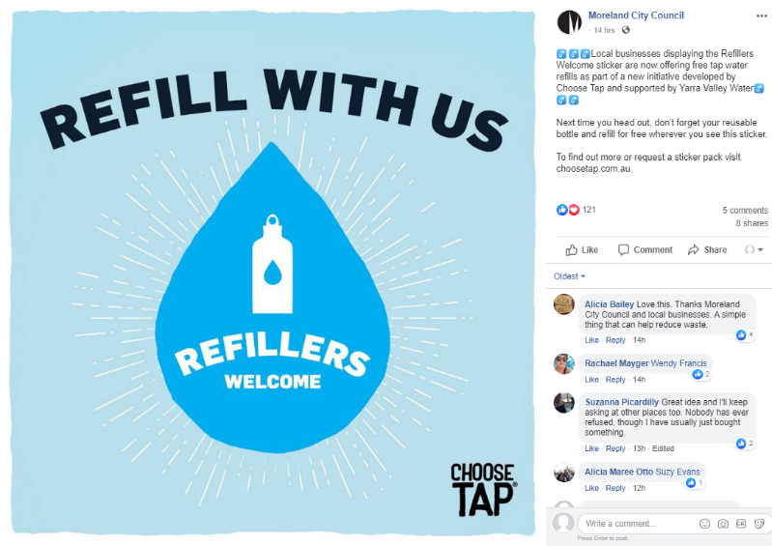
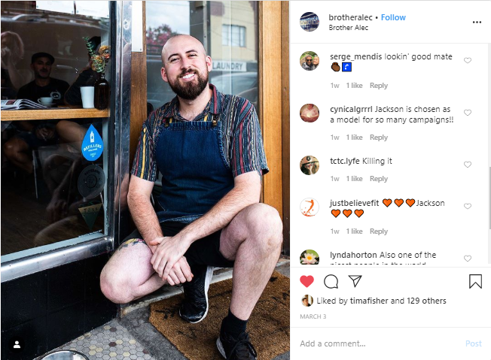
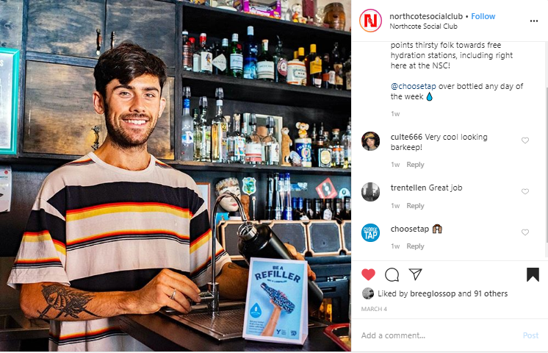
ORGANIC SOCIAL MEDIA COVERAGE
Notes:
Two formats

Slide 24
EARNED CHANNELS
Comments:
Media coverage of the pilot was lower than expected
Some participating businesses shared campaign content on social media, which achieved higher engagement levels compared to
Learnings:
Unsurprisingly, this organic social media content achieved better results compared to ads, suggesting that for this campaign, partners and stakeholders social media channels should leveraged as an equal focus to paid ads
Recommend using a PR agency to ensure adequate media coverage is achieved

Slide 25
results

Slide 26
YVW BRAND TRACKING
The quarterly YVW brand tracking was utilised in lieu of a post-campaign survey.
Results were filtered based on campaign postcode. Therefore sample was small.
Campaign recall was highest among 26-35yo and business customers, and lowest among 50+.
QUESTION | WAVE 18 | WAVE 19* (PRE-CAMPAIGN) | WAVE 20** FULL SERVICE AREA | WAVE 20** CAMPAIGN POSTCODES
Recall seeing / hearing / reading about YVW | 81% | 47% | 36% | 38%
Recall seeing / hearing about Choose Tap | 21% | 20% | 17% | 18%
People can trust to do the right thing | 70% | 70% | 78% | 75%
You can count on to care for the environment | 69% | 67% | 78% | 67%
Great drinking water | 85% | 95% | 92% | 93%
Run their operations in a way that looks after the environment | 71% | 65% | 81% | 62%
Confidence that Yarra Valley Water will meet needs as a customer now and in the future | 70% | 80% | 83% | 71%
Recall "Refillers Welcome” sticker or messages within your local area |  |  | 14%*** | 24%***
*September & December 2019
**March & April 2020
*** Fatberg was 39% however this was with visual prompts

Slide 27
Learnings
Data indicates that we reached our target audience, with recall rates and social media engagement levels higher among this group
Organic social media content posted by stakeholders and participating businesses out-performed paid posts with similar content
Actively providing social media content to businesses, particularly if it’s a photo of their venue, greatly increases the chances of them posting about Refillers on social media
Business receptions were positive, however in-person recruitment was time consuming and limits the number of businesses that you can reach
Facebook performed better than Instagram for video views and engagement

Slide 28
recommendations
Engage with external parties such as traders associations and local councils early (2-3 months prior). They can assist with spreading the message on our behalf, and can provide us access to their communication channels for promotion.
Continue in person recruitment within 1-2 key areas, however reduce the number of visits to 1-2 shorter bursts.
Accompany in-person recruitment with a mass recruitment blast via a bill insert or similar.
Don’t engage the Commercial Customer team, as the context of the communications are very different.
Focus on achieving organic reach on social media wherever possible, by utilising participating businesses, council channels etc to promote the message, as well as owned channels.
Organising a photo shoot of the key businesses worked well, as they shared the photos to social media.
Ensure a post-campaign survey is completed to better understand it’s success.
Consider engaging PCPs to promote the campaign within their local networks.
Develop a written and video case study that highlights the success of the program and how it’s worked for businesses.
If recruiting in-person, offer to add the business to the map on the spot, as most businesses are busy and forget.
Engage a PR agency to ensure the program is adequately supported.
Explore new A/B testing combinations to increase potential learnings of social media buying.
Ensure there is a company credit card available for media buying.
Set an approval process for all social media ads before they are pushed live.
Skew social media spend to Facebook for video.

