Slide 1
APG|SGA Design tutorial module III «Expert»
Designing outdoor advertising effectively
Status November 2022

Slide 2


Overview of design tutorials
Basic
(Consider physiological and medium-specific aspects)
Advanced
(Use cognitive aspects to control perception & attention)
Expert
(Incorporate cognitive aspects of information processing and learning)
Viel Text und Bilder die man gar nicht lesen kann

Slide 3


Table of contents «Expert»
Starting point
6 potential disruptive factors
Summary

Slide 4
«Advertising messages should be transmitted error-free and securely.»

Slide 5







The basic understanding
Advertising is essentially based on learning and remembering
Unwanted loss of impact can occur when delivering and learning the message.
Advertising impact results when the message is understood quickly and with certainty. It must be clear what the message is about (value proposition) and who it is from (sender). There are stumbling blocks to consider here in order to prevent unwanted interference during transmission.
Reward offered
Re-activate
Confirming
Activate
Remembering
Prepare
Learning
Sender
Prepare
Learning
Prepare
Learning

Slide 6
Table of contents «Expert»
Starting point
6 potential disruptive factors
Summary

Slide 7












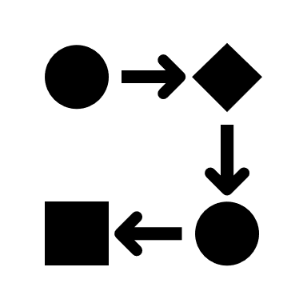
6 potential disruptive factors
Risk of confusion
Target group exclusion
Wrong associations
No campaign effect
Visual focus only
No consistency

Slide 8
Disruptive factor 1
Risk of confusion

Slide 9





Risk of confusion
Our brain instantly assigns advertising with learned codes to the company known for it
Risk of confusion with an established brand from the telecommunications sector
Risk of confusion with an established brand in the field of fashion or optics

Slide 10
Risk of confusion
«Differentiating instead of losing.»
Just as with positioning, your advertising must also differentiate itself, and be as distinctive as possible.
One of the biggest loss factors is when your advertising is assigned to competitors. It's even worse when the misattribution happens to a company outside of your industry! The most devastating thing that can happen to you is when people have no idea what you are talking about and who is advertising.
Recommendation: Make sure that your effect elements - especially colors, images and pictures - are really relevant to your industry and your company and are not already «mentally» occupied elsewhere.

Slide 11
Disruptive factor 2
Target group exclusion

Slide 12


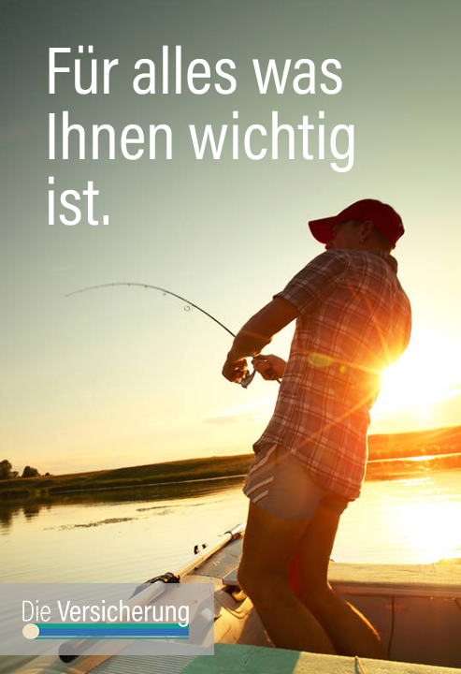


Target group exclusion
The motif influences the reach
Target group approach very narrowly defined i.e. only a few people feel affected
Target group approach broader and more open, i.e. many people feel addressed

Slide 13

Target group exclusion
«The size of the target group is largely determined by the chosen motif.»
If your target group does not feel addressed by your advertising motif, it will ignore your advertisement.
Reach is not only defined by media performance, but is also influenced above all by the motif chosen.
Recommendation: Always use the strongest selling benefit argument for your design that is relevant and therefore of interest to a large part of your target group. The more people feel addressed within your desired target group, the greater your success will be.

Slide 14
Disruptive factor 3
Wrong associations

Slide 15




Wrong associations
Each creation triggers certain - learned - associations that may be congruent
Rather not crunchy: (ice cream with melted chocolate)
Crunchy (ice cream with broken chocolate)

Slide 16
Wrong associations
«If something is not right, we do not buy it.»
Sometimes creations are chosen, during the decoding of which unwanted misdirection happens in people's minds.
If, for example, an ice cream, which is culturally learned to stand for «cold», is depicted with a «melted» chocolate coating, then an undesirable dissonance between expectation and message is created. In the worst case, this leads to a refusal to buy, because the goal (cooling/refreshment) does not correspond to the product promise made visually.
Recommendation: Verify that your motif actually evokes the right and desired associations that align with your message and the value proposition of your brand or product.

Slide 17
Disruptive factor 4
No campaign effect

Slide 18


No campaign effect
Unfavorable if different motifs are not perceived as a coherent campaign
Same campaign, but visually very different motifs make it difficult for people to perceive the campaign as belonging together

Slide 19
No campaign effect
«1 + 1 should not make less than 2.»
The use of different motifs is a good way to address different target groups.
However, if the motifs differ too much from each other in the dominant visual elements, the campaign will no longer be perceived by the population as belonging together, which will result in a deterioration of the advertising effect..
Recommendation: Make sure that your motifs are recognized as belonging together within a campaign and ideally even reinforce each other. Due to the distance effect, the use of the same colors and the placement of the central effect elements in the same position always helps.

Slide 20
Disruptive factor 5
Visual focus only

Slide 21





Visual focus only
Images have the advantage of fast response, but they win with verbal effect elements
Brand name only visible on the product
Brand name also legible in the headline
Drogerie

Slide 22
Visual focus only
«Images are processed visually. Words aurally.»
Images are said to have the highest activation potential in advertising. But enriching the motifs with verbal information is advantageous.
Posters are looked at first, and images are processed more quickly by the brain and are also better recognized later. For many brands, however, it can be an advantage if consumers can also name the brand verbally.
Recommendation: Because reading takes place aurally in the mind, a combination of visual and verbal elements is particularly successful. Therefore, incorporate the brand name into the headline whenever possible. This will ensure the best memory performance.

Slide 23
Disruptive factor 6
No consistency

Slide 24




No consistency
Each new performance starts again at the beginning
Constantly changing design prevents learning effects
2020
2021
2022

Slide 25
No consistency
«Success comes from repeating the same message.»
Strong brands are created in people's minds through permanent repetition of the same emotional message.
Learning, remembering, anchoring and recognizing are based on the building effect of repetition. In addition, repeated visibility also increases trust and competence attribution in the advertising company. If you keep changing your design and messages, you lose the recognition value and start your journey all over again each time.
Recommendation: The most effective advertising images are those that do not change over a long period of time. Consistency and continuity in the message and in the visual design are therefore very central levers for a lasting advertising impact.

Slide 26
Table of contents «Expert»
Starting point
6 potential disruptive factors
Summary

Slide 27
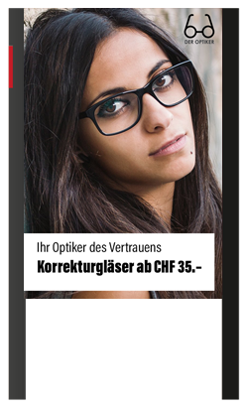
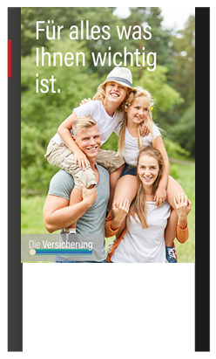
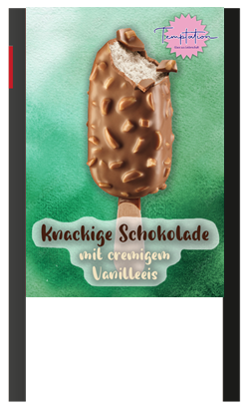


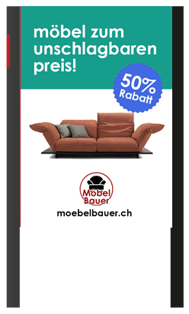
The 6 disruptive factors at a glance
1. Risk of confusion
  Check whether your design is not inadvertently assigned to another company / industry on cursory viewing
2. Target group exclusion
  Make sure your motif is relevant to a large part of your target group
3. Wrong associations
  Make sure that the associations triggered with your design are congruent with your product features and brand
4. No campaign effect
  Multiple motifs make sense in many cases. However, design them in a way that they are perceived as one campaign
5. Visual focus only
  Put your brand in the headline as well to benefit from visual & verbal/auditory processing
6. No consistency
  Memorizing, remembering and assigning are based on previously learned content. Therefore, remain consistent in your appearance for as long as possible

Slide 28
Even more successful together.
APG|SGA, Allgemeine Plakatgesellschaft AG
Giesshübelstrasse 4
8027 Zürich
www.apgsga.ch

