Slide 1
APG|SGA Design tutorial module II «Advanced»
Designing outdoor advertising effectively
Status November 2022

Slide 2


Overview of design tutorials
Basic
(Consider physiological and medium-specific aspects)
Advanced
(Use cognitive aspects to control perception & attention)
Expert
(Incorporate cognitive aspects of information processing and learning)
Viel Text und Bilder die man gar nicht lesen kann

Slide 3


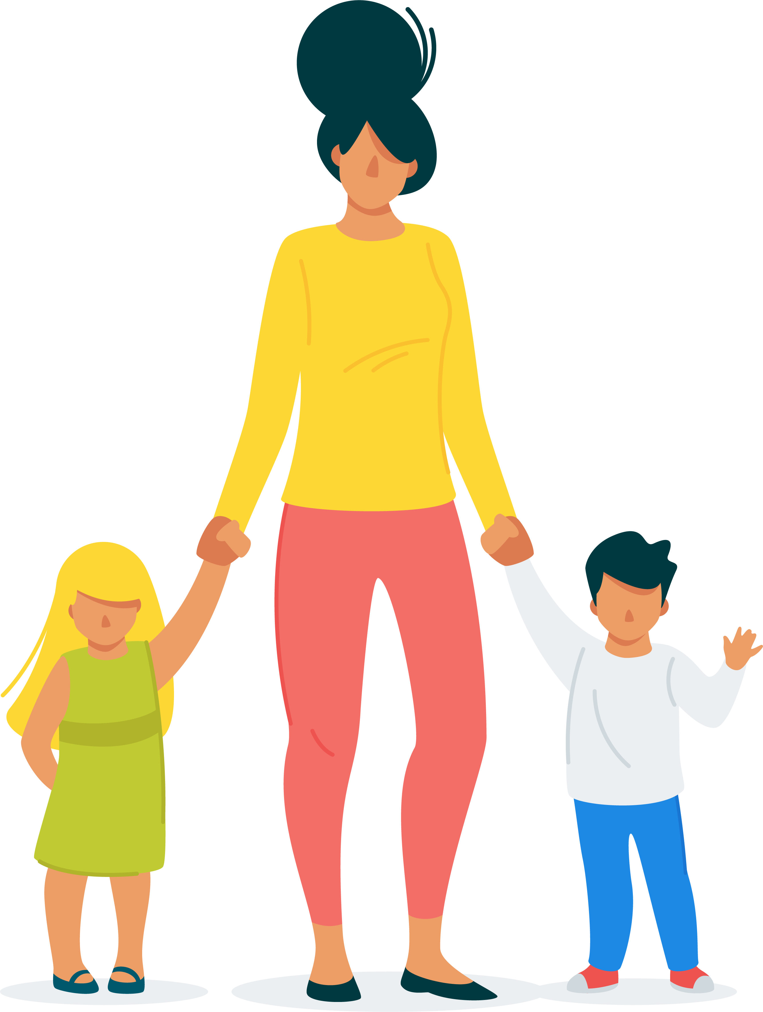
Table of contents «Advanced»
Starting point
The 4 elements for attention
Summary

Slide 4
«Who does not stand out, falls away.»

Slide 5


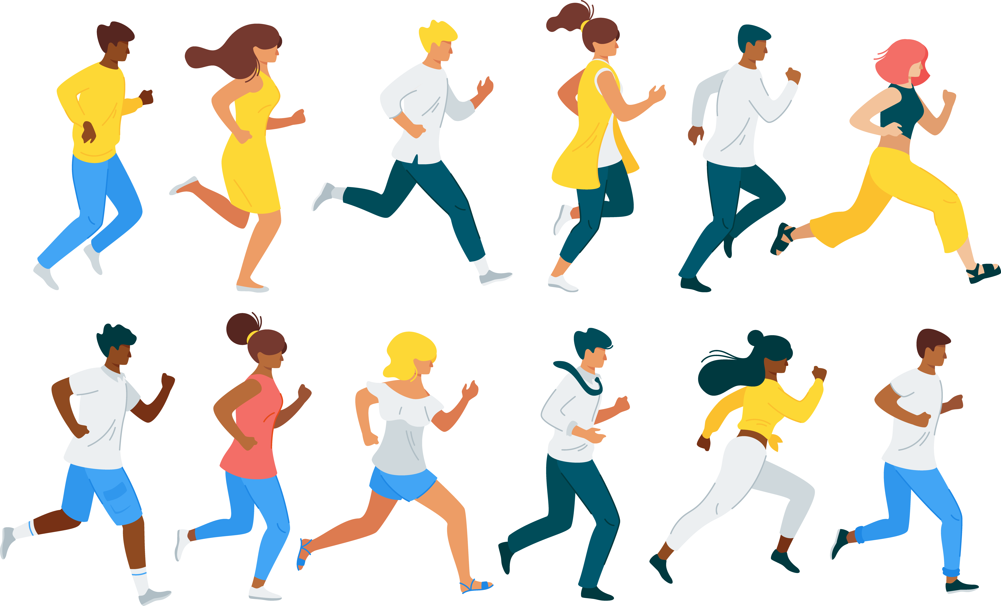

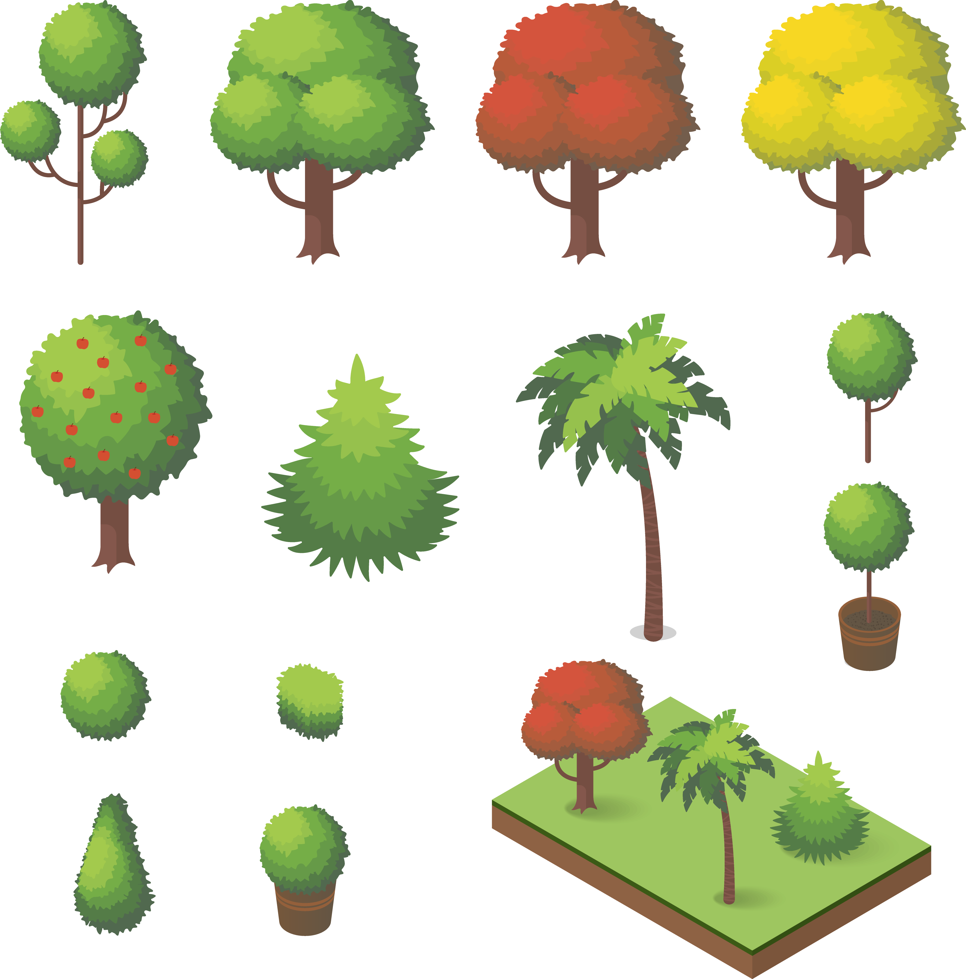
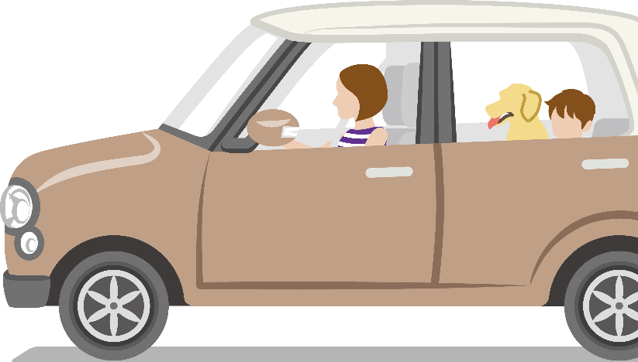


The basic understanding
The environment offers people many sensory stimuli
Outdoor advertising takes place in an environment with many competing influences.
Outdoor advertising must stand up to everyday environmental stimuli. Therefore, after advertising pressure and formal design criteria such as distance effect, knowledge of the cognitive factors for increasing attention is important for advertising success.

Slide 6
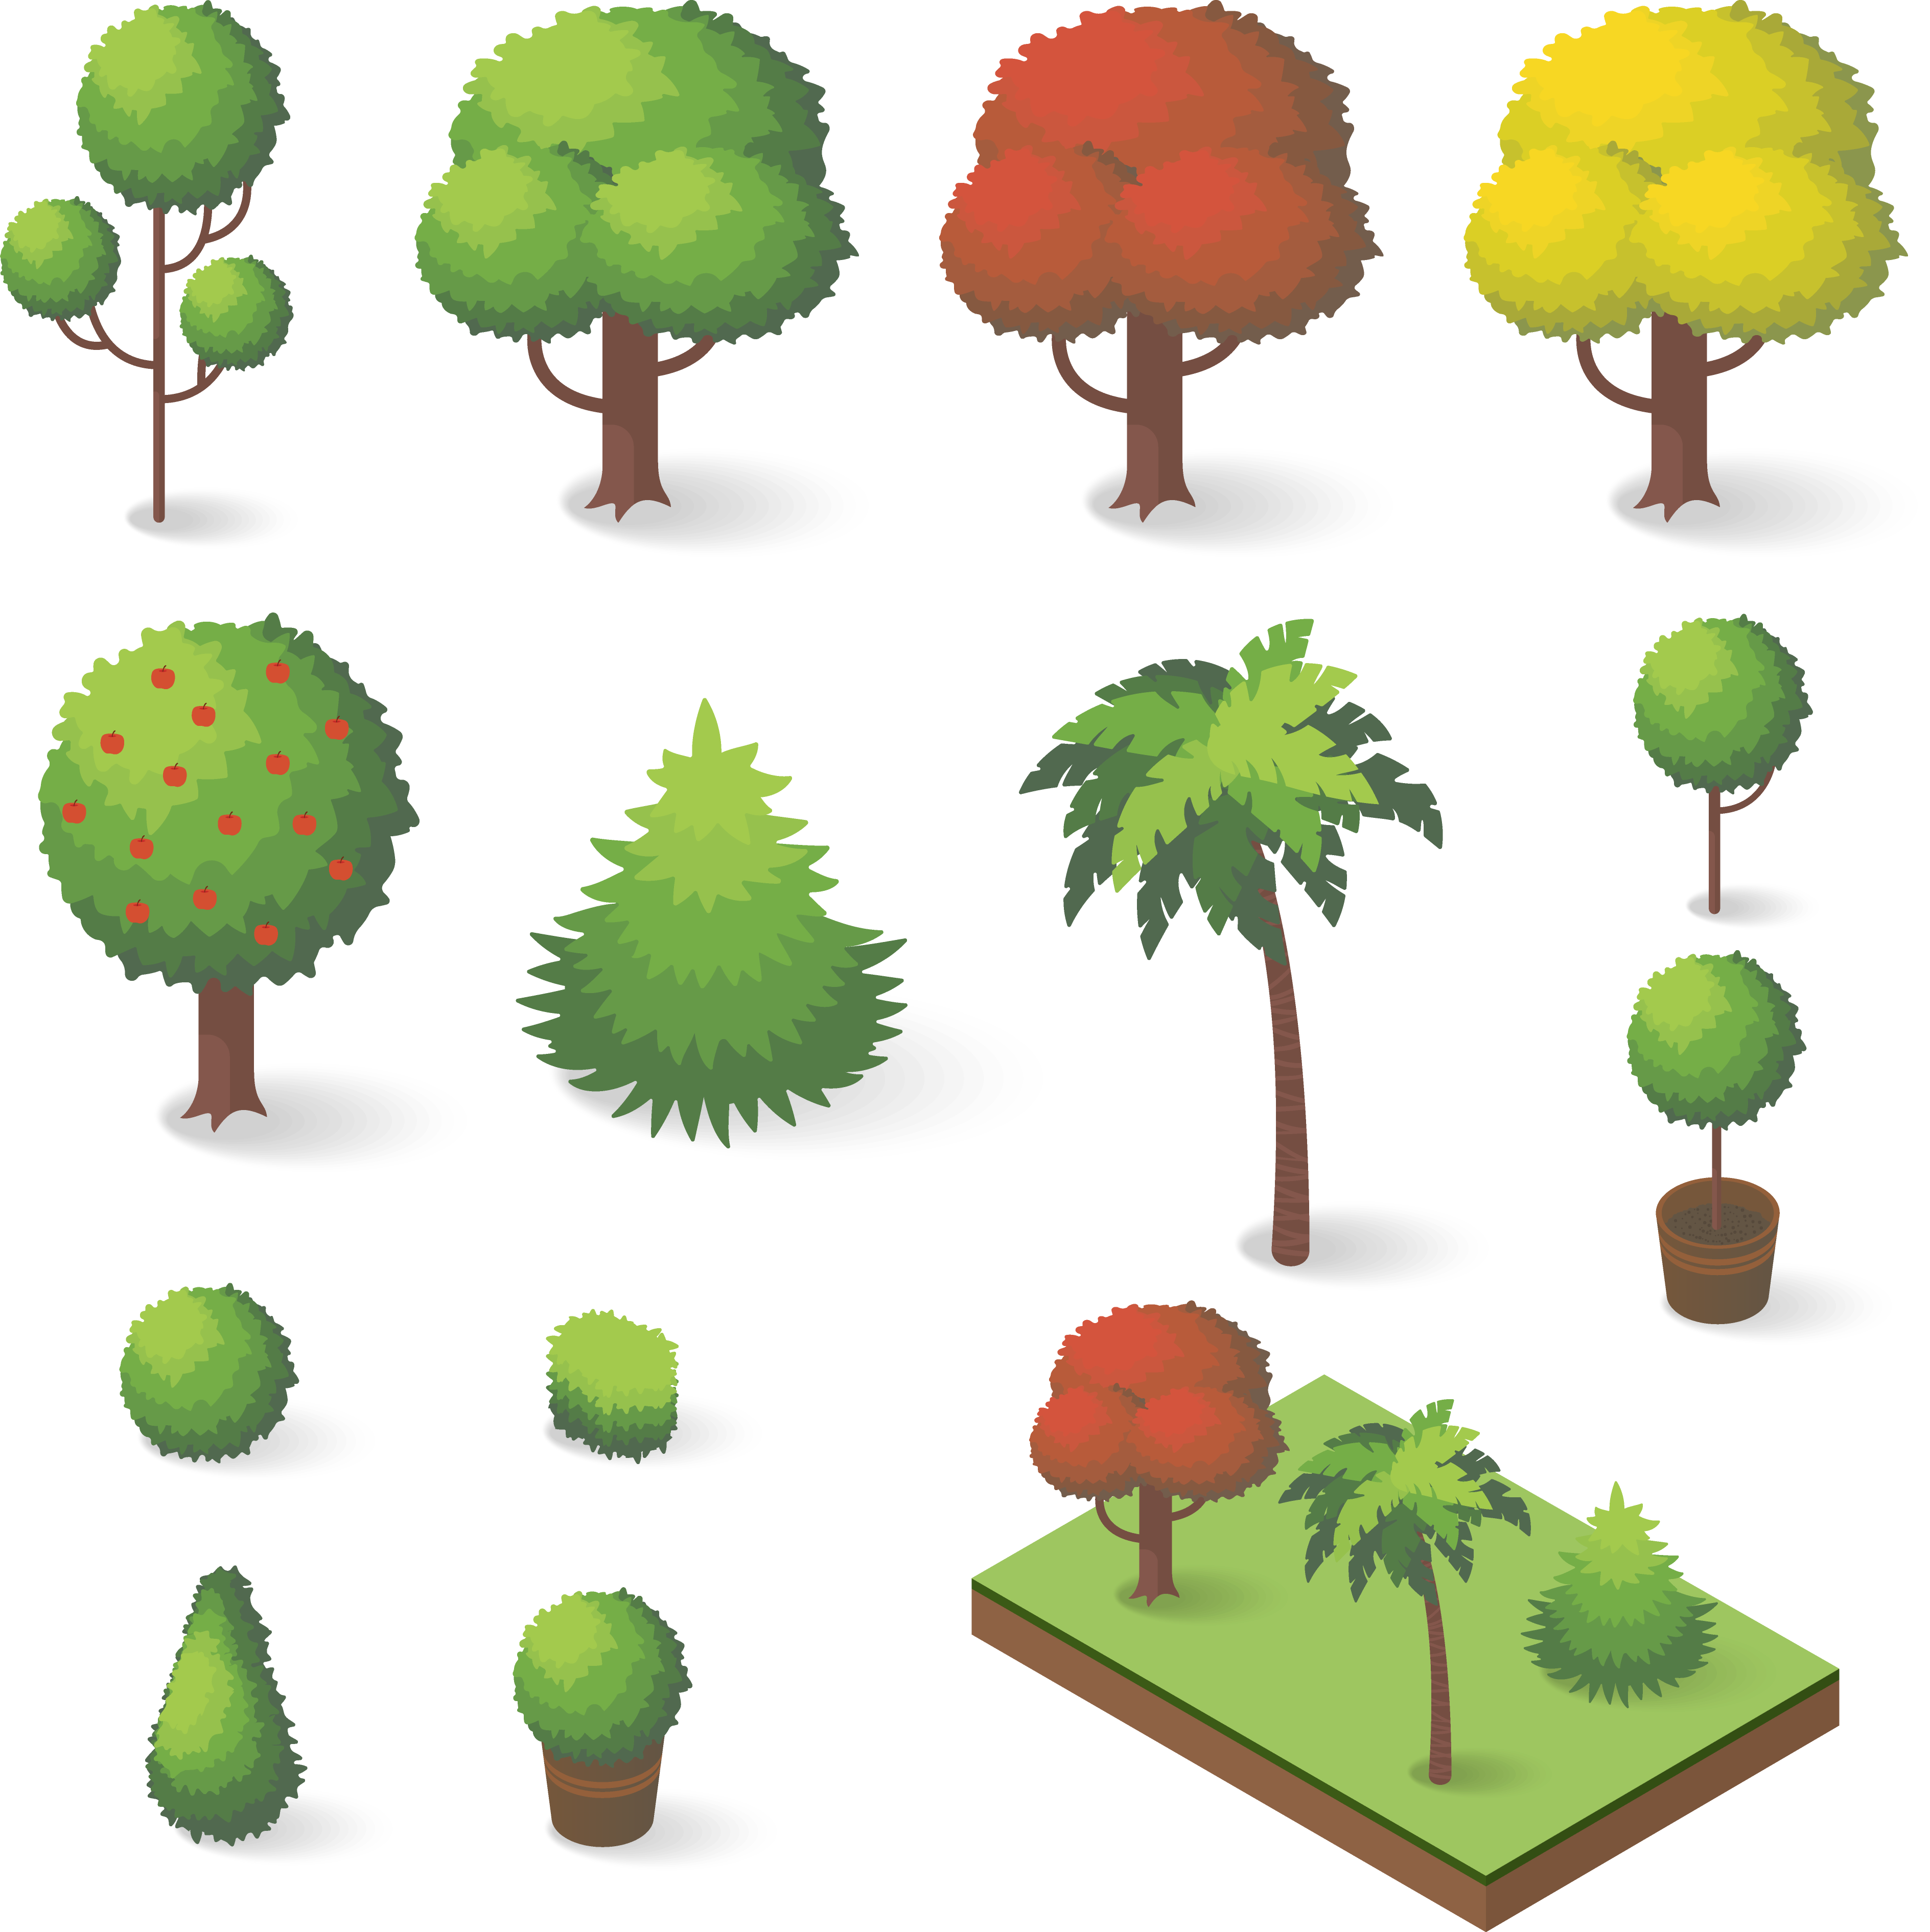
Table of contents «Advanced»
Starting point
The 4 elements for attention
Summary

Slide 7









The 4 elements for attention
People and animals
Movement
Extraordinary
Relevance

Slide 8
Attention element No. 1
People and animals

Slide 9
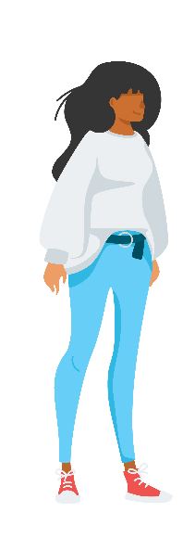


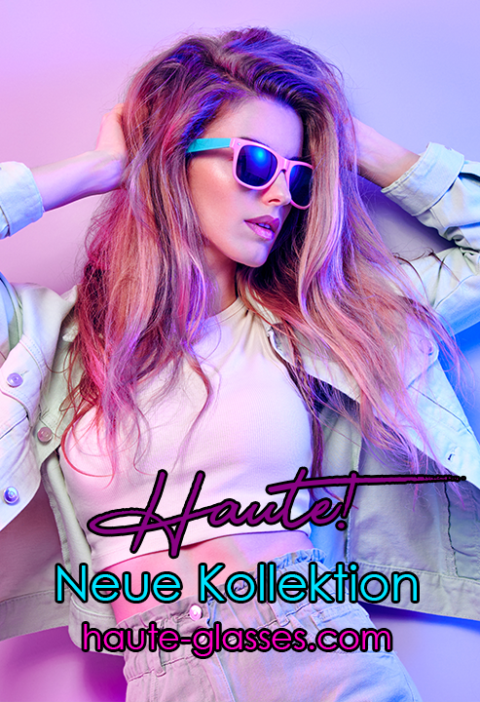
People and animals
Images of people and animals - especially babies, children and faces - catch our eyes
Eye-Catcher
«Sweet babies»
Eye-Catcher
«Cute animals»
Eye-Catcher
«Attractive people»

Slide 10
People and animals
«One of the most important layout criteria is a design that attracts attention.»
Posters with eye-catching images are especially capable of attracting the attention of people passing or driving by.
A good image generates attention, conveys the value proposition at a glance and triggers the desired emotions. Thereby, we naturally react strongly to key stimuli such as the child scheme with babies / animals and also to erotic stimuli. Because our perception is also strongly designed to recognize faces, faces (and also eyes) of other people receive a disproportionate share of our attention - especially those with positive emotions e.g. a beaming smile attract our gaze.
Recommendation: Text alone often does not attract enough attention. Therefore, use eye-catchers that match your brand, product and message, and use at least half of the poster for it.

Slide 11
Attention element No. 2
Movement

Slide 12

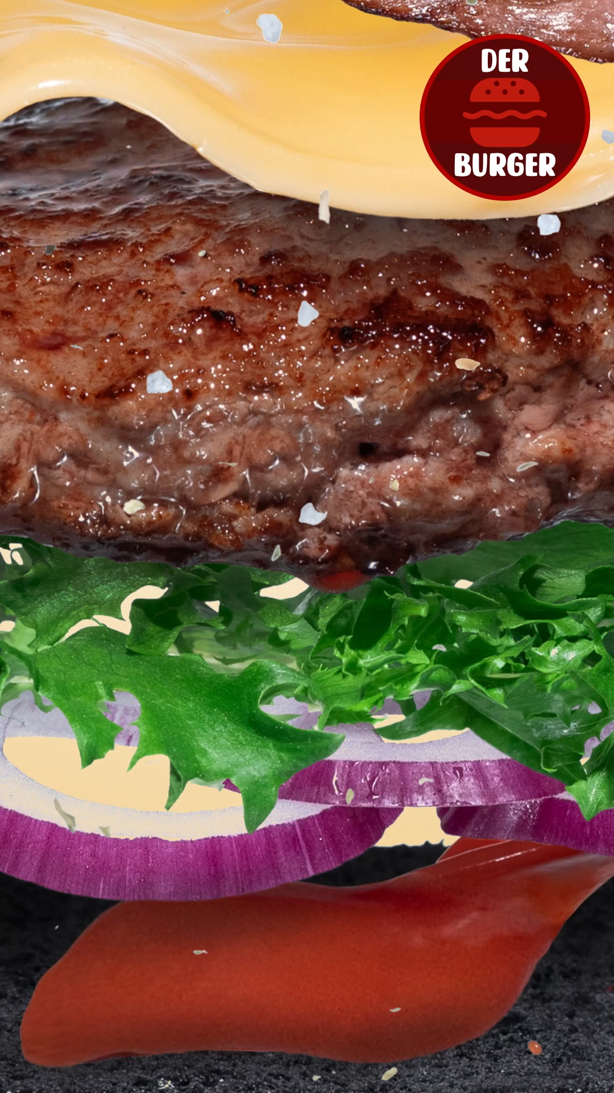
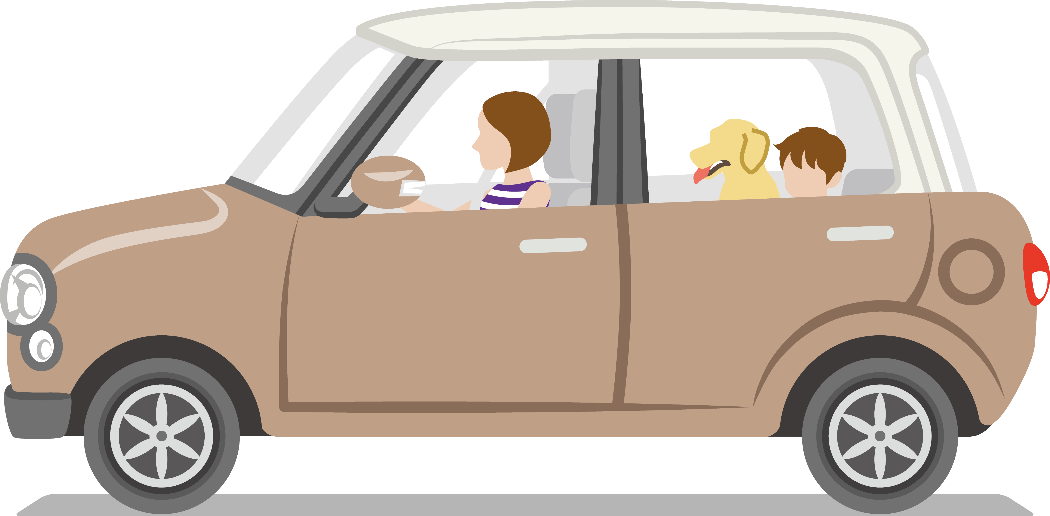
Movement
Movement attracts the eye
Digital Out of Home spots «slightly animated or full motion» attract attention

Slide 13
Movement
«We look where movement happens.»
Movement leads evolutionary-biologically to the fact that we look to see what it is.
Moving images are a winner, especially if the digital panels are large and the advertising is moving. As the AM4DOOH research impressively shows, Digital Out of Home spots on ePanels and eBoards not only attract the eye more strongly - but even more often and for a longer time.
Recommendation: Design your Digital Out of Home spots according to the already familiar poster design rules, and ensure even more attention for your advertising message through selective movement.

Slide 14
Attention element No. 3
Extraordinary

Slide 15

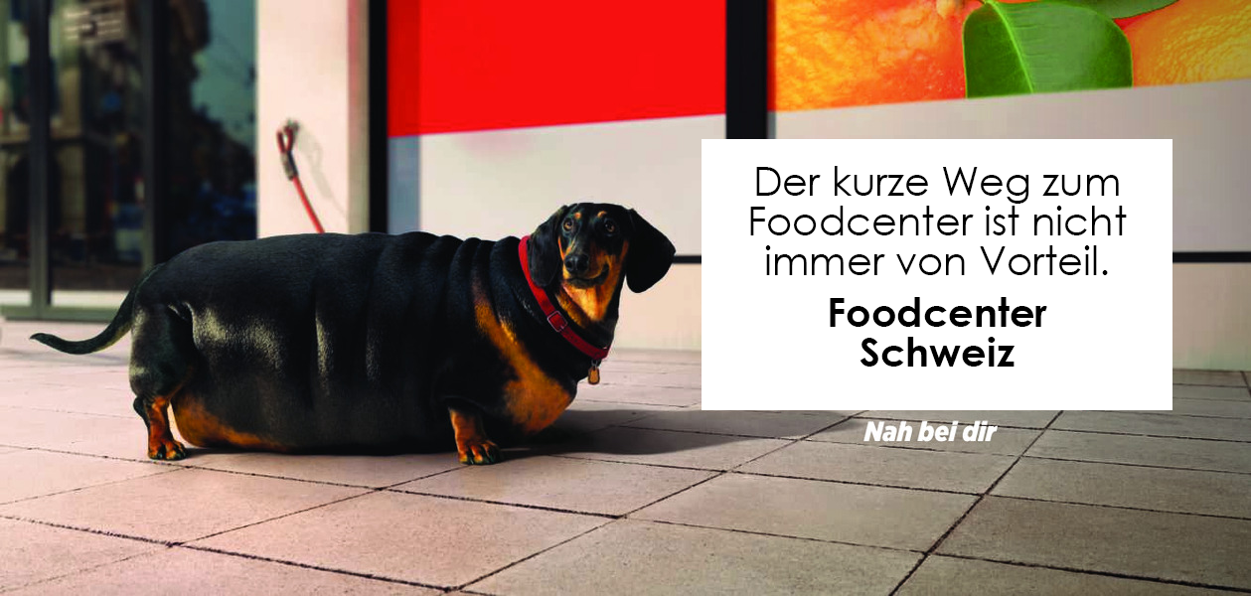

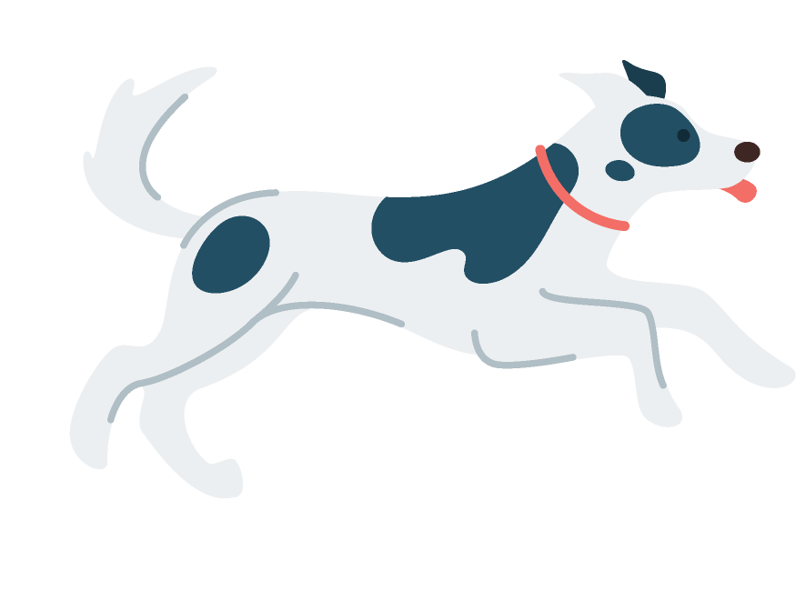
Extraordinary
Deviations from the usual catch our attention
Motifs that deviate from the norm or from known patterns attract our attention.

Slide 16
Extraordinary
«What strikes us is the difference.»
The brain loves the familiar but pays attention to differences. That's why surprising and unusual things catch our attention.
Especially colorful, large, bright, and as mentioned novel stimuli that deviate from familiar and learned patterns increase attention. This arouses our interest and curiosity. Disruptors also fulfill this attention-increasing effect in the broadest sense.
Recommendation: Deviate from the norm for a change and attract more attention with an unusual design. A popular and often used stylistic device are disruptors, which are also good to interrupt a pattern and attract attention.

Slide 17
Attention element No. 4
Relevance

Slide 18






Relevance
Needs and motives control our perception
For example, if we are «hungry» or «thirsty», the appropriate advertising messages catch our eye even more

Slide 19
Relevance
«Our attention is primarily determined by our goals.»
Strong attention is paid to content that corresponds to what we are striving for or to what is currently on our minds.
Good advertising connects to people's goals, dreams and desires. These can be superordinate motifs such as joie de vivre, family, fun, happiness, security, etc.. But also situational imbalances that are active in people at the temporal or local moment of the poster encounter. For example, hunger, thirst, the need for warmth in winter or for cooling down in summer, a time-out from the hectic everyday life or some other form of reward.
Recommendation: Use this knowledge, and present your product as the solution to the relevant goal or need of your target group.

Slide 20
Table of contents «Advanced»
Starting point
The 4 elements for attention
Summary

Slide 21

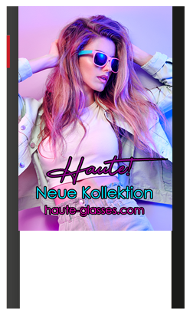

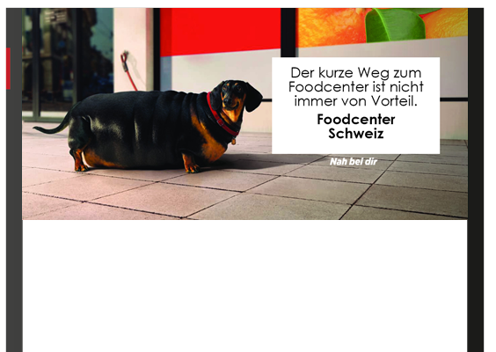
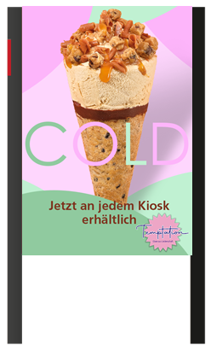
The 4 elements for attention at a glance
1. People and animals
  Child scheme, erotic stimuli and especially faces attract a lot of attention
2. Movement
  DOOH spots attract more and more often views due to the movement
3. Extraordinary
  Our brain primarily notices differences and deviations from the usual. Disruptors work well as such stylistic tool
4. Relevance
  The messages that stand out most to us are those that correspond to our goals, and are thus highly relevant to us

Slide 22
Even more successful together.
APG|SGA, Allgemeine Plakatgesellschaft AG
Giesshübelstrasse 4
8027 Zürich
www.apgsga.ch

