Slide 1
APG|SGA Design tutorial module I «Basic»
Designing outdoor advertising effectively
Status November 2022

Slide 2


Overview of design tutorials
Basic
(Consider physiological and medium-specific aspects)
Advanced
(Use cognitive aspects to control perception & attention)
Expert
(Incorporate cognitive aspects of information processing and learning)
Viel Text und Bilder die man gar nicht lesen kann

Slide 3


Table of contents «Basic»
Starting point
The 6 basic rules
Summary

Slide 4
«The biggest lever for increasing advertising impact lies in creation.»

Slide 5
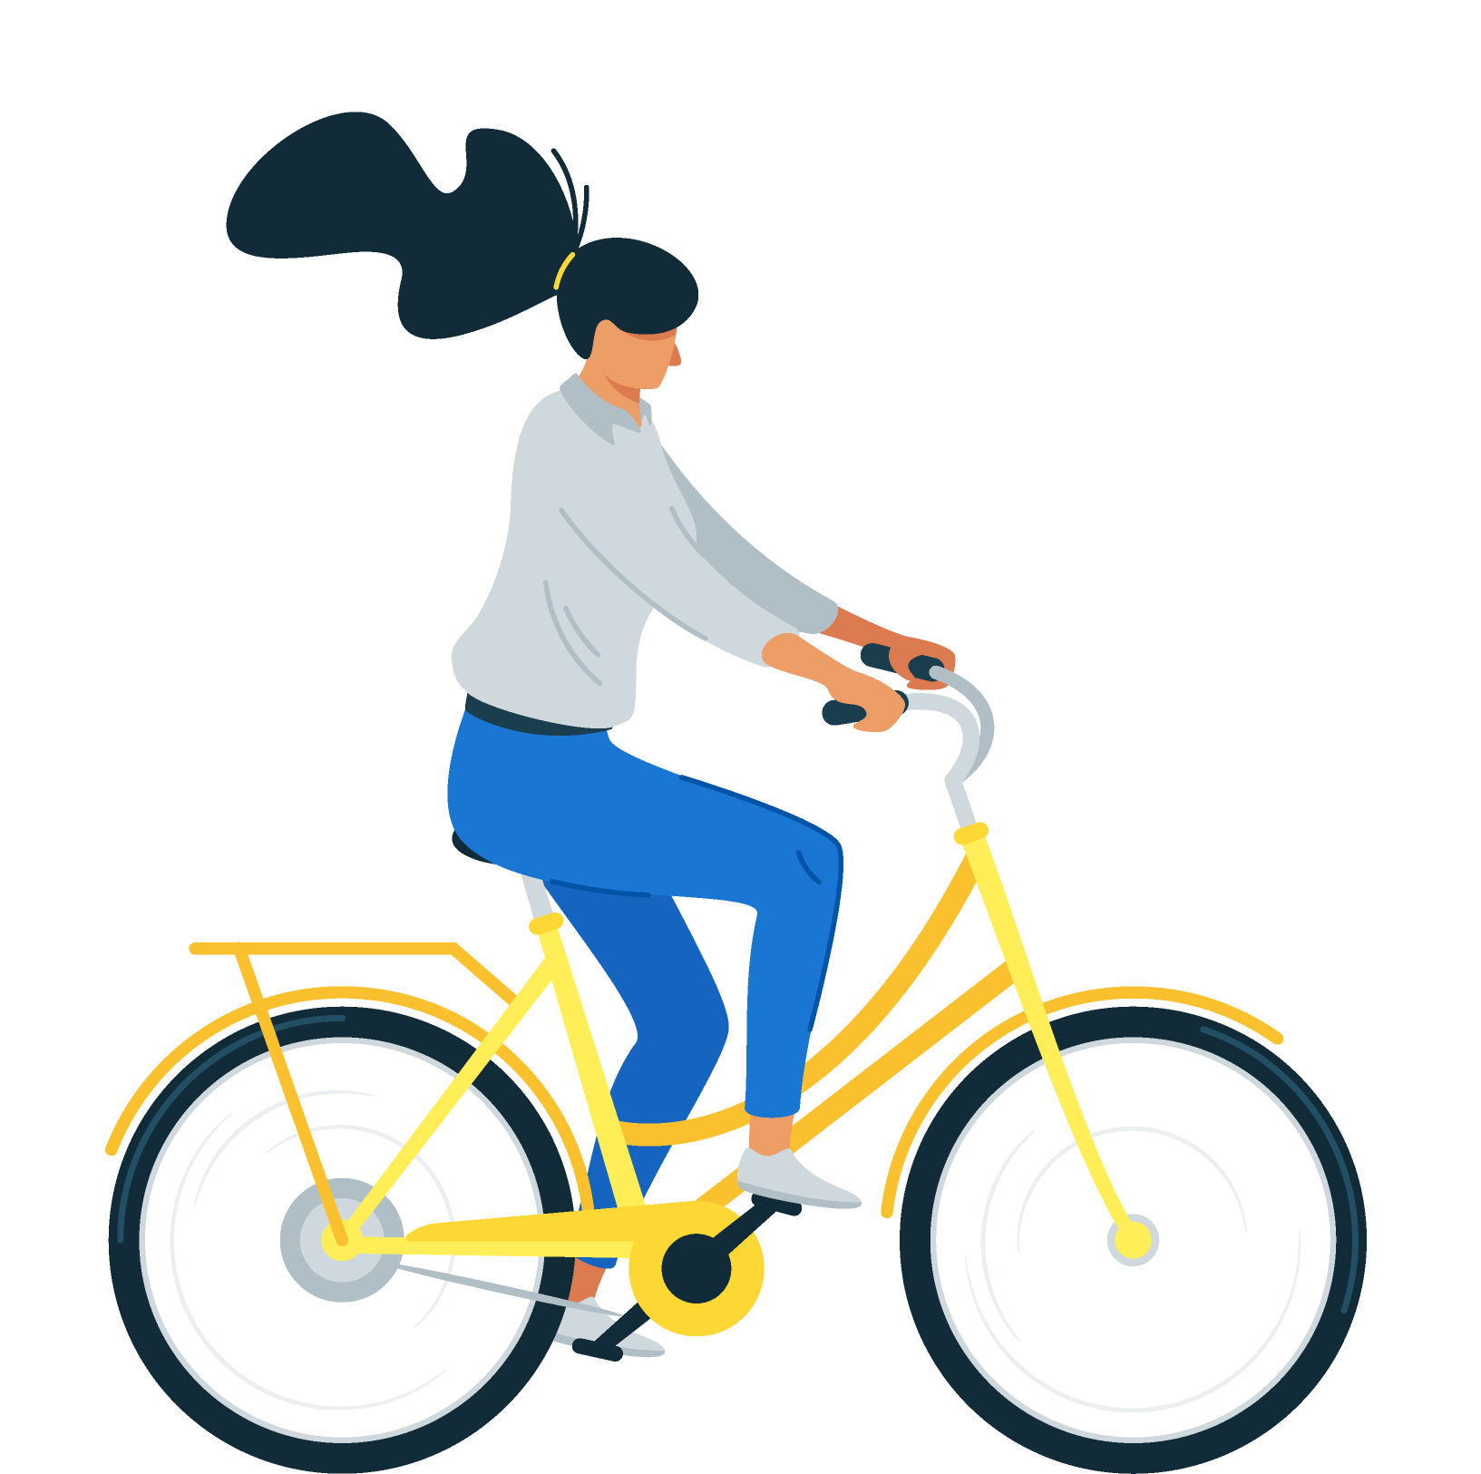


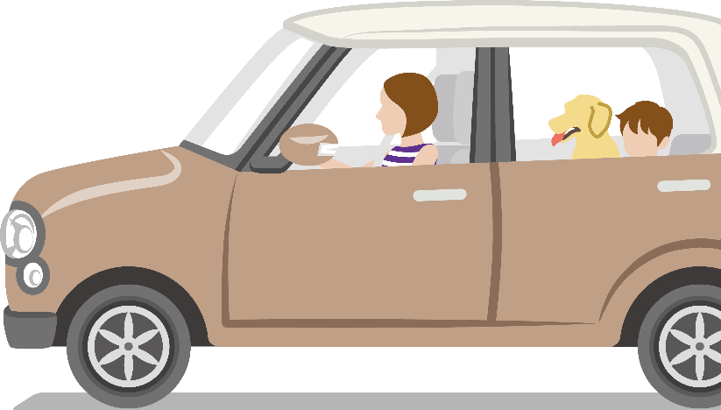

The basic understanding
Crucial moments
The human eye is our most important sensory organ, because we capture more than 80% of all environmental stimuli through the eyes.
Most people in public space are in motion during poster encounter situations. In addition, our visual sensory processing is subject to biophysical laws. These two aspects may be taken into account in poster design.
Ø 2 seconds
ATTENTION TIME
Ø 7 seconds
ATTENTION TIME
Ø 3 seconds
ATTENTION TIME
Notes:
https://www.augentagesklinik-spreebogen.de/de/das-auge#:~:text=Das%20Auge%20ist%20ein%20sehr,Netzhaut)%20ein%20scharfes%20Bild%20entsteht.

Slide 6
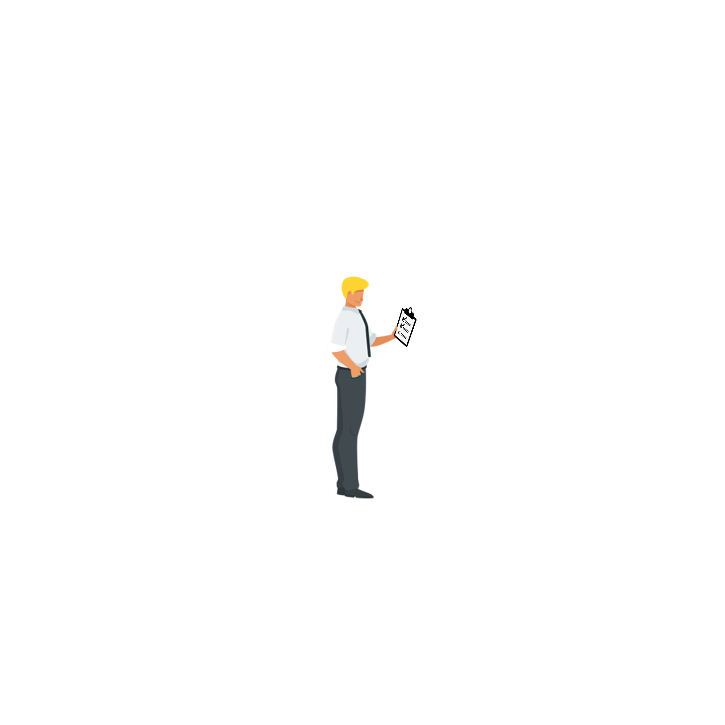


Table of contents «Basic»
Starting point
The 6 basic rules
Summary

Slide 7













The 6 basic rules
Distance effect
Sender assignment
Number of effect elements
Eye-guidance
Contrast effect
Extra: DOOH moving image spots

Slide 8
Rule 1
Distance effect

Slide 9
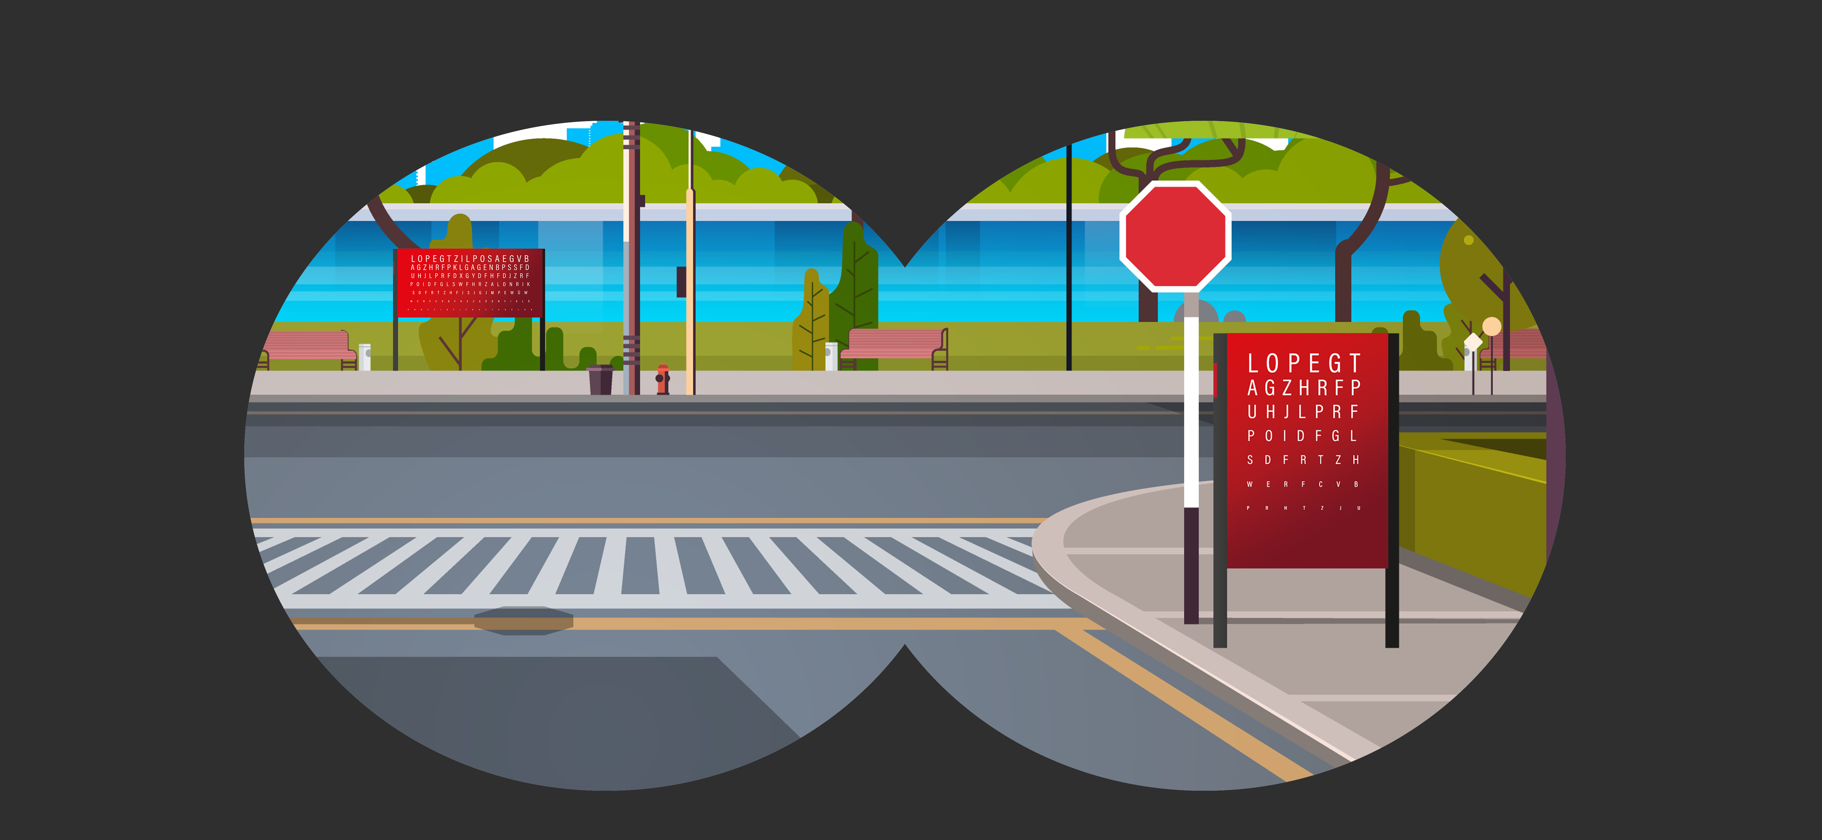
Use distance effect
Good posters work even from a long distance

Slide 10
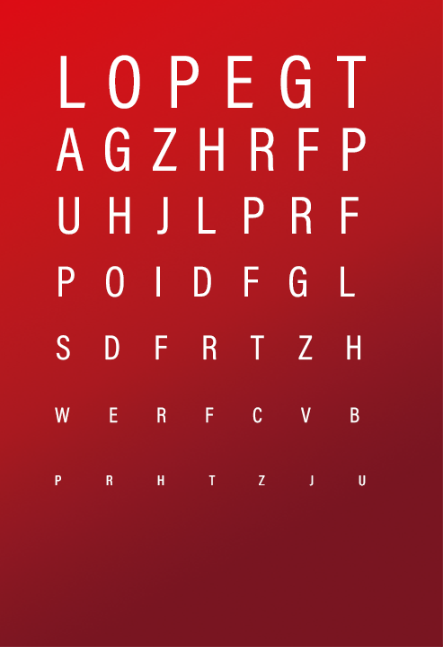
Use distance effect
«A good poster works at a distance, or not at all.»
The enormous impact potential of posters is often wasted due to poor distance effect.
If you design posters with images and fonts that are too small, you lose the people who are in the visibility space of the poster site but cannot perceive the content.
Recommendation: Optimize F12 and F200 posters to a viewing distance of at least 40 meters.

Slide 11
Rule 2
Sender assignment

Slide 12

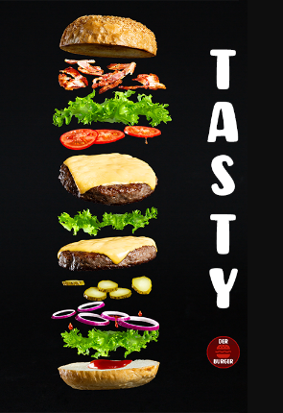
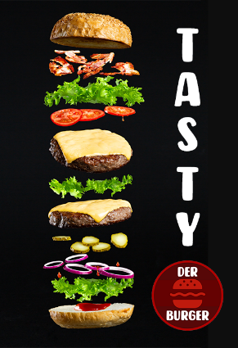

Sender assignment
The sender information is the most important element of your advertising message
Logo too small and only visible up close
Logo is well staged in the image and visible even from a greater distance
Ø 2 seconds
ATTENTION TIME

Slide 13
Sender assignment
«Awareness is the most important company asset.»
The best design is of no use if it does not pay into the sender's account.
With a self-confident appearance and a concise message, you show presence and convey competence. At the same time, making your company known increases customer confidence. Precisely for these branding purposes, it is enormously important that the sender always comes across clearly.
Recommendation: In a stimulating environment, clear and competent branding counts. Your brand should always be in the foreground with maximum presence. From a hierarchical point of view, the logo is therefore the most important effect element. Place it as prominently as possible and optimize it for the greatest possible distance effect.

Slide 14
Rule 3
Number of effect elements

Slide 15





Number of effect elements
The amount of elements has a great influence on the speed of information absorption
No clear message - due to sensory overload, the viewer neither knows where to look nor what is actually being advertised.
Image, headline, disrupter
and logo. The viewer grasps all this in a few moments.
Ø 3 seconds
ATTENTION TIME

Slide 16
Number of effect elements
«Less is often more.»
Clarity and simplicity bring decisive advantages.
People in public space are on the move, and they usually don't have enough time to read long texts, for example. For the design of good posters, this means: omitting or reducing. Limit yourself to a few effective elements that can be looked at, read, and above all understood within a few seconds.
Recommendation: Think about all the elements that you think you need. Think about a (product) image; text a headline with a few words, possibly a disrupter and the logo. Then cross out all the elements you don't really need, so that your poster is reduced to the central message.

Slide 17
Rule 4
Eye-guidance

Slide 18



Eye-guidance
The domino effect: the eye always jumps near the previously fixed element
Chaotic arrangement of the effective elements. Valuable time is lost
Arrangement with clear eye-guidance and hierarchy. The contents can be grasped instantly
Ø 7 seconds
ATTENTION TIME
4
1
1
3
2
2
5
3

Slide 19
Eye-guidance
«Every moment counts.»
Our eyes fixate 3 times per second. During this process, the gaze always jumps to the vicinity of the previously fixed element
(«Domino effect»).
Images in advertising appeal to the feelings and needs of the recipient. The text provides information, and the logo shows who the sender of the message is. Design your posters in a way that the effect elements have a logical and meaningful relationship to each other and are arranged in a way that optimizes the course of vision.
Recommendation: Use this knowledge to attract the eye and then direct it specifically to the sender via the effect elements. A clear reading guide and information hierarchy ensures that passers-by can perceive and process all the information quickly and in the right order.

Slide 20
Rule 5
Contrast effect

Slide 21


Contrast effect
Colors and contrasts increase the conciseness and long-distance effect
Weak contrast e.g. in the interaction with nature and the environment
Strong contrast for more attention

Slide 22
Contrast effect
«The contrast makes the difference.»
Good posters are characterized by eye-catching color scheme.
Colors and contrasts set visual accents. A bright and colorful poster is more likely to stand out than one in pale or dark colors. If the colors are too similar, it can be difficult to make out details when one is in motion.
Recommendation: Pay attention to the right contrast, so that the desired elements, e.g. the text immediately catches the eye. Also consider the environment and season: in winter it's gray, in spring it's green. Therefore, in addition to the contrast effect within the advertising medium, also consider the contrast in relation to the surroundings. However, avoid «overloading» with colors and contrasts. This can quickly appear too colorful and too loud.
Quality contrast
The quality contrast appears - as the name suggests - particularly high-grade. To achieve it, combine a powerful primary or secondary color with a broken, i.e. dull, color in the same hue. For example, orange with reddish brown, turquoise with moss green, or red with pink.
Colors-on-contrast
The color-aspect contrast looks colorful, loud, powerful and decisive - a real eye-catcher. You achieve it when you combine two of the three primary colors, i.e. blue with yellow, blue with red or red with yellow.
Complementary contrast
The complementary contrast is the most blatant contrast. This is because in each case a primary color is combined with the secondary color that results from the mixture of the other two primary colors. So blue with orange, yellow with violet and red with green. The result: both colors are extremely eye-catching.

Slide 23
Extra: Rule 6
DOOH moving image spots

Slide 24
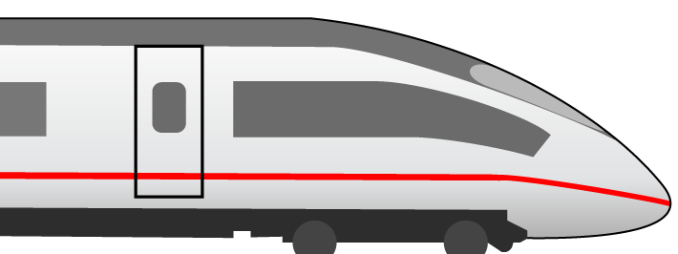

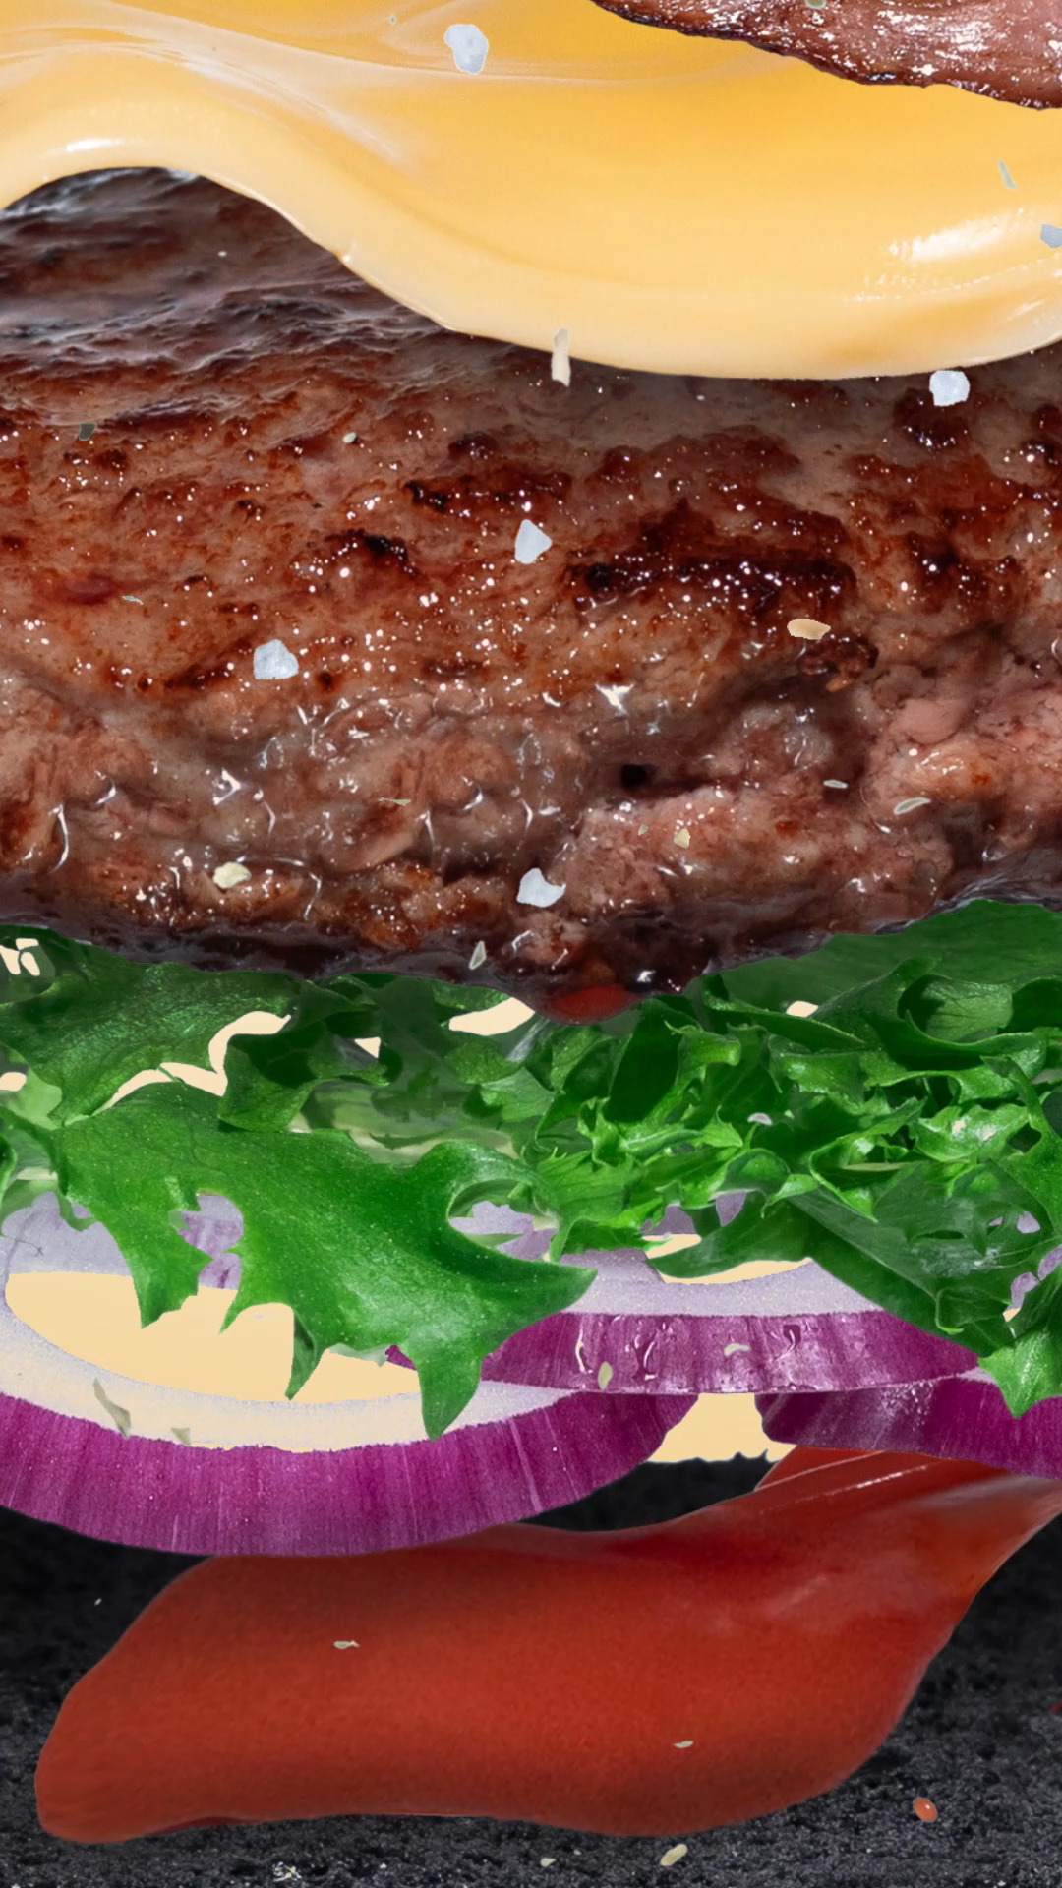
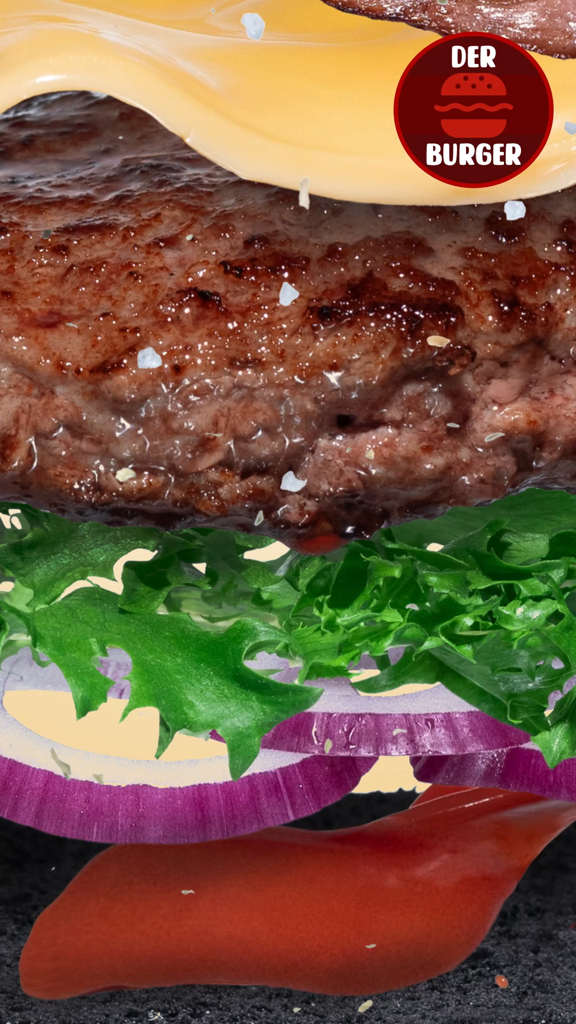
DOOH moving image spots
Digital Out of Home spots must work in every moment
Sender comes only at the end. This means that some people miss this important information during the passage
Sender is recognizable in every frame. Any person can perceive the sender at any moment
Ø 7 seconds
ATTENTION TIME

Slide 25
DOOH moving image spots
«A consistent and striking presentation of the brand in the spot increases top-of-mind awareness.»
In contrast to a classic spot, DOOH spots are consumed «on the fly» and must therefore be thought of as a category of their own.
The poster design rules are also the basic fundament for Digital Out of Home spots. In addition, the following must be considered: People in motion enter the attention space at any point in the spot. And they will also leave the spot at any point. So it may well be that these people only perceive a section of a few seconds per moment of encounter.
Recommendation: Don't design your DOOH spot in a classic linear way, but sequentially. Make sure that your brand / logo and a core message are always visible in each frame.
Notes:
https://invidis.de/2022/11/media-frankfurt-so-funktioniert-gute-flughafenwerbung/

Slide 26
Table of contents «Basic»
Starting point
The 6 basic rules
Summary

Slide 27
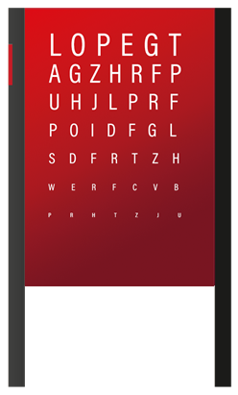
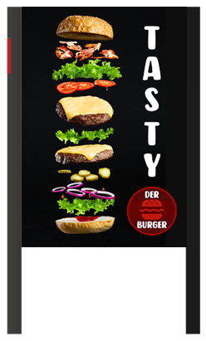
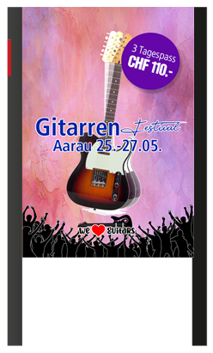

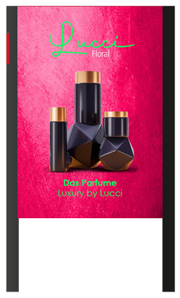
The 6 basic rules at a glance
1. Distance effect
  Ideally, your posters are optimized for a long-distance effect of 40 meters
2. Sender assignment
  Even if the message is unclear, at least your brand or logo should be clearly recognizable
3. Number of effect elements
  Reduce the amount of effect elements to a few elements e.g. image, headline, disrupter and sender for quick detectability
4. Eye-guidance
  Arrange the effect elements in the right hierarchy and ensure targeted eye-guidance from the eye-catcher to the logo.
5. Contrast effect
  Use contrasts in the advertising material and contrasts to the environment for faster and better detectability of your message
6. DOOH moving image spots
  Think in terms of encounter sequences. Make sure that every second in the minimum shows the sender and if possible a key message

Slide 28
Even more successful together.
APG|SGA, Allgemeine Plakatgesellschaft AG
Giesshübelstrasse 4
8027 Zürich
www.apgsga.ch

