Slide 1

Angle Origami
Geometry problem solving and collaboration for remote learning

Slide 2
Acknowledgements
The ideas and activities in this slide pack have been drawn from the Mathematics Curriculum Companion https://fuse.education.vic.gov.au/MCC
The origami activities are drawn from the Mathigon website at https://mathigon.org/origami
All images used in this slide deck are drawn from the above two sites.

Slide 3
Teacher guide: task overview
The task
This task will provide students opportunity to investigate various features of angles in quadrilaterals and other shapes.
Students will
Students will follow paper folding instructions, pose questions about what they notice in the folds and then work collaboratively to identify angle pattern and relationships in polygons.
Key skills
Students will develop skills in problem posing and solving as well as develop strong conceptual knowledge about the qualities and features of polygons and their internal and external angle relationships.

Slide 4
Teacher guide: remote learning challenges and strategies
For this task, it is key that students are encouraged to COLLABORATE in some form. Please refer to the teacher guidance provided on the maths online FUSE page and the DET Learning from home page. Use the provided student slides, modifying where needed to help guide your students through the task and encourage them to collaborate with their classmates to pose and solve problems with each other.
Consider the following general ideas:
  For both synchronous and asynchronous delivery models, consider using an online shared document such as a Google Word document on a OneNote notebook for students to record their questions, ideas and solutions.
  Consider how you would like students to note that they are having difficulty- establish a process for them to seek help from each other and from you as a teacher. This could be through email, through Webex video conferencing or through Skype.
  Consider how you would like students to document their final work and their understanding. Consider using things like quick quizzes through google or Microsoft forms, using a template in a OneNote notebook for each student to complete or a ‘Poll Everywhere’ quiz.
  How will you assess student understanding of the key skills – perhaps focus on one or two of the key skills or have students set their own goals at the beginning of the task and assess their work against these.

Slide 5
Links to the curriculum
Curriculum strand (s) | Measurement and Geometry
Curriculum substrand(s) | Geometric reasoning
Levels addressed | 6, 7, 8
Key learning outcomes. At the end of this activity, student will:
  Use appropriate geometric language and terms for angles
  Identify a number of angles in folds of paper
  Recognise and identify the angle properties of various polygons
  Apply problem solving strategies to pose and solve problems
Common misconceptions or difficulties to look out for:
  Students may not be familiar with key vocabulary – make sure that students are understanding the key words before they start.
  Students may not be familiar with polygons beyond the square, rectangle and triangle and may need support to identify parallelograms and trapeziums
Content descriptors potentially addressed:
Level 6
Investigate, with and without digital technologies, angles on a straight line, angles at a point and vertically opposite angles. Use results to find unknown angles (VCMMG231)
Level 7
Classify triangles according to their side and angle properties and describe quadrilaterals (VCMMG262)
Demonstrate that the angle sum of a triangle is 180° and use this to find the angle sum of a quadrilateral (VCMMG263)
Identify corresponding, alternate and co-interior angles when two straight lines are crossed by a transversal (VCMMG264)
Investigate conditions for two lines to be parallel and solve simple numerical problems using reasoning (VCMMG265)
Level 8
Establish properties of quadrilaterals using congruent triangles and angle properties, and solve related numerical problems using reasoning (VCMMG293)

Slide 6
Format of the activity
You can modify these slides to suit your pedagogy.
The student slides start on slide 12
Throughout the slides, there are prompts for students to do things ‘according to their teacher’s instructions’. You may want to change this text to provide those instructions for them. The sections you may want to modify are marked in green to make it easy for you to identify them.
The ‘solutions’ are provided on the following slides so that you know what you are looking for in student responses and what these responses may mean with respect to the level of understanding students are demonstrating.

Slide 7
Student documentation and collaboration
The information that students are prompted to document throughout this task includes:
  A photograph of their initial paper folding so that you can check they have done it correctly
  Key terms and definitions to support them to be able to complete the task (these are prompted throughout the task)
  questions on angles, number, type and magnitude
  Questions that they pose to others and ones that they answer from others
  Summarise the properties of shapes and patterns that they notice or identify
  Extension task - origami
  Reflection on the final task
Throughout this task, students should be encouraged to document their work. They can do this in a number of ways including:
  They can access a static document that you provide and fill it in as they go – sending it back to you at the end of the task either by email or using school LMS platforms (an example is provided with this activity)
  They can contribute their ideas to you as they go using online and shared documents such as google docs or OneNote / Microsoft online documents or others
  The question posing and answering sections require students to be able to share their questions with each other, answer each others questions and then provide feedback to those providing answers. You will need to consider how you structure this. You could set up a table for students to write their questions into an online shared document or you can have students submit all of the questions to you and you can then redistribute them (the later strategy will be far more time demanding for you). You may also want to set up a quick feedback template or specify the sort of information that you want students to feedback to each other – a suggestion is provided on the next slide.

Slide 8
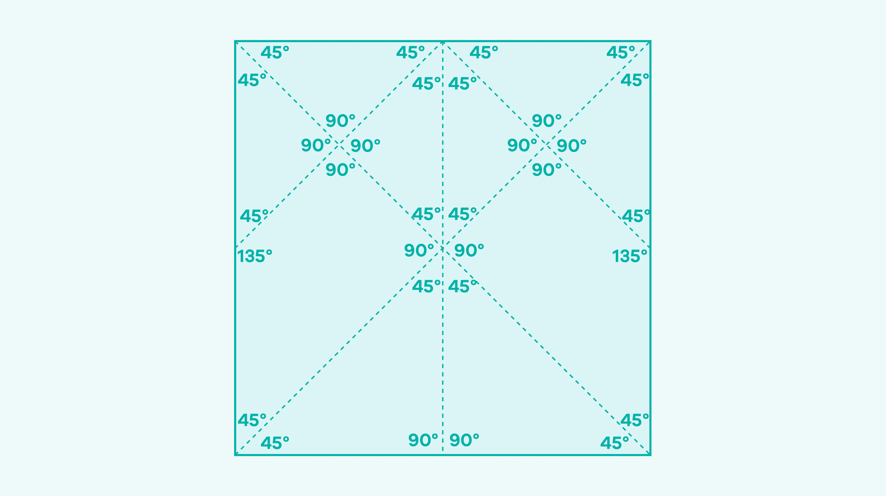
Solutions and what to look for
Step one asks students to complete a folding activity and send you a copy of what they did. What they are aiming for is demonstrated on the diagram.
The questions then ask them to identify the number, type and magnitude of all of the angles. The response you are looking for is represented in the table. Note you may have other responses provided as well and these should give you some insight into the level of student understanding.
Type | Magnitude | Number
Acute | 45degrees | 18
Obtuse | 135 degrees | 2
Right | 90 degrees | 12

Slide 9
The third step in the student slides asks students to identify the different types of shapes, the number of them and the internal angle sums.
You may want students to make their own table up for this so that you don’t give to much away in the asking of the question. What you are essentially looking for is if students can identify the various shape types and that there are shapes of different sizes but their angle sums remain the same. A solution might look like:
Students may need support to see the trapeziums at first or to recognise that there are multiple triangles of various sizes.
Allowing and encouraging students to share their solutions with each other will help support the development of more sophisticated understanding for all students.
Shape type | How many? | Are they all the same size? | Internal angle sum? | Are they all the same?
Triangle | 16 | No | 180 | Yes
Square / rhombus | 2 | No | 360 | Yes
Trapezium | 4 | No | 360 | Yes
Rectangle | 2 | Yes | 360 | Yes
You may also have students who identify that the quadrilaterals all have the same angle sum. This could lead off into further learning and might form the basis of a question that they could ask of their classmates / future learning.

Slide 10
Feedback template suggestion – feedback on the questions asked
What did you like about the question asked?
How difficult did you find the question?
What information did you need to answer the question?
How could you make the question more or less difficult?

Slide 11
Feedback template suggestion – feedback on the answers provided
Was the solution correct / logical?
Did the person answering the question give you enough information for you to understand HOW they came to their solution?
What could they have done differently? Was there another way to think about the problem?

Slide 12

Angle origami
Student slides

Slide 13
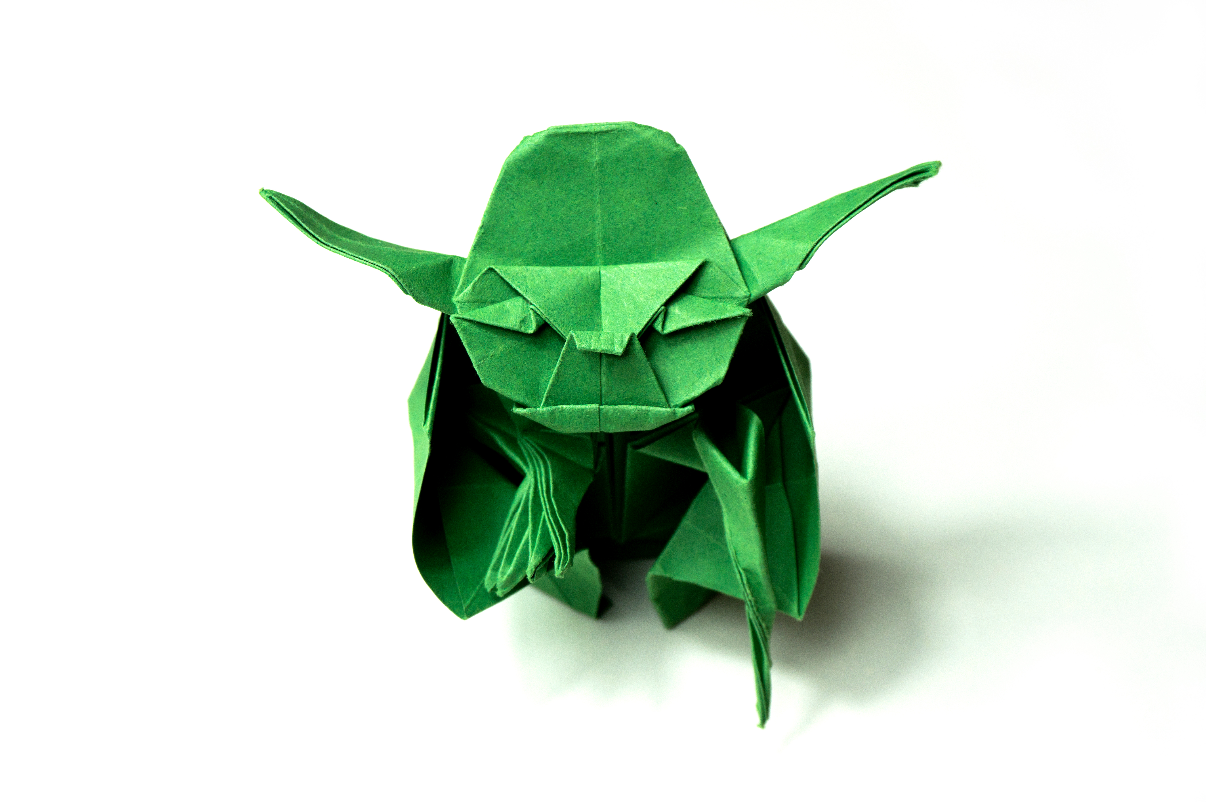
What is ‘origami’?
The word ‘origami’ comes from the Japanese word for folding ori and the word for paper kami.
Distinct paper folding traditions are known to have existed in ancient Chinese and European cultures but it is Japan that is most known for its paper folding traditions where it dates back to at least the year 1680.
It was influences from European cultures (especially the German art of paper folding) that brought about the intricate paper folding sculptures that make up the art of origami today.
the practice and study of origami draws on several mathematical principles from the field of GEOMETRY and for some geometric designs, origami is a better tool to use than a compass or a ruler.
Origami principles have been used in design and engineering, in particular, in the construction of car air bags, medical stents (the things that keep arteries and blood vessels open when they have collapsed) and even the solar panel mounts on satellites used in space.
What started out as a way to pass the time has become a world wide phenomenon that has helped humans to better understand the world we live in!

Slide 14
Angle Origami
The problem:
You will follow some origami (paper folding) instructions to develop a collection of shapes.
You will then identify all of the information about angles and shapes that you can from your paper and challenge your classmates to answer questions that you have designed.
You will then answer some challenge questions yourself to identify what you know about shapes, angles and how they are all related.
Learning intentions
You will use mathematics terms for shapes and angles
You will identify shapes and angle values
You might also identify the properties of some shapes with respect to their angles
You will use your problem solving and collaboration skills to extend your knowledge by sharing your ideas with your classmates
Success criteria
You will produce a final response to the paper folding task and submit this to your teacher
You will have engaged with your classmates, asking them questions and analysing their responses and answering the questions that they ask of you.
Equipment needed
You will need a square piece of paper or thin card it can be any size but too small will be very difficult and too big may be hard to work with. (first challenge - how can you make sure that your piece of paper is truly square?)
You will also need something you can use to take photographs and your computer / laptop / tablet/ phone to communicate with your teacher and classmates.

Slide 15
Origami Mathematics
In this activity, you will be using paper folding techniques to determine the shapes and angles that they make.
Step one – you will follow some simple instructions to complete a paper fold
Step two – you will then identify the angles that these folds make
Step three – you will identify the shapes made by the paper folds
In the last part of the activity, you will complete some origami paper folds to make a variety of shapes and creatures and then the knowledge that you developed in the first 3 steps to help you to identify the shapes and angles made in these creations.
Have fun!

Slide 16


Step one: fold your paper
Follow these instruction to fold your paper:
  Start with a square piece of paper (how DO you make sure that it is actually square?)
  Fold the paper along its vertical line of symmetry and open it back up to a square
  Fold the paper along each diagonal line of symmetry ie corner to corner. Open it up back to a square
  Fold the two top corners to the centre point of the square. Open the folds back to a square
Words that you need to know in order to follow these instructions:
  What is a ‘vertical line of symmetry’? If you are not sure, break it down and identify what the word ‘vertical’ means and what a ‘line of symmetry’ is.
  What is a diagonal line of symmetry?
When you are finished, take a photograph of your paper – clearly showing the folds (you can mark these with a pen or pencil if you need) to your teacher. you may wish to check-in with some of your classmates first to see if yours matches theirs.
Once your teacher confirms that you have the correct fold patterns, you can continue to the next section.

Slide 17
Step two
On your piece of paper, you should be able to recognise ANGLES of various sizes.
Your task now is to identify the TYPE of each angle and its MAGNITUDE
To complete this task, you first need to understand what is meant by:
ANGLE
Angle TYPE
Angle MAGNITUDE
Use the collaboration strategies your teacher has outlined to establish a common understanding of what is meant by these words.
Document your understanding of these words – your teacher will tell you how

Slide 18

Answer the following questions (document):
Success criteria:
You will have answered the questions and shared these with a friend to make sure that they are correct.
You can use these facts to help you to meet the challenges in the next parts of the activity.
How many angles did you find of each ‘type’? Organise your response in a table or according to your teacher’s instructions.
How can you know the MAGNITUDE of these angles without using a protractor – what knowledge did you draw on to figure this out?
List the angle facts that you know and check these with a classmate.

Slide 19
Question posing and question answering
Look at your piece of paper with all of its angles and identify three MATHEMATICAL questions that you could ask about it.
Once you have identified your questions, add these to your class’s questions using the process identified by your teacher.
Have a go at answering some of the questions posed by your classmates – your teacher may specify a process for this.
Submit your answers to your classmates for review and
Review the answers that you receive to your questions – provide the person who answered the question with feedback. Again, your teacher will likely specify a process for this.

Slide 20
Step three: a focus on shapes
How many different shapes can you identify on your piece of paper?
What is the ‘INTERNAL ANGLE SUM’ of each of these shapes (you will need to think about or look up what this phrase means)
How many of each shape are there? Are they all the same size?
If they are not all of the same size, what is different about them?
How do you know that you have found them all?
You will need to document your responses to the above questions and share them with your classmates to see if others had similar responses. If there are differences in what students found, why do you think this is and how can you figure out who has the ‘correct’ responses?

Slide 21
An extension
Can you add another fold to your piece of paper that INCREASES the number of types of shapes that it contains?
What did you do?
How has this changed the number and nature of the shapes on the page?
What patterns do you notice?
  This can include patterns in the number of shapes,
  Patterns in the types of shapes and the types of angles
  Patterns in the angle sums of shapes
Share what you did with other students – try to find someone who did something different to you.

Slide 22
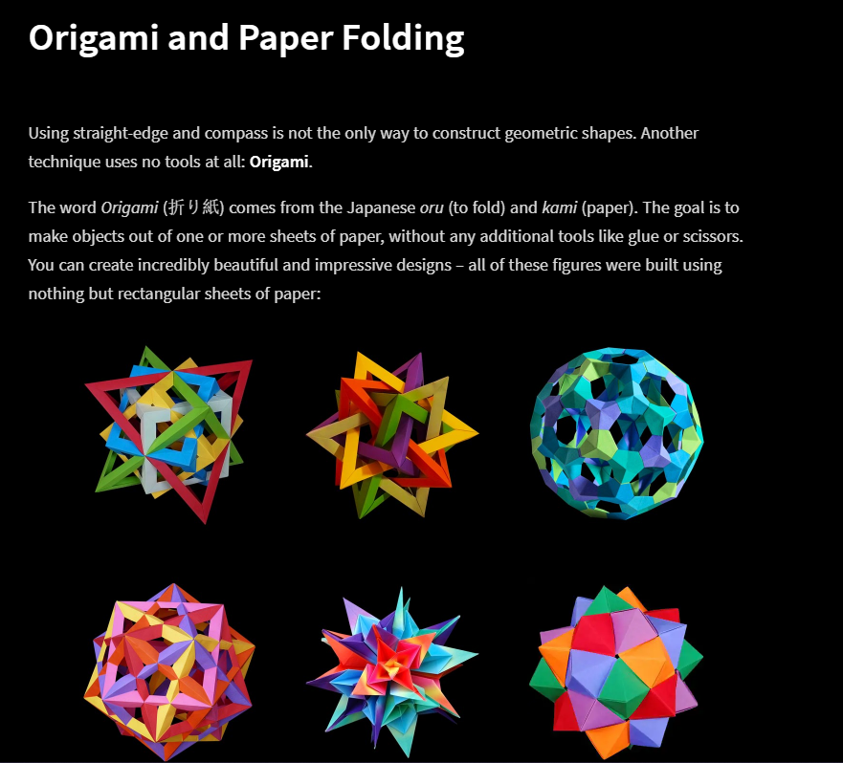
Origami Mathematics
Click on the image on this slide to go to the Mathigon site where you can access detailed instructions including video of how to fold a paper crane and other shapes.
Have a go at completing your own crane and send an image or video of your creation to your teacher when you are done.
Explore this site to see if you can make some other shapes (try the dragons!).
For a real extension on the task, see if you can identify all of the shapes and angles that are formed when you fold a paper crane.

Slide 23
Reflection
In this step, you will summarise and reflect on what you have learnt.
Document this step using the process outlined by your teacher
The questions you need to respond to are:
  Review the learning intentions from the beginning of the task and identify which ones you believe you met from doing this task.
  Outline three things that you learned from the task or found interesting.
  Outline the key strategies that you used to complete the task. Did you COLLABORATE with your classmates? If you did (and you should have) how did this collaboration support your learning?
  What is one question that you have about what you might learn next about shapes and angles?

Slide 24

Submission
Submit your task to your teacher
Task complete

