Slide 1
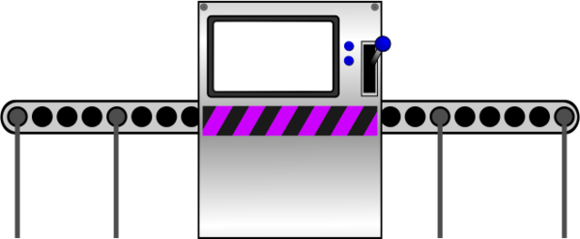
The Function Machine

Slide 2
Machine A
+ 2
3
5
© Department of Education and Training CC BY 4.0

Slide 3
Machine A
+ 2
5
7
© Department of Education and Training CC BY 4.0

Slide 4
Machine B
- 1
8
7
© Department of Education and Training CC BY 4.0

Slide 5
Machine B
11
- 1
10
© Department of Education and Training CC BY 4.0

Slide 6
Machine C
- 4
9
6
© Department of Education and Training CC BY 4.0

Slide 7
Machine C
- 4
6
3
© Department of Education and Training CC BY 4.0

Slide 8
ALERT!
ALERT!
© Department of Education and Training CC BY 4.0

Slide 9
Machine C
10
- 4
7
!Forwards Malfunction!
Level 1 Malfunction
© Department of Education and Training CC BY 4.0

Slide 10
Machine D
- 1
6
7
© Department of Education and Training CC BY 4.0

Slide 11
Machine D
- 1
2
3
© Department of Education and Training CC BY 4.0

Slide 12
ALERT!
ALERT!
© Department of Education and Training CC BY 4.0

Slide 13
Machine D
- 1
9
8
!Backwards Malfunction!
Level 2 Malfunction
© Department of Education and Training CC BY 4.0

Slide 14
Machine E
??
10
5
© Department of Education and Training CC BY 4.0

Slide 15
Machine E
14
??
7
© Department of Education and Training CC BY 4.0

Slide 16
ALERT!
ALERT!
© Department of Education and Training CC BY 4.0

Slide 17
Machine E
??
8
4
!No Pattern Malfunction!
Level 3 Malfunction
© Department of Education and Training CC BY 4.0

Slide 18
Machine F
7 $\frac{1}{2}$
9
??
© Department of Education and Training CC BY 4.0

Slide 19
Machine F
6 $\frac{1}{2}$
5
??
© Department of Education and Training CC BY 4.0

Slide 20
ALERT!
ALERT!
© Department of Education and Training CC BY 4.0

Slide 21
Machine F
4 $\frac{1}{2}$
3
??
!No Pattern Malfunction!
Level 4 Malfunction
© Department of Education and Training CC BY 4.0

Slide 22
Technical Inspection Report
The following slide details the results of the inspection carried out by trained technicians.
© Department of Education and Training CC BY 4.0

Slide 23
Technical Inspection Report
Machine A: PASS
Machine B: PASS
Machine C: FAIL – Level 1 Malfunction
Machine D: FAIL – Level 2 Malfunction
Machine E: FAIL – Level 3 Malfunction
Machine F: FAIL – Level 4 Malfunction
© Department of Education and Training CC BY 4.0

