Slide 1




THE FUTURE ENVELOPE
TOWARDS ZERO CARBON BUILDINGS
15‐16 December 2022 Bolzano/Bozen
GreenThermowall, the next vertical garden generation
Jordi Serramia Ruiz
Singulargreen
Collaborations
Sponsors
Organized by

Slide 2


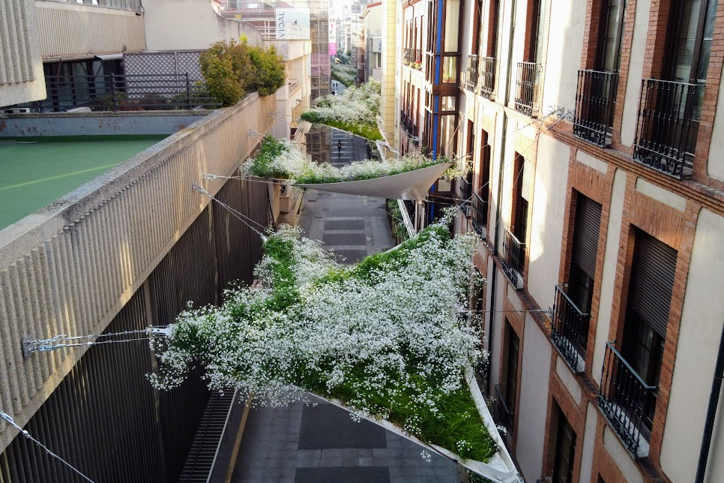
Singulargreen and Indresmat
15 years experience in integrating nature and architecture.

Slide 3
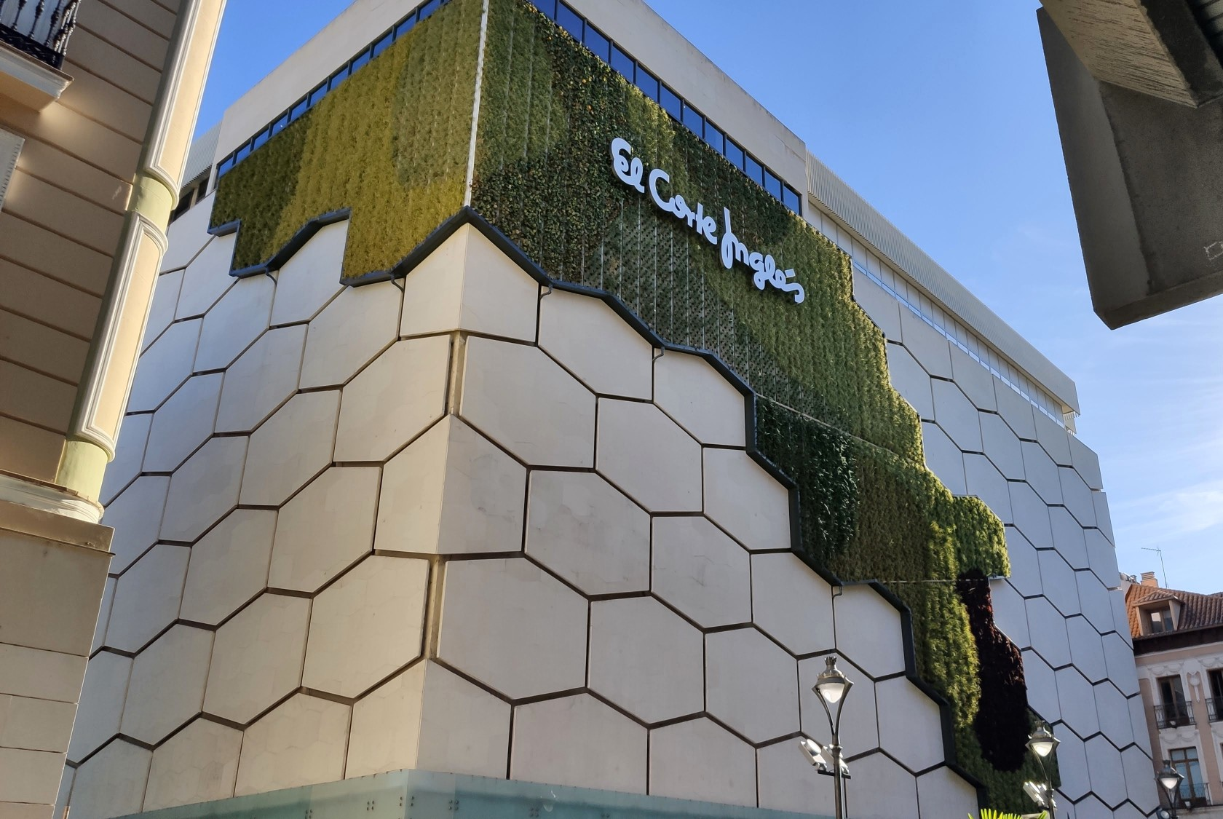
Singulargreen and Indresmat
15 years experience in integrating nature and architecture.

Slide 4
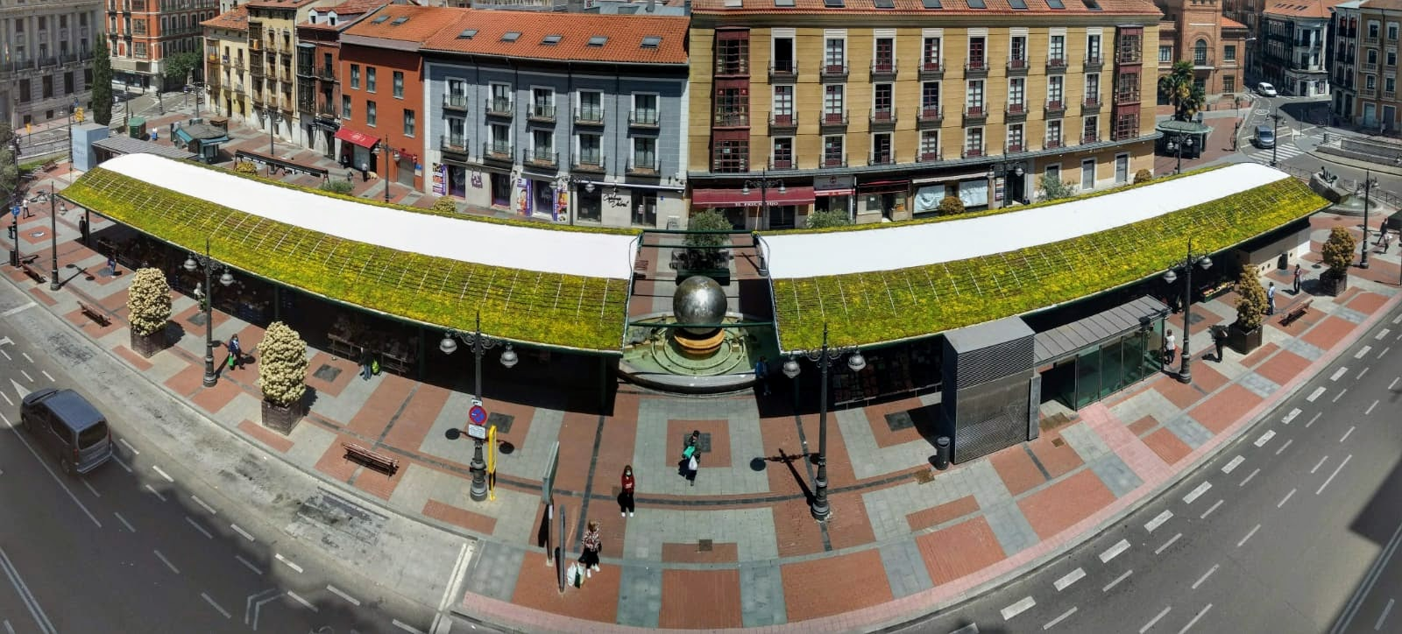
Singulargreen and Indresmat
15 years experience in integrating nature and architecture.

Slide 5

Singulargreen and Indresmat
Indresmat
Indresmat has the know-how in poliurethane chemistry and engineering. BioPUR.

Slide 6
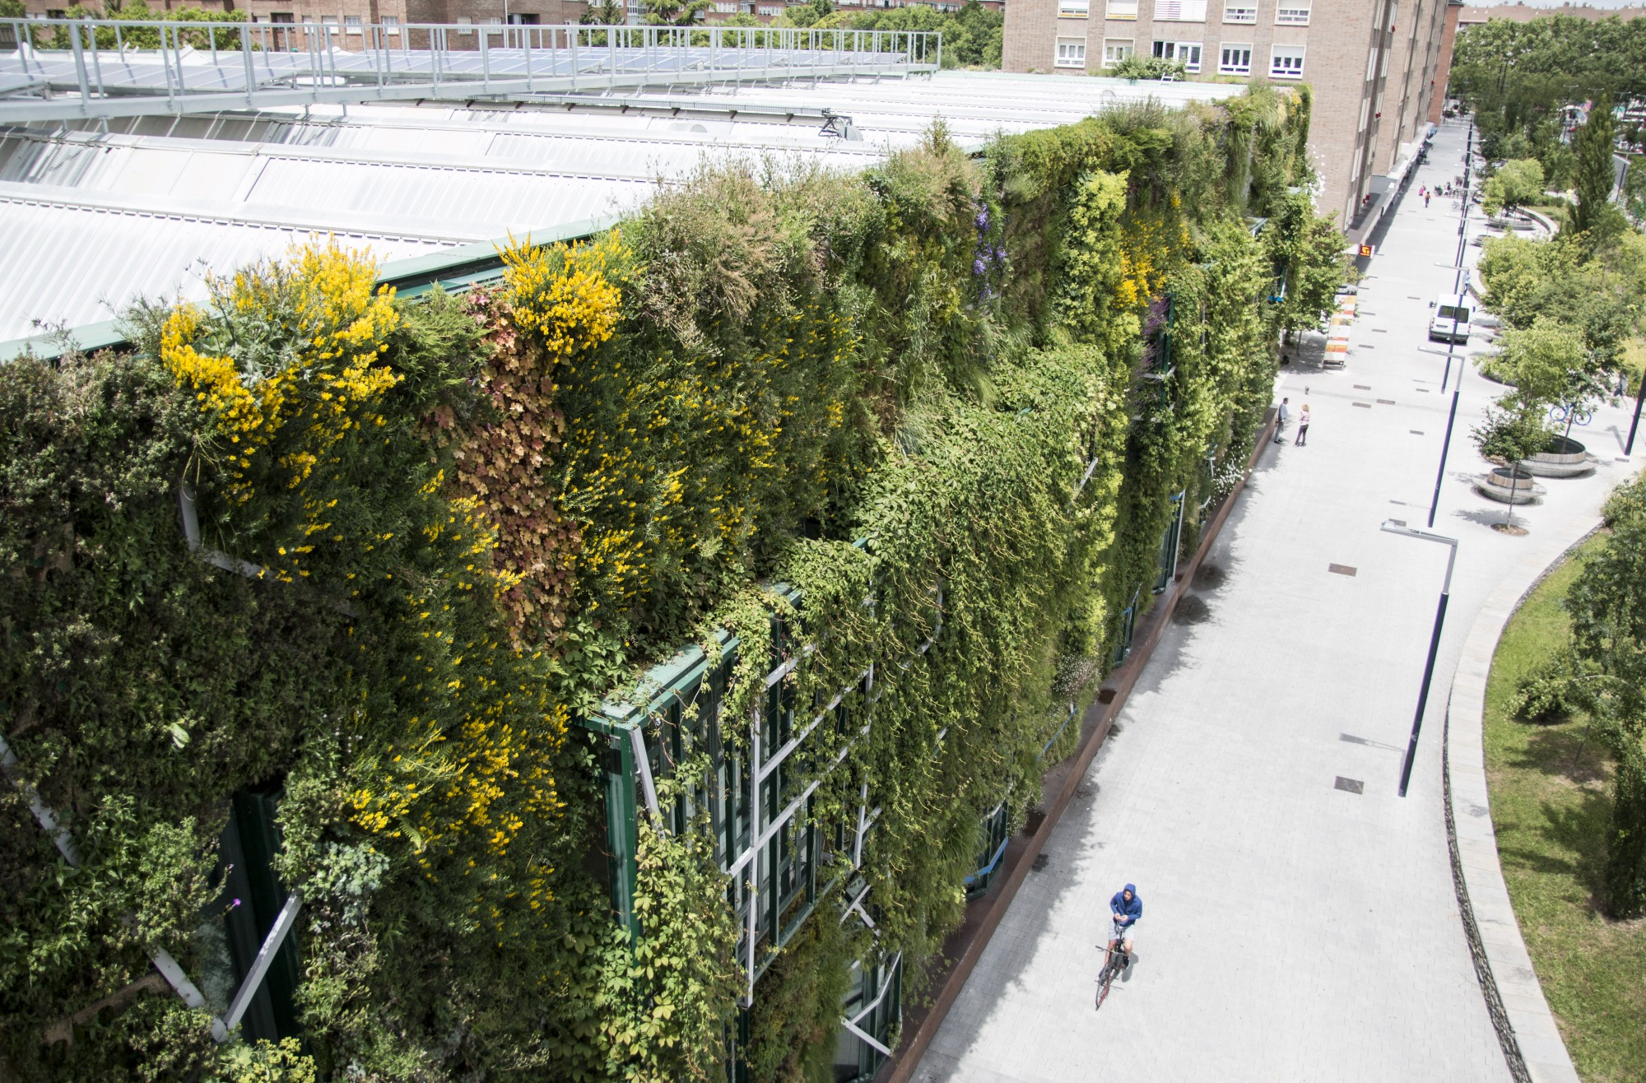
Vertical garden issues
Vertical gardens
Beautiful
Green explotation of space
Biodiversity
Pollutant fixation
Heat island effect reduction
Thermic insulation

Slide 7
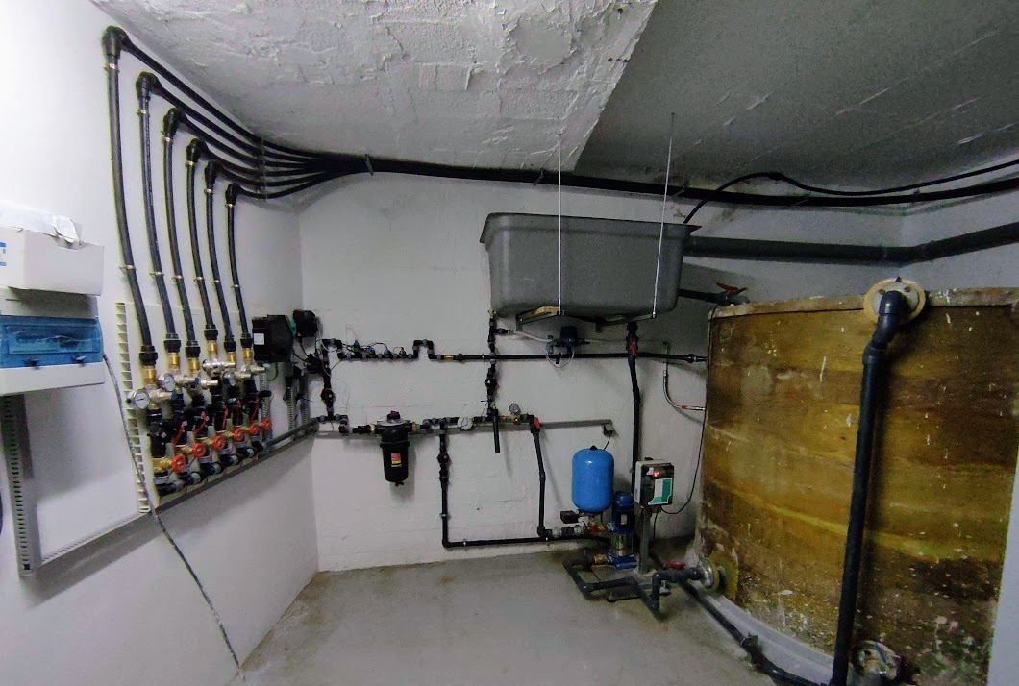
Vertical garden issues
Vertical gardens
Expensive
High maintenance
Green washing
Energy waste
Water waste

Slide 8
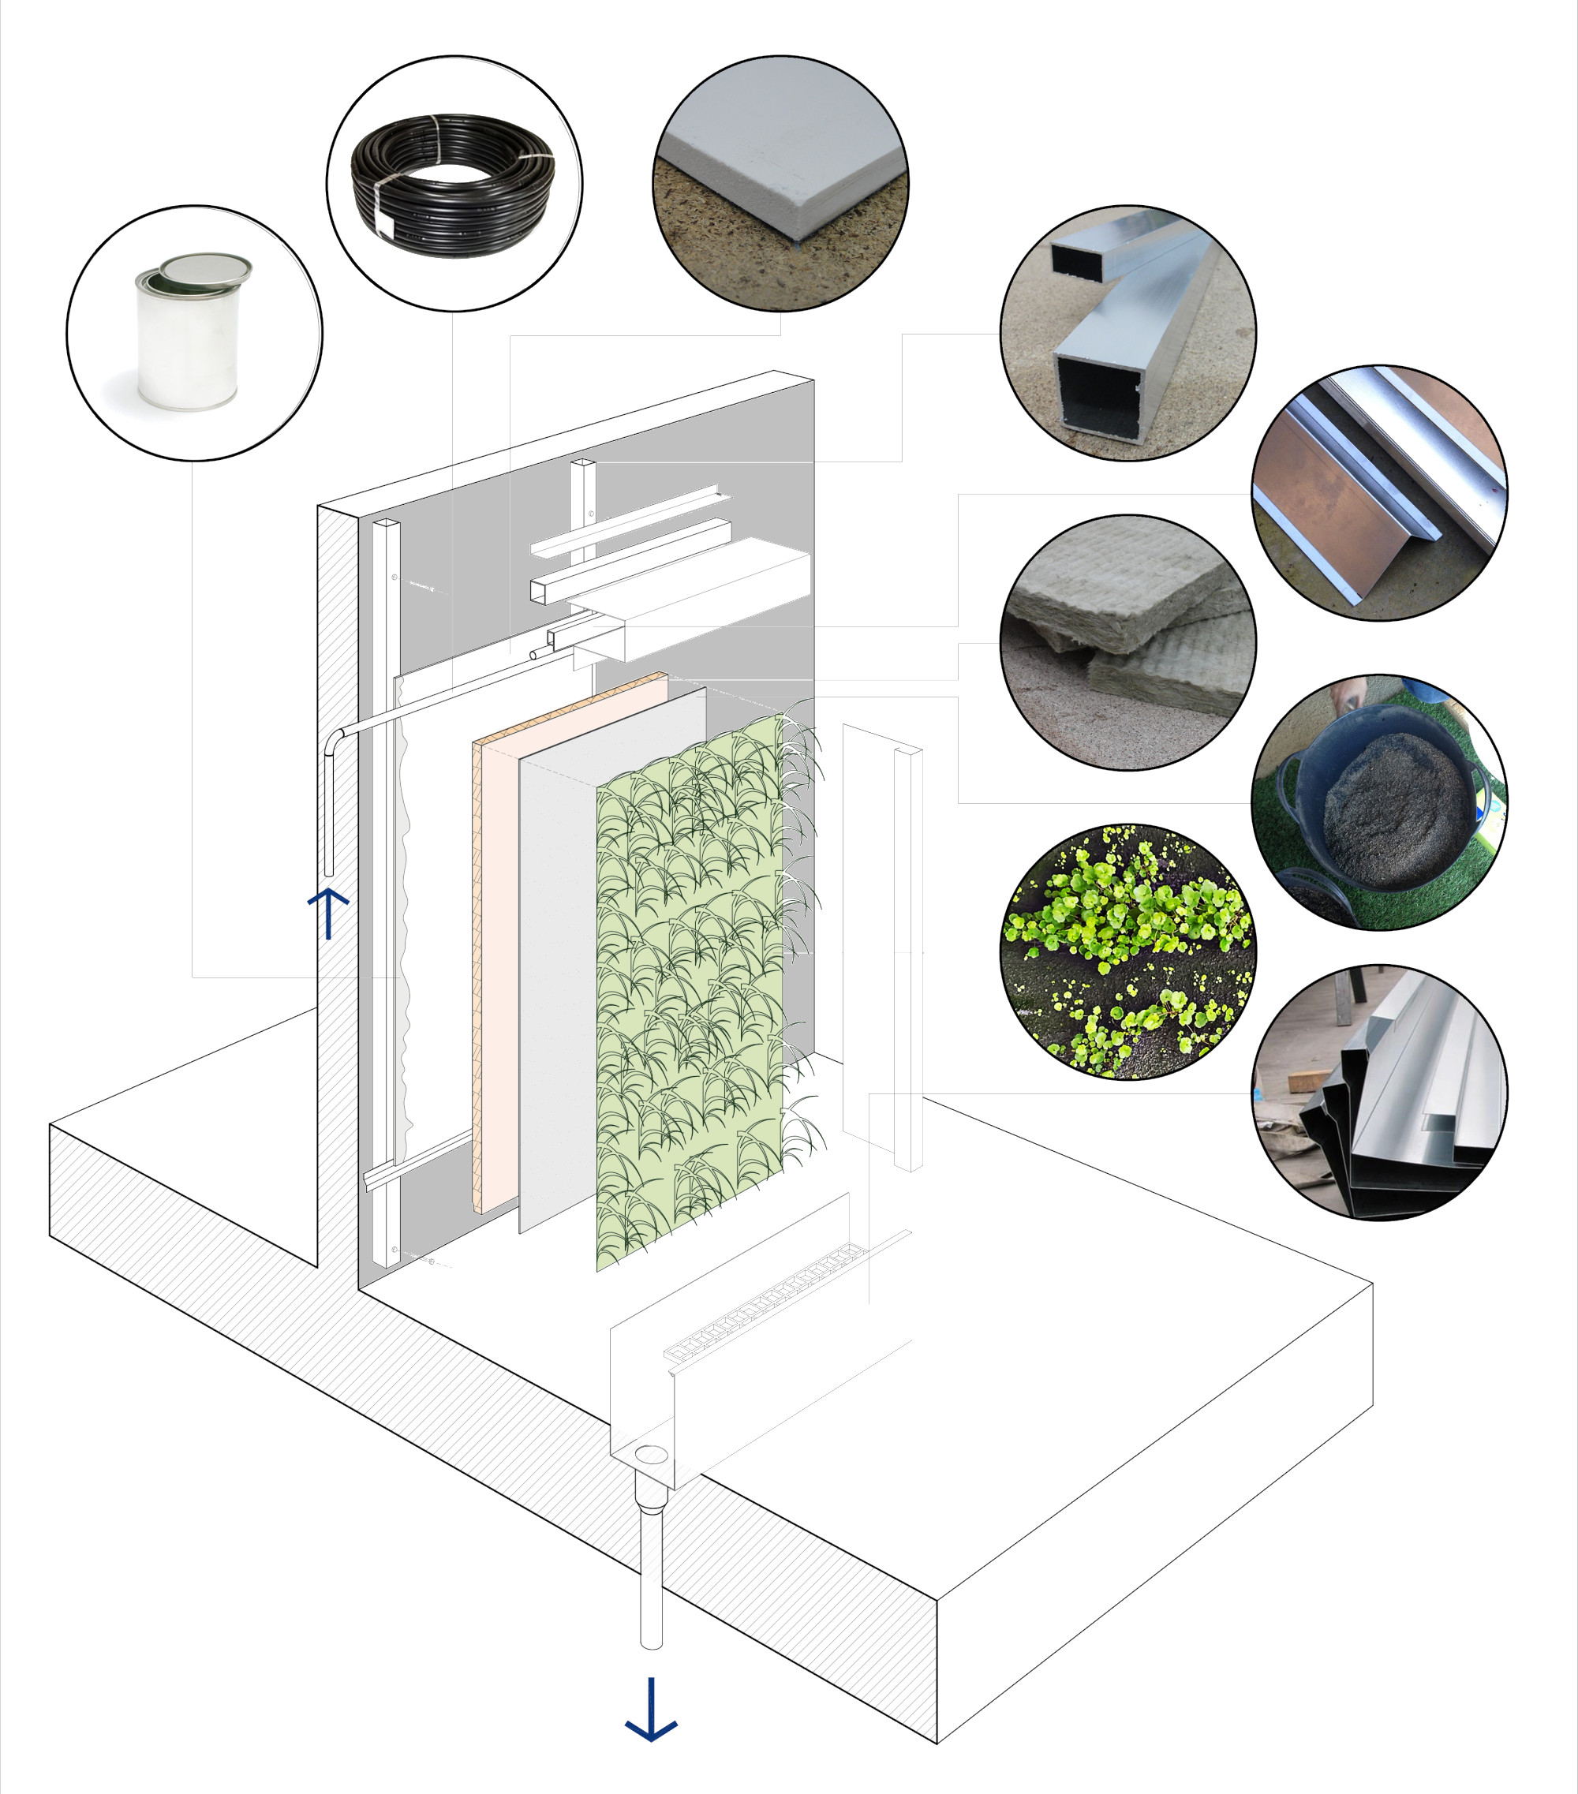
Traditional vertical garden
Traditional vertical garden involves lots of different materials
Fabric
Aluminium
Plants
PVC panel
Etc.

Slide 9
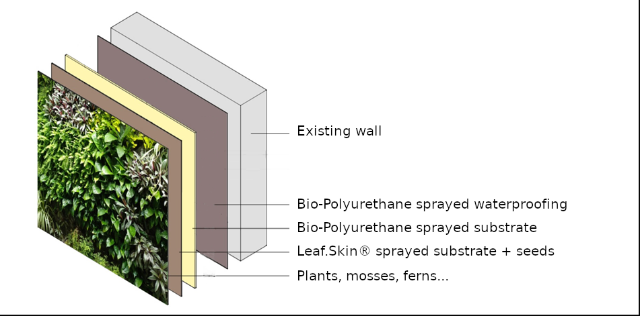
GreenThermowall the sprayed vertical garden
!¿Sprayed vertical garden?!
Few materials
Economic
Optimal insulation
Insulation in winter
Cooling in summer
Drone-automated

Slide 10
GreenThermowall the sprayed vertical garden
Only three materials
Bio-Polyurethane
Leaf.skin® (vegetal fibers)
Seeds

Slide 11
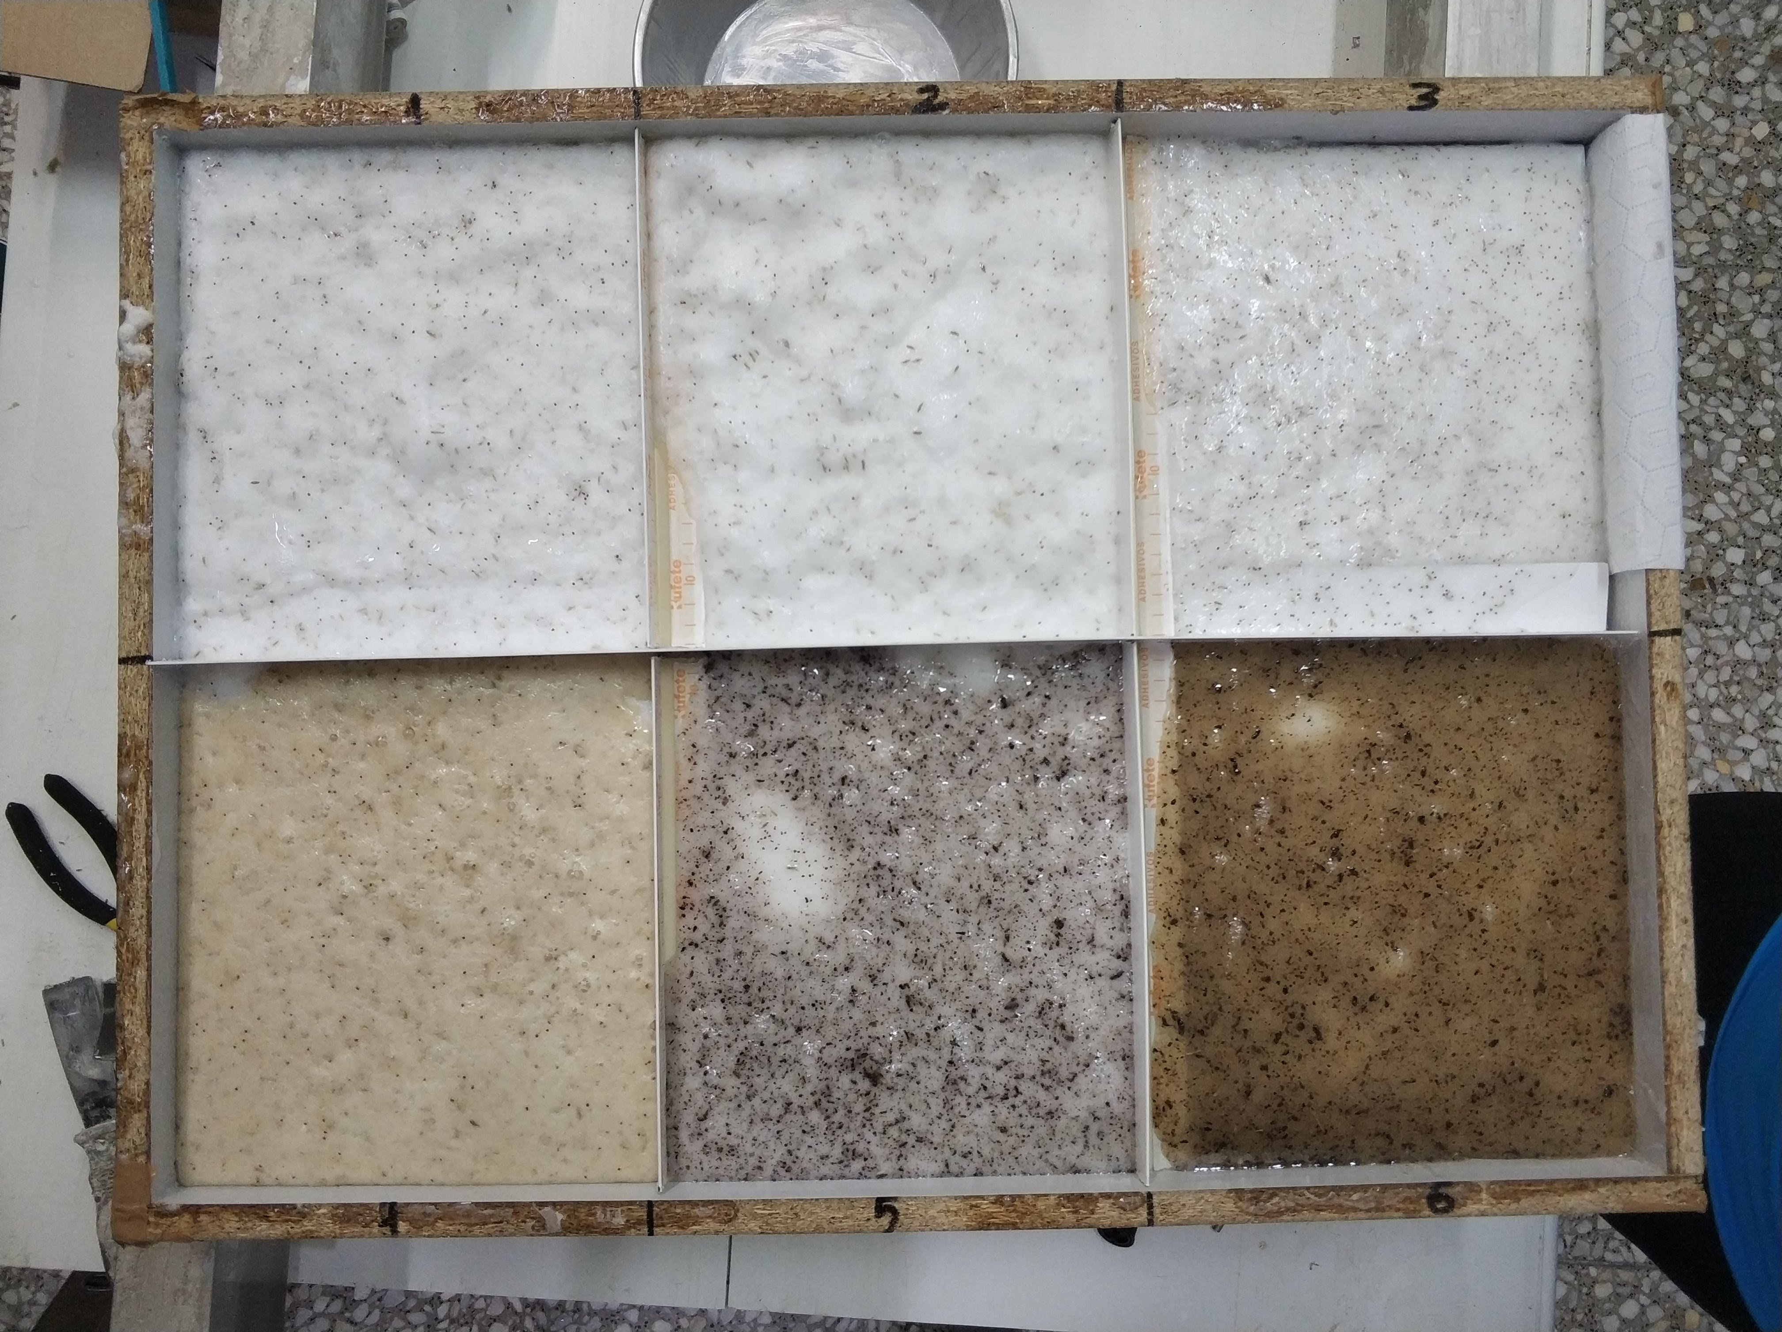
GreenThermowall the sprayed vertical garden
Bio-Polyurethane
Obtained from renewable raw materials
Fully recyclable material

Slide 12
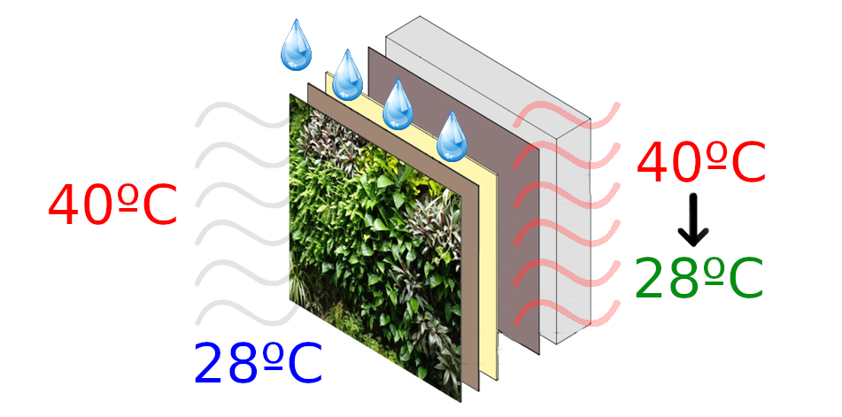
GreenThermowall the sprayed vertical garden
Summer smart insulation
Active heat dissipation via evapotranspiration in summer.
Water reduces the insulation properties.

Slide 13
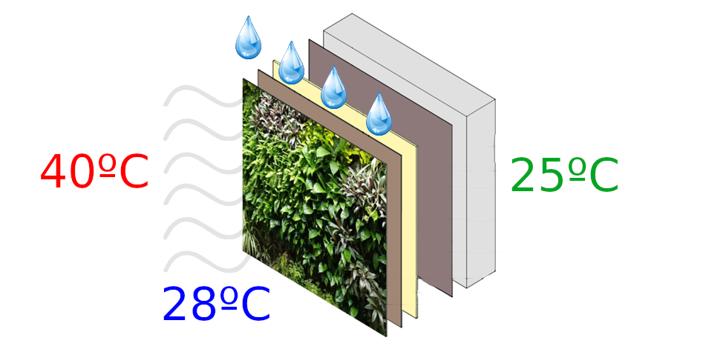
GreenThermowall the sprayed vertical garden
Summer smart insulation
Surface evaporative cooling
Using water for cooling three times more efficient than using electricity

Slide 14
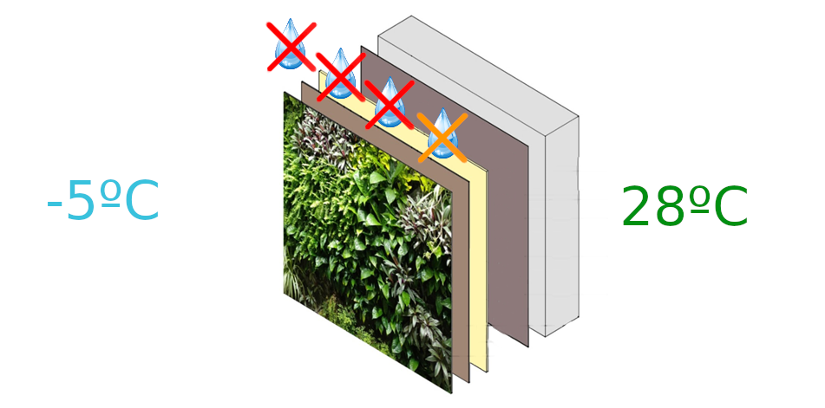
GreenThermowall the sprayed vertical garden
Winter smart insulation
Without irrigation the polyurethane substrate recoveries the insulation properties in winter

Slide 15
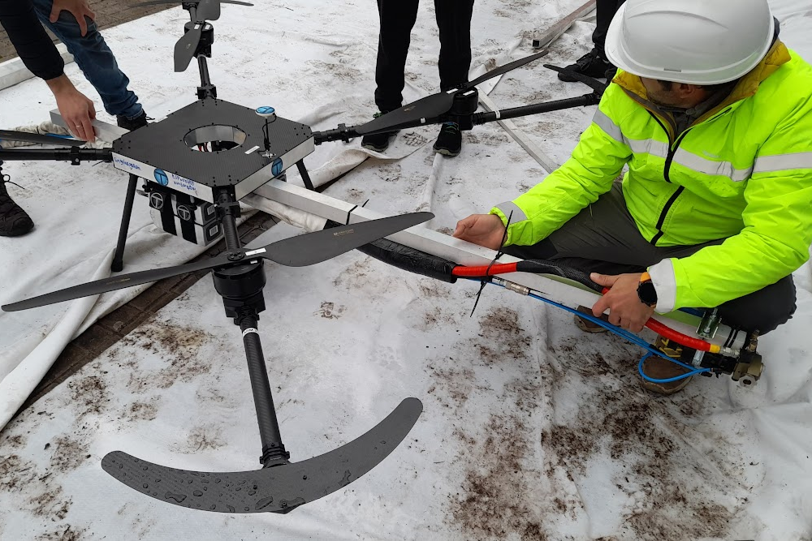
GreenThermowall the sprayed vertical garden
Drone automated construction
Rock and roll!

Slide 16
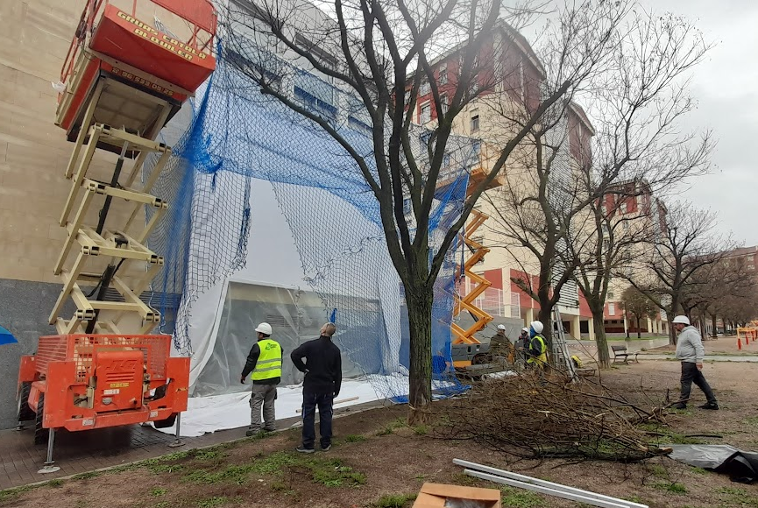
GreenThermowall the sprayed vertical garden
Drone automated construction

Slide 17
GreenThermowall the sprayed vertical garden
Drone automated construction

Slide 18
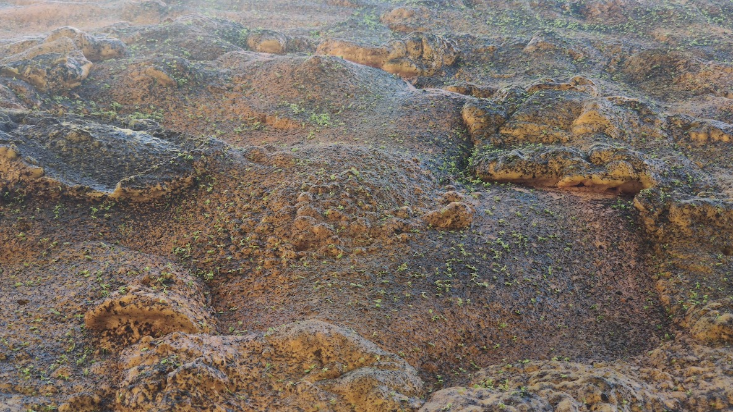
GreenThermowall the sprayed vertical garden
Drone automated construction

Slide 19
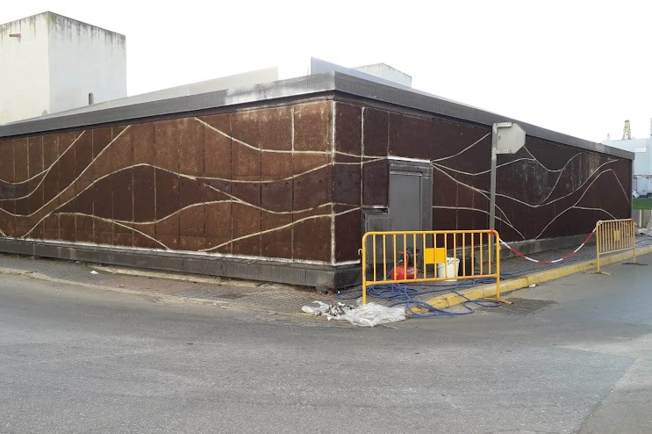
GreenThermowall the sprayed vertical garden
The greenery

Slide 20
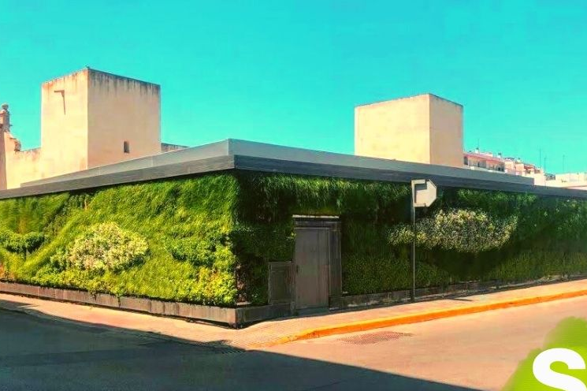
GreenThermowall the sprayed vertical garden
The greenery

Slide 21
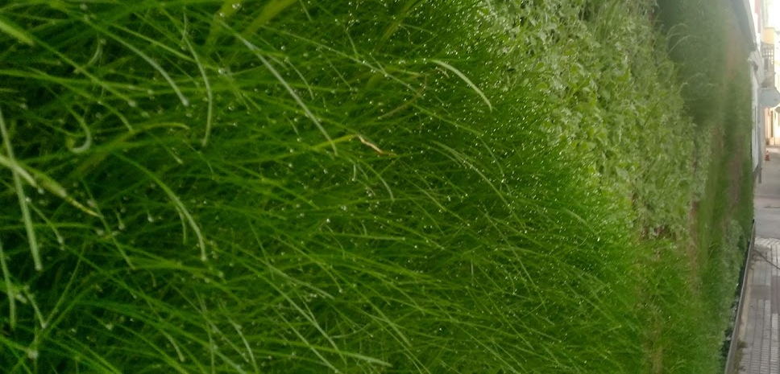
THE FUTURE ENVELOPE
TOWARDS ZERO CARBON BUILDINGS
15‐16 December 2022 Bolzano/Bozen
Last slide
Collaborations
Sponsors
Organized by

