Slide 1

Task Force
on Ukraine and Neighbouring Countries
Eurac Research

Slide 2
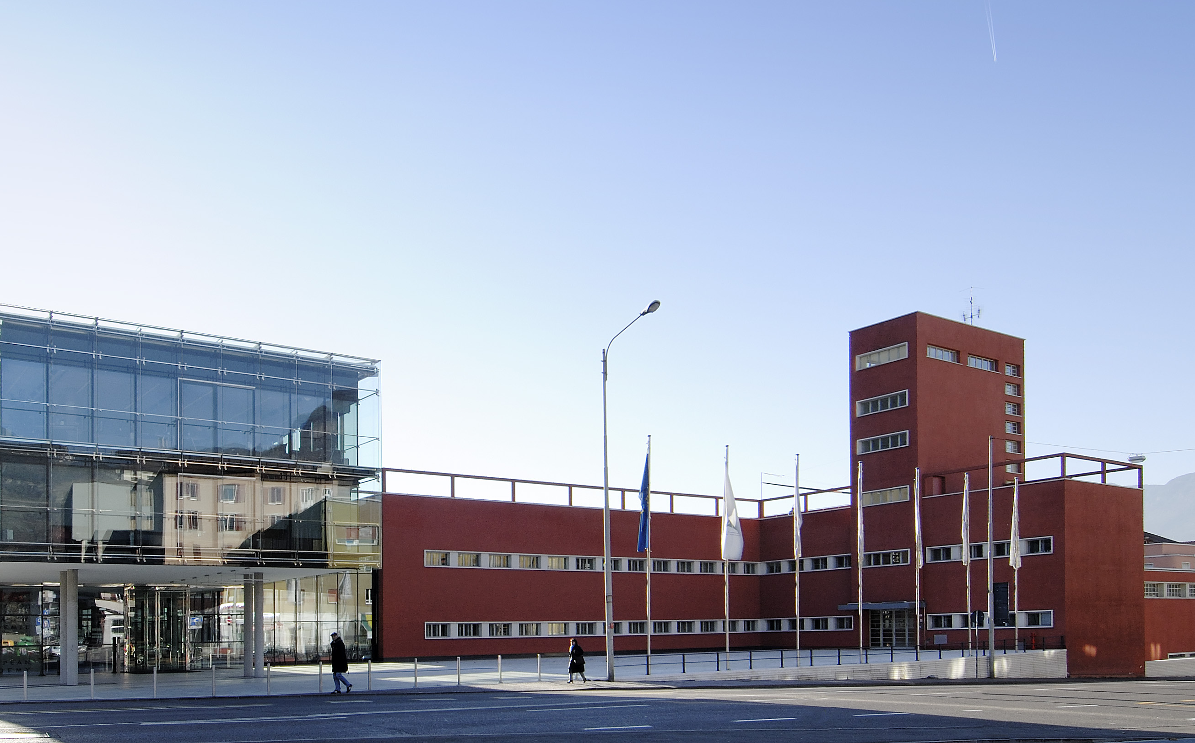
Introduction
to Eurac Research

Slide 3
Global Partnerships
Linked with research networks globally, collaborating with organizations like the Alpine and Carpathian Conventions, UN Environment Programme, European Space Agency, and serves
as an official UN duty station and the Italian headquarters of
United Nations University.
European Cooperation
Works closely with the Council of Europe and other European institutions as such as OSCE and EU.

Slide 4
Foundation
Established in 1992 with a focus on Language and Law, Minorities and Autonomous Regions, and the Alpine Environment.
Collaborative Network and Expansion
Gradually expanded into new research areas, attracting global talent and establishing new structures with 600 collaborators from nearly 50 countries.

Slide 5
Shaping Policy and Community Development through Expertise in Minority Rights, Federalism, and Autonomy

Slide 6
Consultancy Initiatives
Covers constitutional reform impacts on territorial autonomy, political and economic participation of minorities, autonomy arrangements in pluri-ethnic societies, human rights, conflict prevention, peaceful coexistence, EU law effects, competence allocation, financial autonomy developments, cross-border cooperation, participatory democracy.

Slide 7
Consultancy Initiatives
Late 1990s onwards
Initiation of a longstanding consultancy and training relationship with the Central Tibetan Administration focusing on human rights, minority rights and autonomy.
Consultancy on autonomy arrangements in minority contexts
(e.g. in Europe and the Caucasus, and in Asia) and federal/regional state competencies and multi-level governance.
Consultancy and Training for the Central Tibetan Administration.

Slide 8
Consultancy Initiatives
Council Europe Engagement (CoE)
Assessment of the impact of the decentralization reform on national minorities in Ukraine.
Critical analysis contributing to the protection of national minorities and languages.

Slide 9
Consultancy Initiatives
Council Europe Engagement (CoE)
Individual membership in several expert bodies (Advisory Committee on the Framework Convention for the Protection of National Minorities, Group of Independent Experts on the European Charter of Local Self-Government, etc.).
Several studies on different aspects of autonomy and minority rights, including drafting and assessment of laws.

Slide 10
Consultancy Initiatives
OSCE High Commissioner Engagements
Consultancy on autonomy as an instrument for inclusive governance in the OSCE area.
Mapping of indicators for integration in diverse societies.
Participation in drafting several sets of recommendations and guidelines.

Slide 11
Who we are

Slide 12
Institute for Minority Rights
Analyzes social cohesion and minority protection in diverse societies, using South Tyrol’s model for global insights.
Focuses on human and minority rights, equality and non-discrimination, and diversity governance.
Engages in interdisciplinary research, consultancy and training on minority rights, diversity governance and autonomy arrangements worldwide.

Slide 13
Institute for Comparative Federalism
Analyzes governance through federalism, regionalism
and autonomy, promoting unity in diversity.
Carries out comparative research on multilevel governance
and policies.
Improves democracy and policy efficiency through the study
and the implementation of participatory instruments.

Slide 14
Center for Autonomy Experience
Shares South Tyrol’s autonomy and minority protection experiences globally.
Uses educational initiatives to promote understanding of autonomy and minority issues.
Disseminates broadly on minorities, diversity, and the history of autonomies, including media in minority languages.

Slide 15
Research Impact
and Global Network

Slide 16
Governance Support
The Institutes and Center enhance governance in Italy, Europe, and internationally, serving various stakeholders including the EU, the Council of Europe, OSCE, regional/local governments (notably the Autonomous Province of Bolzano/Bozen), government delegations, and independent institutions.

Slide 17
Consultancy Demand
Growing demand for high-level consultancy, alongside with publications and training, forms the core activities of the three institutes. Services include presentations, consultations, report writing, legislation drafting, and studies completion.

Slide 18
Stakeholder Base
Engages with policymakers from the Autonomous Provinces of Bolzano and Trento, international organizations, NGOs, and educational institutions from Asia, Africa, South America and educational institutions from Europe and the Caucasus, Asia, Africa and South America.

Slide 19
Good Practice Focus
Advises on autonomy solutions for conflict resolution in minority contexts (e.g. in Europe and the Caucasus, and in Asia) and federal/regional state competencies and multi-level governance.

Slide 20
Consultancy in Ukraine
and nearby countries

Slide 21
Training project “Combating discrimination, hate speech, hate crimes against minorities in the Republic of Moldova” (2024)
Lectures organized by the Council of Europe for judges and prosecutors in collaboration with the Moldova National Institute of Justice.
Consultancy on the Law of Ukraine “Status of the Crimean Tatar People”
(2024)
Consultancy for Council of Europe on the assessment of a new draft law on the status of this indigenous people of Ukraine.

Slide 22
Kin-State Engagement and its Impact on Minority Protection in Europe: Relevant Findings for Southeast Europe (2023)
Consultancy activities commissioned by the Council of Europe within the Joint Action “Promotion of diversity and equality in Serbia”, which is part of the “Horizontal Facility for the Western Balkans and Turkey”, a joint programme of the European Union and the Council of Europe.
Assessing the functioning of the State Service of Ukraine for Ethnic Policy and Freedom of Conscience (2023)
Consultancy activities commissioned by the Council of Europe within the project “Support for implementing European standards relating to anti-discrimination and rights of national minorities in Ukraine”.

Slide 23
E-Learning course on Ukraine for students and adults (2023)
The e-learning unit was created as a joint project with the Leibniz Institute. The aim of this e-learning unit was to provide basic knowledge about the past and present of Ukraine.
Mapping Integration Indicators.
A Reference Tool for Evaluating the Implementation of Ljubljana Guidelines-based Policy (2020)
Consultancy activities commissioned by the Office of the OSCE High Commissioner on National Minorities to review and evaluate the most relevant indexes on integration and diversity existing across the OSCE.

Slide 24
Assessing the Impact of the decentralization reform on national minorities in Ukraine (2020)
Consultancy activities commissioned by the Council of Europe within the framework of the project “Protecting national minorities, including Roma, and minority languages in Ukraine” which is part of the Council of Europe Action Plan for Ukraine 2018-2021.
Supporting Inclusive Dialogue and Strengthening Capacities for a Better Functioning Gagauz Autonomy in Moldova (2015-2024)
The objective of the project is to contribute to the effective functioning of the Gagauzia autonomy within the Republic of Moldova and to enhance capacities for implementation of the autonomy’s competencies and functioning of institutional mechanisms.

Slide 25
Membership in the commission for constitutional reform (2015)
Assessment of the law on capital city Kyiv. Consultancy on implementation of law on national minorities, assisting in drafting the strategy and the implementing plan.

Slide 26
Capacity Building
Highlights

Slide 27




Summer School on Human Rights, Minorities and Diversity Governance
Postgraduate program
with a different thematic
focus each year.
Winter School on Federalism and Governance
Postgraduate program focusing on federalism and governance education.
Development of
Pedagogical Tools
Creation of games
and toolkits to combat discrimination and
promote diversity.
Federal Scholar
in Residence-Program
Facilitates scholarly
exchange on federalism and regionalism.

Slide 28


E-learning course researchers explain the Autonomy of South Tyrol
The “Autonomy of South Tyrol” e-learning course by the Center for Autonomy Experience, in collaboration with Eurac Research, delves into the history, design, and key legal aspects of South Tyrol’s autonomy. It offers a comprehensive under-standing for individual learners.
CUTE Autonomy
This project studies both non-territorial autonomy arrangements and systems of territorial governance at sub-state level in a comparative perspective. In particular, it focuses on contexts where the participation of minorities in public affairs and in matters concerning them needs to be improved.

Slide 29
Expertise Showcase

Slide 30






Elisabeth Alber
Research
Group Leader
Institute for
Comparative Federalism
Andrea Carlà
Senior Researcher
Institute
for Minority Rights
Francisco Javier
Romero Caro
Senior Researcher
Institute for
Comparative Federalism
Sergiu Constantin
Senior Researcher
Institute
for Minority Rights
Katharina Crepaz
Senior Researcher
Center for
Autonomy Experience
Roberta Medda-Windischer
Research Group
Leader
Institute for Minority Rights

Slide 31





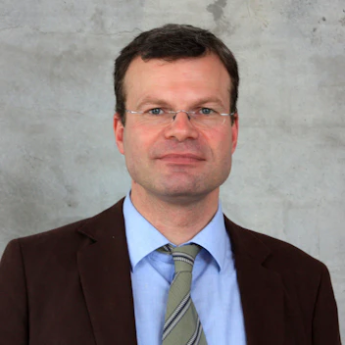

Francesco
Palermo
Head of Institute
Institute for
Comparative Federalism
Lucia Radici
Project Assistant
Institute for
Comparative Federalism
Günther Rautz
Head of Institute
Institute
for Minority Rights
Marc Röggla
Head of Center
Center for
Autonomy Experience
Chiara Salati
Post-Doc-Researcher
Institute for
Comparative Federalism
Jens Woelk
Senior Researcher
Institute for
Comparative Federalism
Mattia Zeba
Post-Doc-Researcher
Institute
for Minority Rights

Slide 32
Publications
and Data bases

Slide 33
The European Yearbook of Minority Issues provides a critical and timely review of contemporary developments in European minority-majority relations and beyond.
It combines analysis, commentary, and documentation concerning conflict management, international legal developments, and domestic legislation affecting European minorities.
CUREDI - Cultural and Religious Diversity under State Law across Europe is a digital repository of cases - with a focus on case law analysis - that have to do with cultural and religious diversity within the domestic legal systems of member states of the EU, UK, and Switzerland.

Slide 34
Diversity Governance Papers DiGoP Constitutional, Territorial and Societal Pluralism (ISSN 2975-2175) is an online and open access working paper series of the Institute for Comparative Federalism and the Institute for Minority Rights at Eurac Research.
“Autonomy Arrangements in the World” is an online compendium that provides a comprehensive collection of autonomy case studies to explore the discrepancies between theory and practice).

Slide 35
Engaging with Eurac Research
Eurac Research
Drususallee/Viale Druso 1
39100 Bozen/Bolzano
T +39 0471 055 055
info@eurac.edu
www.eurac.edu
Institute for Minority Rights
T +39 0471 055 200, minority.rights@eurac.edu
Institute for Comparative Federalism
T +39 0471 055 200, federalism@eurac.edu
Center for Autonomy Experience
T +39 0471 055 771
info@autonomyexperience.org
www.autonomyexperience.org

